Slide 1

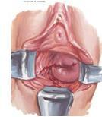
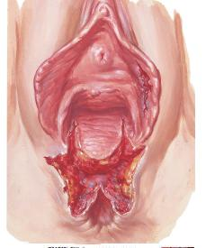
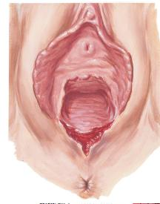
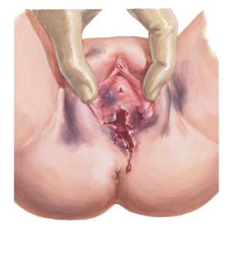

Wedding
Female
Sexual
Genital
Trauma
Dr Muhammad M Al Hennawy
Senior Ob/gyn consultant
Egypt
mmhennawy.site44.com
www.drhennawy.8m.net

Slide 2
Wedding Sexual Genital Trauma
Definition
It is a trauma during first intercourse (wedding )
Most female genital tract injuries consecutive to coitus are minor injuries following “normal” sexual intercourse, frequently during the first sexual experience in the female patient
This type of injury usually resolve with no or minor treatment

Slide 3
Genital Trauma
Intercourse-related lacerations obestetrics Injuries assault
with a foreign object FGM/C
Wedding
accidental gynecologic injury
(Consensual)
Rape

Slide 4
Consensual Coital Lacerations
They are commonly encountered in clinical practice. Though not as common as lacerations sustained during childbirth,
they account for significant morbidity among sexually active women.
Consensual sexual intercourse should ordinarily not cause pain as opposed to rape.
It commonly results from inadequate foreplay prior to penetration leading to non-lubrication of
the vagina.
Severe coital laceration may lead to life threatening blood loss.
pre-menopausal women are more frequent if the coitus is planned, ranging from 25 to 36% without magnification, than if it is part of a normal sex-life (4–11%). There is almost no information regarding young or post-menopausal women.

Slide 5
Sexual violence
It is defined as: any sexual act,
attempt to obtain a sexual act,
unwanted sexual comments or advances,
or acts to traffic, or otherwise directed,
against a person’s sexuality
using coercion,
by any person
regardless of their relationship to the victim, in any setting,
including but not limited to home and work.

Slide 6
Incidence Of Genital Injury
Genital injury occurs in 10-25% of sexual assaults using gross visualization.
Serious injury occurs in only 5%,
Death in 1% may be much lower, as many cases are not reported.

Slide 7
Anogenital injury location
It can be classified as
External (labia majora, labia minora, periurethral area, perineum, and posterior fourchette),
Internal (fossa navicularis, hymen, vagina, cervix), and anal (anus and rectum)

Slide 8
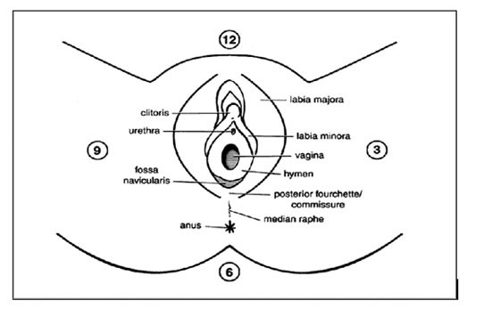


Slide 9
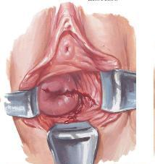
Assessment and Identification of Genital Trauma
Reasons for Identifying Injury
To recognize the need for appropriate treatment
To refer for further evaluation and treatment if necessary
To identify a pattern of injury as well as patterned injury

Slide 10
Types Of Injuries
The European and Australian studies
They use the following:
Laceration = Discontinuity of epidermis and dermis. Caused by blunt force such as tearing, crushing, or overstretching.
Abrasion = Traumatic exposure of lower epidermis or upper dermis. Most often caused by lateral rubbing or sliding against the skin in a tangential rather than a vertical manner. The outermost layer of skin is scraped away from the deeper layers.
Contusion/Hematoma/Bruise = Traumatic extravasation of blood in tissues below an intact epidermis. Caused by blunt force.

Slide 11
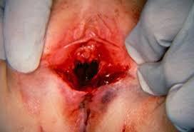
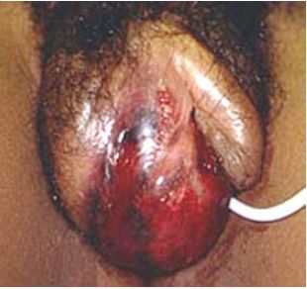
Types Of Injuries( TEARS)
The American literature uses the TEARS definition
T-Tear (laceration) or
Tenderness
E-Ecchymosis (bruising)
A-Abrasion (scrape)
R-Redness (erythema)
S-Swelling (edema)

Slide 12
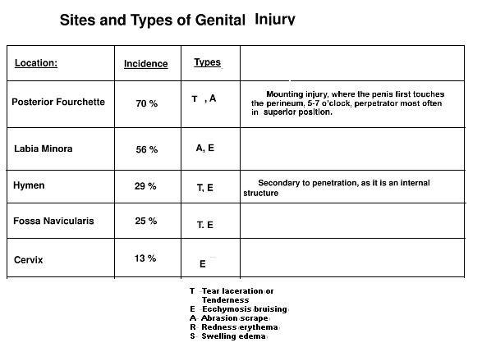
Most Common Sites of Injury Related to Penile Penetration

Slide 13
The spatial orientation of the cervix to the long axis of the vagina predisposes the posterior fornix to injuries, especially during the relative weakness in the structure of the posterior fornix, which is supported by only a few bundles of connective tissue.
The right fornix is also prone to injury because of slight variations of the uterocervical axis.

Slide 14
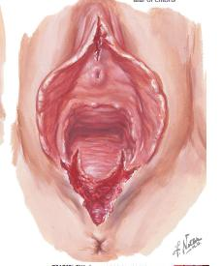
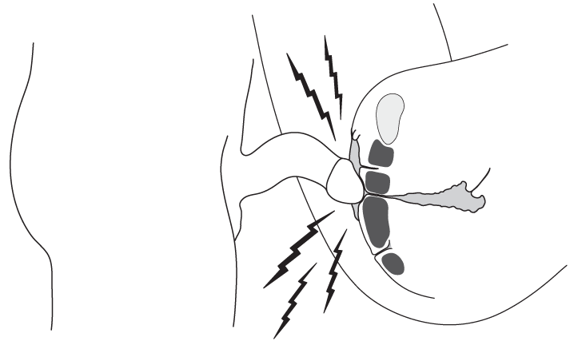
Factors affecting genital injuries
Female :
  size(disproportion of male and female genitalia)
  position (Coital positioning, especially in cases of dorsal decubitus, with hyper-flexion of the thighs and sitting positions )
  Age (Younger victim: Less Injury , More resilient tissue , Faster healing )
  Degree of relaxation or stretchibilty (stenosis and scarring of the vagina because of congenital abnormalities , atrophic vagina in post-menopausal women)
  Friability (previous surgery, or pelvic radiation therapy)
  Amount of lubrication (no sexual excitement due to inadequate foreplay, no lubricant applied)
  Condition of Genital Structures ( infection,engorgment,female genital mutilation, postpartum changes )
Male:--size(disproportion of male and female genitalia) and
  shape
  Amount of force used (rough and violent thrusting of the penis during intercourse),
  Angle (Coital positioning, especially in cases of dorsal decubitus, with hyper-flexion of the thighs and sitting positions )
  insertion of foreign bodies
  sexual assault
Partner Participation
-- Assistance with insertion (Facilitates penile insertion , Use of pelvic tilt and partner assistance with insertion , Position of legs and muscle tension in the lower body )
-- Participation (Active or Passive)
Factors Related To Circumstances
-- Relationship between victim and perpetrator,Physical surroundings of assault ,Objects used during the assault ,Location of the assault (surfaces, etc.)

Slide 15
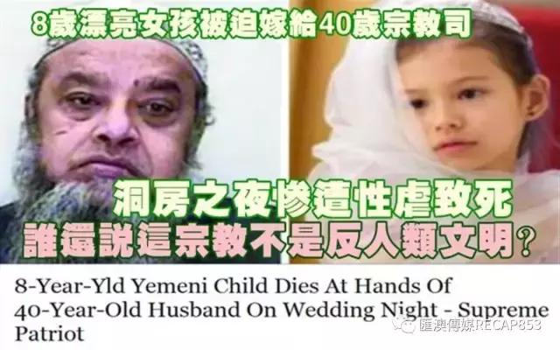

Slide 16
Treatment depends on how severe the tear is
Shallow (superficial) tears may cause mild pain and light bleeding.
These tears often heal on their own with very little treatment.
Deep tears are more likely to cause more severe pain or heavy bleeding.
They must be repaired with surgery.

Slide 17
When to seek medical advice
Call the healthcare provider right away if any of these occur:
Bleeding continues or worsens
Pain continues or worsens
Unusual or foul-smelling discharge from the vagina
Fever of 38ºC or higher, or as directed by your provider
Dizziness, weakness or fainting

Slide 18
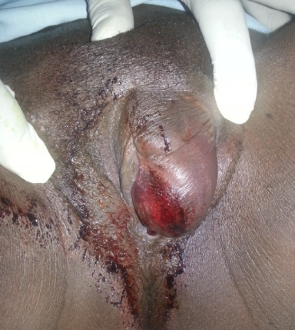
The Diagnosis
The diagnosis of vaginal laceration is not often straightforward.
Because of the personal nature of some of these injuries,
the physician should be cognizant of marked patient delay in obtaining professional help.
A misleading history together with failure to perform an adequate vaginal examination with a speculum may lead to erroneous diagnosis,
thus delaying prompt treatment.
Another important factor to consider is the gross underestimation of blood loss sustained and the necessity

Slide 19
Treatment
the patient may required aggressive fluid resuscitation to reverse their shock status,
and patient may required a blood transfusion.

Slide 20
All patients were taken to the operating room promptly and
examined under general anesthesia.

Slide 21
The lacerations were repaired primarily with continuous interlocking 2-0 or 3-0 chromic sutures.

Slide 22
A diagnostic laparoscopic examination may performed on patient to rule out intra-abdominal injuries,
All patients underwent a digital rectal examination to make sure that the rectal mucosa was intact and free of suture material, and
a cystoscopic examination of the bladder and urethra to rule out urinary tract injury.

Slide 23
Follow-up care
Follow up with your healthcare provider, or as directed. If stitches (sutures) were used to repair your tear, these will dissolve and don’t need to be removed.
women who suffer trauma of the genital tract are more likely to suffer dyspareunia (painful sex), sexual dysfunction, and chronic pain of the lower genital tract and pelvis. The physician should therefore ensure adequate follow-up of these patients in order to identify and administer early treatment of these complication

Slide 24


