Slide 1

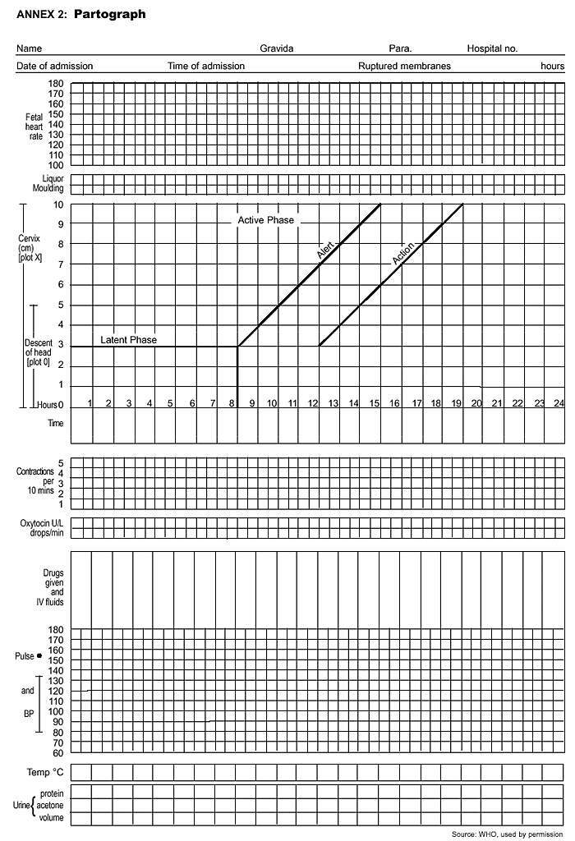
WHO Partograph For Beginner
Dr Muhammad El Hennawy
Ob/gyn specialist
Rass el barr central hospital and
dumyat specialised hospital
Dumyatt – EGYPT
www.geocities.com/mmhennawy

Slide 2
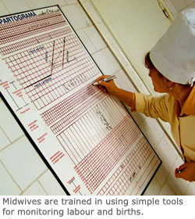
Partograph
A partograph is a graphical record of the observations made of a women in labour
For progress of labour and salient conditions of the mother and fetus
It was developed and extensively tested by the world health organization WHO

Slide 3
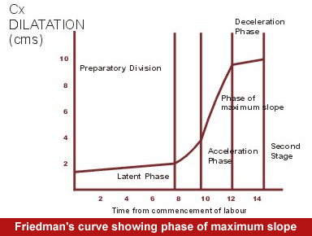
History Of Partogram
Friedman's partogram devised in 1954 was based on observations of cervical dilatation and foetal station against time elapsed in hours from onset of labour. The time onset of labour was based on the patient's subjective perception of her contractility. Plotting cervical dilatation against time yielded the typical sigmoid or 'S' shaped curve and station against time gave rise to the hyperbolic curve. Limits of normal were defined

Slide 4
Philpott and Castle
in 1972 introduced the concept of "ALERT" and "ACTION" lines. The aim of this study was to fulfill the needs of paramedical personnel practising obstetrics in Rhodesian African primigravidae. The alert line represented the mean rate of progress of the slowest 10% of patients in the African population whom they served. Alert line was drawn at a slope of 1 centimetre/hr for nulliparous women starting at zero time i.e. time of admission . Action line drawn four hours to the right of the alert line showing that if the patient has crossed the alert line active management should be instituted within 4 hours, enabling the transfer of the patient to a specialised tertiary care centre.
The action line was subsequently drawn two hours to the right of the alert line

Slide 5
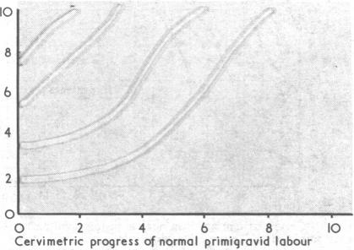
Studd's labour stencils
It were introduced in 1972. These stencils predicted the expected pattern of progression of labour based on the extent of dilataton achieved by the time the patient is admitted (zero time). Curves showing the average course of cervical dilatation were constructed for various dilatation on admission. Five separate patterns representing normal labour progression were constructed. The curves were transcribed onto acrylic stencils On admission in labour, the cervical dilatation was assessed and a stencil was used to draw the relevant pencil line of expected progress on the patient's cervicograph which was then completed. Those crossing the nomogram line were found to have a three fold increase in instrumental delivery.

Slide 6
WHO partograph

Slide 7
Overview
The partograph can be used by health workers with adequate training in midwifery who are able to :
- observe and conduct normal labour and delivery.
- Perform vaginal examination in labour and assess cervical diltation accurately
- plot cervical diltation accurately on a graph against time
There is no place for partograph in deliveries at home conducted by attendants other than those trained in midwifery
Whether used in health centers or in hospitals , the partograph must be accompanied by a program of training in its use and by appropriate supervision and follow up

Slide 8
Objectives
early detection of abnormal progress of a labour
prevention of prolonged labour
recognize cephalopelvic disproportion long before obstructed labour
assist in early decision on transfer , augmentation , or terminjation of labour
increase the quality and regularity of all observations of mother and fetus
early recognition of maternal or fetal problems
the partograph can be highly effective in reducing complications from prolonged labor for the mother (postpartum hemorrhage, sepsis, uterine rupture and its sequelae) and for the newborn (death, anoxia, infections, etc.).

Slide 9
Partograph function
The partograph is designed for use in all maternity settings , but has a different level of function at different levels of health care
in health center, the partograph,s critical function is
to give early warning if labour is likely to be prolonged and to indicate that the woman should be transferred to hospital (ALERT LINE FUNCTION )
in hospital settings, moving to the right of alert line serves as a warning for extra vigilance , but the action line is the critical point at which specific management decisions must be made
other observations on the progress of labour are also recorded on the partograph and are essential features in management of labour

Slide 10
Components of the partograph
Part 1 : fetal condition ( at top )
Pqrt 11 : progress of labour ( at middle )
Part 111 : maternal condition ( at bottom )
Outcome : ………………

Slide 11
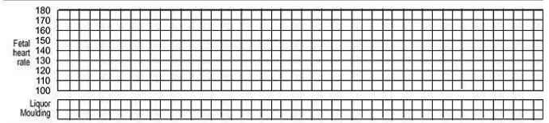
Part 1 : Fetal condition
this part of the graph is used to monitor and assess fetal condition
1 - Fetal heart rate
2 - membranes and liquor
3 - moulding the fetal skull bones
Caput

Slide 12
Fetal heart rate
Basal fetal heart rate?
< 160 beats/mi =tachycardia
> 120 beats/min = bradycardia
>100 beats/min = severe bradycardia
Decelerations? yes/no
Relation to contractions?
  Early
  Variable
  Late – -----Auscultation - return to baseline
> 30 sec ➔ contraction
----- Electronic monitoring
peak and trough (nadir)
➔ > 30 sec

Slide 13
membranes and liquor
intact membranes ……………………………………….I
ruptured membranes + clear liquor …………………….C
ruptured membranes + meconium- stained liquor ……..M
ruptured membranes + blood – stained liquor …………B
ruptured membranes + absent liquor…………………....A

Slide 14
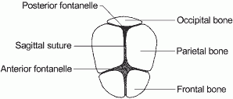
moulding the fetal skull bones
Molding is an important indication of how adequately the pelvis can accommodate the fetal head
increasing molding with the head high in the pelvis is an ominous sign of cephalopelvic disproportion
separated bones . sutures felt easily ……………….….O
bones just touching each other ………………………..+
overlapping bones ( reducible 0 ……………………...++
severely overlapping bones ( non – reducible ) ……..+++

Slide 15
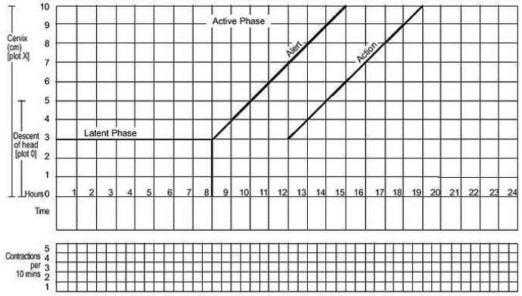
part11 – progress of labour
. Cervical diltation
Descent of the fetal head
Fetal position
Uterine contractions
this section of the paragraph has as its central feature a graph of cervical diltation against time
it is divided into a latent phase and an active phase

Slide 16

latent phase :
it starts from onset of labour until the cervix reaches 3 cm diltation
once 3 cm diltation is reached , labour enters the active phase
lasts 8 hours or less
each lasting < 20 sceonds
at least 2/10 min contractions

Slide 17

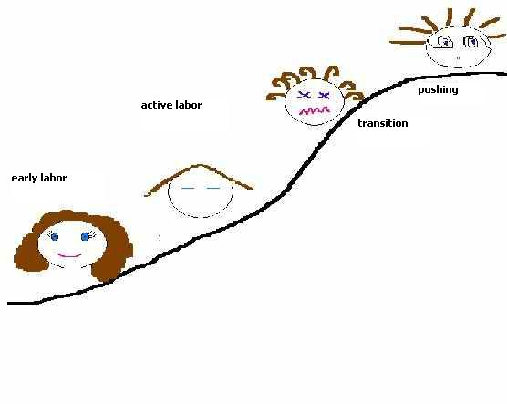
Active phase :
Contractions at least 3 / 10 min
each lasting < 40 sceonds
The cervix should dilate at a rate of 1 cm / hour or faster

Slide 18
Alert line ( health facility line )
The alert line drawn from 3 cm diltation represents the rate of diltation of 1 cm / hour
Moving to the right or the alert line means referral to hospital for extra vigilance

Slide 19
Action line ( hospital line )
The action line is drawn 4 hour to the right of the alert line and parallel to it
This is the critical line at which specific management decisions must be made at the hospital

Slide 20
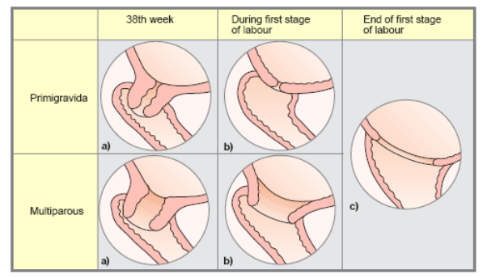
Cervical diltation
It is the most important information and the surest way to assess progress of labour , even though other findings discovered on vaginal examination are also important
when progress of labour is normal and satisfactory , plotting of cervical diltation remains on the alert line or to left of it
if a woman arrives in the active phase of labour , recording of cervical diltation starts on the alert line
when the active phase of labor begins , all recordings are transferred and start by pltting cervical diltation on the alert line

Slide 21
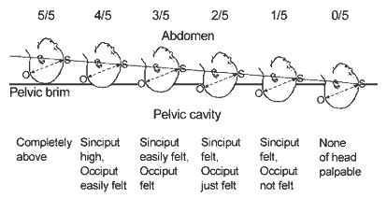
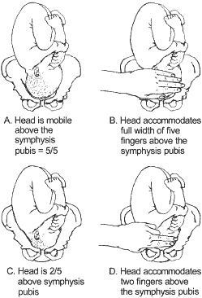
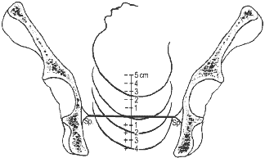
Descent of the fetal head
It should be assessed by abdominal examination immediately before doing a vaginal examination, using the rule of fifth to assess engagement
The rule of fifth means the palpable fifth of the fetal head are felt by abdominal examination to be above the level of symphysis pubis
When 2/5 or less of fetal head is felt above the level of symphysis pubis , this means that the head is engage , and by vaginal examination , the lowest part of vertex has passed or is at the level of ischial spines

Slide 22
Assessing descent of the fetal head by vaginal examination;
0 station is at the level of the ischial spine (Sp).

Slide 23
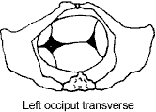
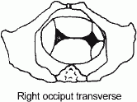
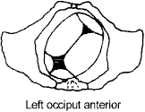
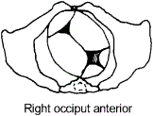
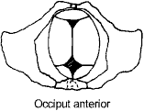
Occiput transverse positions
Fetal position
Occiput anterior positions

Slide 24

Uterine contractions
Observations of the contractions are made every hour in the latent phase and every half-hour in the active phase
frequency how often are they felt ?
Assessed by number of contractions in a 10 minutes period
duration how long do they last ?
Measured in seconds from the time the contraction is first felt abdominally , to the time the contraction phases off
Each square represents one contraction

Slide 25
Palpate number of contraction in ten minutes and duration of each contraction in seconds
Less than 20 seconds:
Between 20 and 40 seconds:
More than 40 seconds:

Slide 26

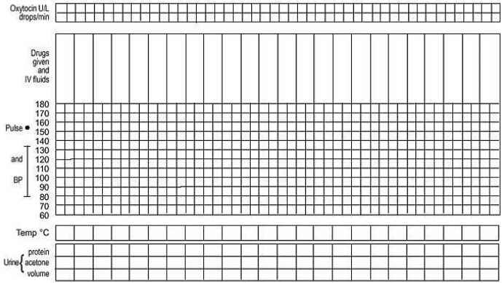
Part111: maternal condition
Name / DOB /Gestation
Medical / Obstetrical issues
Assess maternal condition regularly by monitoring :
drugs , IV fluids , and oxytocin , if labour is augmented
pulse , blood pressure
Temperature
Urine volume , analysis for protein and acetone

Slide 27
Management of labour using the partograph

Slide 28
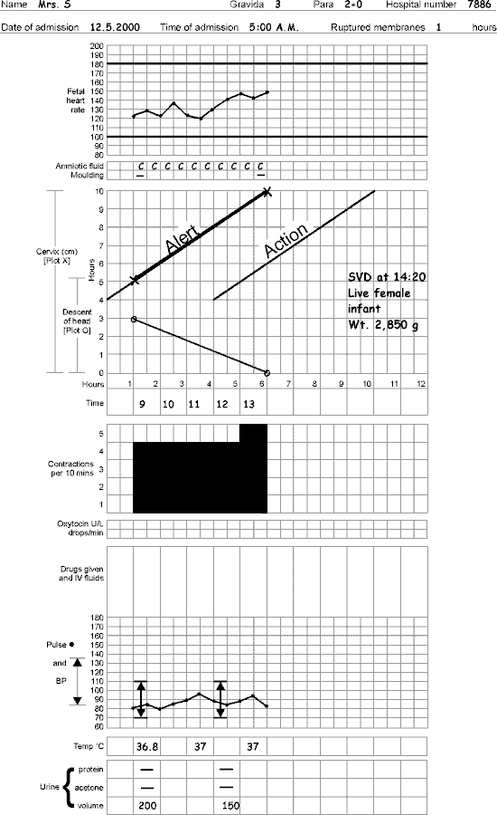
- latant phase is less than 8 hours
- progress in active phase remains on or left of the alert line
Do not augment with oxytocin if latent and active phases go normally
Do not intervene unless complications develop
Artificial rupture of membranes
( ARM )
No ARM in latent phase
ARM at any time in active phase

Slide 29
Between alert and action lines
In health center , the women must be transferred to a hospital with facilities for cesarean section , unless the cervix is almost fully dilated
Observe labor progress for short period before transfer
Continue routine observations
ARM may be performed if membranes are still intact

Slide 30
At or beyond action line
Conduct full medical assessement
Consider intravenous infusion / bladder catheterization / analgesia
Options
- Deliver by cesarean section if there is fetal distress or obstructed labour
- Augment with oxytocin by intravenous infusion if there are no contraindications

Slide 31
ABNORMAL PROGRESS OF LBOR

Slide 32
One of the main functions of the partograph is to detect early deviation from normal progress of labor

Slide 33
Moving to the right of alert line
This means warning
Transfer the woman from health center to hospital
reaching the action line
This means possible danger
Decision needed on future management (usually by obesteritian or resident )

Slide 34
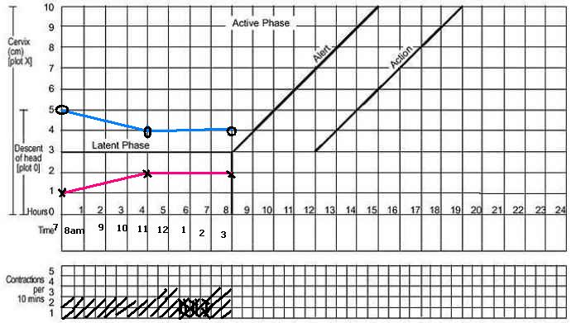
Prolonged latent phase
If a woman is admitted in labor in the latent phase ( less than 3 cm diltation ) and remains in the latent phase for next 8 hours
Progress is abnormal and she must br transferred to a hospital for a decision about further action
This is why there is a heavy line drawn on the partograph at the end of 8 hours of the latent phase

Slide 35
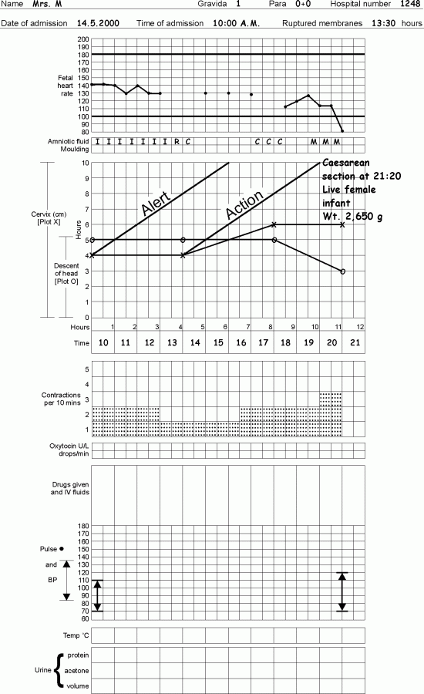
Polonged Active phase
In the active phase of labor , plotting of cervical diltation will normally remain on or to the left of the alert line
But some cases will move to the right of the alert line and this warns that labor may be prolonged
This will happen if the rate of cervical diltation in the active phase of labor is
not 1 cm / hour or faster
A woman whose cervical diltation moves to the right of the alert line must be transferred and manged in a hospital with adequate facilities for obstetric intervention unless delivery is near
at the action line , the woman must be carefully reassessed for why labor is not progressing and a decision made on further management

Slide 36
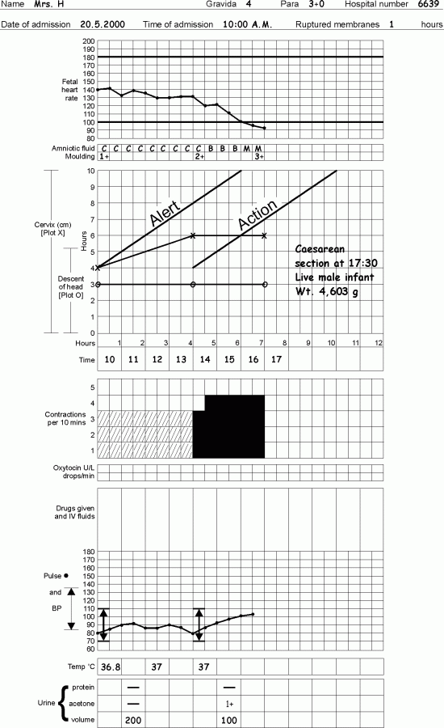
Secondary arrest of cervical diltation
Abnormal progress of labor may occur in cases with normal progress of cervical diltation then followed by secondary arrest of diltation

Slide 37
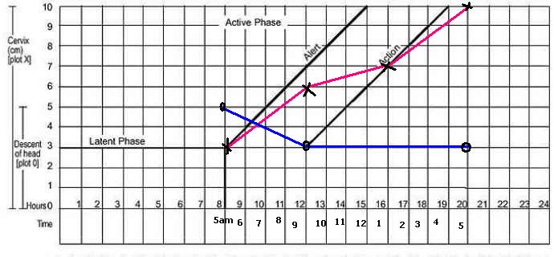
Secondary arrest of head descant
Abnormal progress of labor may occur with normal progress of descent of the fetal head then followed by secondary arrest of desscent of fetal head

Slide 38
Precipitate Labour
- Maximum slope of dilatation of 5 cm/hr or more

Slide 39
USING THE PARTOGRAPH POINTS TO REMEMBER

Slide 40
It is important to realize that the partograph is a tool for managing labor progress only
The partograph does not help to identify other risk factors that may have been present before labor started

Slide 41
only start a partograph when you have checked that there are no complications of pregnancy that require immediate action
a partograph chart must only be started when a woman is in labor,-- be sure that she is contracting enough to start a partograph
if progress of labor is satisfactory , the plotting of cervical diltation will remain or to the left of the alert line

Slide 42
when labor progress well , the diltation should not move to the right of the alert line
the latent phase . 0 – 3 cm diltation , is accompanied by gradual shortening of cervix . normally , the latent phase should not last more than 8 hours
the active phase , 3 – 10 cm diltation , should progress at rate of at least 1 cm/hour
when admission takes place in the active phase , the admission diltation, is immediately plotted on the alert line

Slide 43
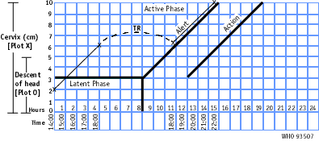
when labor goes from latent to active phase , plotting of the diltation is immediately transferred from the latent phase area to the alert line

Slide 44
diltation of the cervix is plotted ( recorded with an X , desent of the fetal head is plotted with an O , and uterine contractions are plotted with differential shading
desent of the head should always be assessed by abdominal examination ( by the rule of fifths felt above the pelvic brim ) immediately before doing a vaginal examination
assessing descent of the head assists in detecting progress of labor
increased molding with a high head is a sign of cephalopelvic disproportion

Slide 45
vaginal examination should be performed infrequently as this is compatible with safe practice ( once every 4 hours is recommended )
when the woman arrives in the latent phase , time of admission is 0 time
a woman whose cervical diltation moves to the right of the alert line must be transferred and manged in an institution with adequate facilities for obstetric intervention , unless delivery is near

Slide 46
when a woman ,s partograph reaches the action line , she must be carefully reassessed to determine why there is lack of progress , and a decision must be made on further management ( usually by an obesterician or resident )
when a woman in labor passes the latent phase in less than 8 hours i.e., transfers from latent to active phase , the most important feature is to transfer plotting of cervical diltation to the alert line using the letters TR,
Leaving the area between the transferred recording blank. The broken transfer line is not part of the process of labor
do not forget to transfer all other findings vertically

Slide 47
IMPORTANT COSIDERATIONS

Slide 48
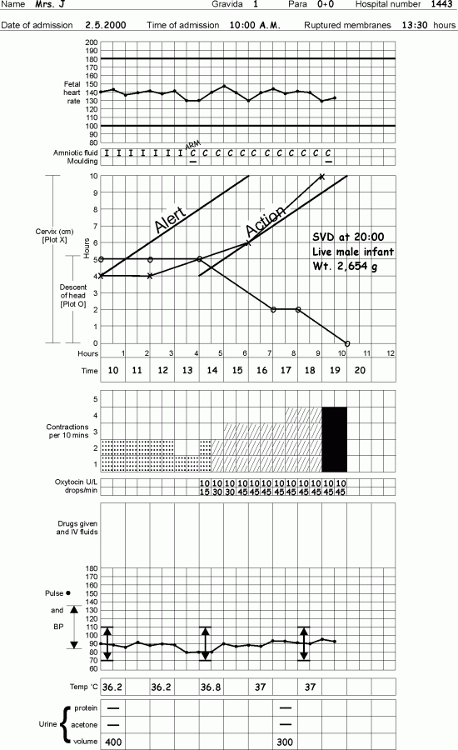
OXYTOCIN
Oxytocics must be preserved in a cool , dark place
A local regime may be used
Oxytocin should be titrates against uterine contractions and increased every half- hour until contractions are 3 or 4 in10 minutes , each lasting 40 – 50 seconds
It may br maintained at the rate thoughout the second stage of labor
Stop oxytocin infusion if there is evidence of uterine hyperactivity and / or fetal distress
Oxytocin must be used with caution in multiparous women and rarely , if at all , in women of para 4 or more
Augment with oxytocin only after artificial rupture of membranes and provided that the liquor is clear

Slide 49
MEMBRANES
if membranes have been ruptured for 12 hours or more , antibiotics should be given
As a first defense against serious infections, give a combination of antibiotics:
- ampicillin 2 g IV every 6 hours;
- PLUS gentamicin 5 mg/kg body weight IV every 24 hours;
- PLUS metronidazole 500 mg IV every 8 hours.
Note:
If the infection is not severe, amoxicillin 500 mg by mouth every 8 hours can be used instead of ampicillin. Metronidazole can be given by mouth instead of IV.

Slide 50
FETAL DISTRESS
If a woman is laboring in a health center . transfer her to a hospital with facilities for operative delivery
In a hospital , immediately :
- Conduct a vaginal examination to exclude cord prolapse and observe amniotic fluid
- Provide adequate hydraion
- Administer oxygen , if avaliablestop oxytocin
-Turn the woman or her left side

Slide 51
Diagnosis of labour
Regular painful contractions resulting
in progressive change of the cervix
+/- show
+/- rupture of membranes

Slide 52
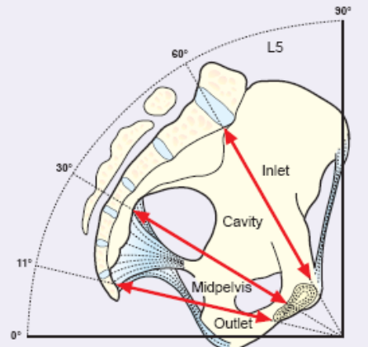
Components of normal labour
Patient
pain , bladder empty , dehydration , exhaustion
Powers
Uterine contractions
Maternal effort
Passages
Maternal pelvis ( Inlet - Outlet )
Maternal soft tissue
Passenger
Fetal ( size - presentation - position – Moulding)
cord
placenta
membranes

Slide 53
The partograph in the management of labor following cesarean section.
In women undergoing a trial of labor following cesarean section, the partographic zone 2-3 h after the alert line represents a time of high risk of scar rupture. An action line in this time zone would probably help reduce the rupture rate without an unacceptable increase in the rate of cesarean section

Slide 54
ELECTRONIC PARTOGRAPH

Slide 55
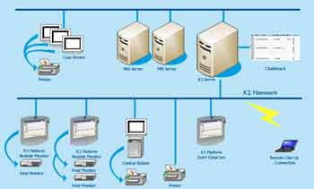
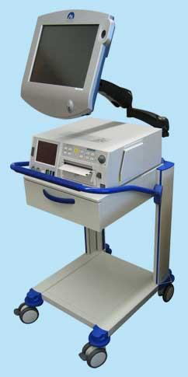
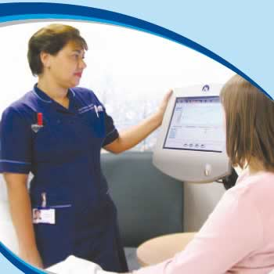
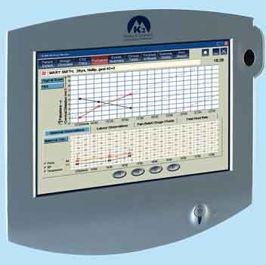
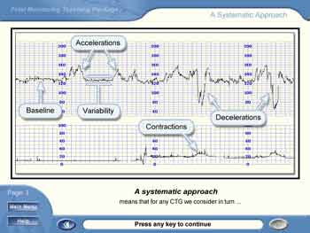
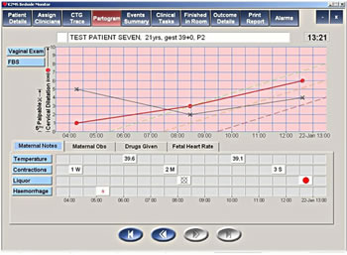
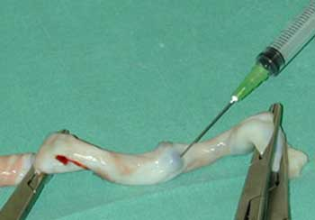
Full electronic capture of patient information during childbirth including,
CTG's,
partograms,
all labour events,
outcome information,
fetal blood sampling results and cord blood gases direct from the blood gas analyser
This information can be shown in real time to enhance communication within and outside the delivery suite to improve patient care and reduce human error.
It can be accessed over the anywhere, anytime, from within a hospital or from a home..

Slide 56
COMPUTERIZED LABOR MANAGEMENT
To accurately and continuously measure cervical dilatation and fetal head station in labor and the fetal monitoring and the mother monitoring
A ultrasound–based computerized labor management system was designed
The Fetal Monitoring System and
The mother Monitoring System with
The system´s in-vivo generated individual Partograms with real time dilatation and head station measurements.
The measurements had accuracy of < 5mm = all parturients were comfortable throughout the insertion and the testing period.
There was no infection, bleeding or any significant local complication at any attachment site

Slide 57
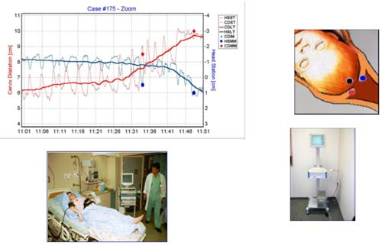
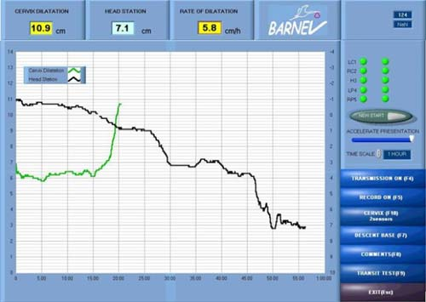
This system provides accurate continuous measurements of dilatation and station.
The method is superior to digital examination and provides real time diagnosis of non-progressive and precipitous labor.
The system is likely to reduce discomfort and infections associated to multiple vaginal examinations..

Slide 58
The Fetal Monitoring System is a computer based training system that can be accessed over the anywhere, anytime, from within a hospital or from a home.

Slide 59
The Mother Monitoring System

