Slide 1
LSTM Workshop
Text Classification

Slide 2
Recurrent Neural Networks
Humans don’t start their thinking from scratch every second. As you read this, you understand each word based on your understanding of previous words. You don’t throw everything away and start thinking from scratch again. Your thoughts have persistence.
Traditional neural networks can’t do this, and it seems like a major shortcoming. For example, imagine you want to classify what kind of event is happening at every point in a movie. It’s unclear how a traditional neural network could use its reasoning about previous events in the film to inform later ones.
Recurrent neural networks address this issue. They are networks with loops in them, allowing information to persist.

Slide 3

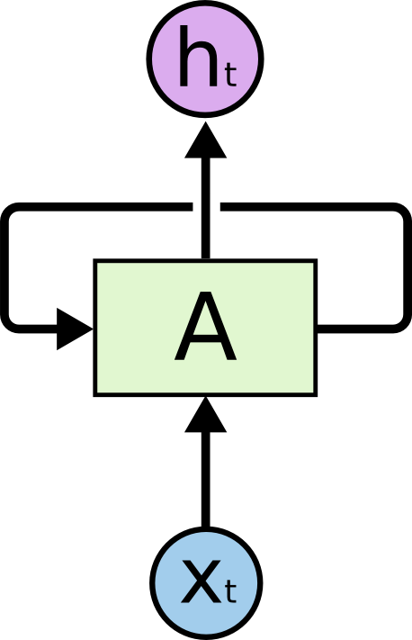
Recurrent Neural Networks have loops

Slide 4
Recurrent Neural Networks
In the above diagram, a chunk of neural network, A, looks at some input xt and outputs a value ht. A loop allows information to be passed from one step of the network to the next.
These loops make recurrent neural networks seem kind of mysterious. However, if you think a bit more, it turns out that they aren’t all that different than a normal neural network. A recurrent neural network can be thought of as multiple copies of the same network, each passing a message to a successor. Consider what happens if we unroll the loop:

Slide 5
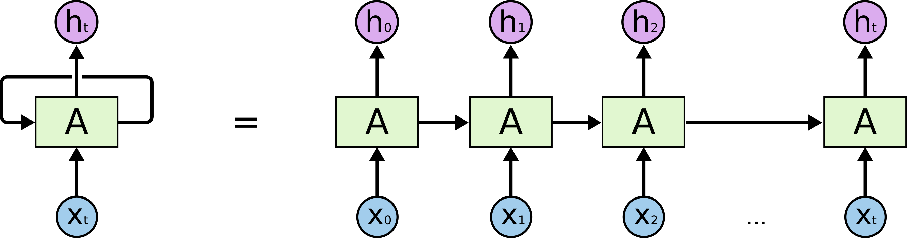
An unrolled recurrent neural network
This Photo by Unknown author is licensed under CC BY-SA.

Slide 6
The Problem of Long-Term Dependencies
One of the appeals of RNNs is the idea that they might be able to connect previous information to the present task, such as using previous video frames might inform the understanding of the present frame. If RNNs could do this, they’d be extremely useful. But can they? It depends.
Sometimes, we only need to look at recent information to perform the present task. For example, consider a language model trying to predict the next word based on the previous ones. If we are trying to predict the last word in “the clouds are in the sky,” we don’t need any further context – it’s pretty obvious the next word is going to be sky. In such cases, where the gap between the relevant information and the place that it’s needed is small, RNNs can learn to use the past information.

Slide 7
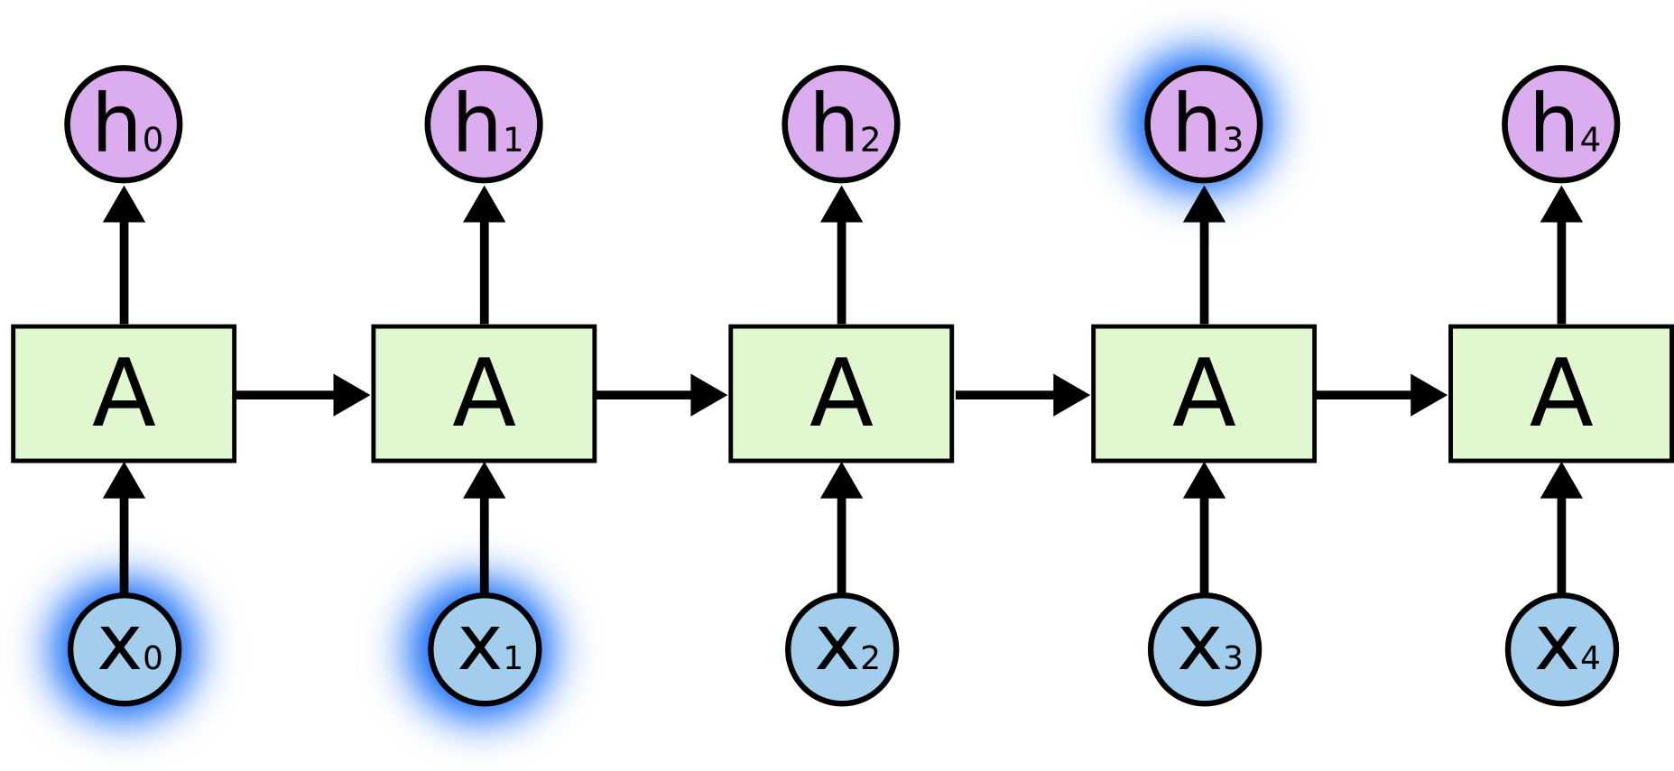

Slide 8
The Problem of Long-Term Dependencies
But there are also cases where we need more context. Consider trying to predict the last word in the text “I grew up in France… I speak fluent French.” Recent information suggests that the next word is probably the name of a language, but if we want to narrow down which language, we need the context of France, from further back. It’s entirely possible for the gap between the relevant information and the point where it is needed to become very large.
Unfortunately, as that gap grows, RNNs become unable to learn to connect the information.

Slide 9
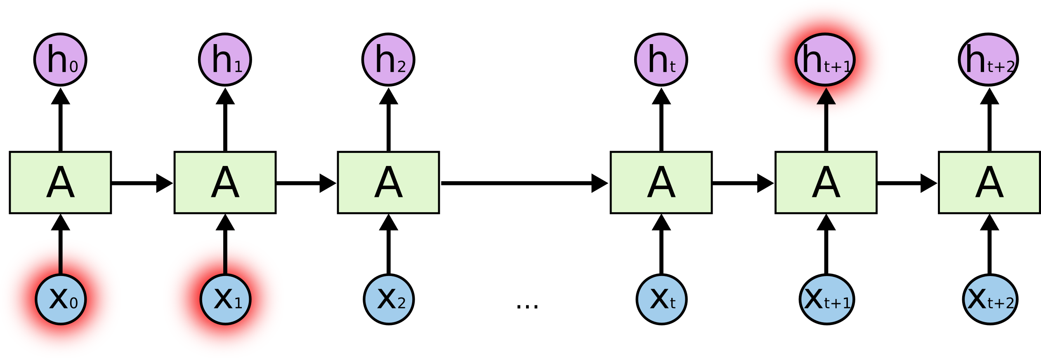
Thankfully, LSTMs don’t have this problem!

Slide 10
LSTM Networks
Long Short Term Memory networks – usually just called “LSTMs” – are a special kind of RNN, capable of learning long-term dependencies. They were introduced by Hochreiter & Schmidhuber (1997), and were refined and popularized by many people in following work.¹ They work tremendously well on a large variety of problems, and are now widely used.
LSTMs are explicitly designed to avoid the long-term dependency problem. Remembering information for long periods of time is practically their default behavior, not something they struggle to learn!
All recurrent neural networks have the form of a chain of repeating modules of neural network. In standard RNNs, this repeating module will have a very simple structure, such as a single tanh layer.

Slide 11
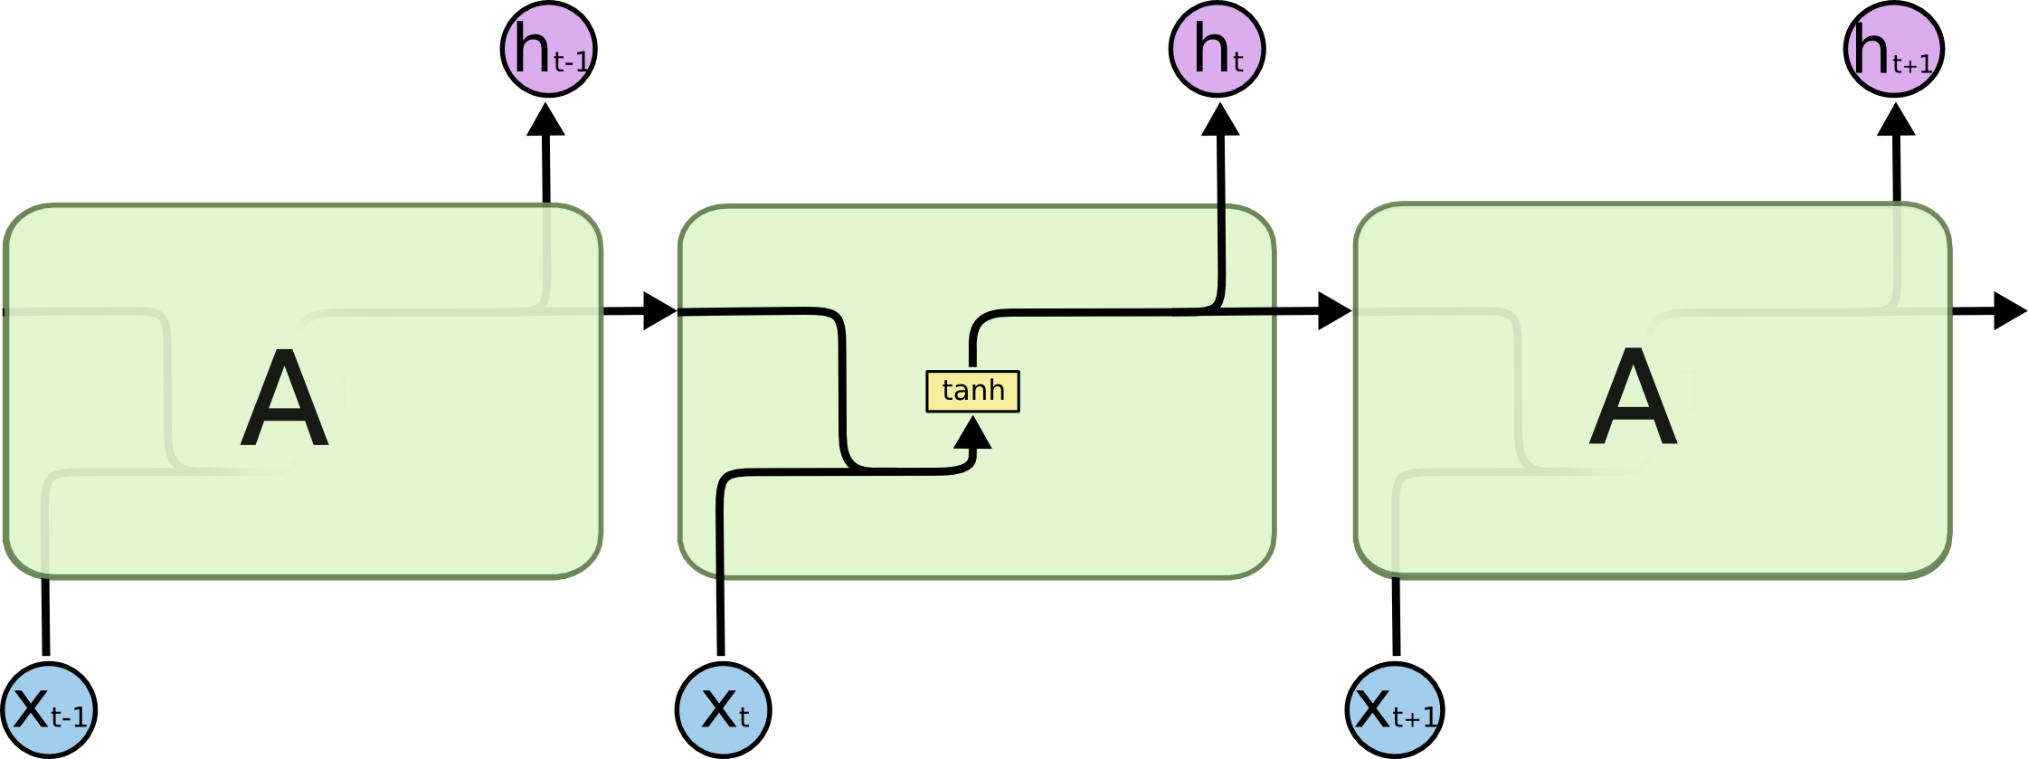
The repeating module in a standard RNN contains a single layer

Slide 12

The repeating module in an LSTM contains four interacting layers
LSTMs also have this chain like structure, but the repeating module has a different structure. Instead of having a single neural network layer, there are four, interacting in a very special way.

Slide 13
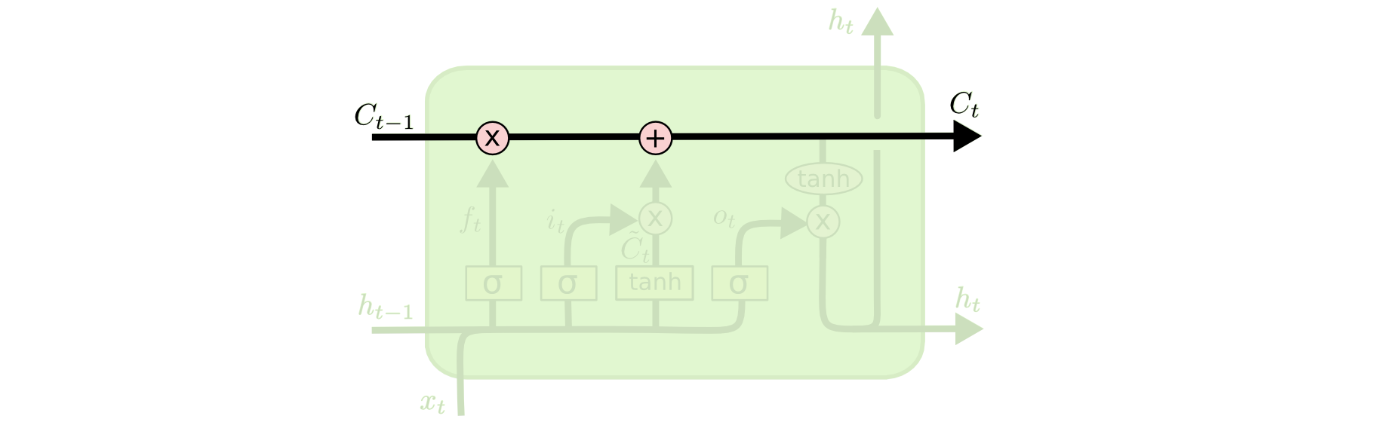
The Core Idea Behind LSTMs
The key to LSTMs is the cell state, the horizontal line running through the top of the diagram.
The cell state is kind of like a conveyor belt. It runs straight down the entire chain, with only some minor linear interactions. It’s very easy for information to just flow along it unchanged.

Slide 14
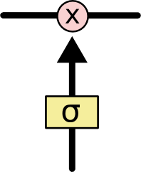
The LSTM does have the ability to remove or add information to the cell state, carefully regulated by structures called gates.
Gates are a way to optionally let information through. They are composed out of a sigmoid neural net layer and a pointwise multiplication operation.
The sigmoid layer outputs numbers between zero and one, describing how much of each component should be let through. A value of zero means “let nothing through,” while a value of one means “let everything through!”
An LSTM has three of these gates, to protect and control the cell state.

Slide 15
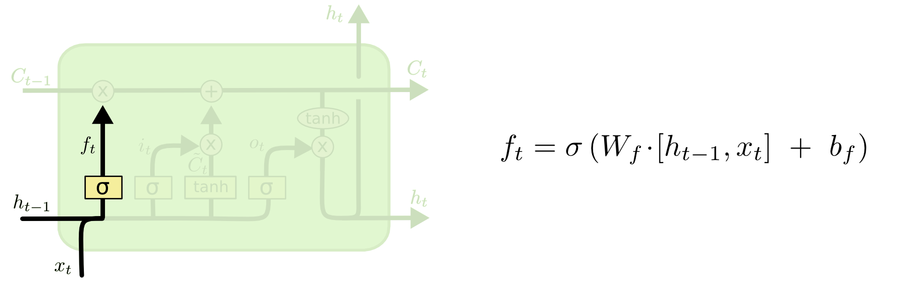
Step-by-Step LSTM Walk Through
The first step in our LSTM is to decide what information we’re going to throw away from the cell state. This decision is made by a sigmoid layer called the “forget gate layer.” It looks at ht−1ht−1and xt, and outputs a number between 00 and 11 for each number in the cell state Ct−1Ct−1. A 11represents “completely keep this” while a 00 represents “completely get rid of this.”
Let’s go back to our example of a language model trying to predict the next word based on all the previous ones. In such a problem, the cell state might include the gender of the present subject, so that the correct pronouns can be used. When we see a new subject, we want to forget the gender of the old subject.

Slide 16
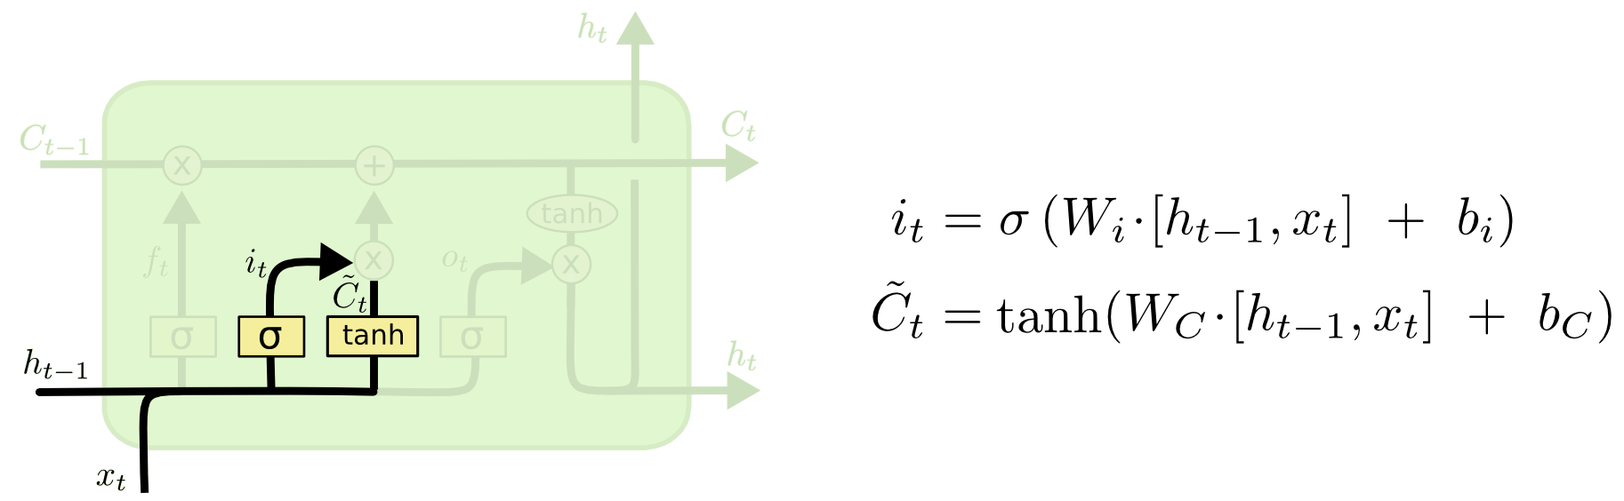
Step-by-Step LSTM Walk Through
The next step is to decide what new information we’re going to store in the cell state. This has two parts. First, a sigmoid layer called the “input gate layer” decides which values we’ll update. Next, a tanh layer creates a vector of new candidate values, C~tC~t, that could be added to the state. In the next step, we’ll combine these two to create an update to the state.
In the example of our language model, we’d want to add the gender of the new subject to the cell state, to replace the old one we’re forgetting.

Slide 17
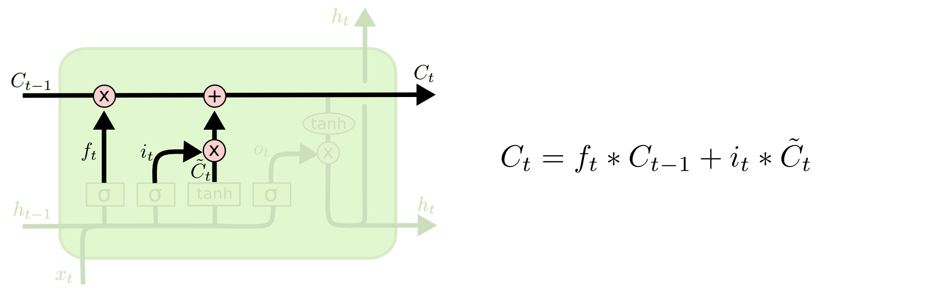
Step-by-Step LSTM Walk Through
It’s now time to update the old cell state, Ct−1Ct−1, into the new cell state CtCt. The previous steps already decided what to do, we just need to actually do it.
We multiply the old state by ftft, forgetting the things we decided to forget earlier. Then we add it∗C~tit∗C~t. This is the new candidate values, scaled by how much we decided to update each state value.
In the case of the language model, this is where we’d actually drop the information about the old subject’s gender and add the new information, as we decided in the previous steps.

Slide 18
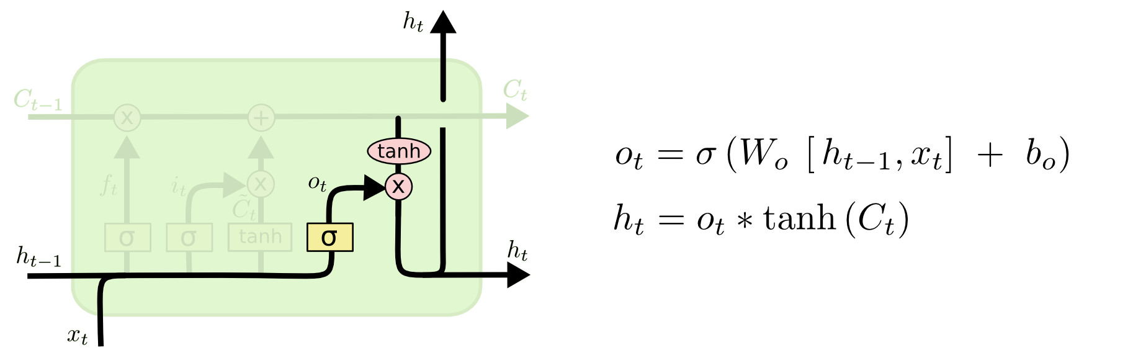
Step-by-Step LSTM Walk Through
Finally, we need to decide what we’re going to output. This output will be based on our cell state, but will be a filtered version. First, we run a sigmoid layer which decides what parts of the cell state we’re going to output. Then, we put the cell state through tanhtanh (to push the values to be between −1−1 and 11) and multiply it by the output of the sigmoid gate, so that we only output the parts we decided to.
For the language model example, since it just saw a subject, it might want to output information relevant to a verb, in case that’s what is coming next. For example, it might output whether the subject is singular or plural, so that we know what form a verb should be conjugated into if that’s what follows next.

Slide 19
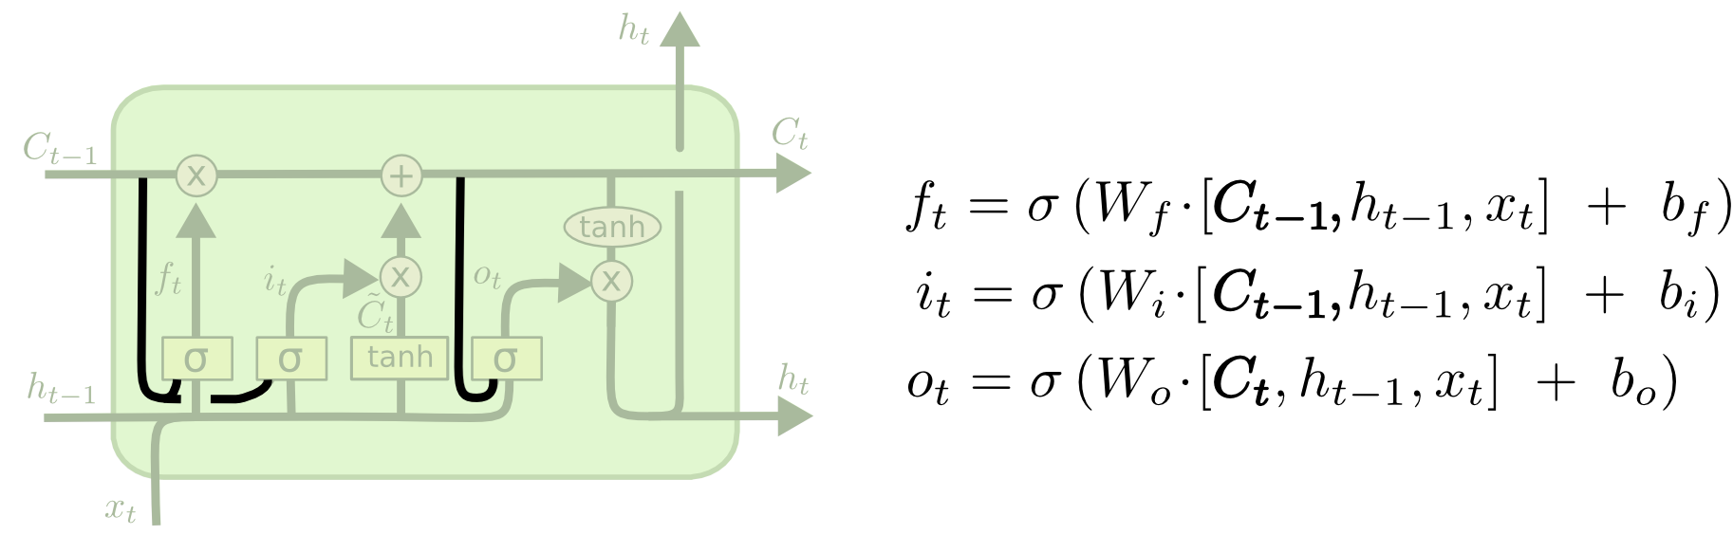
Variants on Long Short Term Memory
What I’ve described so far is a pretty normal LSTM. But not all LSTMs are the same as the above. In fact, it seems like almost every paper involving LSTMs uses a slightly different version. The differences are minor, but it’s worth mentioning some of them.
One popular LSTM variant, introduced by Gers & Schmidhuber (2000), is adding “peephole connections.” This means that we let the gate layers look at the cell state.

Slide 20
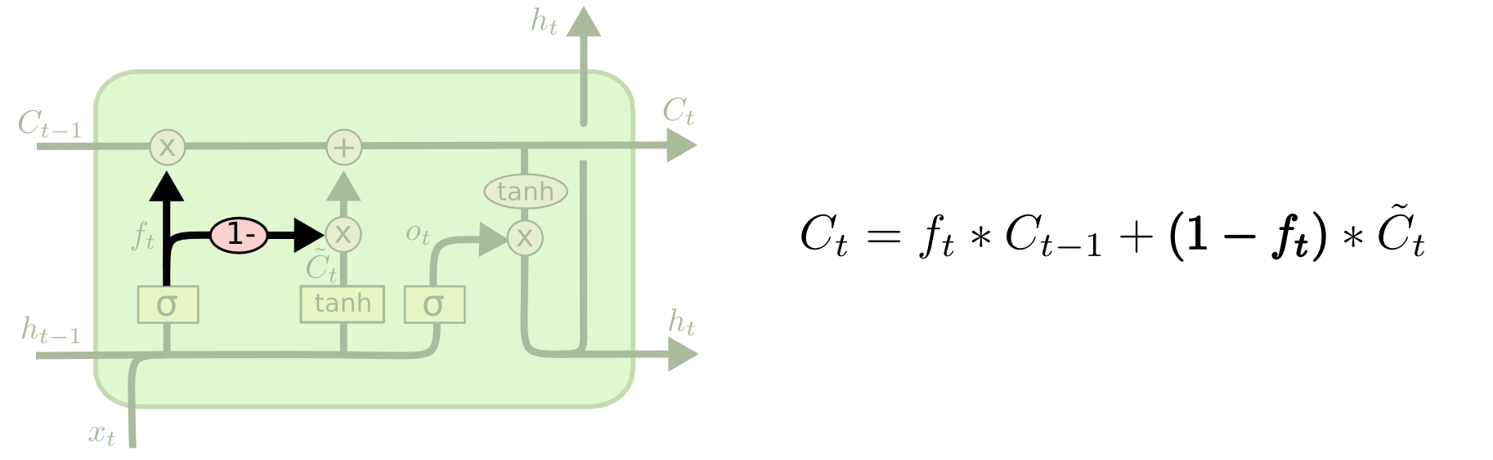
Variants on Long Short Term Memory
The above diagram adds peepholes to all the gates, but many papers will give some peepholes and not others.
Another variation is to use coupled forget and input gates. Instead of separately deciding what to forget and what we should add new information to, we make those decisions together. We only forget when we’re going to input something in its place. We only input new values to the state when we forget something older.

Slide 21
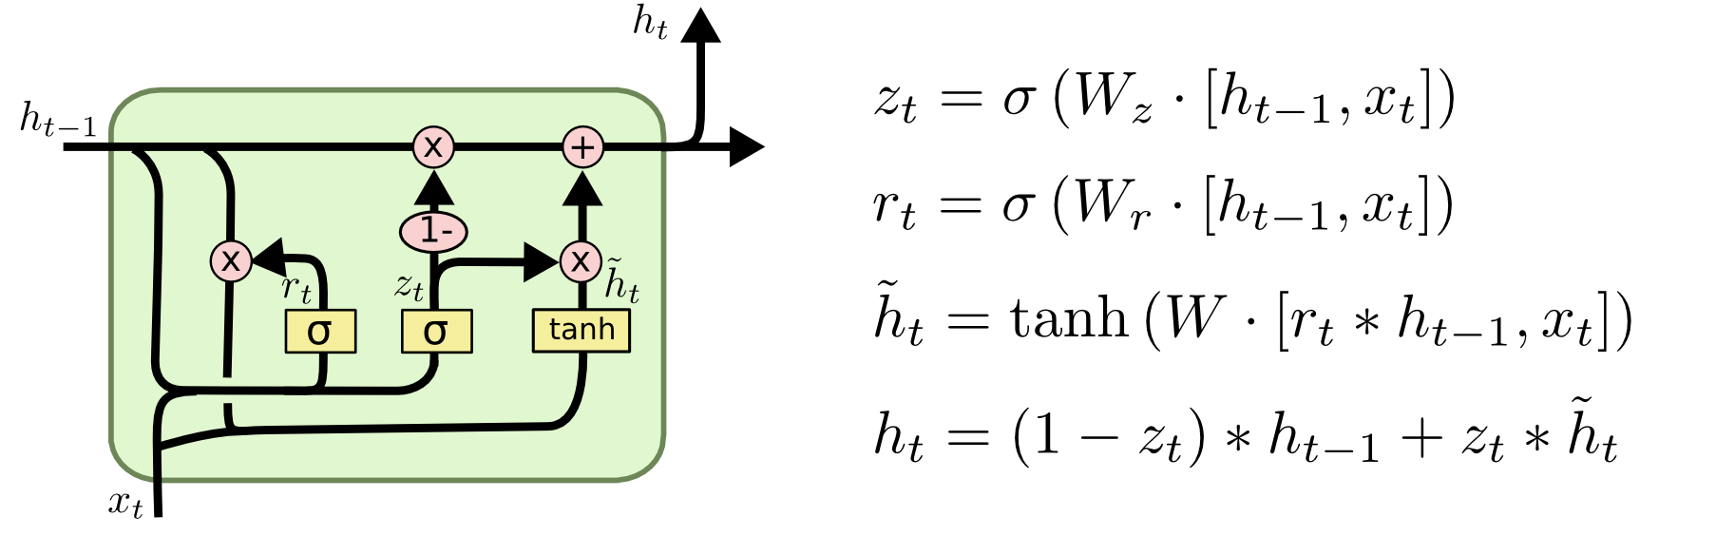
Variants on Long Short Term Memory
A slightly more dramatic variation on the LSTM is the Gated Recurrent Unit, or GRU, introduced by Cho, et al. (2014). It combines the forget and input gates into a single “update gate.” It also merges the cell state and hidden state, and makes some other changes. The resulting model is simpler than standard LSTM models, and has been growing increasingly popular.

Slide 22
Variants on Long Short Term Memory
These are only a few of the most notable LSTM variants. There are lots of others, like Depth Gated RNNs by Yao, et al. (2015). There’s also some completely different approach to tackling long-term dependencies, like Clockwork RNNs by Koutnik, et al. (2014).
Which of these variants is best? Do the differences matter? Greff, et al. (2015) do a nice comparison of popular variants, finding that they’re all about the same. Jozefowicz, et al. (2015)tested more than ten thousand RNN architectures, finding some that worked better than LSTMs on certain tasks.

Slide 23
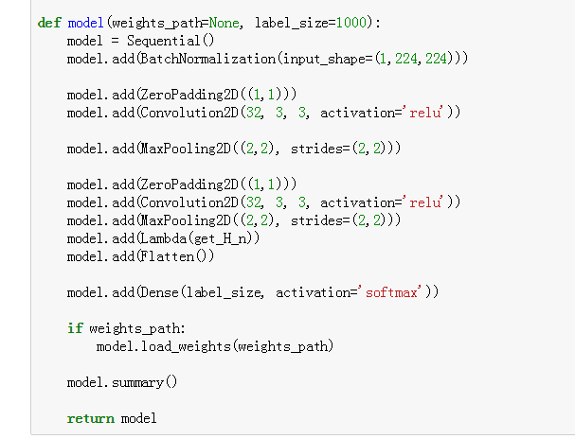
Now Code Time

