Slide 1

Muhammad Maarig
Front End developer
Content writer
Bachelor Of commerce - University of Karachi

Slide 2
What a developer need the most ?
Integrated Development Environment
(IDE)

Slide 3
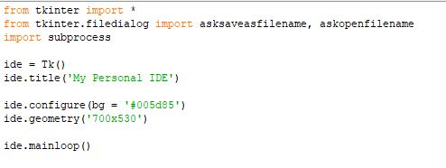
Step 1
Initiating Tkinter GUI by importing desired libraries.
Defining GUI
Title
Configure
Geometry
Mainloop

Slide 4
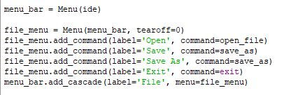
Step 2
Placing menu bar similar to navbar in Website User Interface.
Cascading “File” button
Dropped down “Open”
Dropped down “Save”
Dropped down “Save As”
Dropped down “Exit”

Slide 5

Step 3
Placing menu bar for Run Command.
Cascading “Run” button
Dropped down “Run”

Slide 6
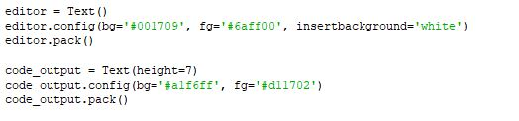
Step 4
Creating the text editor and output like a terminal.
Creating and styling Text Editor
Creating and styling Output Screen

Slide 7
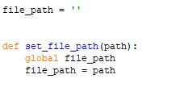
Step 5
Creating the path a global variable as file_path.

Slide 8
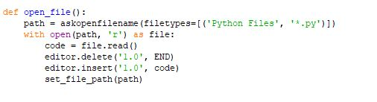
Step 6
Creating function to open file using predefined file path.
Deleting data and clearing entire screen
Inserting data from file on entire screen

Slide 9
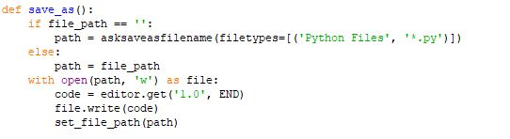
Step 7
Creating function to save file using predefined file path.
Getting / fetching data from the entire screen

Slide 10
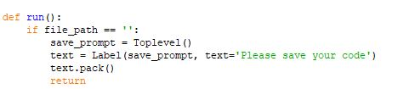
Step 8
Creating function to run file using predefined file path.
Error message to save file first

Slide 11

Step 9
Using subprocess library to initiate shell
Error message would appear on shell aka output screen created earlier.

Slide 12
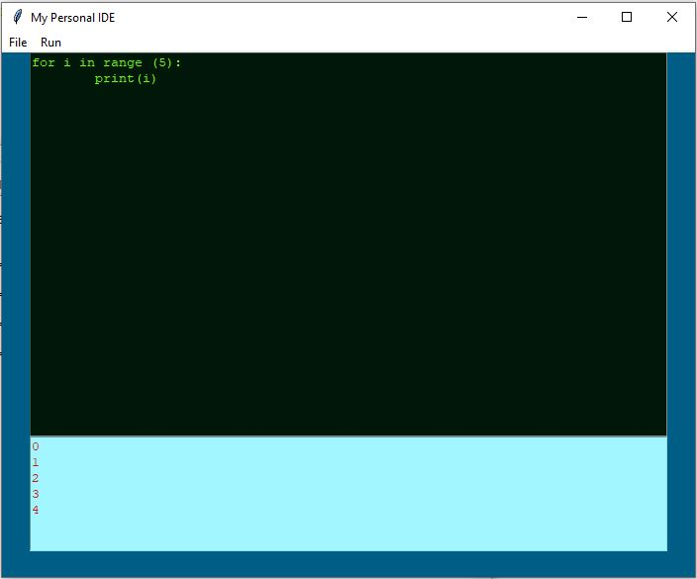
Output
The look of the IDE application

Slide 13
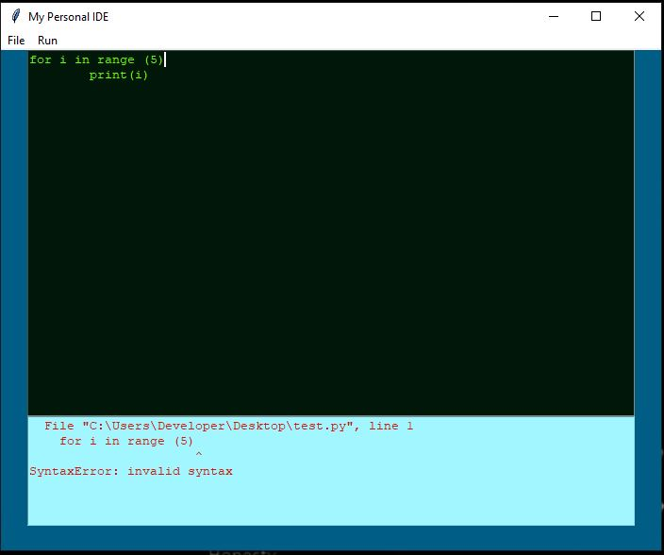
Error
Notice the error message is shown in output window used as shell

Slide 14
Thanks to
SSUET & NAVTTC
And every other teaching and non-teaching staff.

Slide 15
Extra

