Slide 1
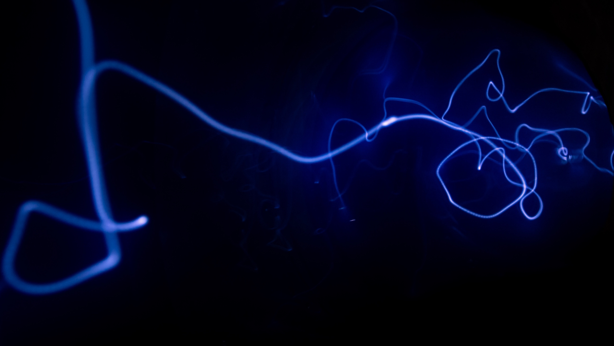
MovieMind: End-to-End Movie Recommendation System
AI/ML for Industry Capstone | IIT Delhi CEP
From data pipeline to explainable deployment: Baseline/ML/DL models, API, UI, and NLP layer.
Author: Ashraf | Date: Apr 2026
Name
X/X/202X
AI/ML for Industry
Continuing Education Programme
Indian Institute of Technology Delhi

Slide 2
Background
Why this project
Recommendation systems face sparsity, long-tail catalogs, and cold-start constraints.
Capstone goal was to build a full lifecycle system: accurate, explainable, reproducible, and demo-ready.
Dataset: MovieLens 1M with ratings + user/movie metadata.

Slide 3
Problem Statement
Business + engineering objective
Predict user-movie ratings and generate top-N recommendations.
Compare Baseline, ML, DL, and Tuned DL with leakage-safe time-based evaluation.
Expose inspectable model metadata and recommendation logic in API + Streamlit UI.

Slide 4
Methodology, Dataset, and Tools
Lifecycle implemented
Phases 1-8 completed: setup -> EDA -> features -> ML -> DL -> post-analysis -> API -> UI/agent.
Critical modeling choice: strict time-based split to prevent leakage.
Stack: pandas, scikit-learn, PyTorch, Optuna, FastAPI, Streamlit.
Flow diagram source: evidence/presentation/ai_lifecycle_flow_diagram.md (Mermaid, horizontal LR)

Slide 5
Results 1: Model Evaluation Comparison
Offline evaluation (time-based split): model-wise RMSE/MAE/time
Model | Family | RMSE | MAE | Time (sec) | Outcome
Baseline (Global Mean) | Baseline | 1.1043 | 0.9195 | 0.00 | Reference floor
Linear Regression | ML | 0.9002 | 0.7085 | 0.07 | Fast + strong baseline
Random Forest | ML | 0.8988 | 0.7076 | 20.23 | Improves over linear
Gradient Boosting | ML | 0.8971 | 0.7054 | 193.17 | Champion (best error)
NCF Baseline | DL | 1.1146 | 0.9307 | - | Below ML champion
NCF Tuned (Optuna + retrained weights) | DL Tuned | 0.9754 | 0.7936 | Trial-based | Improved DL, still behind GB
Decision: Gradient Boosting selected as primary model due to best RMSE/MAE under leakage-safe evaluation.

Slide 6
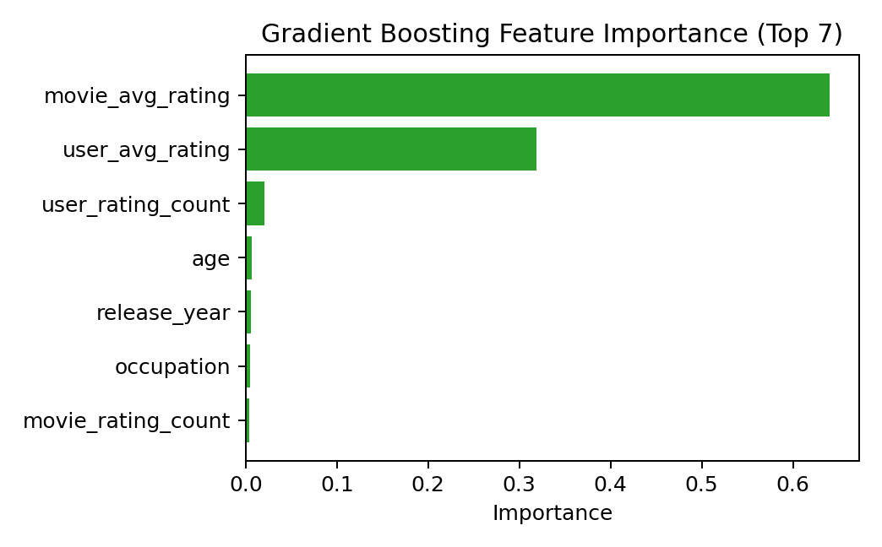
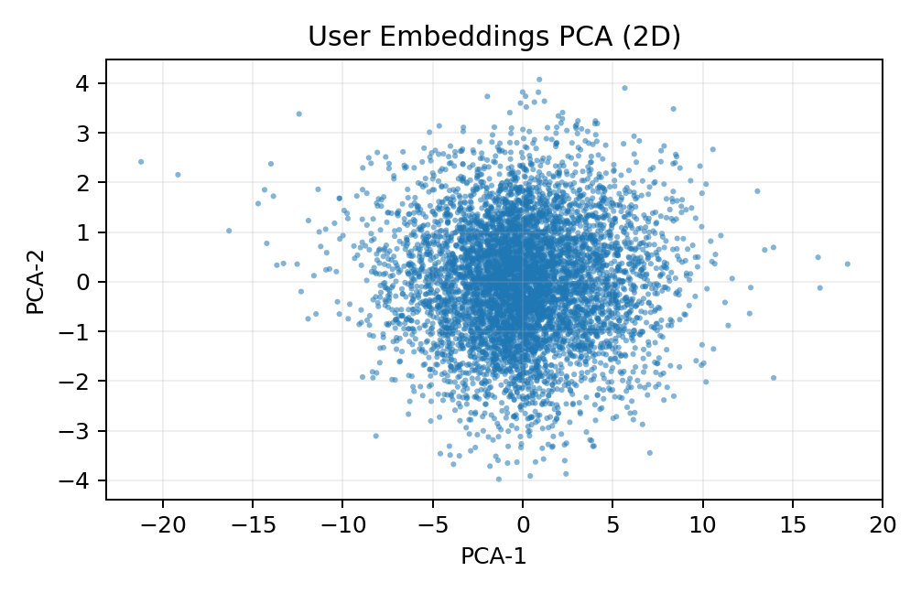
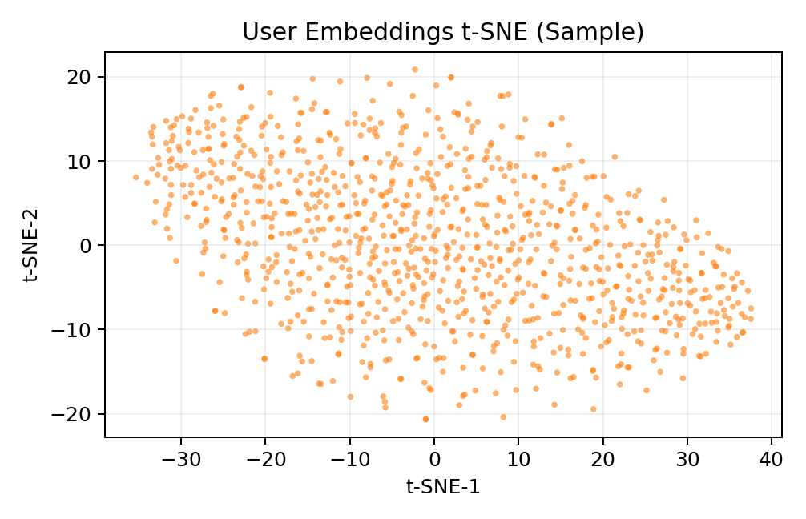
Results 2: Tuned DL, Explainability, and Diversity Controls
A) Tuned DL best hyperparameters
B) Diversity slider logic in recommendation ranking
Hyperparameter | Value
learning_rate | 0.0054401120
embedding_dim | 32
dropout_rate | 0.4431288799
n_layers | 3
n_units_l0/l1/l2 | 256 / 64 / 32
best_rmse | 1.0061
Control / Output | Definition / Role
diversity_alpha | User control: novelty vs relevance trade-off
Formula | adjusted_score = predicted_rating_raw - alpha * overlap_penalty
Debug fields | predicted_rating_raw, overlap_penalty, adjusted_score, overlap_genres
User impact | Higher alpha reduces repetitive genre overlap
Feature Importance
PCA Embeddings
t-SNE Embeddings

Slide 7
Conclusions and Next Steps
What was achieved
End-to-end lifecycle delivered with reproducible evidence and multi-model serving.
Champion model: Gradient Boosting; Tuned DL used for representation/analysis depth.
Diversity slider and taste-map added for controllable exploration and explainability.
Open item: dedicated cold-start strategy for brand-new users/items (future work).
Next: stronger local LLM integration and presentation/demo polish.

Slide 8
Q&A (2-minute defense)
1) Why time-based split? -> Prevents future-to-past leakage and gives honest evaluation.
2) Why Gradient Boosting champion? -> Lowest RMSE/MAE among tested models.
3) Why keep DL then? -> Better representation artifacts + future personalization extension.
4) What does diversity slider do? -> Penalizes genre overlap via alpha-controlled reranking.
5) Is cold-start solved? -> Not as dedicated module yet; tracked as future work.

Slide 9
UI Evidence: Recommend Page Screenshot
Insert screenshot from Streamlit Recommend tab (with selected model, top-N, diversity slider, and result cards).
[PLACEHOLDER IMAGE] Paste Recommend page screenshot here
Tip: capture screen after clicking Get Recommendations so diversity/taste-map context is visible.

Slide 10
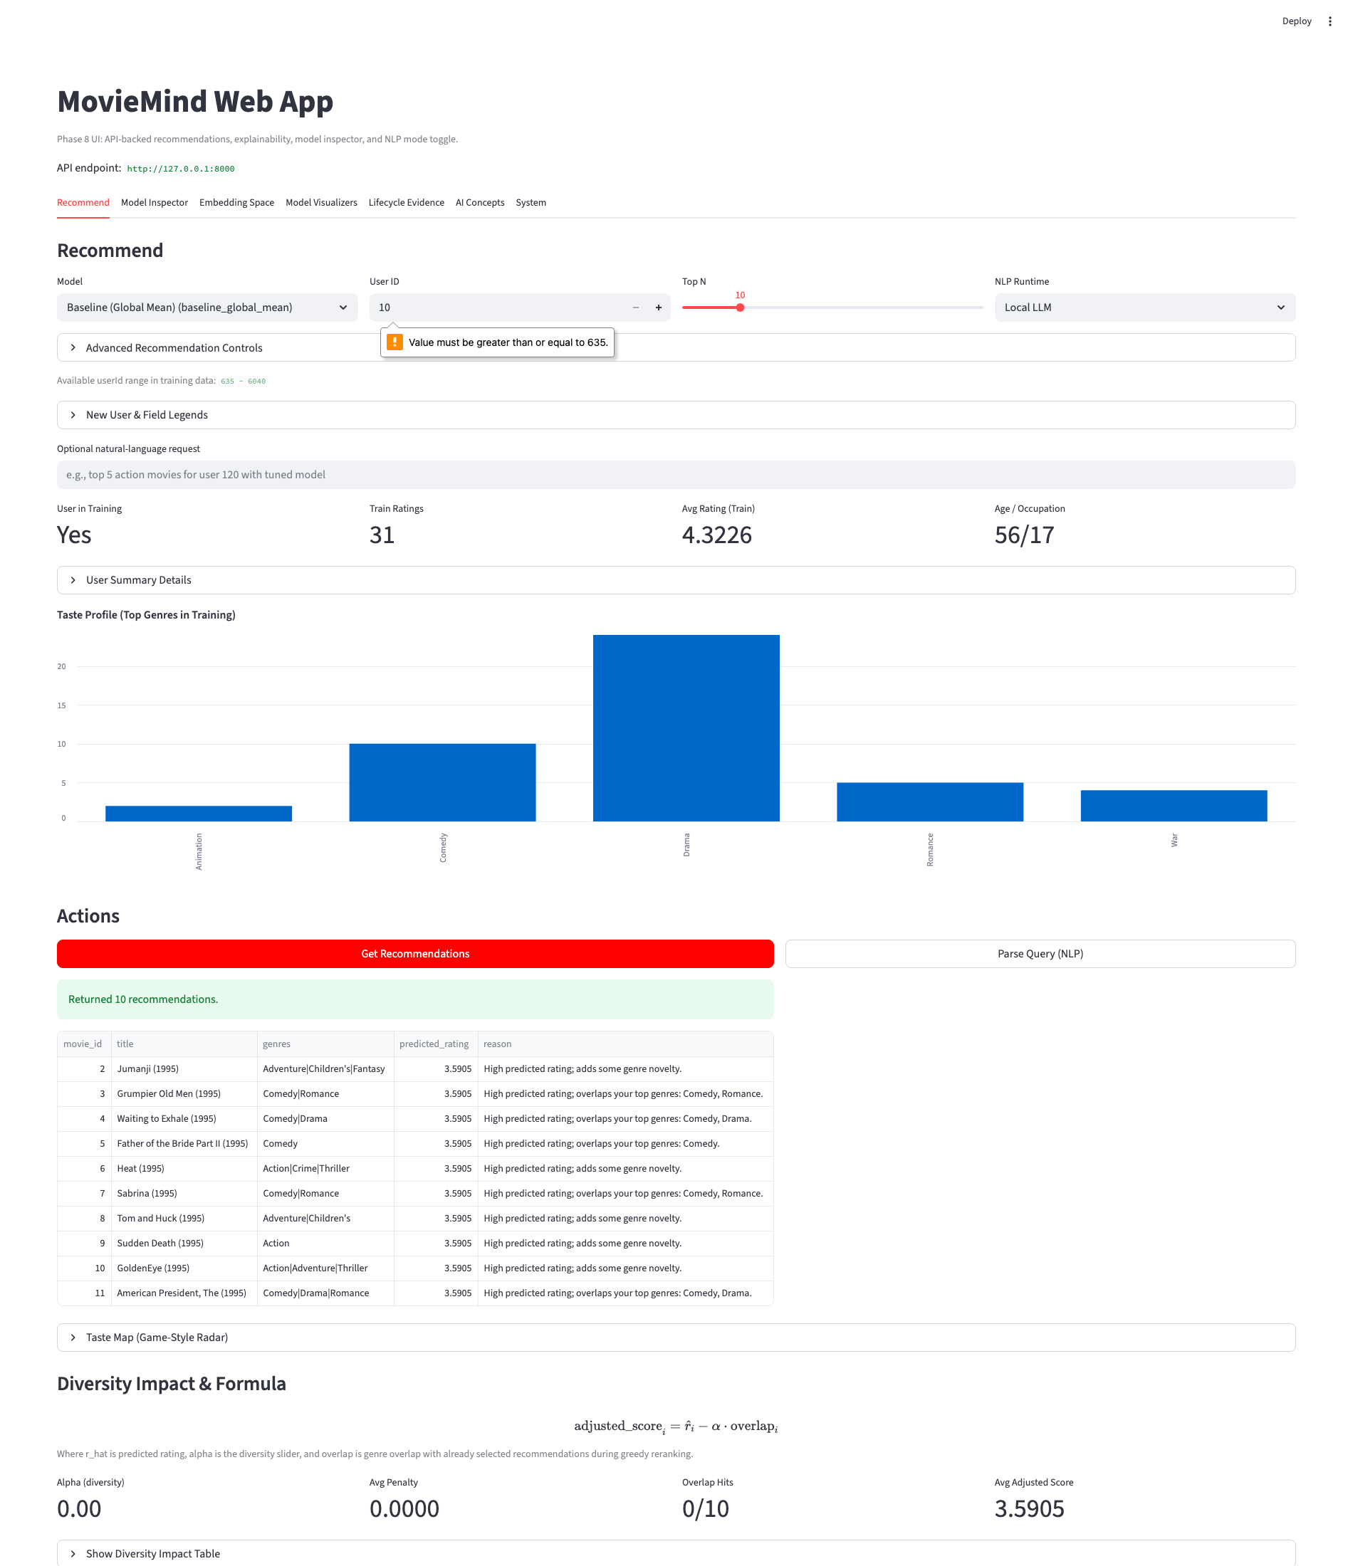
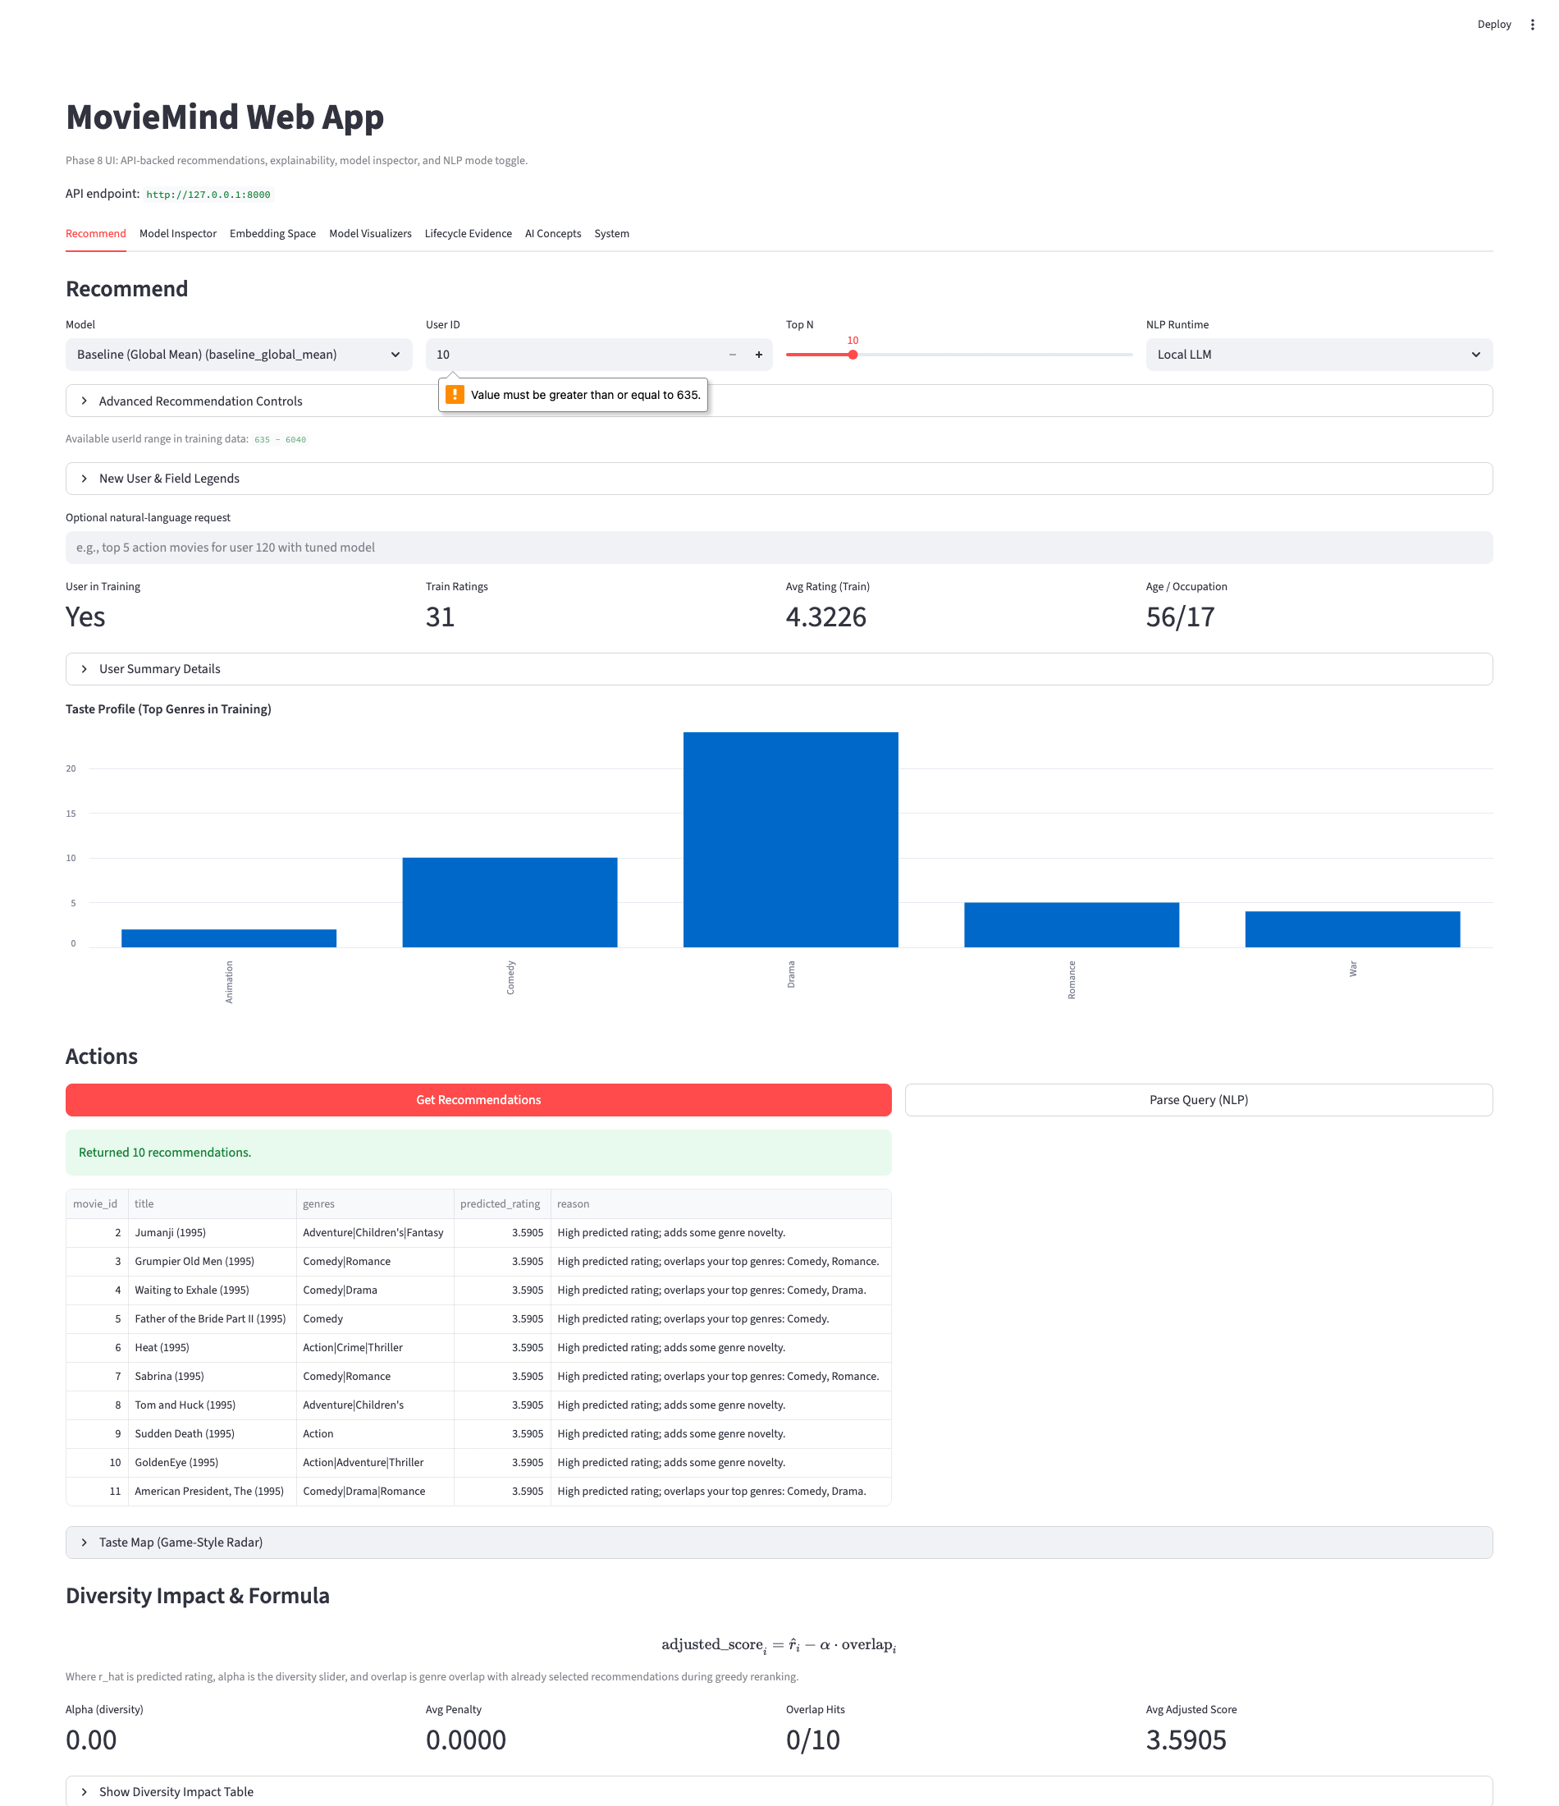
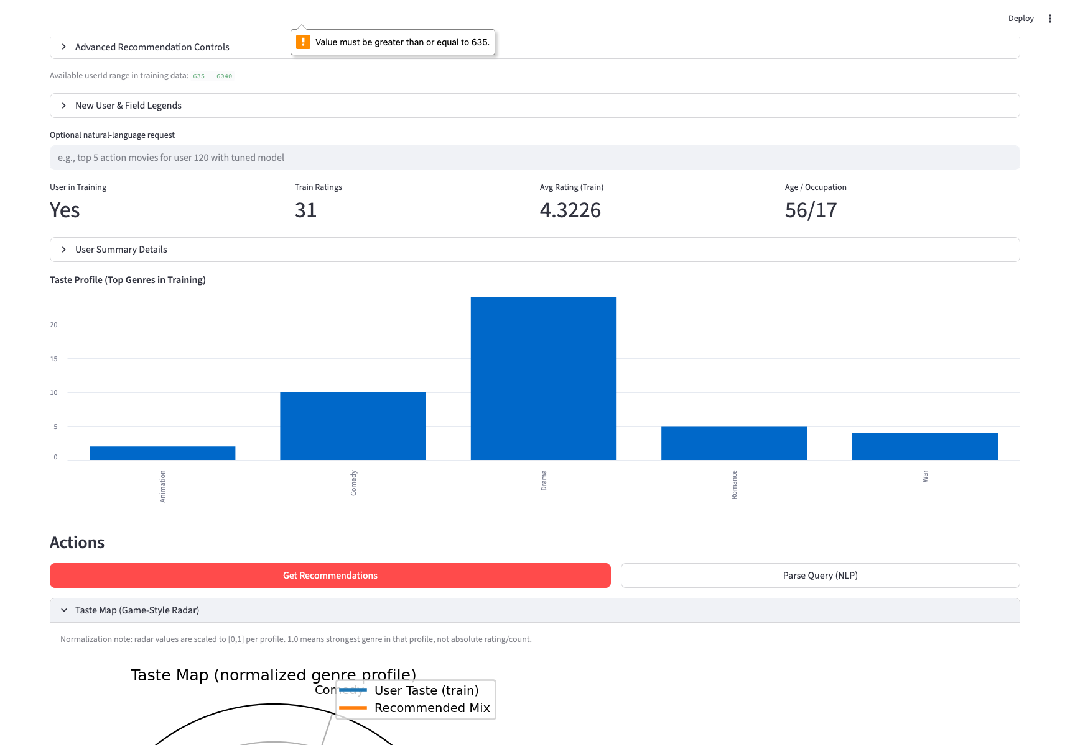
UI Evidence: Diversity Slider + Taste Map
Captured after clicking Get Recommendations with diversity slider set to a non-zero value.
Diversity slider and recommendation context
Full Taste Map view (not cropped)

