Slide 1
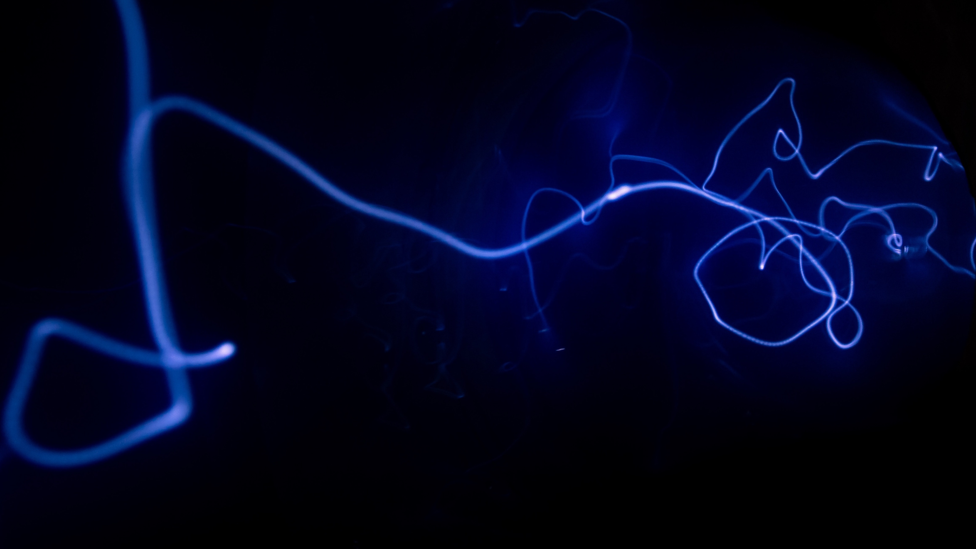
Project Title
MovieMind: End-to-End Movie Recommendation System
IIT Delhi CEP Final Project
Data -> Modeling -> Explainability -> API -> Web App -> NLP Interface
Name
X/X/202X
AI/ML for Industry
Continuing Education Programme
Indian Institute of Technology Delhi

Slide 2
Background
Recommenders are core to OTT/e-commerce personalization.
Key challenges: sparsity, long-tail catalog, cold-start behavior.
Goal: accurate, explainable, and production-ready recommendations.
Dataset: MovieLens 1M with ratings, user, and movie metadata.

Slide 3
Problem Statement
Predict user-movie ratings for unseen interactions.
Generate Top-N recommendations with model switch support.
Compare Baseline, ML, DL, and Tuned-DL under leakage-safe evaluation.
Expose explanations and model metadata in serving layer.

Slide 4
Methodology, Datasets, and Tools used
Method: lifecycle pipeline from data wrangling to deployment.
Evaluation split: strict chronological train/test to avoid leakage.
Models: Baseline, Linear/RF/GB, NCF, Tuned NCF (Optuna).
Stack: pandas, scikit-learn, PyTorch, FastAPI, Streamlit.
XAI: feature importance, embedding visualizations, model inspector.

Slide 5
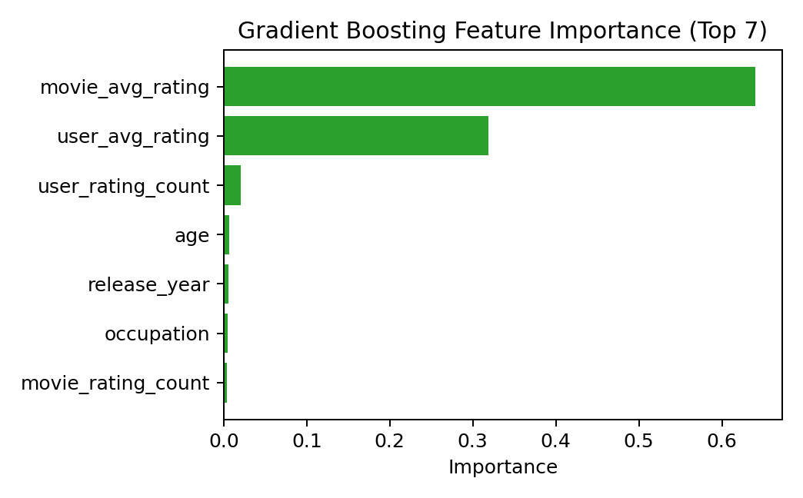
Results 1
Unified evaluation across model families in one framework.
Champion selected via leakage-safe test metrics.
Tuned DL improved representation quality and recommendation behavior.
ML models remain reliable and fast serving alternatives.
Key RMSE outcomes: tuned-best=1.0061 | retrain-check=0.9754
Model | Family | Available
Baseline (Global Mean) | baseline | Yes
Linear Regression | ml | Yes
Random Forest | ml | Yes
Gradient Boosting | ml | Yes
NCF Baseline | dl | Yes
NCF Tuned Best | dl_tuned | Yes

Slide 6
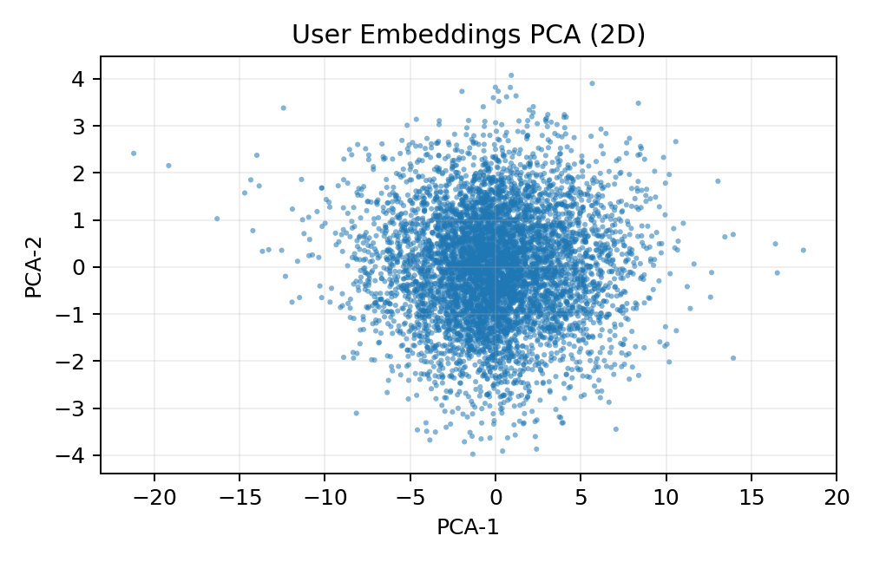
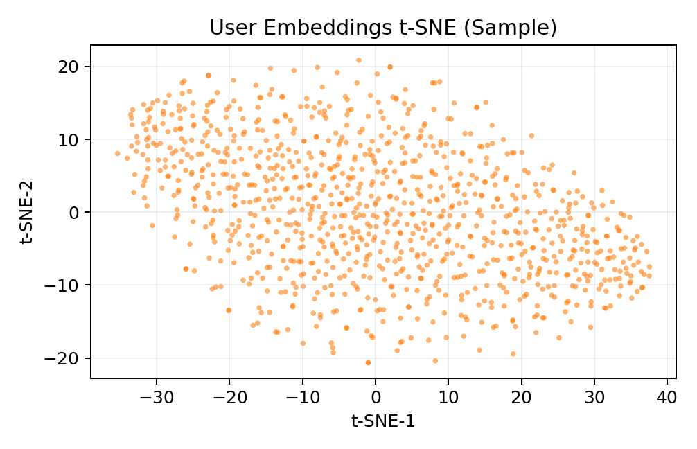
Results 2
FastAPI endpoints for health, models, predict, recommend, and NLP query.
Streamlit UI with recommendation controls, model inspector, and visualizers.
Taste Map compares user historical profile vs recommended mix.
Diversity reranking adds controllable novelty with transparent math.
Runtime NLP guardrails support safe parsing in multiple modes.
Figure: PCA embedding view from Phase 6 artifacts.
Figure: t-SNE sample embedding view from Phase 6 artifacts.

Slide 7
Conclusions
Delivered an end-to-end capstone-grade recommender system.
Balanced performance, explainability, and maintainability.
Institutionalized evidence capture and reproducible workflows.
Next: full local LLM integration, stronger cold-start onboarding, deeper evaluation.

