Slide 1
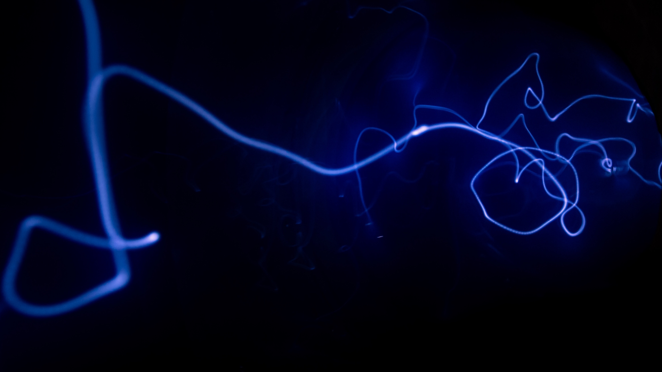
Project Title
MovieMind: End-to-End Movie Recommendation System
AI/ML for Industry Capstone | IIT Delhi CEP
Author: Ashraf (update if needed) | Date: (update before final submit)
Name
X/X/202X
AI/ML for Industry
Continuing Education Programme
Indian Institute of Technology Delhi

Slide 2
Background
Background
Personalization problem in movie recommendation with sparse user-item data.
Need to balance accuracy, explainability, and deployment readiness.
Dataset used: MovieLens 1M (ratings + users + movies metadata).

Slide 3
Problem Statement
Problem Statement
Build a full-lifecycle recommender: data -> models -> explainability -> API -> UI.
Compare Baseline, ML, DL, and tuned DL under leakage-safe evaluation.
Expose model inspector, recommendation rationale, and evidence artifacts.

Slide 4
Methodology, Datasets, and Tools used
Methodology, Datasets, and Tools used
Time-based split used to avoid leakage (train on past, test on future).
Models: Baseline, Linear/RF/GB, NCF, Tuned NCF (Optuna).
Stack: pandas, scikit-learn, PyTorch, FastAPI, Streamlit.
[PLACEHOLDER] Insert pipeline diagram image here (data -> train -> serve).

Slide 5
Results 1
Results 1
[PLACEHOLDER TABLE] Paste final model comparison table here (RMSE/MAE/etc).
[PLACEHOLDER IMAGE] Insert feature-importance plot here.
Decision: choose champion under leakage-safe test protocol.
MANUAL INSERT ZONE: You can replace this box with your final screenshot/table.

Slide 6
Results 2
Results 2
[PLACEHOLDER IMAGE] Insert Streamlit Recommend page screenshot here.
[PLACEHOLDER IMAGE] Insert Model Inspector screenshot here.
[PLACEHOLDER IMAGE] Insert PCA/t-SNE embedding visualization here.
[PLACEHOLDER IMAGE] Insert API response (recommend endpoint) screenshot/table here.
MANUAL INSERT ZONE: You can replace this box with your final screenshot/table.

Slide 7
Conclusions
Conclusions
Delivered: end-to-end recommender with API, UI, and explainability support.
Implemented: diversity reranking, model registry, evidence capture workflow.
Not yet implemented: dedicated cold-start strategy for brand-new users/items.
Future work: cold-start onboarding, full local LLM integration, richer online evaluation.

