Slide 1

Pinterest
M. M. Abdollahpour

Slide 2
Features: A Quick Look
Users
User Data Search
Visual Search
Following
Suggestion
Pins
Boards
Sections

Slide 3
Feature List (Users)
Fetch User Data
Search User Data
Create Following
Fetch Followings
Remove Following

Slide 4

Fetch User Data
Basic Data (Name, ID, URL)
Boards
Suggested Boards
Pins

Slide 5
Search User Data
Boards (by Name)
Pins (by Name)

Slide 6
Create Following
Follow a Board
Follow a User

Slide 7
Fetch Followings
Followers
Following Boards
Following Interests (Topics)
Following Users

Slide 8
Remove Following
Boards
Users

Slide 9
Feature List (Boards)
Create a Board
Fetch Board Data
Edit a Board
Delete a Board
*Board of mine or another user

Slide 10
Create a Board
Simple! (Name, Description)

Slide 11
Fetch Board Data
All Boards
Specific Board
Pins of a Board

Slide 12
Edit a Board
Name
Description

Slide 13
Delete a Board
Simple Again!

Slide 14
Feature List (Pins)
Create a Pin
Fetch Pin Data
Edit a Pin
Delete a Pin

Slide 15
Create a Pin
Board
Note
Link
Image / Image URL

Slide 16
Fetch Pin Data
Basic Data (ID, Link, URL, Description) of a Pin
(Again!) All Pins of a Board
My Pins

Slide 17
Edit a Pin
Board
Note
Description

Slide 18
Delete a Pin
Simple! (By ID)

Slide 19
Feature List (Sections)
Create a Section
Fetch Section Data
Delete Section

Slide 20
Create a Section
[of a] Board
Title

Slide 21
Fetch Section Data
Sections of a Board
Pins of a Section

Slide 22
Delete a Section
[of a] Board

Slide 23
Visual Search
Find Similar Pins by a Given Image

Slide 24
Wrap Up
Add a Board
Fetch a Board
Fetch All Boards
Add a Pin
Fetch a Pin
Fetch All Pins
Follow a Board
Fetch Following Boards
Basic User Management*

Slide 25
Three Qs
So far we’ve answered 2 first Qs
  Is it part of the essence of the system?
  What does it really mean?
Let’s answer the last Q
  How can I implement it?

Slide 26
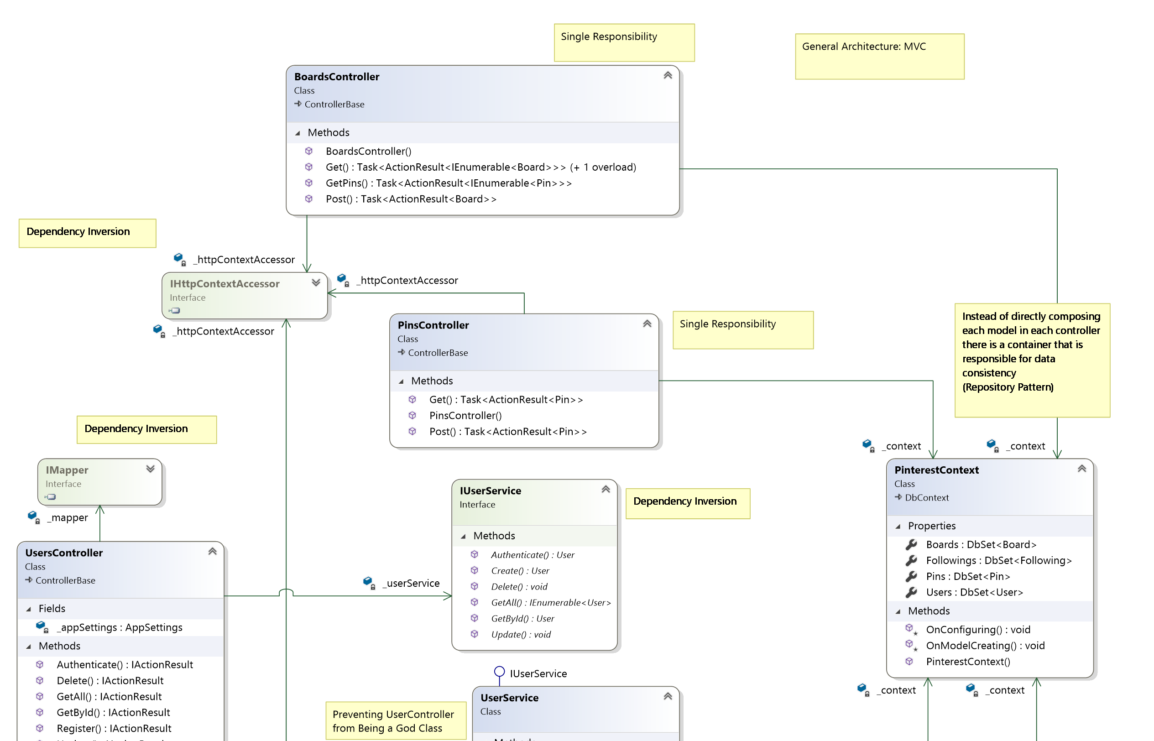
Controllers (Part 1)

Slide 27
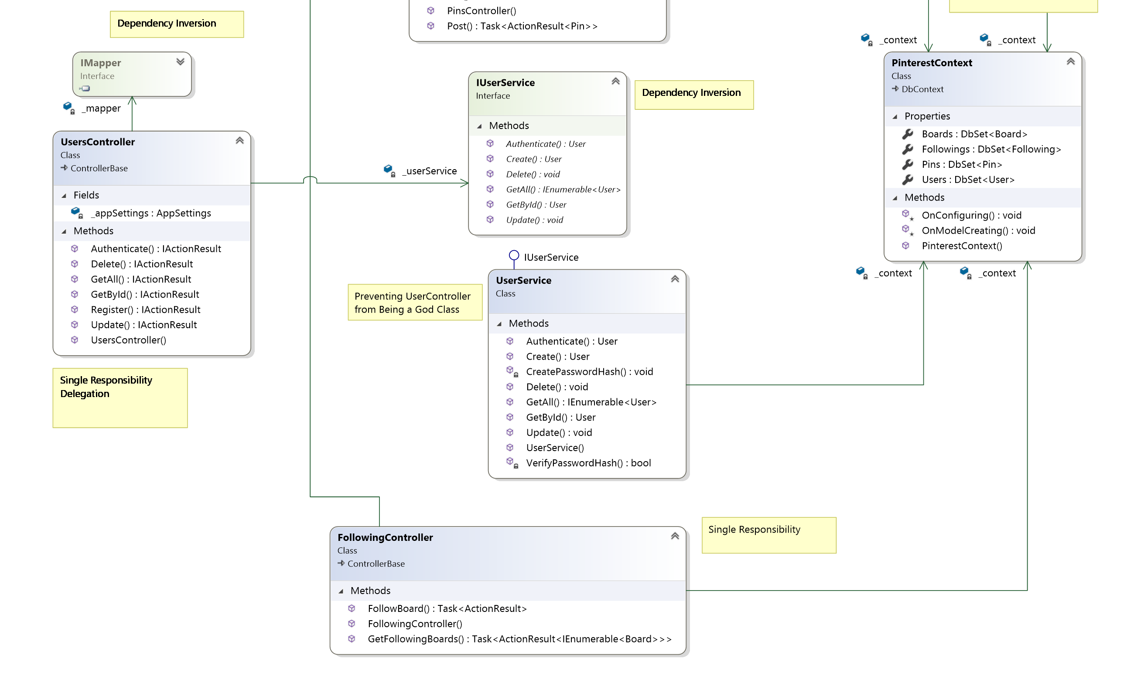
Controllers (Part 2)

Slide 28
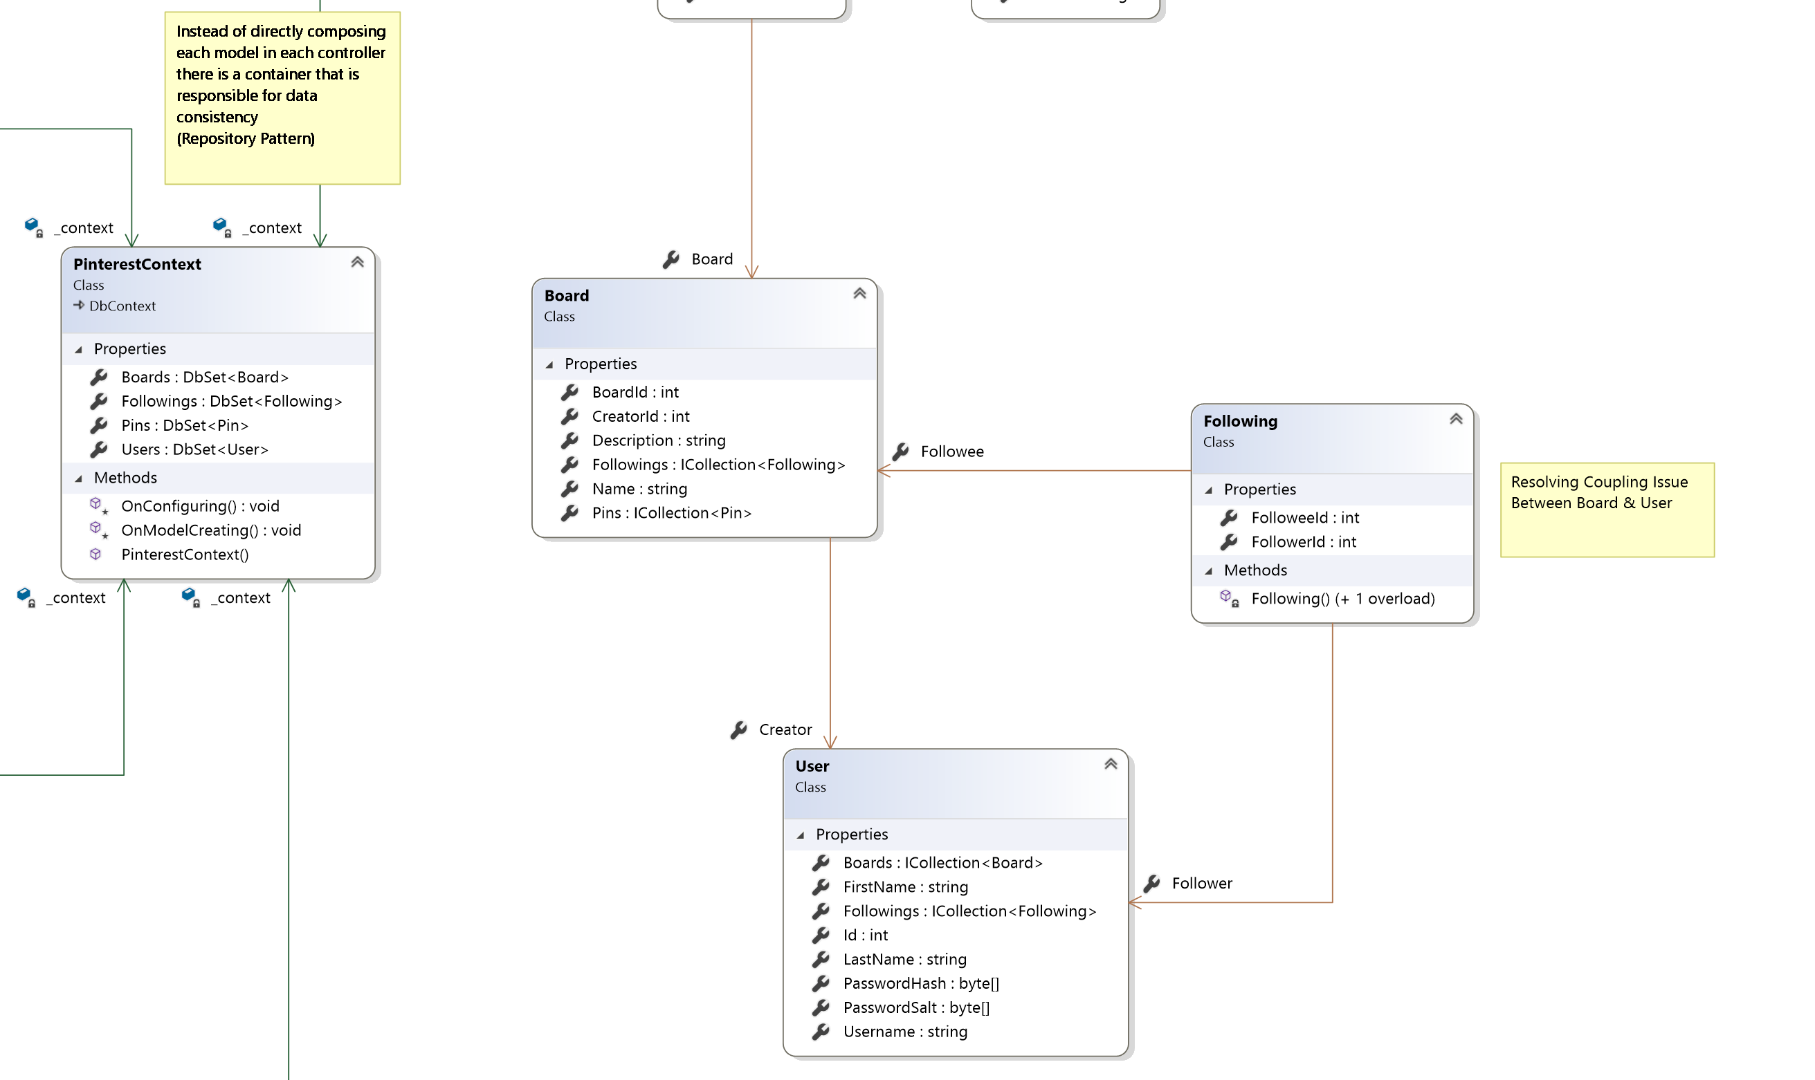
Models (Part 1)

Slide 29
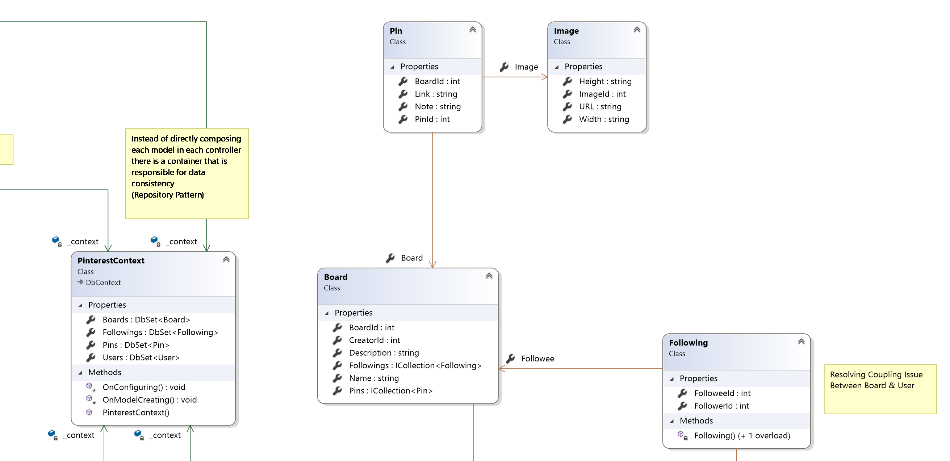
Models (Part 2)

Slide 30
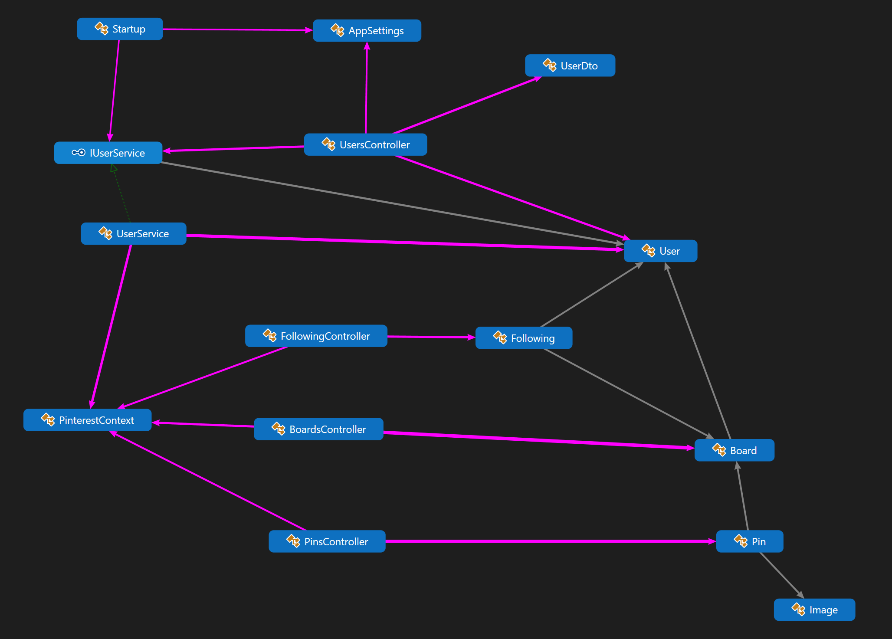
Function Calls

Slide 31
Views
ActionResult Class
  Ok()
  BadRequest()
  CreatedAt()
  …
HTML Response filled with model

