Slide 1
RIS clusterProfiler wrapper
Marissa Macchietto

Slide 2
ClusterProfiler
R package for analyzing and visualizing functional profiles (pathways) of gene and gene clusters
Supported analyses:
  Over-representation analysis
  Gene set enrichment analysis
  Biological theme comparison
Pathway databases:
  Gene Ontology (GO)
  Kyoto Encyclopedia of Genes and Genomes (KEGG)
  Reactome
  MsigDB
Visualization (plot types):
  barplots
  cnetplot
  dotplot
  emapplot
gseaplot
goplot
upsetplot

Slide 3
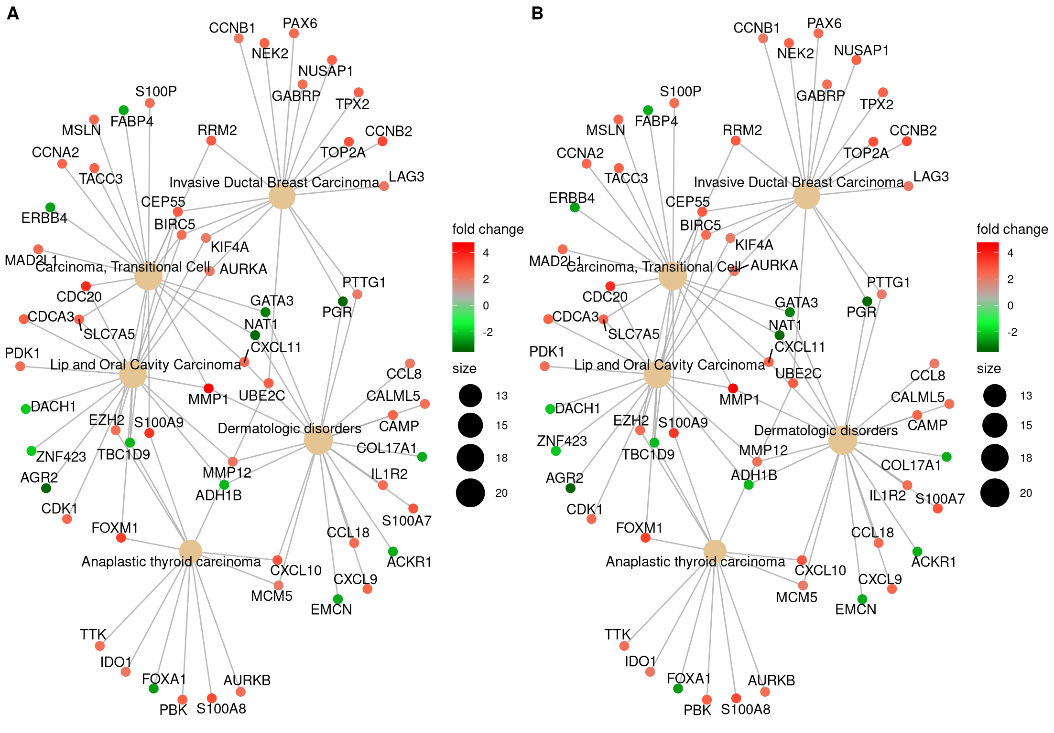
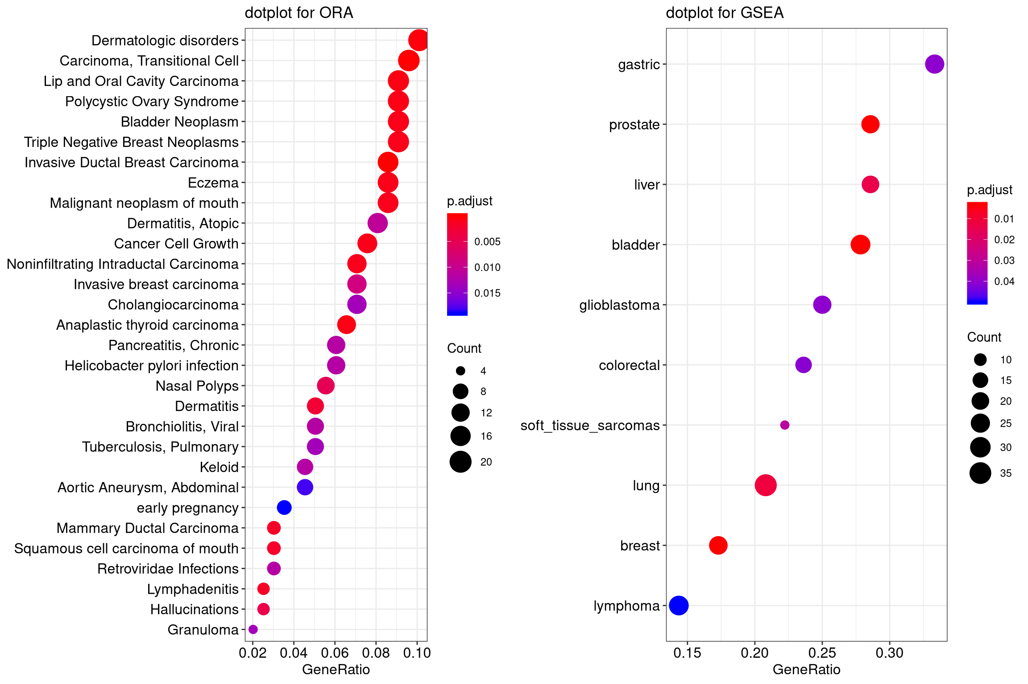
ClusterProfiler – examples of analysis plots
dotplot
cnetplot
All of these plots can be generated for GO, KEGG, Reactome, and others

Slide 4
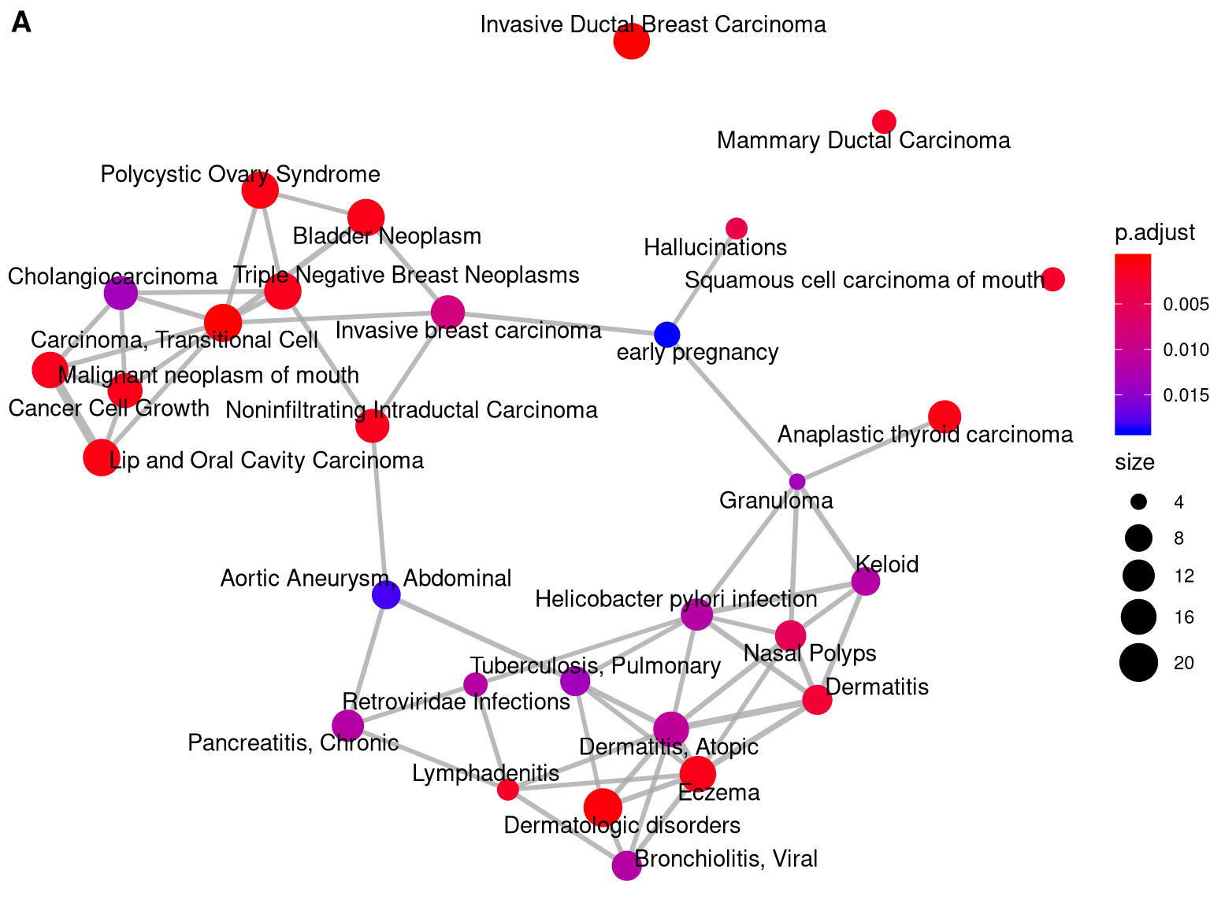
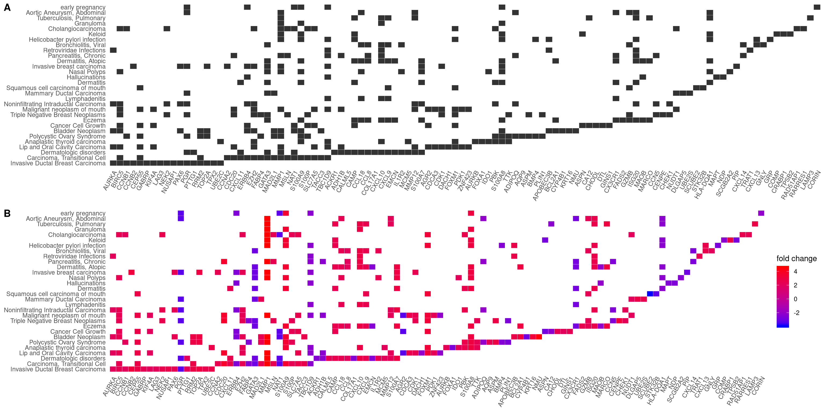
ClusterProfiler – examples of analysis plots
emapplot
heatplot
terms
genes

Slide 5
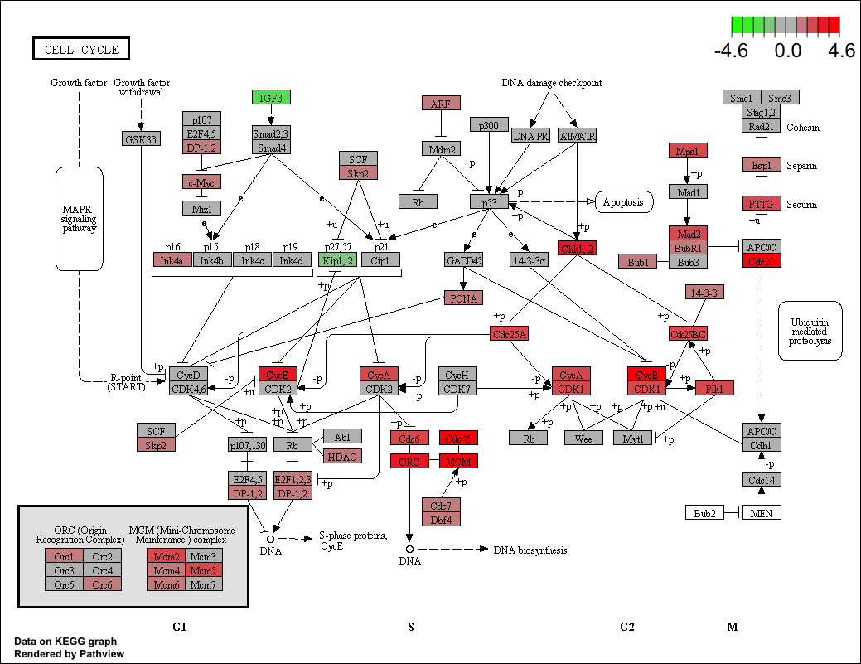
ClusterProfiler – examples of analysis plots
Pathview plots (KEGG-specific)

Slide 6
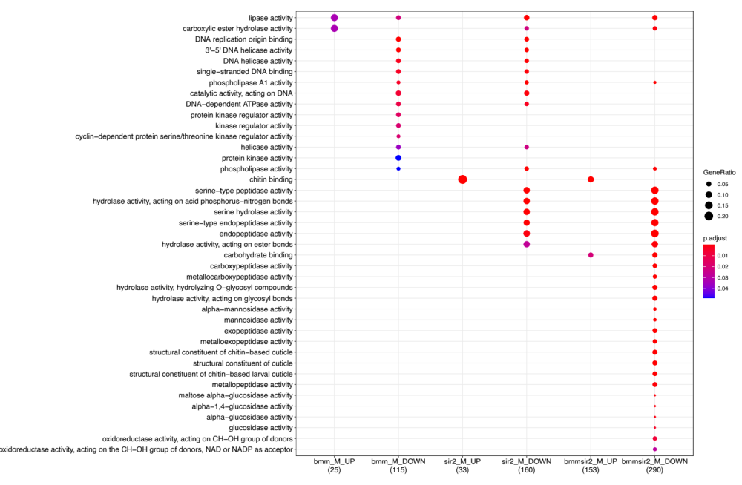
ClusterProfiler – compare profiles (“Biological theme comparison”)
Gene X overexpression
Gene Y knockdown
Gene X over +
Y knockdown

Slide 7
ClusterProfiler wrapper
R package wrapper around clusterProfiler for analyzing and visualizing functional profiles (pathways) of gene and gene clusters from an edgeR differential expression table (results from a pairwise-comparison)
Supported analyses:
  Over-representation analysis
  Gene set enrichment analysis
  Biological theme comparison
Pathway databases:
  Gene Ontology (GO) – cell processes,
  Kyoto Encyclopedia of Genes and Genomes (KEGG)
  Reactome
  MsigDB
Visualization (plot types):
  barplot
  cnetplot
  dotplot
  emapplot
Databases that wrapper calls on so far…
Plots generated will also be appropriately sized!
gseaplot
goplot
upsetplot
pathview plots (KEGG)

Slide 8
ClusterProfiler wrapper supported organisms
species_databases.txt
USED BY GO
USED BY KEGG
USED BY REACTOME
msig_species | db | KEGG_species | reactome_species
Bos taurus | org.Bt.eg.db | bta
Caenorhabditis elegans | org.Ce.eg.db | cel | celegans
Canis lupus familiaris | org.Cf.eg.db | cfa | canine
Danio rerio | org.Dr.eg.db | dre | zebrafish
Drosophila melanogaster | org.Dm.eg.db | dme | fly
Gallus gallus | org.Gg.eg.db | gga
Homo sapiens | org.Hs.eg.db | hsa | human
Mus musculus | org.Mm.eg.db | mmu | mouse
Rattus norvegicus | org.Rn.eg.db | rno | rat
Saccharomyces cerevisiae | org.Sc.eg.db | sce | yeast
Sus scrofa | org.Ss.eg.db | ssc
11 organisms so far
.
.
.
Can add additional species to this file, and in theory, the Rscript should work.
AT A MINIMUM, will need information in the first two columns.

Slide 9
ClusterProfiler wrapper supported organisms
species_databases.txt
msig_species | db | KEGG_species | reactome_species
Bos taurus | org.Bt.eg.db | bta
Caenorhabditis elegans | org.Ce.eg.db | cel | celegans
Canis lupus familiaris | org.Cf.eg.db | cfa | canine
Danio rerio | org.Dr.eg.db | dre | zebrafish
Drosophila melanogaster | org.Dm.eg.db | dme | fly
Gallus gallus | org.Gg.eg.db | gga
Homo sapiens | org.Hs.eg.db | hsa | human
Mus musculus | org.Mm.eg.db | mmu | mouse
Rattus norvegicus | org.Rn.eg.db | rno | rat
Saccharomyces cerevisiae | org.Sc.eg.db | sce | yeast
Sus scrofa | org.Ss.eg.db | ssc
11 organisms so far
This is an actually a Bioconductor package name that is loaded (required for gene ID conversions to ENTREZ IDs)
.
.
.
Can add additional species to this file, and in theory, the Rscript should work.
AT A MINIMUM, will need information in the first two columns.

Slide 10
ClusterProfiler wrapper usage
There are two files you need to have in the same directory:
  run_clusterProfiler.R
  species_databases.txt
Load R/3.6.0 (TESTED)
Run clusterprofiler wrapper:
Rscript run_clusterProfiler.R -f edgeR_DEresults_table.txt -s Mus_musculus
Will install all the required packages – including the organism database package
Required arguments:
-f DE results table from edgeR (either all genes or the subset of DE genes)
-s Organism name (Genus_species)

Slide 11
ClusterProfiler wrapper options and default settings
Option | Option Description | Default
-d [string] | Output directory name to save results to (creates a folder called “clusterprofiler_results” | Current working directory (./)
-i [string] | GeneID format/type. Either: ENSEMBL, SYMBOL, ENTREZ, etc. (Can find available gene types from Org.Xx.eg.db) | ENSEMBL
-p [float] | Gene FDR cut-off to apply to the DEG table prior to functional pathway analysis (float) [Use if DEG table contains all significant and non-significant results] | 0.05
-c [float] | Log2 fold change cutoff for differentially expressed genes | 1
-n [integer] | Number of ontology terms to report (report top X terms) | Reports all terms
-g [integer] | Number of DEGs to use for functional pathway analysis (use top X DEGs) (Genes with p-value less than 0.05 (or user-specified cutoff) are sorted (largest to smallest) by the absolute value of log2FC. Top 200 genes are kept be default). | 200
-a [float] | Ontology term over representation test p-value cutoff | 0.05
-b [string] | Gene Ontology (GO) domain or branch to query. Either: MF (Molecular Function), CC (Cellular Component), BP (Biological Process), or ALL (all three) | ALL

Slide 12
ClusterProfiler wrapper usage examples
Mouse
Rscript run_clusterProfiler.R
-f DEresults_Group3_vs_Group4_allgenes.txt
-d test_mouse_top20terms_pvalue0.01
-s Mus_musculus
-i SYMBOL
-n 20
-p 0.01

Slide 13
ClusterProfiler wrapper usage examples
Mouse
Rscript run_clusterProfiler.R
-f DEresults_Group3_vs_Group4_allgenes.txt
-d test_mouse_top20terms_pvalue0.01
-s Mus_musculus
-i SYMBOL
-n 20
-p 0.01
Gene IDs are in gene SYMBOL format
gene
logFC
logCPM
pValue
FDR

Slide 14
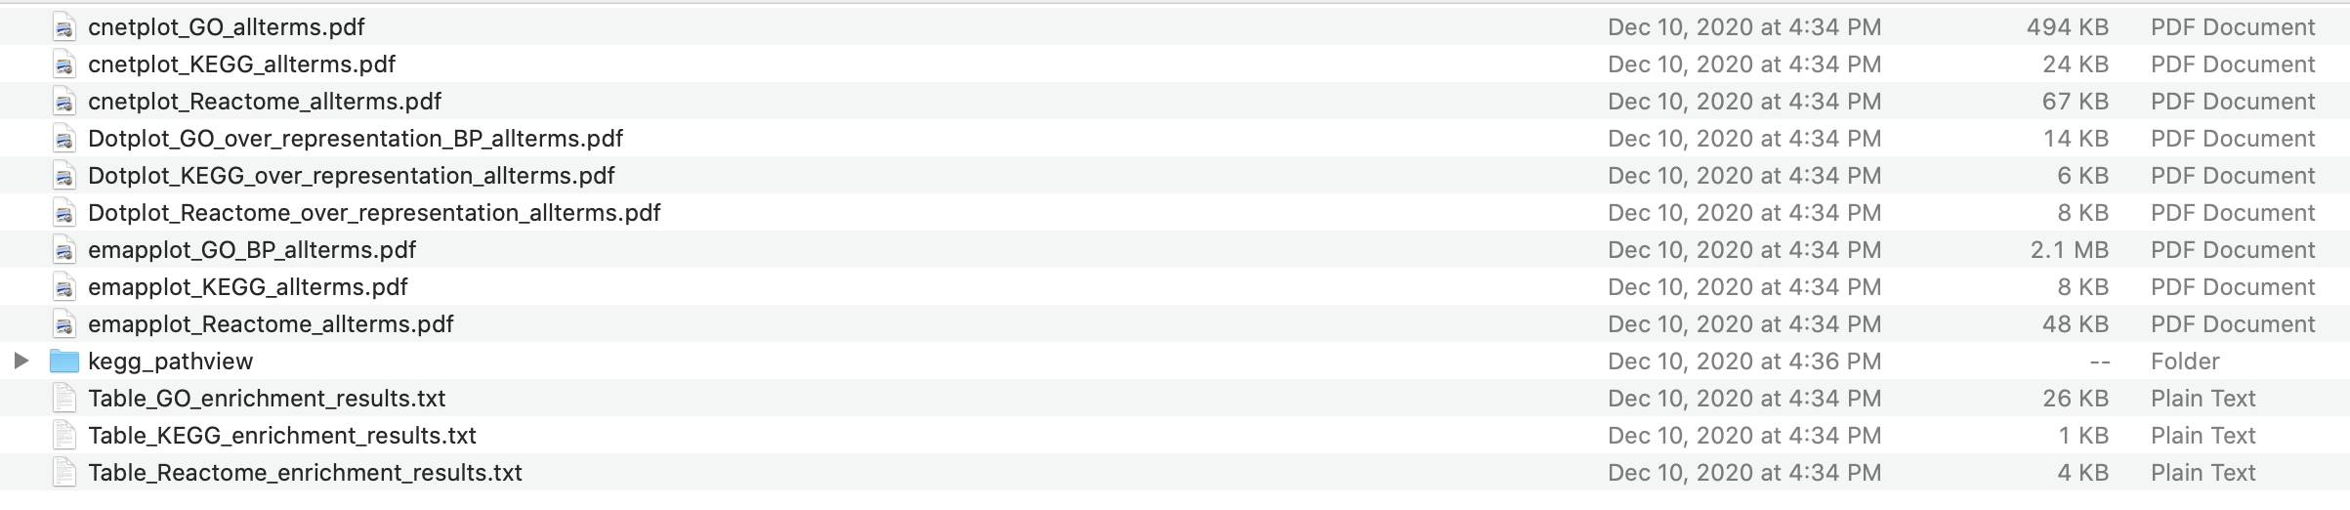
ClusterProfiler wrapper usage examples
Mouse
Rscript run_clusterProfiler.R
-f DEresults_Group3_vs_Group4_allgenes.txt
-d test_mouse_top20terms_pvalue0.01
-s Mus_musculus
-i SYMBOL
-n 20
-p 0.01
[reports top 20 ontology terms – all analyses]
[p-value cut-off for DEGs]

Slide 15
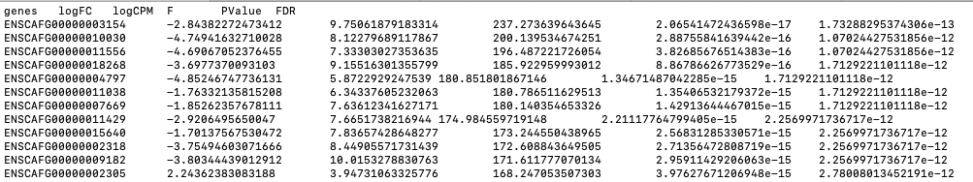
ClusterProfiler wrapper usage examples
Dog
Rscript run_clusterProfiler.R
-f DE_control-case_list_no_outliers_dog.txt
-d test_dog_top20terms_allGObranch_pval0.01_foldchange1.5x
-s Canis_lupus_familiaris
-n 20
-p 0.01
-a 0.01
-c 1.5
[reports top 20 ontology terms – all analyses]
[p-value cut-off for DEGs]
[p-value cut-off for Ontology terms]
[genes with log2(FC) > 1.5X will be used for pathway analyses]
Gene IDs are in ENSEMBL format (which is default setting)

Slide 16
ClusterProfiler wrapper usage examples
Zebrafish
Rscript run_clusterProfiler.R
-f Danio_rerio_DE_table_madefromhumanDFV.txt
-d test_drerio_top10terms_top150genes
-s Danio_rerio
-n 10
-g 150
[reports top 10 ontology terms – all analyses]
[use top 150 genes for pathway analysis]

Slide 17
ClusterProfiler wrapper uses Over Representation Analysis(ORA) for GO, KEGG, and Reactome
ORA
Analyses whether a supplied gene (DEG) list is significantly associated with a particular pathway or set of pathways
Requires a list of gene identifiers (universe) as background
  This can either be a subset of genes (all genes that are significantly different in the comparison) or all genes
  The clusterProfiler wrapper uses all genes as the universe. Gene information is pulled from the respective organism database.
Notes:
ORA looks at whether a subset of genes that you have already separated out associate significantly with certain pathways.
GSEA takes differential data from every measured gene and looks for pathways displaying significantly co-ordinated shifts in those values.

Slide 18
ClusterProfiler wrapper pros and cons
PROS
Generates dotplots, cnetplots, emapplots for overrepresented terms from GO, KEGG, and REACTOME pathways
All plots that are generated are (hopefully) sized appropriately
Saves ontology term results tables
Runs KEGG pathview on all enriched KEGG terms
CONS
Does not currently handle a simple list of genes
Currently does not perform GSEA
Does not handle Biological theme comparisons
What I would like to include:
Option to activate pathview for KEGG ( it takes a long time to run), default setting = off
GO term slimming option → refine to most descriptive child terms
Ability to handle a list of genes
Molecular Signatures DB?
Other things?

Slide 19
ClusterProfiler wrapper
Download from Github:
https://github.umn.edu/MSI-RIS/clusterProfiler_wrapper

