Slide 1
PRD Genie
Submitted By Manjeera Madduri

Slide 2
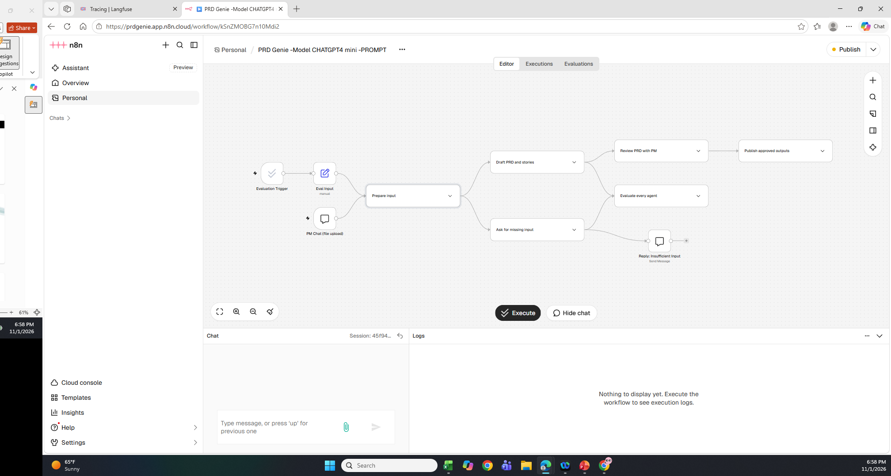
N8N workflow

Slide 3
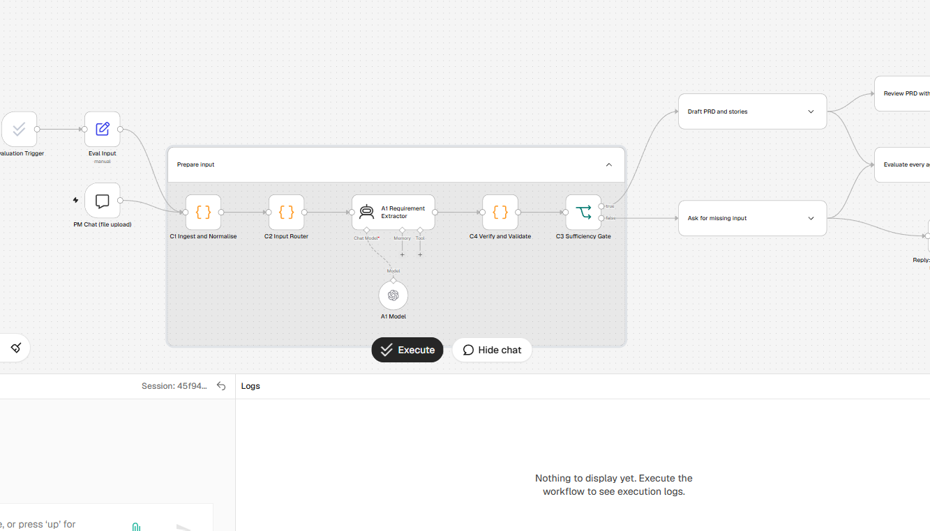
N8N workflow1:Prepare input

Slide 4
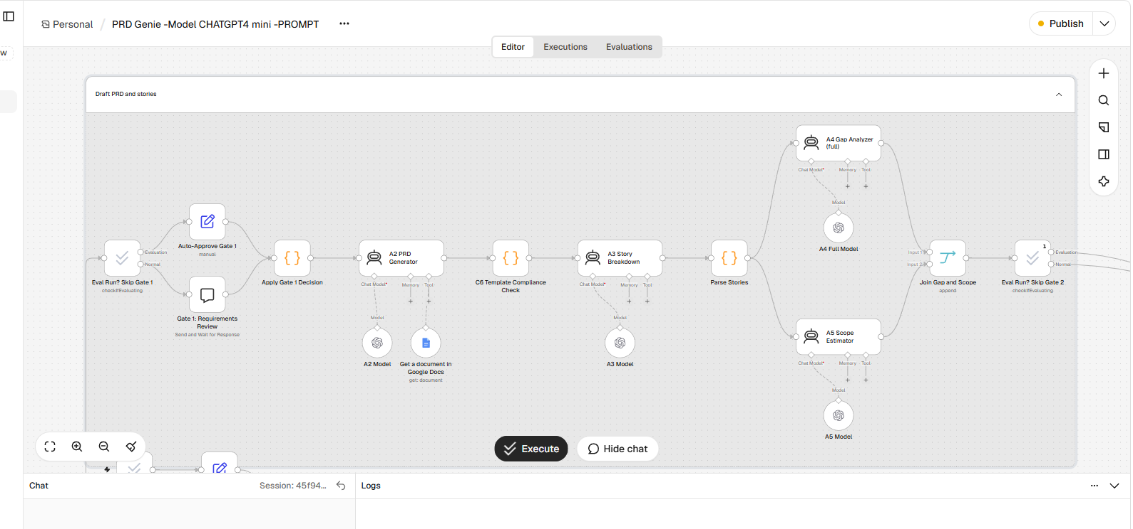
N8N workflow 2:Draft and PRD stories

Slide 5
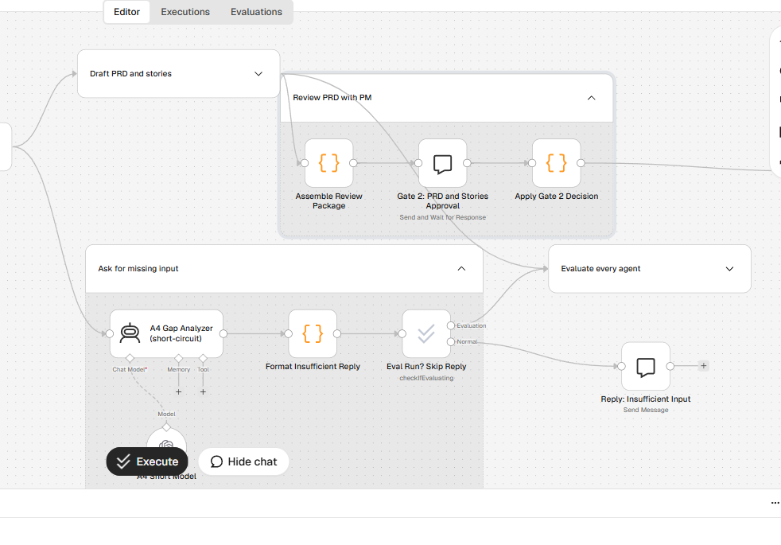
N8N workflow 3:Gate 2 and Gap Analyzer

Slide 6
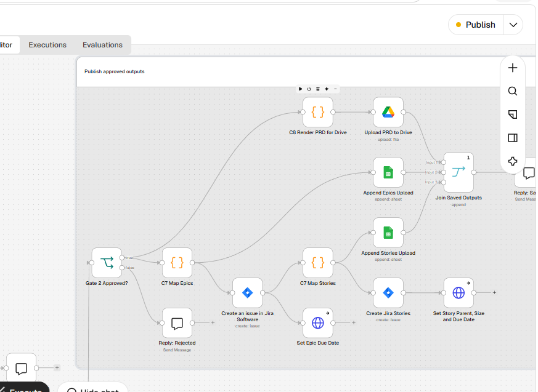
N8N workflow 4:Output saved to Google Drives and Stories are created in JIRA

Slide 7
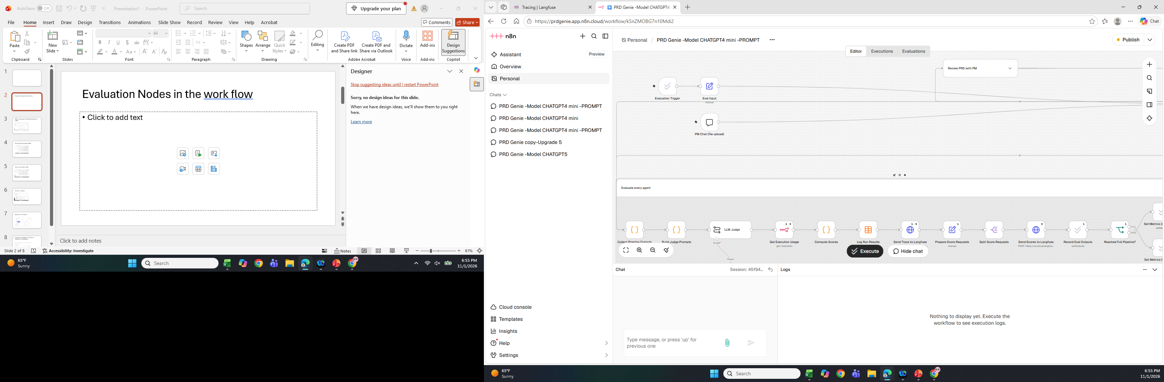
Evaluation 1:Evaluation every agent flow in N8N

Slide 8
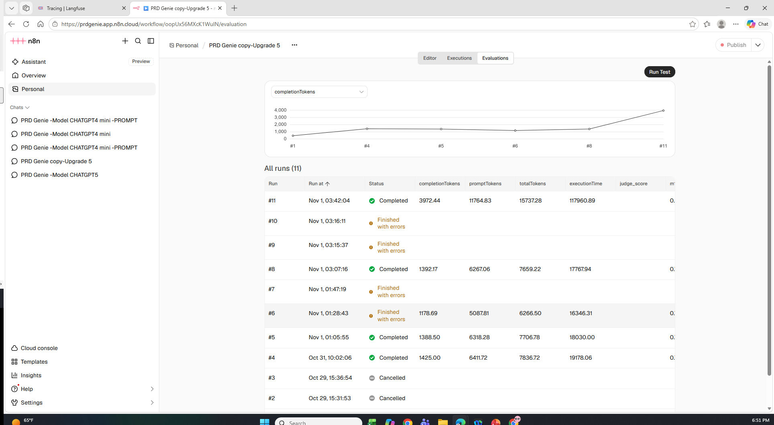
Evaluation 2:N8N Eval Runs(Automated for all Tests)

Slide 9
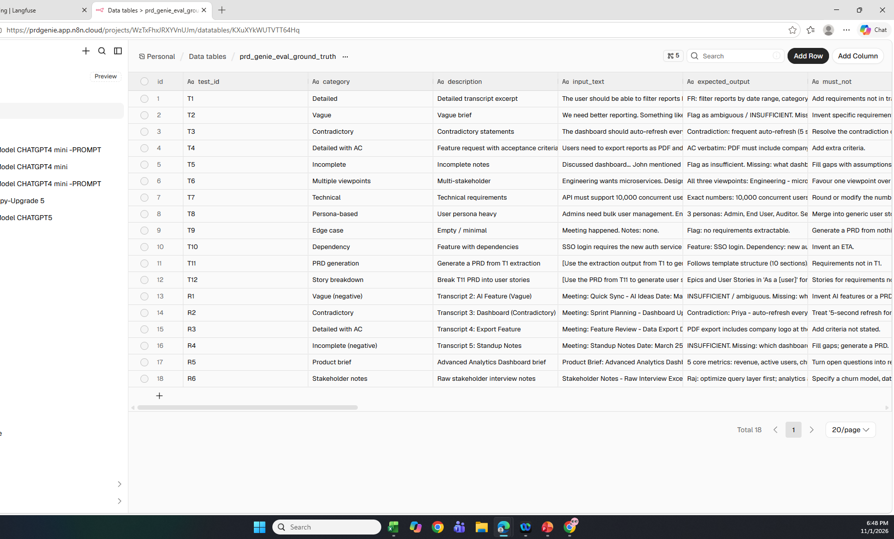
Evaluation 3:Ground truth data table in N8N

Slide 10
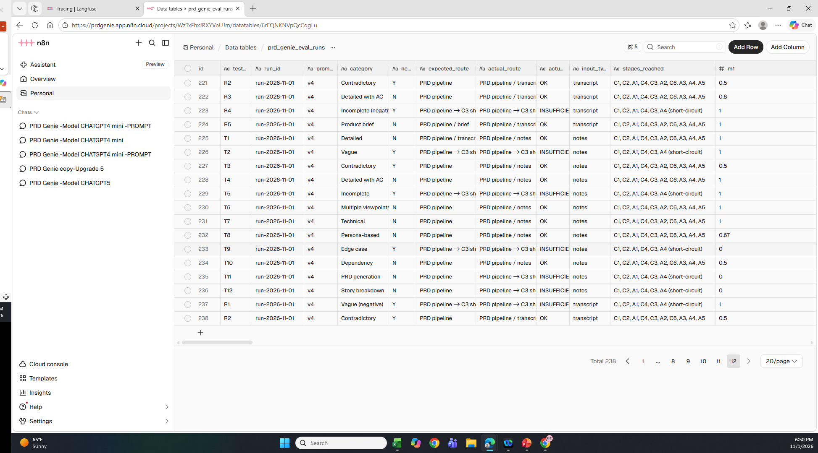
Evaluation 4:Output data table in N8N

Slide 11
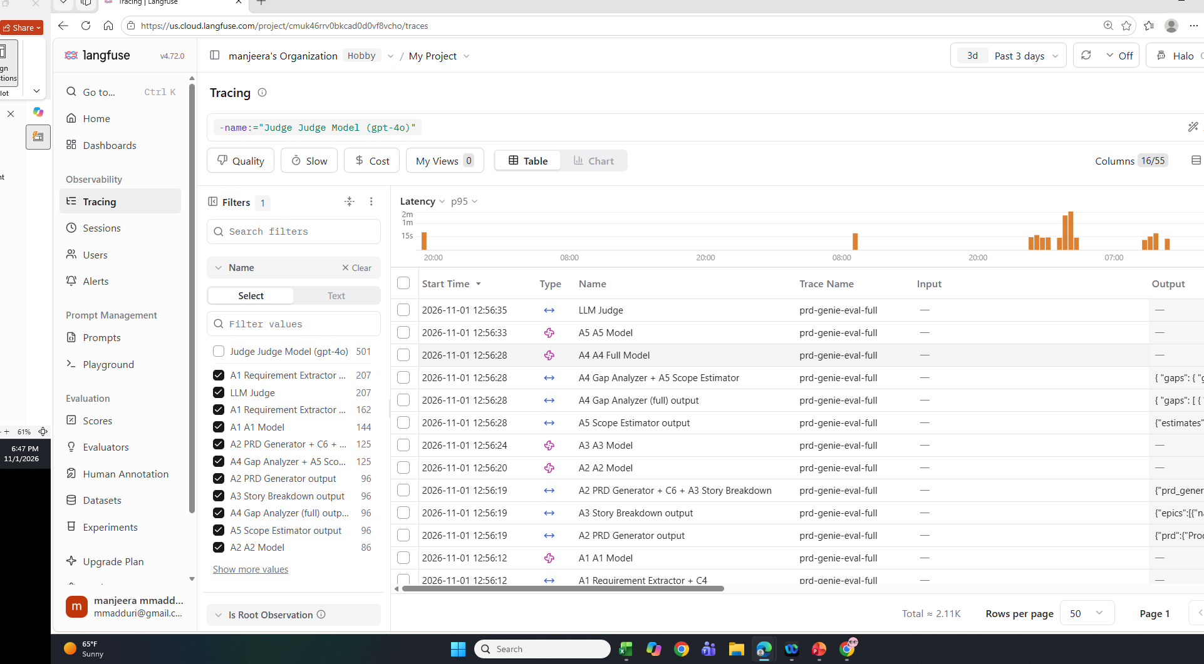
Evaluation 5:Traces in Langfuse

Slide 12
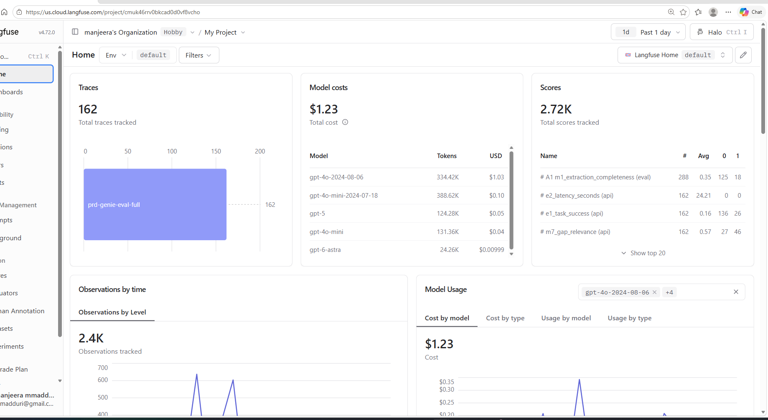
Evaluation 6:Dashboard in Langfuse

Slide 13
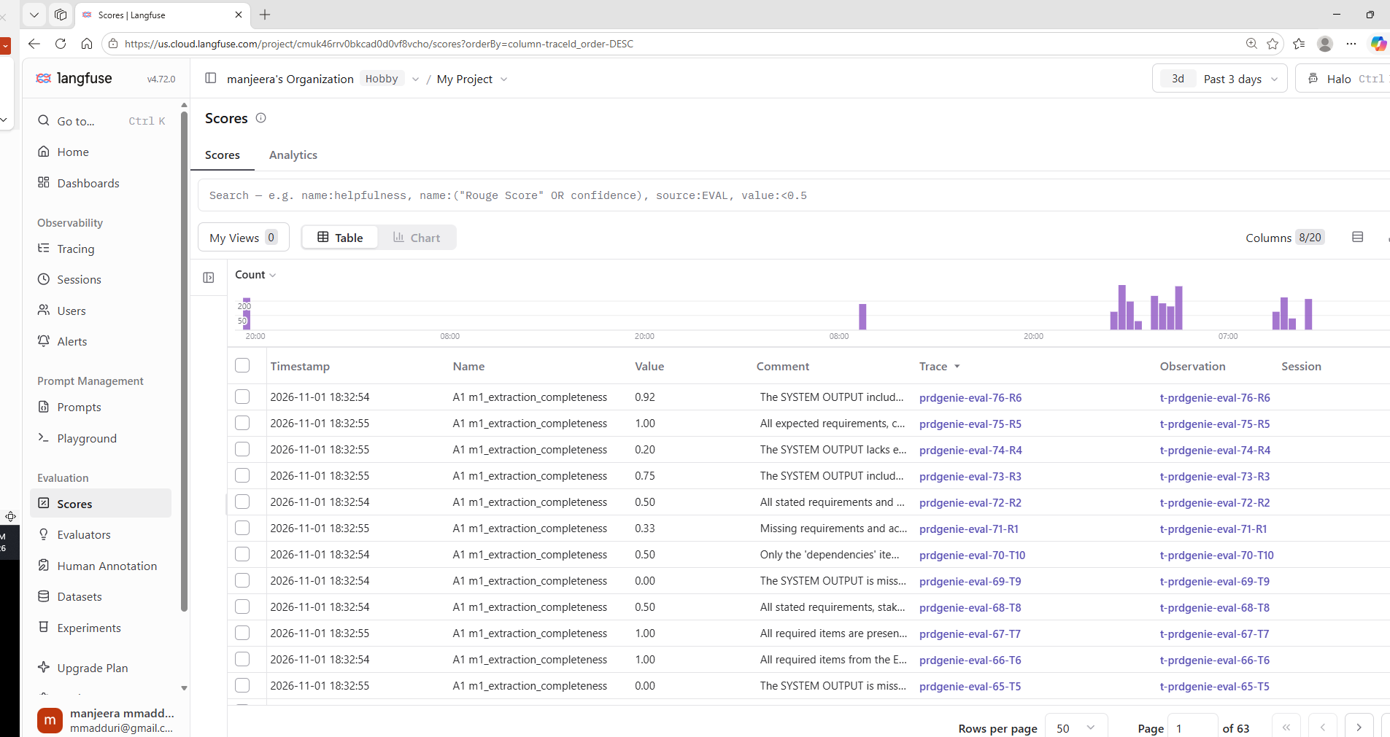
Evaluation 7:Langfuse LLM judge for the Metrics1 – Extraction completeness

Slide 14
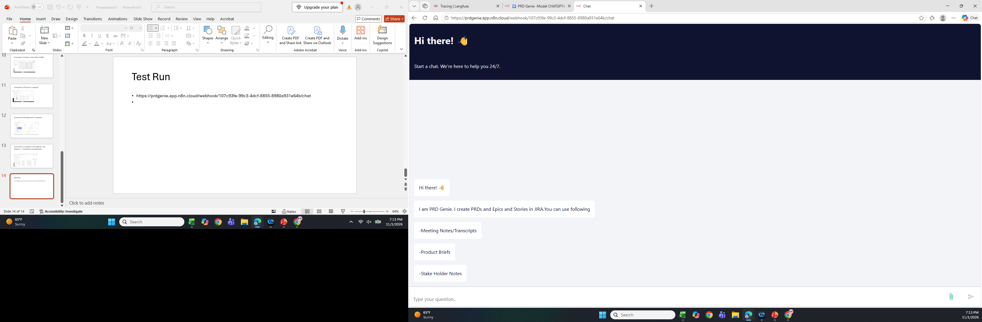
Test Demo 1: Starting screen
https://prdgenie.app.n8n.cloud/webhook/107c93fe-99c3-4dcf-8855-8980a931e64b/chat

Slide 15
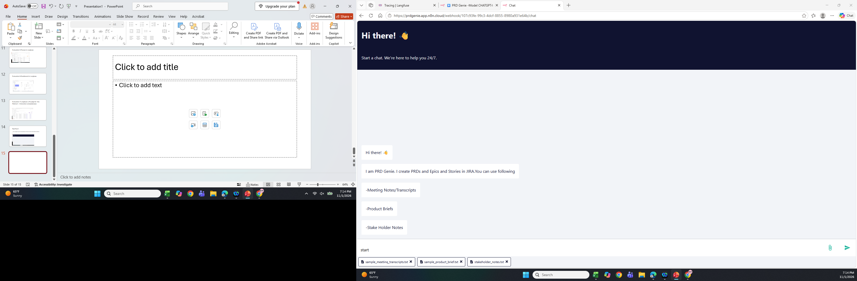
Test Demo 2: User entered message

Slide 16
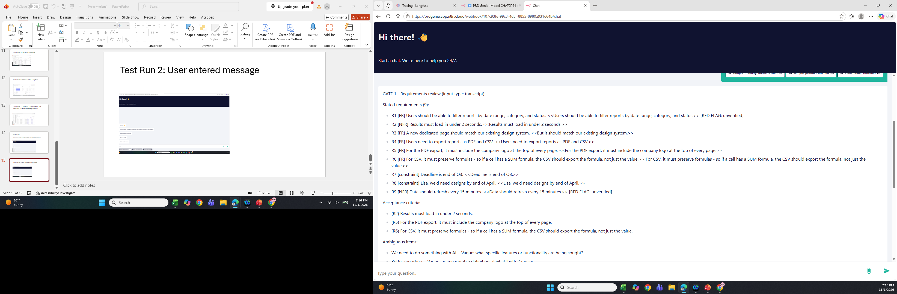
Test Demo 3: Gate 1 output

Slide 17
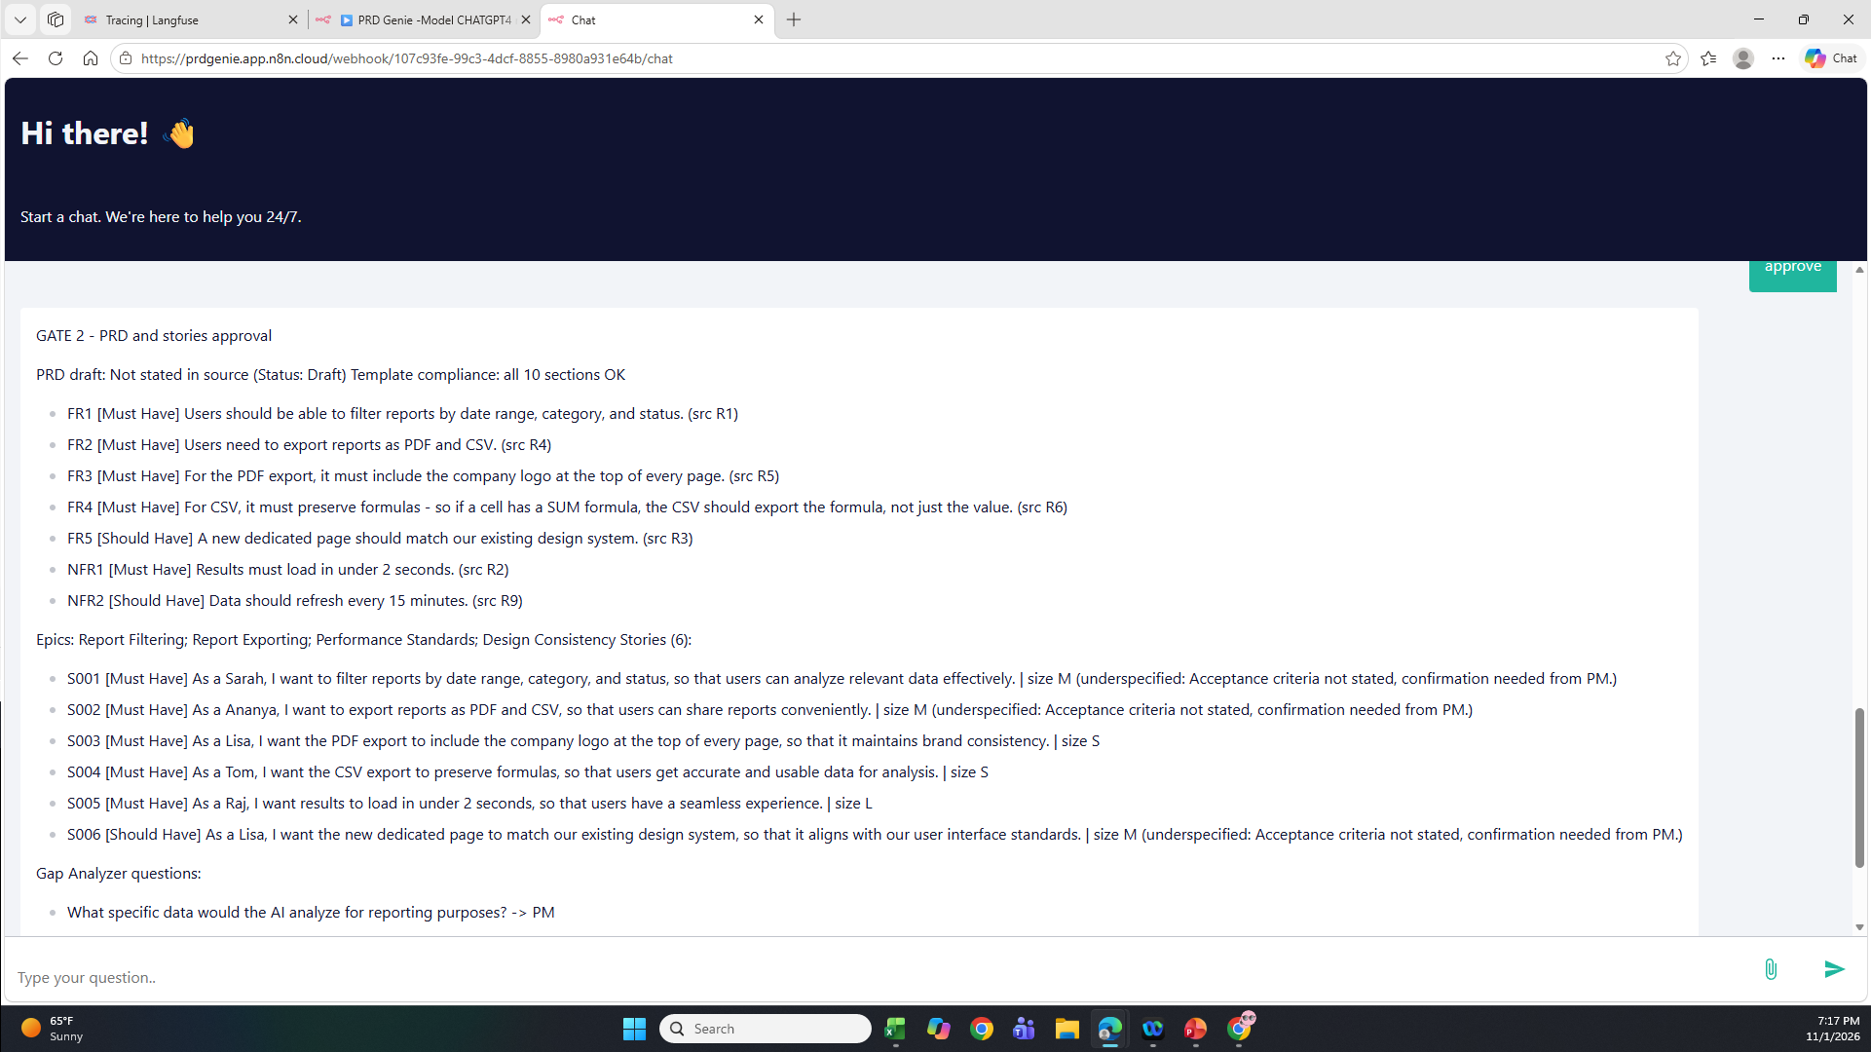
Test Demo 4: Gate 2 output

Slide 18
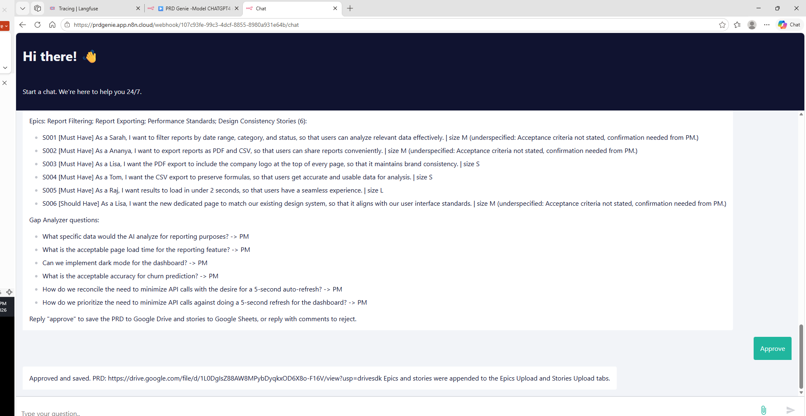
Test Demo 4:Execution Complete

Slide 19
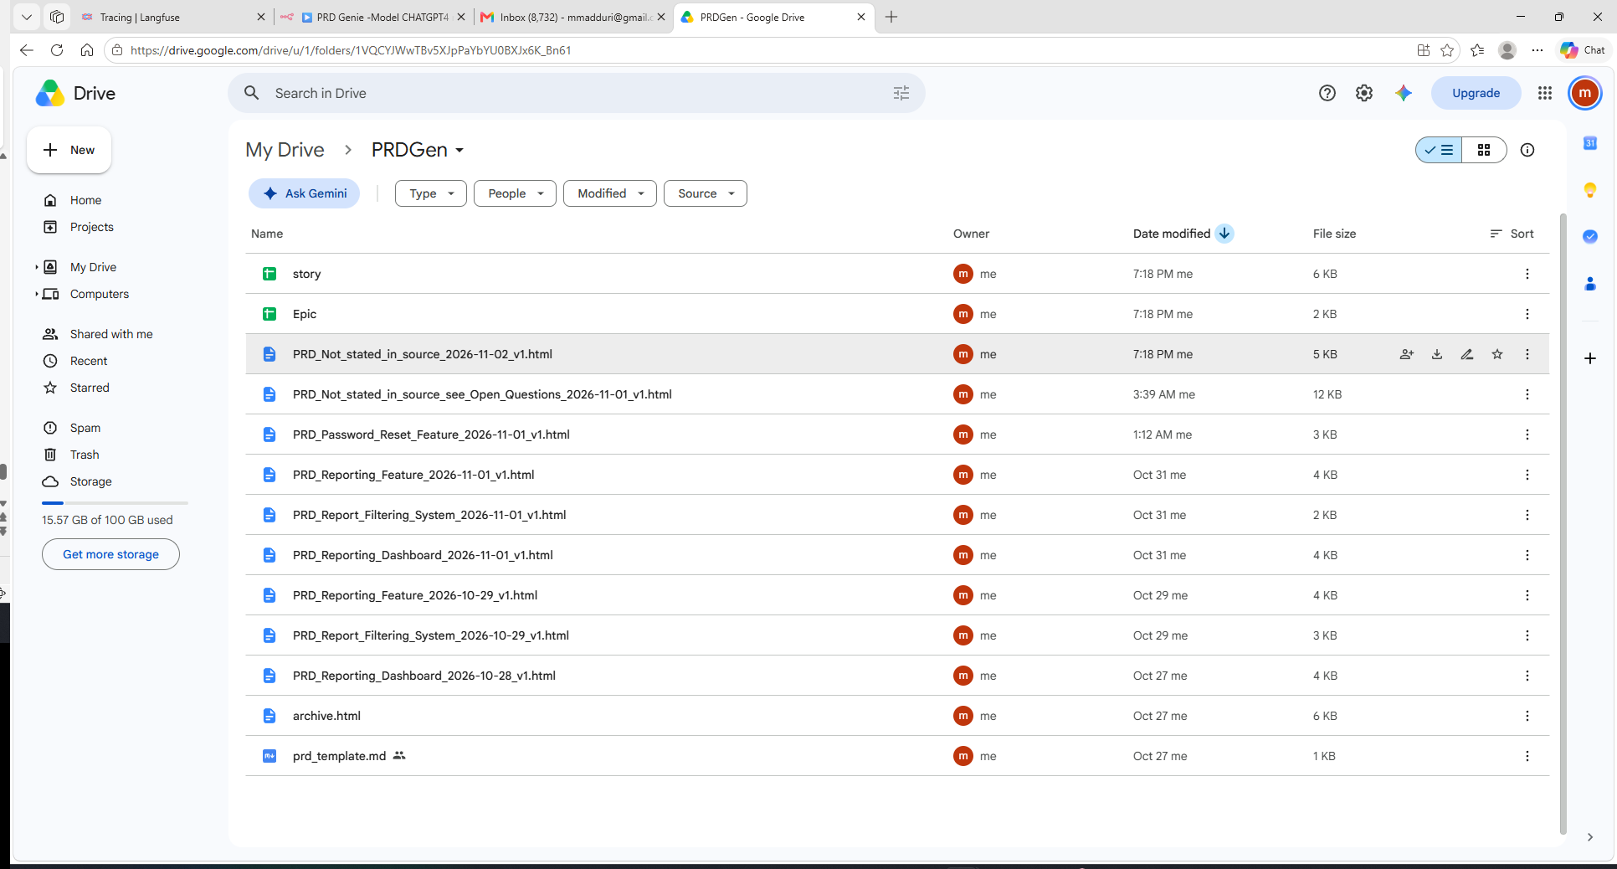
Google Drive :PRD, Stories and Epics created

Slide 20
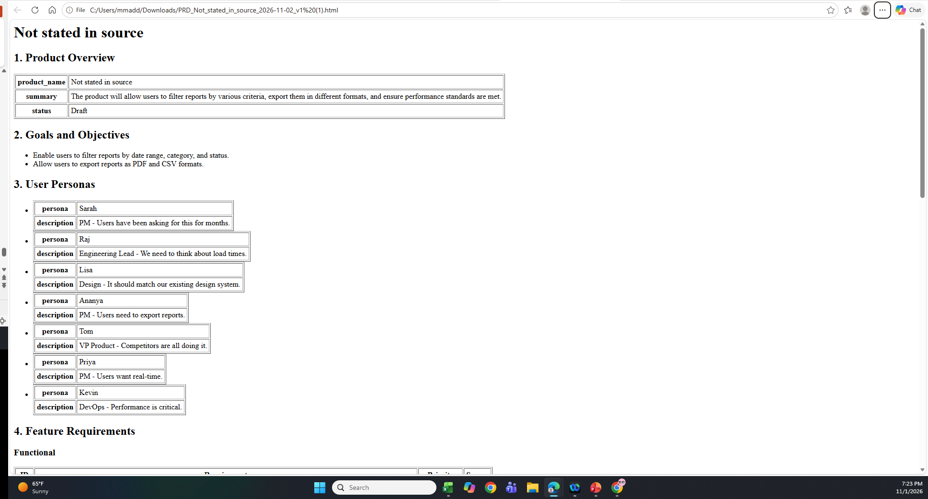
Generated PRD
https://drive.google.com/file/d/1L0DgIsZ88AW8MPybDyqkxOD6X8o-F16V/view?usp=sharing

Slide 21
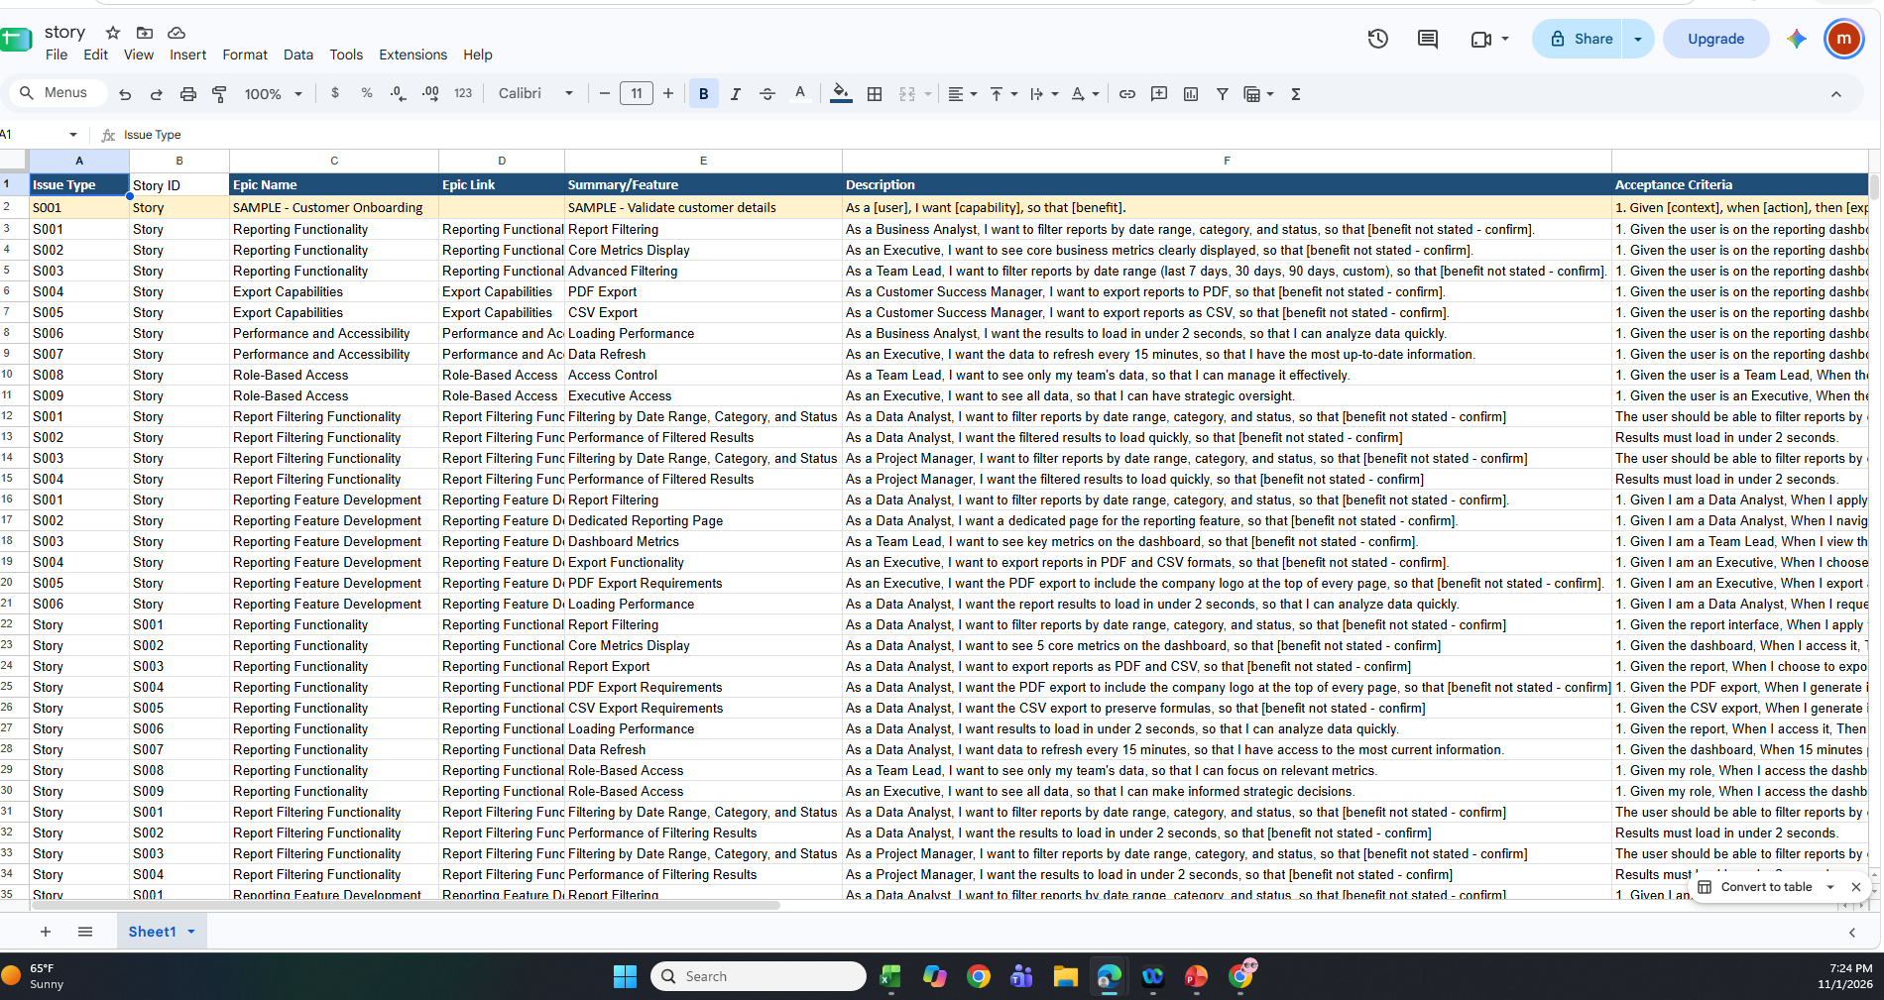
Generated stories and Epics
https://docs.google.com/spreadsheets/d/1TNW51wpd6dJHWLD1cmsMDl2LGQ_Y90hd5Y36s6GVwFU/edit?usp=sharing

Slide 22
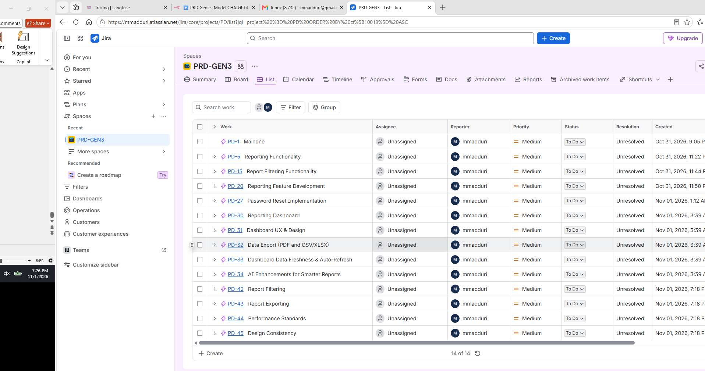
JIRA stories( Auto matically created by the flow)

