Slide 1
Python Programming - II
-By Nimesh Kumar Dagur, CDAC, India

Slide 2
Standard Data Types:
The data stored in memory can be of many types.
For example, a person's age is stored as a numeric value and his or her address is stored as alphanumeric characters.
Python has various standard types that are used to define the operations possible on them and the storage method for each of them.

Slide 3
Standard Data Types:
Python has following standard data types:
Numbers
String
List
Tuple
Dictionary
set

Slide 4
Working With Numbers
The interpreter acts as a simple calculator: you can type an expression at it and it will write the value.
Expression syntax is straightforward:
operators +, -, * and / work just like in most other languages (for example, C);
parentheses can be used for grouping.

Slide 5
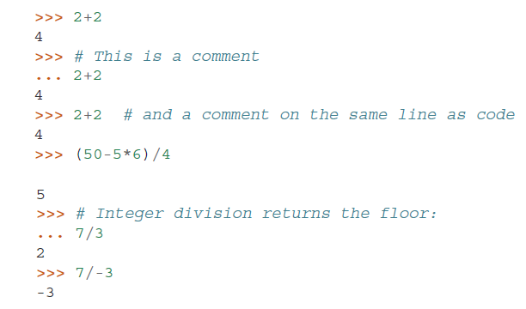
Examples

Slide 6
Python Numbers
Python supports following different numerical types
int (signed integers): positive or negative whole numbers with no decimal point.
long (long integers ): integers of unlimited size, written like integers and followed by an uppercase or lowercase L. It is not supported in Python 3.x version.
float (floating point real values) :represent real numbers and are written with a decimal point dividing the integer and fractional parts.
Floats may also be in scientific notation, with E or e indicating the power of 10 (2.5e2 = 2.5 x 10² = 250).
complex (complex numbers) : are of the form a + bJ, where a and b are floats and J (or j) represents the square root of -1 (which is an imaginary number).
The real part of the number is a, and the imaginary part is b.

Slide 7

Working With Numbers
The equal sign (’=’) is used to assign a value to a variable. Afterwards, no result is displayed before the next interactive prompt:

Slide 8
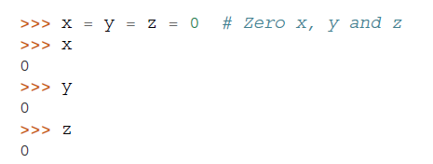
Working With Numbers
A value can be assigned to several variables simultaneously:

Slide 9
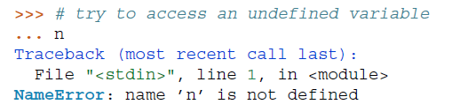
Working With Numbers
Variables must be “defined” (assigned a value) before they can be used, or an error will occur:

Slide 10

Working With Numbers
There is full support for floating point; operators with mixed type operands convert the integer operand to floating point:
a+bj
0+1j

Slide 11
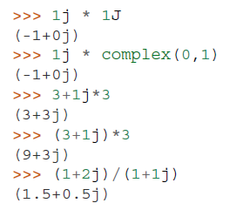
Working With Numbers
Complex numbers are also supported;
imaginary numbers are written with a suffix of j or J.
Complex numbers with a nonzero real component are written as (real+imagj), or can be created with the complex(real, imag) function.

Slide 12
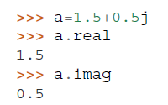
Working With Numbers
Complex numbers are always represented as two floating point numbers, the real and imaginary part.
To extract these parts from a complex number z, use z.real and z.imag.

Slide 13
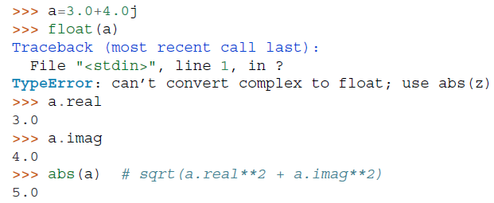
Working With Numbers
The conversion functions to floating point and integer (float(), int() and long()) don’t work for complex numbers — there is no one correct way to convert a complex number to a real number.
Use abs(z) to get its magnitude (as a float) or z.real to get its real part.

Slide 14


Mathematical Functions
abs() : The method abs() returns absolute value of x - the (positive) distance between x and zero.
Syntax
Example

Slide 15

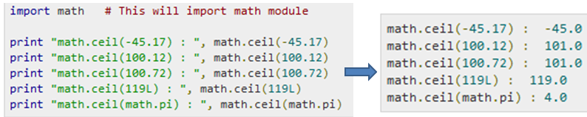
Mathematical Functions
ceil() : The method ceil() returns ceiling value of x - the smallest integer not less than x.
Syntax
x is a numeric expression.
Example

Slide 16

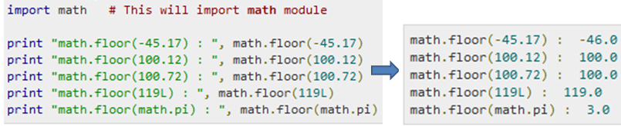
Mathematical Functions
floor() : The method floor() returns floor of x - the largest integer not greater than x.
Example

Slide 17
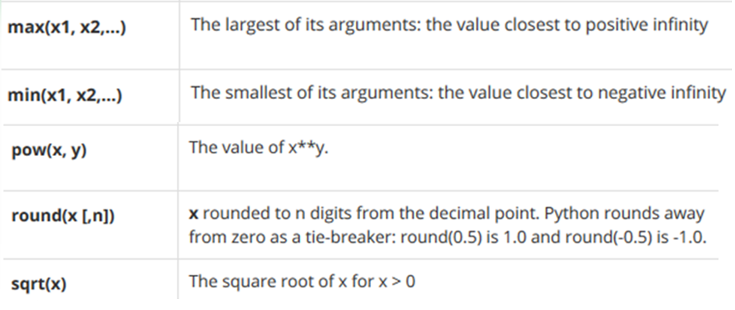
Mathematical Functions

