Slide 1
PCA and Factor Analysis of Workload variables

Slide 2
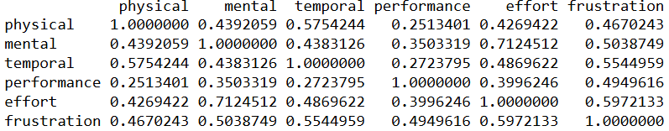
Workload variables Overview
6 qualitative WL variables.
Each of them presented by 7 Likert scales
WL variables are overlapped
They are moderately to strongly correlated
Correlation matrix

Slide 3
Two challenges
7 Likert scale
Hard for ML models to predict 7 scales
Overlapping WL variables
Correlations create redundancy (“double-counting”)
Model instability / multicollinearity
Difficulty in interpretation
Noise amplification

Slide 4
Solution
PCA or Factor Analysis reduces the correlated variables into smaller number of underlying dimensions (components/factors)
These new dimensions:
Capture the major patterns of variation in the workload measures.
Remove noise and redundancy.
Make the data more stable and suitable for prediction.

Slide 5
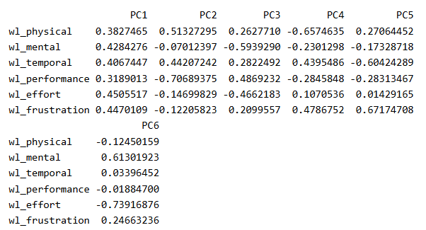
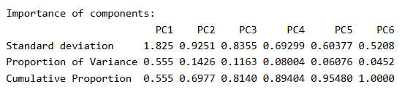
PCAs
Summary
Workload dimensions cluster into 3 PCs
PC1 → Overall workload
PC2 → Physical vs. performance trade-off
PC3 → Mental vs. performance trade-off

Slide 6
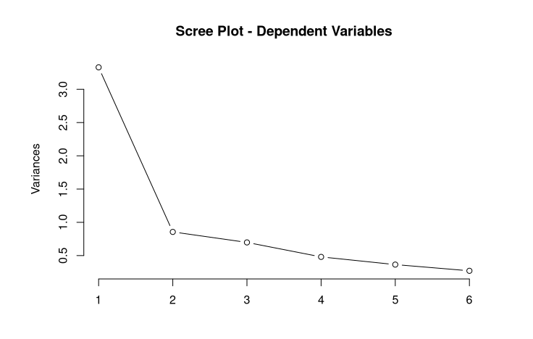

Slide 7
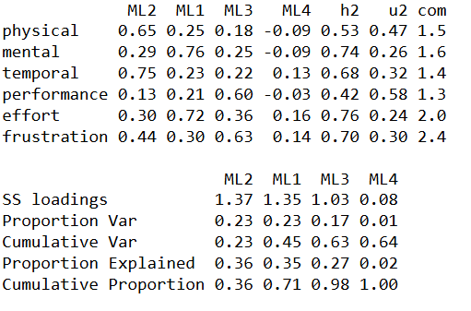
Factor Analysis
Summary
ML2 (Factor 1): physical & temporal demand factor
ML1 (Factor 2): effort & mental workload factor
ML3 (Factor 3): frustration & performance factor
Communalities (h2)
Moderate to high
Most factors explain much of each item’s variation
Variance explained
ML2 (23%) + ML1 (23%) + ML3 (17%) = ~63%

