Slide 1
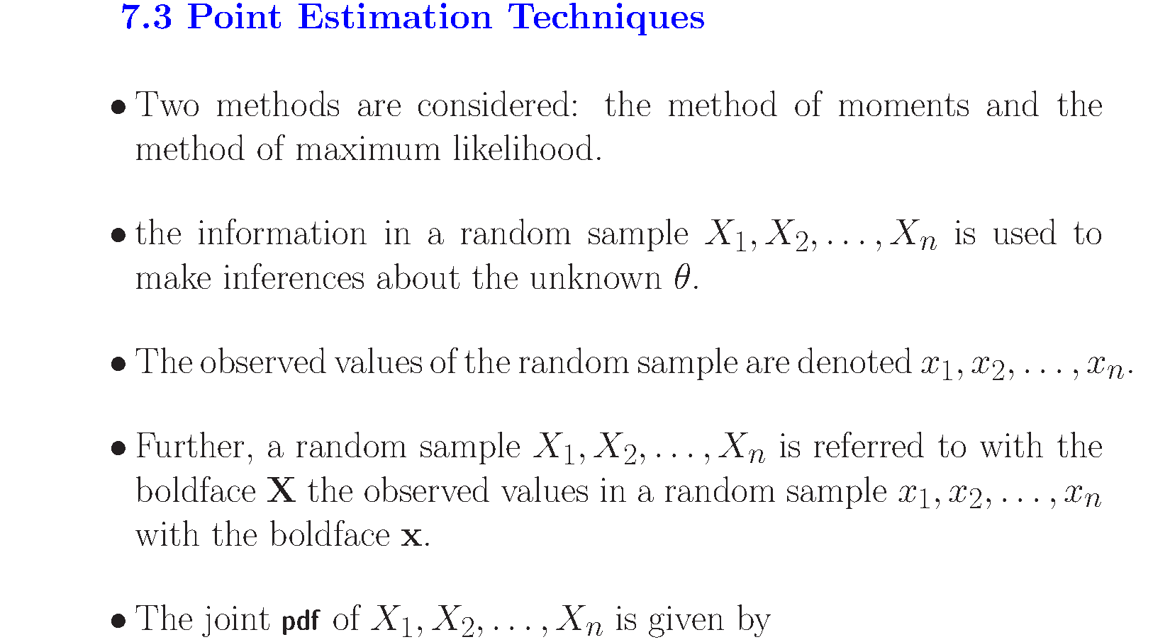
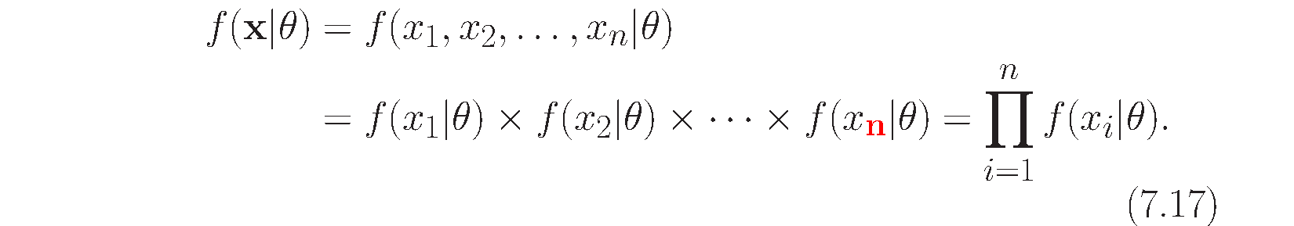

Slide 2
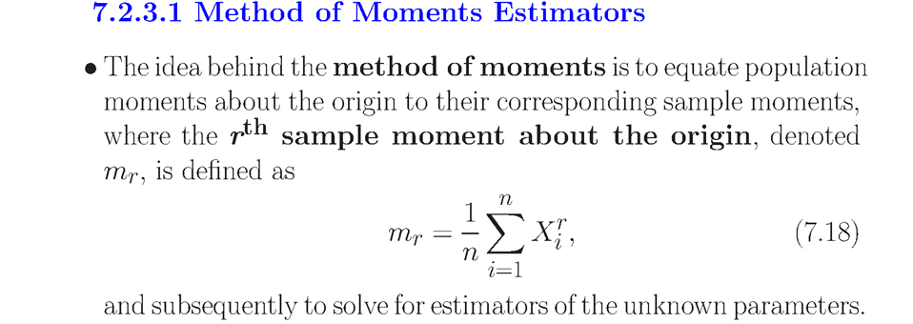
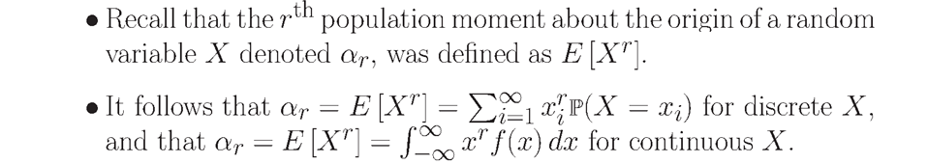

Slide 3
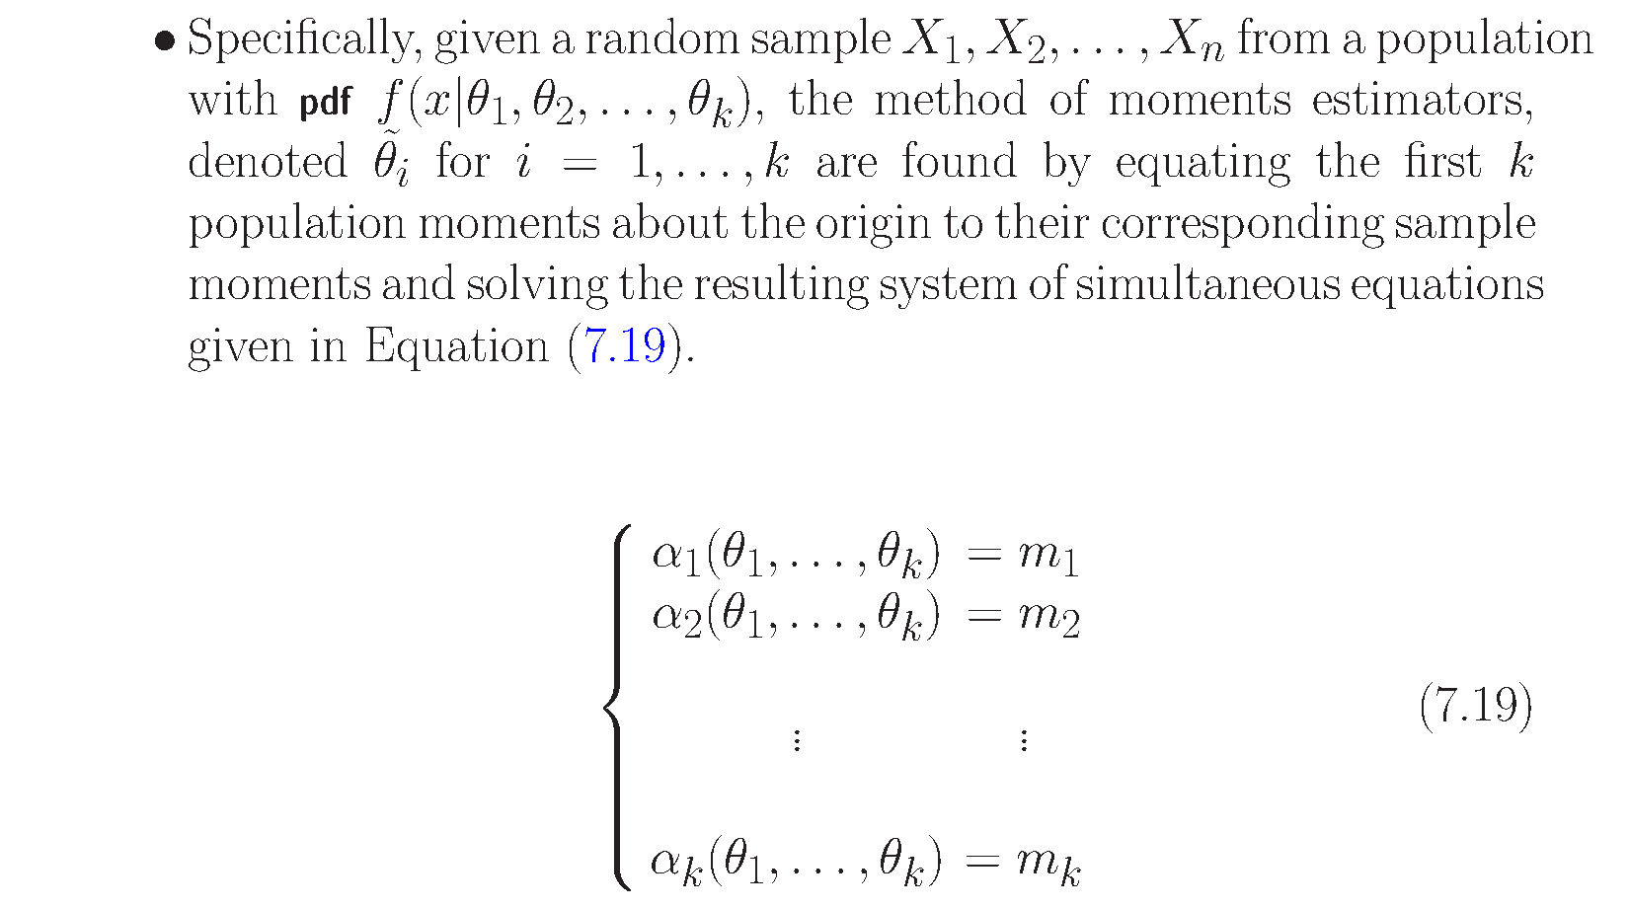

Slide 4
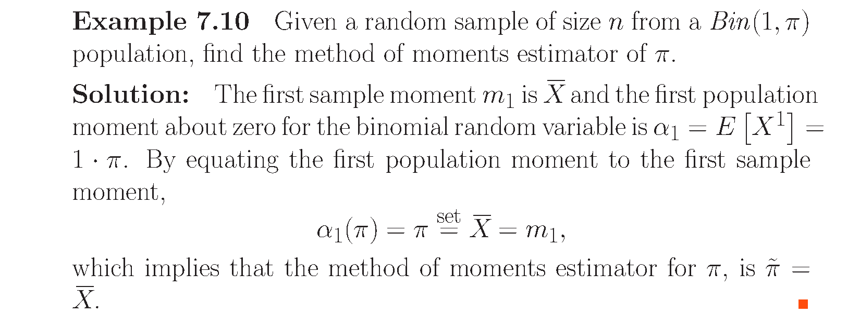

Slide 5
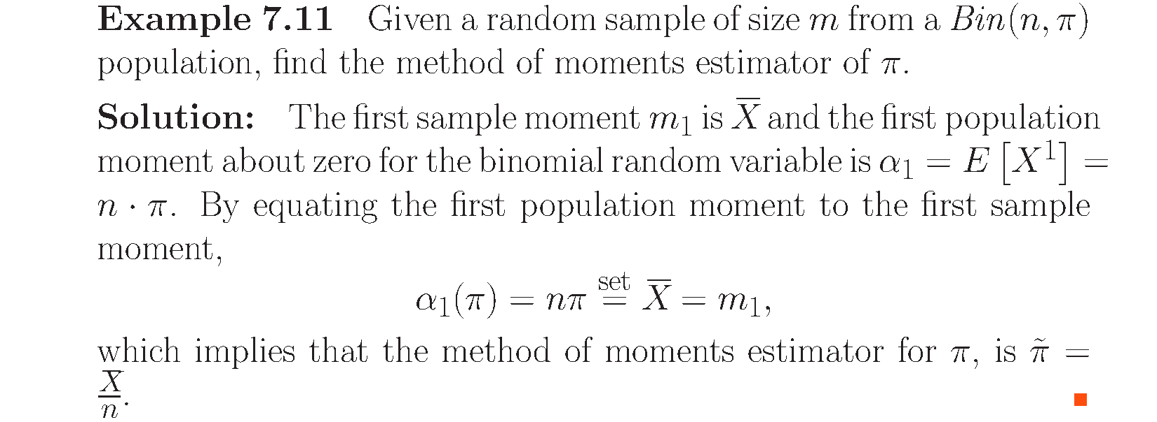

Slide 6


Slide 7
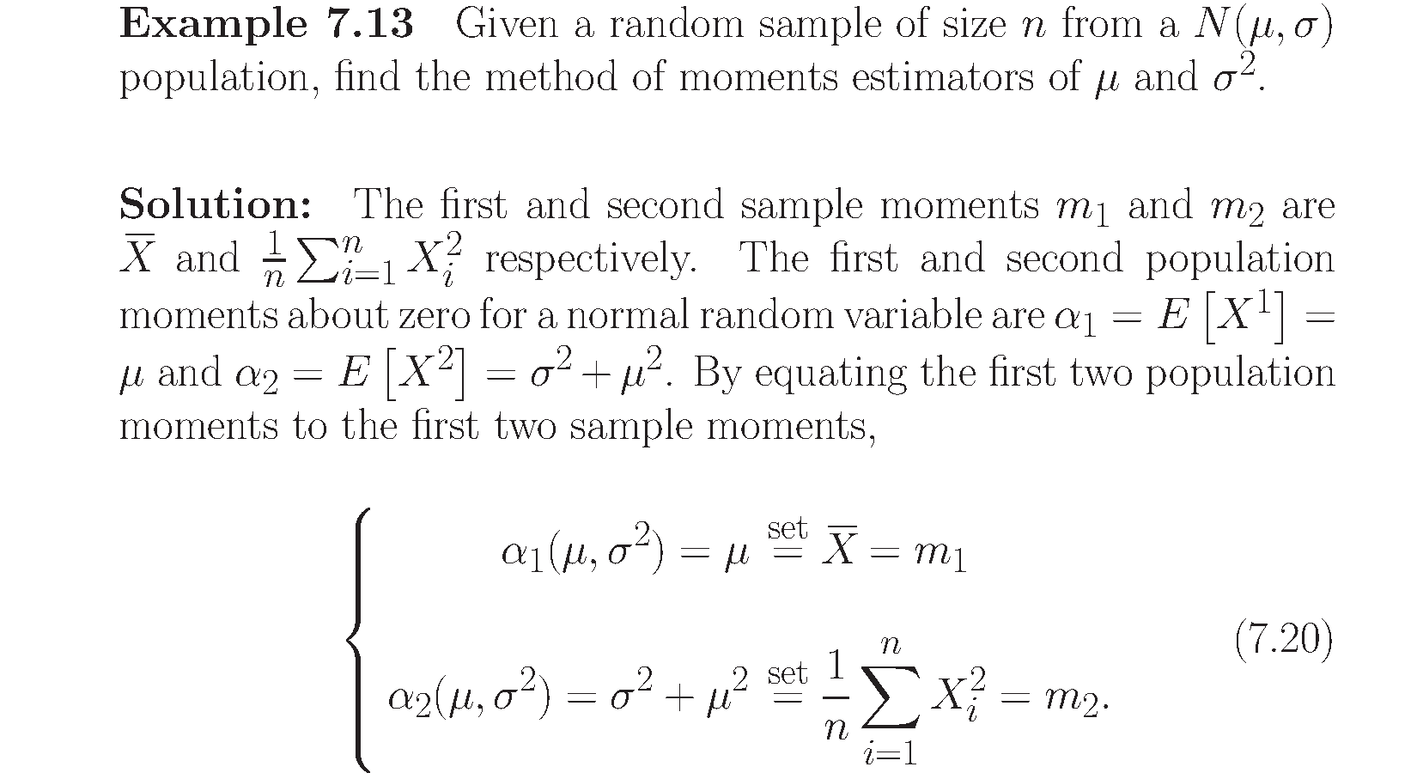
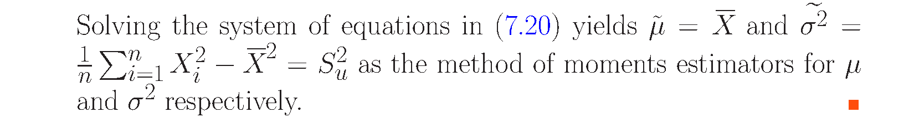

Slide 8
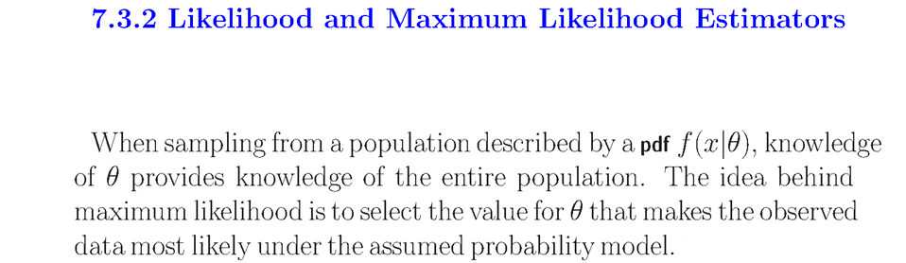
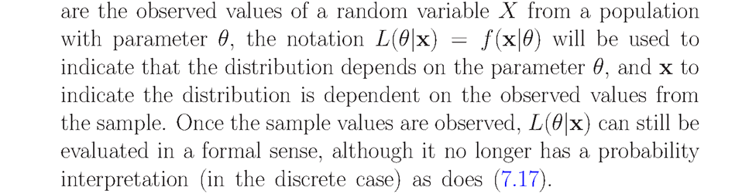


Slide 9
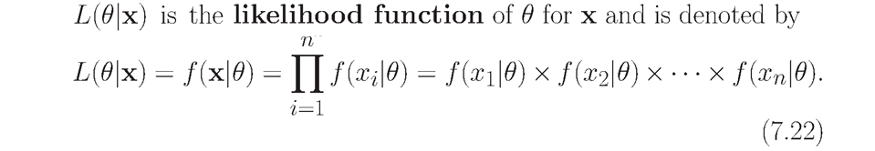
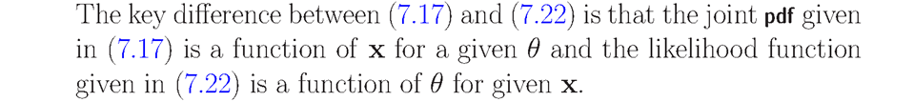
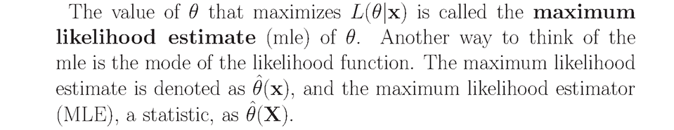


Slide 10
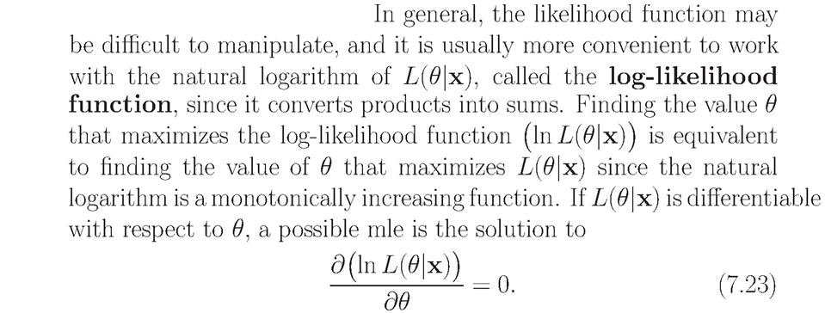
Log-Likelihood vs Likelihood
L <- logL <- NULL; par(mfrow=c(1,2));
n <- 10; mus <- seq(0,10,length=100); mu <- 5; x <- rnorm(n,mean=mu);
Like <- function(mu, data=x) {prod(dnorm(x,mean=mu))}
logLike <- function(mu, data=x) {sum(dnorm(x,mean=mu,log=TRUE))}
max.L <- optim(1, Like, data=x, control=list(fnscale=-1))
# max.L <- optim(1, Like, data=x, control=list(fnscale=-1), method="Brent",lower=0,upper=10)
max.logL <- optim(1, logLike, data=x, control=list(fnscale=-1))
for (i in 1:length(mus)) {L[i] <- Like(mus[i], x); logL[i] <- logLike(mus[i], x)}
plot(mus,L,type="l"); abline(v=max.L$par, col=2)
plot(mus,logL,type="l"); abline(v=max.logL$par, col=2)

Slide 11
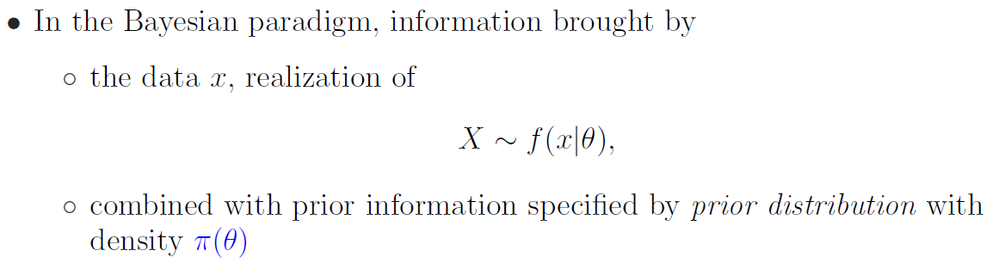
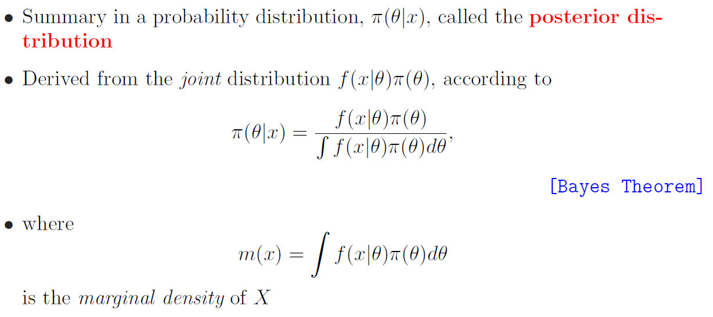
Bayesian Methods

Slide 12
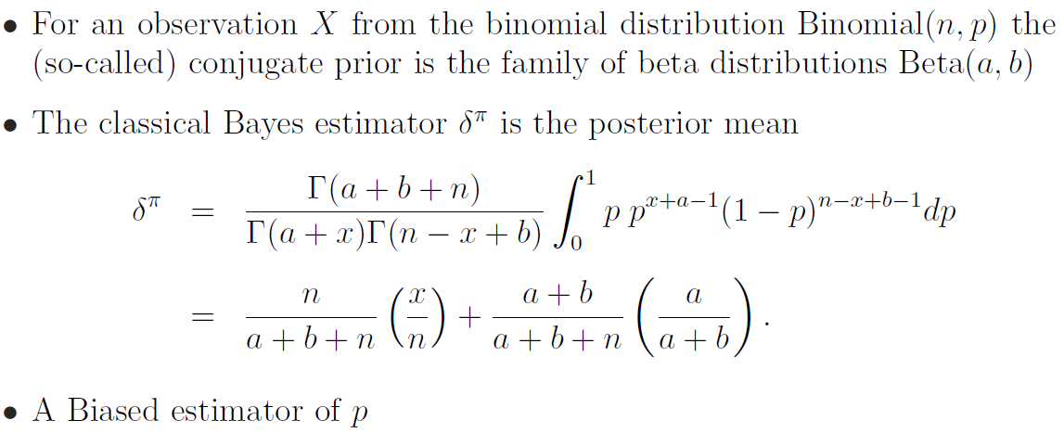
Example: Binomial Bayes Estimator

Slide 13
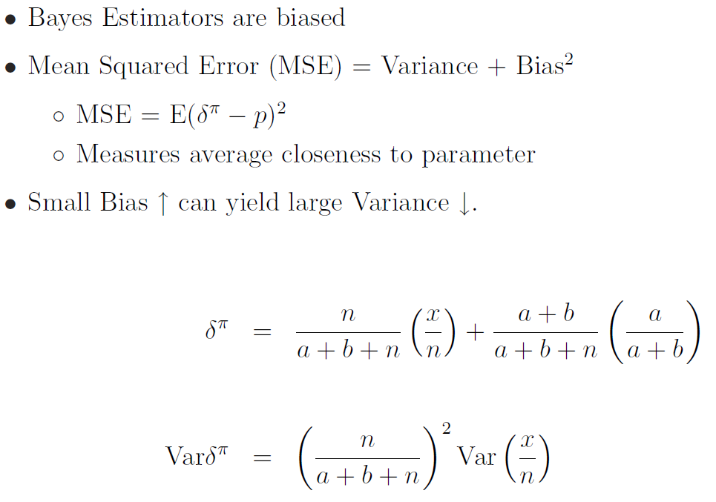
The Variance/Bias Trade-off

