Slide 1
TOPIC X: Ridge Regression AND Lasso

Slide 2
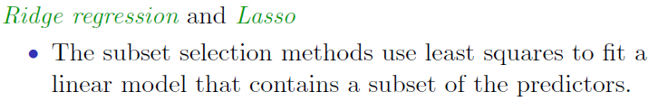
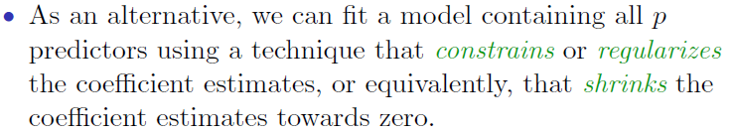
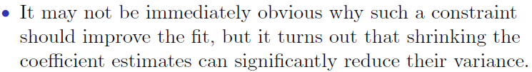

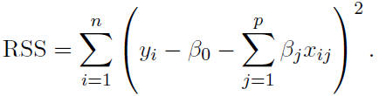
Shrinkage Methods

Slide 3
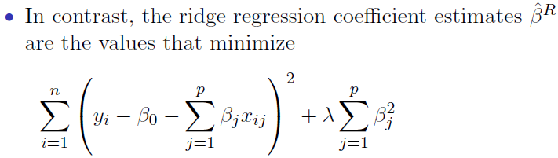


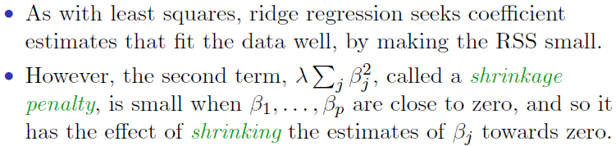
Ridge regression

Slide 4

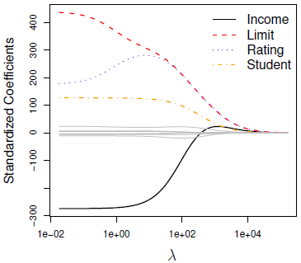
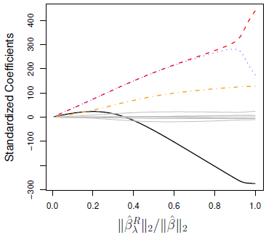
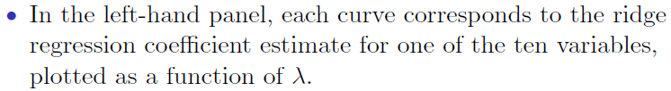
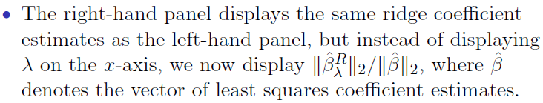
Credit data example

Slide 5
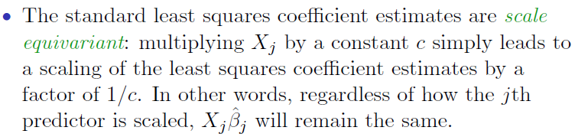
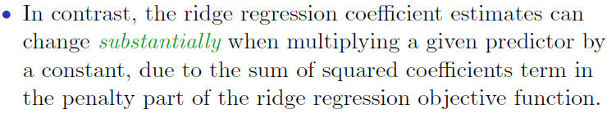
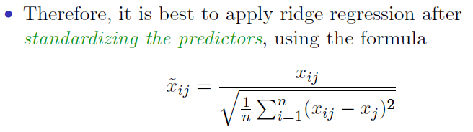
Ridge regression: scaling of predictors
The penalty term makes the ridge regression estimates biased but can also substantially reduce variance

Slide 6
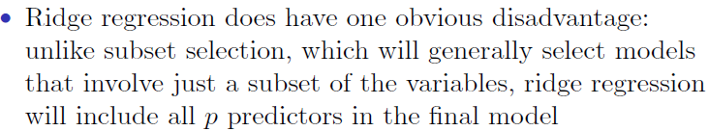
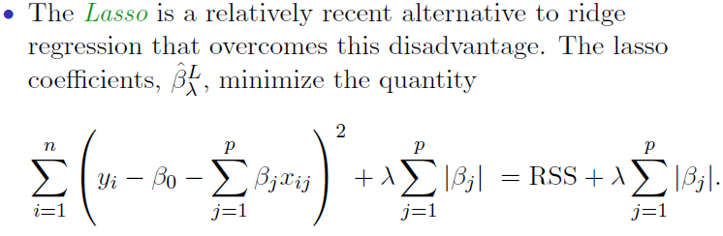
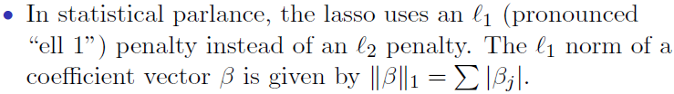
The Lasso

Slide 7
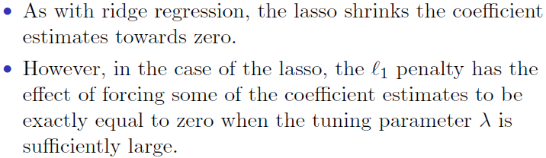
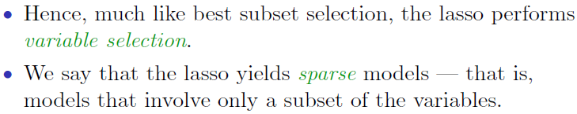

The Lasso: continued

Slide 8
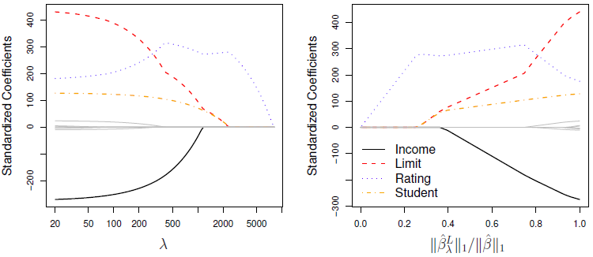
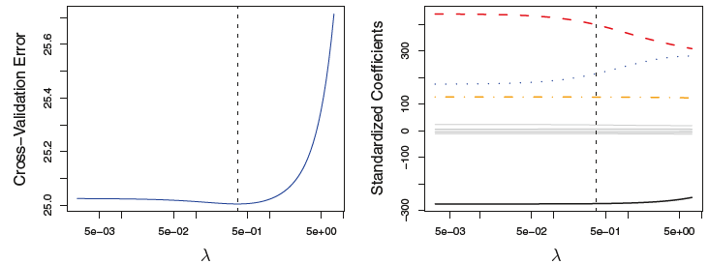
Example: Credit dataset
Cross-validation errors that result from applying ridge regression to the Credit data set with various value of λ.

Slide 9
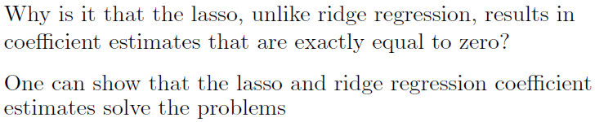
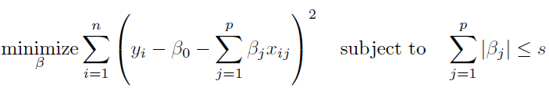
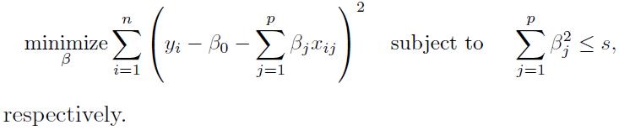
The Variable Selection Property of the Lasso
Lasso:
Ridge:

Slide 10
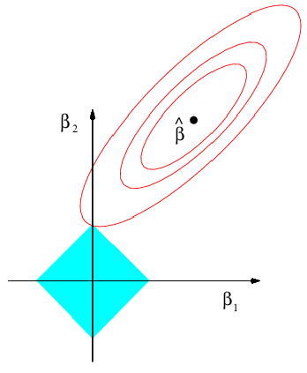
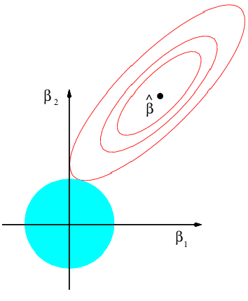
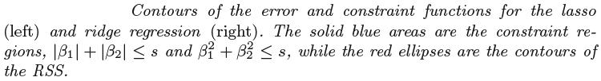
The Lasso and Ridge in Picture
Lasso
Ridge

Slide 11
Flexibility of “loss + penalty” framework
Minimize (Loss + λ Penalty)
Loss function | Penalty function | Resulting algorithm
Hinge loss: |  | SVMs
Mean squared error: |  | Ridge regression
Mean squared error: |  | Lasso
Mean squared error: |  | Elastic net
Hinge loss: |  | 1-norm SVM

Slide 12
questions?
ANY QUESTION?

