Slide 1
Lecture 1

Slide 2
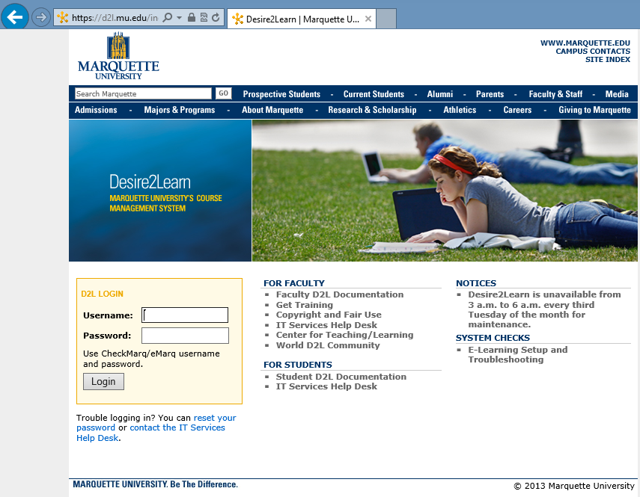
Syllabus - D2L - online materials
Syllabus
Go to https://d2l.mu.edu/index.asp
Enter your account info and click on Log in!

Slide 3

Analyzing data
Minitab is a statistical software package that we mostly use in this course.
You can access Minitab for from open access labs.

Slide 4
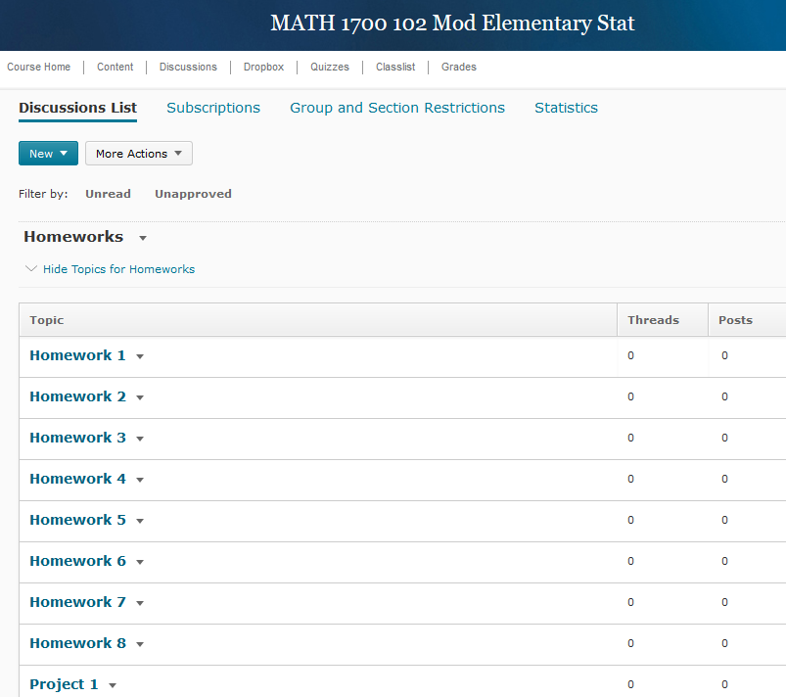
MATH 4720 Cont…
Any General questions about Homework and Exams:
SHOULD be posted in d2l Discussion Board.
Grader and I will NOT answer general emails about Homework and Exams.
Homework and Projects:
Should be submitted as a PDF file:
How to use your phone to scan documents
How to Combine Images into a PDF file [FREE & EASY + No Software] (YouTube)
Microsoft Word to PDF in 10 Seconds (YouTube)
How to: convert Images to PDF in Macbook/iMac (YouTube)
http://apple.stackexchange.com/questions/11163/how-do-i-combine-two-or-more-images-to-get-a-single-pdf-file

Slide 5
Topic 1: Chapter 1-2
Statistics and Data Description
Populations and Samples
Types of Studies
Confounding Variable

Slide 6
What is Statistics?
What do you think of when you hear the word “statistics”?
Statistics: The science of collecting, classifying, and interpreting data.
Anticipated learning outcomes:
appreciate and apply basic statistical methods in their scientific field
appreciate and apply basic statistical methods in an everyday life setting

Slide 7
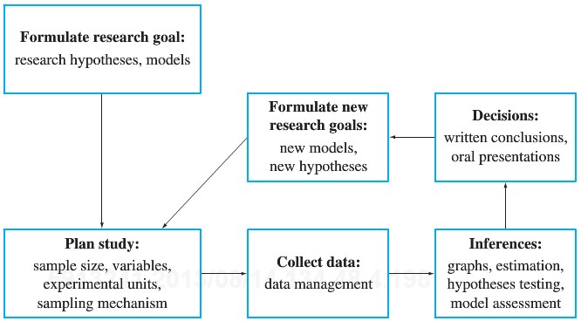
How to learn from Data?

Slide 8
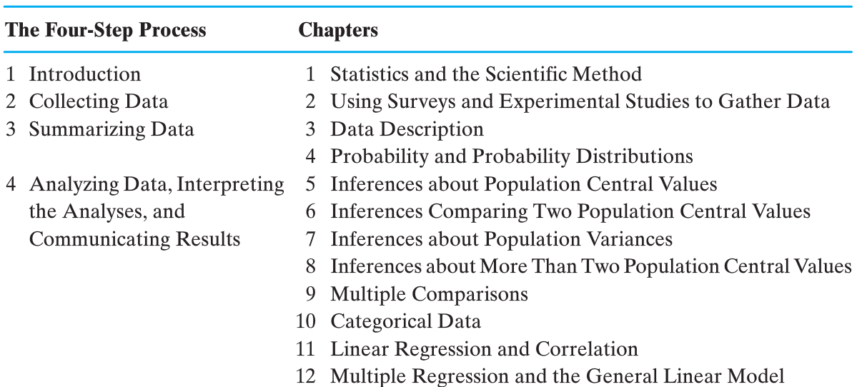
What should you expect?

Slide 9
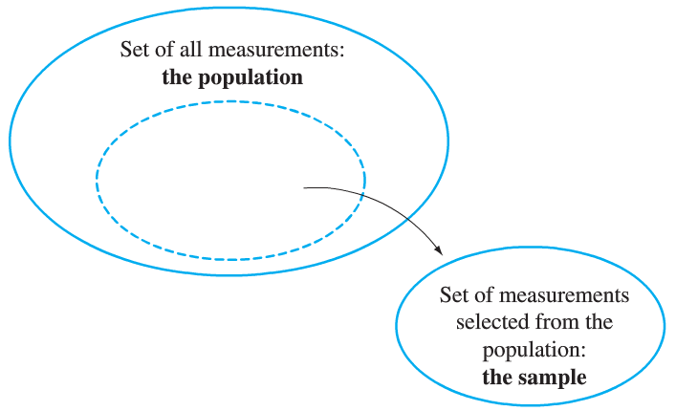
Population vs. Sample
Population: The entire group of interest
Sample: A part of the population selected to draw conclusions about the entire population

Slide 10
Collecting data
Observational study: Observe a group and measure quantities of interest. This is passive data collection in that one does not attempt to influence the group. The purpose of the study is to describe the group.
Experiment: Deliberately impose treatments on groups in order to observe responses. The purpose is to study whether the treatments cause a change in the responses.

Slide 11
Experiment Terms
Experimental Group: A collection of experimental units subjected to a real treatment.
Control Group: A collection of experimental units subjected to the same conditions as those in an experimental group except that no treatment is imposed.
This design helps control for potential confounding effects.

Slide 12
What is confounding?
The Variables that are not in control of the researcher.
A variable that is not among the explanatory or response variables in a study and yet may influence the interpretation of relationships among those variables.
A perceived relationship between an dependent(response) variable and a independent(explanatory) variable that has been misestimated due to the failure to account for a confounding factor is termed a spurious relationship
Socioeconomic status and Life expectancy
Berkeley gender bias case (http://en.wikipedia.org/wiki/Simpson's_Paradox)

Slide 13
Lurking Variable and Simpson’s Paradox
Lurking variable: A variable that is not included in a study but has an effect on the variables of the study and makes it appear that those variables are related.
Simpson’s Paradox: An association or comparison that holds for all of several groups can reverse direction when a lurking variable is present.
Example: Kidney stone treatment(Br Med J (Clin Res Ed) 292 (6524): 879–882)
http://en.wikipedia.org/wiki/Simpson’s_Paradox
 | Treatment A | Treatment B
 | . . | . .
 | . . | . .
Both | 78% (273/350) | 83% (289/350)
 | Treatment A | Treatment B
Small Stones | Group 1 93% (81/87) | Group 2 87% (234/270)
Large Stones | Group 3 73% (192/263) | Group 4 69% (55/80)

Slide 14
Association between cell phone use and the occurrence of cancer?
Recent USA Today article.
Three studies:
A German study (Stang et al., 2001) compared 118 patients with a rare form of eye cancer to 475 healthy patients who did not have the eye cancer. The patients cell phone use was measured using a questionnaire. The eye cancer patients used cell phones more often, on the average.
A British study (Hepworth et al., 2006) compared 966 patients with brain cancer to 1716 patients who did not have brain cancer. The patients cell phone use was measured using a questionnaire. The two groups’ use of cell phones was similar.
An Australian study (Repacholi, 1997) conducted an experiment with 200 transgenic mice, specially bred to be susceptible to cancers of the immune system. One hundred mice were exposed for two-half hour periods a day to the same kind of microwaves with roughly the same power as that transmitted from a cell phone. The other 100 were not exposed. After 18 months, the brain tumor rate for the mice exposed to radiation was twice as high as the brain tumor rate for the unexposed mice.
Source: Agresti, A & Franklin C (2009) Statistics: The Art and Science of Learning from Data (2nd edn) Pearson Prentice Hall

Slide 15
References for cell phone & cancer studies
Hepworth, SJ et al., (2006) Mobile phone use and risk of glioma in adults: case control study. British Medical Journal, 332, 883-887.
Repacholi, HM (1997) Radio frequency field exposure and cancer. Environ. Health Prospect, 105, 1565-1568.
Stang A et al., (2001) The possible role of radio frequency radiation in the development of uveal melanoma. Epidemiology, 12(1), 7-12.

Slide 16
Questions to consider about these three studies
How do the three studies differ?
In studies 1 and 2 no treatments are assigned. Patients are merely questioned. Thus, studies 1 and 2 are observational studies.
Study 3 uses experiments on mice with the hope of generalizing to humans.
Why do the results of different medical studies sometimes disagree?
Differing types of studies, data collection, sample frames.
Sampling variability.
Could the third study have used human subjects instead?
No, because it would be unethical to knowingly expose humans to possibly harmful waves.

Slide 17
Inferential Statistics
Example (1988, the Steering Committee of the Physicians' Health Study Research Group) Question: Can aspirin reduce the risk of heart attack in humans?
Sample: Sample of 22,071 male physicians between the ages of 40 and 84, randomly assigned to one of two groups. One group took an ordinary aspirin tablet every other day (headache or not). The other group took a placebo every other day. This group is the control group.
Summary statistic: The rate of heart attacks in the group taking aspirin was only 55% of the rate of heart attacks in the placebo group.
Inference to population: Taking aspirin causes lower rate of heart attacks in humans.

Slide 18
Sampling a Single Population
Sampling Techniques
Simple Random Sample (SRS): every member of the population has an equal chance of being selected.
Simple Random Sample
Sample
Population

Slide 19

Is iT that easy?

Slide 20
Sampling a Single Population
Sampling Techniques
Stratified Random Sample: Divide the sample into several strata. Then take a SRS from each stratum.
Advantage: Each stratum is guaranteed to be randomly sampled
Example: Obtain a list of all SSN for individuals in the U.S. who are over 65. Divide up the SSNs into region of the country (time zones). Then randomly sample 30 from each time zone.
Strata 1
Strata 2
Strata 3
Sample
Population

Slide 21
Sampling a Single Population
Sampling Techniques
Cluster Sample: Divide the sample into several strata or clusters. Then take a SRS of clusters.
Strata 2
Strata 1
Strata 1
Strata 3
Strata 4
Strata 4
Strata 5
Strata 6
Strata 7
Sample
Strata 8
Population
Strata 9
Strata 9

Slide 22
Sampling a Single Population
Sampling Techniques
Cluster Sample
Advantage: May be the only feasible method, given resoures.
Example: Obtain a list of all SSNs for individuals in the U.S. who are over 65. Sort the SSNs by the last 4 digits making each set of 100 a cluster. Use a random number table to pick the clusters. You may get the 4100’s, 5600’s and 8200’s for example.

Slide 23
Inference Overview
Describing a Population
It is common practice to use Greek letters when talking about a population.
We call the mean of a population μ.
We call the standard deviation of a population σ and the variance σ².
When we are talking about percentages, we call the population proportion π. (or pi).
It is important to know that for a given population there is only one true mean and one true standard deviation and variance or one true proportion.
There is a special name for these values: parameters.

Slide 24
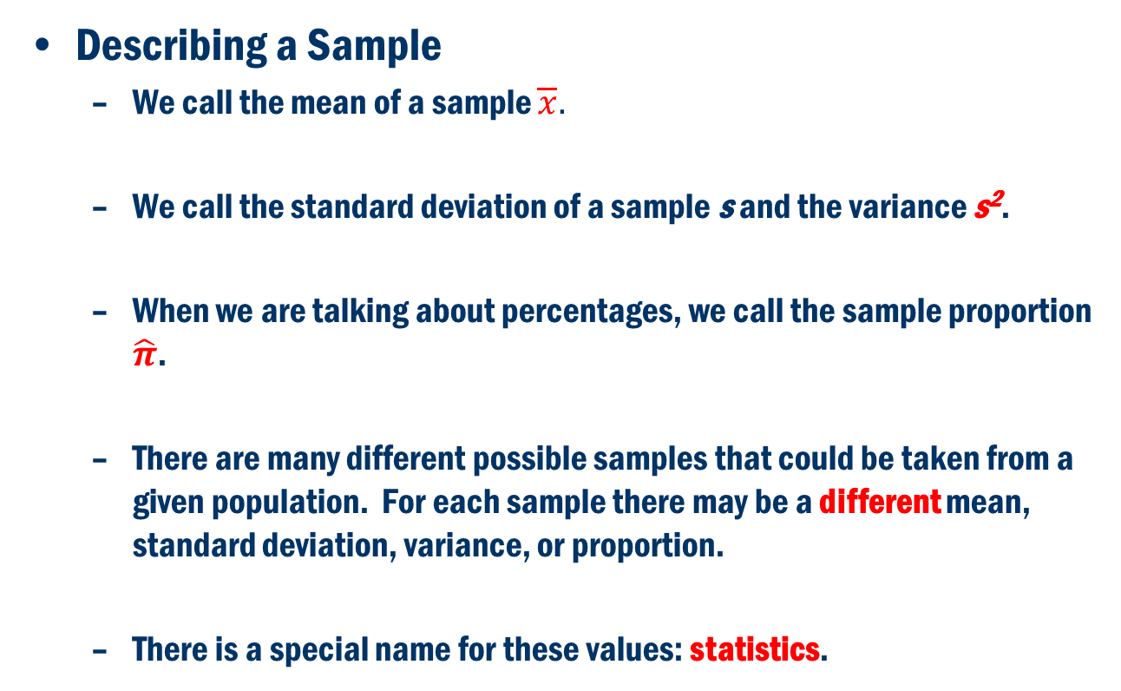
Inference Overview
Describing a Sample
We call the mean of a sample $\overline{x}.$
We call the standard deviation of a sample s and the variance s².
When we are talking about percentages, we call the sample proportion $\hat{π}$.
There are many different possible samples that could be taken from a given population. For each sample there may be a different mean, standard deviation, variance, or proportion.
There is a special name for these values: statistics.

Slide 25

Inference Overview
We use sample statistics to make inference about population parameters
Population
Sample
Mean:
μ
Standard Deviation:
σ
s
Proportion:
π
$$\hat{π}$$

