Slide 1
Chapter 10(Part A)

Slide 2
Categorical Data Analysis (Analysis for Count Data)
Two Categorical Variables
Example: (Evaluation of president’s performance vs Gender)
Variables:
President’s Job Performance: Approve, Disapprove, No Opinion
Gender: Male, Female
First variable has three levels, and the second has two levels
subject | President’s Job Performance | Gender
1 | Approve | F
2 | Disapprove | M
. | No opinion | F
. | .
100 | Approve | M

Slide 3
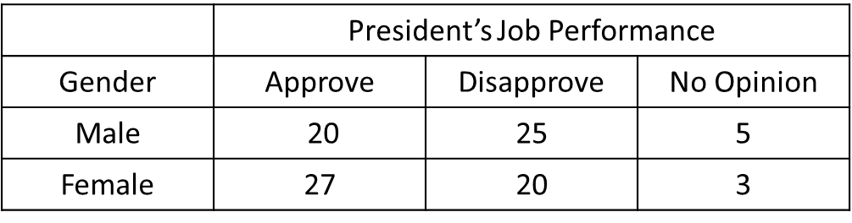
Analysis of Count Data
We can of course convert this data into count data
One question may be to test whether the opinion on
President’s Job Performance depends on Gender.
How to formulate this problem in hypothesis testing?
What is the probability distribution?
Of course, we cannot use normal distribution.

Slide 4
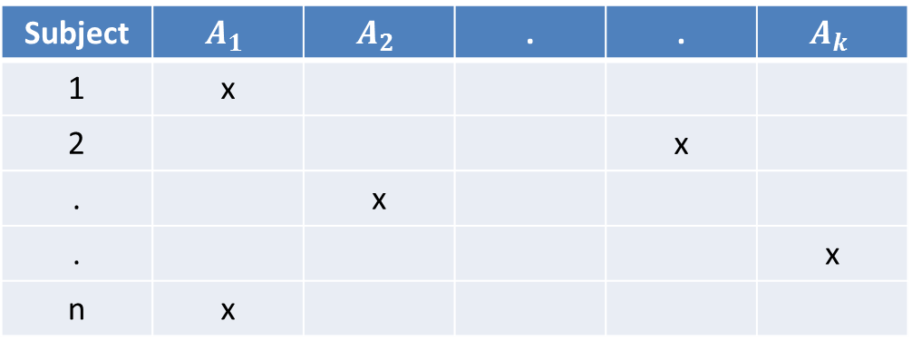
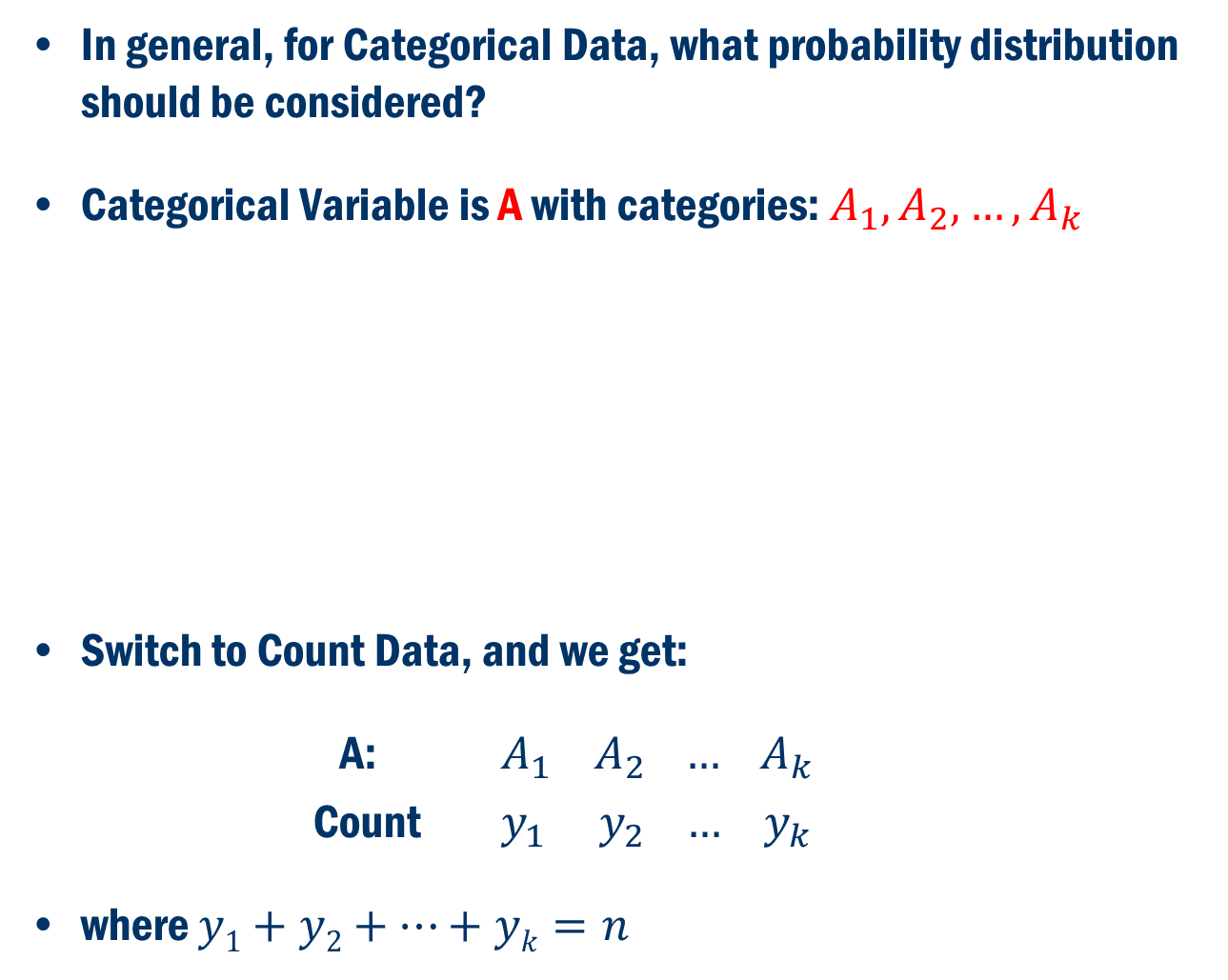
Analysis of Count Data Cont’D
In general, for Categorical Data, what probability distribution should be considered?
Categorical Variable is A with categories: $A_{1}, A_{2}, …,A_{k}$
Switch to Count Data, and we get:
A: $A_{1} A_{2 }… A_{k}$
Count $y_{1} y_{2} …{ y}_{k}$
where $y1+y2+…+yk=n$

Slide 5
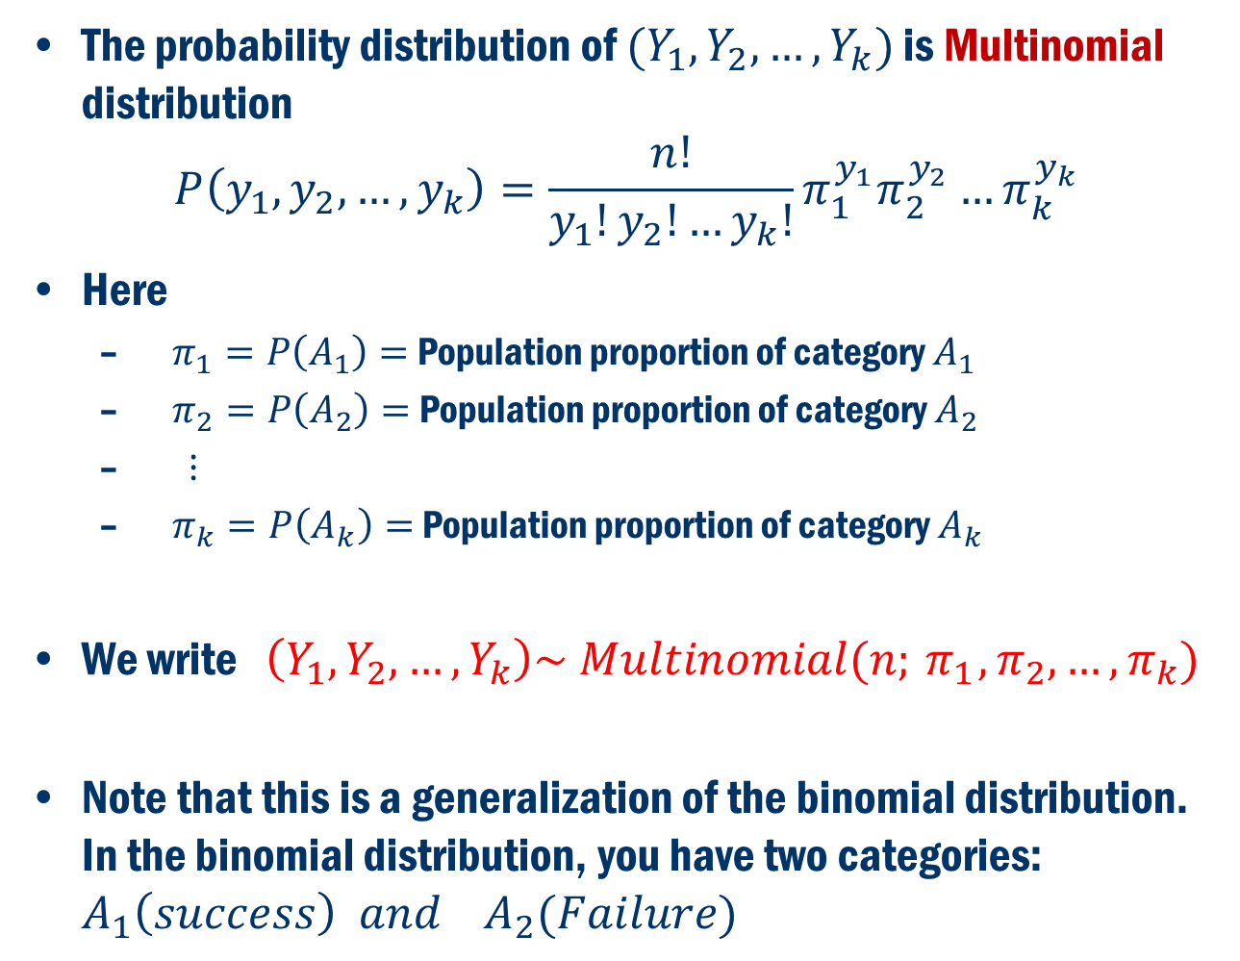
What is the Probability Distribution of This Counts?
The probability distribution of $(Y_{1}, Y_{2}, …, Y_{k})$ is Multinomial distribution
$$P\left(y_{1},y_{2},…,y_{k}\right)=\frac{n!}{y_{1}!y_{2}!…y_{k}!}π_{1}^{y_{1}}π_{2}^{y_{2}}…π_{k}^{y_{k}}$$
Here
$π_{1}=P\left(A_{1}\right)=$ Population proportion of category $A_{1}$
$π_{2}=P\left(A_{2}\right)=$ Population proportion of category $A_{2}$
$⋮$
$π_{k}=P\left(A_{k}\right)=$ Population proportion of category $A_{k}$
We write $\left(Y_{1},Y_{2},…,Y_{k}\right)\sim Multinomial(n;{ π}_{1},π_{2},…, π_{k})$
Note that this is a generalization of the binomial distribution. In the binomial distribution, you have two categories: $A_{1}\left(success\right) and A_{2}(Failure)$

Slide 6
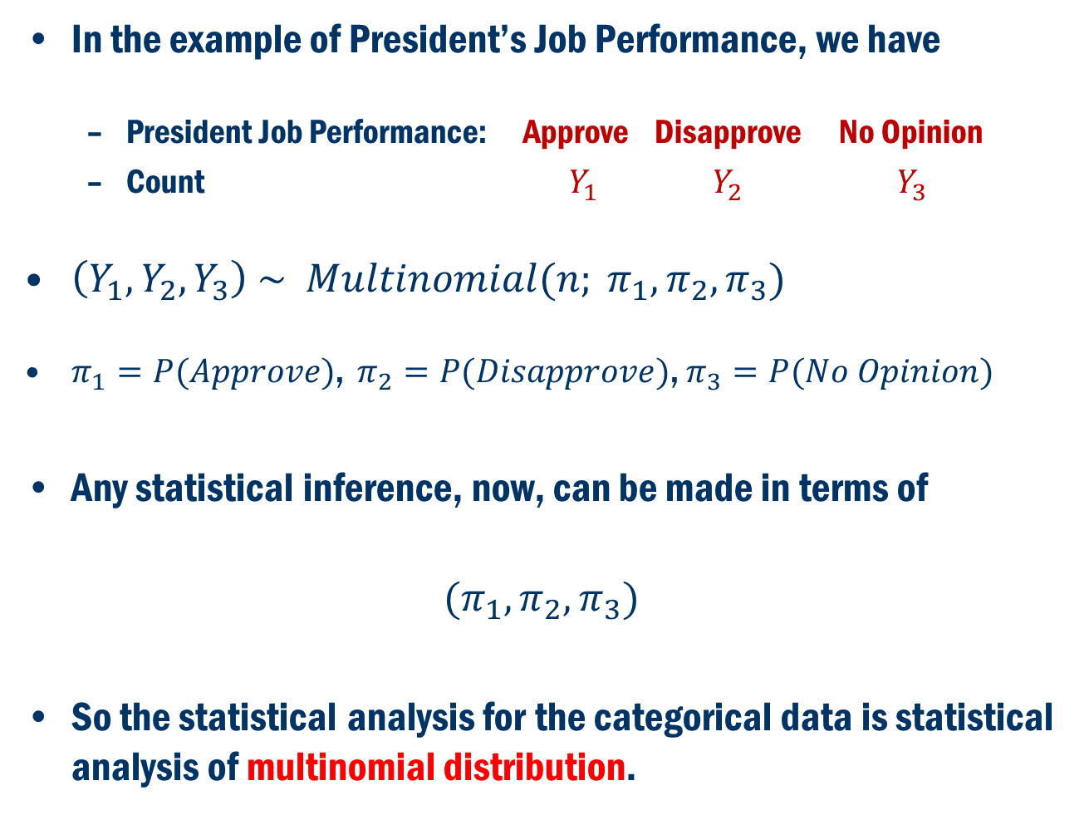
Going Back to Example
In the example of President’s Job Performance, we have
President Job Performance: Approve Disapprove No Opinion
Count $Y_{1}$ $Y_{2}$ $Y_{3}$
$\left(Y_{1}, Y_{2}, Y_{3}\right) \sim Multinomial(n; π_{1}, π_{2},π_{3})$
$π_{1}=P(Approve)$, $π_{2}=P(Disapprove)$, $π_{3}=P(No Opinion)$
Any statistical inference, now, can be made in terms of
$$(π_{1}, π_{2},π_{3})$$
So the statistical analysis for the categorical data is statistical analysis of multinomial distribution.

Slide 7
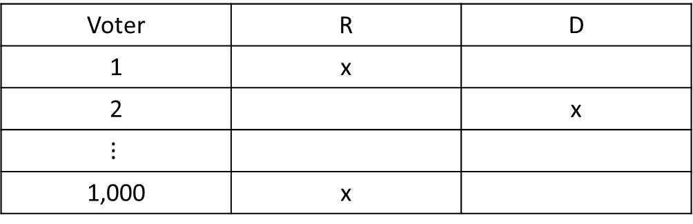
Simple Example (Binomial)
Example: Exit Poll
Suppose, we collected data on 1,000 voters in election with only two candidates: R and D
Data
Based on this data, we want to forecast who won the election.

Slide 8
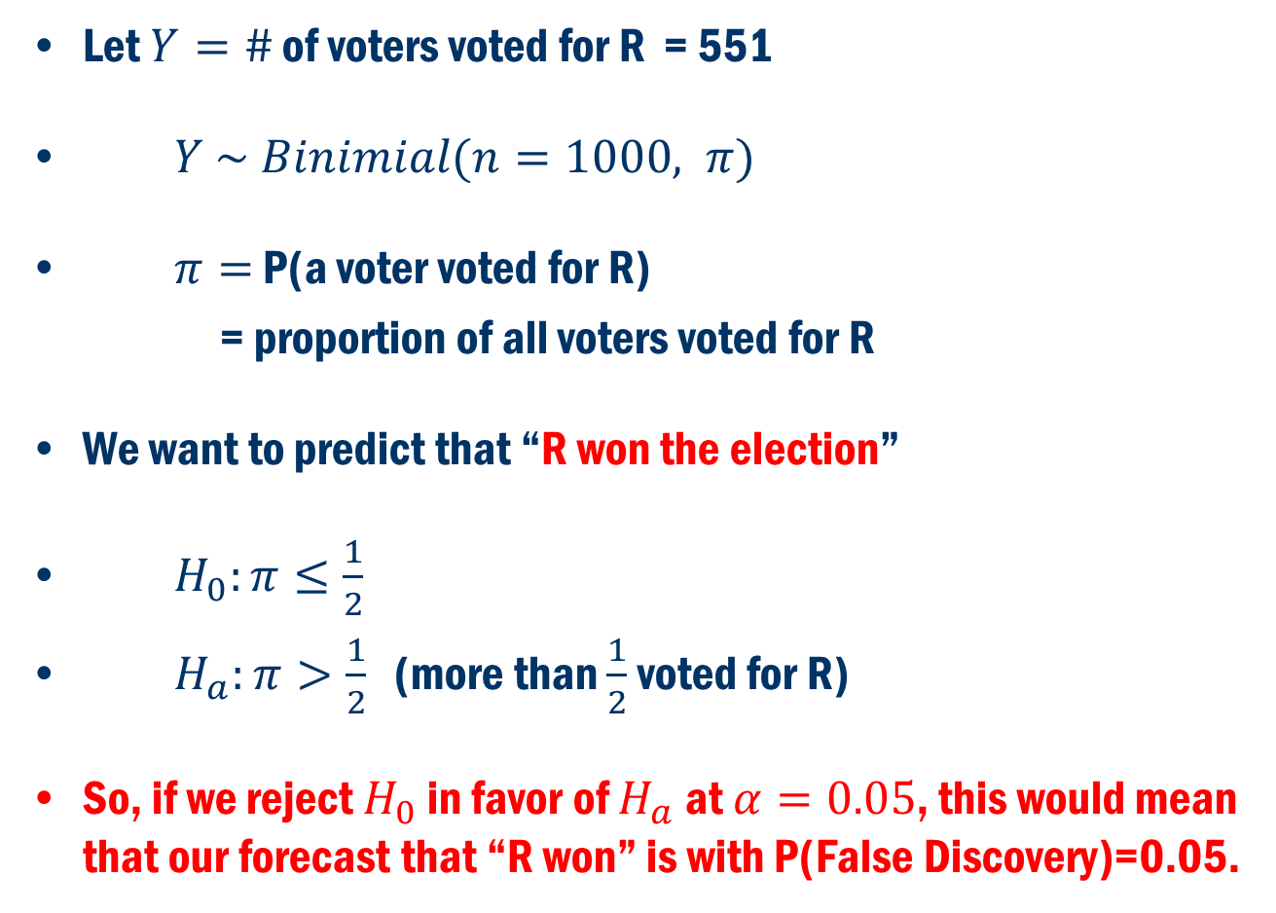
Poll Example Cont’d
Let $Y=\#$ of voters voted for R = 551
$Y \sim Binimial(n=1000, π)$
$π=$ P(a voter voted for R)
= proportion of all voters voted for R
We want to predict that “R won the election”
$H_{0}:π≤\frac{1}{2}$
$H_{a}:π>\frac{1}{2}$ (more than $\frac{1}{2}$ voted for R)
So, if we reject $H_{0}$ in favor of $H_{a}$ at $α=0.05$, this would mean that our forecast that “R won” is with P(False Discovery)=0.05.

Slide 9
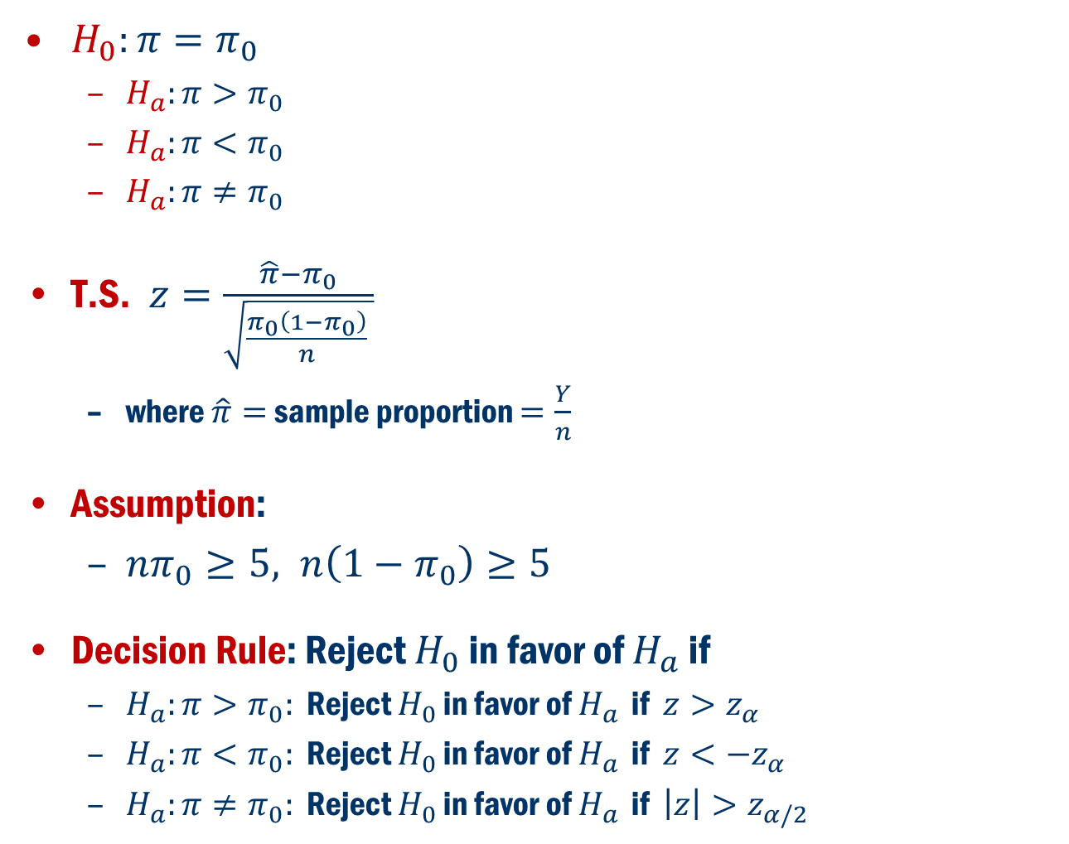
Hypthesis Testing for $π$
$H_{0}:π=π_{0}$
$H_{a}:π>π_{0}$
$H_{a}:π<π_{0}$
$H_{a}:π≠π_{0}$
T.S. $z=\frac{\hat{π}−π_{0}}{\sqrt{\frac{π_{0}\left(1−π_{0}\right)}{n} }}$
where $\hat{π}=$ sample proportion $=\frac{Y}{n}$
Assumption:
$nπ_{0}≥5, n\left(1−π_{0}\right)≥5$
Decision Rule: Reject $H_{0}$ in favor of $H_{a}$ if
$H_{a}:π>π_{0}:$ Reject $H_{0}$ in favor of $H_{a}$ if $z>z_{α}$
$H_{a}:π<π_{0}:$ Reject $H_{0}$ in favor of $H_{a}$ if $z<−z_{α}$
$H_{a}:π≠π_{0}:$ Reject $H_{0}$ in favor of $H_{a}$ if $\left|z\right|>z_{α/2}$

Slide 10

Confidence interval for $π$
Estimate $π$ with a 100(1-$α$)% confidence interval
$\hat{π}±z_{α/2}\sqrt{\frac{\hat{π}\left(1−\hat{π}\right)}{n}}$
Assumption:
$$n\hat{π}≥5, n\left(1−\hat{π}\right)≥5$$

Slide 11
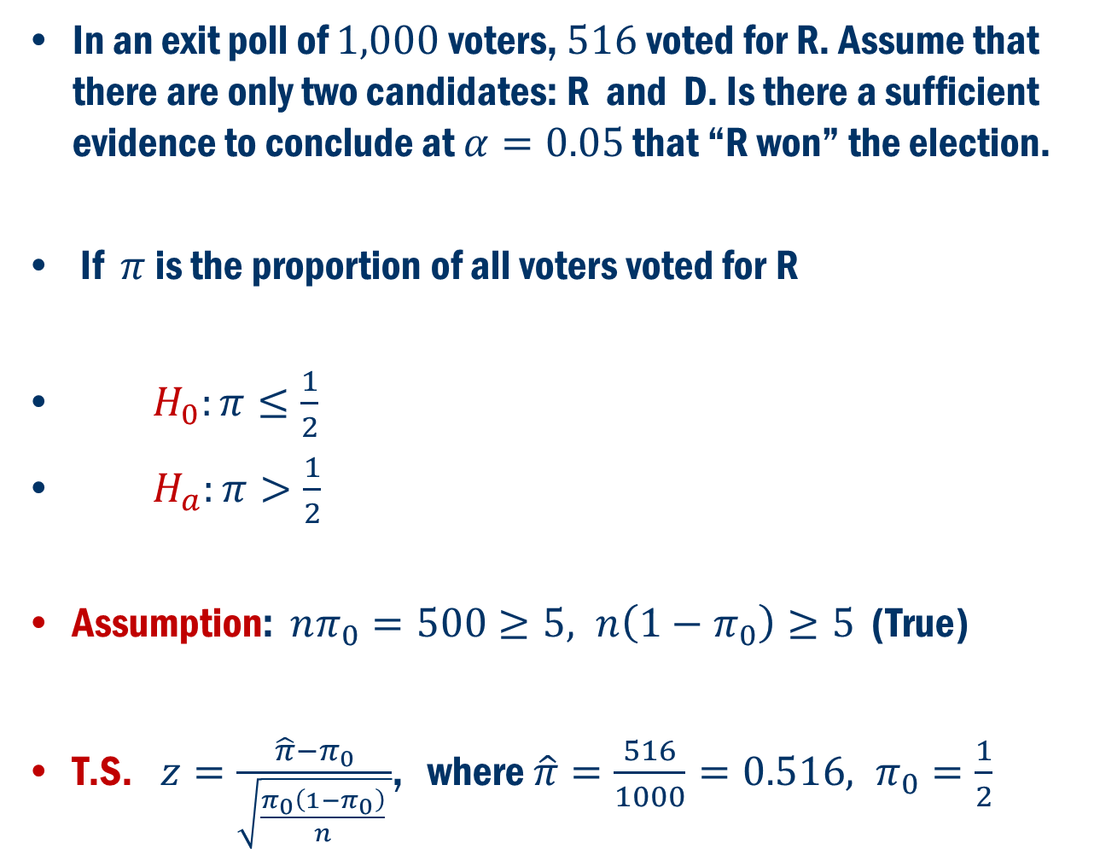
Back to Example
In an exit poll of $1,000$voters, $516$voted for R. Assume that there are only two candidates: R and D. Is there a sufficient evidence to conclude at $α=0.05$ that “R won” the election.
If $π$ is the proportion of all voters voted for R
$H_{0}:π≤\frac{1}{2}$
$H_{a}:π>\frac{1}{2}$
Assumption: $nπ_{0}=500≥5, n\left(1−π_{0}\right)≥5$ (True)
T.S. $z=\frac{\hat{π}−π_{0}}{\sqrt{\frac{π_{0}\left(1−π_{0}\right)}{n} }}$, where $\hat{π}=\frac{516}{1000}=0.516, π_{0}=\frac{1}{2}$

Slide 12
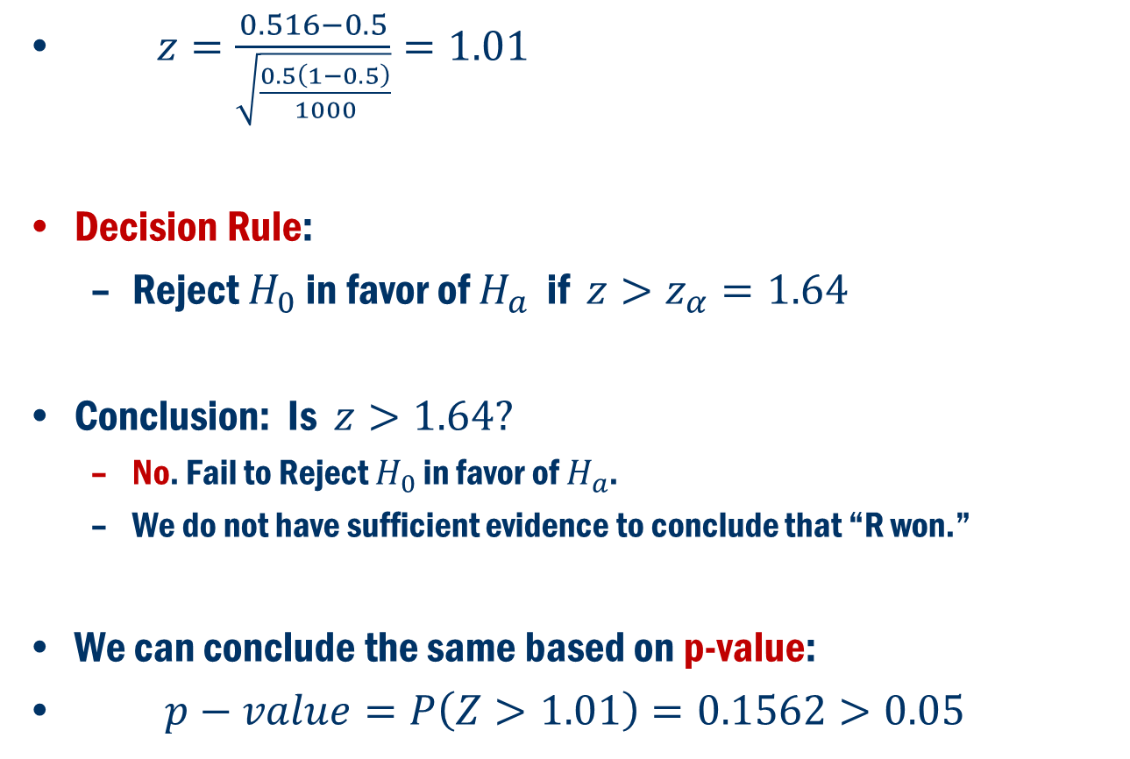
Example Cont’D
$z=\frac{0.516−0.5}{\sqrt{\frac{0.5\left(1−0.5\right)}{1000}}}=1.01$
Decision Rule:
Reject $H_{0}$ in favor of $H_{a}$ if $z>z_{α}=1.64$
Conclusion: Is $z>1.64?$
No. Fail to Reject $H_{0}$ in favor of $H_{a}$.
We do not have sufficient evidence to conclude that “R won.”
We can conclude the same based on p-value:
$p−value=P\left(Z>1.01\right)=0.1562>0.05$

Slide 13
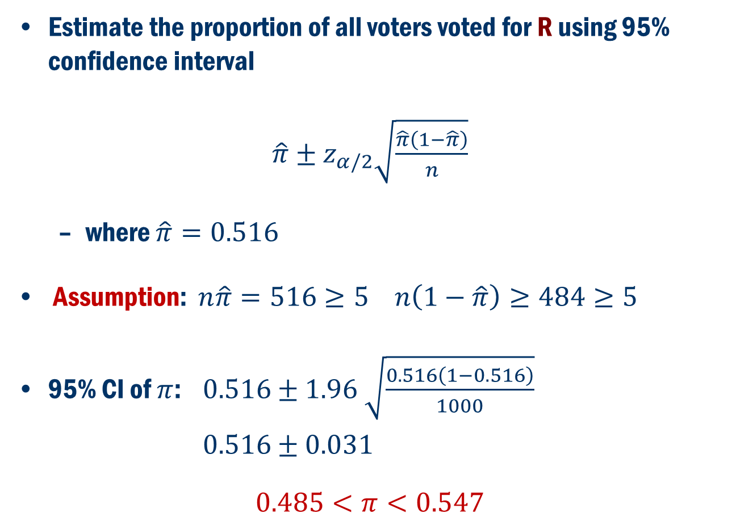
Example Cont’D
Estimate the proportion of all voters voted for R using 95% confidence interval
$\hat{π}±z_{α/2}\sqrt{\frac{\hat{π}\left(1−\hat{π}\right)}{n}}$
where $\hat{π}=0.516$
Assumption: $n\hat{π}=516≥5 n\left(1−\hat{π}\right)≥484≥5$
95% CI of $π$: $0.516±1.96 \sqrt{\frac{0.516\left(1−0.516\right)}{1000}}$
$0.516±0.031$
$$0.485<π<0.547$$

Slide 14
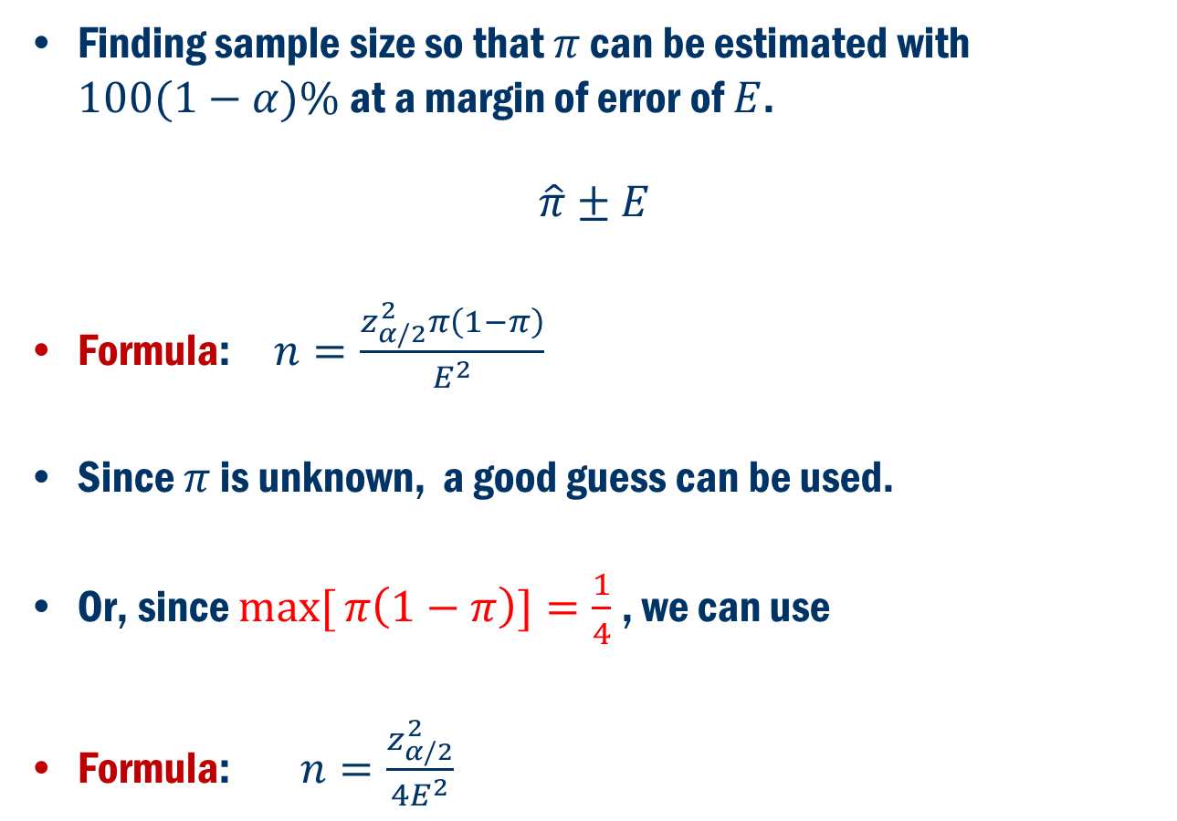
Sample Size Determination
Finding sample size so that $π$ can be estimated with $100(1−α)\%$at a margin of error of $E$.
$$\hat{π}±E$$
Formula: $n=\frac{z_{α/2}^{2}π\left(1−π\right)}{E^{2}}$
Since $π$ is unknown, a good guess can be used.
Or, since $max[{π\left(1−π\right)]=\frac{1}{4}}$ , we can use
Formula: $n=\frac{z_{α/2}^{2}}{4E^{2}}$

Slide 15
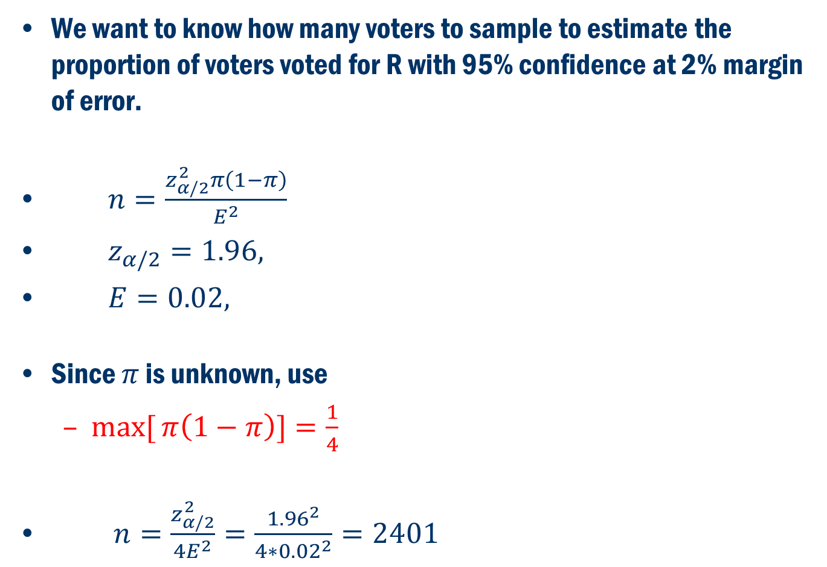
Back to Exit Poll Example:
We want to know how many voters to sample to estimate the proportion of voters voted for R with 95% confidence at 2% margin of error.
$n=\frac{z_{α/2}^{2}π\left(1−π\right)}{E^{2}}$
$z_{α/2}=1.96,$
$E=0.02,$
Since $π$ is unknown, use
$max[{π\left(1−π\right)]=\frac{1}{4}}$
$n=\frac{z_{α/2}^{2}}{4E^{2}}=\frac{{1.96}^{2}}{4∗{0.02}^{2}}=2401$

Slide 16
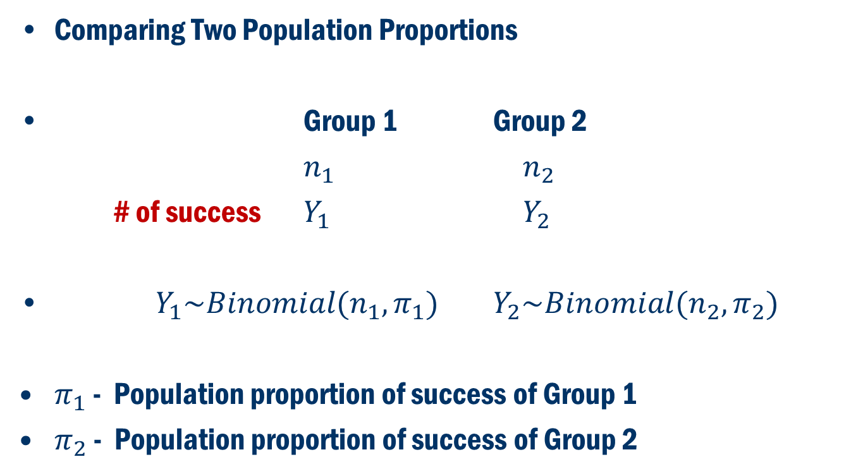
Two Population Proportion
Comparing Two Population Proportions
Group 1 Group 2
$n_{1}$ $n_{2}$
# of success $Y_{1}$ $Y_{2}$
$Y_{1}\sim Binomial(n_{1}, π_{1})$ $Y_{2}\sim Binomial(n_{2}, π_{2})$
$π_{1}$ - Population proportion of success of Group 1
$π_{2}$ - Population proportion of success of Group 2

Slide 17
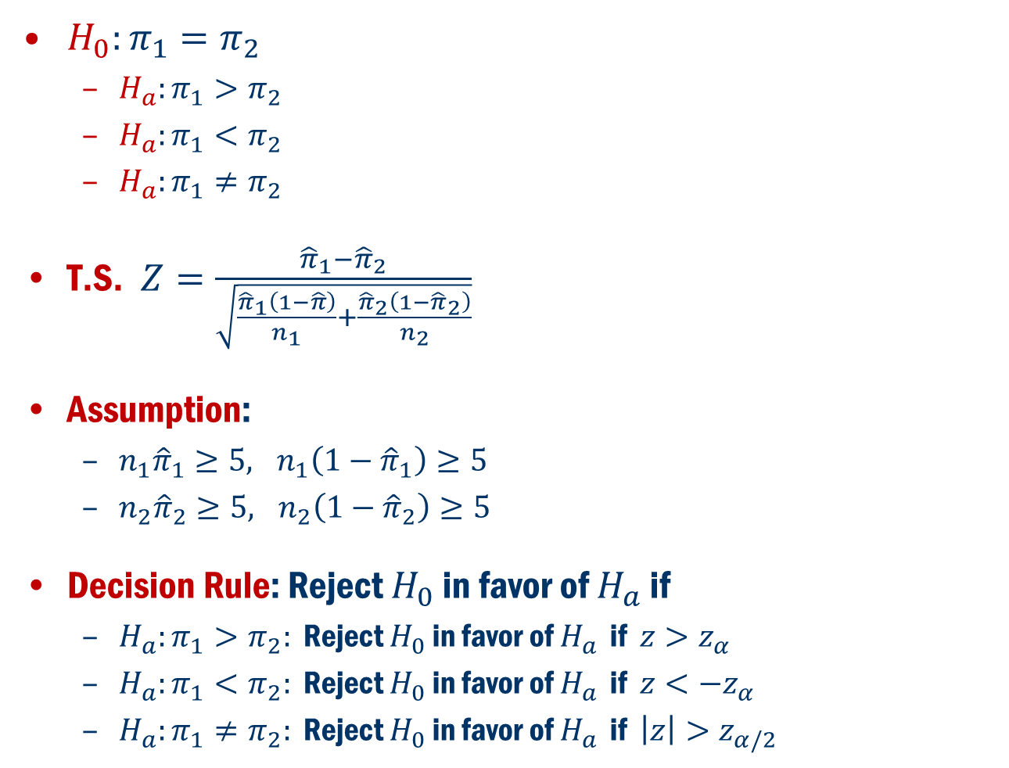
Hypthesis Testing for $π$
$H_{0}:π_{1}=π_{2}$
$H_{a}:π_{1}>π_{2}$
$H_{a}:π_{1}<π_{2}$
$H_{a}:π_{1}≠π_{2}$
T.S. $Z=\frac{{\hat{π}}_{1}−{\hat{π}}_{2}}{\sqrt{\frac{{\hat{π}}_{1}\left(1−\hat{π}\right)}{n_{1}}+\frac{{\hat{π}}_{2}\left(1−{\hat{π}}_{2}\right)}{n_{2}}}}$
Assumption:
$n_{1}{\hat{π}}_{1}≥5, n_{1}\left(1−{\hat{π}}_{1}\right)≥5$
$n_{2}{\hat{π}}_{2}≥5, n_{2}\left(1−{\hat{π}}_{2}\right)≥5$
Decision Rule: Reject $H_{0}$ in favor of $H_{a}$ if
$H_{a}:π_{1}>π_{2}:$ Reject $H_{0}$ in favor of $H_{a}$ if $z>z_{α}$
$H_{a}:π_{1}<π_{2}:$ Reject $H_{0}$ in favor of $H_{a}$ if $z<−z_{α}$
$H_{a}:π_{1}≠π_{2}:$ Reject $H_{0}$ in favor of $H_{a}$ if $\left|z\right|>z_{α/2}$

Slide 18
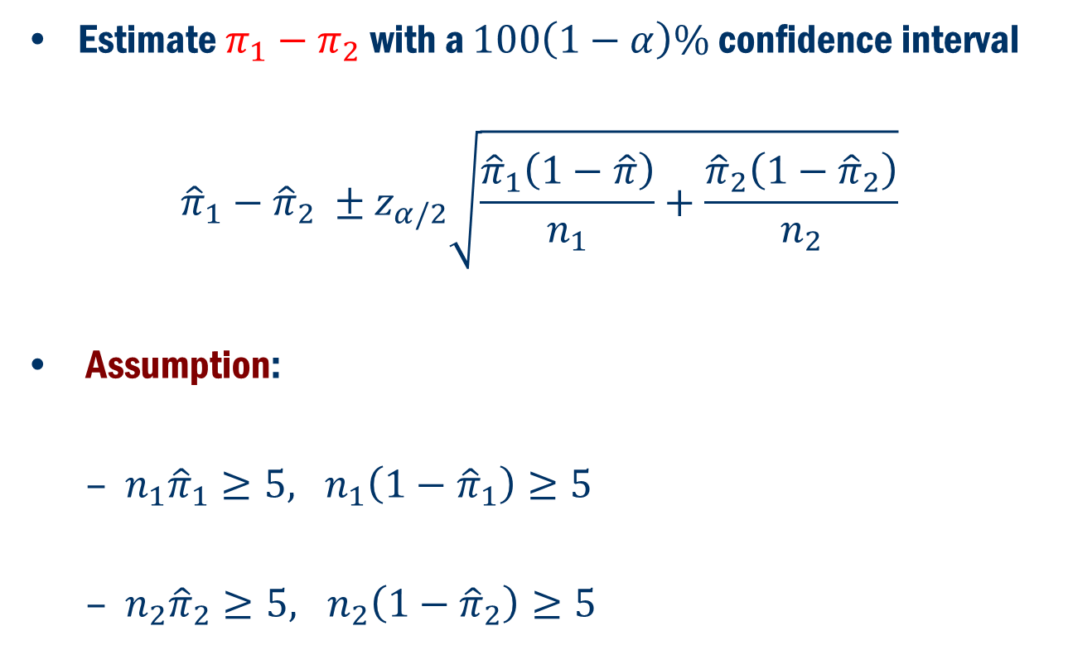
Confidence interval for $π_{1}−π_{2}$
Estimate $π_{1}−π_{2}$with a $100\left(1−α\right)\%$ confidence interval
$${\hat{π}}_{1}−{\hat{π}}_{2} ±z_{α/2}\sqrt{\frac{{\hat{π}}_{1}\left(1−\hat{π}\right)}{n_{1}}+\frac{{\hat{π}}_{2}\left(1−{\hat{π}}_{2}\right)}{n_{2}}}$$
Assumption:
$n_{1}{\hat{π}}_{1}≥5, n_{1}\left(1−{\hat{π}}_{1}\right)≥5$
$n_{2}{\hat{π}}_{2}≥5, n_{2}\left(1−{\hat{π}}_{2}\right)≥5$

Slide 19
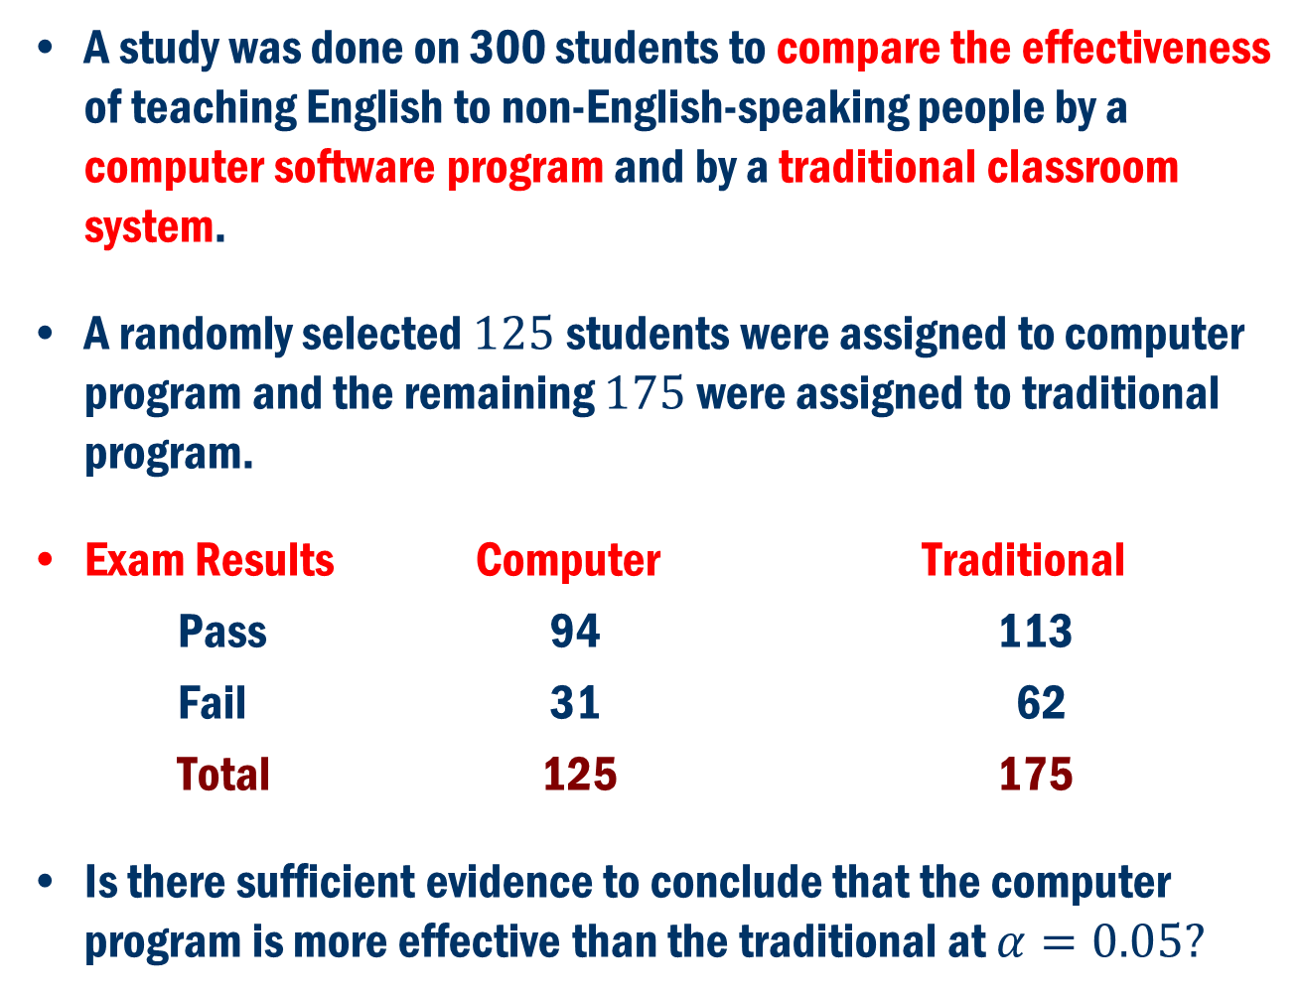
Book Example 10.7
A study was done on 300 students to compare the effectiveness of teaching English to non-English-speaking people by a computer software program and by a traditional classroom system.
A randomly selected $125$students were assigned to computer program and the remaining $175$were assigned to traditional program.
Exam Results Computer Traditional
Pass 94 113
Fail 31 62
Total 125 175
Is there sufficient evidence to conclude that the computer program is more effective than the traditional at $α=0.05?$

Slide 20
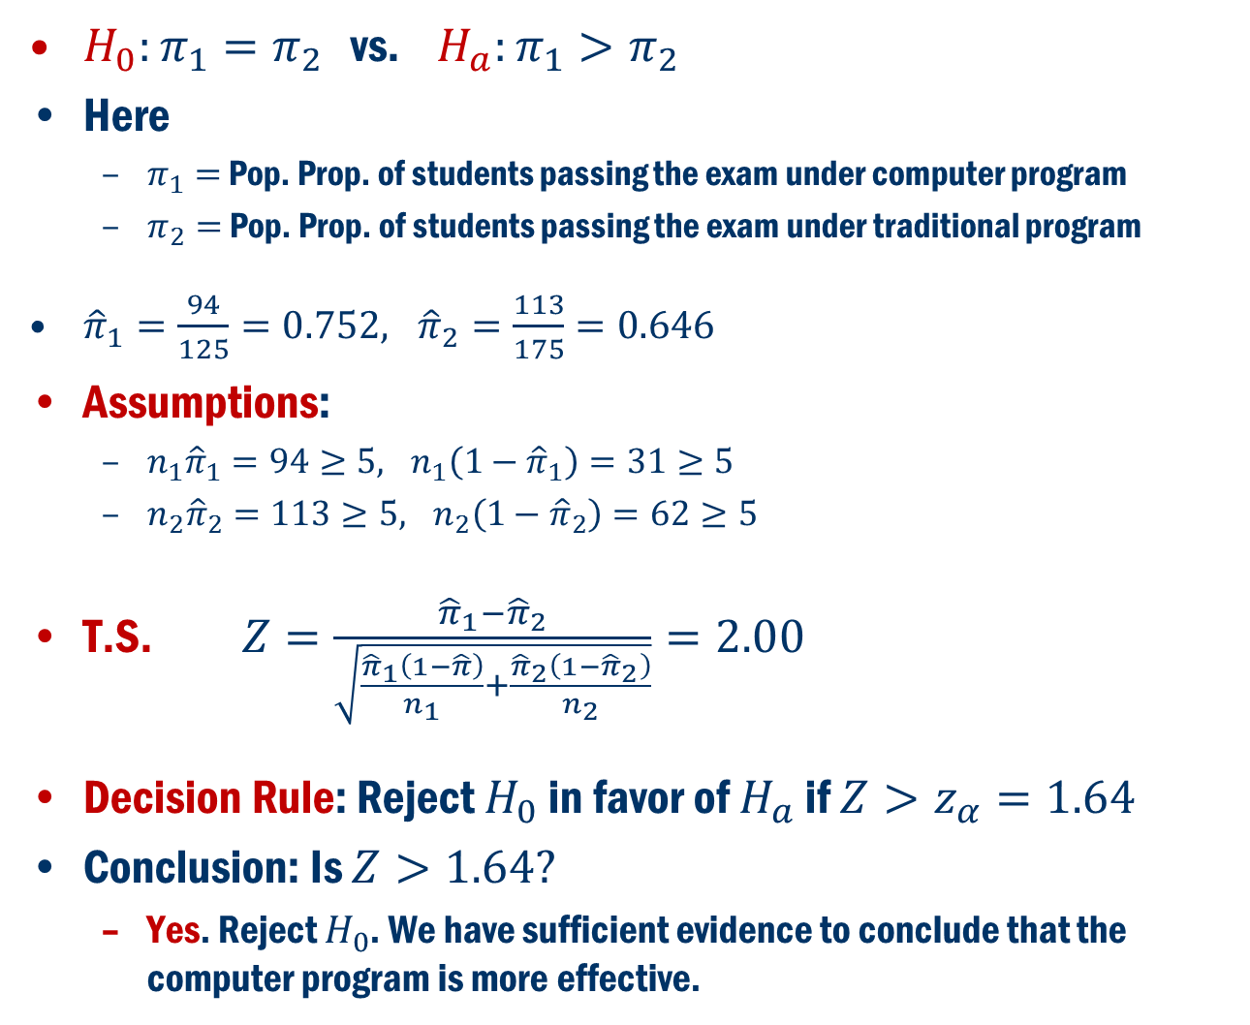
Example 10.7 Cont’D
$H_{0}:π_{1}=π_{2}$ vs. $H_{a}:π_{1}>π_{2}$
Here
$π_{1}=$ Pop. Prop. of students passing the exam under computer program
$π_{2}=$ Pop. Prop. of students passing the exam under traditional program
${\hat{π}}_{1}=\frac{94}{125}=0.752, {\hat{π}}_{2}=\frac{113}{175}=0.646$
Assumptions:
$n_{1}{\hat{π}}_{1}=94≥5, n_{1}\left(1−{\hat{π}}_{1}\right)=31≥5$
$n_{2}{\hat{π}}_{2}=113≥5, n_{2}\left(1−{\hat{π}}_{2}\right)=62≥5$
T.S. $Z=\frac{{\hat{π}}_{1}−{\hat{π}}_{2}}{\sqrt{\frac{{\hat{π}}_{1}\left(1−\hat{π}\right)}{n_{1}}+\frac{{\hat{π}}_{2}\left(1−{\hat{π}}_{2}\right)}{n_{2}}}}=2.00$
Decision Rule: Reject $H_{0}$ in favor of $H_{a}$ if $Z>z_{α}=1.64$
Conclusion: Is $Z>1.64?$
Yes. Reject $H_{0}$. We have sufficient evidence to conclude that the computer program is more effective.

Slide 21
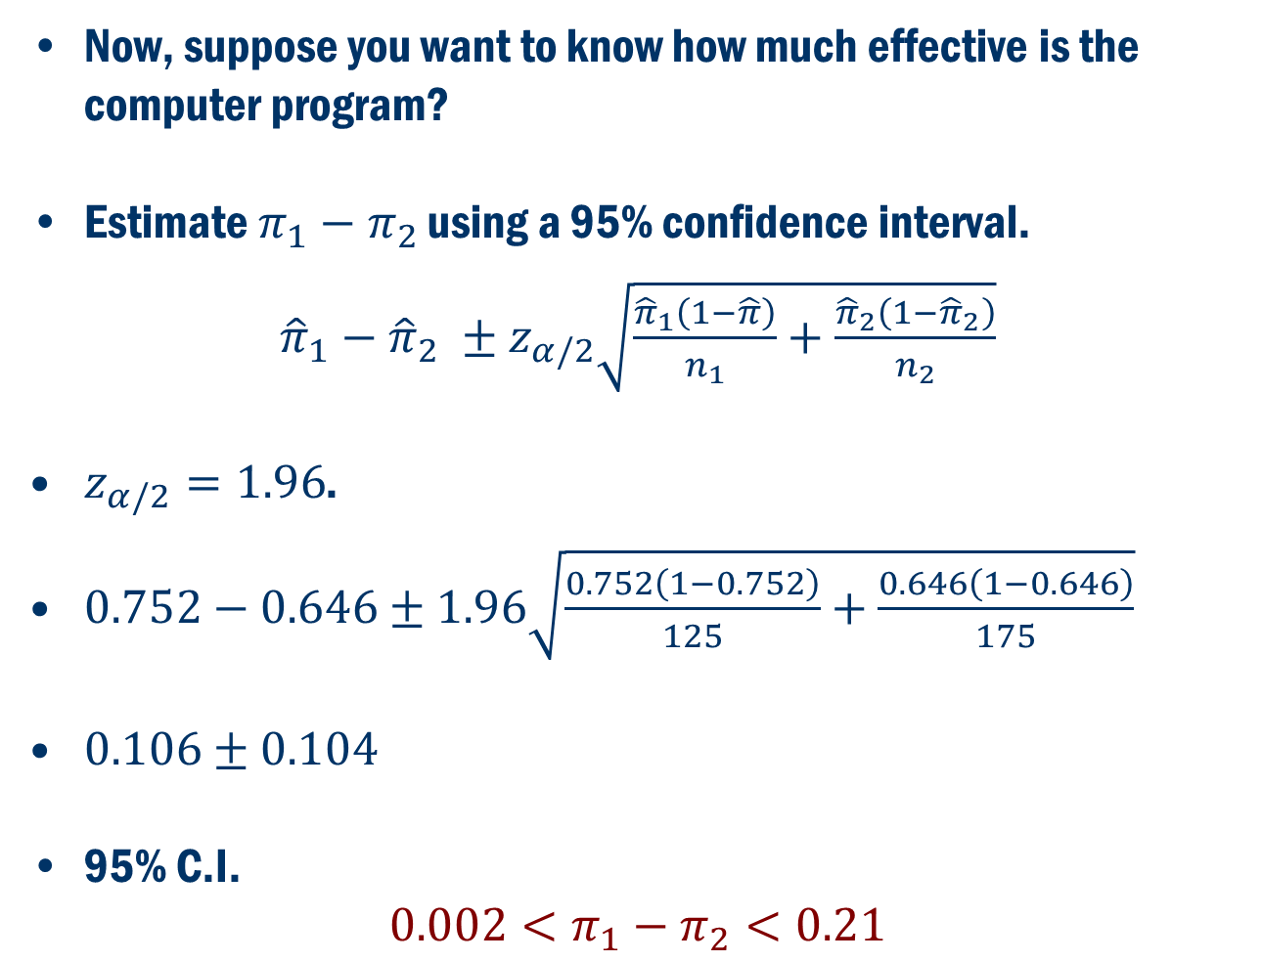
Example 10.7 Cont’D (Confidence Int.)
Now, suppose you want to know how much effective is the computer program?
Estimate $π_{1}−π_{2}$ using a 95% confidence interval.
${\hat{π}}_{1}−{\hat{π}}_{2} ±z_{α/2}\sqrt{\frac{{\hat{π}}_{1}\left(1−\hat{π}\right)}{n_{1}}+\frac{{\hat{π}}_{2}\left(1−{\hat{π}}_{2}\right)}{n_{2}}}$
$z_{α/2}=1.96$.
$0.752−0.646±1.96\sqrt{\frac{0.752\left(1−0.752\right)}{125}+\frac{0.646\left(1−0.646\right)}{175}}$
$0.106±0.104$
95% C.I.
$$0.002<π_{1}−π_{2}<0.21$$

Slide 22
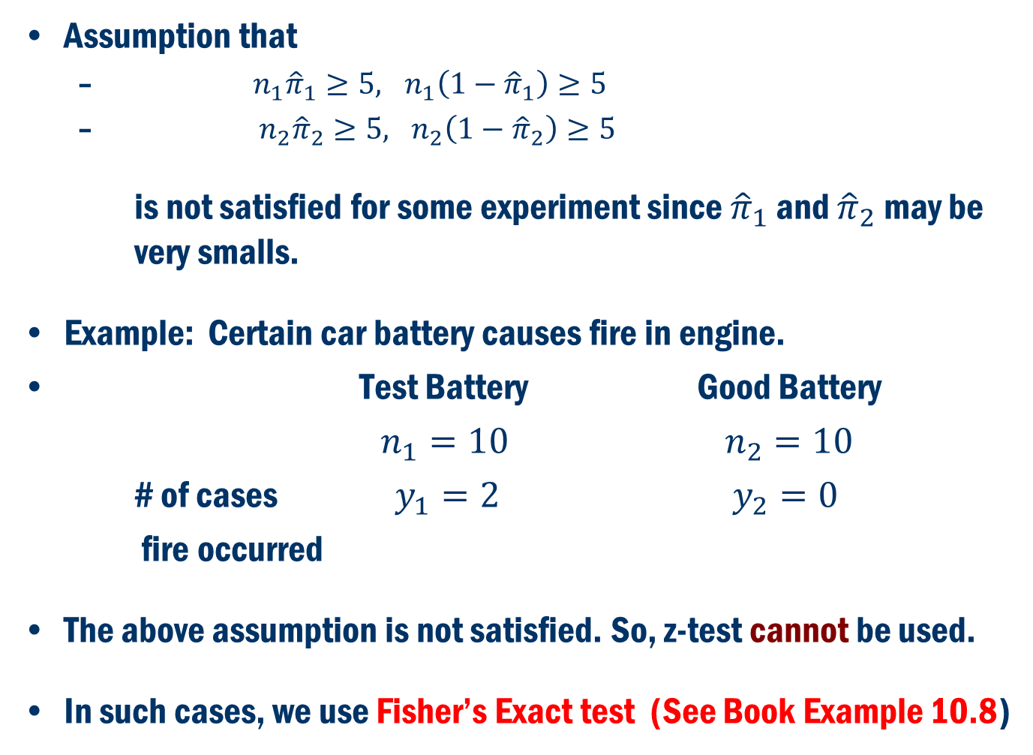
Remark
Assumption that
$n_{1}{\hat{π}}_{1}≥5, n_{1}\left(1−{\hat{π}}_{1}\right)≥5$
$n_{2}{\hat{π}}_{2}≥5, n_{2}\left(1−{\hat{π}}_{2}\right)≥5$
is not satisfied for some experiment since ${\hat{π}}_{1}$ and ${\hat{π}}_{2}$ may be very smalls.
Example: Certain car battery causes fire in engine.
Test Battery Good Battery
$n_{1}=10$ $n_{2}=10$
# of cases $y_{1}=2$ $y_{2}=0$
fire occurred
The above assumption is not satisfied. So, z-test cannot be used.
In such cases, we use Fisher’s Exact test (See Book Example 10.8)

