Slide 1
Chapter 10 (Part B)

Slide 2
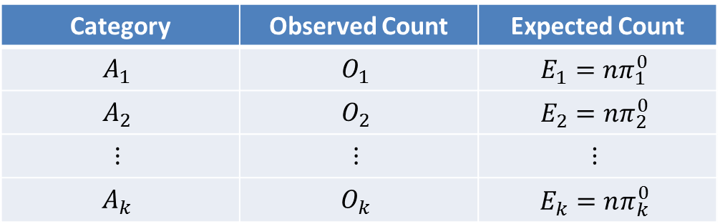
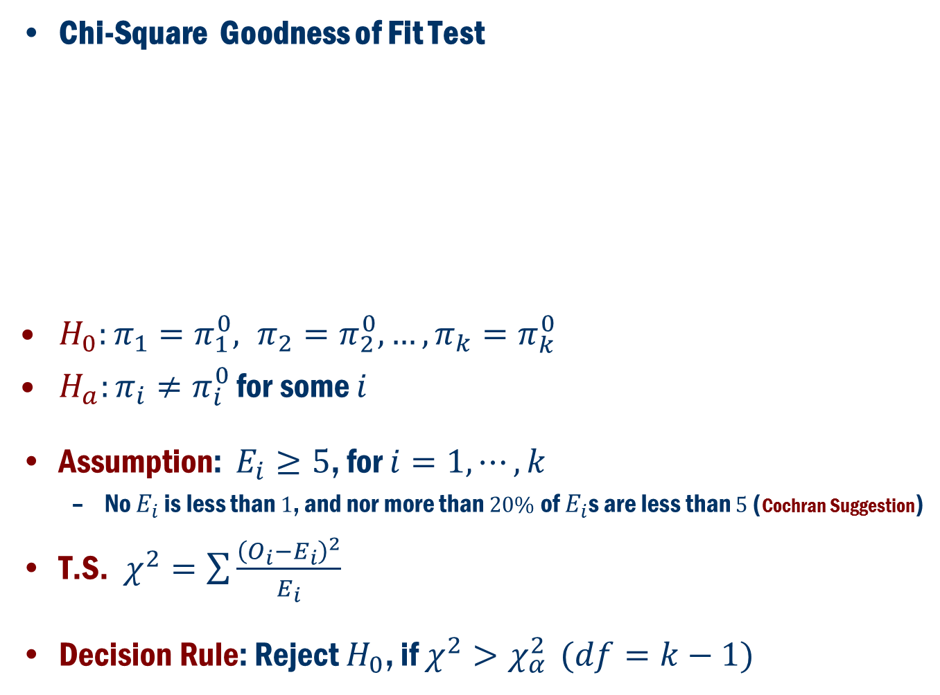
Inference for more than two proportions
Chi-Square Goodness of Fit Test
$H_{0}:π_{1}=π_{1}^{0}, π_{2}=π_{2}^{0},…, π_{k}=π_{k}^{0}$
$H_{a}:π_{i}≠π_{i}^{0}$ for some $i$
Assumption: $E_{i}≥5$, for $i=1,⋯,k$
No $E_{i}$ is less than $1$, and nor more than $20\%$ of $E_{i}$s are less than $5$ (Cochran Suggestion)
T.S. $χ^{2}=\sum{\frac{{\left(O_{i}−E_{i}\right)}^{2}}{E_{i}}}$
Decision Rule: Reject $H_{0}$, if $χ^{2}>χ_{α}^{2}$ $(df=k−1)$
Category | Observed Count | Expected Count
$$A_{1}$$ | $$O_{1}$$ | $$E_{1}=nπ_{1}^{0}$$
$$A_{2}$$ | $$O_{2}$$ | $$E_{2}=nπ_{2}^{0}$$
$$⋮$$ | $$⋮$$ | $$⋮$$
$$A_{k}$$ | $$O_{k}$$ | $$E_{k}=nπ_{k}^{0}$$

Slide 3
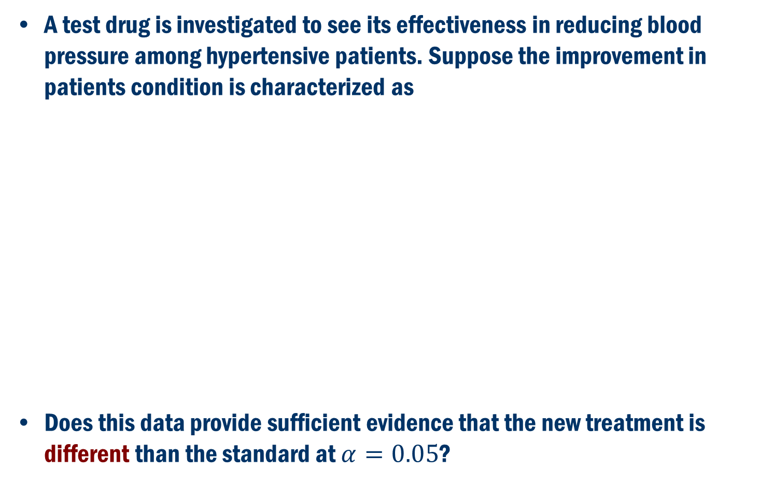
Book Example 10.10:
A test drug is investigated to see its effectiveness in reducing blood pressure among hypertensive patients. Suppose the improvement in patients condition is characterized as
Does this data provide sufficient evidence that the new treatment is different than the standard at $α=0.05$?
Category | Standard Treatment | Observe count
Marked decrease in BP | 50% | 120
Moderate decrease in BP | 25% | 60
Slight decrease in BP | 10% | 10
No decrease in BP | 15% | 10

Slide 4
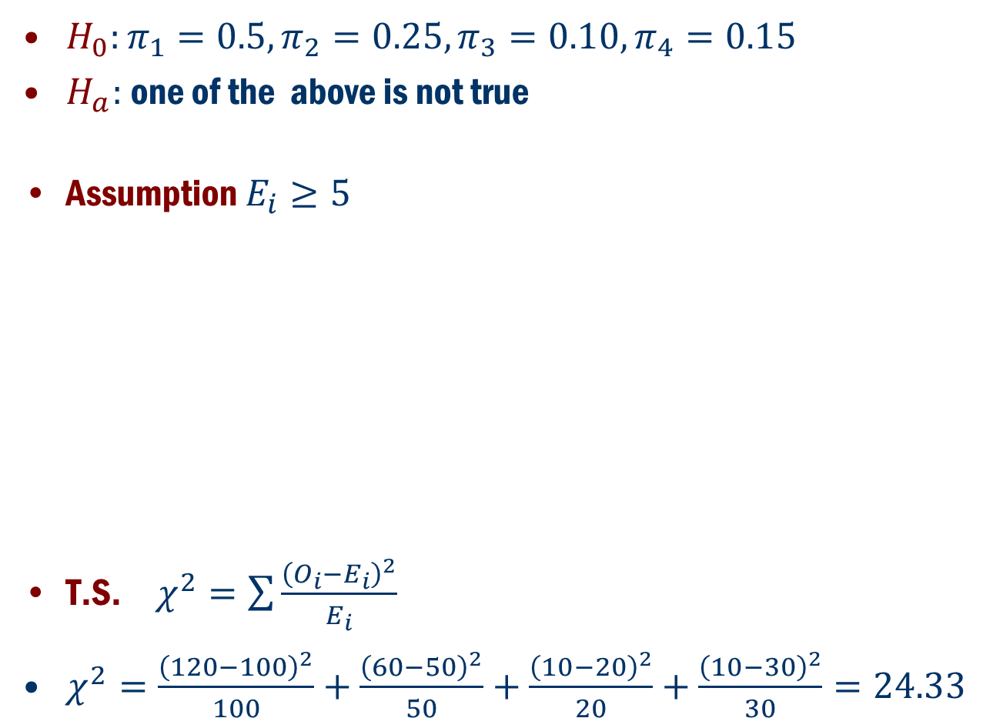
Example 10.10 Cont’d
$H_{0}:π_{1}=0.5, π_{2}=0.25, π_{3}=0.10, π_{4}=0.15$
$H_{a}:$one of the above is not true
Assumption $E_{i}≥5$
T.S. $χ^{2}=\sum{\frac{{\left(O_{i}−E_{i}\right)}^{2}}{E_{i}}}$
$χ^{2}=\frac{{\left(120−100\right)}^{2}}{100}+\frac{{\left(60−50\right)}^{2}}{50}+\frac{{\left(10−20\right)}^{2}}{20}+\frac{{\left(10−30\right)}^{2}}{30}=24.33$
Category | Observe count | Expected Count
Marked decrease in BP | 120 | 200*0.5=100
Moderate decrease in BP | 60 | 200*0.25=50
Slight decrease in BP | 10 | 200*0.10=20
No decrease in BP | 10 | 200*0.15=30
Total | 200

Slide 5
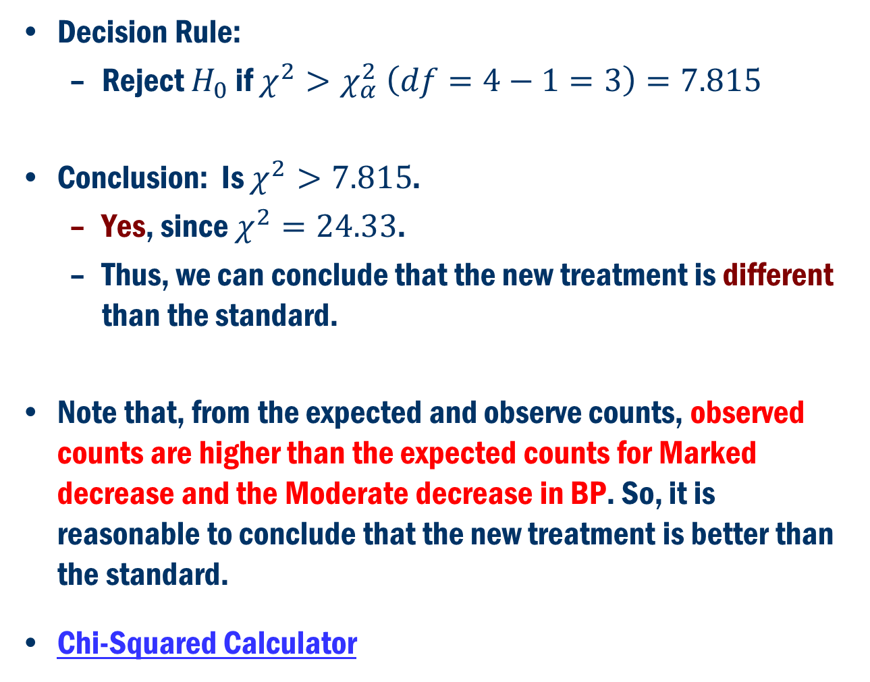
Example 10.10 Cont’d
Decision Rule:
Reject $H_{0}$ if $χ^{2}>χ_{α}^{2} \left(df=4−1=3\right)=7.815$
Conclusion: Is $χ^{2}>7.815$.
Yes, since $χ^{2}=24.33$.
Thus, we can conclude that the new treatment is different than the standard.
Note that, from the expected and observe counts, observed counts are higher than the expected counts for Marked decrease and the Moderate decrease in BP. So, it is reasonable to conclude that the new treatment is better than the standard.
Chi-Squared Calculator

Slide 6
Generalize Chi-Square goodness of fit Test
The Chi-Square test of goodness of fit can be used for many different types of inference. Here we give an example to test if a random number generator of Minitab truly generate random numbers.
Example: Let us look at the uniform random number in [0, 1] generated by Minitab. Note that any random number can be described in a decimal form, and it is sufficient to test the randomness of numbers at each decimal places.
Let us look at the tenth decimal place. The random numbers are
{0, 1, 2, 3, …, 9}
Q. Are these numbers generated by Minitab truly random?

Slide 7
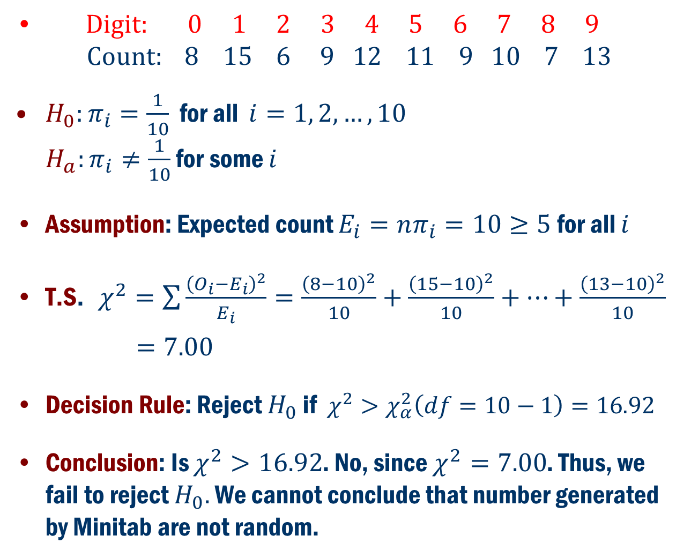
Example Cont’D
$Digit: 0 1 2 3 4 5 6 7 8 9$ $Count: 8 15 6 9 12 11 9 10 7 13$
$H_{0}:π_{i}=\frac{1}{10}$ for all $i=1, 2, …,10$ $H_{a}:π_{i}≠\frac{1}{10}$ for some $i$
Assumption: Expected count $E_{i}=nπ_{i}=10≥5$ for all $i$
T.S. $χ^{2}=\sum{\frac{{\left(O_{i}−E_{i}\right)}^{2}}{E_{i}}=\frac{{\left(8−10\right)}^{2}}{10}+\frac{{\left(15−10\right)}^{2}}{10}+…+\frac{{\left(13−10\right)}^{2}}{10}}$
$=7.00$
Decision Rule: Reject $H_{0}$ if $χ^{2}>χ_{α}^{2}\left(df=10−1\right)=16.92$
Conclusion: Is $χ^{2}>16.92$. No, since $χ^{2}=7.00$. Thus, we fail to reject $H_{0}.$ We cannot conclude that number generated by Minitab are not random.

Slide 8
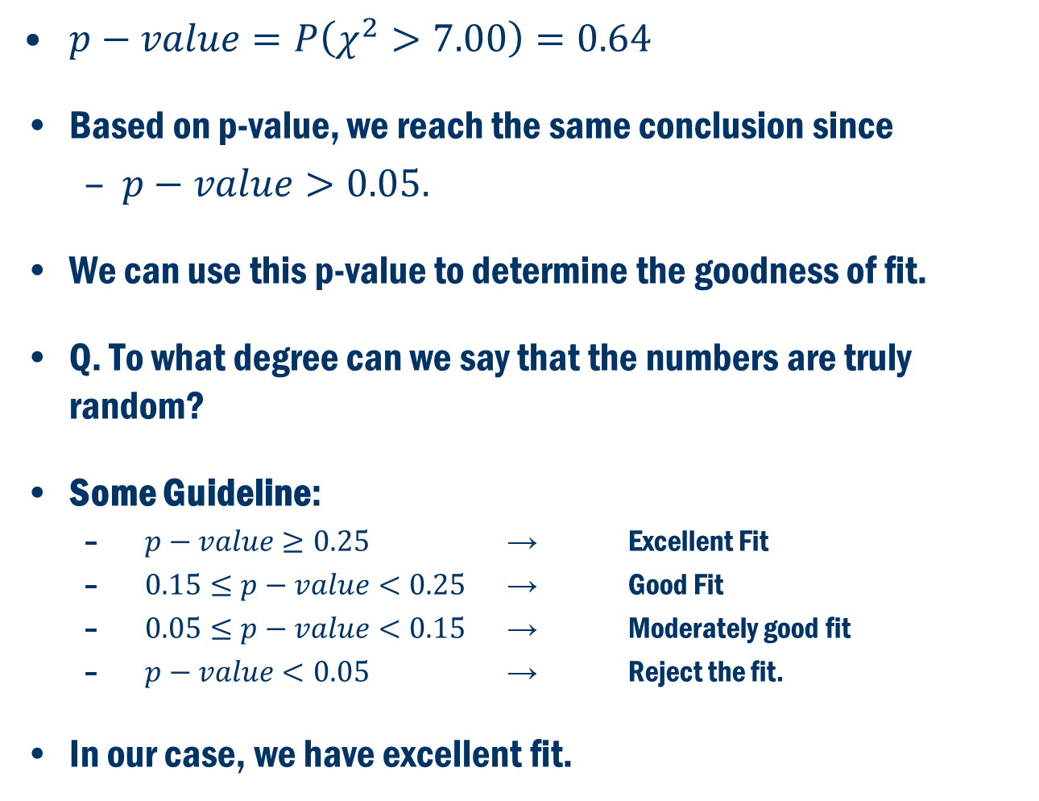
Example Cont’D and p-Values
$p−value=P\left(χ^{2}>7.00\right)=0.64$
Based on p-value, we reach the same conclusion since
$p−value>0.05.$
We can use this p-value to determine the goodness of fit.
Q. To what degree can we say that the numbers are truly random?
Some Guideline:
$p−value≥0.25$ → Excellent Fit
$0.15≤p−value<0.25$ → Good Fit
$0.05≤p−value<0.15$ → Moderately good fit
$p−value<0.05$ → Reject the fit.
In our case, we have excellent fit.

Slide 9

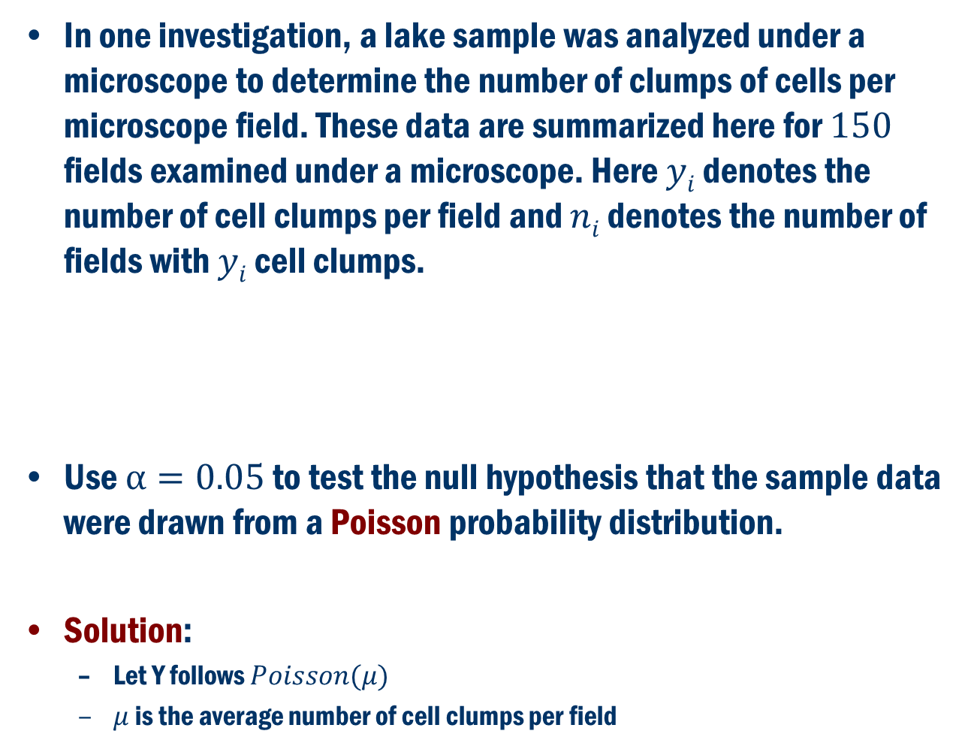
Book Example 10.11:
In one investigation, a lake sample was analyzed under a microscope to determine the number of clumps of cells per microscope field. These data are summarized here for $150$ fields examined under a microscope. Here $yi$ denotes the number of cell clumps per field and $ni$ denotes the number of fields with $yi$ cell clumps.
Use $α=0.05$ to test the null hypothesis that the sample data were drawn from a Poisson probability distribution.
Solution:
Let Y follows $Poisson(μ)$
$μ$ is the average number of cell clumps per field

Slide 10

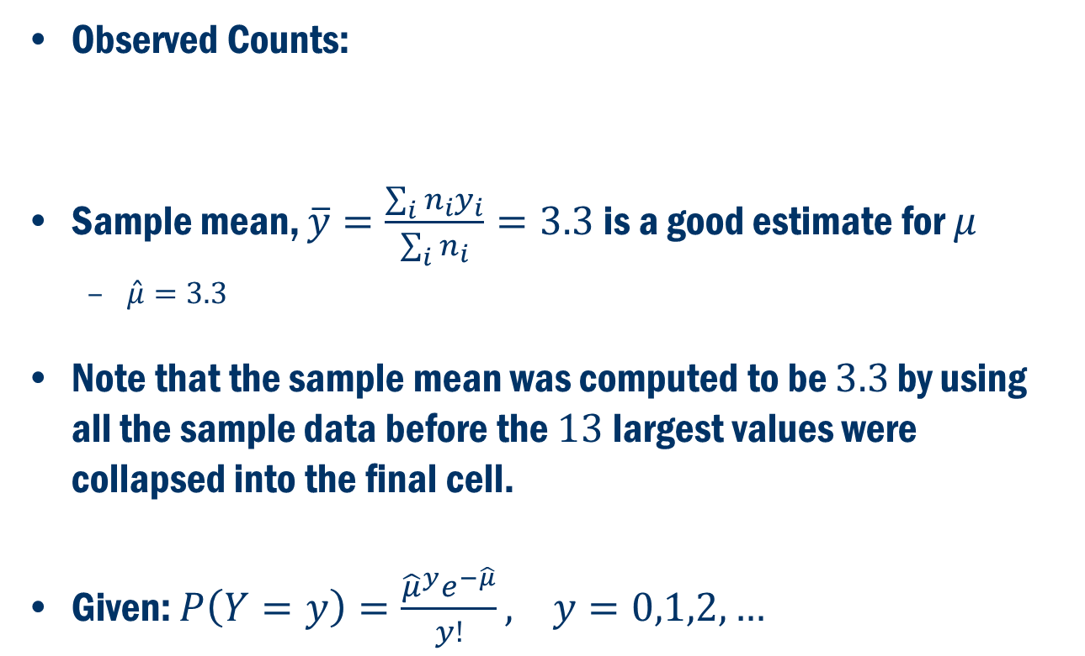
Example 10.11 Cont’D
Observed Counts:
Sample mean, $\overline{y}=\frac{\sum_{i}{n_{i}y_{i}}}{\sum_{i}{n_{i}}}=3.3$ is a good estimate for $μ$
$\hat{μ}=3.3$
Note that the sample mean was computed to be $3.3$ by using all the sample data before the $13$largest values were collapsed into the final cell.
Given: $P\left(Y=y\right)=\frac{{{\hat{μ}}^{y}e}^{−\hat{μ}}}{y!}, y=0,1,2,…$

Slide 11

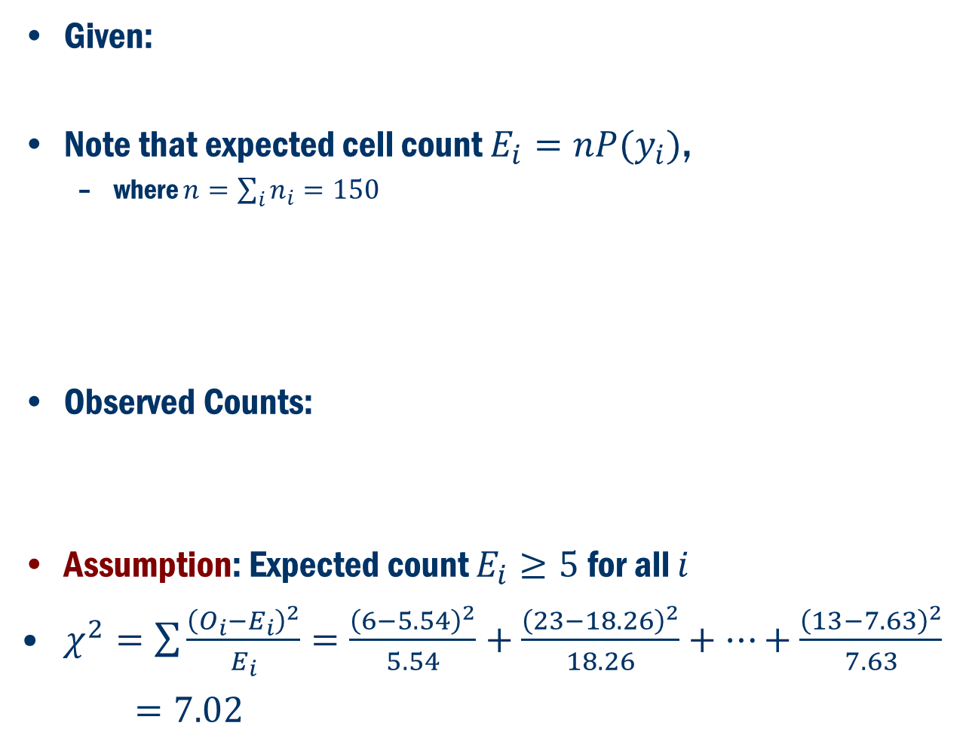
Example 10.11 Cont’D
Given:
Note that expected cell count $E_{i}=nP(y_{i})$,
where $n=\sum_{i}{n_{i}=150}$
Observed Counts:
Assumption: Expected count $E_{i}≥5$ for all $i$
$χ^{2}=\sum{\frac{{\left(O_{i}−E_{i}\right)}^{2}}{E_{i}}=\frac{{\left(6−5.54\right)}^{2}}{5.54}+\frac{{\left(23−18.26\right)}^{2}}{18.26}+…+\frac{{\left(13−7.63\right)}^{2}}{7.63}}$
$=7.02$

Slide 12
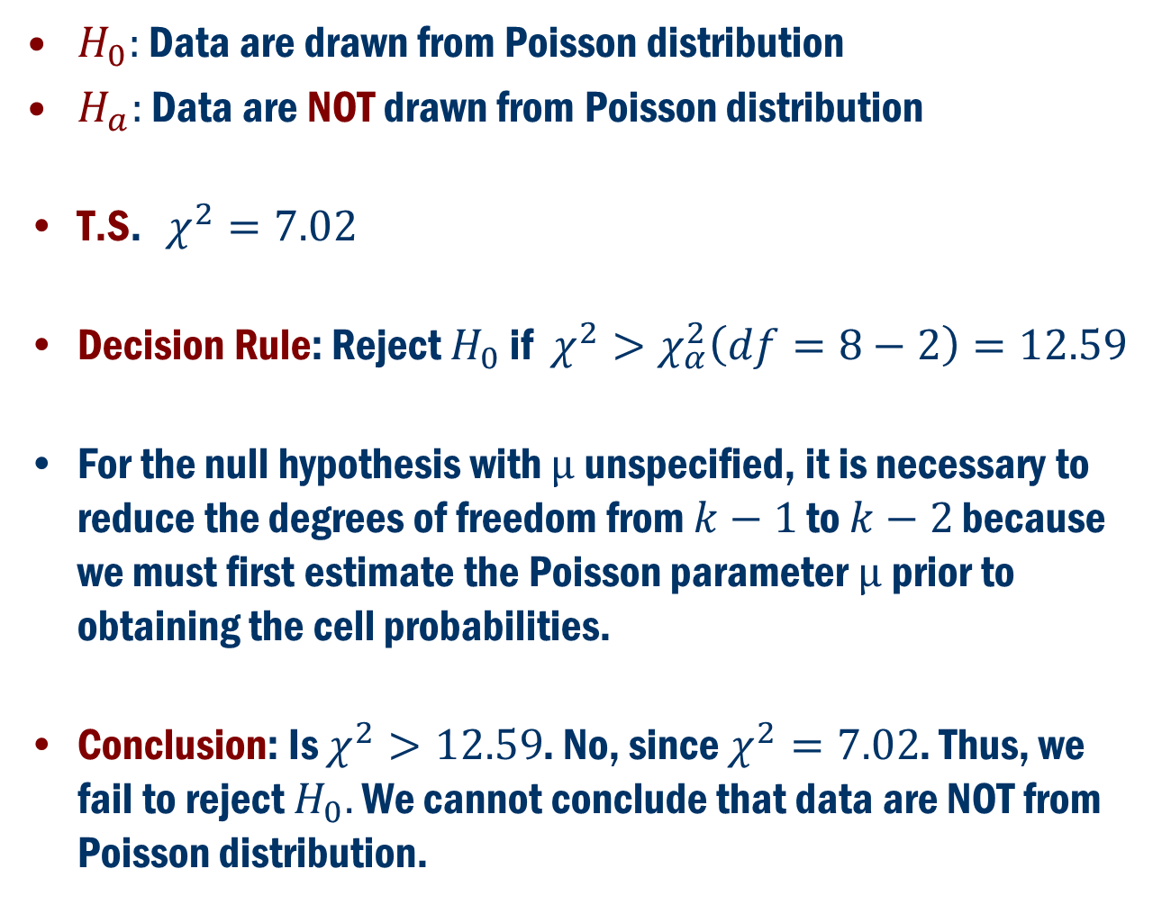
Example 10.11 Cont’D
$H_{0}:$ Data are drawn from Poisson distribution
$H_{a}:$ Data are NOT drawn from Poisson distribution
T.S. $χ^{2}=7.02$
Decision Rule: Reject $H_{0}$ if $χ^{2}>χ_{α}^{2}\left(df=8−2\right)=12.59$
For the null hypothesis with $µ$unspecified, it is necessary to reduce the degrees of freedom from $k−1$ to $k−2$ because we must first estimate the Poisson parameter $µ$prior to obtaining the cell probabilities.
Conclusion: Is $χ^{2}>12.59$. No, since $χ^{2}=7.02$. Thus, we fail to reject $H_{0}.$ We cannot conclude that data are NOT from Poisson distribution.

Slide 13
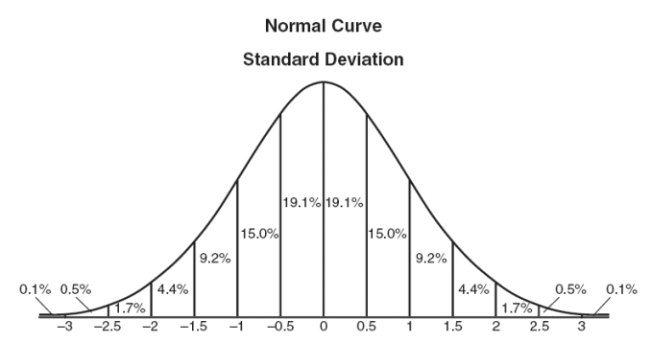
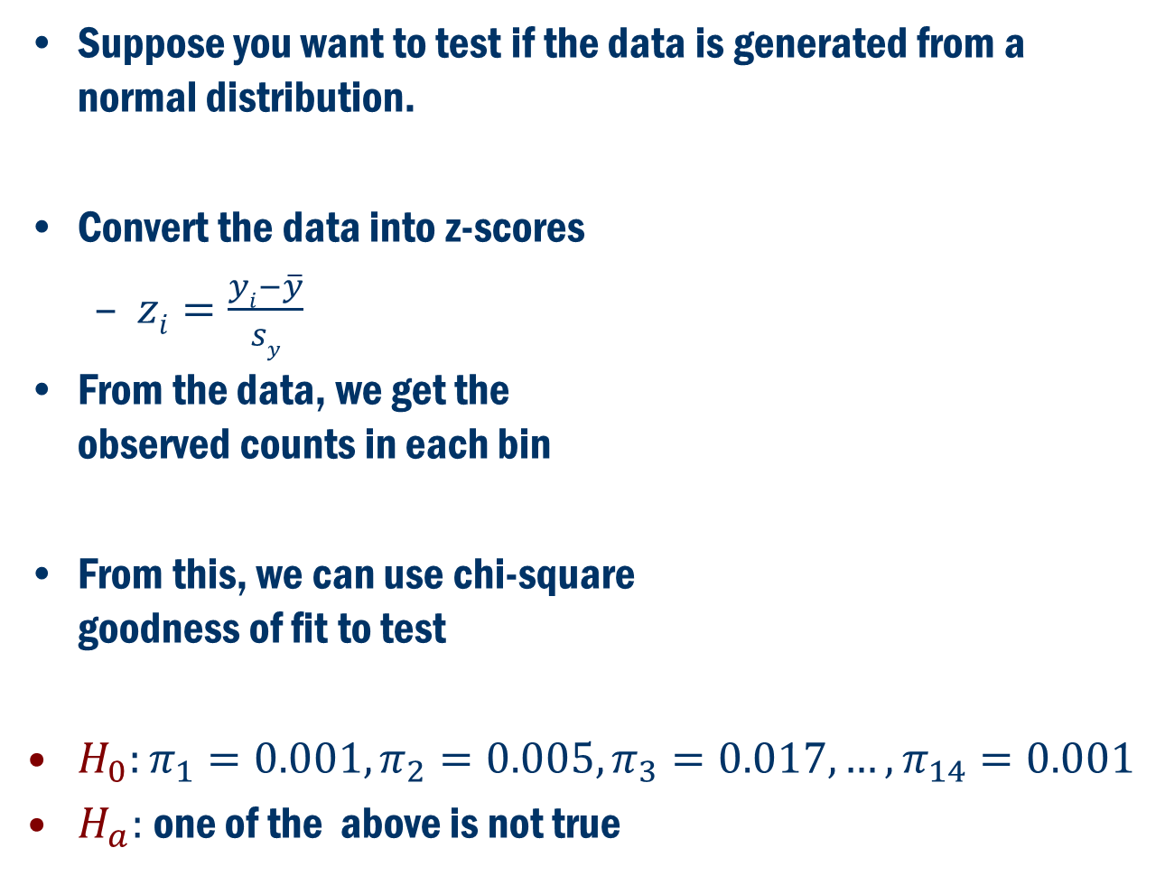
More Use of Chi-Square goodness of fit Test
Suppose you want to test if the data is generated from a normal distribution.
Convert the data into z-scores
$zi=\frac{yi−\overline{y}}{sy}$
From the data, we get the observed counts in each bin
From this, we can use chi-square goodness of fit to test
$H_{0}:π_{1}=0.001, π_{2}=0.005, π_{3}=0.017,…, π_{14}=0.001$
$H_{a}:$one of the above is not true

Slide 14
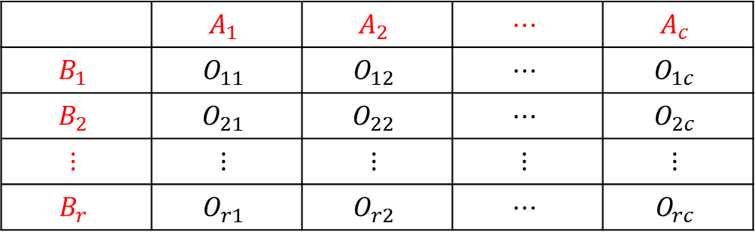
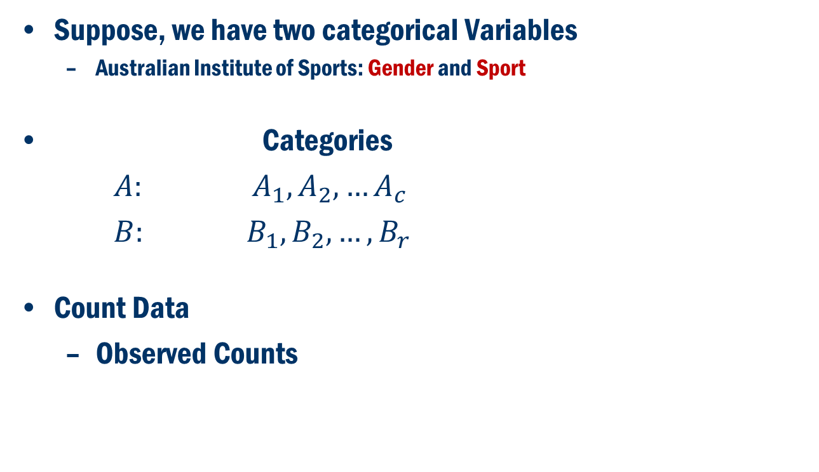

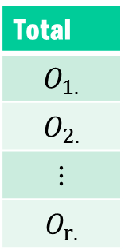
Chi-Square Test of Independence
Suppose, we have two categorical Variables
Australian Institute of Sports: Gender and Sport
Categories
$A: A_{1}, A_{2}, …A_{c}$
$B: B_{1}, B_{2}, …, B_{r}$
Count Data
Observed Counts
 | $$A_{1}$$ | $$A_{2}$$ | $$⋯$$ | $$A_{c}$$
$$B_{1}$$ | $$O_{11}$$ | $$O_{12}$$ | $$⋯$$ | $$O_{1c}$$
$$B_{2}$$ | $$O_{21}$$ | $$O_{22}$$ | $$⋯$$ | $$O_{2c}$$
$$⋮$$ | $$⋮$$ | $$⋮$$ | $$⋮$$ | $$⋮$$
$$B_{r}$$ | $$O_{r1}$$ | $$O_{r2}$$ | $$⋯$$ | $$O_{rc}$$
Total
$$O_{1.}$$
$$O_{2.}$$
$$⋮$$
$$O_{r.}$$
Total | $$O_{.1}$$ | $$O_{.2}$$ | $$⋯$$ | $$O_{.c}$$
$$O_{..}$$

Slide 15
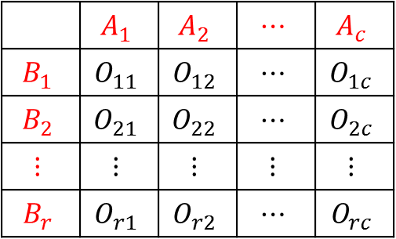
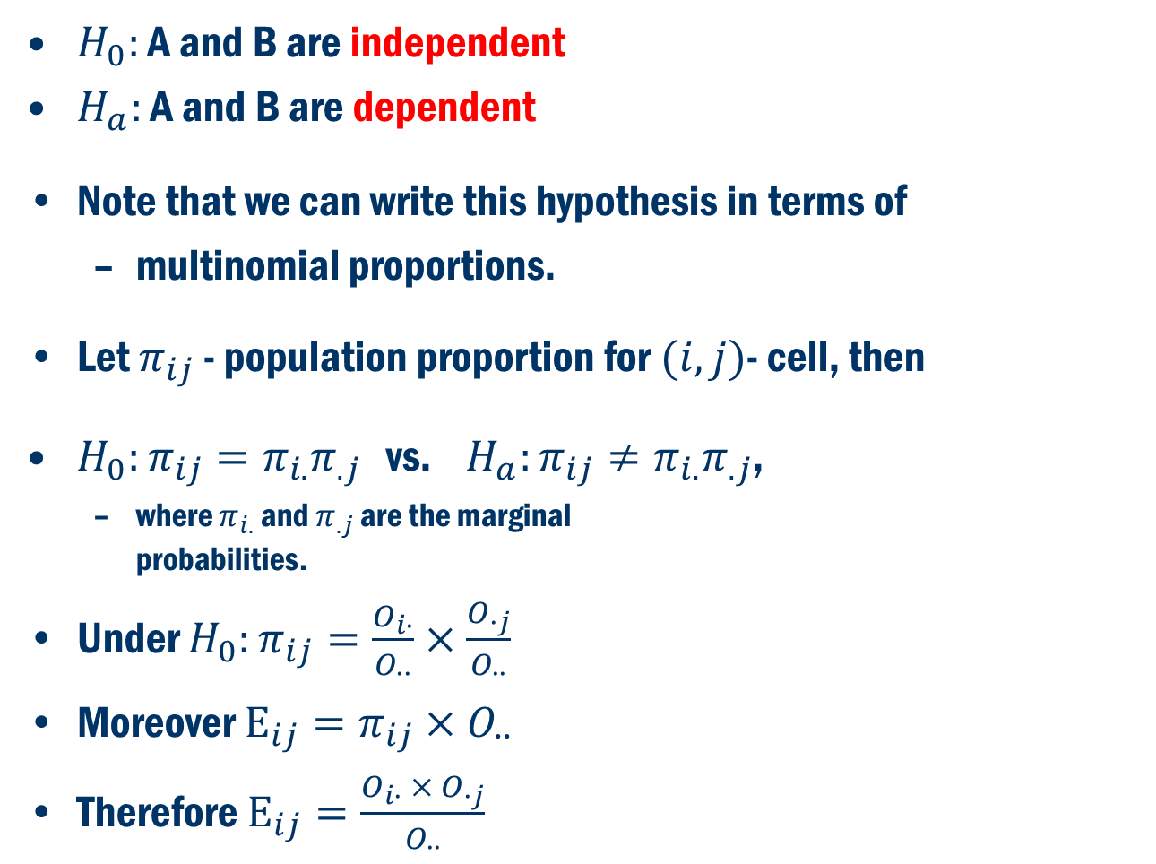


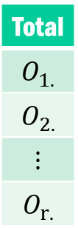
Chi-Square Test of Independence Cont’D
$H_{0}:$ A and B are independent
$H_{a}:$ A and B are dependent
Note that we can write this hypothesis in terms of
multinomial proportions.
Let $π_{ij}$ - population proportion for $(i, j)$- cell, then
$H_{0}:π_{ij}=π_{i.}π_{.j}$ vs. $H_{a}:π_{ij}≠π_{i.}π_{.j}$,
where $π_{i.}$ and $π_{.j}$ are the marginal probabilities.
Under $H_{0}:π_{ij}=\frac{O_{i∙}}{O_{∙∙}}×\frac{O_{∙j}}{O_{∙∙}}$
Moreover $E_{ij}=π_{ij}{×O}_{∙∙}$
Therefore $E_{ij}=\frac{O_{i∙} × O_{∙j}}{O_{∙∙}}$
 | $$A_{1}$$ | $$A_{2}$$ | $$⋯$$ | $$A_{c}$$
$$B_{1}$$ | $$O_{11}$$ | $$O_{12}$$ | $$⋯$$ | $$O_{1c}$$
$$B_{2}$$ | $$O_{21}$$ | $$O_{22}$$ | $$⋯$$ | $$O_{2c}$$
$$⋮$$ | $$⋮$$ | $$⋮$$ | $$⋮$$ | $$⋮$$
$$B_{r}$$ | $$O_{r1}$$ | $$O_{r2}$$ | $$⋯$$ | $$O_{rc}$$
Total
$$O_{1.}$$
$$O_{2.}$$
$$⋮$$
$$O_{r.}$$
Total | $$O_{.1}$$ | $$O_{.2}$$ | $$⋯$$ | $$O_{.c}$$
$$O_{..}$$

Slide 16
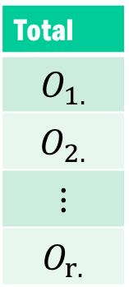

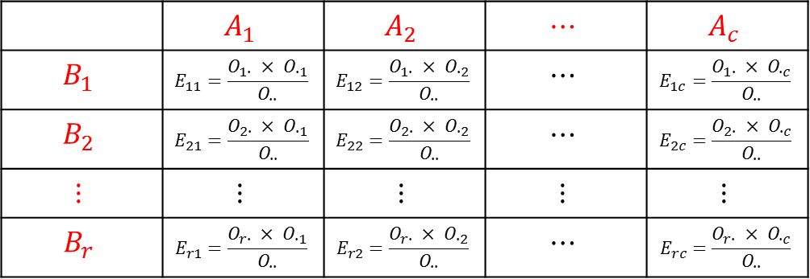
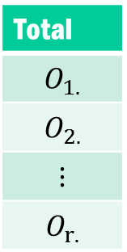
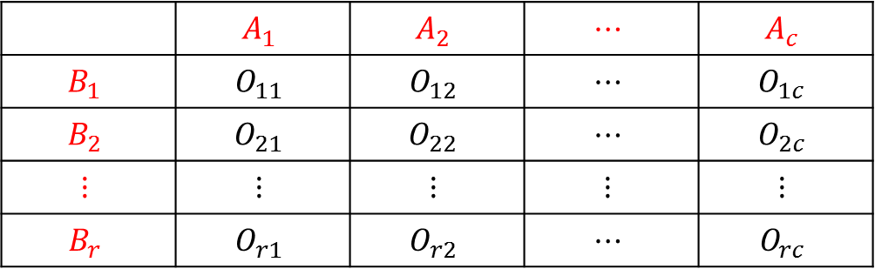
Chi-Square Test of Independence Cont’D
Observed Counts
Expected Counts
 | $$A_{1}$$ | $$A_{2}$$ | $$⋯$$ | $$A_{c}$$
$$B_{1}$$ | $$O_{11}$$ | $$O_{12}$$ | $$⋯$$ | $$O_{1c}$$
$$B_{2}$$ | $$O_{21}$$ | $$O_{22}$$ | $$⋯$$ | $$O_{2c}$$
$$⋮$$ | $$⋮$$ | $$⋮$$ | $$⋮$$ | $$⋮$$
$$B_{r}$$ | $$O_{r1}$$ | $$O_{r2}$$ | $$⋯$$ | $$O_{rc}$$
Total
$$O_{1.}$$
$$O_{2.}$$
$$⋮$$
$$O_{r.}$$
Total | $$O_{.1}$$ | $$O_{.2}$$ | $$⋯$$ | $$O_{.c}$$
$$O_{..}$$
 | $$A_{1}$$ | $$A_{2}$$ | $$⋯$$ | $$A_{c}$$
$$B_{1}$$ | $$E_{11}=\frac{O_{1∙} × O_{∙1}}{O_{∙∙}}$$ | $$E_{12}=\frac{O_{1∙} × O_{∙2}}{O_{∙∙}}$$ | $$⋯$$ | $$E_{1c}=\frac{O_{1∙} × O_{∙c}}{O_{∙∙}}$$
$$B_{2}$$ | $$E_{21}=\frac{O_{2∙} × O_{∙1}}{O_{∙∙}}$$ | $$E_{22}=\frac{O_{2∙} × O_{∙2}}{O_{∙∙}}$$ | $$⋯$$ | $$E_{2c}=\frac{O_{2∙} × O_{∙c}}{O_{∙∙}}$$
$$⋮$$ | $$⋮$$ | $$⋮$$ | $$⋮$$ | $$⋮$$
$$B_{r}$$ | $$E_{r1}=\frac{O_{r∙} × O_{∙1}}{O_{∙∙}}$$ | $$E_{r2}=\frac{O_{r∙} × O_{∙2}}{O_{∙∙}}$$ | $$⋯$$ | $$E_{rc}=\frac{O_{r∙} × O_{∙c}}{O_{∙∙}}$$
Total
$$O_{1.}$$
$$O_{2.}$$
$$⋮$$
$$O_{r.}$$
Total | $$O_{.1}$$ | $$O_{.2}$$ | $$⋯$$ | $$O_{.c}$$
$$O_{..}$$

Slide 17
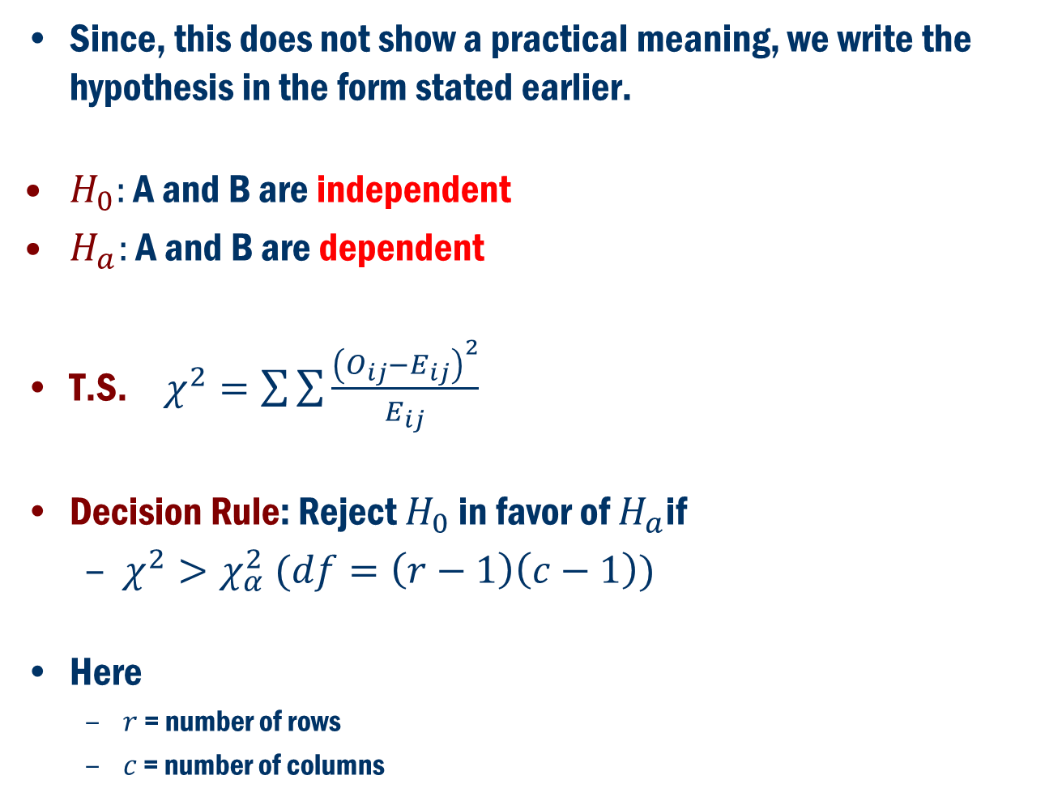
Chi-Square Test of Independence Cont’D
Since, this does not show a practical meaning, we write the hypothesis in the form stated earlier.
$H_{0}:$ A and B are independent
$H_{a}:$ A and B are dependent
T.S. $χ^{2}=\sum{\sum{\frac{{\left(O_{ij}−E_{ij}\right)}^{2}}{E_{ij}}}}$
Decision Rule: Reject $H_{0}$ in favor of $H_{a}$if
$χ^{2}>χ_{α}^{2} (df=\left(r−1\right)\left(c−1\right))$
Here
$r$ = number of rows
$c$ = number of columns

Slide 18
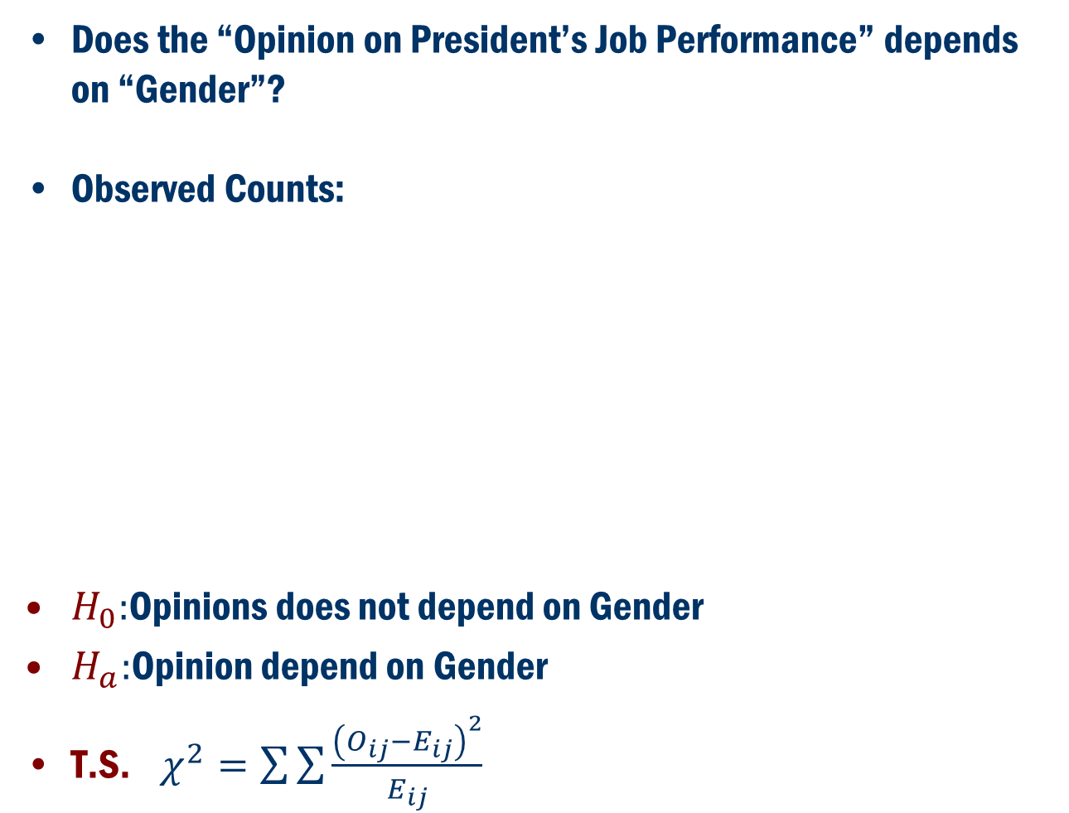
Example
Does the “Opinion on President’s Job Performance” depends on “Gender”?
Observed Counts:
$H_{0}:$Opinions does not depend on Gender
$H_{a}:$Opinion depend on Gender
T.S. $χ^{2}=\sum{\sum{\frac{{\left(O_{ij}−E_{ij}\right)}^{2}}{E_{ij}}}}$
 | President’s Job Performance
Gender | Approve | Disapprove | No Opinion | Total
Male | 20 | 25 | 5 | 50
Female | 27 | 20 | 3 | 50
Total | 47 | 45 | 8 | 100

Slide 19
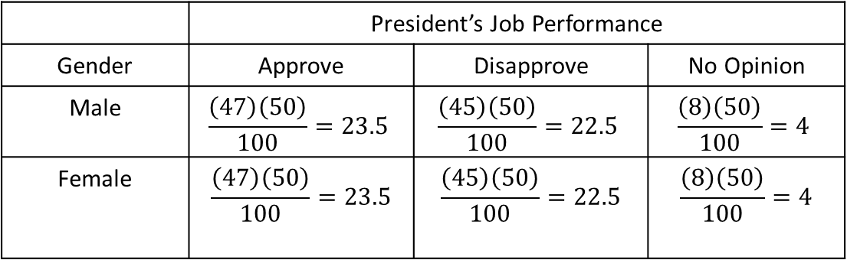
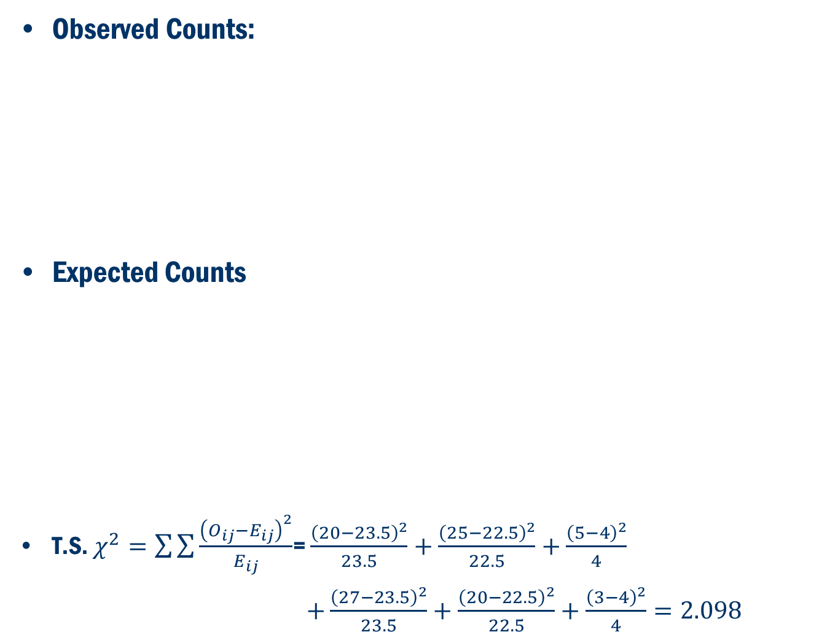
Example Cont’D
Observed Counts:
Expected Counts
T.S. $χ^{2}=\sum{\sum{\frac{{\left(O_{ij}−E_{ij}\right)}^{2}}{E_{ij}}}}$= $\frac{{\left(20−23.5\right)}^{2}}{23.5}+\frac{{\left(25−22.5\right)}^{2}}{22.5}+\frac{{\left(5−4\right)}^{2}}{4}$
$+\frac{{\left(27−23.5\right)}^{2}}{23.5}+\frac{{\left(20−22.5\right)}^{2}}{22.5}+\frac{{\left(3−4\right)}^{2}}{4}=2.098$
 | President’s Job Performance
Gender | Approve | Disapprove | No Opinion | Total
Male | 20 | 25 | 5 | 50
Female | 27 | 20 | 3 | 50
Total | 47 | 45 | 8 | 100
 | President’s Job Performance
Gender | Approve | Disapprove | No Opinion
Male | $$\frac{\left(47\right)\left(50\right)}{100}=23.5$$ | $$\frac{\left(45\right)\left(50\right)}{100}=22.5$$ | $$\frac{\left(8\right)\left(50\right)}{100}=4$$
Female | $$\frac{\left(47\right)\left(50\right)}{100}=23.5$$ | $$\frac{\left(45\right)\left(50\right)}{100}=22.5$$ | $$\frac{\left(8\right)\left(50\right)}{100}=4$$

Slide 20
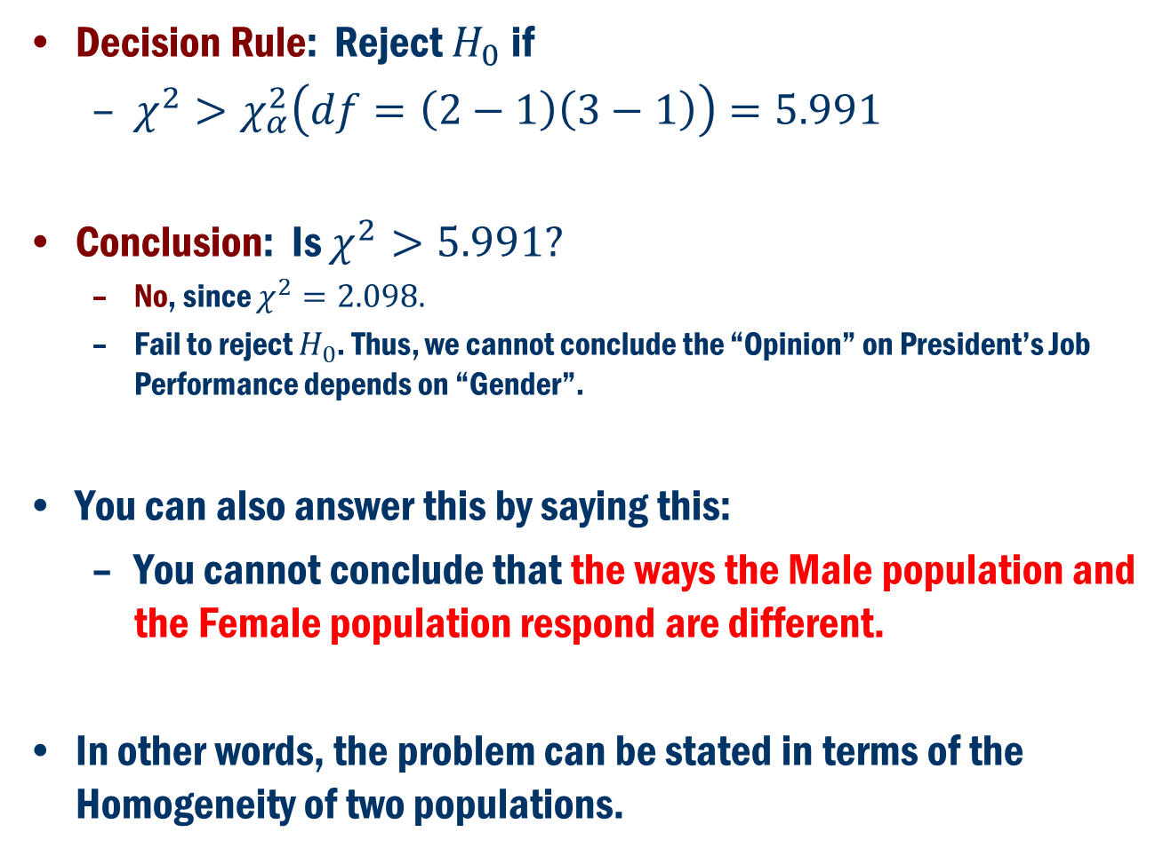
Example Cont’D
Decision Rule: Reject $H_{0}$ if
$χ^{2}>χ_{α}^{2}\left(df=\left(2−1\right)\left(3−1\right)\right)=5.991$
Conclusion: Is $χ^{2}>5.991?$
No, since $χ^{2}=2.098.$
Fail to reject $H_{0}$. Thus, we cannot conclude the “Opinion” on President’s Job Performance depends on “Gender”.
You can also answer this by saying this:
You cannot conclude that the ways the Male population and the Female population respond are different.
In other words, the problem can be stated in terms of the Homogeneity of two populations.

Slide 21
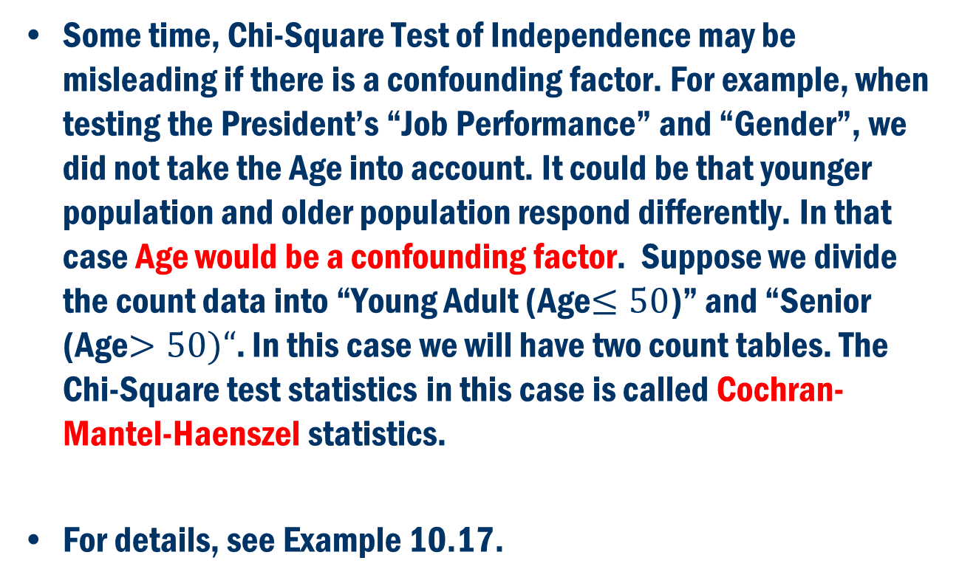
Chi-Square Test with Confounding Factor
Some time, Chi-Square Test of Independence may be misleading if there is a confounding factor. For example, when testing the President’s “Job Performance” and “Gender”, we did not take the Age into account. It could be that younger population and older population respond differently. In that case Age would be a confounding factor. Suppose we divide the count data into “Young Adult (Age$≤50$)” and “Senior (Age$>50)“$. In this case we will have two count tables. The Chi-Square test statistics in this case is called Cochran-Mantel-Haenszel statistics.
For details, see Example 10.17.

