Slide 1
Chapter 11

Slide 2
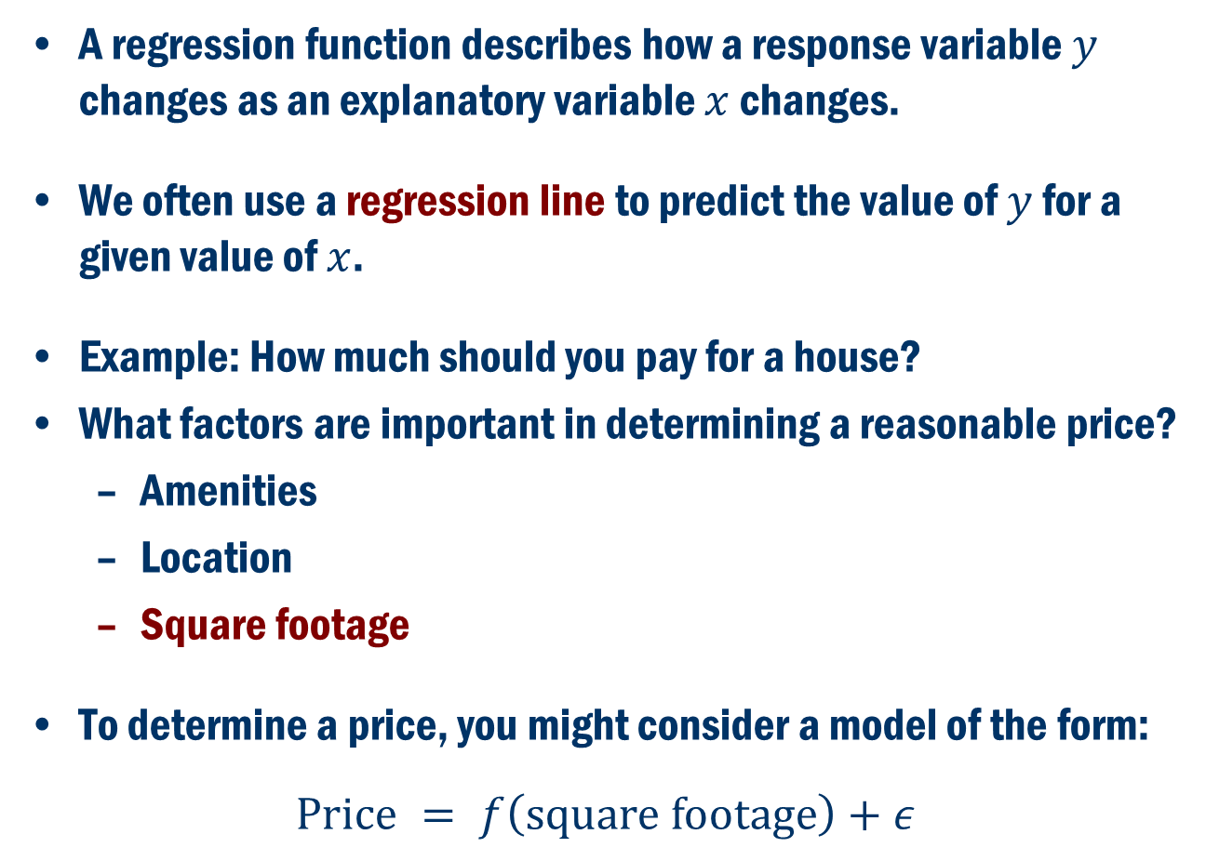
Regression
A regression function describes how a response variable $y$ changes as an explanatory variable $x$ changes.
We often use a regression line to predict the value of $y$ for a given value of $x$.
Example: How much should you pay for a house?
What factors are important in determining a reasonable price?
Amenities
Location
Square footage
To determine a price, you might consider a model of the form:
$$\text{Price} = f\left(\text{square} \text{footage}\right)+ε$$

Slide 3
Example – Australian Institute of Sport
Data on 102 male and 100 female athletes collected at the Australian Institute of Sport, (courtesy of Richard Telford and Ross Cunningham.)
Gender Bfat Wt
1 female 19.75 78.9
2 female 21.30 74.4
3 female 19.88 69.1
4 female 23.66 74.9
5 female 17.64 64.6
: : :
198 male 11.79 93.2
199 male 10.05 80.0
200 male 8.51 73.8
201 male 11.50 71.1
202 male 6.26 76.7

Slide 4
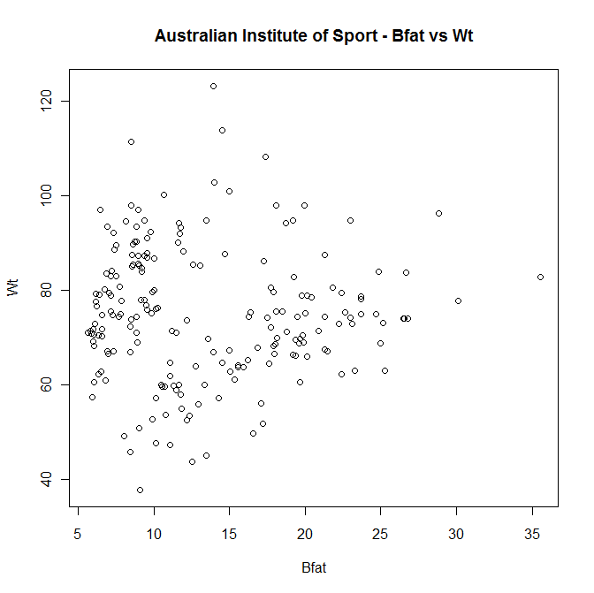
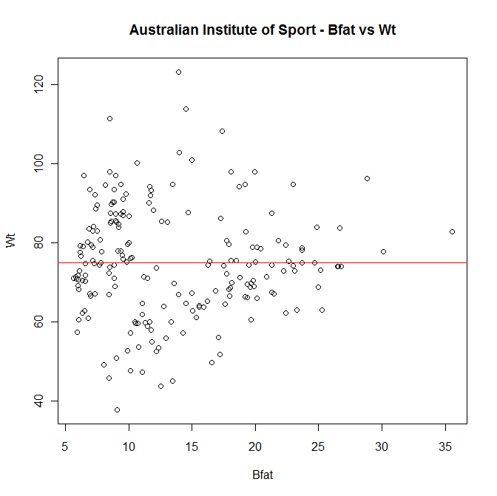
Example Cont’D

Slide 5
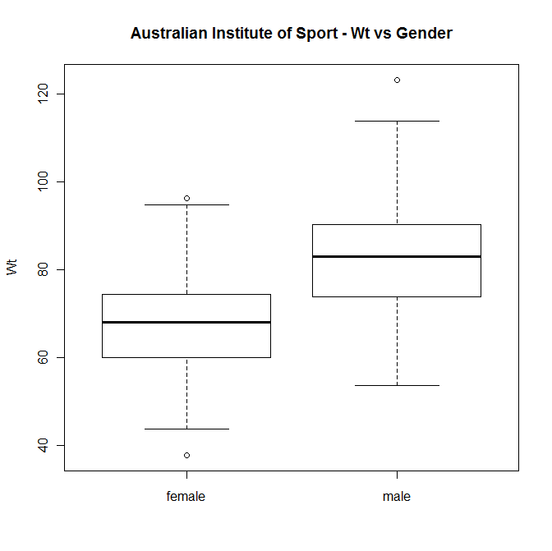
Example Cont’D

Slide 6
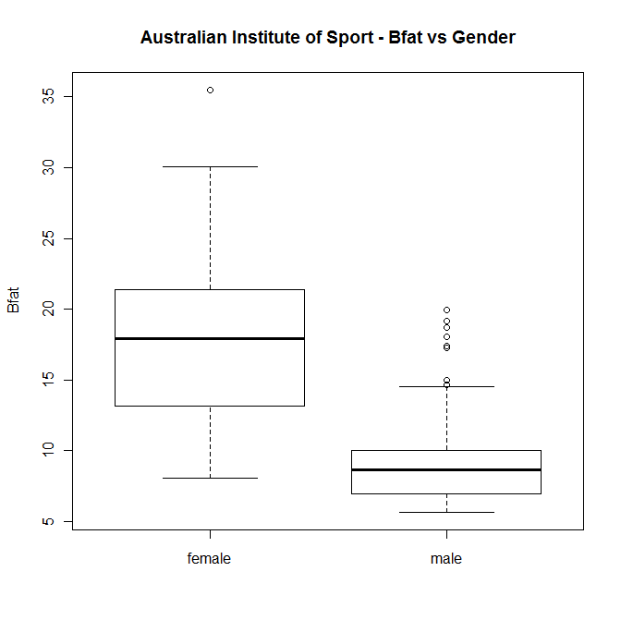
Example Cont’D

Slide 7
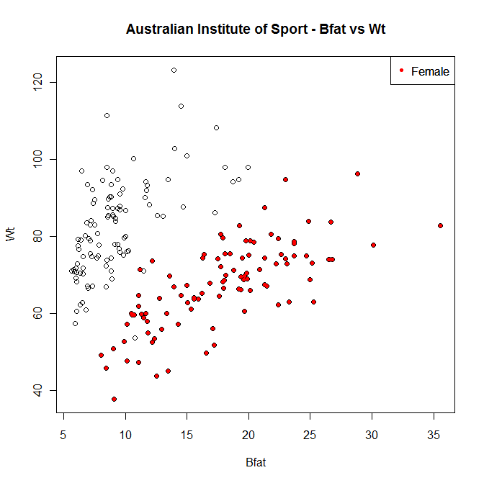
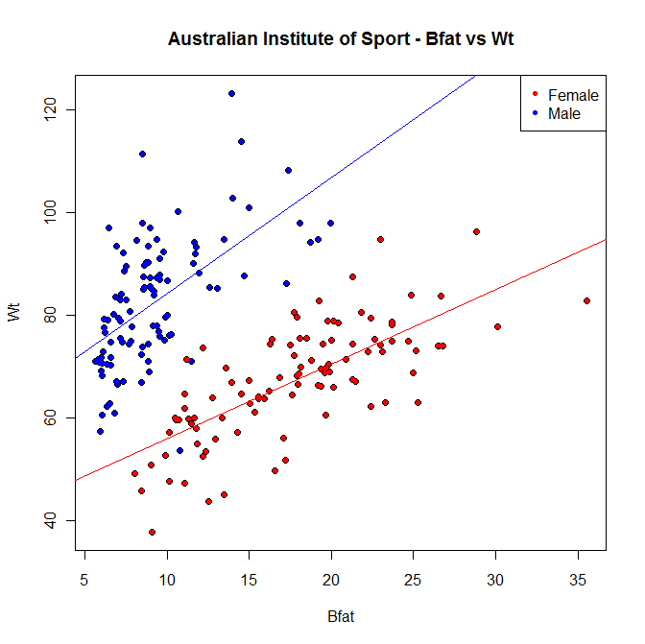
Example Cont’D

Slide 8
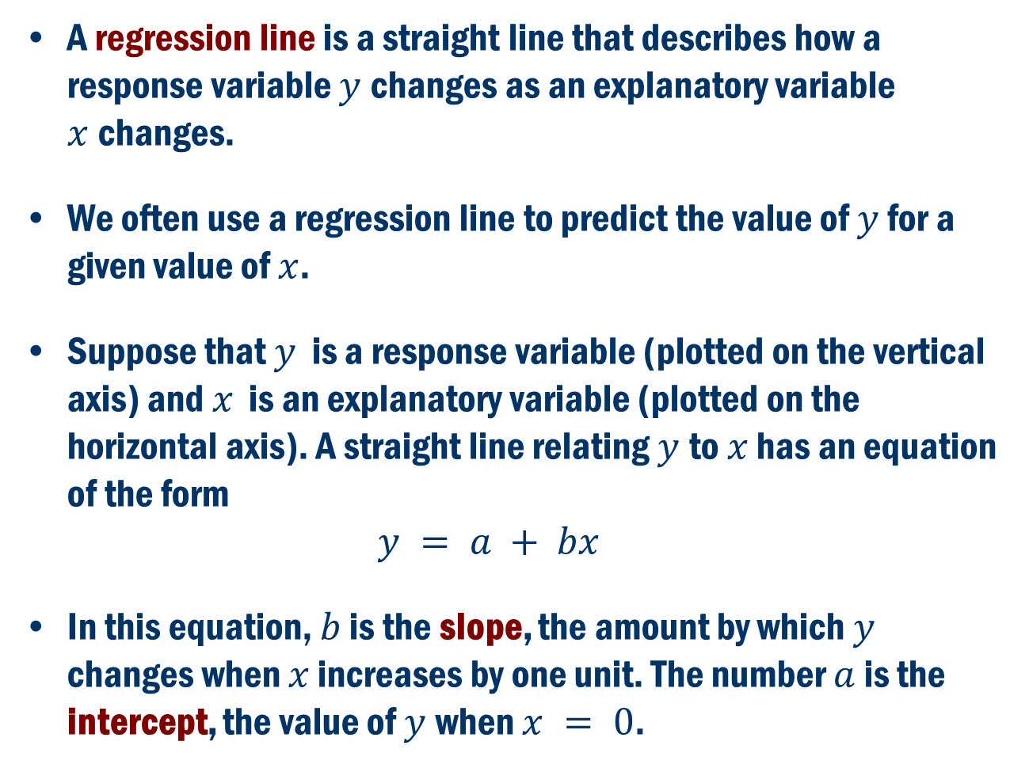
Regression Line
A regression line is a straight line that describes how a response variable $y$changes as an explanatory variable $x$changes.
We often use a regression line to predict the value of $y$ for a given value of $x$.
Suppose that $y$ is a response variable (plotted on the vertical axis) and $x$ is an explanatory variable (plotted on the horizontal axis). A straight line relating $y$to $x$ has an equation of the form $y = a + bx$
In this equation, $b$ is the slope, the amount by which $y$ changes when $x$ increases by one unit. The number $a$ is the intercept, the value of $y$when $x = 0$.

Slide 9
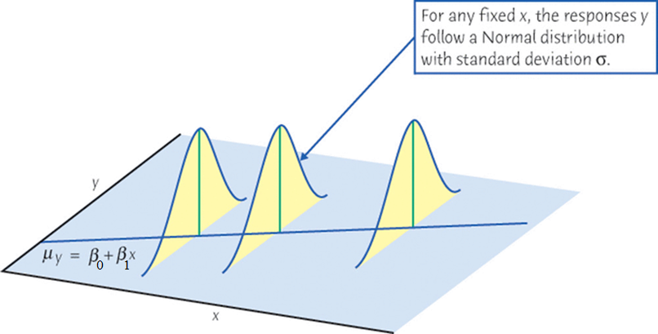
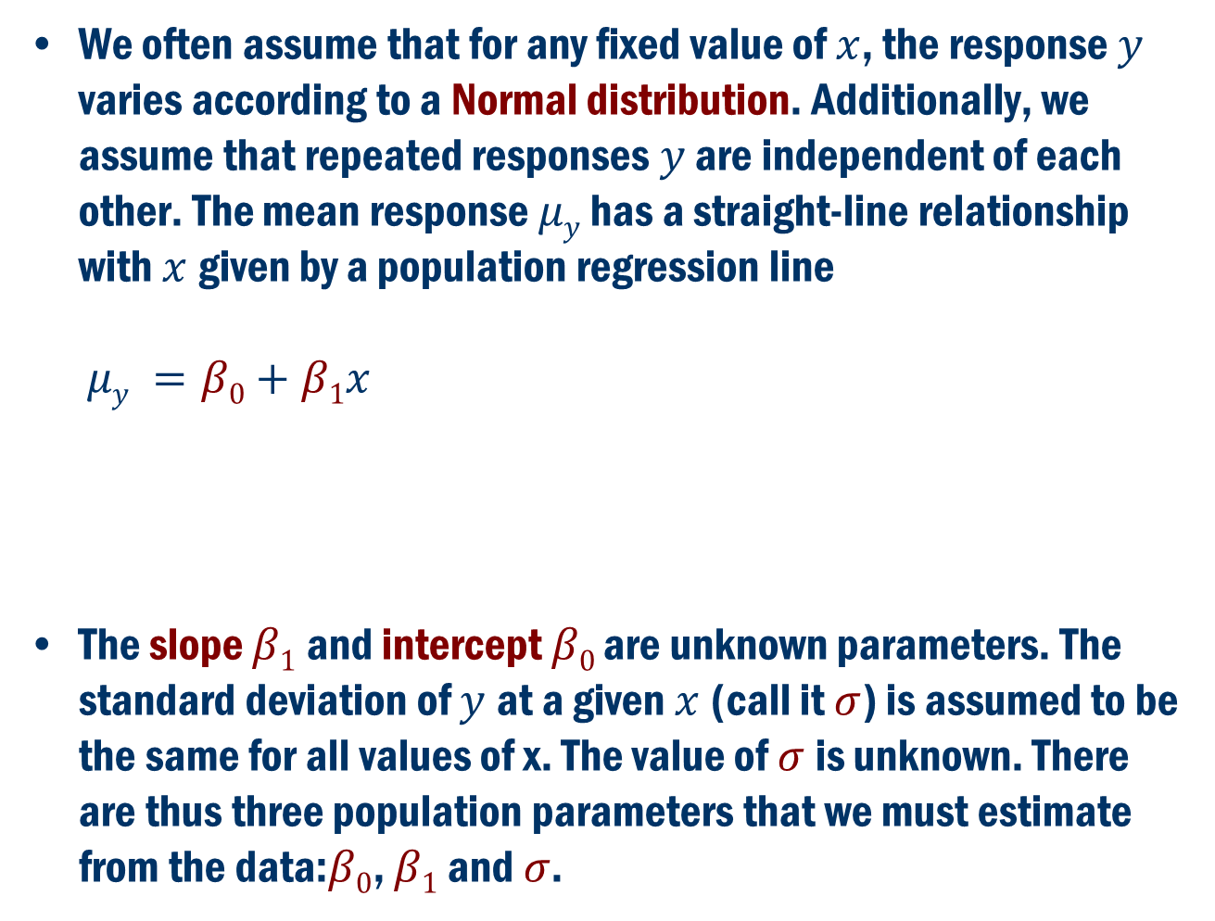
Population Regression Line
We often assume that for any fixed value of $x$, the response $y$ varies according to a Normal distribution. Additionally, we assume that repeated responses $y$ are independent of each other. The mean response $μy$ has a straight-line relationship with $x$given by a population regression line $μy =β0+β1x$
The slope $β1$ and intercept $β0$are unknown parameters. The standard deviation of $y$at a given $x$(call it $σ$) is assumed to be the same for all values of x. The value of $σ$is unknown. There are thus three population parameters that we must estimate from the data:$β0$, $β1$ and $σ$.

Slide 10
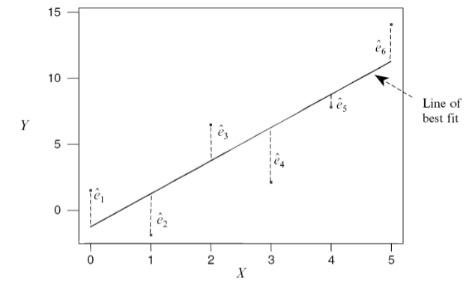
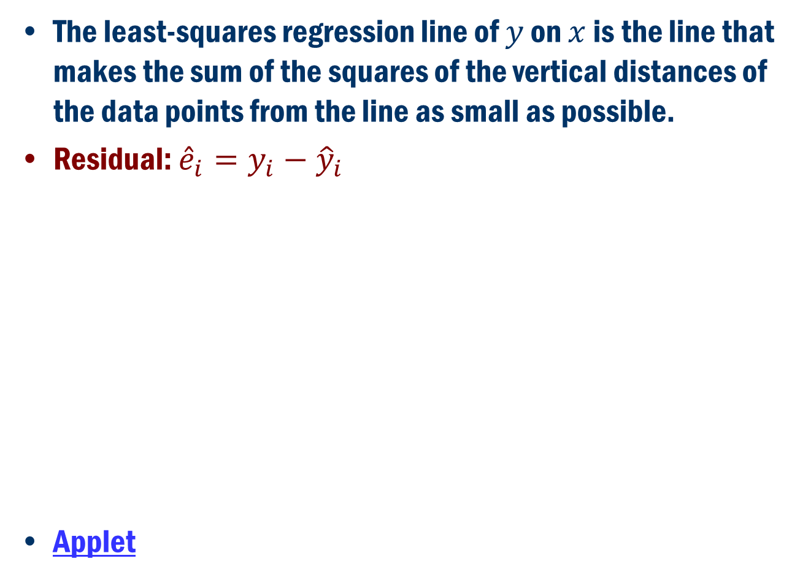
Least Squares Regression Line
The least-squares regression line of $y$ on $x$ is the line that makes the sum of the squares of the vertical distances of the data points from the line as small as possible.
Residual: ${\hat{e}}_{i}=y_{i}−{\hat{y}}_{i}$
Applet

Slide 11
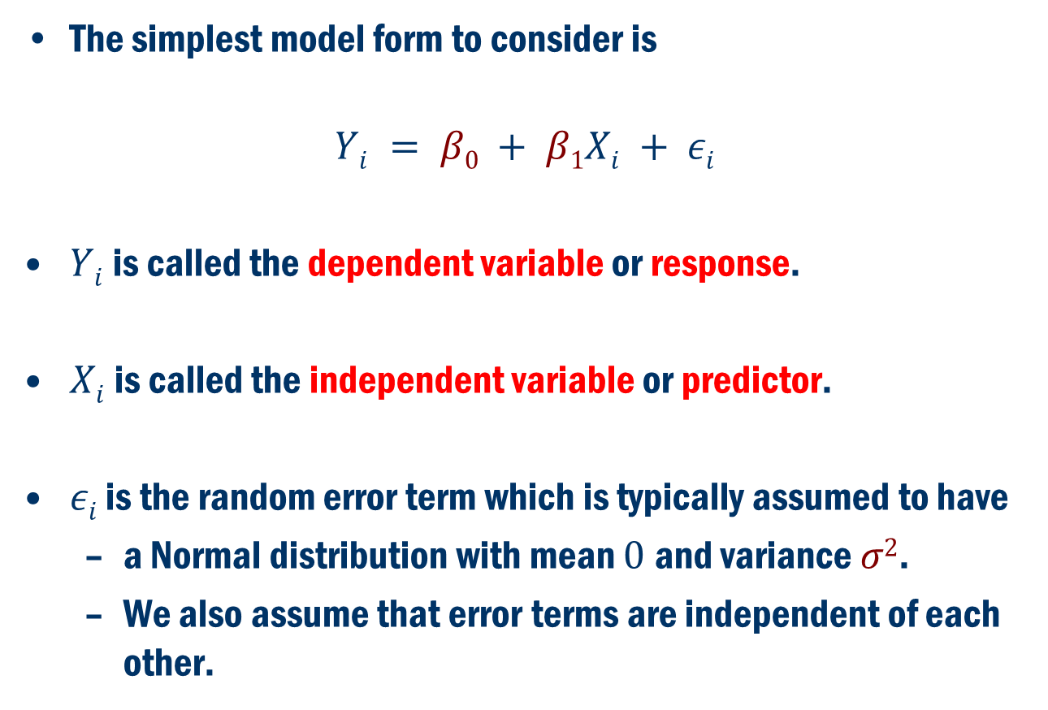
Simple Linear Regression
The simplest model form to consider is
$$Yi = β0 + β1Xi + εi$$
$Yi$is called the dependent variable or response.
$Xi$is called the independent variable or predictor.
$εi$ is the random error term which is typically assumed to have
a Normal distribution with mean $0$and variance $σ2$.
We also assume that error terms are independent of each other.

Slide 12
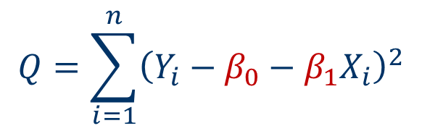
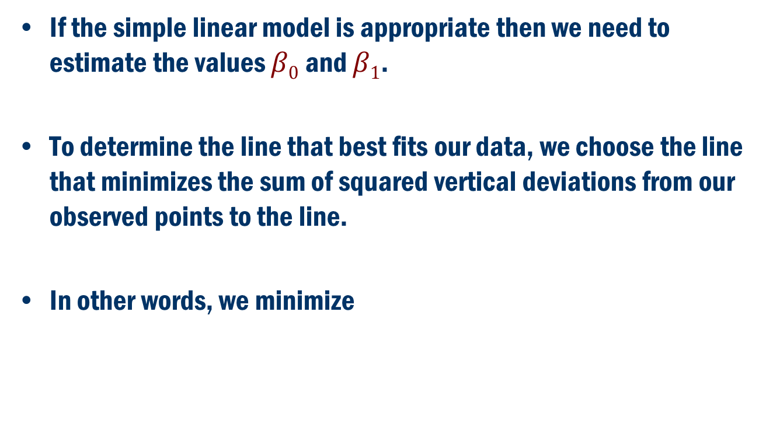
Least squares criterion
If the simple linear model is appropriate then we need to estimate the values $β0$ and $β1$.
To determine the line that best fits our data, we choose the line that minimizes the sum of squared vertical deviations from our observed points to the line.
In other words, we minimize
$$Q=\sum_{i=1}^{n}{{\left(Y_{i}−β_{0}−β_{1}X_{i}\right)}^{2}}$$

Slide 13
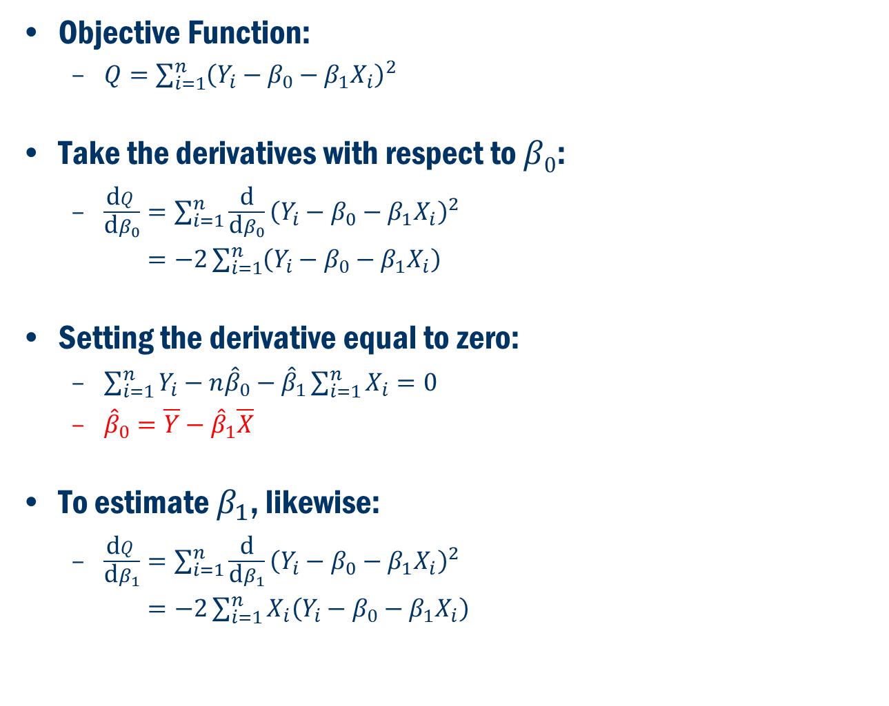
Least Squares Estimators
Objective Function:
$Q=\sum_{i=1}^{n}{{\left(Y_{i}−β_{0}−β_{1}X_{i}\right)}^{2}}$
Take the derivatives with respect to $β0$:
$\frac{\text{d}Q}{\text{d}β_{0}}=\sum_{i=1}^{n}{\frac{\text{d}}{\text{d}β_{0}}}{\left(Y_{i}−β_{0}−β_{1}X_{i}\right)}^{2}$
$=−2\sum_{i=1}^{n}{\left(Y_{i}−β_{0}−β_{1}X_{i}\right)}$
Setting the derivative equal to zero:
$\sum_{i=1}^{n}{Y_{i}}−{n\hat{β}}_{0}−{\hat{β}}_{1}\sum_{i=1}^{n}{X_{i}}=0$
${\hat{β}}_{0}=\overline{Y}−{\hat{β}}_{1}\overline{X}$
To estimate $β_{1}$, likewise:
$\frac{\text{d}Q}{\text{d}β_{1}}=\sum_{i=1}^{n}{\frac{\text{d}}{\text{d}β_{1}}}{\left(Y_{i}−β_{0}−β_{1}X_{i}\right)}^{2}$
$=−2\sum_{i=1}^{n}{X_{i}\left(Y_{i}−β_{0}−β_{1}X_{i}\right)}$

Slide 14
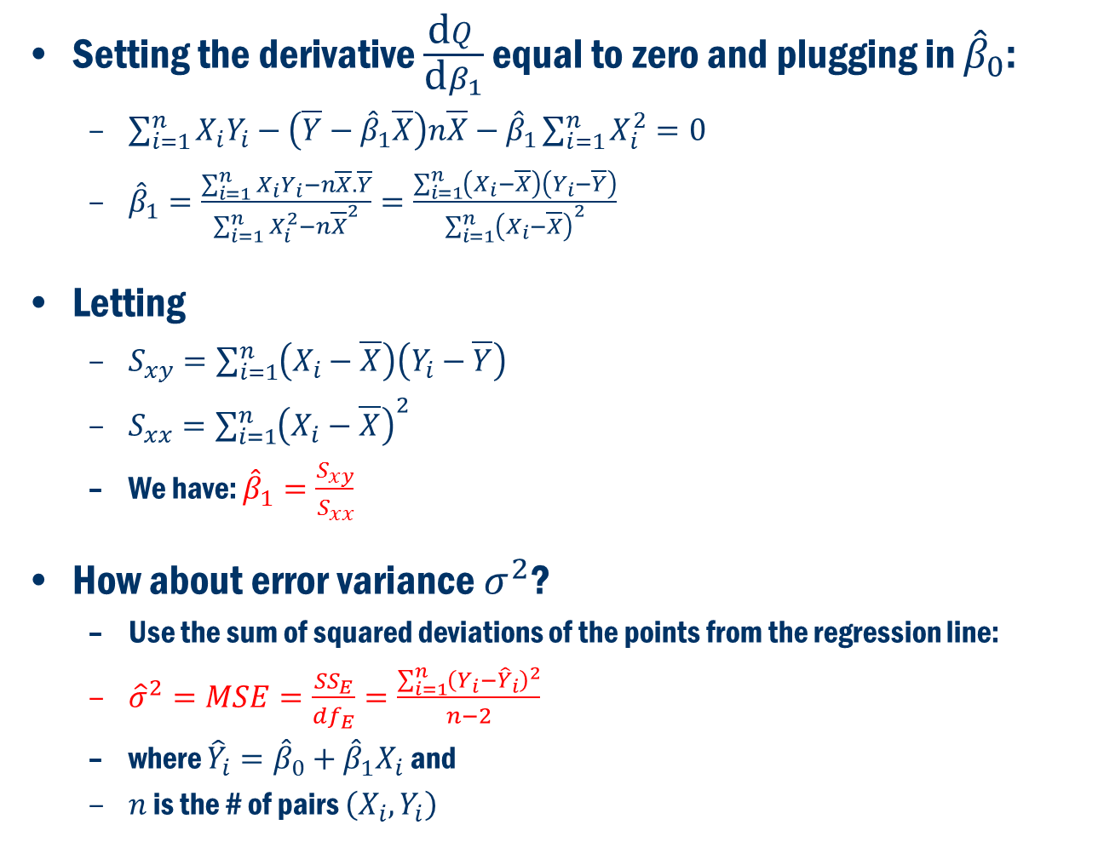
Least Squares Estimators
Setting the derivative $\frac{\text{d}Q}{\text{d}β_{1}}$ equal to zero and plugging in ${\hat{β}}_{0}$:
$\sum_{i=1}^{n}{X_{i}Y_{i}}−\left(\overline{Y}−{\hat{β}}_{1}\overline{X}\right)n\overline{X}−{\hat{β}}_{1}\sum_{i=1}^{n}{X_{i}^{2}}=0$
${\hat{β}}_{1}=\frac{\sum_{i=1}^{n}{X_{i}Y_{i}}−n\overline{X}.\overline{Y}}{\sum_{i=1}^{n}{X_{i}^{2}}−n{\overline{X}}^{2}}=\frac{\sum_{i=1}^{n}{\left(X_{i}−\overline{X}\right)\left(Y_{i}−\overline{Y}\right)}}{\sum_{i=1}^{n}{{\left(X_{i}−\overline{X}\right)}^{2}}}$
Letting
$S_{xy}=\sum_{i=1}^{n}{\left(X_{i}−\overline{X}\right)\left(Y_{i}−\overline{Y}\right)}$
$S_{xx}=\sum_{i=1}^{n}{{\left(X_{i}−\overline{X}\right)}^{2}}$
We have: ${\hat{β}}_{1}=\frac{S_{xy}}{S_{xx}}$
How about error variance $σ^{2}$?
Use the sum of squared deviations of the points from the regression line:
${\hat{σ}}^{2}=MSE=\frac{{SS}_{E}}{{df}_{E}}=\frac{\sum_{i=1}^{n}{{\left(Y_{i}−{\hat{Y}}_{i}\right)}^{2}}}{n−2}$
where ${\hat{Y}}_{i}={\hat{β}}_{0}+{\hat{β}}_{1}X_{i}$ and
$n$ is the # of pairs $\left(X_{i},Y_{i}\right)$

Slide 15
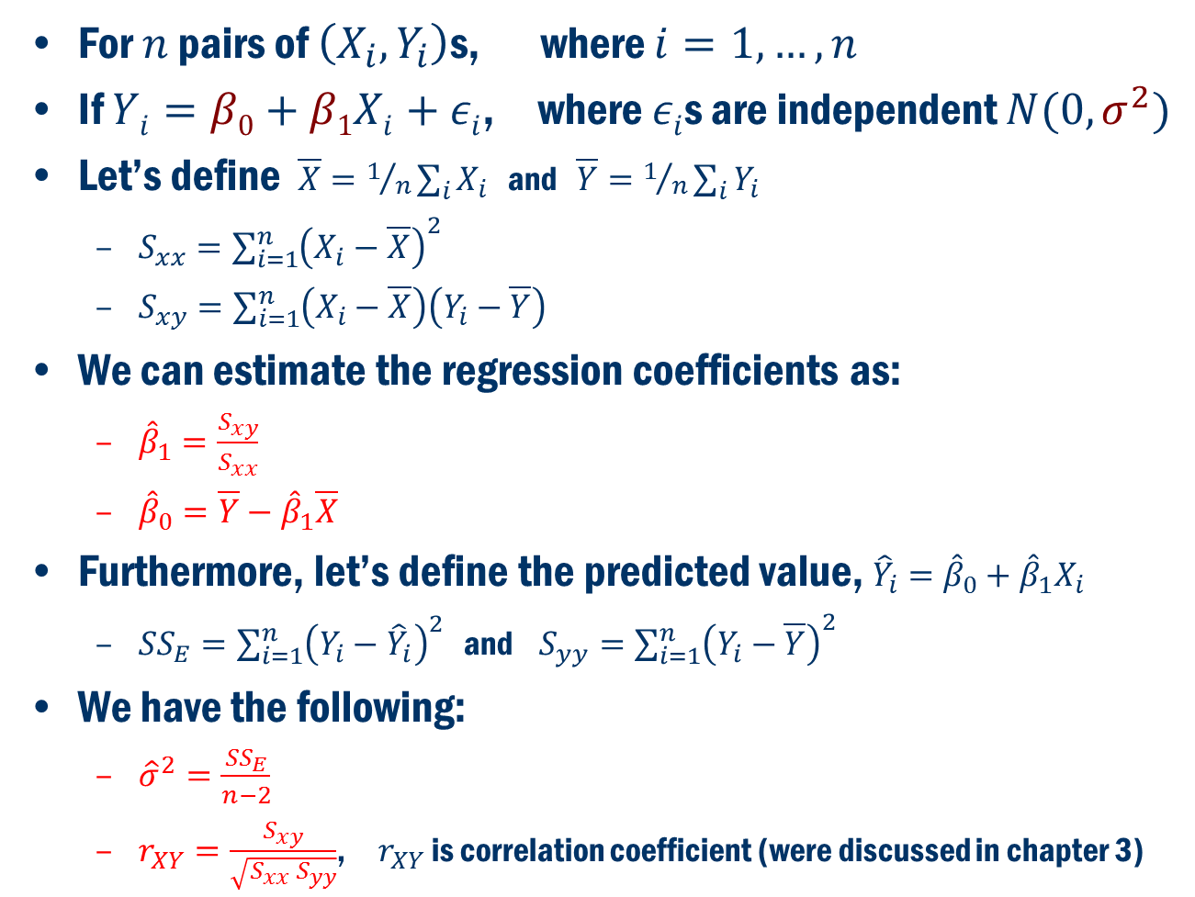
Least Squares Estimators
For $n$ pairs of $\left(X_{i},Y_{i}\right)$s, where $i=1,…,n$
If $Yi=β0+β1Xi+εi$, where $εi$s are independent $N(0,σ^{2})$
Let’s define $\overline{X}=1/n\sum_{i}{X_{i}}$ and $\overline{Y}=1/n\sum_{i}{Y_{i}}$
$S_{xx}=\sum_{i=1}^{n}{{\left(X_{i}−\overline{X}\right)}^{2}}$
$S_{xy}=\sum_{i=1}^{n}{\left(X_{i}−\overline{X}\right)\left(Y_{i}−\overline{Y}\right)}$
We can estimate the regression coefficients as:
${\hat{β}}_{1}=\frac{S_{xy}}{S_{xx}}$
${\hat{β}}_{0}=\overline{Y}−{\hat{β}}_{1}\overline{X}$
Furthermore, let’s define the predicted value, ${\hat{Y}}_{i}={\hat{β}}_{0}+{\hat{β}}_{1}X_{i}$
${SS}_{E}=\sum_{i=1}^{n}{{\left(Y_{i}−{\hat{Y}}_{i}\right)}^{2}}$ and $S_{yy}=\sum_{i=1}^{n}{{\left(Y_{i}−\overline{Y}\right)}^{2}}$
We have the following:
${\hat{σ}}^{2}=\frac{{SS}_{E}}{n−2}$
$r_{XY}=\frac{S_{xy}}{\sqrt{S_{xx} S_{yy}}}$, $r_{XY}$ is correlation coefficient (were discussed in chapter 3)

Slide 16
Relationships between 2 numeric variables
Correlation or r : measures the direction and strength of the linear relationship between two numeric variables
General Properties
It must be between -1 and 1, or (-1≤ r ≤ 1).
If r is negative, the relationship is negative.
If r = –1, there is a perfect negative linear relationship (extreme case).
If r is positive, the relationship is positive.
If r = 1, there is a perfect positive linear relationship (extreme case).
If r is 0, there is no linear relationship.
r measures the strength of the linear relationship.
If explanatory and response are switched, r remains the same.
r has no units of measurement associated with it
Scale changes do not affect r
Correlation Applet

Slide 17
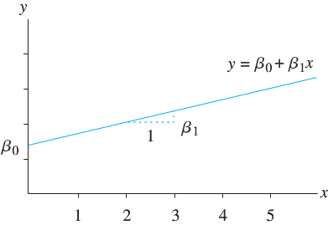
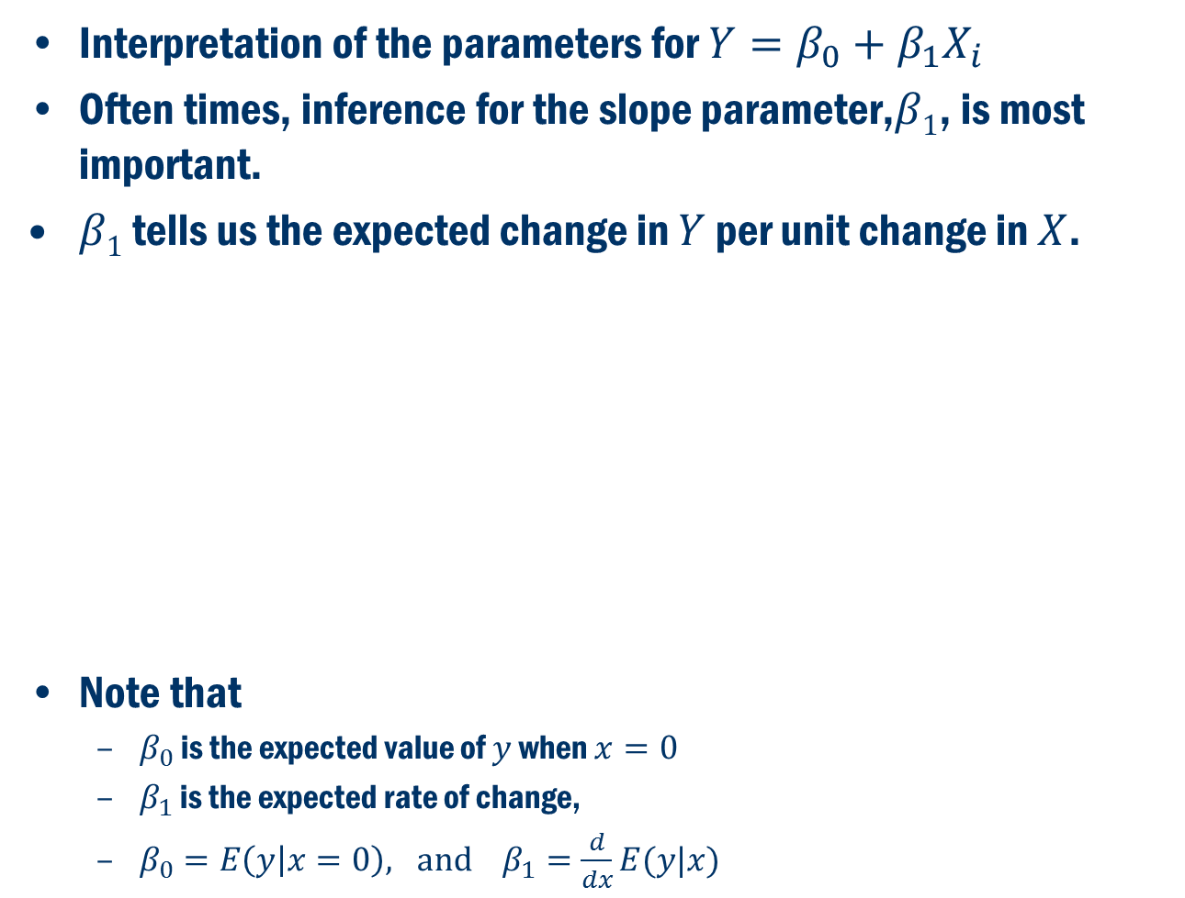
Inference
Interpretation of the parameters for $Y=β_{0}+β_{1}X_{i}$
Often times, inference for the slope parameter,$β1$, is most important.
$β1$ tells us the expected change in $Y$ per unit change in $X$.
Note that
$β_{0}$ is the expected value of $y$ when $x=0$
$β_{1}$ is the expected rate of change,
$β_{0}=E\left(y | x=0\right), and β_{1}=\frac{d}{dx}E(y|x)$

Slide 18
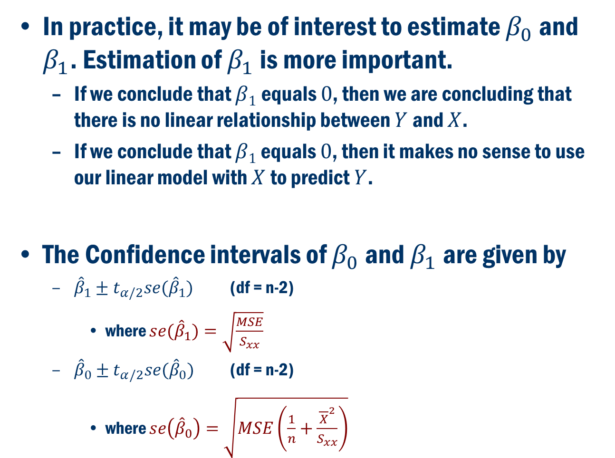
Inference Cont’d
In practice, it may be of interest to estimate $β_{0}$ and $β_{1}$. Estimation of $β_{1}$ is more important.
If we conclude that $β1$equals $0$, then we are concluding that there is no linear relationship between $Y$ and $X$.
If we conclude that $β1$ equals $0$, then it makes no sense to use our linear model with $X$ to predict $Y$.
The Confidence intervals of $β_{0}$ and $β_{1}$ are given by
${\hat{β}}_{1}±t_{α/2}se({\hat{β}}_{1})$ (df = n-2)
where $se({\hat{β}}_{1})=\sqrt{\frac{MSE}{S_{xx}}}$
${\hat{β}}_{0}±t_{α/2}se({\hat{β}}_{0})$ (df = n-2)
where $se\left({\hat{β}}_{0}\right)=\sqrt{MSE\left(\frac{1}{n}+\frac{{\overline{X}}^{2}}{S_{xx}}\right)}$

Slide 19
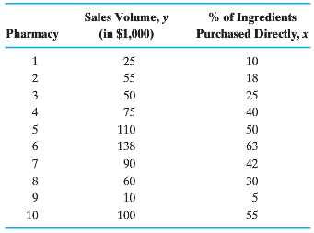
Book Example 11.2:
Data from a sample of 10 pharmacies are used to examine the relation between prescription sales volume and the percentage of prescription ingredients purchased directly from the supplier.

Slide 20
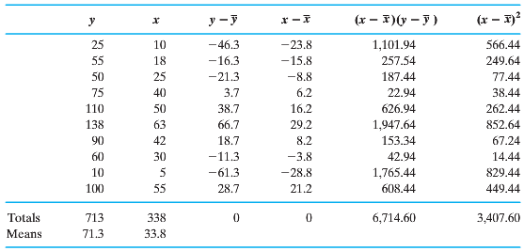
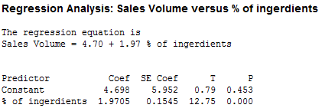

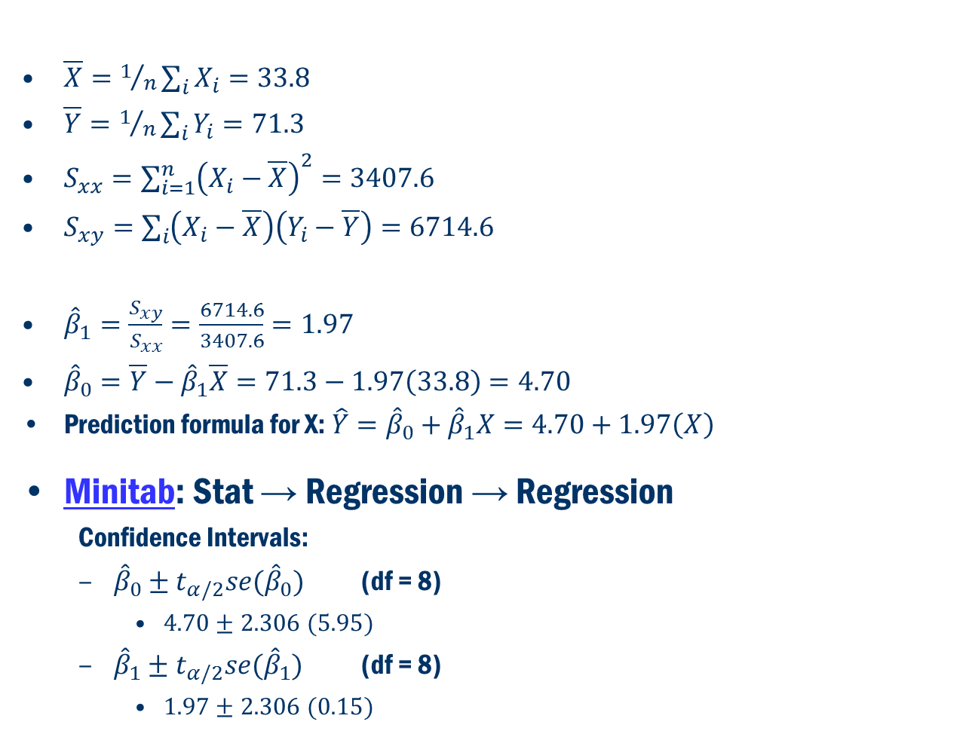
Book Example 11.2 Cont’D
$\overline{X}=1/n\sum_{i}{X_{i}}=33.8$
$\overline{Y}=1/n\sum_{i}{Y_{i}}=71.3$
$S_{xx}=\sum_{i=1}^{n}{{\left(X_{i}−\overline{X}\right)}^{2}}=3407.6$
$S_{xy}=\sum_{i}{\left(X_{i}−\overline{X}\right)\left(Y_{i}−\overline{Y}\right)}=6714.6$
${\hat{β}}_{1}=\frac{S_{xy}}{S_{xx}}=\frac{6714.6}{3407.6}=1.97$
${\hat{β}}_{0}=\overline{Y}−{\hat{β}}_{1}\overline{X}=71.3−1.97\left(33.8\right)=4.70$
$\text{Prediction} \text{formula} \text{for} \text{X}\text{:} \hat{Y}={\hat{β}}_{0}+{\hat{β}}_{1}X=4.70+1.97\left(X\right)$
Minitab: Stat → Regression → Regression
Confidence Intervals:
${\hat{β}}_{0}±t_{α/2}se({\hat{β}}_{0})$ (df = 8)
$4.70±2.306 (5.95)$
${\hat{β}}_{1}±t_{α/2}se({\hat{β}}_{1})$ (df = 8)
$1.97±2.306 (0.15)$
T-statistics and p-value for testing
$$H_{0}:β_{1}=0 \text{vs} { H}_{a}:β_{1}≠0$$

Slide 21
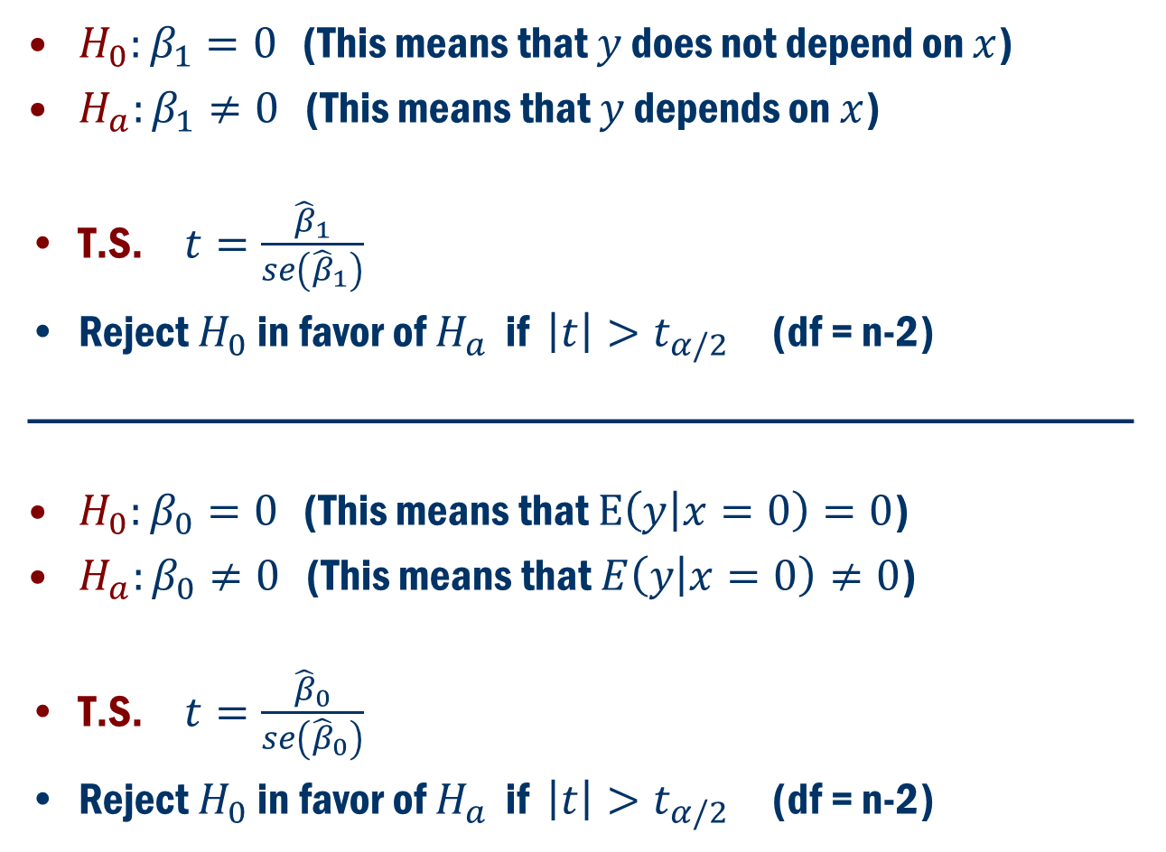
Hypothesis Testing
$H_{0}:β_{1}=0$ (This means that $y$ does not depend on $x$)
$H_{a}:β_{1}≠0$ (This means that $y$ depends on $x$)
T.S. $t=\frac{{\hat{β}}_{1}}{se\left({\hat{β}}_{1}\right)}$
Reject $H_{0}$ in favor of $H_{a}$ if $\left|t\right|>t_{α/2}$ (df = n-2)
_________________________________________________
$H_{0}:β_{0}=0$ (This means that $E\left(y | x=0\right)=0$)
$H_{a}:β_{0}≠0$ (This means that $E\left(y | x=0\right)≠0$)
T.S. $t=\frac{{\hat{β}}_{0}}{se\left({\hat{β}}_{0}\right)}$
Reject $H_{0}$ in favor of $H_{a}$ if $\left|t\right|>t_{α/2}$ (df = n-2)

Slide 22
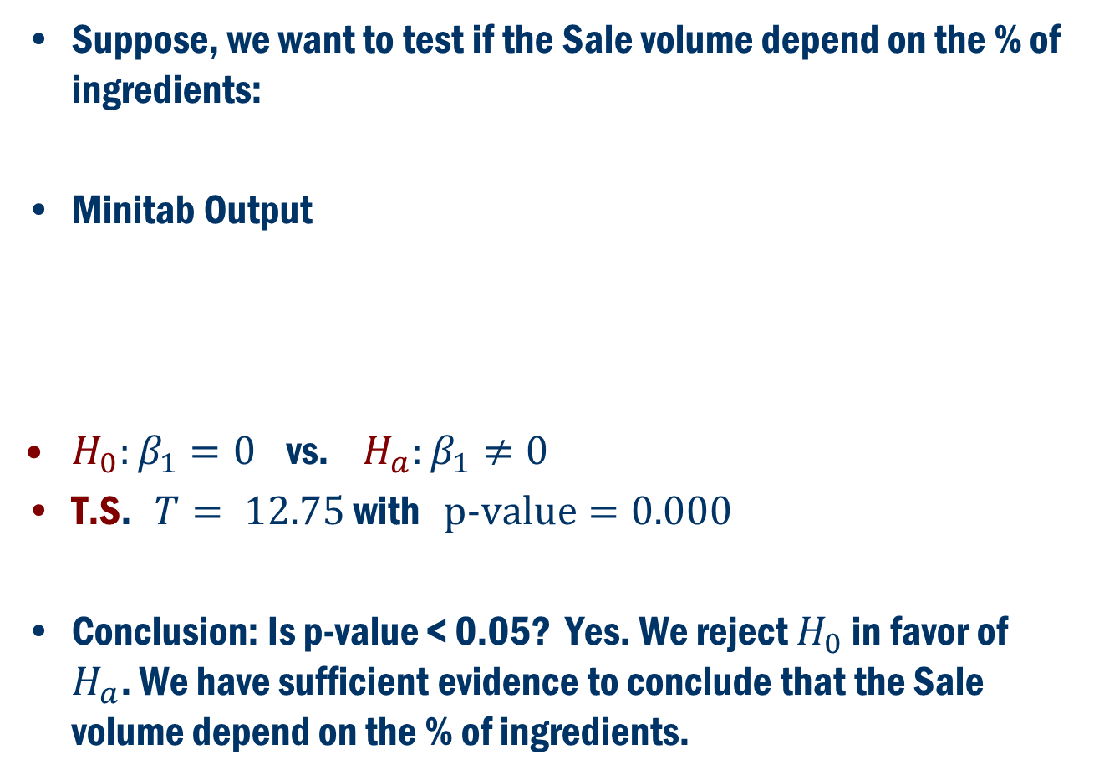
Back to Example 11.2
Suppose, we want to test if the Sale volume depend on the % of ingredients:
Minitab Output
$H_{0}:β_{1}=0$ vs. $H_{a}:β_{1}≠0$
T.S. $T= 12.75$with $\text{p}\text{−}\text{value}=0.000$
Conclusion: Is p-value < 0.05? Yes. We reject $H_{0}$ in favor of $H_{a}$. We have sufficient evidence to conclude that the Sale volume depend on the % of ingredients.

Slide 23
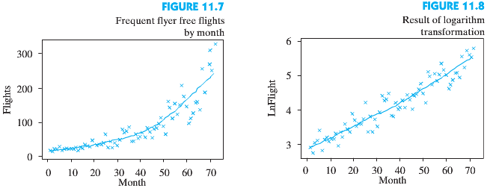
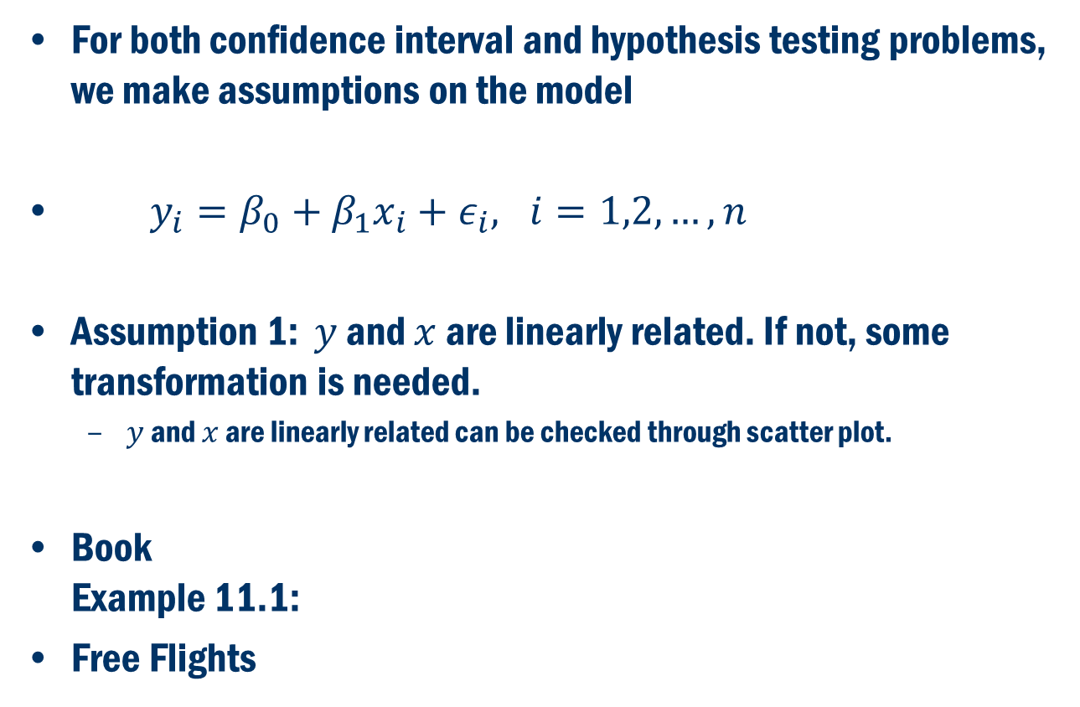
Assumptions
For both confidence interval and hypothesis testing problems, we make assumptions on the model
$y_{i}=β_{0}+β_{1}x_{i}+ε_{i}, i=1,2,…,n$
Assumption 1: $y$ and $x$ are linearly related. If not, some transformation is needed.
$y$ and $x$ are linearly related can be checked through scatter plot.
Book Example 11.1:
Free Flights

Slide 24
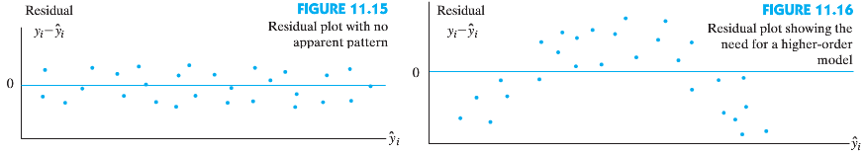
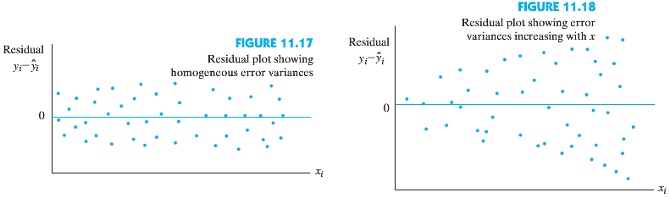

How to Check the Assumptions
Assumption 2: The error terms $ε_{i}, i=1,2,…,n$ are independent and identically distributed as normal.
Second assumption that errors are independent and identically distributed can be checked through the normal probability plot of the residual, and the residual plots.
Assumption 3: $Var\left(ε_{i}\right)=constant$

Slide 25
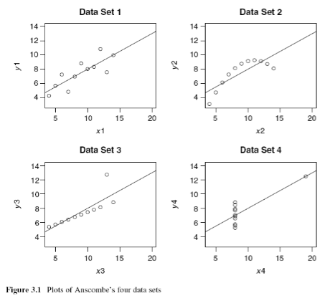
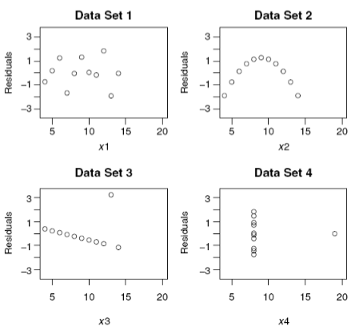
4 datasets with the same least squares regression line
4 Scatterplot with same Regression Estimates:
4 Residual Plots:
Source: Sheather, S.J. (2009) A Modern Approach to Regression with R, Springer, New York

Slide 26
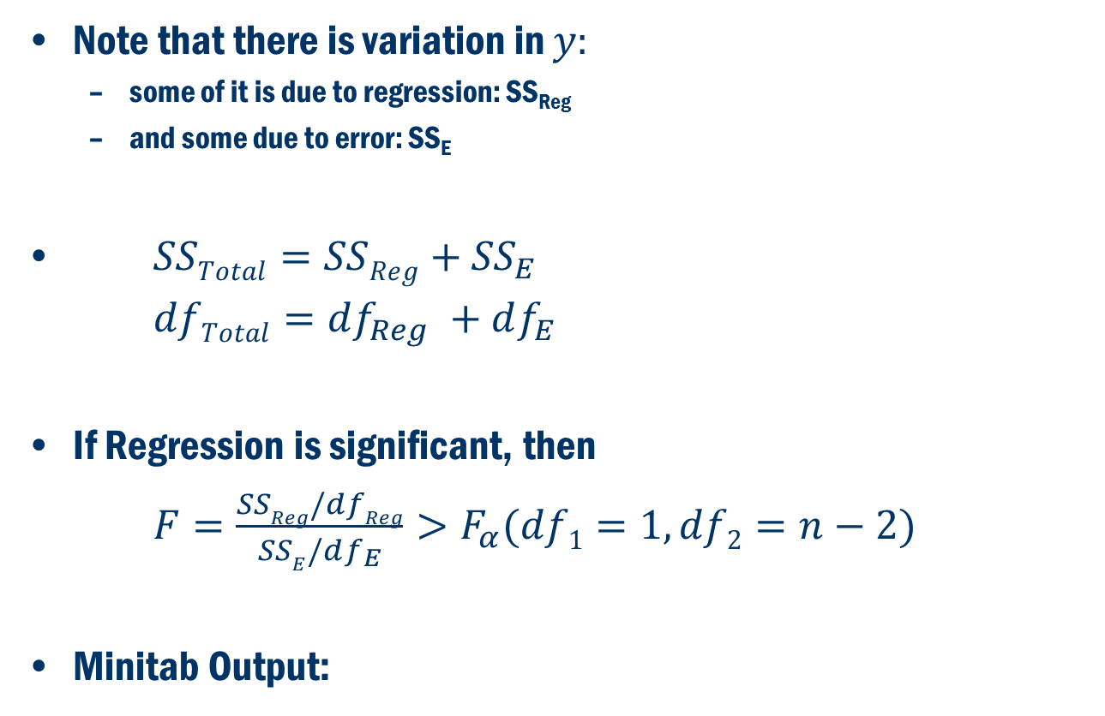
Regression Analysis Using ANOVA
Note that there is variation in $y:$
some of it is due to regression: SS_{Reg}
and some due to error: SS_{E}
$SSTotal=SSReg+{SS}_{E}$
$dfTotal=df_{Reg} +df_{E}$
If Regression is significant, then
$F=\frac{SSReg/dfReg}{SSE/df_{E}}>F_{α}(df1=1,df2=n−2)$
Minitab Output:
Source | DF | SS | MS | F-ratio
Regression/ Explained | 1 | SS_{Reg} | MS_{Reg} = SS_{Reg}/1 | F = MS_{Reg}/MSE
Residual/Error/Unexplained | n-2 | SS_{E} | MSE = SS_{E}/(n-2)
Total | n-1 = df_{Reg} + df_{E} | SST = SS_{Reg} + SS_{E}

Slide 27
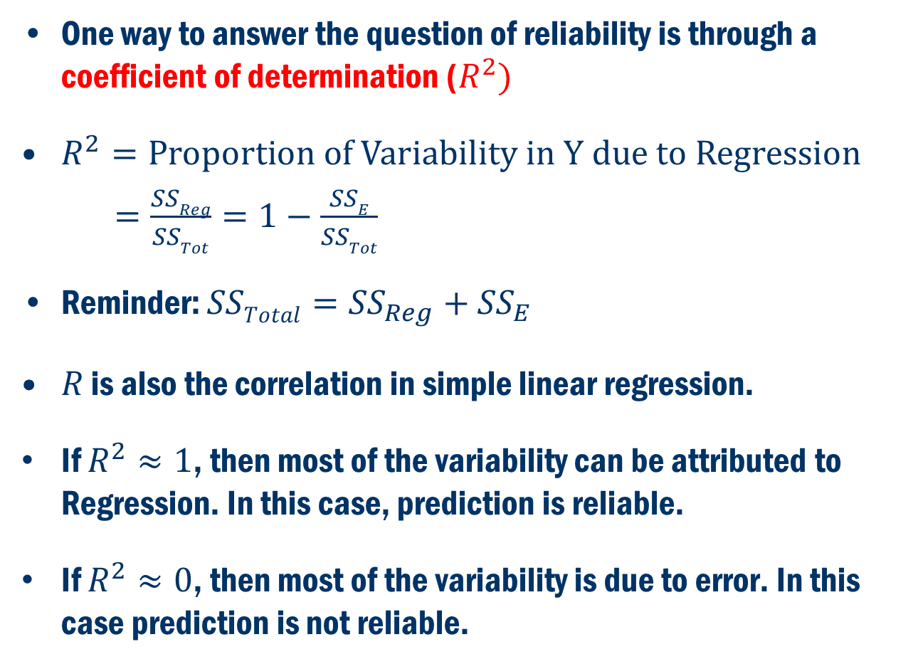
Coefficient of Determination
One way to answer the question of reliability is through a coefficient of determination ($R^{2})$
$R^{2}=\text{Proportion} \text{of} \text{Variability} \text{in} \text{Y} \text{due} \text{to} \text{Regression}$
$=\frac{SSReg}{SSTot}=1−\frac{SSE}{SSTot}$
Reminder: $SSTotal={SS}_{Reg}+{SS}_{E}$
$R$ is also the correlation in simple linear regression.
If $R^{2}≈1$, then most of the variability can be attributed to Regression. In this case, prediction is reliable.
If $R^{2}≈0$, then most of the variability is due to error. In this case prediction is not reliable.

Slide 28
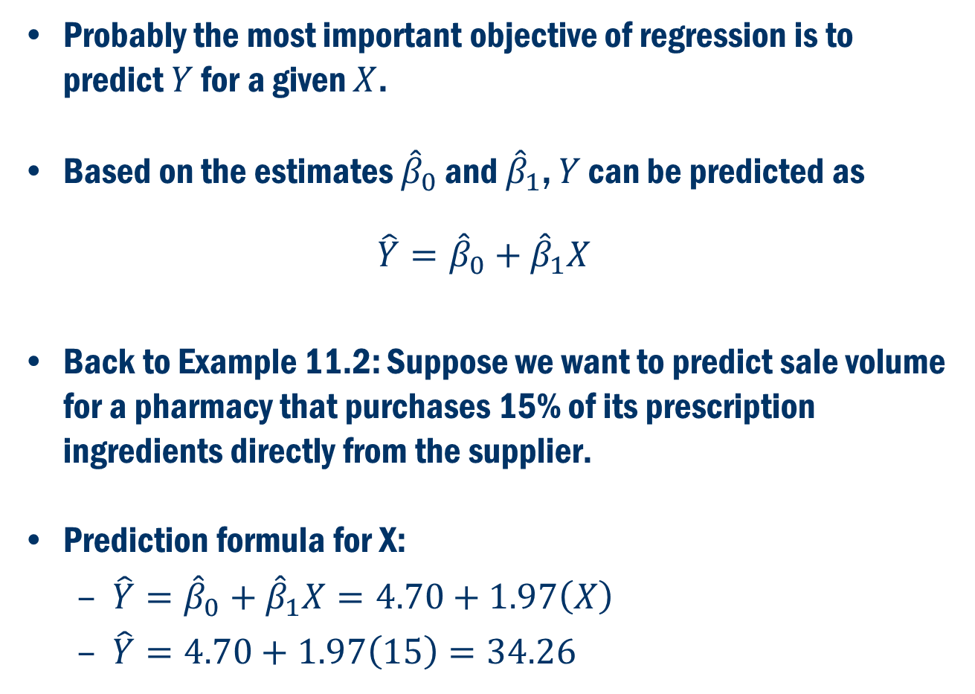
Prediction
Probably the most important objective of regression is to predict $Y$ for a given $X$.
Based on the estimates ${\hat{β}}_{0}$ and ${\hat{β}}_{1}$, $Y$ can be predicted as
$$\hat{Y}={\hat{β}}_{0}+{\hat{β}}_{1}X$$
Back to Example 11.2: Suppose we want to predict sale volume for a pharmacy that purchases 15% of its prescription ingredients directly from the supplier.
$\text{Prediction} \text{formula} \text{for} \text{X}\text{:}$
$\hat{Y}={\hat{β}}_{0}+{\hat{β}}_{1}X=4.70+1.97\left(X\right)$
$\hat{Y}=4.70+1.97\left(15\right)=34.26$

Slide 29
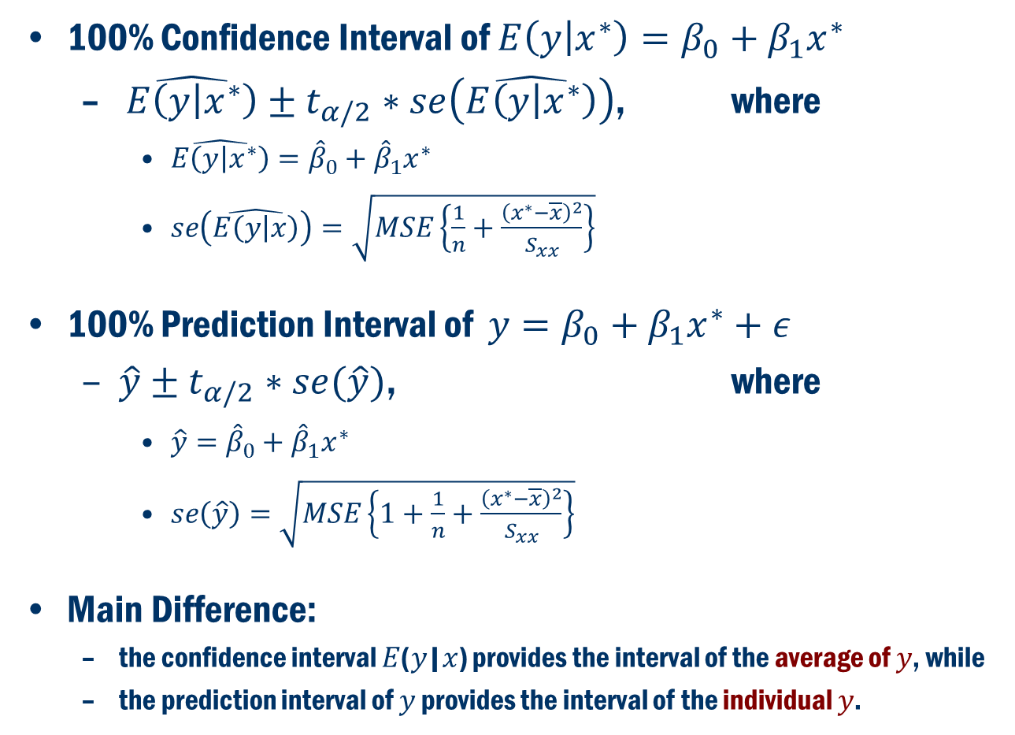
Confidence Interval and Prediction Interval
100% Confidence Interval of $E\left(y | x^{∗}\right)=β_{0}+β_{1}x^{∗}$
$\hat{E\left(y | x^{∗}\right)}±t_{α/2}∗se\left(\hat{E\left(y | x^{∗}\right)}\right)$, where
$\hat{E\left(y | x^{∗}\right)}={\hat{β}}_{0}+{\hat{β}}_{1}x^{∗}$
$se\left(\hat{E\left(y | x\right)}\right)=\sqrt{MSE\left\{\frac{1}{n}+\frac{{\left(x^{∗}−\overline{x}\right)}^{2}}{S_{xx}}\right\}}$
100% Prediction Interval of $y=β_{0}+β_{1}x^{∗}+ε$
$\hat{y}±t_{α/2}∗se(\hat{y})$, where
$\hat{y}={\hat{β}}_{0}+{\hat{β}}_{1}x^{∗}$
$se\left(\hat{y}\right)=\sqrt{MSE\left\{1+\frac{1}{n}+\frac{{\left(x^{∗}−\overline{x}\right)}^{2}}{S_{xx}}\right\}}$
Main Difference:
the confidence interval 𝐸(𝑦|𝑥) provides the interval of the average of 𝑦, while
the prediction interval of 𝑦 provides the interval of the individual 𝑦.

Slide 30
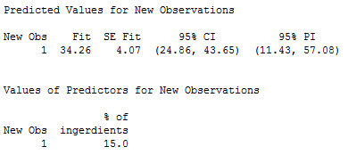
Back to Book Example 11.2:
Suppose we want to obtain the Confidence and Prediction intervals of sale volume for a pharmacy that purchases 15% of its prescription ingredients directly from the supplier.

Slide 31
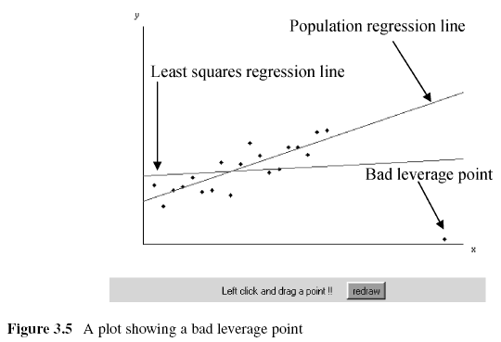

Influential points – bad leverage points
An observation is influential for a statistical calculation if removing it would markedly change the result of the calculation.
Points that are outliers in the $x$direction are often influential for the least-squares regression line.
Applet

Slide 32
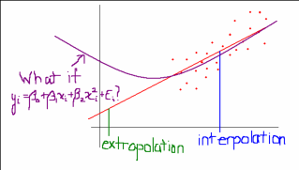
Extrapolation vs Interpolation

Slide 33
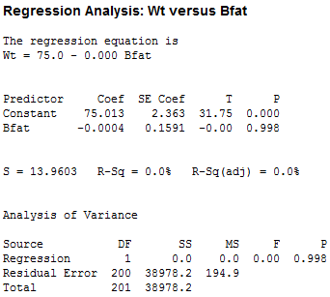

Going Back to AIS Data
Wrong Analysis:
Fail to Reject
$H_{0}:β_{1}=0$
$R^{2}≈0$,
Most of the variability is due to Error
Regression Model is NOT significant

Slide 34

Model Assumptions (Wrong Analysis)
The error terms $ε_{i}, i=1,2,…,n$ are NOT independent
$Var\left(ε_{i}\right)$ is NOT constant

Slide 35
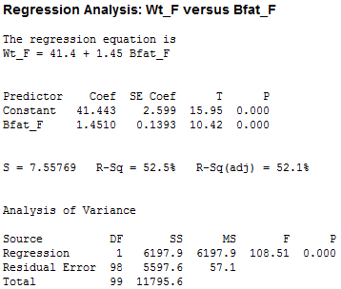
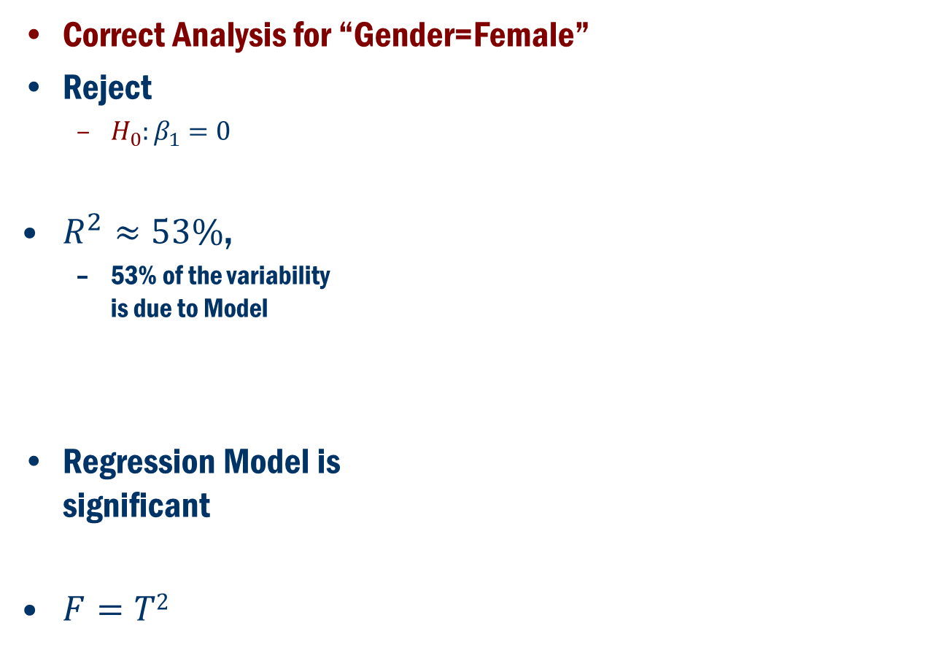
Going Back to AIS Data
Correct Analysis for “Gender=Female”
Reject
$H_{0}:β_{1}=0$
$R^{2}≈53\%$,
53% of the variability is due to Model
Regression Model is significant
$F=T2$

Slide 36

Model Assumptions
The error terms $ε_{i}, i=1,2,…,n$ are independent
$Var\left(ε_{i}\right)$ is constant

Slide 37
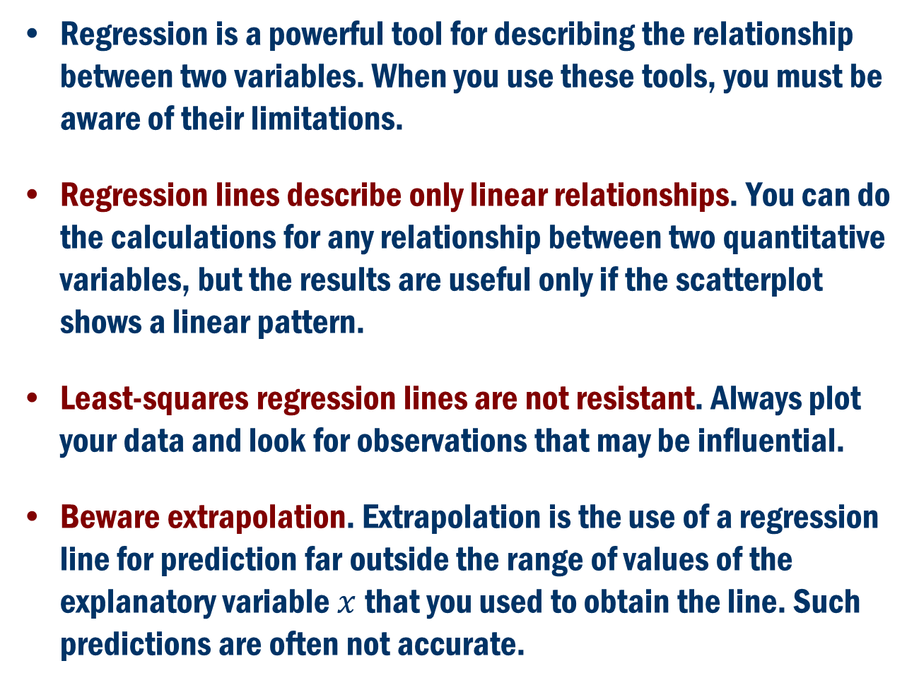
Cautions about regression
Regression is a powerful tool for describing the relationship between two variables. When you use these tools, you must be aware of their limitations.
Regression lines describe only linear relationships. You can do the calculations for any relationship between two quantitative variables, but the results are useful only if the scatterplot shows a linear pattern.
Least-squares regression lines are not resistant. Always plot your data and look for observations that may be influential.
Beware extrapolation. Extrapolation is the use of a regression line for prediction far outside the range of values of the explanatory variable $x$that you used to obtain the line. Such predictions are often not accurate.

