Slide 1
Chapter 3

Slide 2
Topic 2 - Chapter 3
Type of Variables
Frequency distributions
Histograms
Mean, median, variance and standard deviation
Quartiles, interquartile range
Boxplots
Correlation

Slide 3
All about variables
Variable: Any characteristic or quantity to be measured on units in a study
Categorical variable: Places a unit into one of several categories
Examples: Gender, race, political party
Quantitative variable: Takes on numerical values for which arithmetic makes sense
Examples: SAT score, number of siblings, cost of textbooks
Univariate data has one variable.
Bivariate data has two variables.
Multivariate data has three or more variables.

Slide 4
Types of Variables
Examples:
Numeric
Variable Discrete Continuous Categorical
Length
Hours Enrolled
Major
Zip Code
Examples:
Numeric
Variable Discrete Continuous Categorical
Length X
Hours Enrolled X
Major X
Zip Code X

Slide 5
Australian Institute of Sport data
Description
Data on 102 male and 100 female athletes collected at the Australian Institute of Sport, courtesy of Richard Telford and Ross Cunningham.
Source
Cook and Weisberg (1994), An Introduction to Regression Graphics. John Wiley & Sons, New York.
AIS.mjp
Variable | Description
sex | sex
sport | sport
rcc | red cell count
wcc | white cell count
Hc | Hematocrit
Hg | Hemoglobin
Fe | plasma ferritin concentration
bmi | body mass index, weight/(height)
ssf | sum of skin folds
Bfat | body fat percentage
lbm | lean body mass
Ht | height (cm)
Wt | weight (Kg)

Slide 6
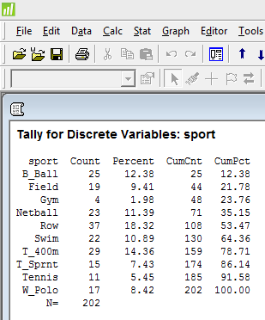
Summarizing a single categorical variable
Frequency (Count) - number of times the value occurs in the data
Relative frequency (Percent) - proportion of the data with the value
Cumulative Frequency
Cumulative Relative Frequency
ais.mjp (D2L/Content/Datasets)

Slide 7
Analyzing a single quantitative variable
Consider the AIS data which contains 202 athletes.
What is a typical height of athletes?
How much spread is there in their Body fats?
Typical is generally characterized by the center of the data
Spread is generally reported as an interval containing most of the data

Slide 8
Histograms
Histogram - bar graph of binned data where the height of the bar above each bin denotes the frequency (relative frequency) of values in the bin
Typical concentration?
Spread?
Roughly how many athletes are shorter than 180 cm?

Slide 9
Describing the shape of quantitative data
Symmetric data has roughly the same mirror image on each side of a center value.
Skewed data has one side (either right or left) which is much longer than the other relative to the mode (peak value).
The above definitions are most useful when describing data with a single mode.
Multimodal data has more than one mode.
Beware of outliers when describing shape.
Shape of the AIS Data?

Slide 10
Describing the shape (CONT…)
Bfat: Body Fat
skewed to the right
Bimodal
Hematocrit (Hc): Volume percentage (%) of red blood cells in blood
Outlier

Slide 11
Stem and leaf plots
Separate each value into a stem (all but the rightmost digit) and a leaf (the rightmost digit)
Write unique sorted stems in a vertical column
Add each leaf to the right of its stem in increasing order
Example from AIS:
rcc (red cell counts)
Female-Row:
4.26 4.63 4.36 3.91 4.51 4.37 4.90 4.46 3.95 4.46 5.02 4.26 4.46 4.16 4.49 4.21 4.57 4.87 4.44 4.45 4.41 4.87
Male-Row:
4.87 5.04 4.40 4.95 4.78 5.21 5.22 5.18 5.40 4.92 5.24 5.09 4.83 5.22 4.71
Stem-and-leaf of rcc N = 37
Leaf Unit = 0.010
2 39 15
2 40
3 41 6
6 42 166
8 43 67
16 44 01456669
18 45 17
(1) 46 3
18 47 18
16 48 3777
12 49 025
9 50 249
6 51 8
5 52 1224
1 53
1 54 0

Slide 12
Histograms vs. Stem and leaf plots
Stem and leaf plots (typically) display actual data values whereas histograms do not
Stem and leaf plots are more useful for small data sets (less than 100 values)
Histograms can be constructed for larger data sets

Slide 13
Summary statistics for quantitative data
Measures of center (typical)
The sample median is the middle observation if the values are arranged in increasing order.
The sample mean of n observations is the average, the sum of the values divided by n.

Slide 14
Summary statistics for quantitative data
Measures of spread:
Interquartile range, IQR = Q3-Q1, the range of the middle 50% of the data
first quartile (Q1) is the 25th percentile
third quartile (Q3) is the 75th percentile
sample variance, s², is the sum of squared deviations from the sample mean divided by n-1
sample standard deviation, s, is the square root of sample variance. Preferred because it has the same units as the data.

Slide 15
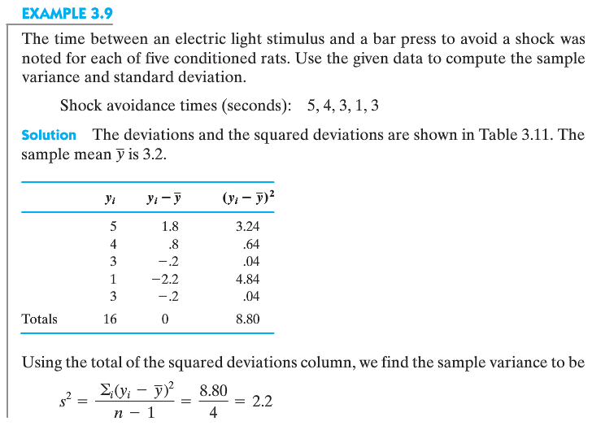
Example on how to calculate the variance

Slide 16
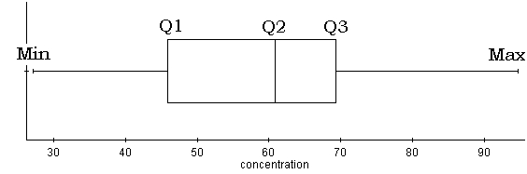
Summary statistics for quantitative data
pth percentile -the value such that p×100% of values are below it and (1-p) ×100% are above it
first quartile (Q1) is the 25th percentile
second quartile (Q2) 50th percentile (median)
third quartile (Q3) is the 75th percentile
5-number summary: Min, Q1, Q2, Q3, Max
Boxplots: Stacking boxplots can be very useful for comparing multiple groups

Slide 17
Box Plot
Minimum, Q₁, Median, Q₃, and Maximum of AIS-weight
These five numbers
are called the
Five Number Summary
What are these points?
Outliers
Interquartile Range (IQR):
Distance between the first quartile (Q₁) and the third quartile (Q₃). IQR = Q₃ – Q₁

Slide 18
Box Plot (Cont…)
Outliers
________: observations that are unusually far from the bulk of the data.
What are some possible explanations for outliers?
The data point was recorded wrong.
The data point wasn’t actually a member of the population we were trying to sample.
We just happened to get an extreme value in our sample.
The 1.5 x IQR Criterion for Outliers: Designate an observation a suspected outlier if it falls more than 1.5 x IQR below the first quartile or above the third quartile.

Slide 19
1.5*IQR Criterion Example
Suppose you had the following data set:
-2, 15, 3, 7, 10, 21, 1, 5, 12, 8, 1, 35, 10
List data from smallest to largest:
Find Q₁, Median, Q₃, Min, and Max:
IQR = Q₃ – Q₁ = ______
1.5*IQR = _______
Q₁ – 1.5*IQR = ________If less than this number, then outlier
Q₃ + 1.5*IQR = ________If more than this number, then outlier
Are there any outliers in this data set?

Slide 20
1.5*IQR Criterion Example
Suppose you had the following data set:
-2, 15, 3, 7, 10, 21, 1, 5, 12, 8, 1, 35, 10
List data from smallest to largest:
-2, 1, 1, 3, 5, 7, 8, 10, 10, 12, 15, 21, 35
Find Q₁, Median, and Q₃:
Q₁ = (1+3)/2 = 2 Median = 8 Q₃ = (12 + 15)/2 = 13.5
IQR = Q₃ – Q₁ = 11.5
1.5*IQR = 17.25
Q₁ – 1.5*IQR = -15.25 If less than this number, then outlier
Q₃ + 1.5*IQR = 30.75 If more than this number, then outlier
Are there any outliers in this data set? Yes, 35

Slide 21
Side-by-Side Box plot

Slide 22
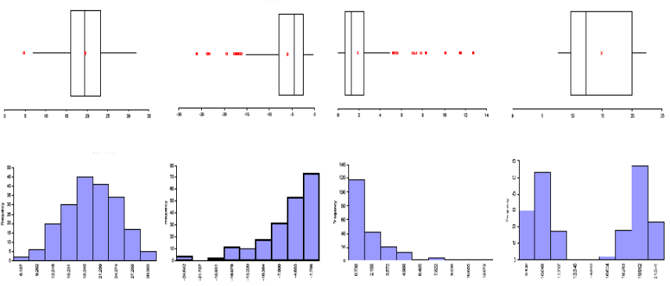
Comparing Histograms and Corresponding Boxplots
Symmetric
Left Skewed
Right Skewed
Bimodal

Slide 23
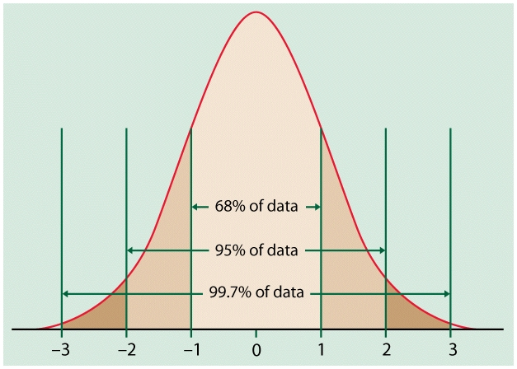
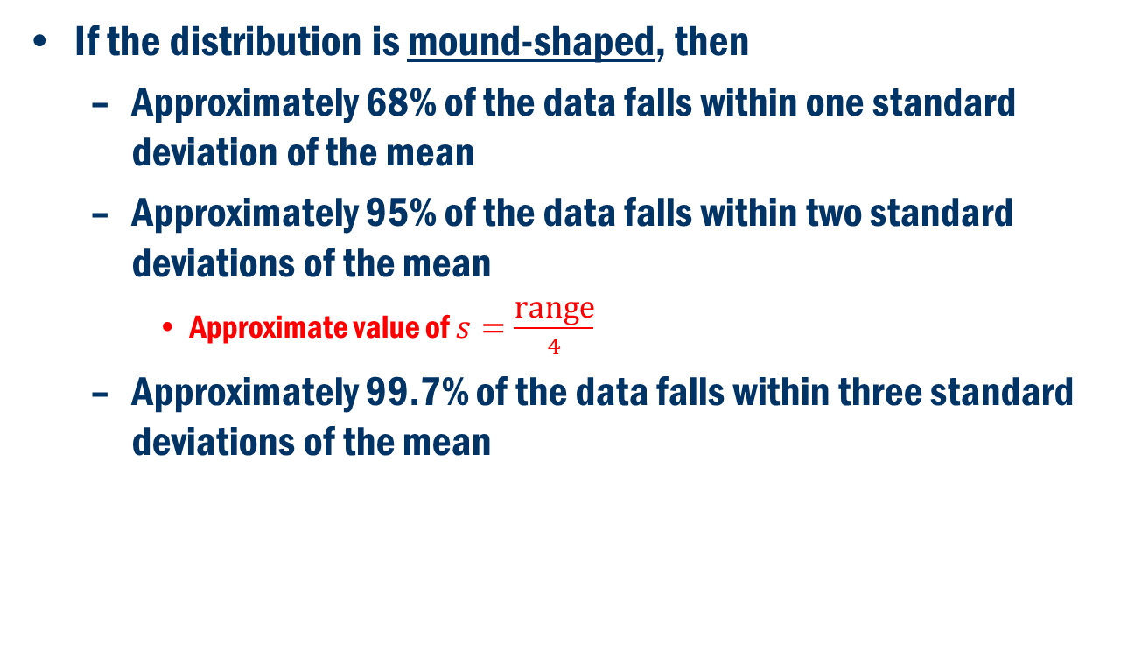
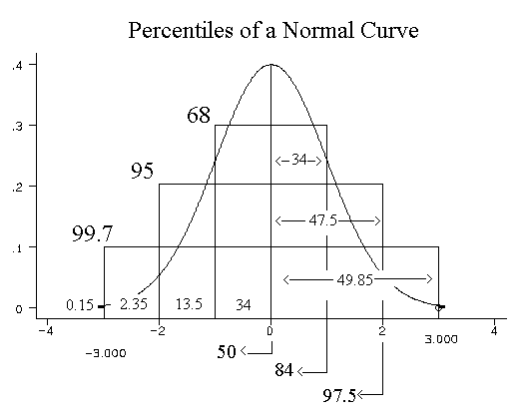
Empirical Rule (The 68-95-99.7 Rule)
If the distribution is mound-shaped, then
Approximately 68% of the data falls within one standard deviation of the mean
Approximately 95% of the data falls within two standard deviations of the mean
Approximate value of $s=\frac{\text{range}}{4}$
Approximately 99.7% of the data falls within three standard deviations of the mean

Slide 24
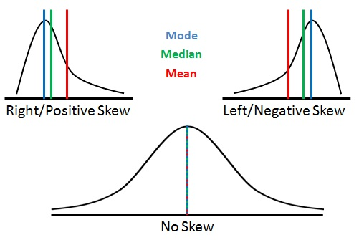
Comparing measures of center and spread
The sample mean and the sample standard deviation are good measures of center and spread, respectively, for symmetric data
If the data set is skewed or has outliers, the sample median and the interquartile range are more commonly used
Mean versus median

Slide 25
Relationships Between 2 Numeric Variables
Depending on the situation, one of the variables is the explanatory variable and the other is the response variable.
There is not always an explanatory-response relationship.
Examples:
Height and Weight
Income and Age
SAT scores on math exam and on verbal exam
Amount of time spent studying for an exam and exam score

Slide 26
Relationships Between 2 Numeric Variables
Scatterplots
Look for overall pattern and any striking deviations from that pattern.
Look for outliers, values falling outside the overall pattern of the relationship
You can describe the overall pattern of a scatterplot by the form, direction, and strength of the relationship.
Form: Linear or clusters
Direction
Two variables are positively associated when above-average values of one tend to accompany above-average values of the other and likewise below-average values also tend to occur together.
Two variables are negatively associated when above-average values of one variable accompany below-average values of the other variable, and vice-versa.
Strength-how close the points lie to a line

Slide 27
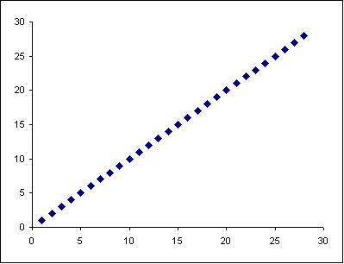
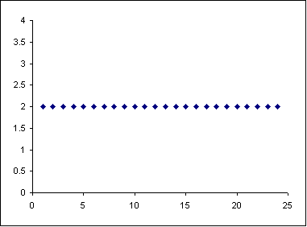
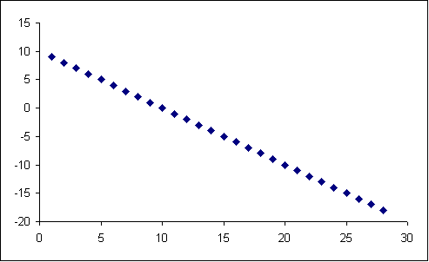
Relationships between 2 numeric variables
Examples of extreme cases
r = 1
r = 0
r = -1

Slide 28
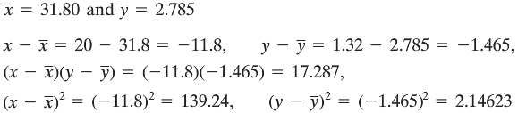
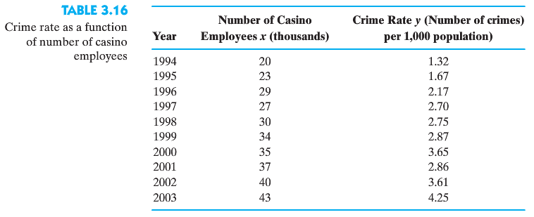
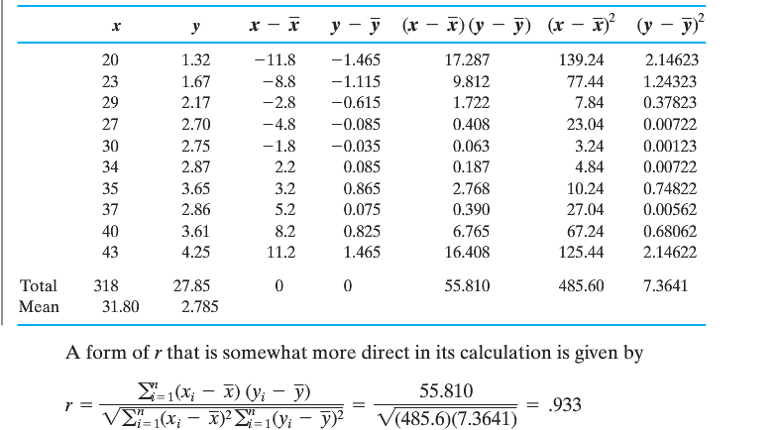
Example for Correlation

Slide 29
Relationships between 2 numeric variables
Correlation or r : measures the direction and strength of the linear relationship between two numeric variables
General Properties
It must be between -1 and 1, or (-1≤ r ≤ 1).
If r is negative, the relationship is negative.
If r = –1, there is a perfect negative linear relationship (extreme case).
If r is positive, the relationship is positive.
If r = 1, there is a perfect positive linear relationship (extreme case).
If r is 0, there is no linear relationship.
r measures the strength of the linear relationship.
If explanatory and response are switched, r remains the same.
r has no units of measurement associated with it
Scale changes do not affect r
Correlation Applet

Slide 30
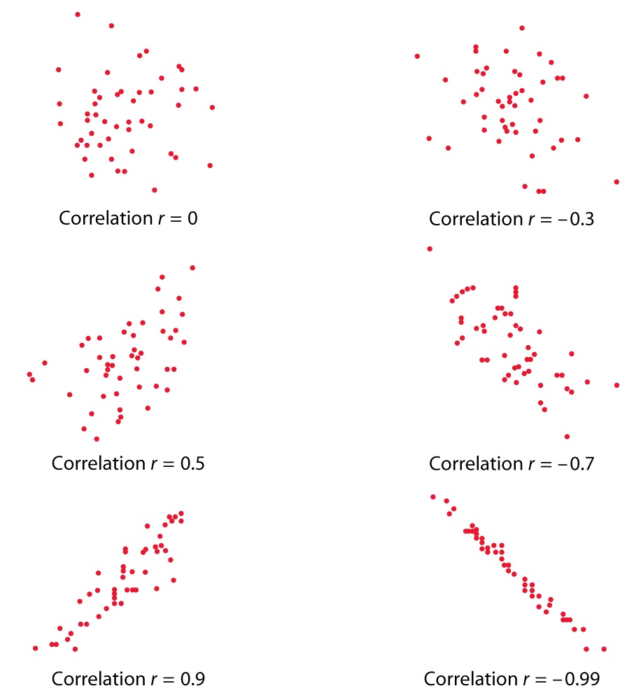

Slide 31
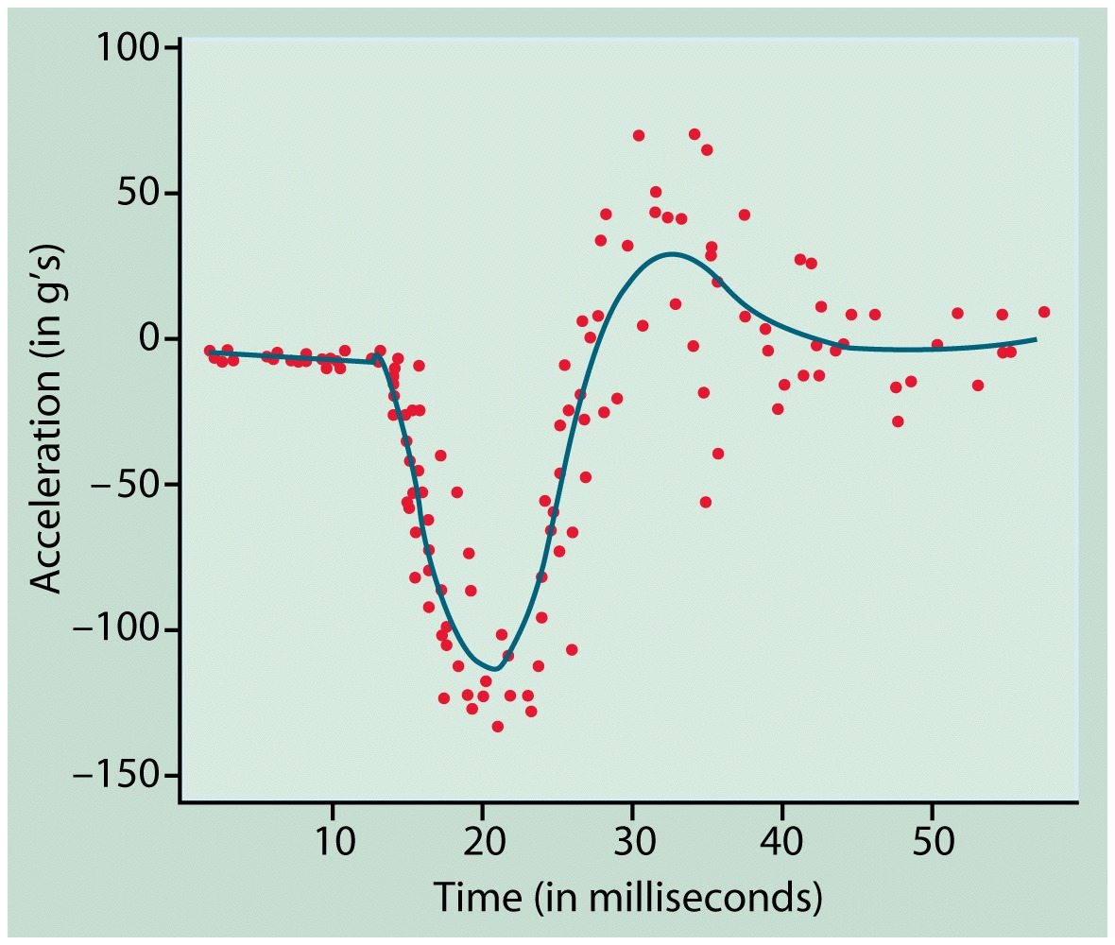
Relationships between 2 numeric variables
It is possible for there to be a strong relationship between two variables and still have r ≈ 0.
EX.

Slide 32
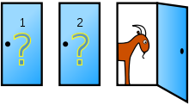
Let’s Make a Deal
Let’s Make a Deal (Monty Hall problem)
http://en.wikipedia.org/wiki/Monty_Hall_problem
This is motivation to study probability.
Should you switch or should you stay with your original choice?

Slide 33
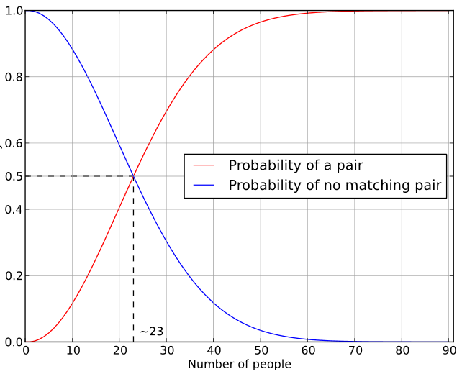
Birthday Paradox
What’s the chances that two people in our class have the same birthday?

