Slide 1
Chapter 4 (Part A)

Slide 2
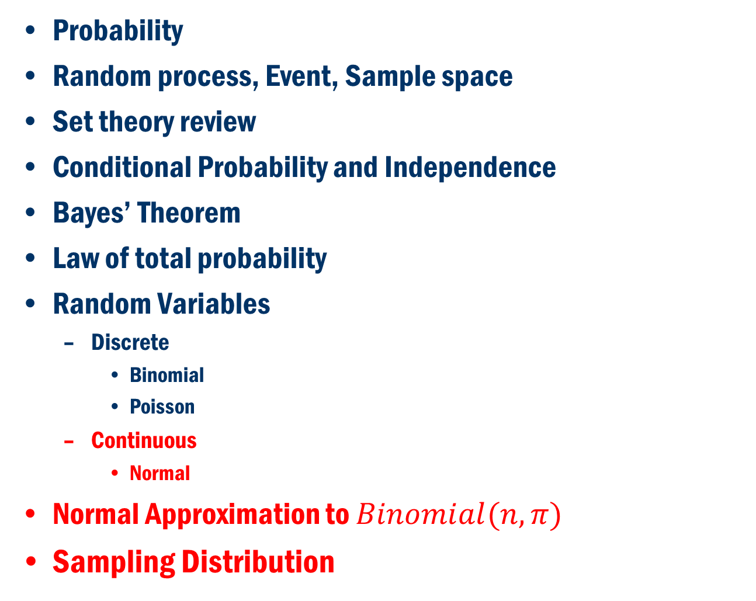
Chapter 4 (Part A)
Probability
Random process, Event, Sample space
Set theory review
Conditional Probability and Independence
Bayes’ Theorem
Law of total probability
Random Variables
Discrete
Binomial
Poisson
Continuous
Normal
Normal Approximation to $Binomial(n, π)$
Sampling Distribution

Slide 3
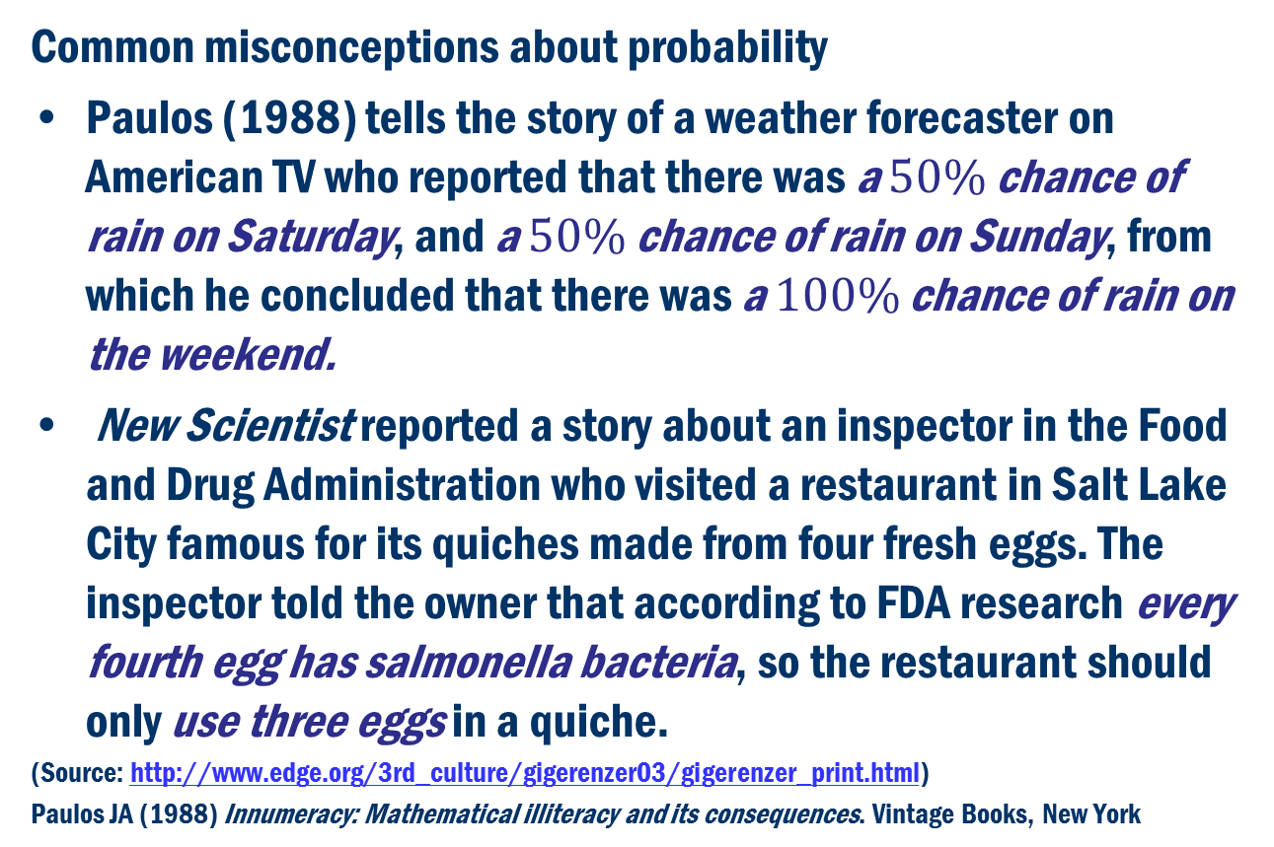
Probability
Common misconceptions about probability
Paulos (1988) tells the story of a weather forecaster on American TV who reported that there was a $50\%$ chance of rain on Saturday, and a $50\%$ chance of rain on Sunday, from which he concluded that there was a $100\%$ chance of rain on the weekend.
New Scientist reported a story about an inspector in the Food and Drug Administration who visited a restaurant in Salt Lake City famous for its quiches made from four fresh eggs. The inspector told the owner that according to FDA research every fourth egg has salmonella bacteria, so the restaurant should only use three eggs in a quiche.
(Source: http://www.edge.org/3rd_culture/gigerenzer03/gigerenzer_print.html)
Paulos JA (1988) Innumeracy: Mathematical illiteracy and its consequences. Vintage Books, New York
3

Slide 4
Randomness and probability
We call a phenomenon random if individual outcomes are uncertain but there is nonetheless a regular distribution of outcomes in a large number of repetitions
The probability of any outcome of a random phenomenon is the proportion of times the outcome would occur in a very long series of repetitions. If a random experiment is repeated n times then,
Example: Tossing coins

Slide 5
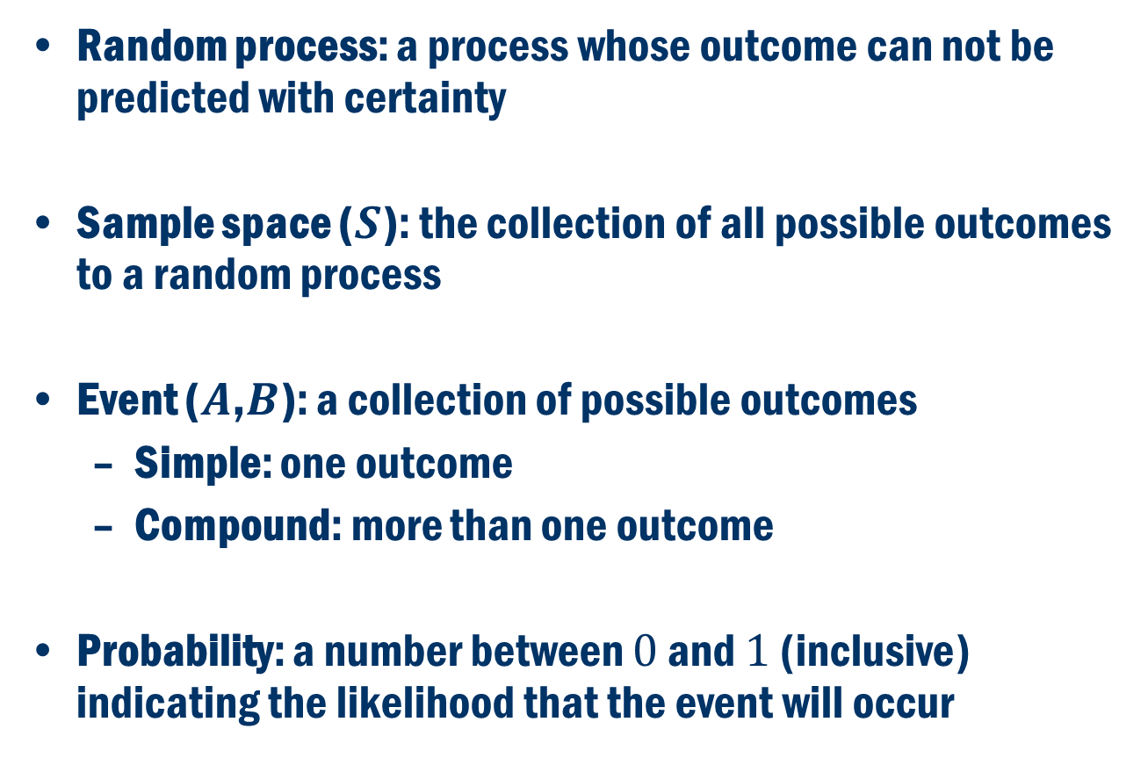
Probability definitions
Random process: a process whose outcome can not be predicted with certainty
Sample space ($S$): the collection of all possible outcomes to a random process
Event ($A$,$B$): a collection of possible outcomes
Simple: one outcome
Compound: more than one outcome
Probability: a number between $0$ and $1$ (inclusive) indicating the likelihood that the event will occur

Slide 6
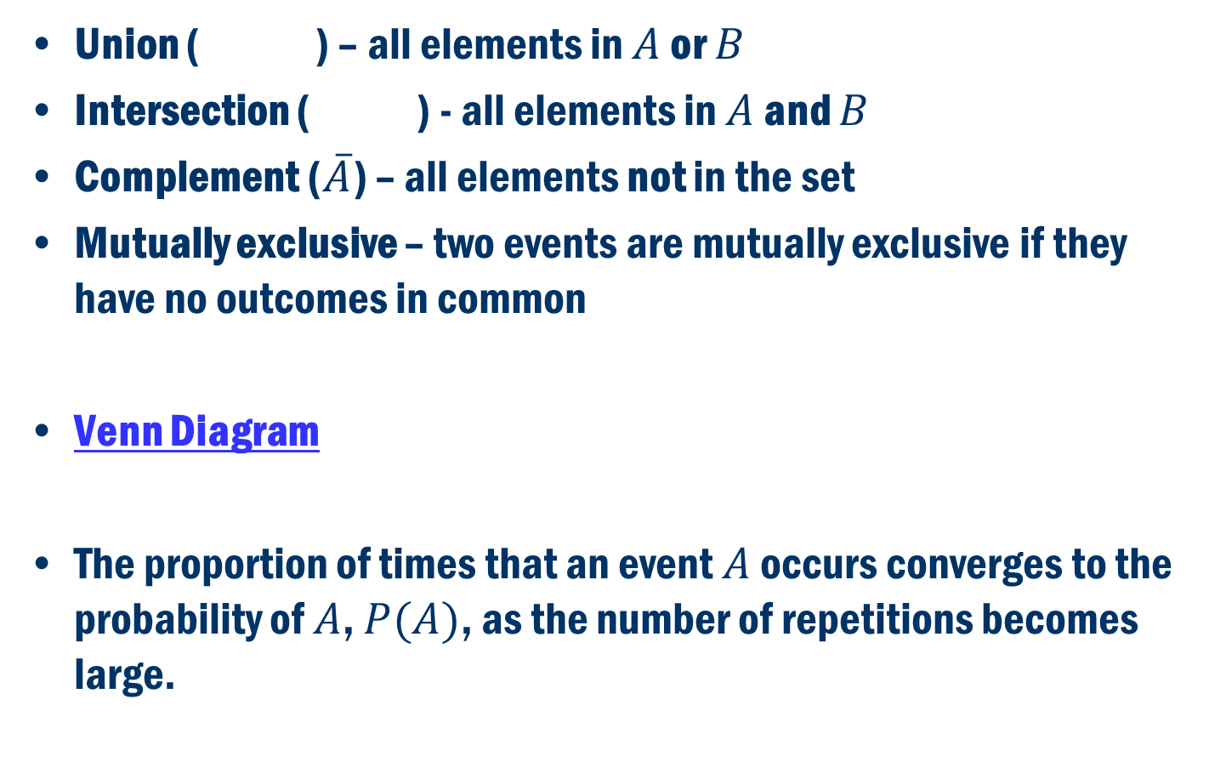
Set theory review
Union ( ) – all elements in $A$ or $B$
Intersection ( ) - all elements in $A$ and $B$
Complement ($\overline{A}$) – all elements not in the set
Mutually exclusive – two events are mutually exclusive if they have no outcomes in common
Venn Diagram
The proportion of times that an event $A$ occurs converges to the probability of $A$, $P(A)$, as the number of repetitions becomes large.

Slide 7
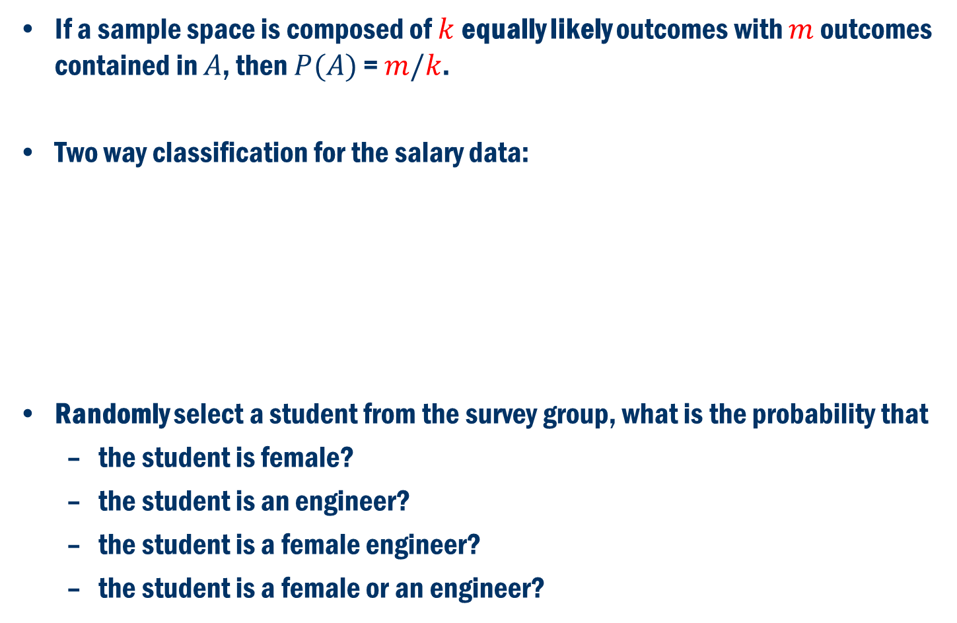
Probability with equally likely outcomes
If a sample space is composed of $k$ equally likely outcomes with $m$ outcomes contained in $A$, then $P(A)$ = $m/k$.
Two way classification for the salary data:
Randomly select a student from the survey group, what is the probability that
the student is female?
the student is an engineer?
the student is a female engineer?
the student is a female or an engineer?
 | Education | Engineering | Total
Female | 856 | 232 | 1088
Male | 220 | 924 | 1144
Total | 1076 | 1156 | 2232

Slide 8
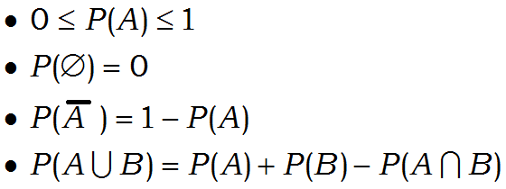
Properties of Probability
Axioms:
Properties that follow:

Slide 9
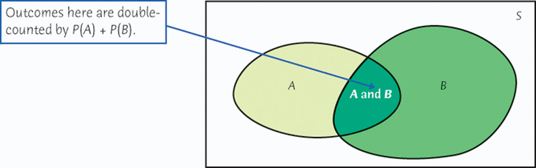
Addition rule in general

Slide 10
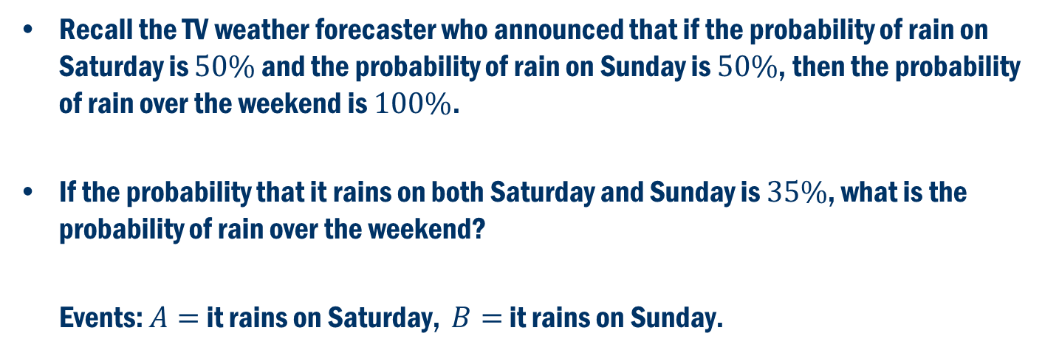
A rainy weekend?
Recall the TV weather forecaster who announced that if the probability of rain on Saturday is $50\%$ and the probability of rain on Sunday is $50\%$, then the probability of rain over the weekend is $100\%$.
If the probability that it rains on both Saturday and Sunday is $35\%$, what is the probability of rain over the weekend?
Events: $A=$ it rains on Saturday, $B=$ it rains on Sunday.

Slide 11
Back to the salary example
Consider the following two way classification table between major and gender for the salary data:
If we randomly select a student from this group, what is the probability that
the student is not a male educator?
the student is a female or an engineer?
 | Education | Engineering | Total
Female | 856 | 232 | 1088
Male | 220 | 924 | 1144
Total | 1076 | 1156 | 2232

Slide 12
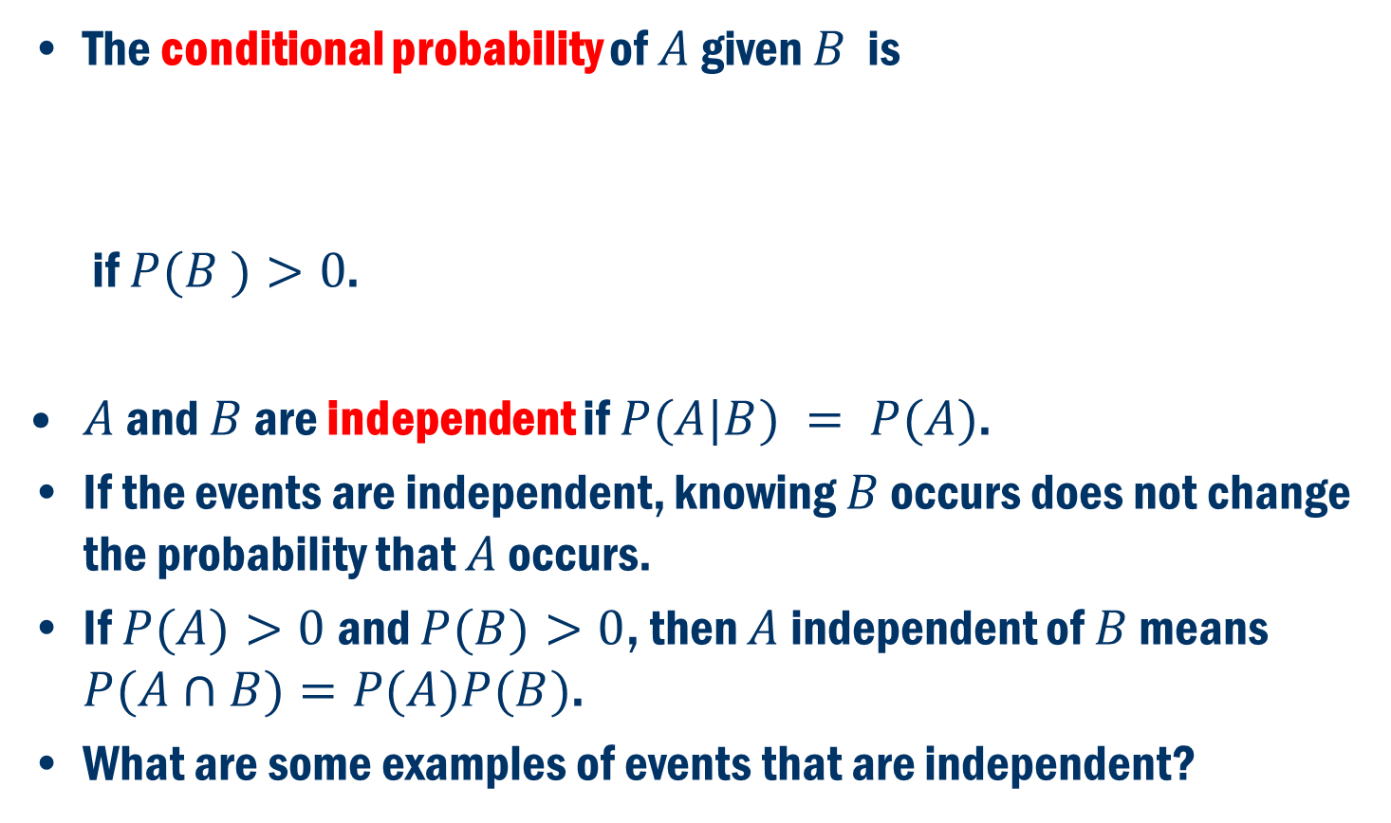
Conditional Probability and Independence
The conditional probability of $A$ given $B$ is
if $P(B )>0$.
$A$ and $B$ are independent if $P(A|B) = P(A)$.
If the events are independent, knowing $B$ occurs does not change the probability that $A$ occurs.
If $P(A)>0$and $P(B)>0$, then $A$ independent of $B$ means $P(A∩B)=P(A)P(B)$.
What are some examples of events that are independent?

Slide 13
Back to the examples
For the salary example, is the gender of the student selected independent of the student’s major?
 | Education | Engineering | Total
Female | 856 | 232 | 1088
Male | 220 | 924 | 1144
Total | 1076 | 1156 | 2232

Slide 14
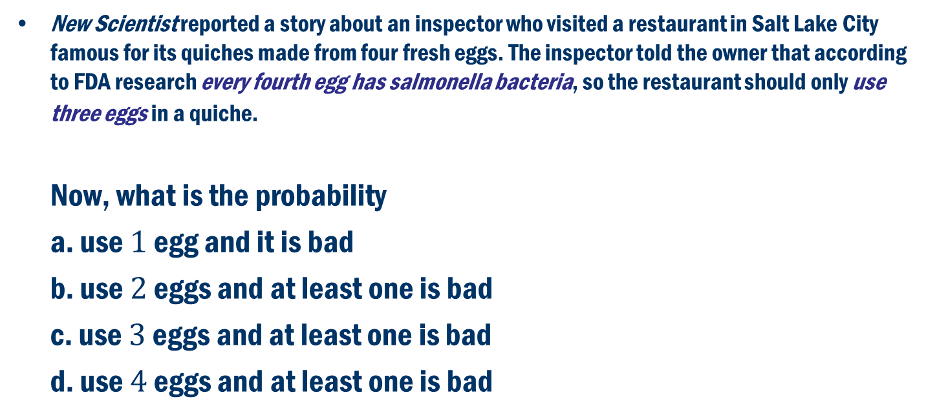
Applying the multiplication rule to independent events: The bad egg?
New Scientist reported a story about an inspector who visited a restaurant in Salt Lake City famous for its quiches made from four fresh eggs. The inspector told the owner that according to FDA research every fourth egg has salmonella bacteria, so the restaurant should only use three eggs in a quiche.
Now, what is the probability
a. use $1$ egg and it is bad
b. use $2$ eggs and at least one is bad
c. use $3$ eggs and at least one is bad
d. use $4$ eggs and at least one is bad

Slide 15
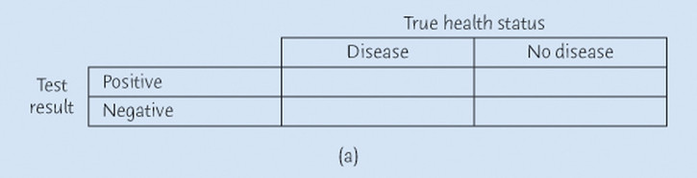
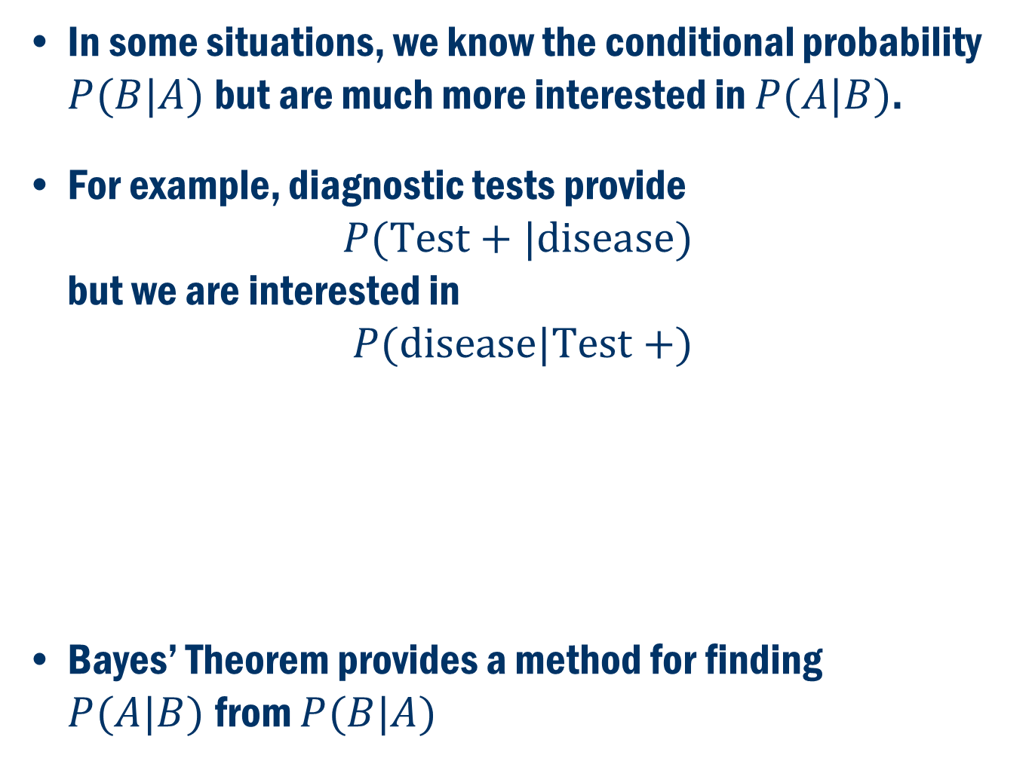
Bayes’ Theorem
In some situations, we know the conditional probability $P(B|A)$but are much more interested in $P(A|B)$.
For example, diagnostic tests provide $P(Test+|disease)$ but we are interested in
$$P(disease|Test +)$$
Bayes’ Theorem provides a method for finding $P(A|B)$from $P(B|A)$
False positive
False negative

Slide 16
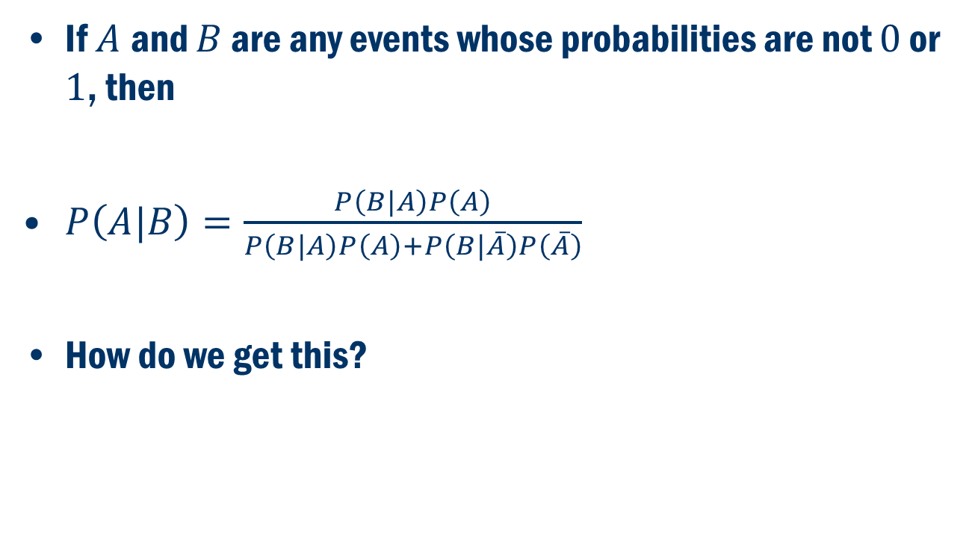
Bayes’ Formula
If $A$and $B$ are any events whose probabilities are not $0$ or $1$, then
$P\left(A|B\right)=\frac{P\left(B|A\right)P\left(A\right)}{P\left(B|A\right)P\left(A\right)+P\left(B|\overline{A}\right)P\left(\overline{A}\right)}$
How do we get this?

Slide 17
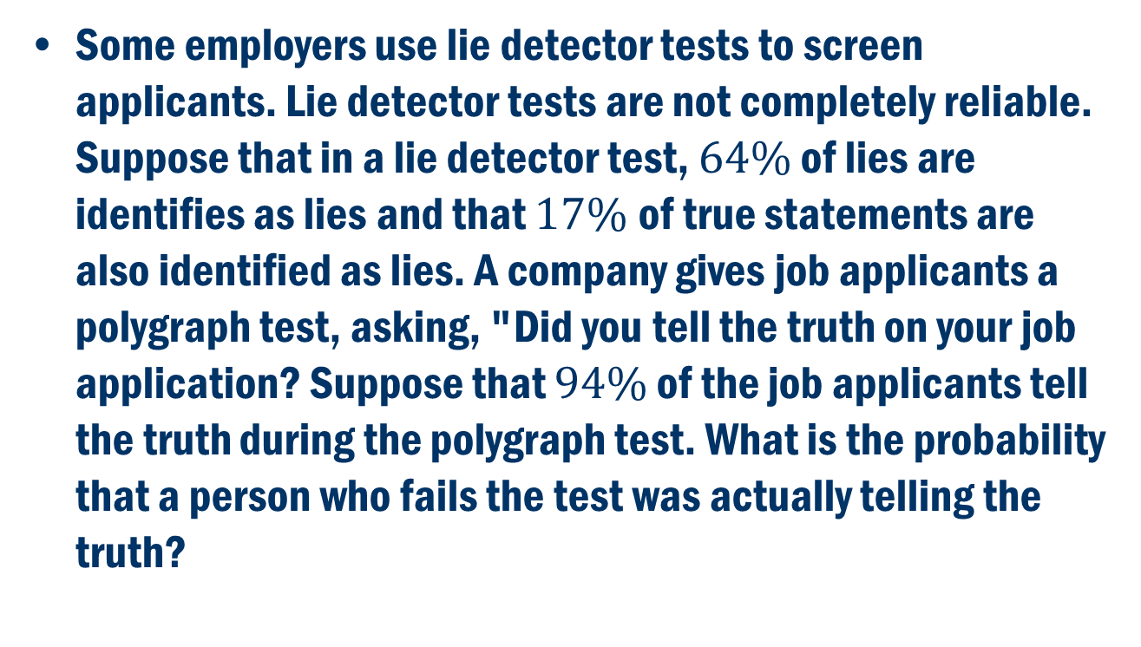
Polygraph TEST
Some employers use lie detector tests to screen applicants. Lie detector tests are not completely reliable. Suppose that in a lie detector test, $64\%$ of lies are identifies as lies and that $17\%$of true statements are also identified as lies. A company gives job applicants a polygraph test, asking, "Did you tell the truth on your job application? Suppose that $94\%$ of the job applicants tell the truth during the polygraph test. What is the probability that a person who fails the test was actually telling the truth?

Slide 18
Law of total probability and Bayes rule

Slide 19
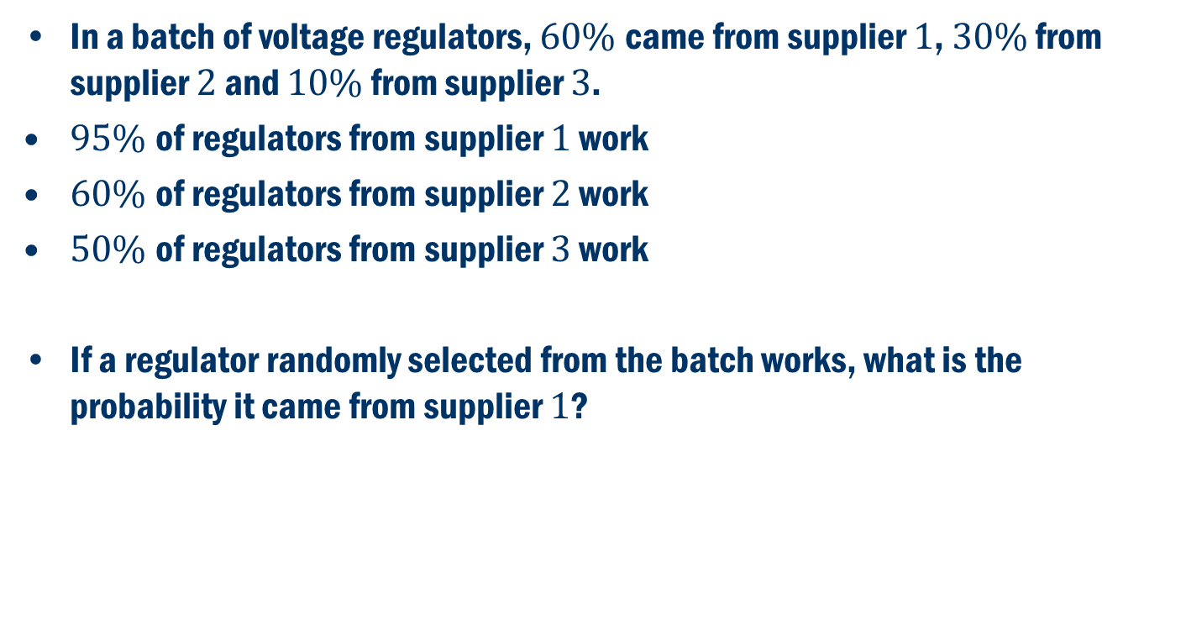
Voltage regulator example
In a batch of voltage regulators, $60\%$came from supplier $1$, $30\%$ from supplier $2$ and $10\%$ from supplier $3$.
$95\%$of regulators from supplier $1$ work
$60\%$of regulators from supplier $2$ work
$50\%$of regulators from supplier $3$ work
If a regulator randomly selected from the batch works, what is the probability it came from supplier $1$?

Slide 20
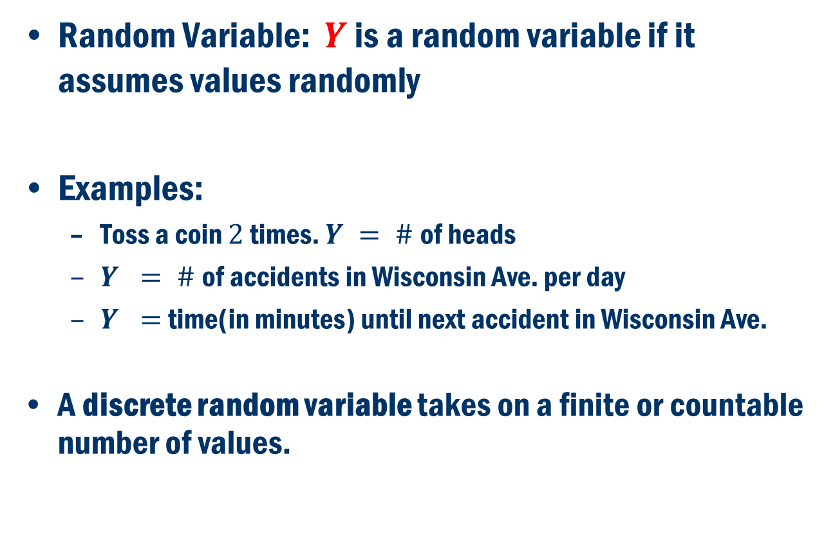
Random Variables
Random Variable: $Y$ is a random variable if it assumes values randomly
Examples:
Toss a coin $2$ times. $Y = \#$of heads
$Y = \#$of accidents in Wisconsin Ave. per day
$Y =$ time(in minutes) until next accident in Wisconsin Ave.
A discrete random variable takes on a finite or countable number of values.

Slide 21
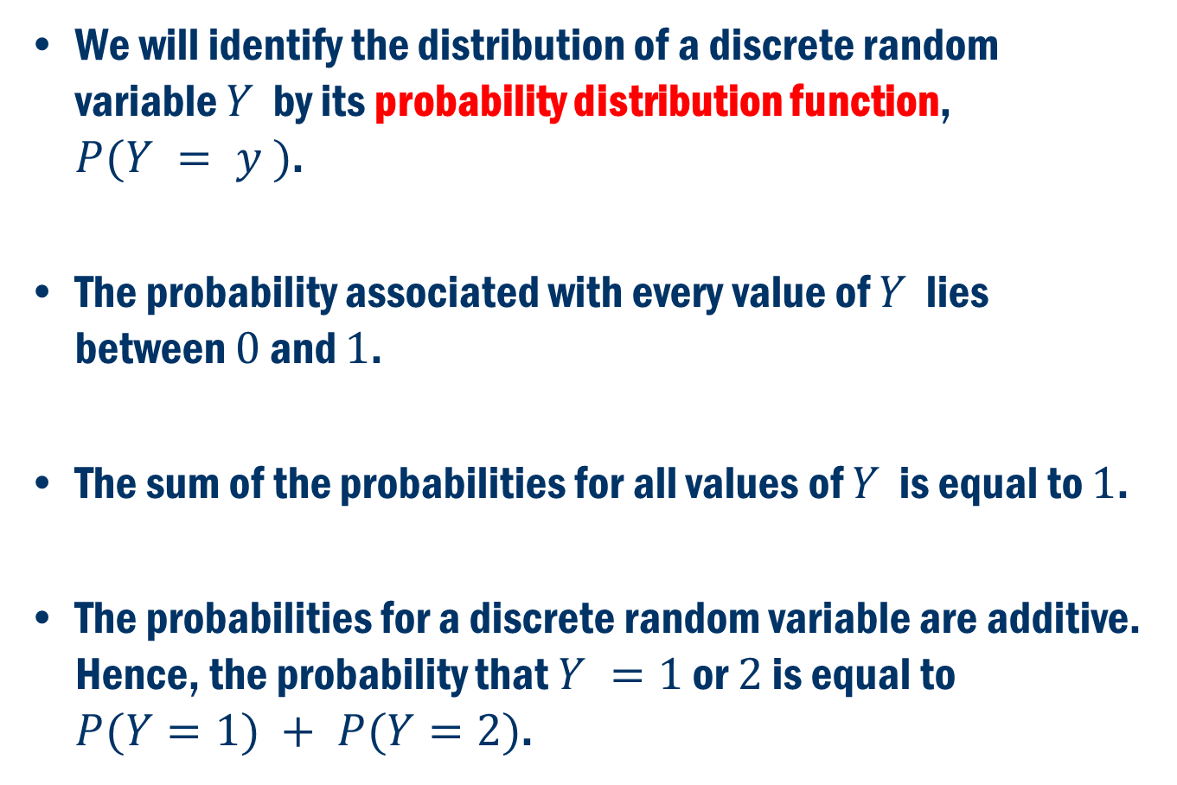
discrete random variable
We will identify the distribution of a discrete random variable $Y$ by its probability distribution function, $P(Y = y )$.
The probability associated with every value of $Y$ lies between $0$ and $1$.
The sum of the probabilities for all values of $Y$ is equal to $1$.
The probabilities for a discrete random variable are additive. Hence, the probability that $Y =1$ or $2$ is equal to $P(Y=1) + P(Y=2)$.

Slide 22
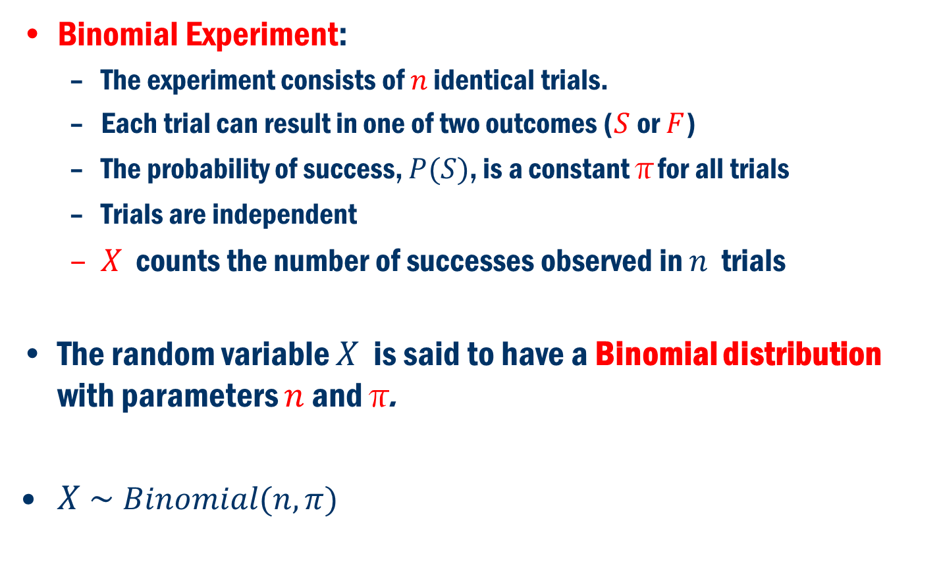
Binomial distribution
Binomial Experiment:
The experiment consists of $n$ identical trials.
Each trial can result in one of two outcomes ($S$or $F$)
The probability of success, $P(S)$, is a constant π for all trials
Trials are independent
$X$ counts the number of successes observed in $n$ trials
The random variable $X$ is said to have a Binomial distribution with parameters $n$ and π.
$X \sim Binomial(n, π)$

Slide 23
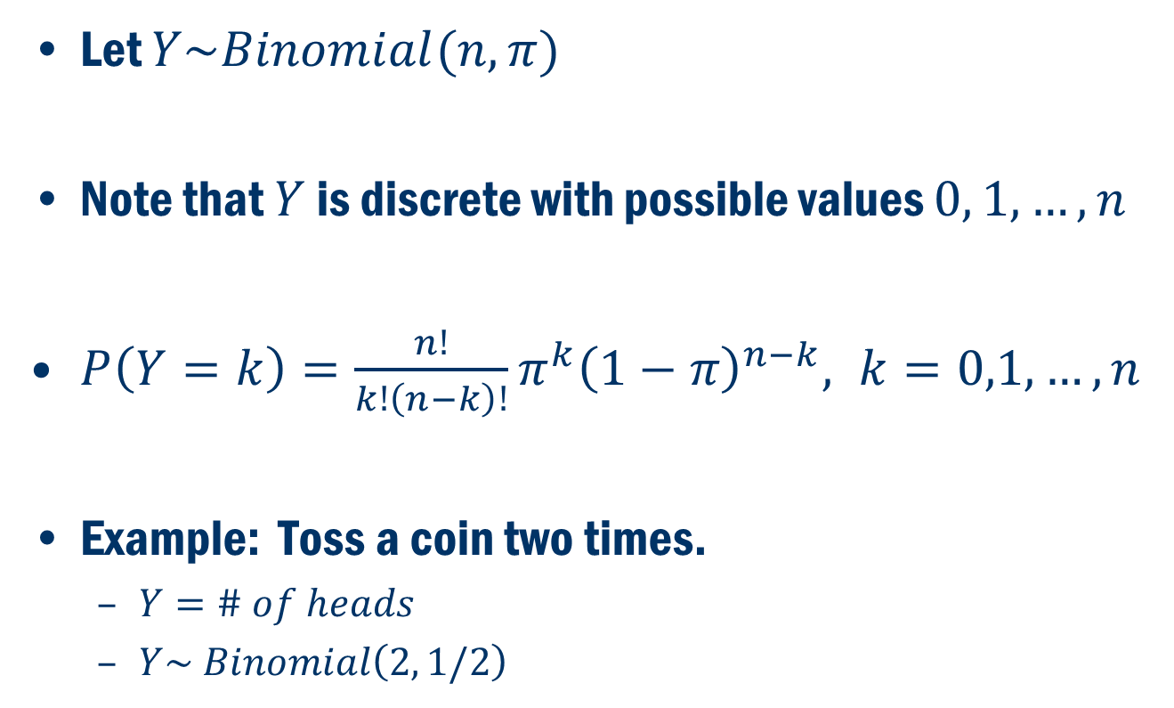
Binomial distribution Cont…
Let $Y\sim Binomial(n, π)$
Note that $Y$ is discrete with possible values $0, 1, …, n$
$P\left(Y=k\right)=\frac{n!}{k!\left(n−k\right)!}π^{k}{\left(1−π\right)}^{n−k}, k=0,1,…,n$
Example: Toss a coin two times.
$Y=\# of heads$
$Y\sim Binomial\left(2, 1/2\right)$

Slide 24
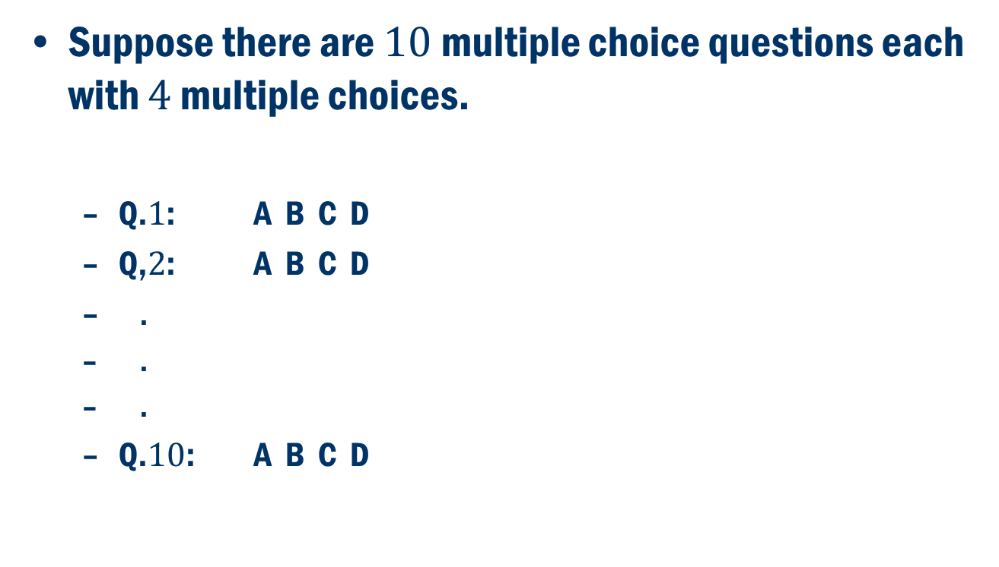
Another Example
Suppose there are $10$ multiple choice questions each with $4$ multiple choices.
Q.$1$: A B C D
Q,$2$: A B C D
.
.
.
Q.$10$: A B C D

Slide 25
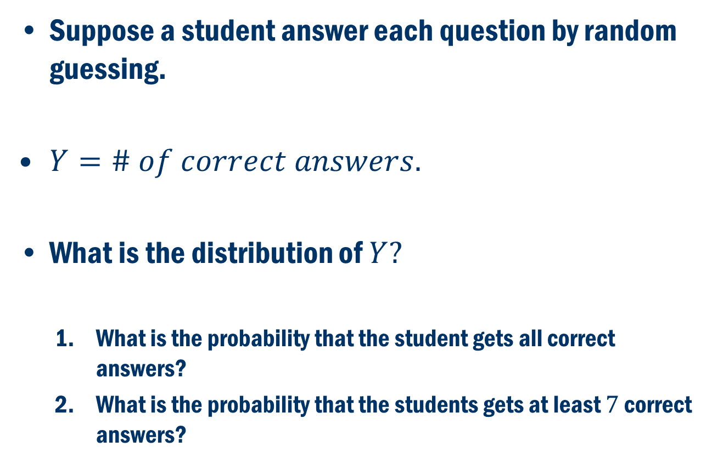
Multiple choice Example
Suppose a student answer each question by random guessing.
$Y=\# of correct answers.$
What is the distribution of $Y?$
What is the probability that the student gets all correct answers?
What is the probability that the students gets at least $7$ correct answers?

Slide 26
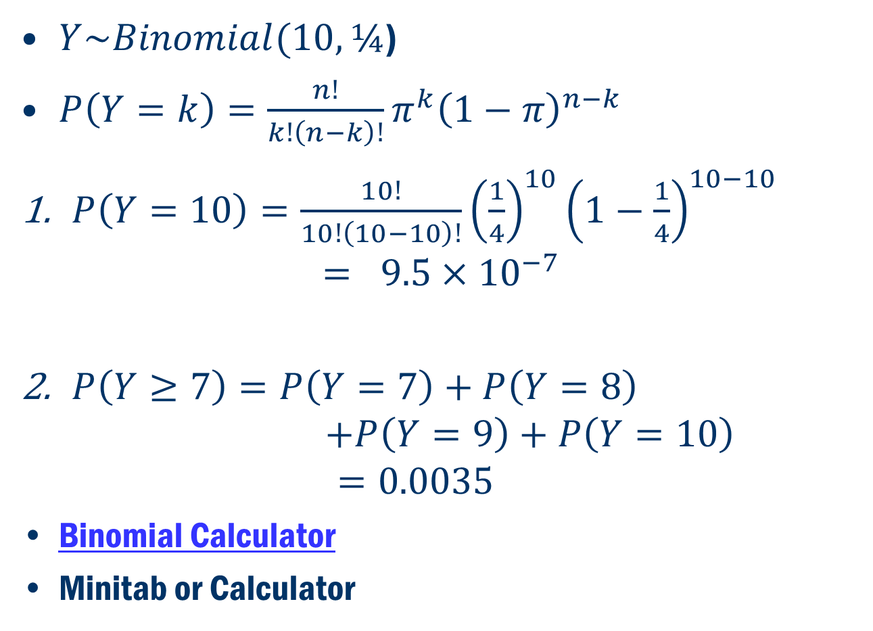
Example CONT.
$Y\sim Binomial(10, ¼$)
$P\left(Y=k\right)=\frac{n!}{k!\left(n−k\right)!}π^{k}{\left(1−π\right)}^{n−k}$
$P\left(Y=10\right)=\frac{10!}{10!\left(10−10\right)!}{\left(\frac{1}{4}\right)}^{10}{\left(1−\frac{1}{4}\right)}^{10−10}$ $= 9.5×{10}^{−7}$
$P\left(Y≥7\right)=P\left(Y=7\right)+P\left(Y=8\right)$ $+P\left(Y=9\right)+P\left(Y=10\right)$ $=0.0035$
Binomial Calculator
Minitab or Calculator

Slide 27
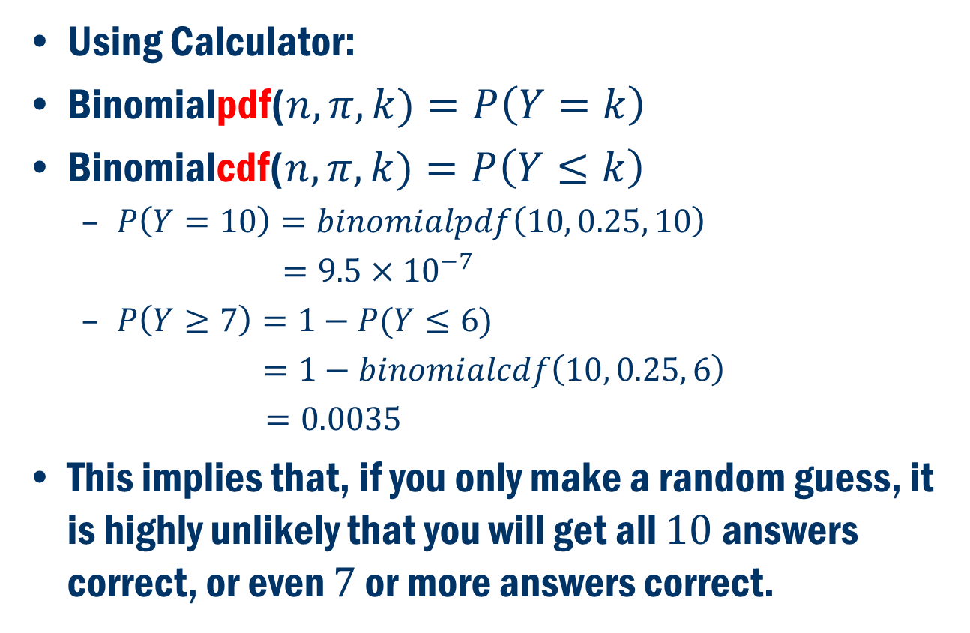
Example CONT.
Using Calculator:
Binomialpdf($n, π, k)=P\left(Y=k\right)$
Binomialcdf($n, π, k)=P\left(Y≤k\right)$
$P\left(Y=10\right)=binomialpdf\left(10, 0.25, 10\right)$
$=9.5×{10}^{−7}$
$P\left(Y≥7\right)=1−P(Y≤6)$
$=1−binomialcdf\left(10, 0.25, 6\right)$
$=0.0035$
This implies that, if you only make a random guess, it is highly unlikely that you will get all $10$ answers correct, or even $7$ or more answers correct.

Slide 28
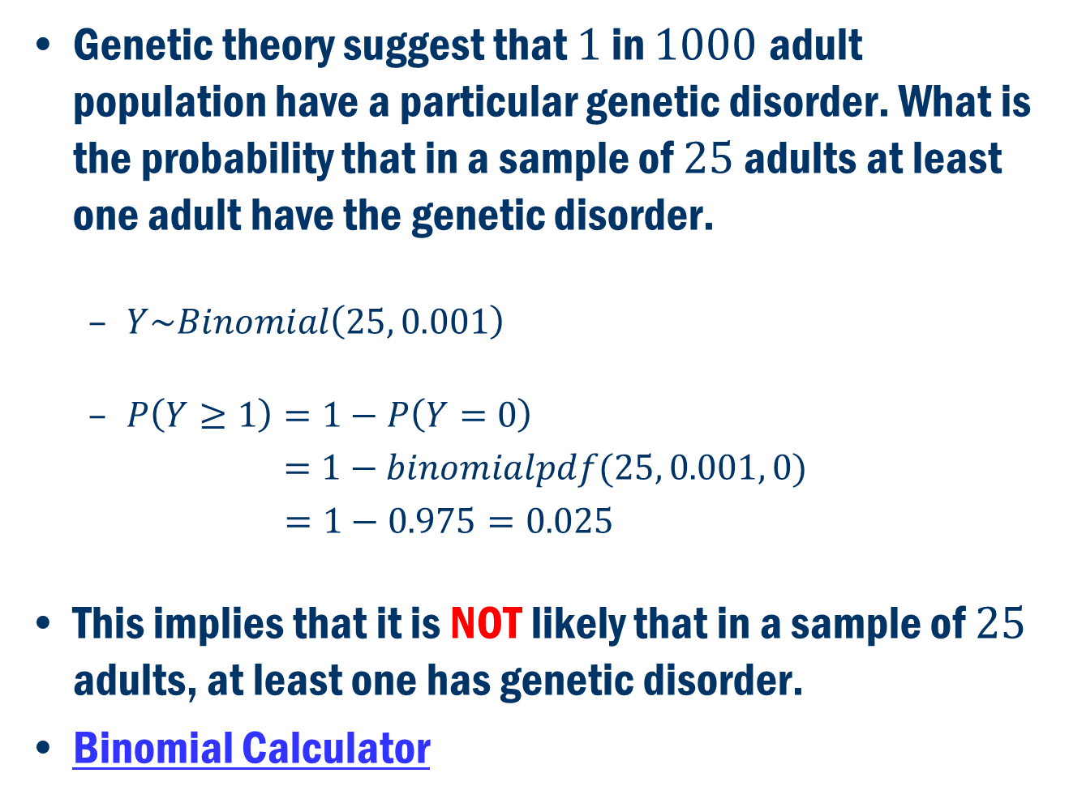
Example
Genetic theory suggest that $1$ in $1000$adult population have a particular genetic disorder. What is the probability that in a sample of $25$ adults at least one adult have the genetic disorder.
$Y\sim Binomial\left(25, 0.001\right)$
$P\left(Y≥1\right)=1−P\left(Y=0\right)$
$=1−binomialpdf(25, 0.001, 0)$
$=1−0.975=0.025$
This implies that it is NOT likely that in a sample of $25$ adults, at least one has genetic disorder.
Binomial Calculator

Slide 29
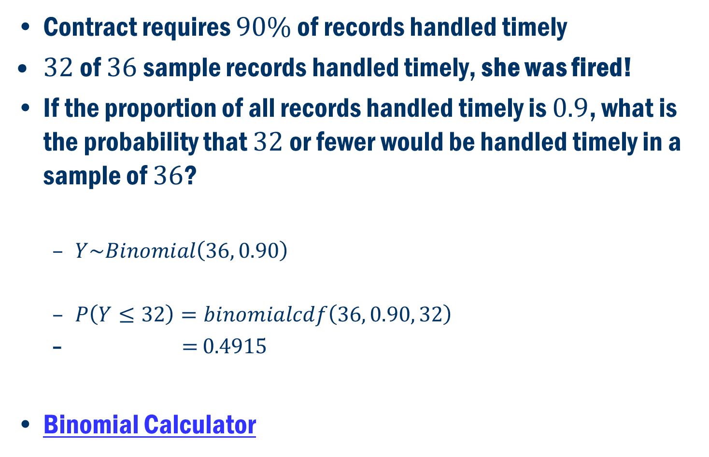
Nurse employment case
Contract requires $90\%$ of records handled timely
$32$ of $36$ sample records handled timely, she was fired!
If the proportion of all records handled timely is $0.9$, what is the probability that $32$ or fewer would be handled timely in a sample of $36$?
$Y\sim Binomial\left(36, 0.90\right)$
$P\left(Y≤32\right)=binomialcdf\left(36, 0.90, 32\right)$
$=$ $0.4915$
Binomial Calculator

Slide 30
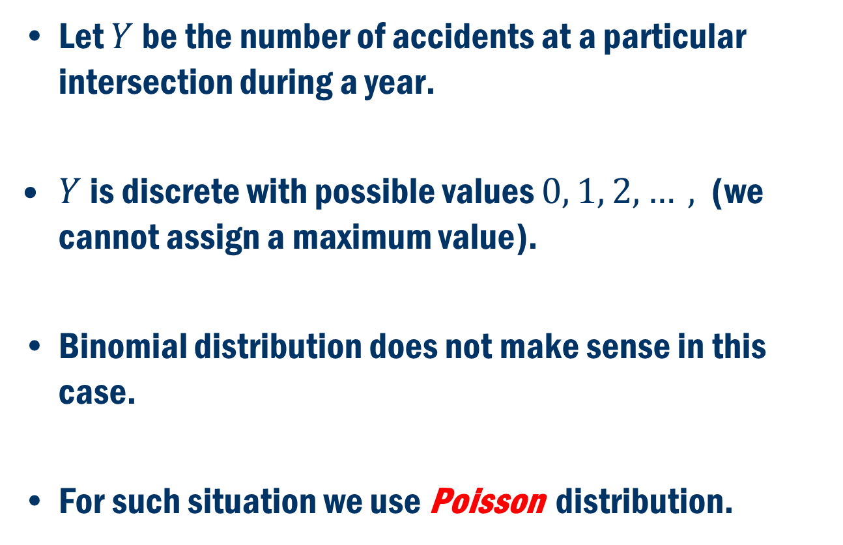
Poisson Distribution
Let $Y$ be the number of accidents at a particular intersection during a year.
$Y$ is discrete with possible values $0, 1, 2, …,$ (we cannot assign a maximum value).
Binomial distribution does not make sense in this case.
For such situation we use Poisson distribution.

Slide 31
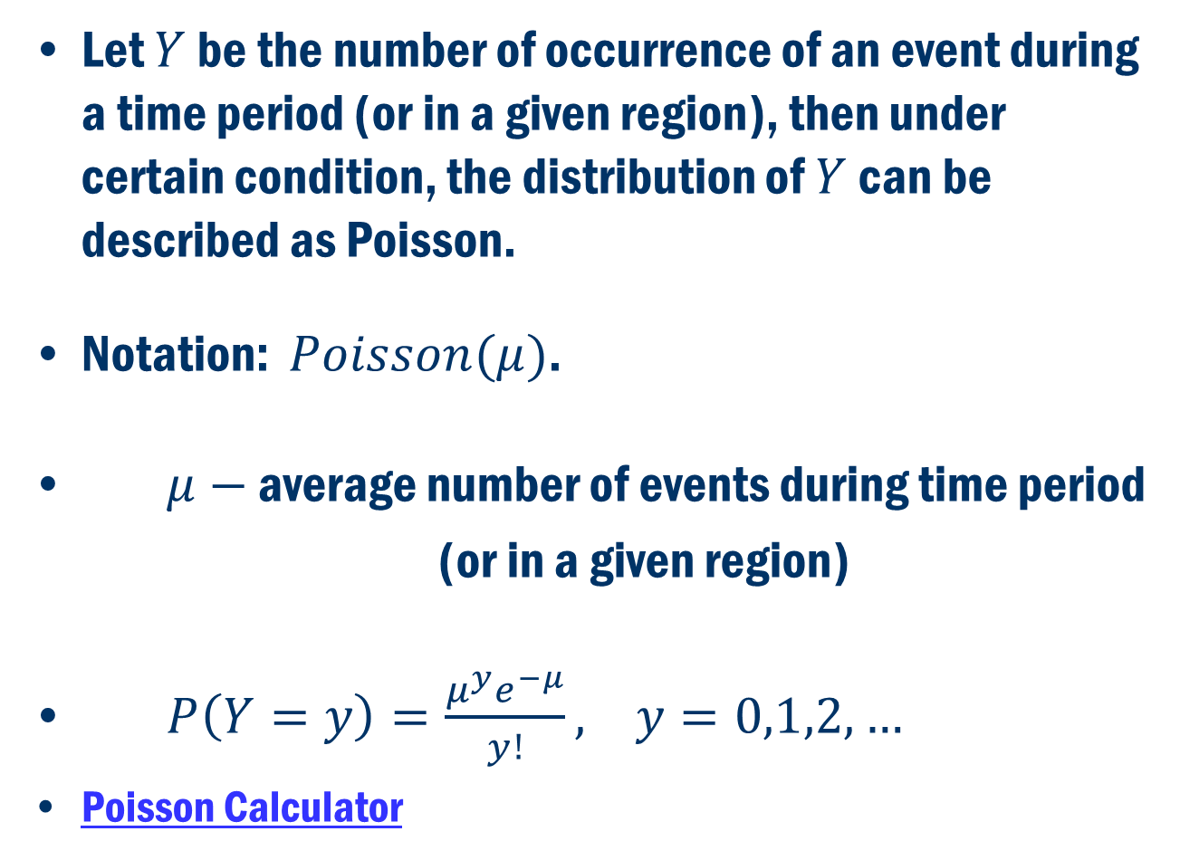
Poisson Distribution
Let $Y$ be the number of occurrence of an event during a time period (or in a given region), then under certain condition, the distribution of $Y$ can be described as Poisson.
Notation: $Poisson(μ)$.
$μ−$ average number of events during time period
(or in a given region)
$P\left(Y=y\right)=\frac{{μ^{y}e}^{−μ}}{y!}, y=0,1,2,…$
Poisson Calculator

Slide 32
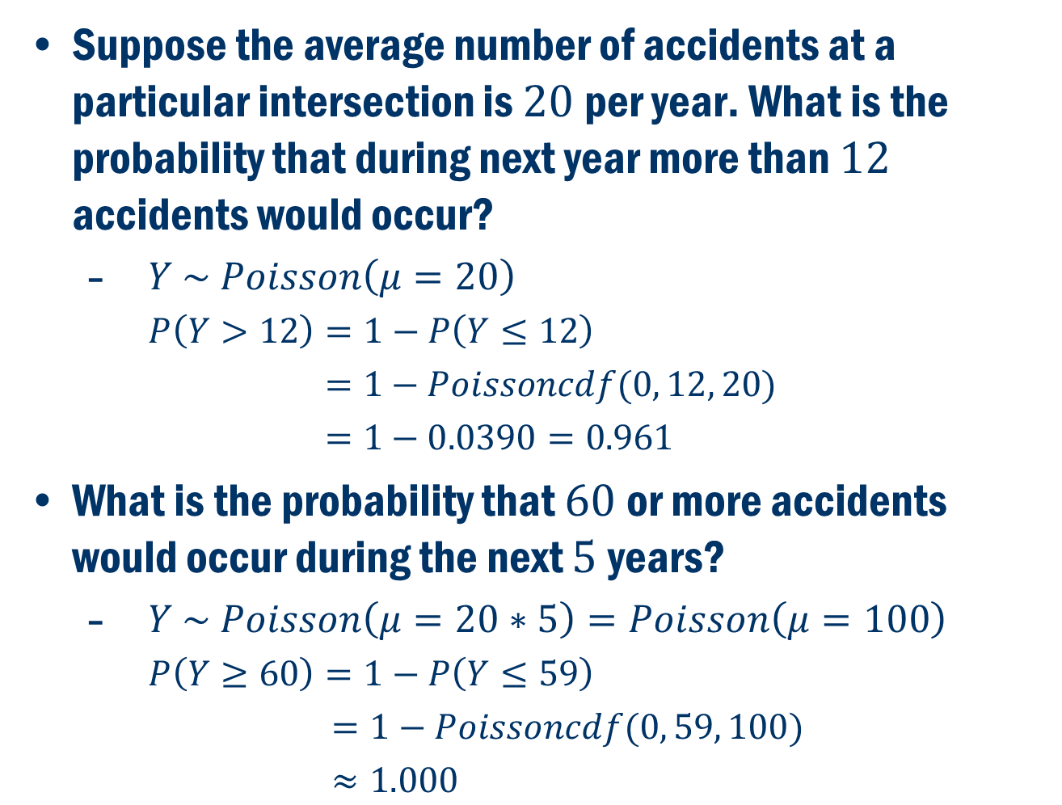
Example 1
Suppose the average number of accidents at a particular intersection is $20$per year. What is the probability that during next year more than $12$ accidents would occur?
$Y \sim Poisson\left(μ=20\right)$
$P\left(Y>12\right)=1−P\left(Y≤12\right)$
$=1−Poissoncdf(0, 12, 20)$
$=1−0.0390=0.961$
What is the probability that $60$or more accidents would occur during the next $5$years?
$Y \sim Poisson\left(μ=20∗5\right)=Poisson\left(μ=100\right)$
$P\left(Y≥60\right)=1−P\left(Y≤59\right)$
$=1−Poissoncdf(0, 59, 100)$
$≈1.000$
Poisson Calculator

Slide 33
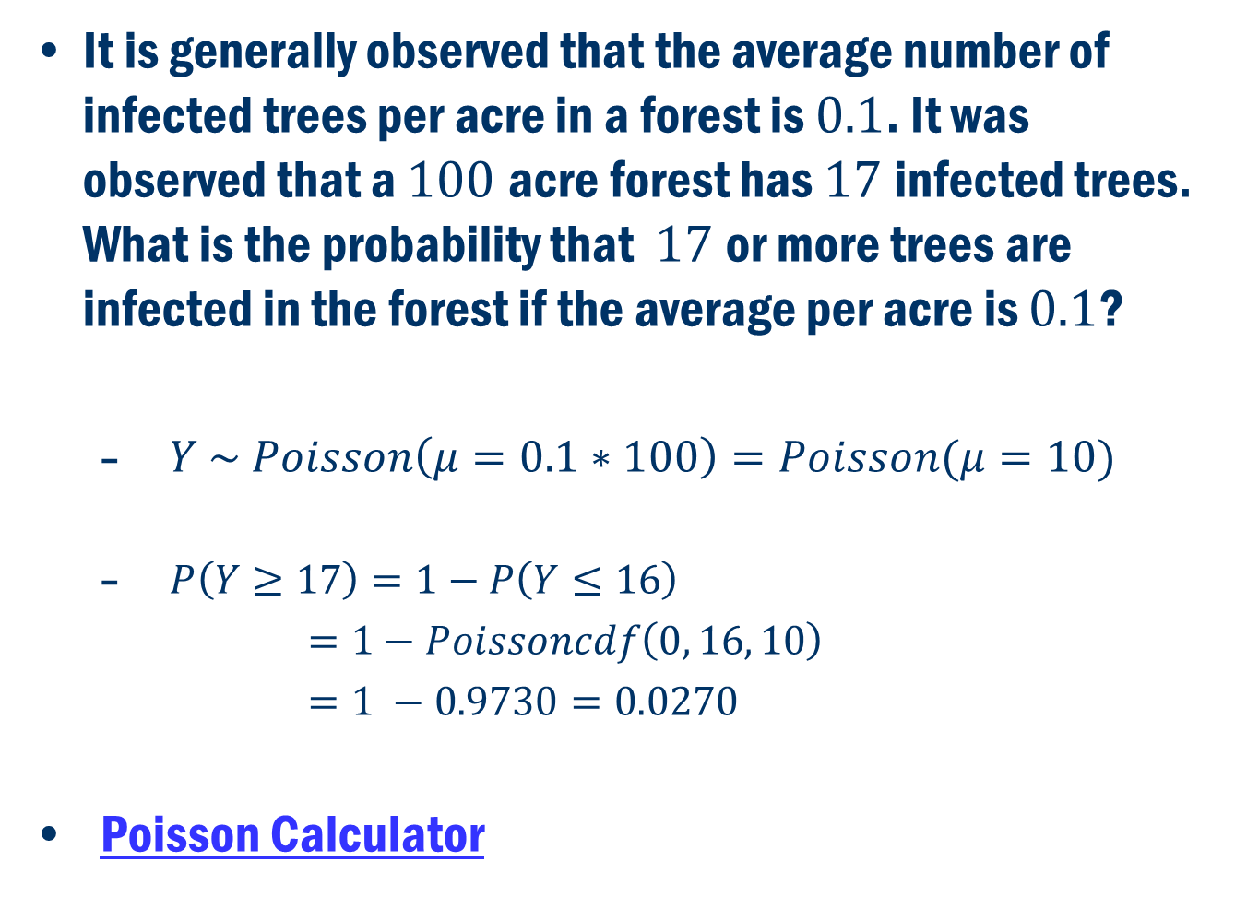
Example 2
It is generally observed that the average number of infected trees per acre in a forest is $0.1$. It was observed that a $100$acre forest has $17$infected trees. What is the probability that $17$or more trees are infected in the forest if the average per acre is $0.1$?
$Y \sim Poisson\left(μ=0.1∗100\right)=Poisson(μ=10)$
$P\left(Y≥17\right)=1−P\left(Y≤16\right)$
$=1−Poissoncdf\left(0, 16, 10\right)$
$=1 −0.9730=0.0270$
Poisson Calculator

Slide 34

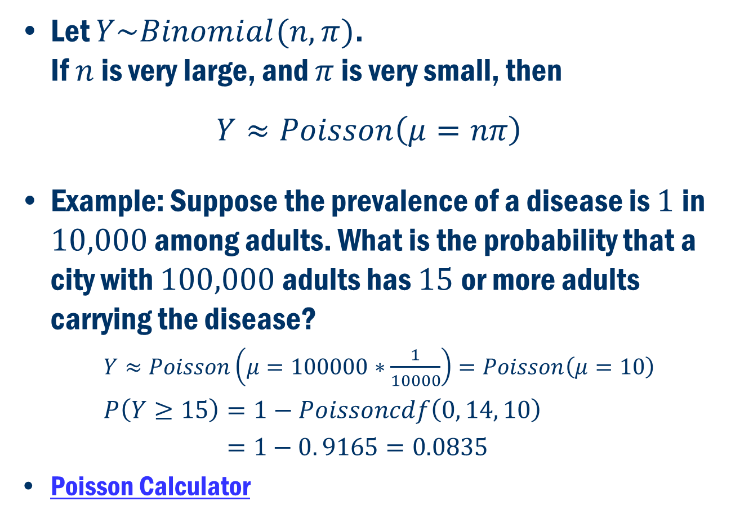
Poisson Approximation of the $Binomial(n, π)$ distribution
Let $Y\sim Binomial(n, π)$. If $n$ is very large, and $π$ is very small, then
$$Y≈Poisson\left(μ=nπ\right)$$
Example: Suppose the prevalence of a disease is $1$in $10,000$ among adults. What is the probability that a city with $100,000$ adults has $15$or more adults carrying the disease?
$Y≈Poisson\left(μ=100000∗\frac{1}{10000}\right)=Poisson\left(μ=10\right)$
$P\left(Y≥15\right)=1−Poissoncdf\left(0, 14, 10\right)$
$=1−0. 9165=0.0835$
Poisson Calculator

