Slide 1
Chapter 4 (Part B)

Slide 2
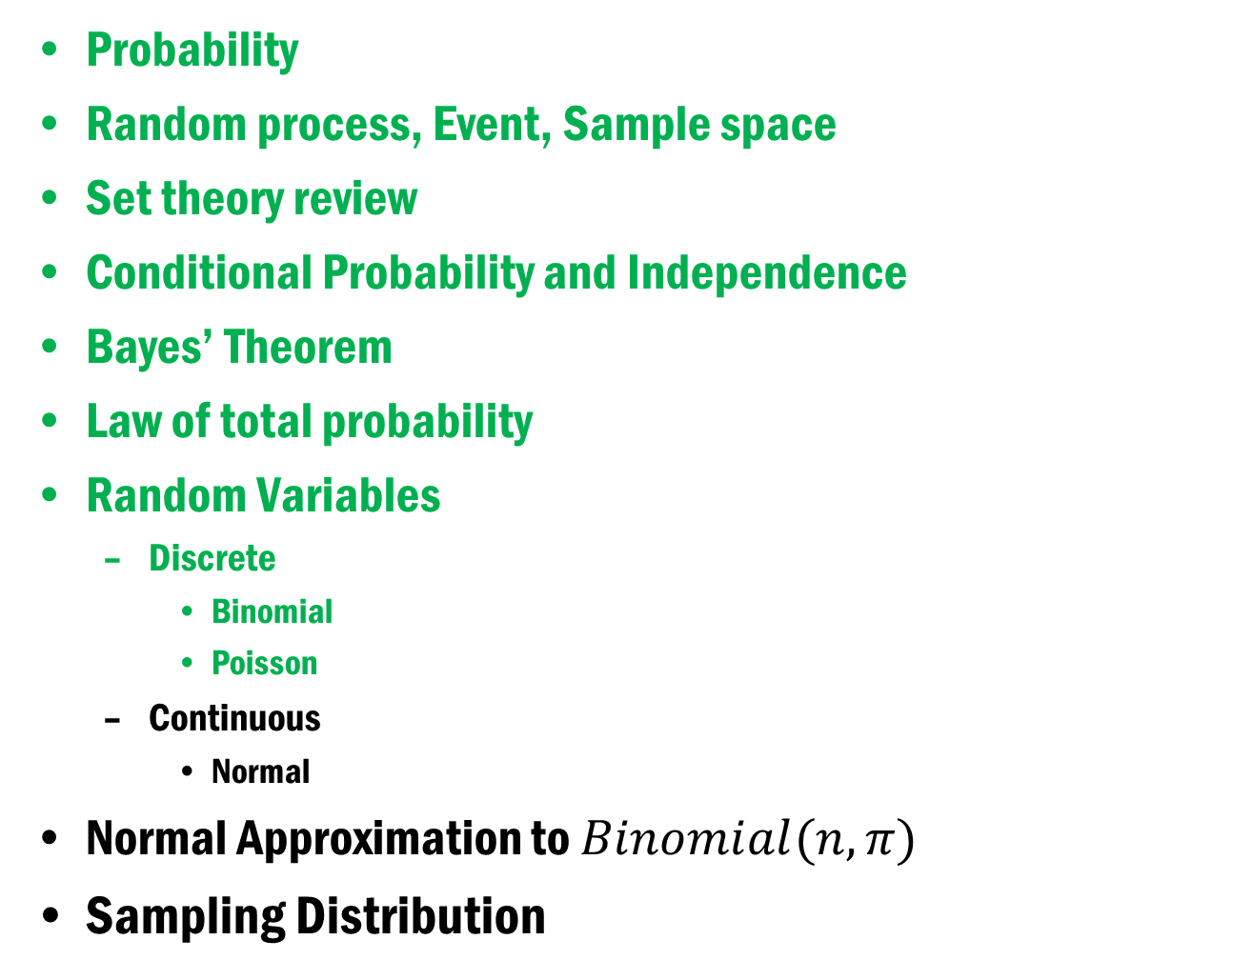
Chapter 4 (Part B)
Probability
Random process, Event, Sample space
Set theory review
Conditional Probability and Independence
Bayes’ Theorem
Law of total probability
Random Variables
Discrete
Binomial
Poisson
Continuous
Normal
Normal Approximation to $Binomial(n, π)$
Sampling Distribution

Slide 3
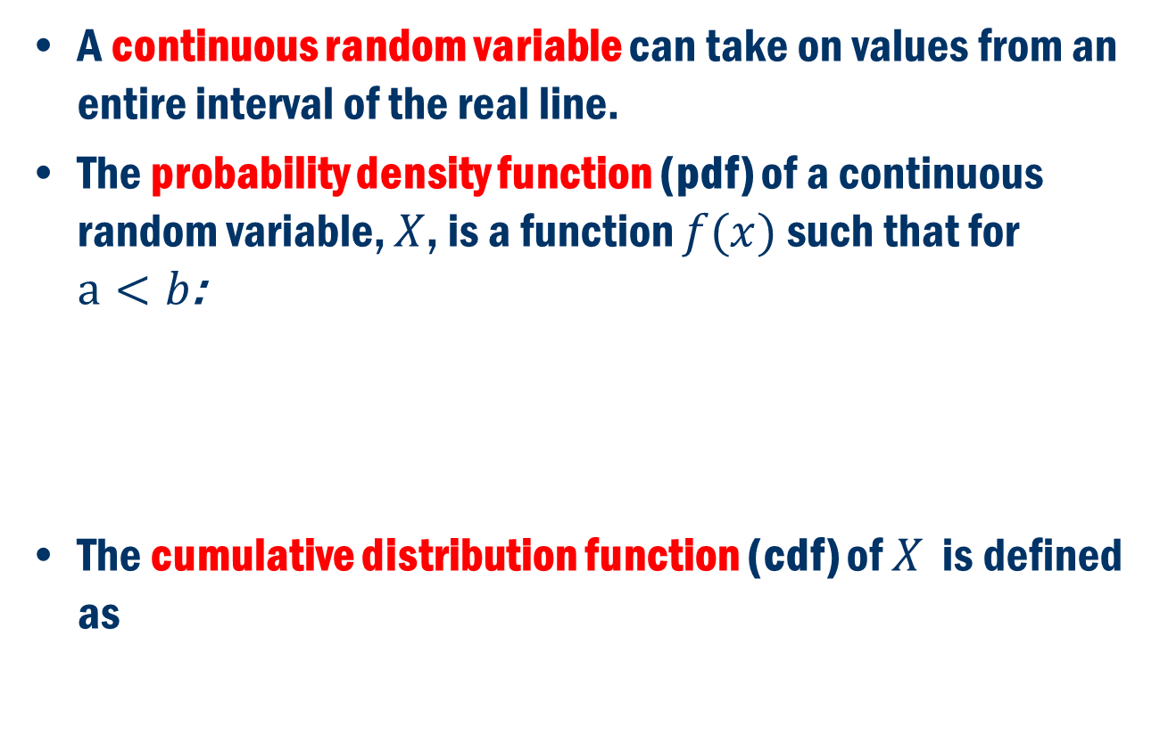
Continuous Random Variables
A continuous random variable can take on values from an entire interval of the real line.
The probability density function (pdf) of a continuous random variable, $X$, is a function $f(x)$ such that for $a<b$:
The cumulative distribution function (cdf) of $X$ is defined as

Slide 4

Some relationships
What is the relationship between $f$ and $F$ ?
$P (a ≤ X ≤ b) = F (b) – F (a)$
$P\left(X = a\right) = P \left(a ≤ X ≤ a\right)$
$$= F (a) – F (a) = 0$$

Slide 5
Requirements of a pdf
A pdf must satisfy the following two requirements:
A density curve shows the likelihood of a random variable at all possible values.
The area under the curve and above any range of values on the horizontal axis is the proportion of all observations that fall in that range.
0

Slide 6
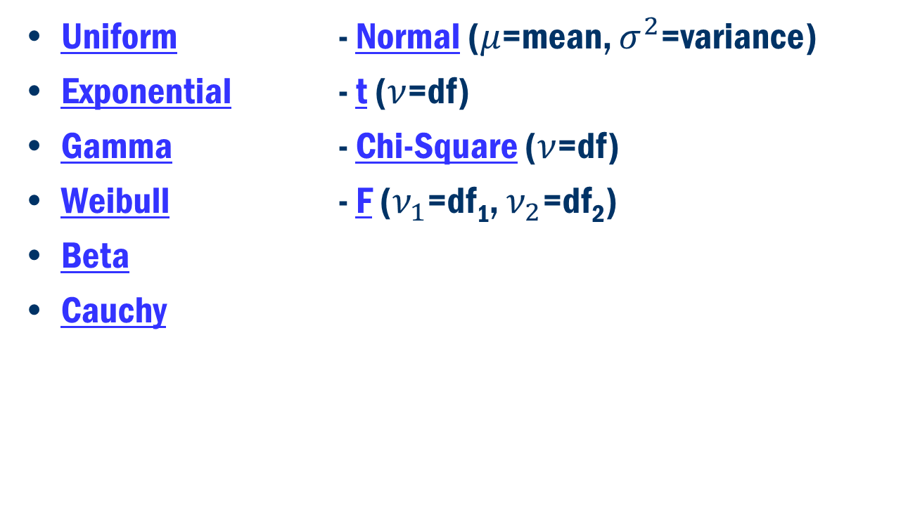
Some Common Continuous Distributions:
Uniform - Normal ($μ$=mean, $σ^{2}$=variance)
Exponential - t ($ν$=df)
Gamma - Chi-Square ($ν$=df)
Weibull - F ($ν_{1}$=df₁, $ν_{2}$=df₂)
Beta
Cauchy

Slide 7
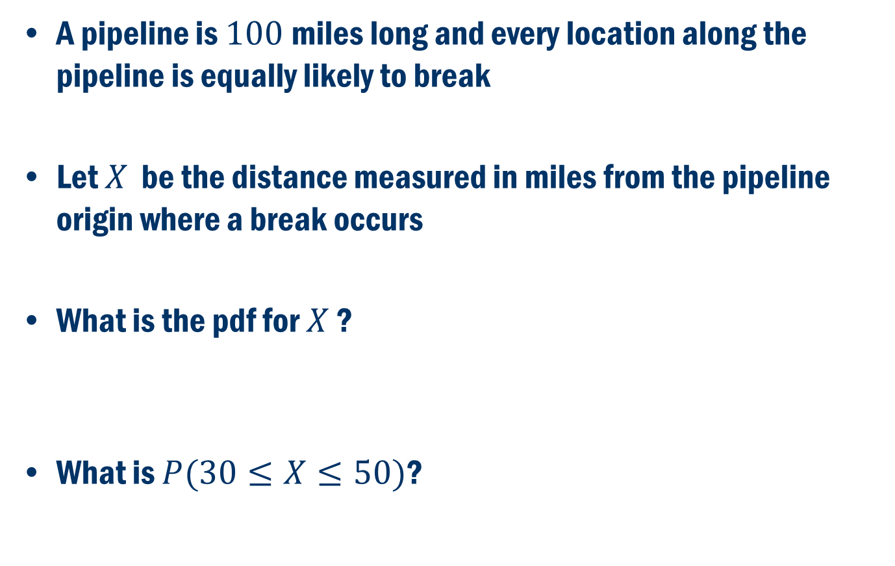
Pipeline example
A pipeline is $100$miles long and every location along the pipeline is equally likely to break
Let $X$ be the distance measured in miles from the pipeline origin where a break occurs
What is the pdf for $X$ ?
What is $P(30≤X≤50)$?

Slide 8
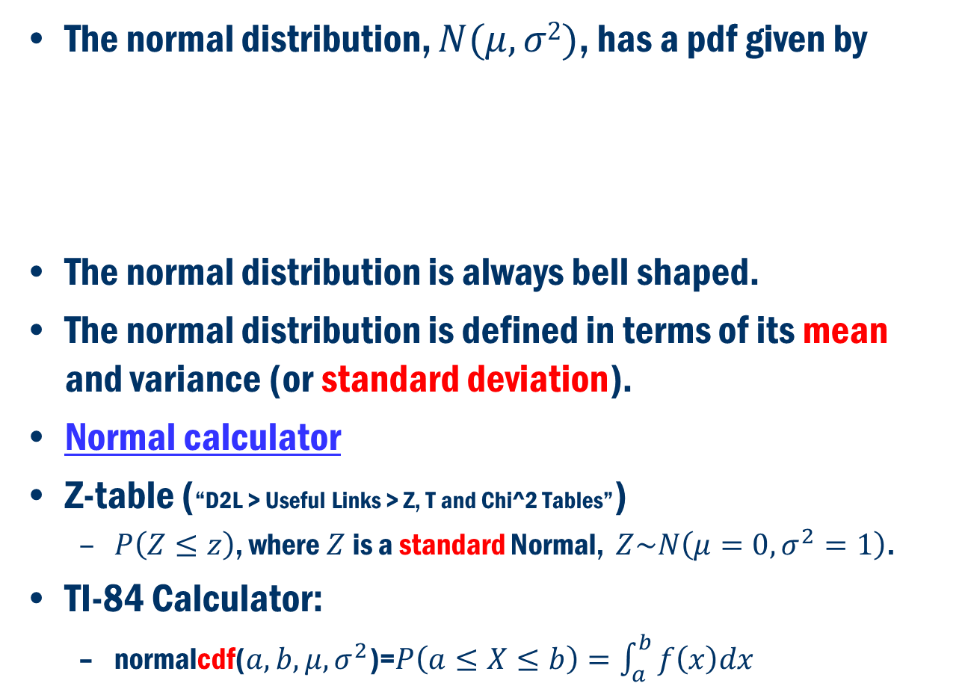
Normal distribution
The normal distribution, $N(μ,σ2)$, has a pdf given by
The normal distribution is always bell shaped.
The normal distribution is defined in terms of its mean and variance (or standard deviation).
Normal calculator
Z-table (“D2L > Useful Links > Z, T and Chi^2 Tables”)
$P\left(Z≤z\right)$, where $Z$is a standard Normal, $Z\sim N\left(μ=0,σ^{2}=1\right)$.
TI-84 Calculator:
normalcdf($a,b,μ,σ^{2}$)=$P\left(a≤X≤b\right)=\int_{a}^{b}{f\left(x\right)dx}$

Slide 9
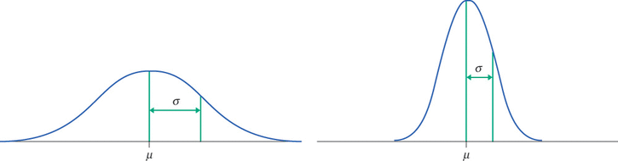
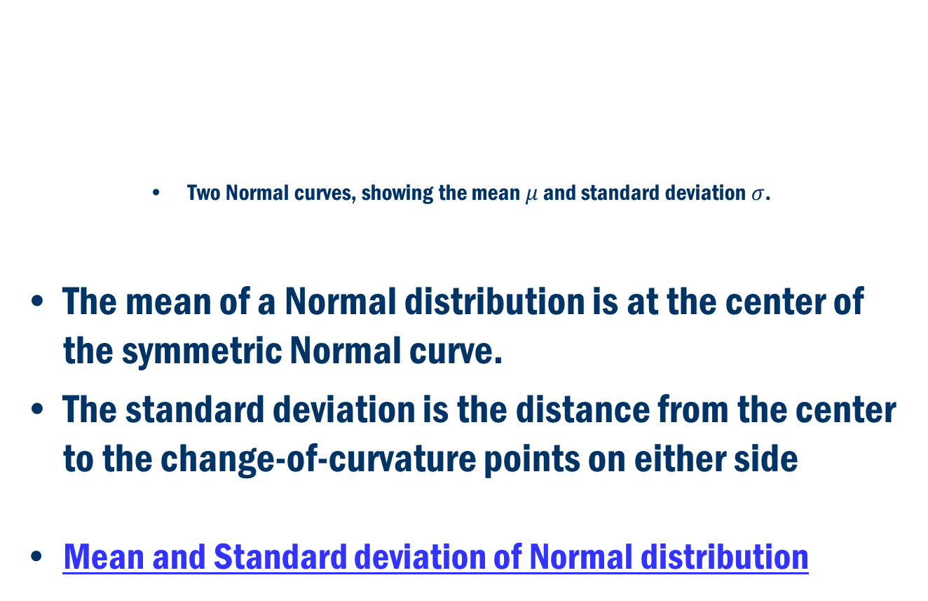
The normal distribution
Two Normal curves, showing the mean $μ$ and standard deviation $σ$.
The mean of a Normal distribution is at the center of the symmetric Normal curve.
The standard deviation is the distance from the center to the change-of-curvature points on either side
Mean and Standard deviation of Normal distribution

Slide 10
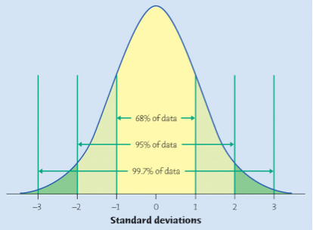
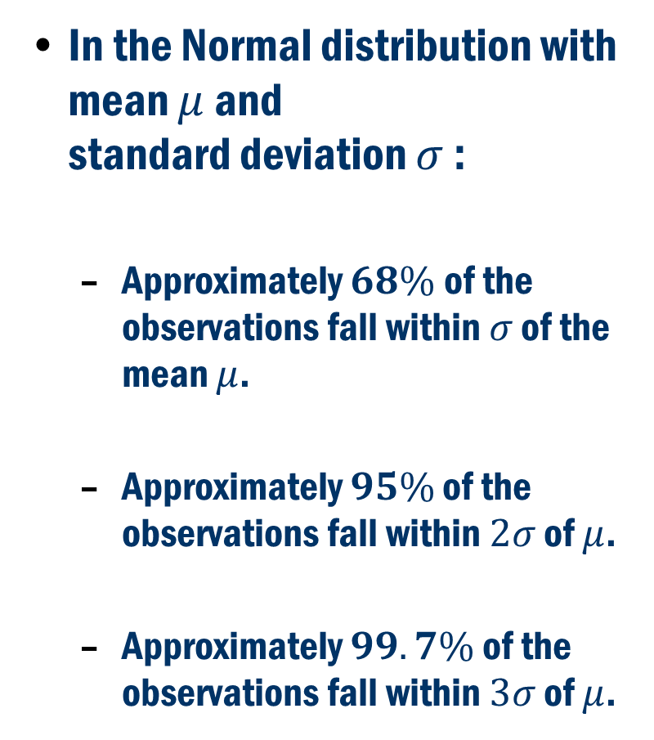
Flashback to The 68–95–99.7 rule (a.k.a. the Empirical Rule)
In the Normal distribution with mean $μ$ and standard deviation $σ$ :
Approximately $68\%$of the observations fall within $σ$ of the mean $μ$.
Approximately $95\%$ of the observations fall within $2σ$ of $μ$.
Approximately $99.7\%$ of the observations fall within $3σ$ of $μ$.

Slide 11
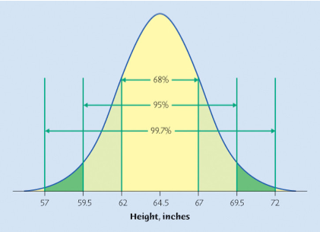
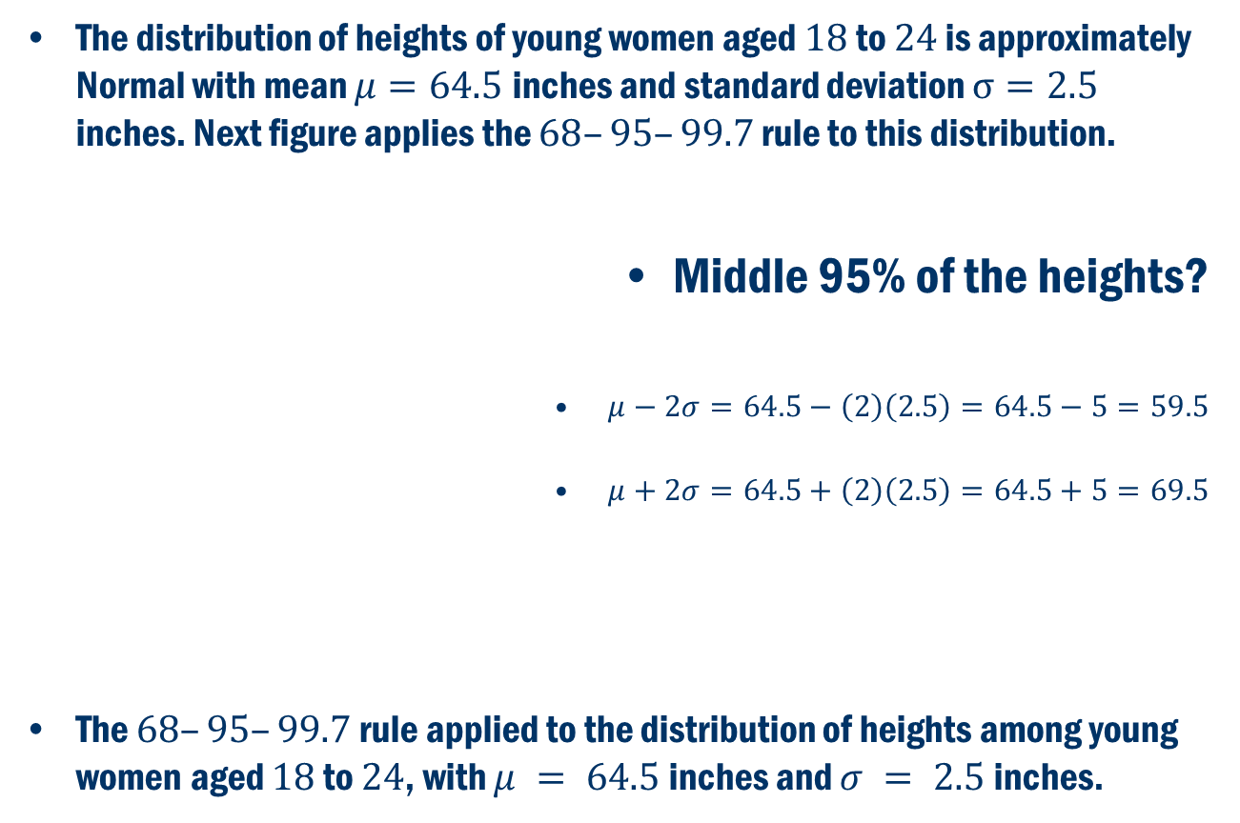
Example: Heights of young women
The distribution of heights of young women aged $18$ to $24$ is approximately Normal with mean $μ=64.5$inches and standard deviation $σ=2.5$ inches. Next figure applies the $68–95–99.7$ rule to this distribution.
Middle 95% of the heights?
$μ−2σ=64.5−\left(2\right)\left(2.5\right)=64.5−5=59.5$
$μ+2σ=64.5+\left(2\right)\left(2.5\right)=64.5+5=69.5$
The $68–95–99.7$ rule applied to the distribution of heights among young women aged $18$ to $24$, with $μ = 64.5$inches and $σ = 2.5$inches.

Slide 12
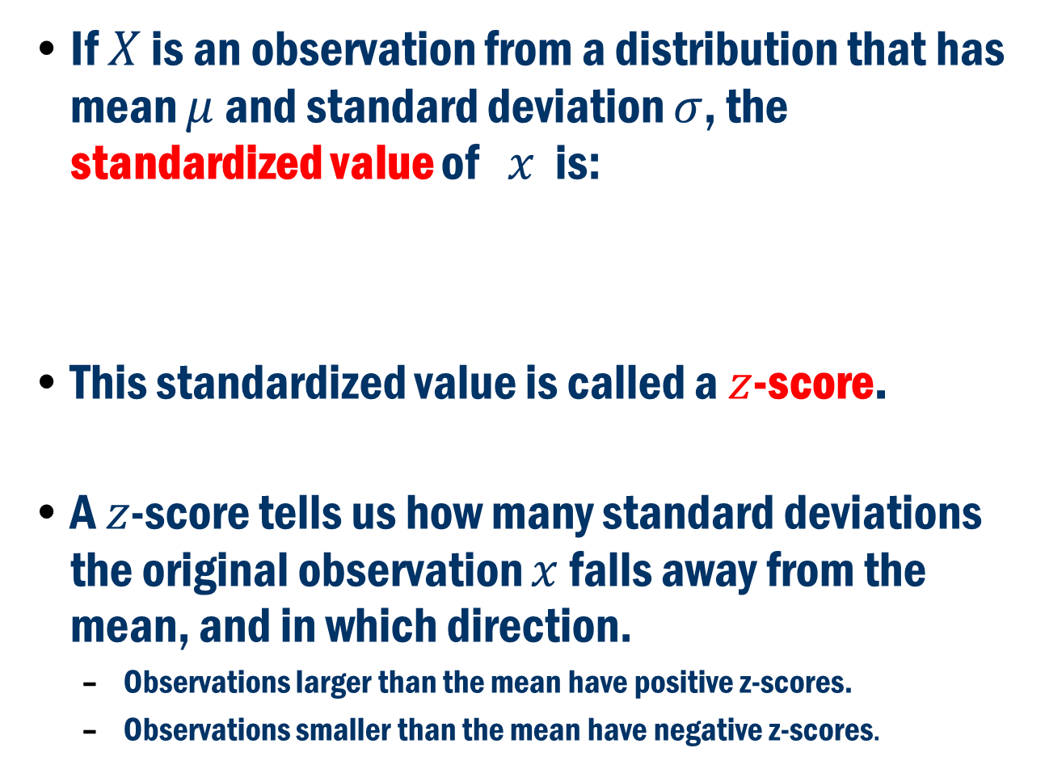
Standardizing and z-scores
If $X$ is an observation from a distribution that has mean $μ$ and standard deviation $σ$, the standardized value of $x$ is:
This standardized value is called a $z$-score.
A $z$-score tells us how many standard deviations the original observation $x$ falls away from the mean, and in which direction.
Observations larger than the mean have positive z-scores.
Observations smaller than the mean have negative z-scores.

Slide 13
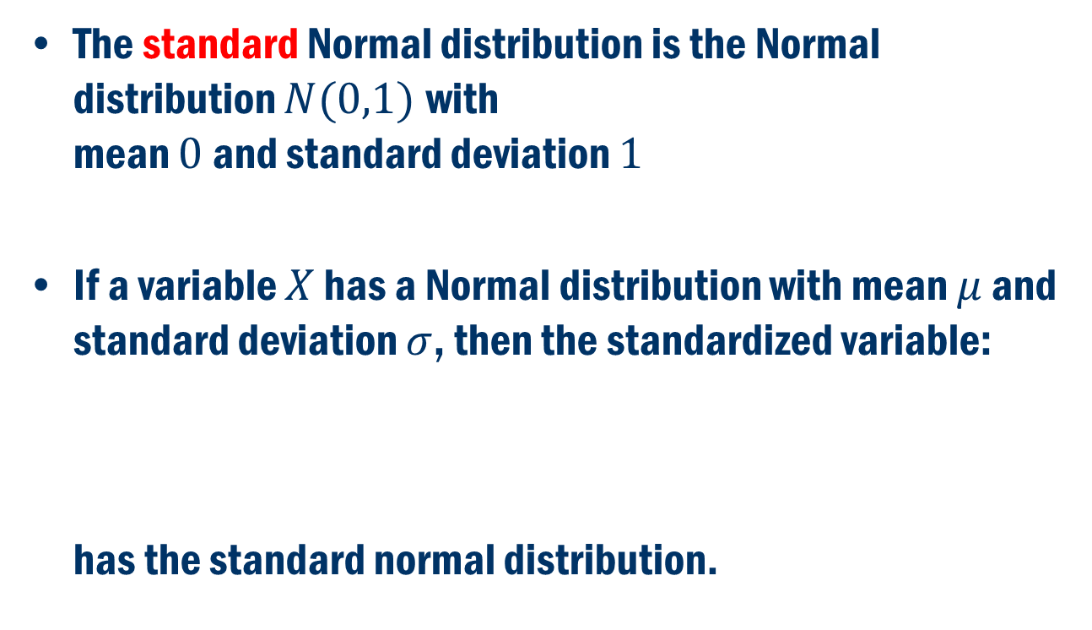
Standard Normal Distribution
The standard Normal distribution is the Normal distribution $N(0,1)$with mean $0$ and standard deviation $1$
If a variable $X$ has a Normal distribution with mean $μ$ and standard deviation $σ$, then the standardized variable: has the standard normal distribution.

Slide 14
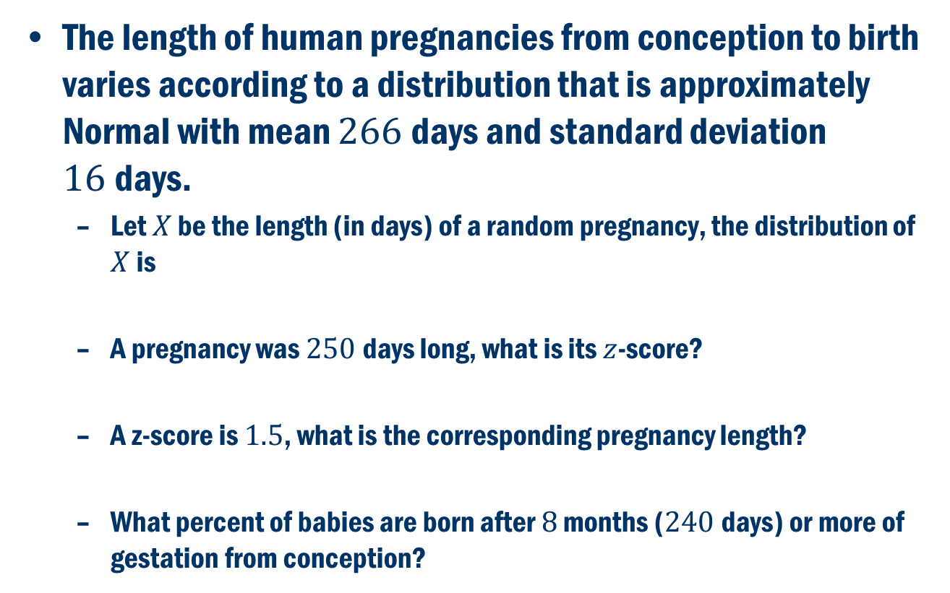
Example: Length of human pregnancies
The length of human pregnancies from conception to birth varies according to a distribution that is approximately Normal with mean $266$days and standard deviation $16$days.
Let $X$ be the length (in days) of a random pregnancy, the distribution of $X$ is
A pregnancy was $250$days long, what is its $z$-score?
A z-score is $1.5$, what is the corresponding pregnancy length?
What percent of babies are born after $8$ months ($240$days) or more of gestation from conception?

Slide 15
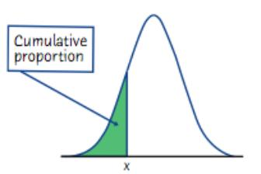
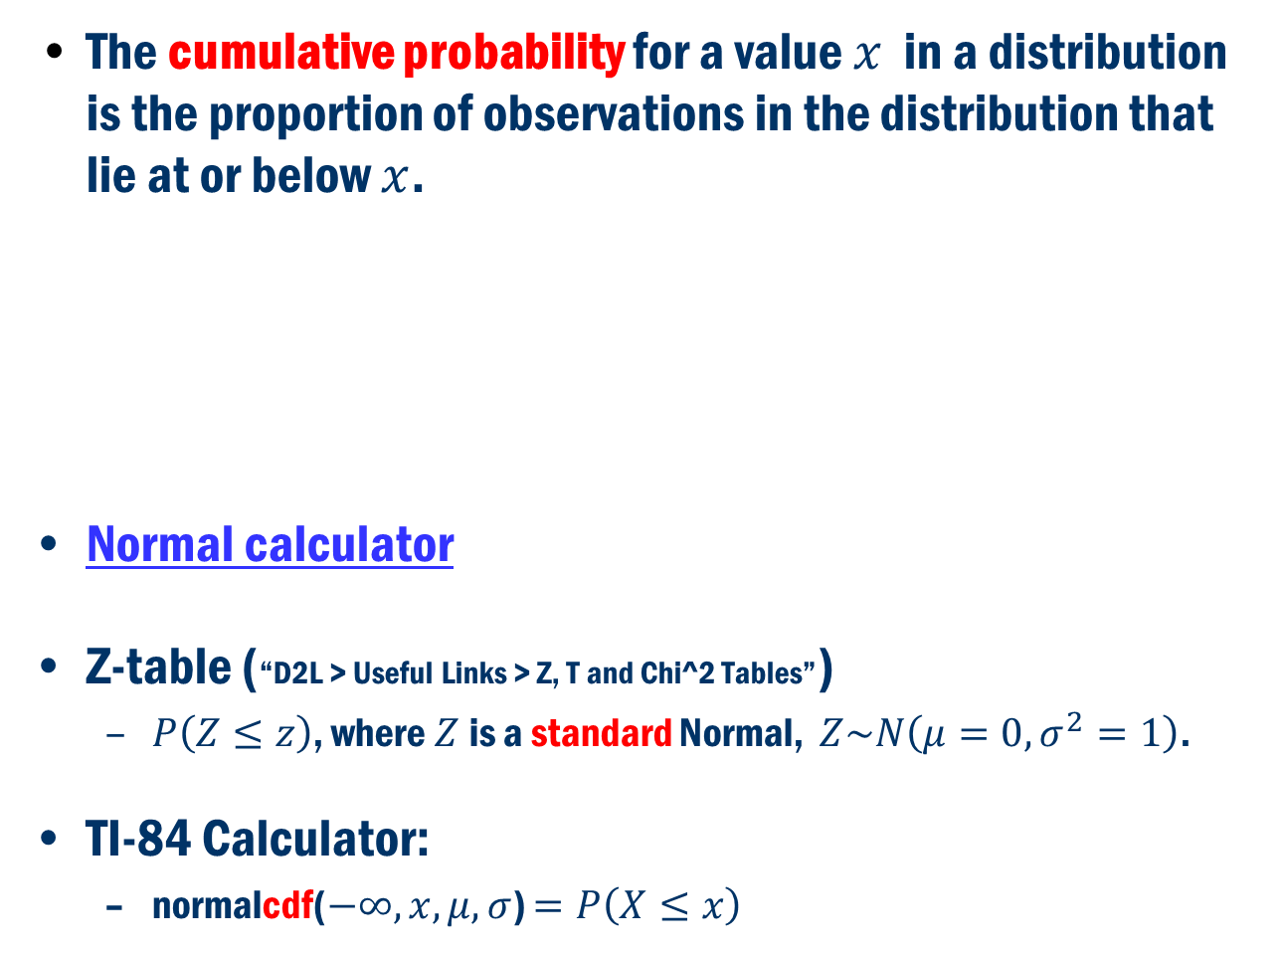
Finding Normal probabilities
The cumulative probability for a value $x$ in a distribution is the proportion of observations in the distribution that lie at or below $x$.
Normal calculator
Z-table (“D2L > Useful Links > Z, T and Chi^2 Tables”)
$P\left(Z≤z\right)$, where $Z$is a standard Normal, $Z\sim N\left(μ=0,σ^{2}=1\right)$.
TI-84 Calculator:
normalcdf($−∞,x,μ,σ$) $=P\left(X≤x\right)$

Slide 16
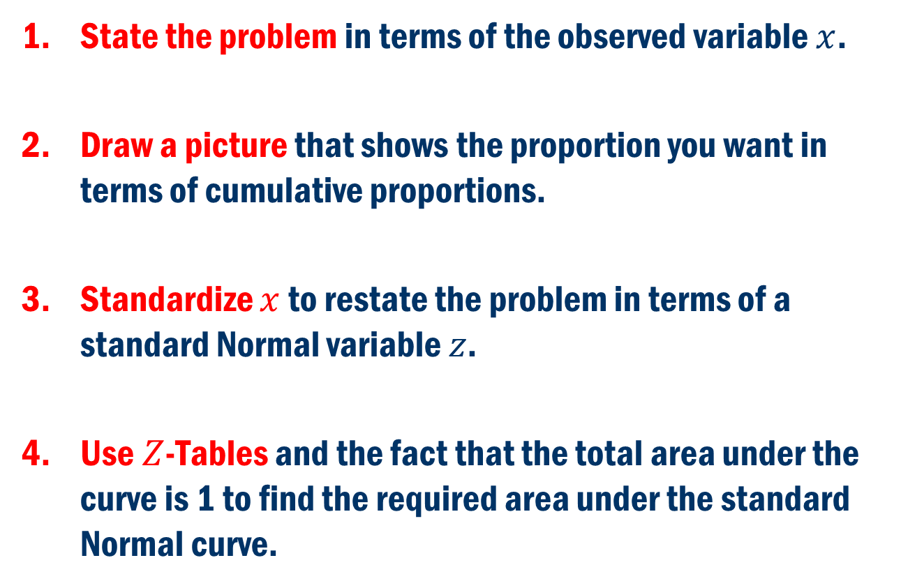

Finding Normal Probabilities with $Z$-Tables
State the problem in terms of the observed variable $x$.
Draw a picture that shows the proportion you want in terms of cumulative proportions.
Standardize $x$ to restate the problem in terms of a standard Normal variable $z$.
Use $Z$-Tables and the fact that the total area under the curve is 1 to find the required area under the standard Normal curve.

Slide 17
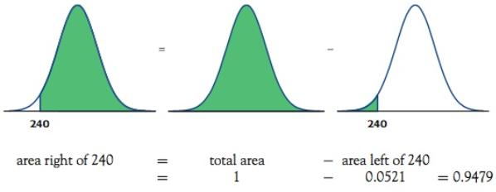

Length of human pregnancies (cont’d)
What percent of babies are born after $8$ months ($240$ days) or more of gestation from conception?

Slide 18
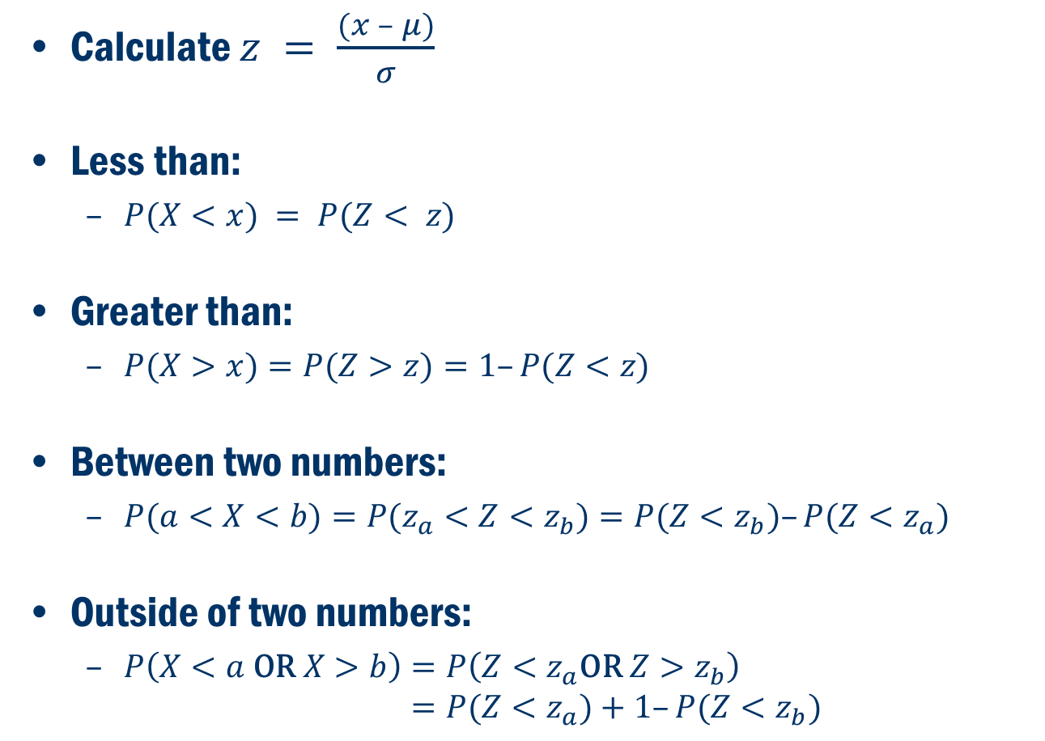
Tips on Finding Normal Probabilities
Calculate $z = \frac{(x – μ)}{σ}$
Less than:
$P(X<x) = P(Z< z)$
Greater than:
$P(X>x)=P(Z>z)=1–P(Z<z)$
Between two numbers:
$P(a<X<b)=P(z_{a}<Z<z_{b})=P(Z<z_{b})–P(Z<z_{a})$
Outside of two numbers:
$P\left(X<a \text{OR} X>b\right)=P\left(Z<z_{a}\text{OR} Z>z_{b}\right)$ $=P(Z<z_{a})+1–P(Z<z_{b})$

Slide 19
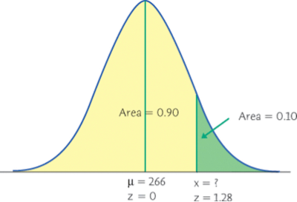
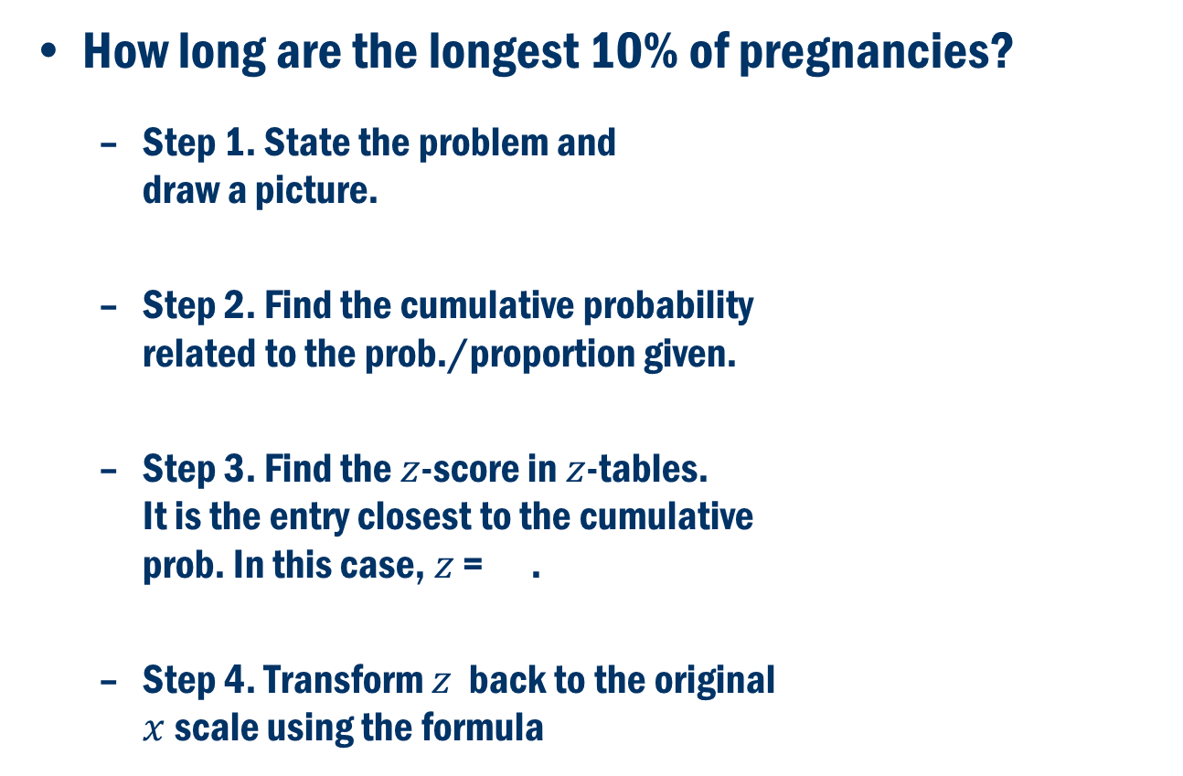
Length of human pregnancies (cont’d)
How long are the longest 10% of pregnancies?
Step 1. State the problem and draw a picture.
Step 2. Find the cumulative probability related to the prob./proportion given.
Step 3. Find the $z$-score in $z$-tables. It is the entry closest to the cumulative prob. In this case, $z$ = .
Step 4. Transform $z$ back to the original $x$ scale using the formula

Slide 20
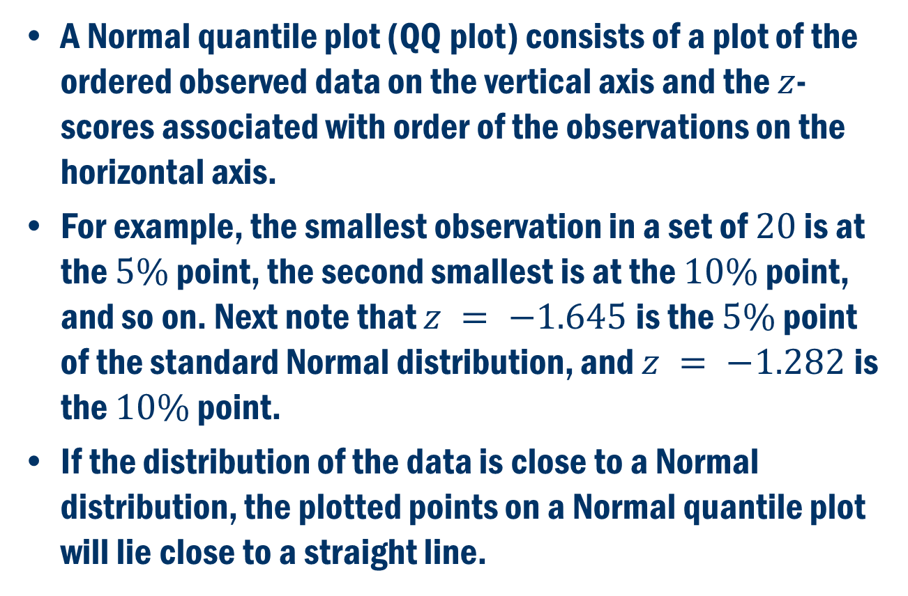
Checking Normality: Normal quantile plots
A Normal quantile plot (QQ plot) consists of a plot of the ordered observed data on the vertical axis and the $z$-scores associated with order of the observations on the horizontal axis.
For example, the smallest observation in a set of $20$ is at the $5\%$ point, the second smallest is at the $10\%$ point, and so on. Next note that $z = −1.645$is the $5\%$ point of the standard Normal distribution, and $z = −1.282$is the $10\%$ point.
If the distribution of the data is close to a Normal distribution, the plotted points on a Normal quantile plot will lie close to a straight line.

Slide 21
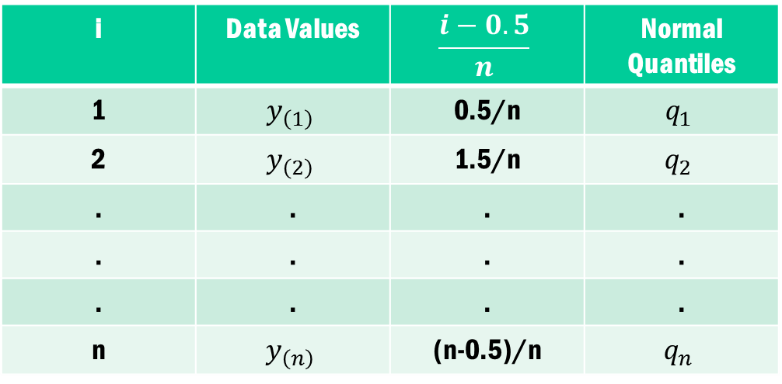

Normal Probability Plot
Rank the data from the lowest to the highest.
$$y_{\left(1\right)}<y_{\left(2\right)}<…<y_{\left(n\right)}$$
Empirical cumulative probability
i | Data Values | $$\frac{i−0.5}{n}$$ | Normal Quantiles
1 | $$y_{\left(1\right)}$$ | 0.5/n | $$q_{1}$$
2 | $$y_{\left(2\right)}$$ | 1.5/n | $$q_{2}$$
. | . | . | .
. | . | . | .
. | . | . | .
n | $$y_{\left(n\right)}$$ | (n-0.5)/n | $$q_{n}$$

Slide 22
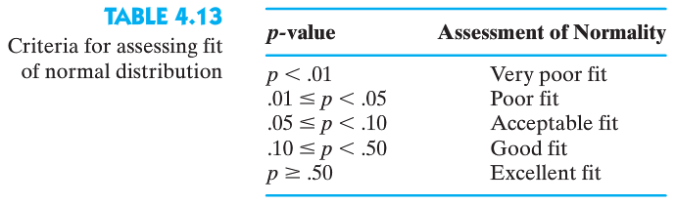
AIS Example (Height - sum of skin fold)

Slide 23
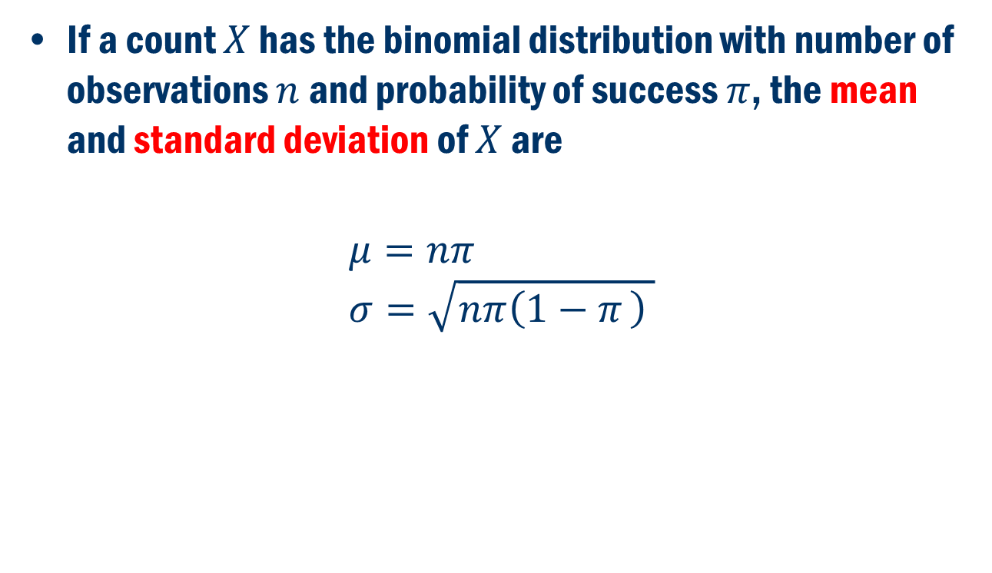
Binomial mean and standard deviation
If a count $X$ has the binomial distribution with number of observations $n$ and probability of success $π$, the mean and standard deviation of $X$ are
$$μ=nπ \\ σ=\sqrt{nπ\left(1−π \right) }$$

Slide 24
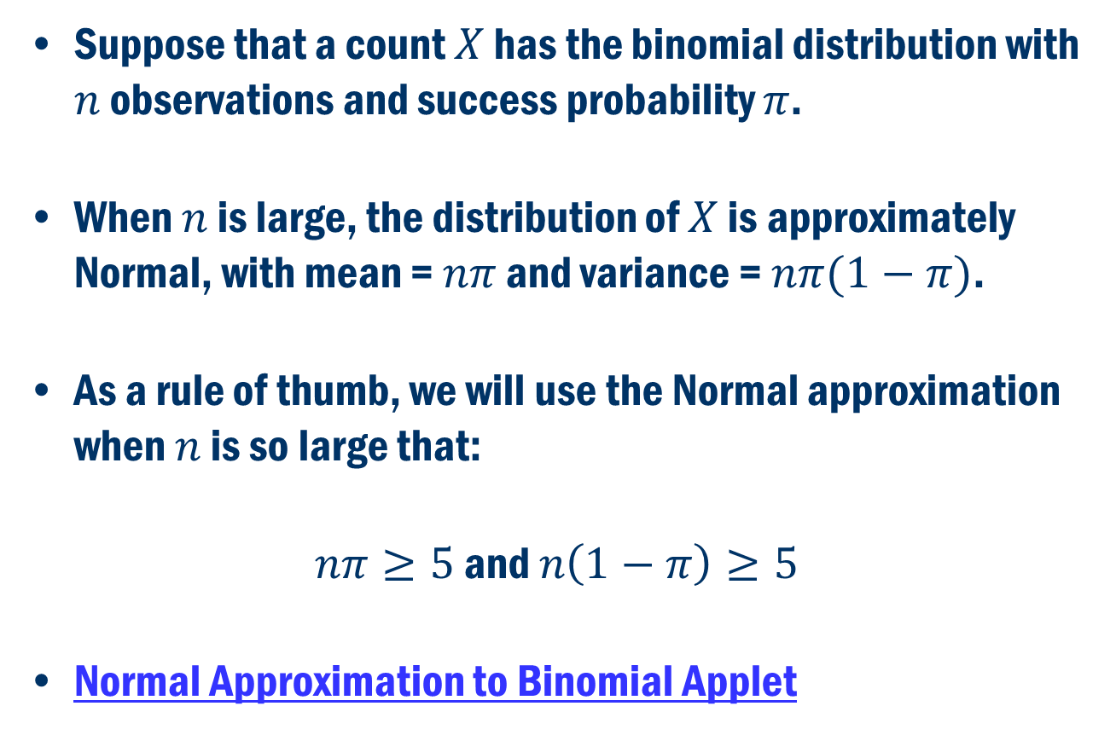
Normal approximation for binomial distributions
Suppose that a count $X$ has the binomial distribution with $n$ observations and success probability $π$.
When $n$ is large, the distribution of $X$ is approximately Normal, with mean = $nπ$ and variance = $nπ(1−π)$.
As a rule of thumb, we will use the Normal approximation when $n$ is so large that:
$nπ≥5$ and $n\left(1−π\right)≥5$
Normal Approximation to Binomial Applet

Slide 25
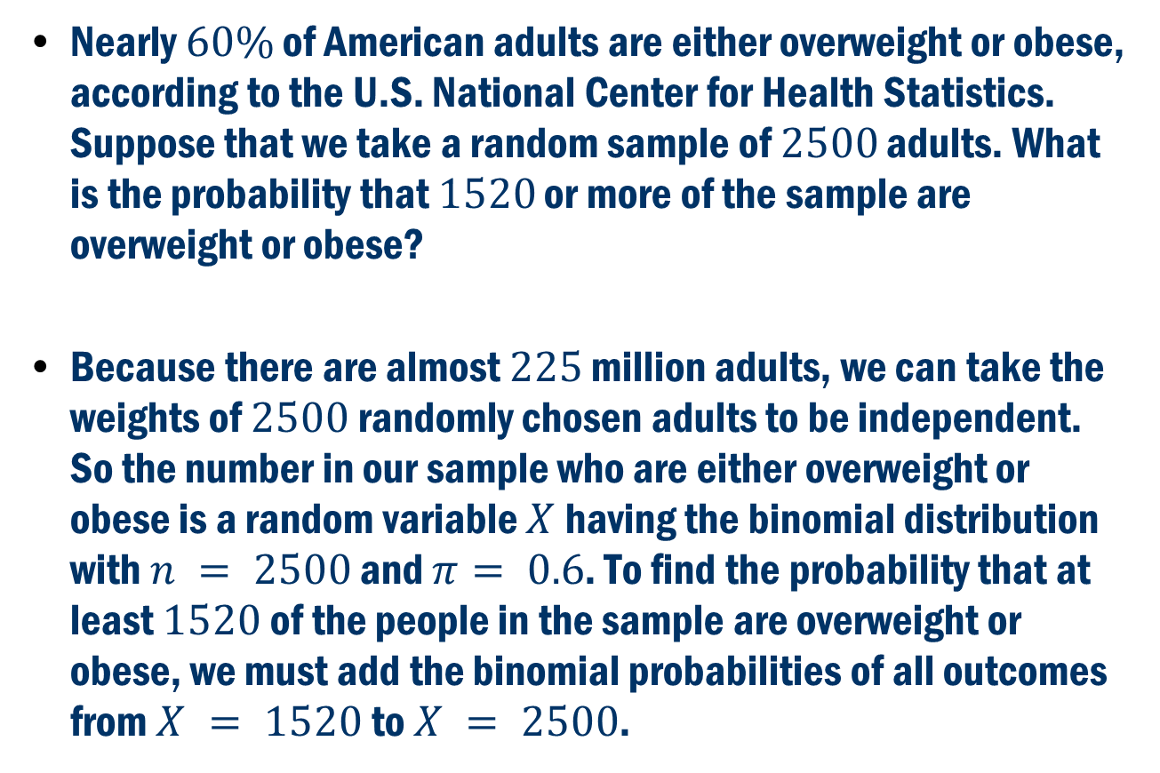
Example: Overweight Americans
Nearly $60\%$ of American adults are either overweight or obese, according to the U.S. National Center for Health Statistics. Suppose that we take a random sample of $2500$ adults. What is the probability that $1520$ or more of the sample are overweight or obese?
Because there are almost $225$ million adults, we can take the weights of $2500$randomly chosen adults to be independent. So the number in our sample who are either overweight or obese is a random variable $X$having the binomial distribution with $n = 2500$ and $π= 0.6$. To find the probability that at least $1520$of the people in the sample are overweight or obese, we must add the binomial probabilities of all outcomes from $X = 1520$to $X = 2500$.

Slide 26
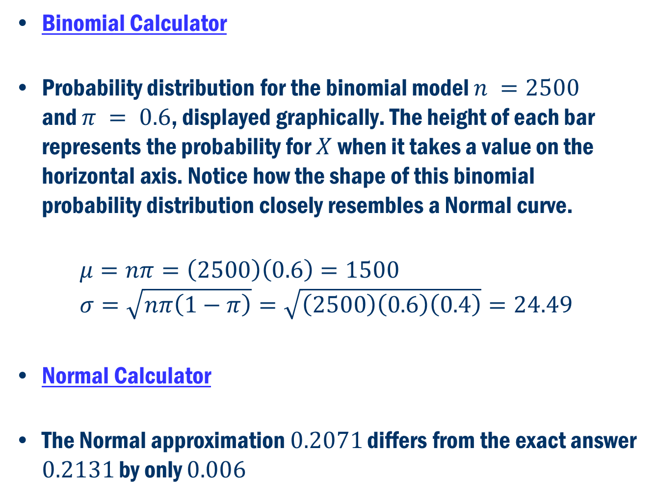
Overweight Americans (Cont’D)
Binomial Calculator
Probability distribution for the binomial model $n =2500$ and $π = 0.6$, displayed graphically. The height of each bar represents the probability for $X$ when it takes a value on the horizontal axis. Notice how the shape of this binomial probability distribution closely resembles a Normal curve.
$$μ=nπ=\left(2500\right)\left(0.6\right)=1500 \\ σ=\sqrt{nπ\left(1−π\right)}=\sqrt{\left(2500\right)\left(0.6\right)\left(0.4\right)}=24.49$$
Normal Calculator
The Normal approximation $0.2071$ differs from the exact answer $0.2131$ by only $0.006$

Slide 27
Sampling distributions
Review:
A parameter is a number that describes the population.
Ex: population mean, population variance, population proportion
A statistic is a number that can be computed from the sample data without making use of any unknown parameters. In practice, we use a statistic to estimate an unknown parameter.
Ex: sample mean, sample variance, sample proportion
The sampling distribution of a statistic is the distribution of values taken by the statistic in all possible samples of the same size from the same population.

Slide 28
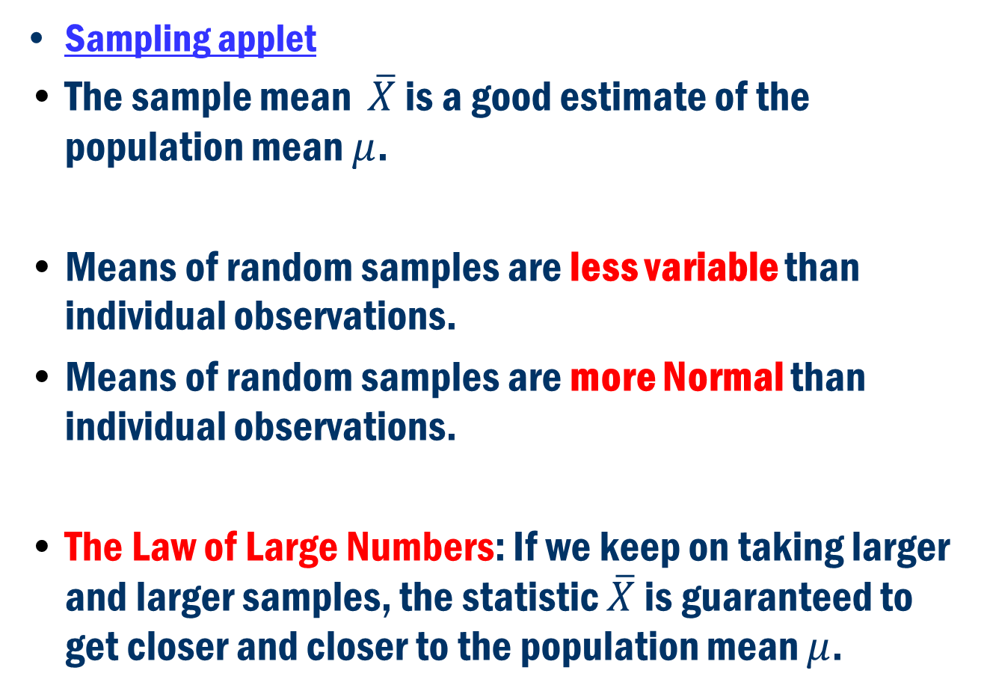
The sample mean and the population mean
Sampling applet
The sample mean $\overline{X}$ is a good estimate of the population mean $μ$.
Means of random samples are less variable than individual observations.
Means of random samples are more Normal than individual observations.
The Law of Large Numbers: If we keep on taking larger and larger samples, the statistic $\overline{X}$ is guaranteed to get closer and closer to the population mean $μ$.

Slide 29
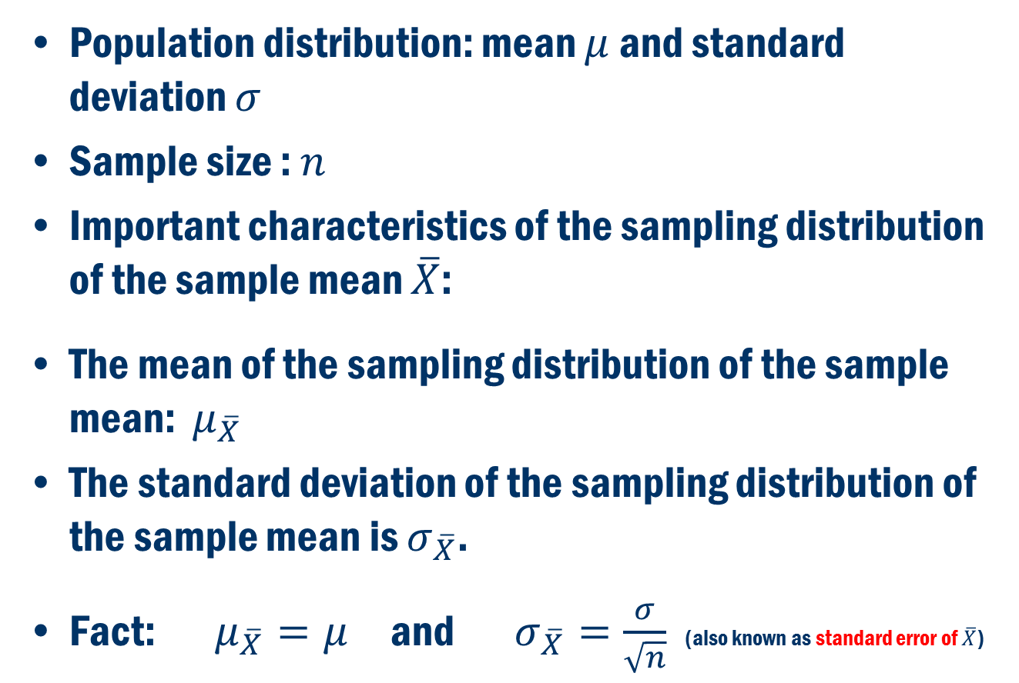
Sampling Distributions of the sample mean
Population distribution: mean $μ$ and standard deviation $σ$
Sample size : $n$
Important characteristics of the sampling distribution of the sample mean $\overline{X}$:
The mean of the sampling distribution of the sample mean: $μ_{\overline{X}}$
The standard deviation of the sampling distribution of the sample mean is $σ_{\overline{X}}$.
Fact: $μ_{\overline{X}}=μ$ and $σ_{\overline{X}}=\frac{σ}{\sqrt{n}}$ (also known as standard error of $\overline{X}$)

Slide 30
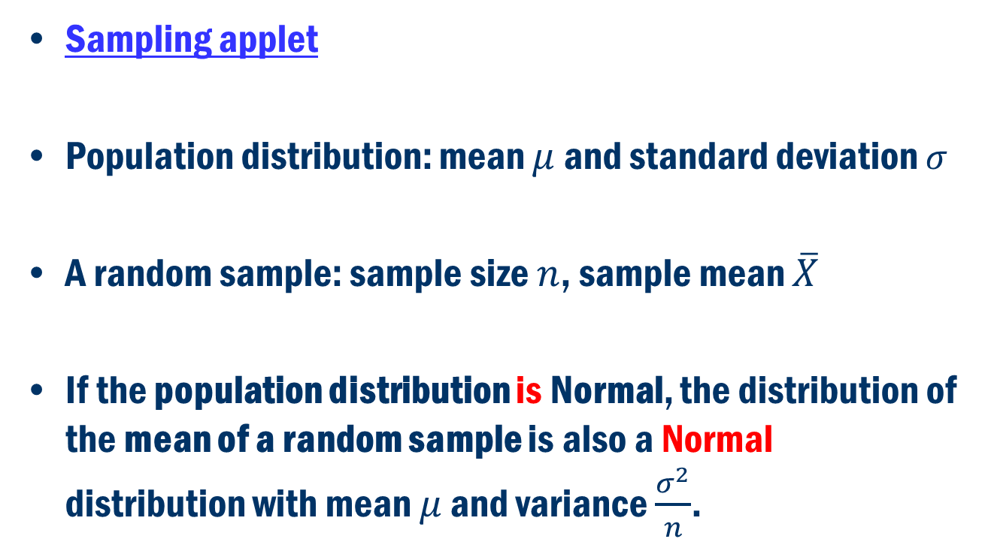
Sampling Dist. of the sample mean (I)
Sampling applet
Population distribution: mean $μ$ and standard deviation $σ$
A random sample: sample size $n$, sample mean $\overline{X}$
If the population distribution is Normal, the distribution of the mean of a random sample is also a Normal distribution with mean $μ$ and variance $\frac{σ^{2}}{n}$.

Slide 31
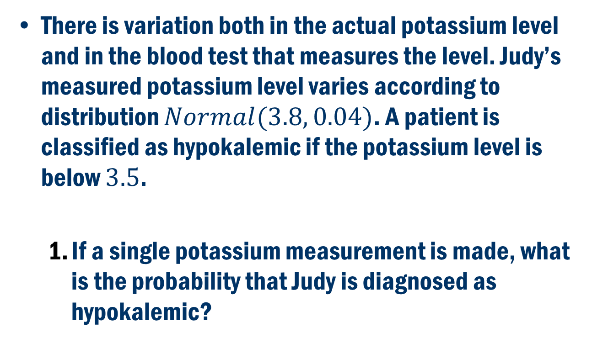
Example: Potassium in the blood
There is variation both in the actual potassium level and in the blood test that measures the level. Judy’s measured potassium level varies according to distribution $Normal(3.8, 0.04)$. A patient is classified as hypokalemic if the potassium level is below $3.5$.
If a single potassium measurement is made, what is the probability that Judy is diagnosed as hypokalemic?

Slide 32
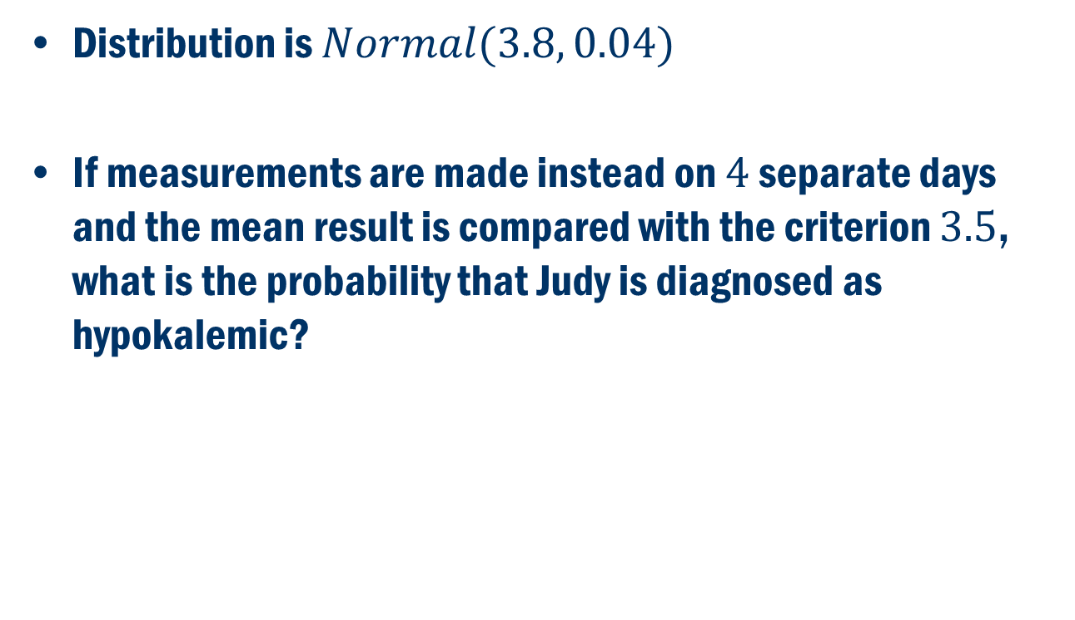
Potassium in the blood (cont’d)
Distribution is $Normal(3.8, 0.04)$
If measurements are made instead on $4$ separate days and the mean result is compared with the criterion $3.5$, what is the probability that Judy is diagnosed as hypokalemic?

Slide 33
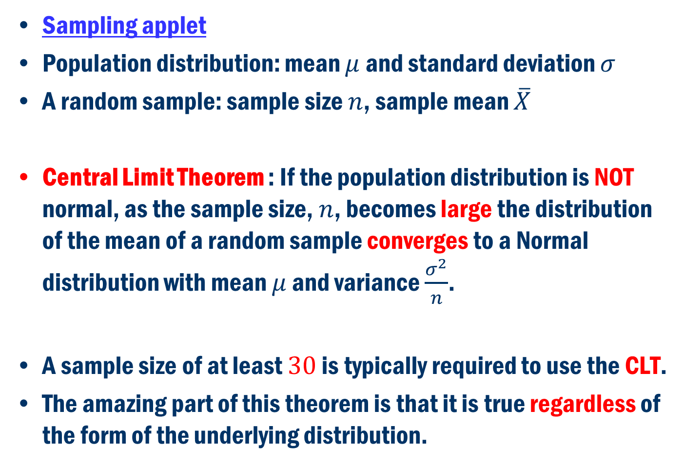
Sampling Dist. of the sample mean (II)
Sampling applet
Population distribution: mean $μ$ and standard deviation $σ$
A random sample: sample size $n$, sample mean $\overline{X}$
Central Limit Theorem : If the population distribution is NOT normal, as the sample size, $n$, becomes large the distribution of the mean of a random sample converges to a Normal distribution with mean $μ$ and variance $\frac{σ^{2}}{n}$.
A sample size of at least $30$ is typically required to use the CLT.
The amazing part of this theorem is that it is true regardless of the form of the underlying distribution.

Slide 34
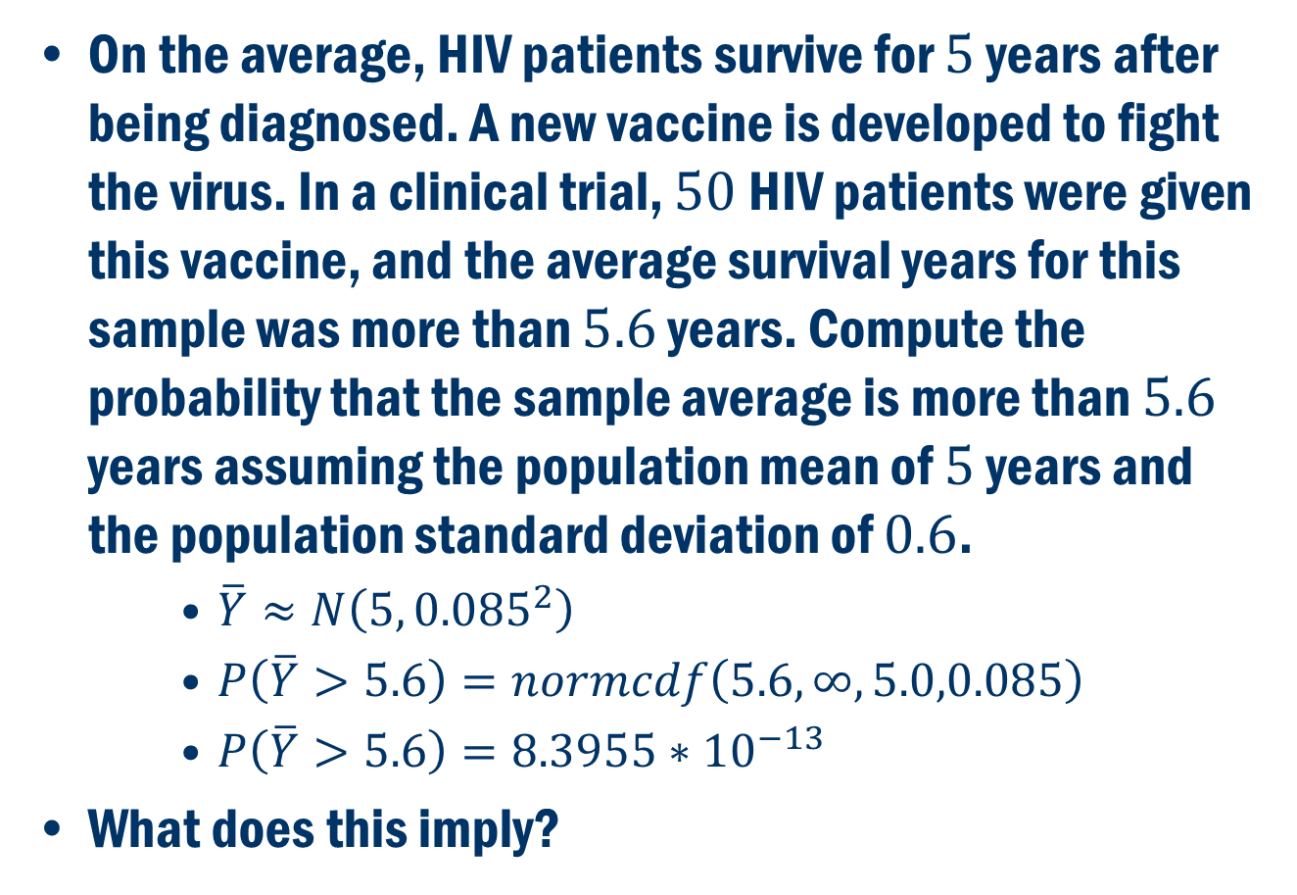
Example 2: Vaccine for HIV
On the average, HIV patients survive for $5$ years after being diagnosed. A new vaccine is developed to fight the virus. In a clinical trial, $50$ HIV patients were given this vaccine, and the average survival years for this sample was more than $5.6$ years. Compute the probability that the sample average is more than $5.6$ years assuming the population mean of $5$ years and the population standard deviation of $0.6$.
$\overline{Y}≈N\left(5, {0.085}^{2}\right)$
$P\left(\overline{Y}>5.6\right)=normcdf\left(5.6,∞,5.0,0.085\right)$
$P\left(\overline{Y}>5.6\right)=8.3955∗{10}^{−13}$
What does this imply?

