Slide 1
Chapter 5 (Part B)

Slide 2
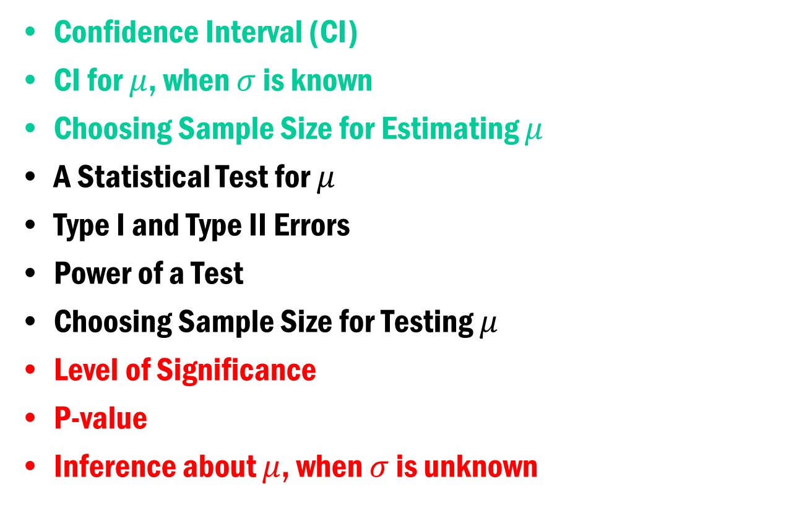
Chapter 5 (Part B)
Confidence Interval (CI)
CI for $μ$, when $σ$ is known
Choosing Sample Size for Estimating $μ$
A Statistical Test for $μ$
Type I and Type II Errors
Power of a Test
Choosing Sample Size for Testing $μ$
Level of Significance
P-value
Inference about $μ$, when $σ$ is unknown

Slide 3
Hypothesis Testing
Hypothesis testing is the most used statistical methodology of statistics. Whenever you collect data to test a hypothesis, you would most likely use this methodology. In application, this is how it works,
1. First build or assume a statistical model for the data.
2. Write the hypothesis of interest in terms of the parameters of the model.
3. Use a statistical decision rule (that minimizes the rate of false discovery) to draw conclusion.

Slide 4
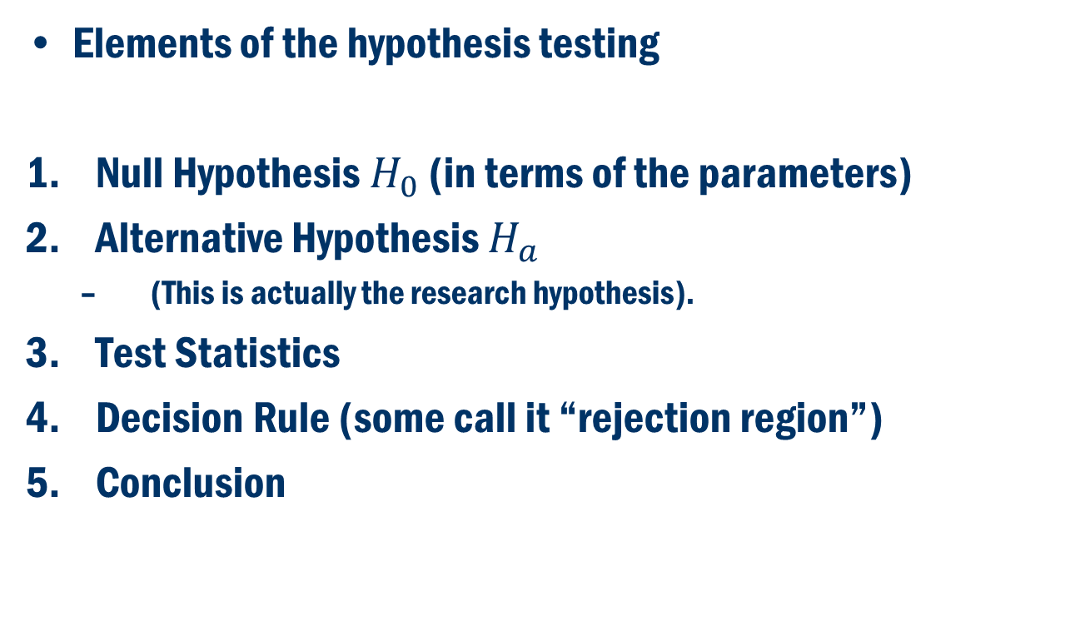
A General Framework:
Elements of the hypothesis testing
Null Hypothesis $H_{0}$ (in terms of the parameters)
Alternative Hypothesis $H_{a}$
(This is actually the research hypothesis).
Test Statistics
Decision Rule (some call it “rejection region”)
Conclusion

Slide 5
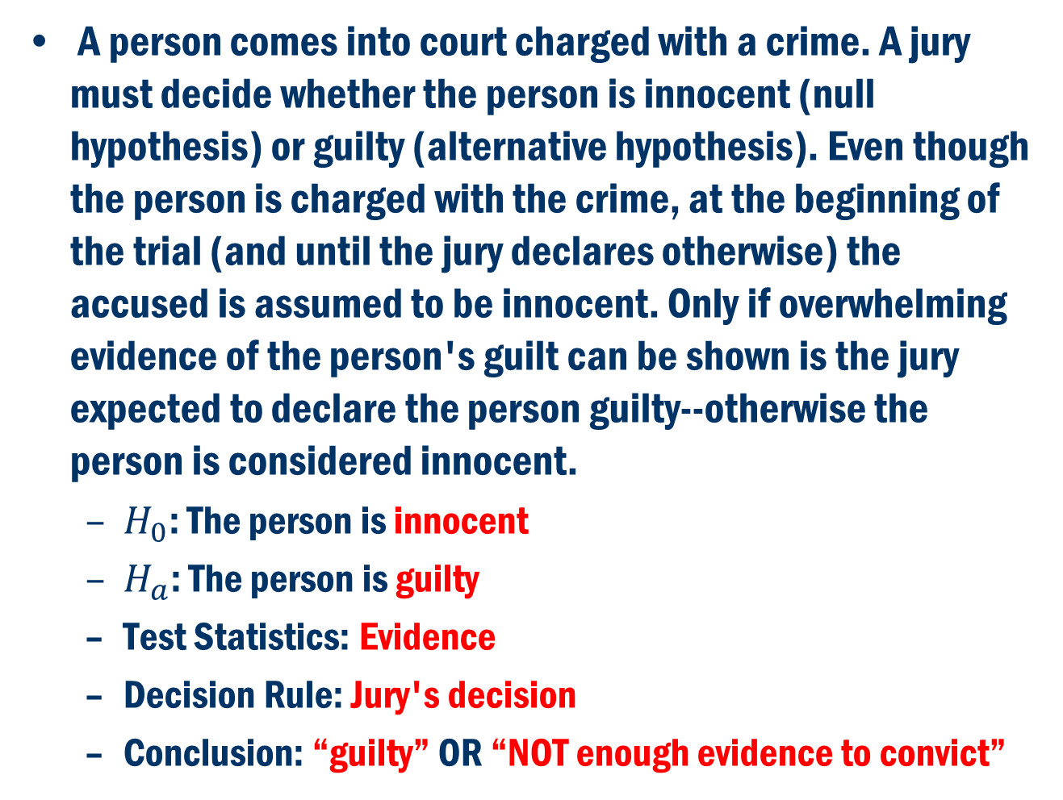
Example 1
A person comes into court charged with a crime. A jury must decide whether the person is innocent (null hypothesis) or guilty (alternative hypothesis). Even though the person is charged with the crime, at the beginning of the trial (and until the jury declares otherwise) the accused is assumed to be innocent. Only if overwhelming evidence of the person's guilt can be shown is the jury expected to declare the person guilty--otherwise the person is considered innocent.
$H_{0}$: The person is innocent
$H_{a}$: The person is guilty
Test Statistics: Evidence
Decision Rule: Jury's decision
Conclusion: “guilty” OR “NOT enough evidence to convict”

Slide 6
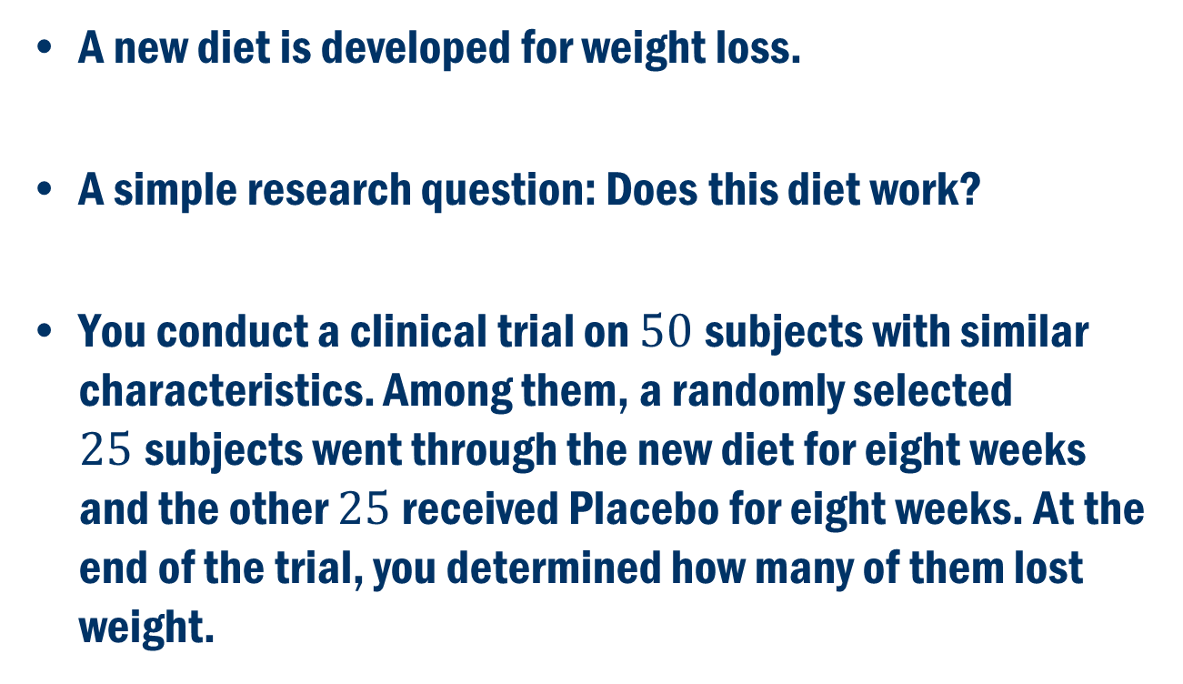
Example 2
A new diet is developed for weight loss.
A simple research question: Does this diet work?
You conduct a clinical trial on $50$subjects with similar characteristics. Among them, a randomly selected $25$subjects went through the new diet for eight weeks and the other $25$ received Placebo for eight weeks. At the end of the trial, you determined how many of them lost weight.

Slide 7
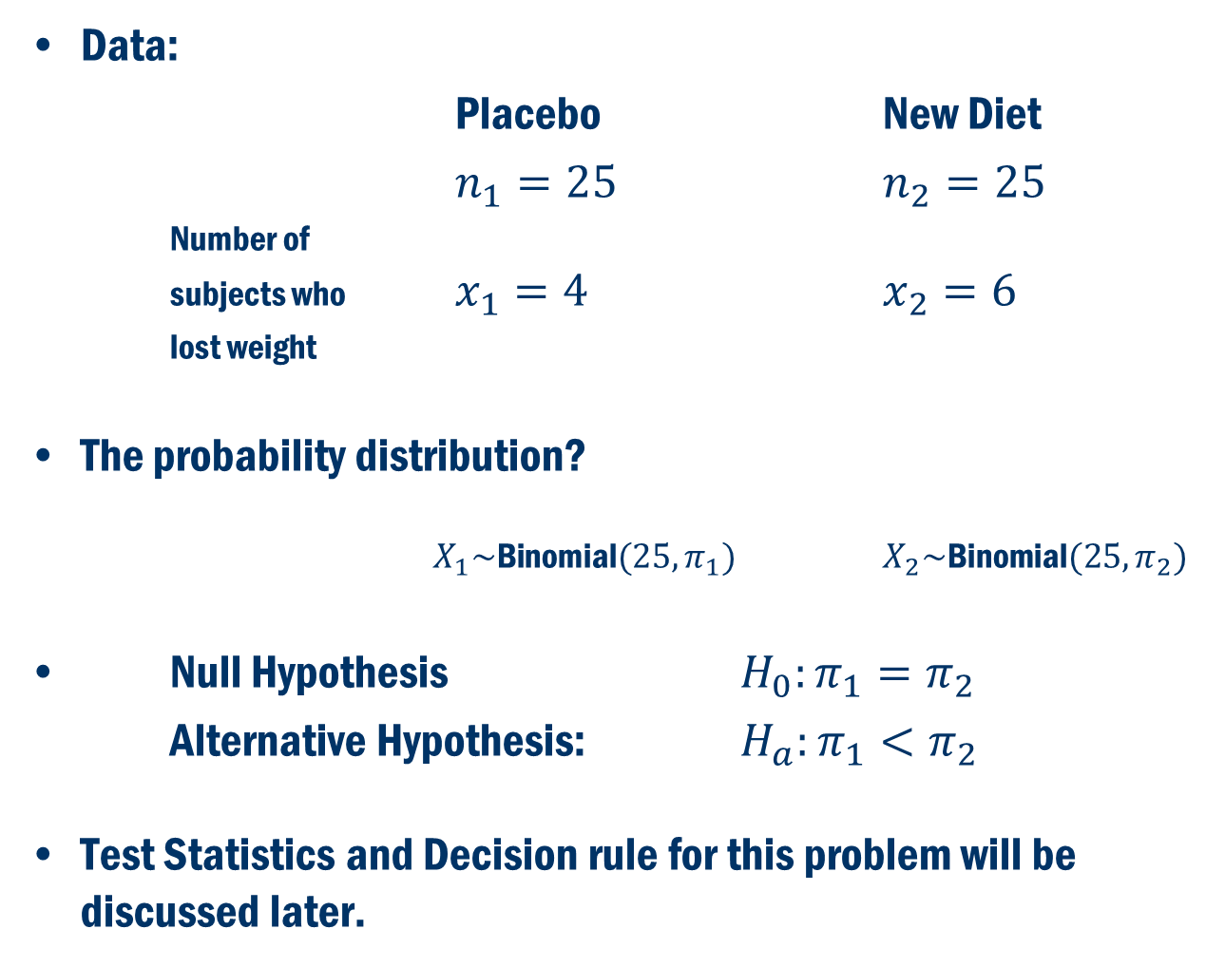
Example 2 Cont’D
Data:
Placebo New Diet
$n_{1}=25$ $n_{2}=25$
Number of subjects who $x_{1}=4$ $x_{2}=6$
lost weight
The probability distribution?
$X_{1}\sim \text{Bin}\text{omial}(25, π_{1})$ $X_{2}\sim \text{Bin}\text{omial}(25, π_{2})$
Null Hypothesis $H_{0}:π_{1}=π_{2}$
Alternative Hypothesis: $H_{a}:π_{1}<π_{2}$
Test Statistics and Decision rule for this problem will be discussed later.

Slide 8
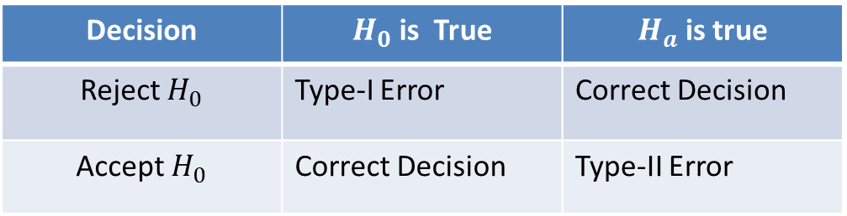
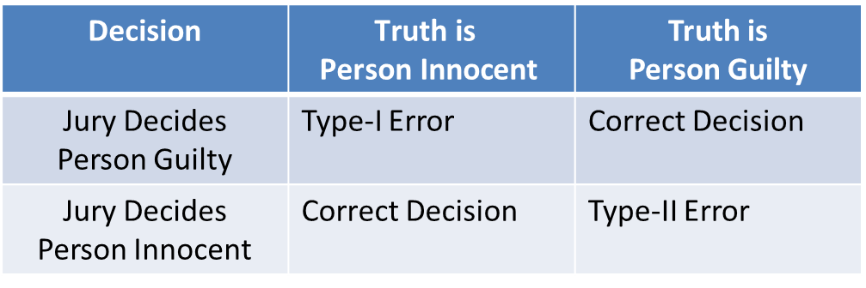





Concepts of Hypothesis Testing
$H_{0}$: Null Hypothesis $H_{a}$: Alternative Hypotheses (Research Hypothesis)
Based on the evidence from the data, either we reject $H_{0}$ in favor of $H_{a}$ or we accept $H_{0}$.
Back to Example 1:

Slide 9
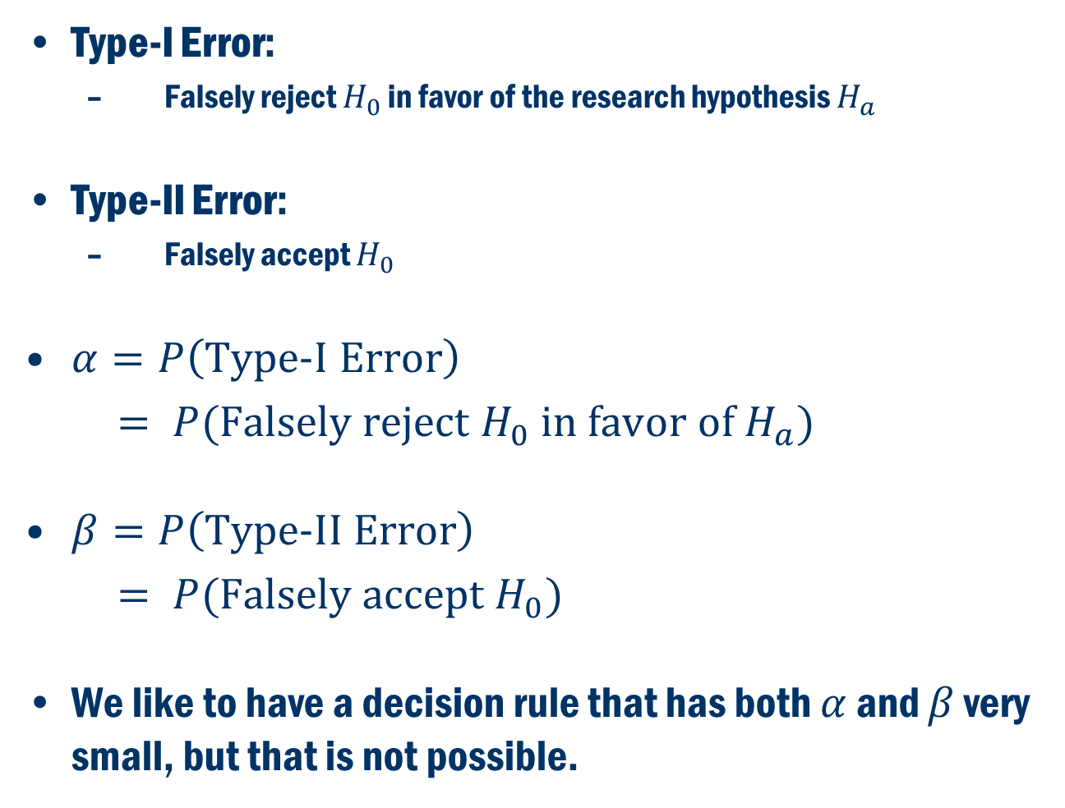
Types of Error
Type-I Error:
Falsely reject $H_{0}$ in favor of the research hypothesis $H_{a}$
Type-II Error:
Falsely accept $H_{0}$
$α=P\left(\text{Type}\text{−}\text{I} \text{Error}\right)$
$= P(\text{Falsely} \text{reject} H_{0} \text{in} \text{favor} \text{of} H_{a})$
$β=P\left(\text{Type}\text{−}\text{II} \text{Error}\right)$
$= P(\text{Falsely} \text{accept} H_{0})$
We like to have a decision rule that has both $α$ and $β$ very small, but that is not possible.

Slide 10
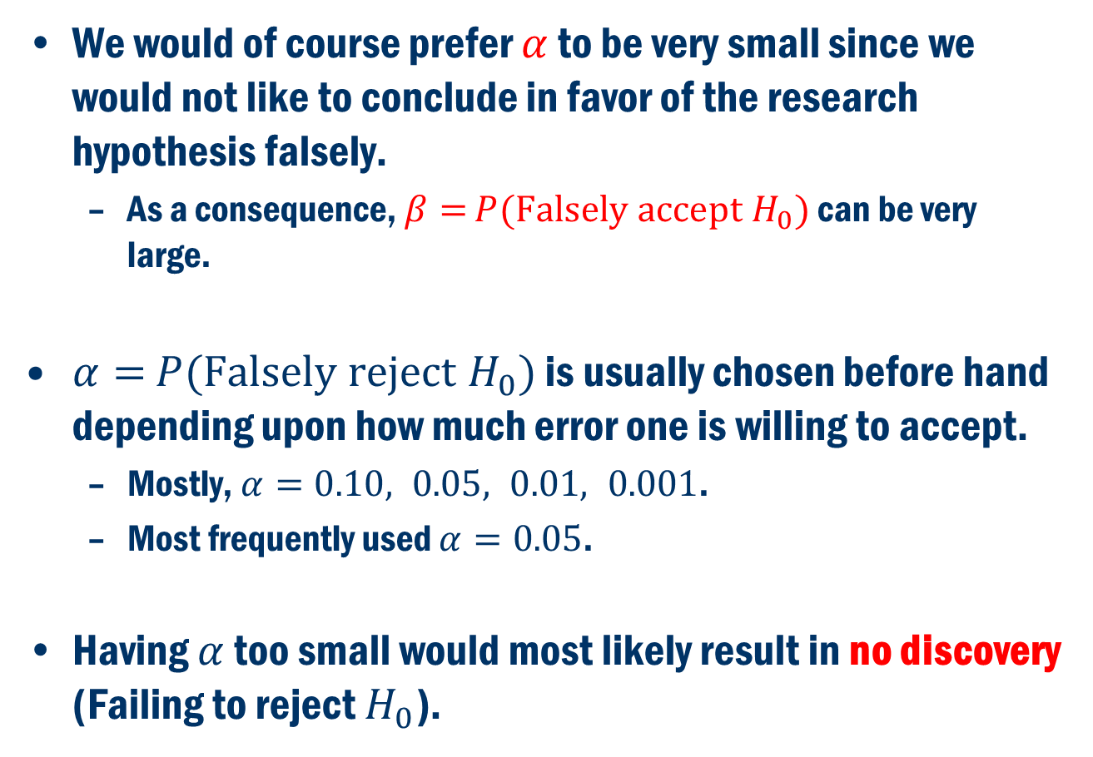
Types of Error CONT’D
We would of course prefer $α$ to be very small since we would not like to conclude in favor of the research hypothesis falsely.
As a consequence, $β=$ $P(\text{Falsely} \text{accept} H_{0})$ can be very large.
$α=$ $P(\text{Falsely} \text{reject} H_{0})$ is usually chosen before hand depending upon how much error one is willing to accept.
Mostly, $α=0.10, 0.05, 0.01, 0.001$.
Most frequently used $α=0.05$.
Having $α$ too small would most likely result in no discovery (Failing to reject $H_{0}$).

Slide 11
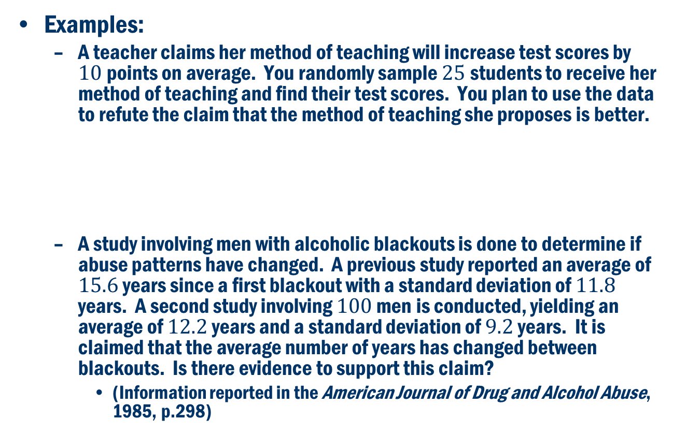
Hypothesis Testing for the Mean
Examples:
A teacher claims her method of teaching will increase test scores by $10$points on average. You randomly sample $25$students to receive her method of teaching and find their test scores. You plan to use the data to refute the claim that the method of teaching she proposes is better.
A study involving men with alcoholic blackouts is done to determine if abuse patterns have changed. A previous study reported an average of $15.6$ years since a first blackout with a standard deviation of $11.8$ years. A second study involving $100$ men is conducted, yielding an average of $12.2$ years and a standard deviation of $9.2$ years. It is claimed that the average number of years has changed between blackouts. Is there evidence to support this claim?
(Information reported in the American Journal of Drug and Alcohol Abuse, 1985, p.298)
Notice the Null Hypothesis ALWAYS has equality associated with it.
Null Hypothesis:
One-sided alternative hypothesis.
Alternative Hypothesis:
The researchers only wanted to see if the number of years had “changed.” They weren’t looking for a direction of change.
Null Hypothesis:
Two-sided alternative hypothesis.
Alternative Hypothesis:

Slide 12
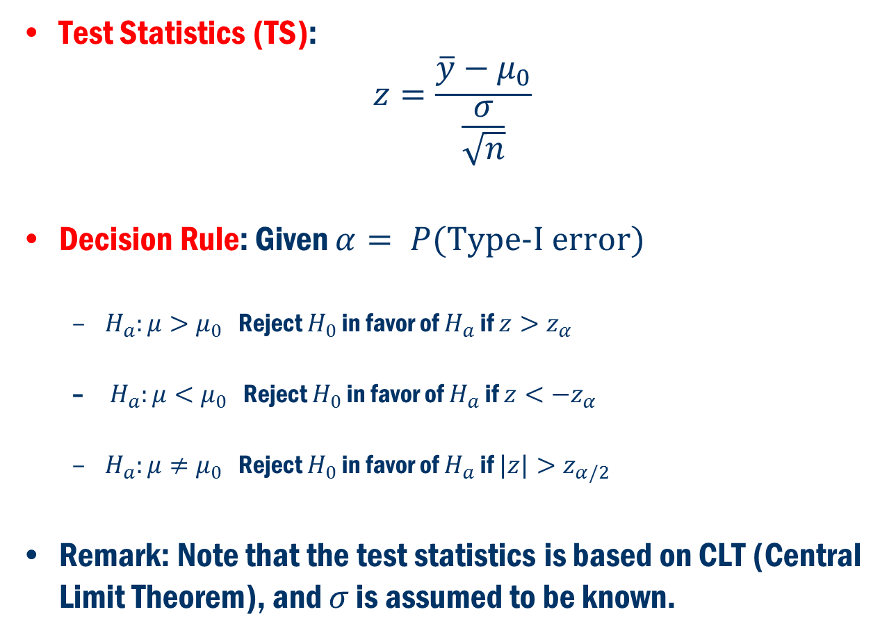
Hypothesis Testing for the Mean Cont’D
Test Statistics (TS):
$$z=\frac{\overline{y}−μ_{0}}{\frac{σ}{\sqrt{n}}}$$
Decision Rule: Given $α= P(\text{Type}\text{−}\text{I} \text{error})$
$H_{a}:μ>μ_{0}$ Reject $H_{0}$ in favor of $H_{a}$ if $z>z_{α}$
$H_{a}:μ<μ_{0}$ Reject $H_{0}$ in favor of $H_{a}$ if $z<−z_{α}$
$H_{a}:μ≠μ_{0}$ Reject $H_{0}$ in favor of $H_{a}$ if $|z|>z_{α/2}$
Remark: Note that the test statistics is based on CLT (Central Limit Theorem), and $σ$ is assumed to be known.

Slide 13
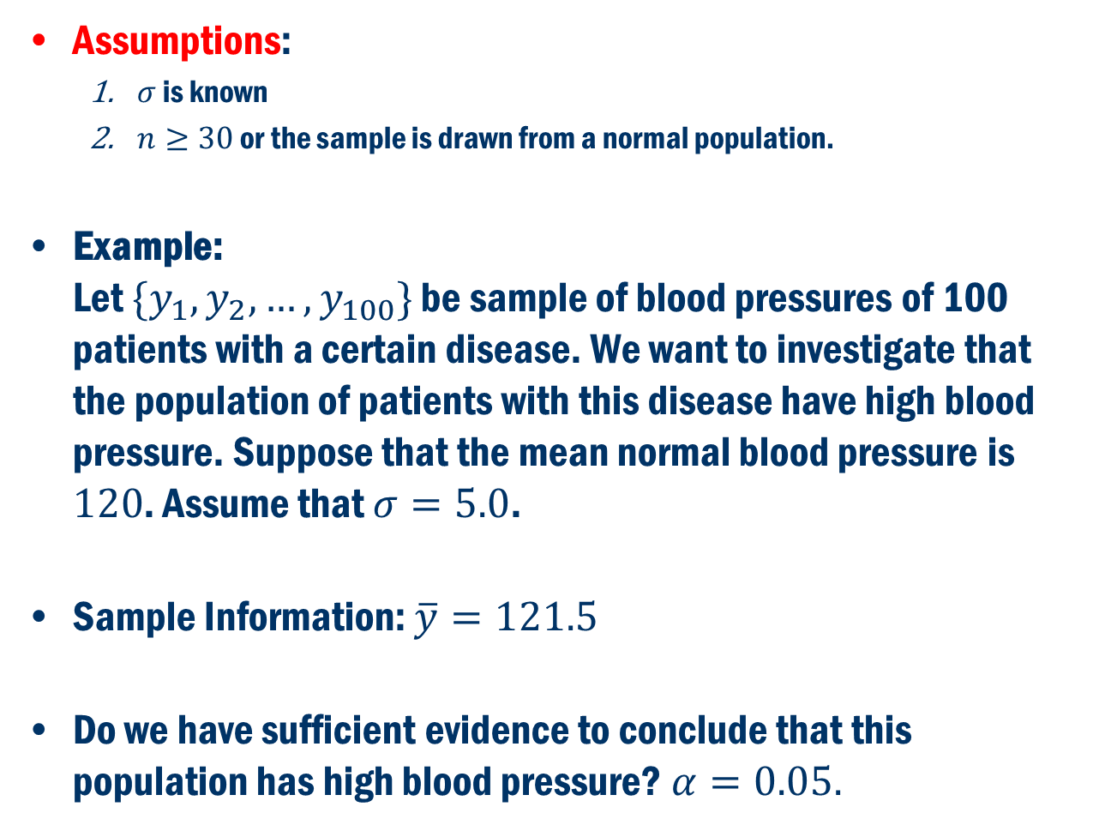
Hypothesis Testing for the Mean Cont’D
Assumptions:
$σ$ is known
$n≥30$ or the sample is drawn from a normal population.
Example: Let $\{y_{1},y_{2},…,y_{100}\}$ be sample of blood pressures of 100 patients with a certain disease. We want to investigate that the population of patients with this disease have high blood pressure. Suppose that the mean normal blood pressure is $120$. Assume that $σ=5.0$.
Sample Information: $\overline{y}=121.5$
Do we have sufficient evidence to conclude that this population has high blood pressure? $α=0.05.$

Slide 14
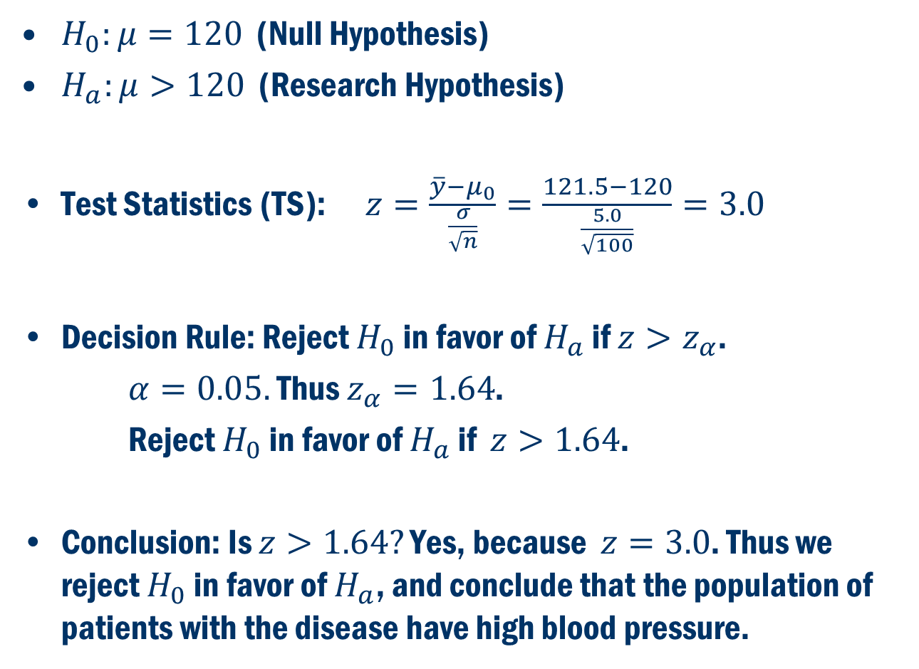
Example Cont’D
$H_{0}:μ=120$ (Null Hypothesis)
$H_{a}:μ>120$ (Research Hypothesis)
Test Statistics (TS): $z=\frac{\overline{y}−μ_{0}}{\frac{σ}{\sqrt{n}}}=\frac{121.5−120}{\frac{5.0}{\sqrt{100}}}=3.0$
Decision Rule: Reject $H_{0}$ in favor of $H_{a}$ if $z>z_{α}$.
$α=0.05.$ Thus $z_{α}=1.64$.
Reject $H_{0}$ in favor of $H_{a}$ if $z>1.64$.
Conclusion: Is $z>1.64?$ Yes, because $z=3.0$. Thus we reject $H_{0}$ in favor of $H_{a}$, and conclude that the population of patients with the disease have high blood pressure.

Slide 15
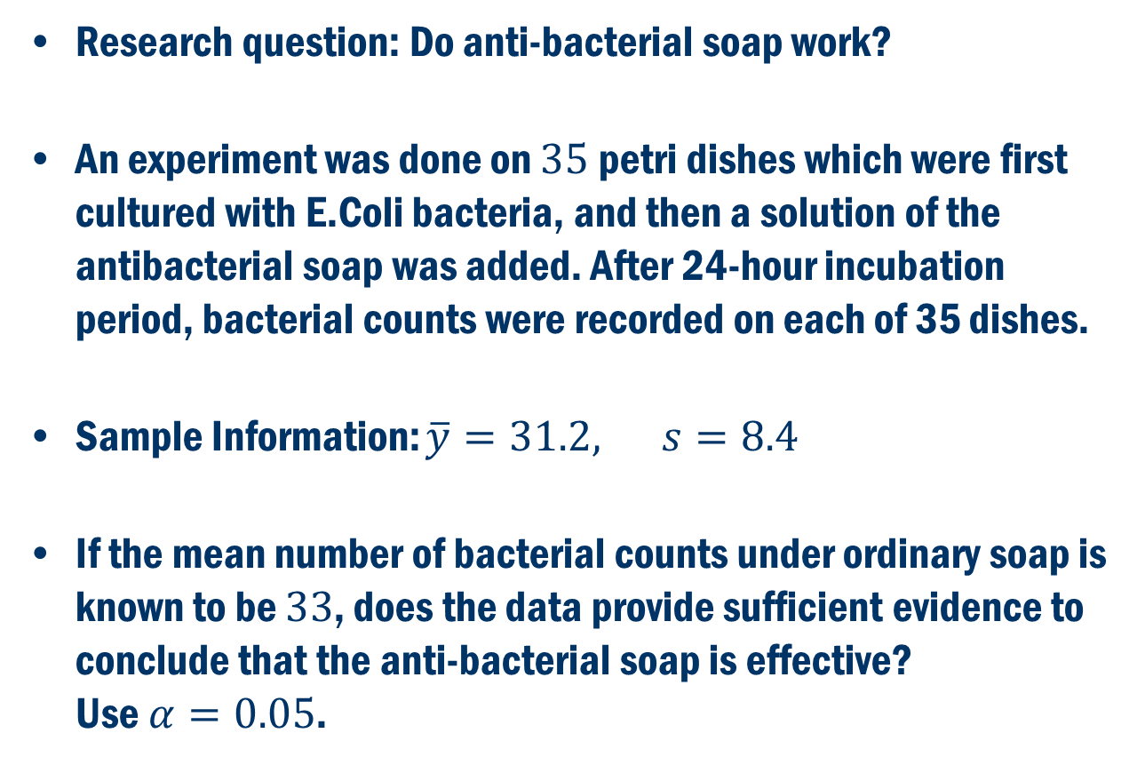
Book Example 5.9
Research question: Do anti-bacterial soap work?
An experiment was done on $35$petri dishes which were first cultured with E.Coli bacteria, and then a solution of the antibacterial soap was added. After 24-hour incubation period, bacterial counts were recorded on each of 35 dishes.
Sample Information: $\overline{y}=31.2, s=8.4$
If the mean number of bacterial counts under ordinary soap is known to be $33$, does the data provide sufficient evidence to conclude that the anti-bacterial soap is effective? Use $α=0.05$.

Slide 16
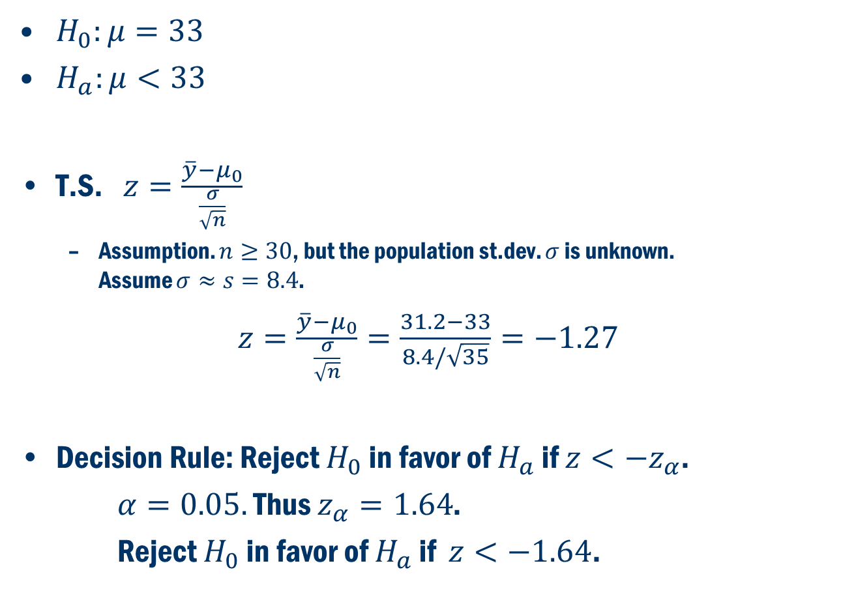
Book Example 5.9 CONT’D
$H_{0}:μ=33$
$H_{a}:μ<33$
T.S. $z=\frac{\overline{y}−μ_{0}}{\frac{σ}{\sqrt{n}}}$
Assumption. $n≥30$, but the population st.dev. $σ$ is unknown. Assume $σ≈s=8.4$.
$z=\frac{\overline{y}−μ_{0}}{\frac{σ}{\sqrt{n}}}=\frac{31.2−33}{8.4/\sqrt{35}}=−1.27$
Decision Rule: Reject $H_{0}$ in favor of $H_{a}$ if $z<−z_{α}$.
$α=0.05.$ Thus $z_{α}=1.64$.
Reject $H_{0}$ in favor of $H_{a}$ if $z<−1.64$.

Slide 17
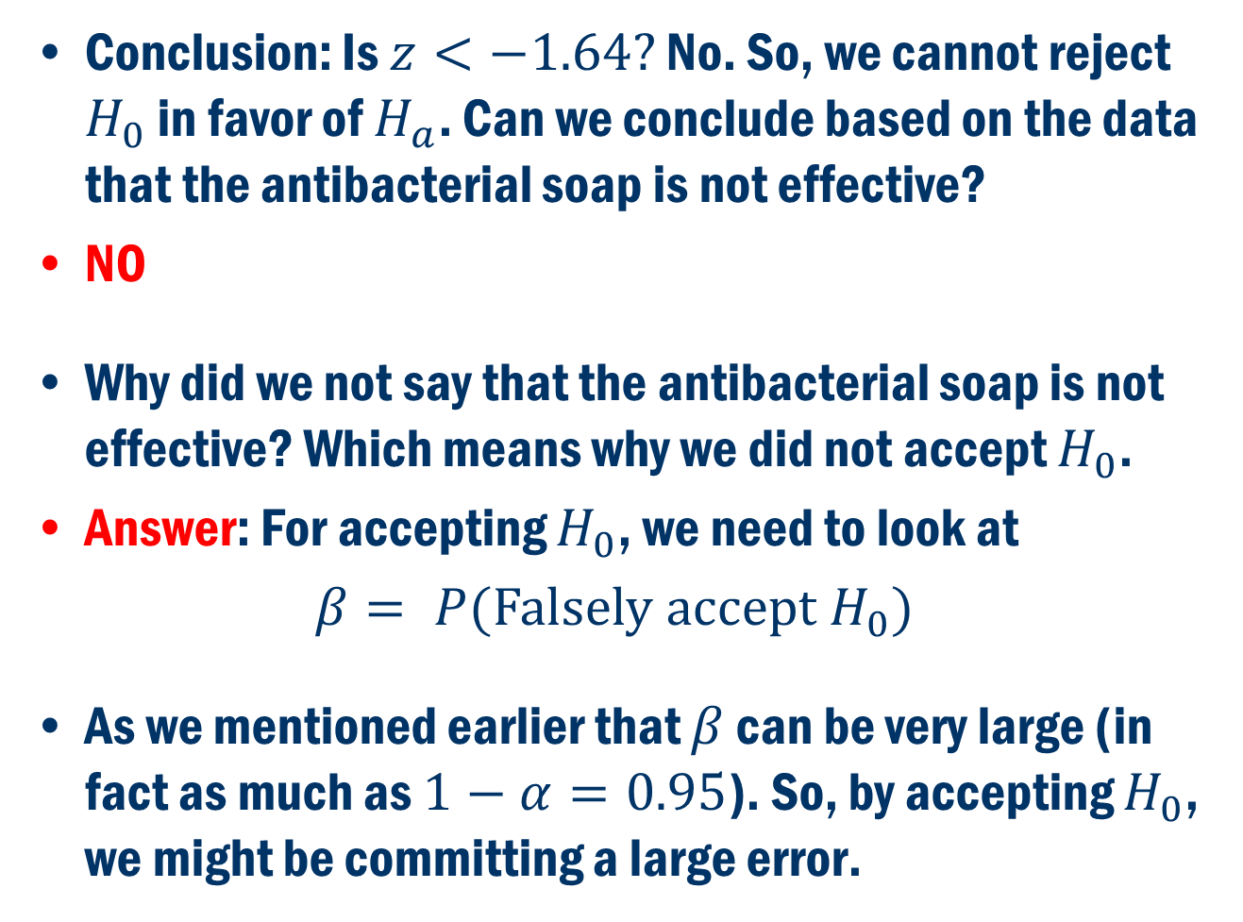
Book Example 5.9 CONT’D
Conclusion: Is $z<−1.64?$ No. So, we cannot reject $H_{0}$ in favor of $H_{a}$. Can we conclude based on the data that the antibacterial soap is not effective?
NO
Why did we not say that the antibacterial soap is not effective? Which means why we did not accept $H_{0}$.
Answer: For accepting $H_{0}$, we need to look at
$β= P(\text{Falsely} \text{accept} H_{0})$
As we mentioned earlier that $β$ can be very large (in fact as much as $1−α=0.95$). So, by accepting $H_{0}$, we might be committing a large error.

Slide 18
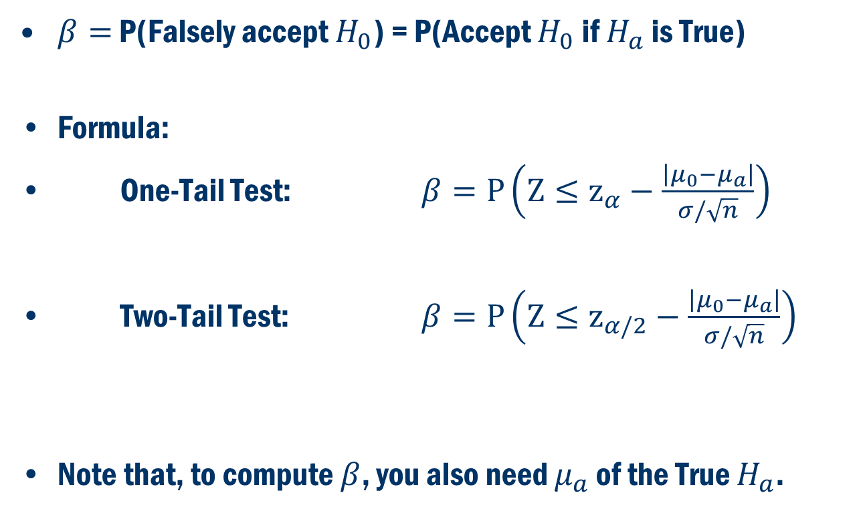

Computing $β$ (Type-II Error)
$β=$ P(Falsely accept $H_{0}$) = P(Accept $H_{0}$ if $H_{a}$ is True)
Formula:
One-Tail Test: $β=P\left(Z≤z_{α}−\frac{\left|μ_{0}−μ_{a}\right|}{σ/\sqrt{n}}\right)$
Two-Tail Test: $β=P\left(Z≤z_{α/2}−\frac{\left|μ_{0}−μ_{a}\right|}{σ/\sqrt{n}}\right)$
Note that, to compute $β$, you also need $μ_{a}$ of the True $H_{a}$.

Slide 19
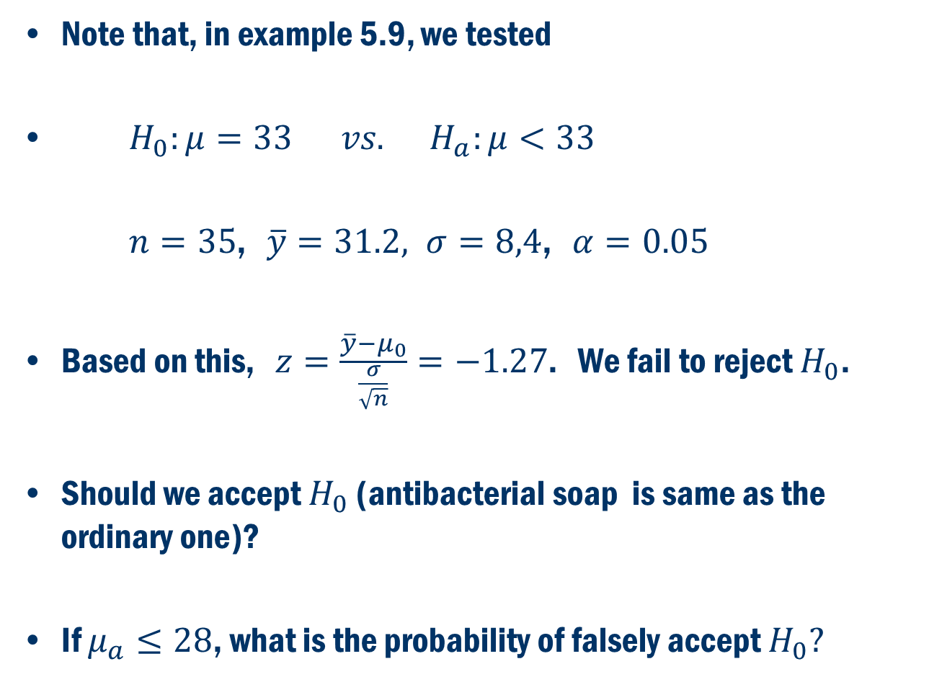
Book Example 5.10 (Cont. Example 5.9)
Note that, in example 5.9, we tested
$H_{0}:μ=33 vs. H_{a}:μ<33$
$n=35$, $\overline{y}=31.2, σ=8,4$, $α=0.05$
Based on this, $z=\frac{\overline{y}−μ_{0}}{\frac{σ}{\sqrt{n}}}=−1.27$. We fail to reject $H_{0}$.
Should we accept $H_{0}$ (antibacterial soap is same as the ordinary one)?
If $μ_{a}≤28$, what is the probability of falsely accept $H_{0}?$

Slide 20
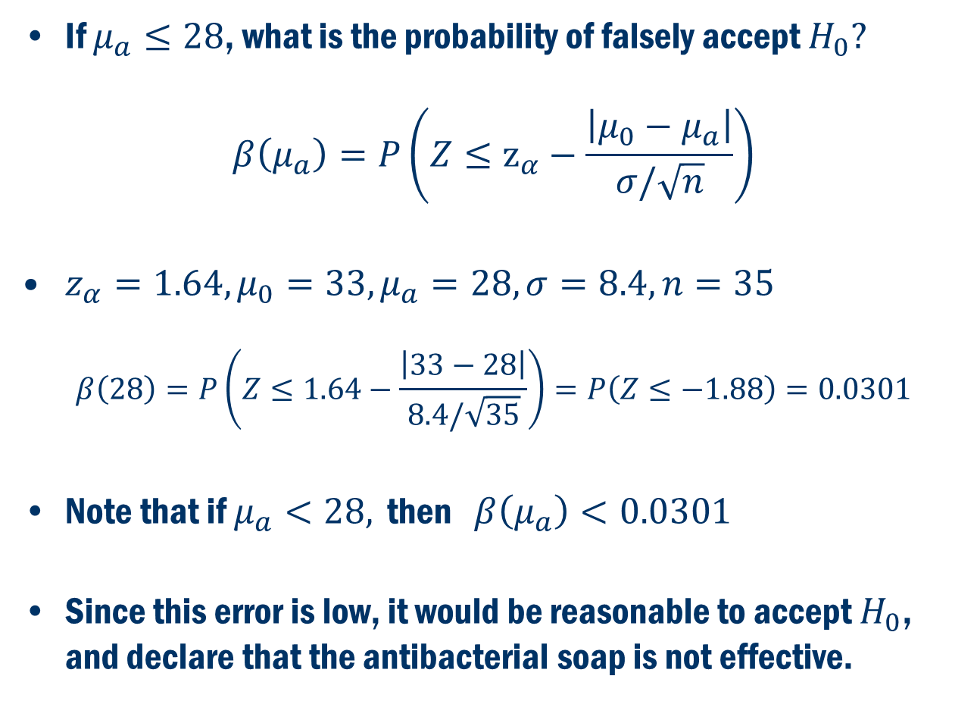
Book Example 5.10 Cont’D
If $μ_{a}≤28$, what is the probability of falsely accept $H_{0}?$
$$β\left(μ_{a}\right)=P\left(Z≤z_{α}−\frac{\left|μ_{0}−μ_{a}\right|}{σ/\sqrt{n}}\right)$$
$z_{α}=1.64, μ_{0}=33, μ_{a}=28, σ=8.4, n=35$
$$β\left(28\right)=P\left(Z≤1.64−\frac{\left|33−28\right|}{8.4/\sqrt{35}}\right)=P\left(Z≤−1.88\right)=0.0301$$
Note that if $μ_{a}<28,$ then $β\left(μ_{a}\right)<0.0301$
Since this error is low, it would be reasonable to accept $H_{0}$, and declare that the antibacterial soap is not effective.

Slide 21
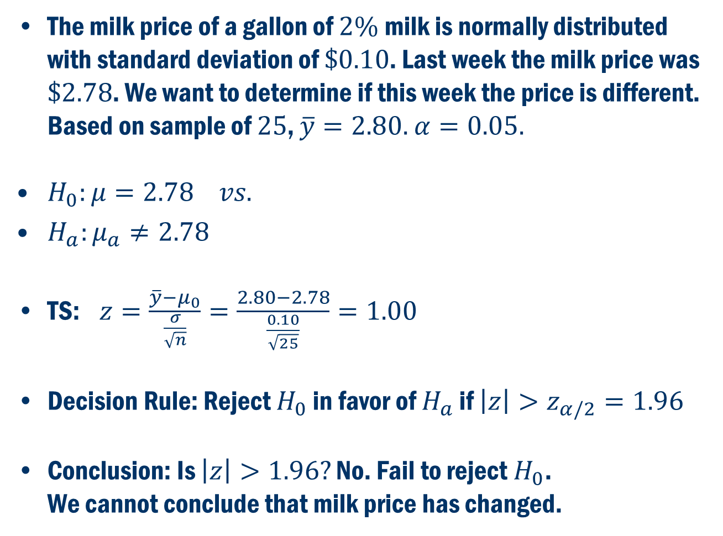
Another Example
The milk price of a gallon of $2\%$milk is normally distributed with standard deviation of $\$0.10$. Last week the milk price was $\$2.78$. We want to determine if this week the price is different. Based on sample of $25$, $\overline{y}=2.80.$ $α=0.05.$
$H_{0}:μ=2.78 vs.$
$H_{a}:μ_{a}≠2.78$
TS: $z=\frac{\overline{y}−μ_{0}}{\frac{σ}{\sqrt{n}}}=\frac{2.80−2.78}{\frac{0.10}{\sqrt{25}}}=1.00$
Decision Rule: Reject $H_{0}$ in favor of $H_{a}$ if $\left|z\right|>z_{α/2}=1.96$
Conclusion: Is $\left|z\right|>1.96?$ No. Fail to reject $H_{0}$. We cannot conclude that milk price has changed.

Slide 22
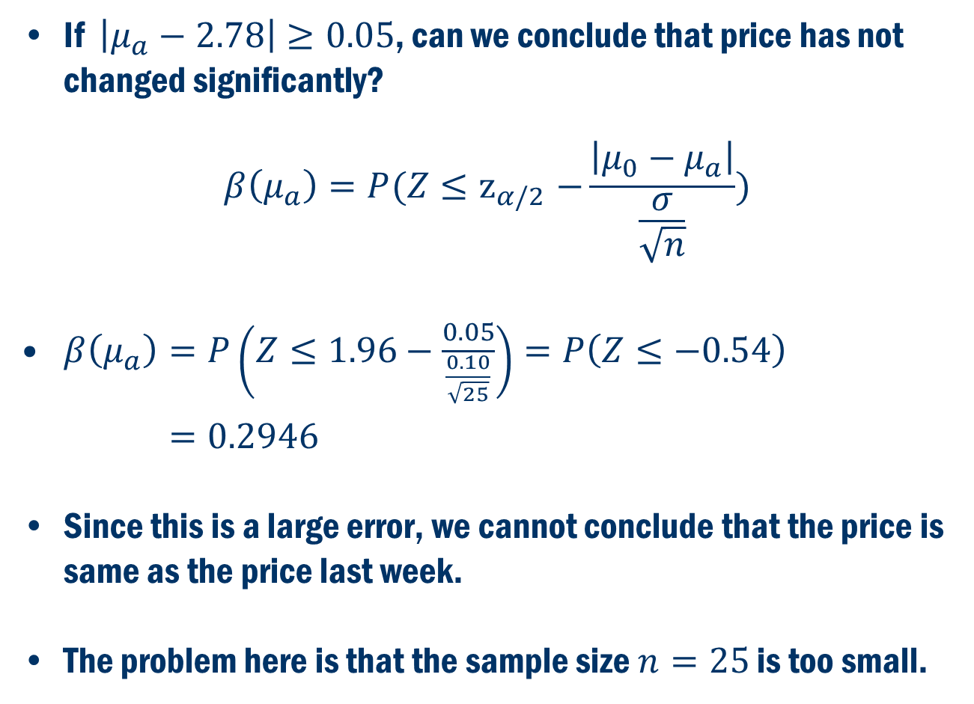
Another Example Cont’D
If $\left|μ_{a}−2.78\right|≥0.05$, can we conclude that price has not changed significantly?
$$β\left(μ_{a}\right)=P(Z{≤z}_{α/2}−\frac{\left|μ_{0}−μ_{a}\right|}{\frac{σ}{\sqrt{n}}})$$
$β\left(μ_{a}\right)=P\left(Z≤1.96−\frac{0.05}{\frac{0.10}{\sqrt{25}}}\right)=P\left(Z≤−0.54\right)$
$=0.2946$
Since this is a large error, we cannot conclude that the price is same as the price last week.
The problem here is that the sample size $n=25$ is too small.

Slide 23
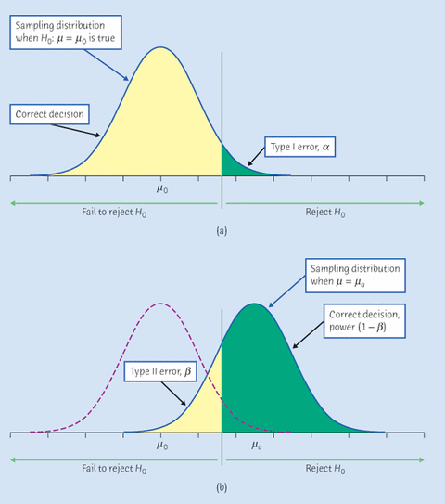
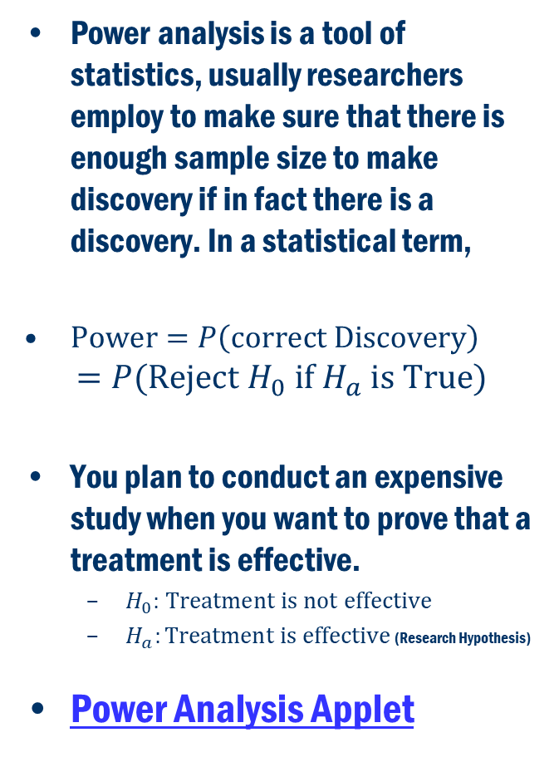
Power Analysis
Power analysis is a tool of statistics, usually researchers employ to make sure that there is enough sample size to make discovery if in fact there is a discovery. In a statistical term,
$\text{Power}=P\left(\text{correct} \text{Discovery}\right)$
$$=P(\text{Reject} H_{0} \text{if} H_{a} \text{is} \text{True})$$
You plan to conduct an expensive study when you want to prove that a treatment is effective.
$H_{0}:$ $\text{Treatment} \text{is} \text{not} \text{effective}$
$H_{a}:\text{Treatment} \text{is} \text{effective}$ (Research Hypothesis)
Power Analysis Applet

Slide 24
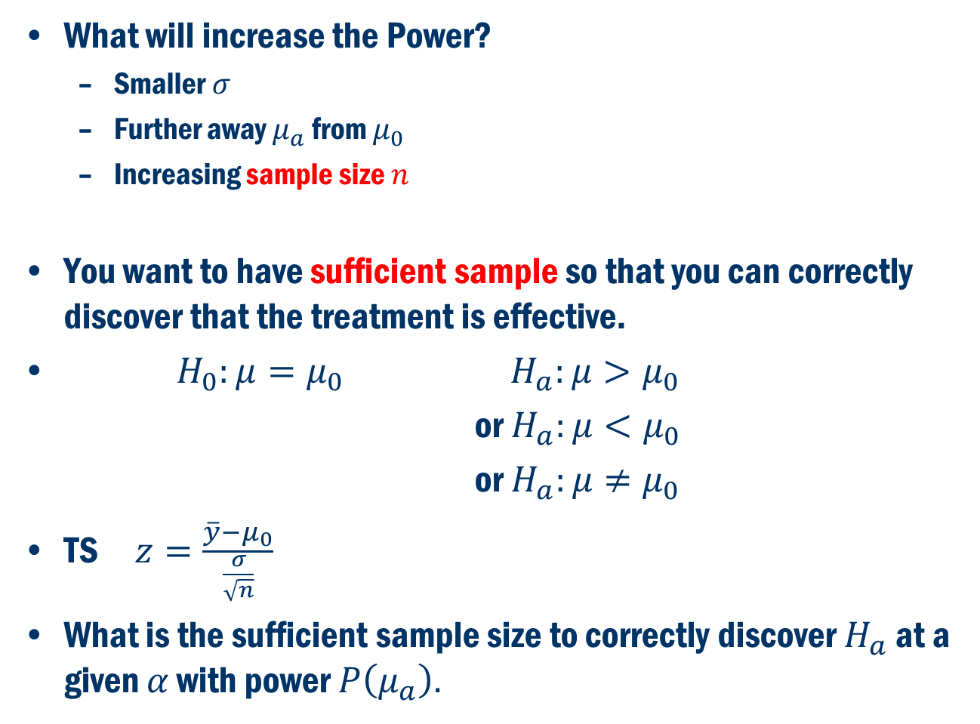
Power Analysis Cont’D
What will increase the Power?
Smaller $σ$
Further away $μ_{a}$ from $μ_{0}$
Increasing sample size $n$
You want to have sufficient sample so that you can correctly discover that the treatment is effective.
${ H}_{0}:μ=μ_{0}$ $H_{a}:μ>μ_{0}$
or $H_{a}:μ<μ_{0}$
or $H_{a}:μ≠μ_{0}$
TS $z=\frac{\overline{y}−μ_{0}}{\frac{σ}{\sqrt{n}}}$
What is the sufficient sample size to correctly discover $H_{a}$ at a given $α$ with power $P\left(μ_{a}\right).$

Slide 25
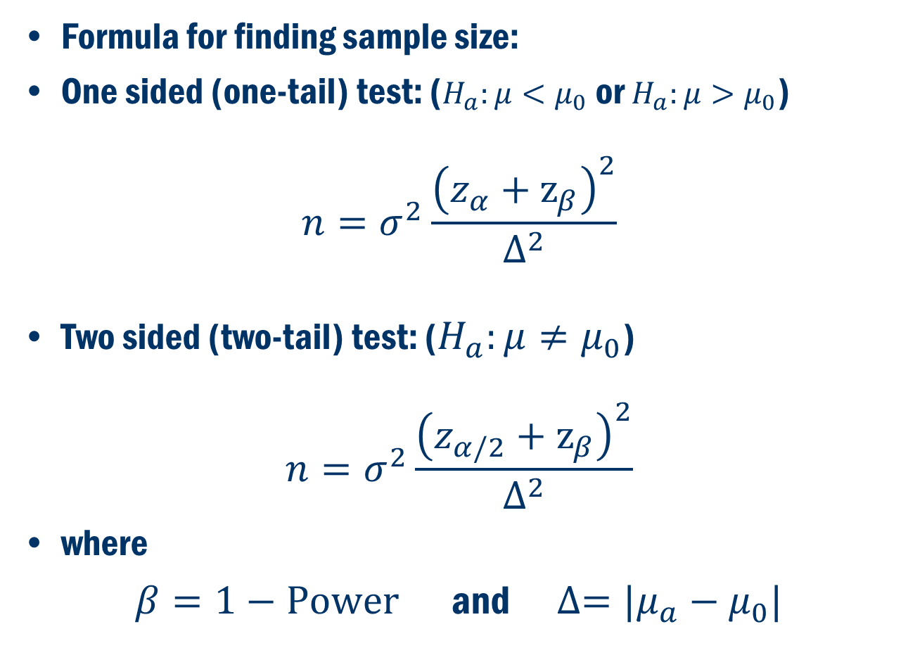
Power Analysis Cont’D
Formula for finding sample size:
One sided (one-tail) test: ($H_{a}:μ<μ_{0}$ or $H_{a}:μ>μ_{0}$)
$$n=σ^{2}\frac{{\left(z_{α}+z_{β}\right)}^{2}}{∆^{2}}$$
Two sided (two-tail) test: ($H_{a}:μ≠μ_{0}$)
$$n=σ^{2}\frac{{\left(z_{α/2}+z_{β}\right)}^{2}}{∆^{2}}$$
where
$β=1−\text{Power}$ and $∆=|μ_{a}−μ_{0}|$

Slide 26
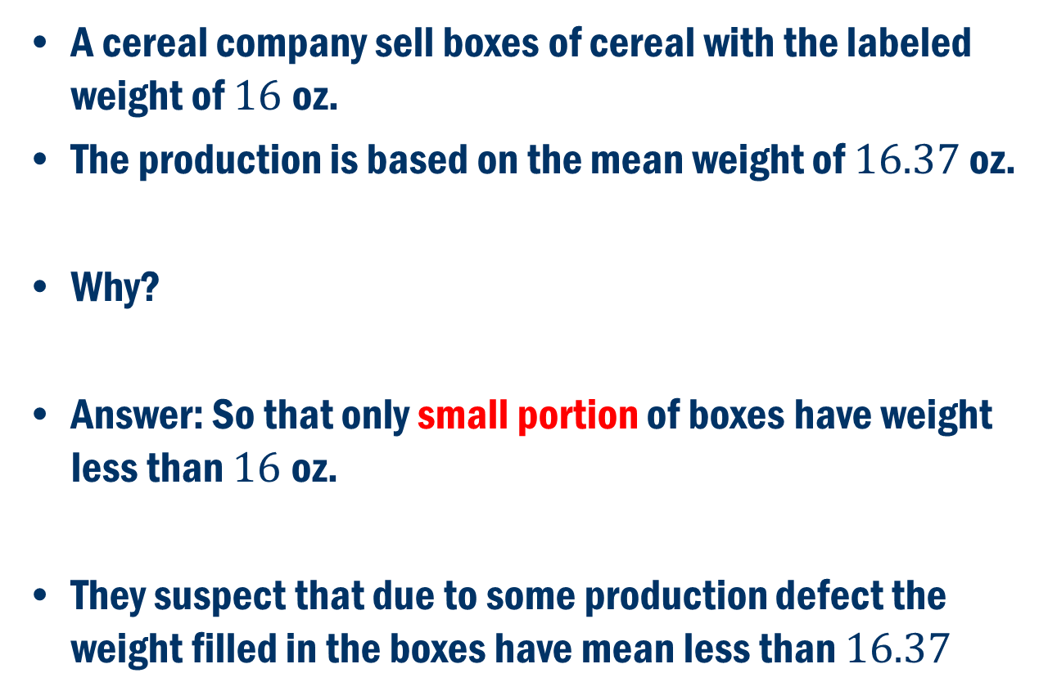
Book Example 5.11
A cereal company sell boxes of cereal with the labeled weight of $16$oz.
The production is based on the mean weight of $16.37$ oz.
Why?
Answer: So that only small portion of boxes have weight less than $16$oz.
They suspect that due to some production defect the weight filled in the boxes have mean less than $16.37$

Slide 27
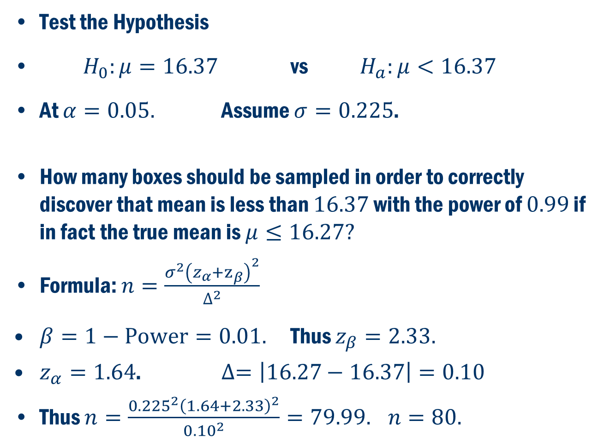
Book Example 5.11 Cont’D
Test the Hypothesis
$H_{0}:μ=16.37$ vs $H_{a}:μ<16.37$
At $α=0.05.$ Assume $σ=0.225$.
How many boxes should be sampled in order to correctly discover that mean is less than $16.37$ with the power of $0.99$ if in fact the true mean is $μ≤16.27?$
Formula: $n=\frac{σ^{2}{\left(z_{α}+z_{β}\right)}^{2}}{∆^{2}}$
$β=1−\text{Power}=0.01.$ Thus $z_{β}=2.33.$
$z_{α}=1.64$. $∆=\left|16.27−16.37\right|=0.10$
Thus $n=\frac{{0.225}^{2}{\left(1.64+2.33\right)}^{2}}{{0.10}^{2}}=79.99.$ $n=80.$

