Slide 1
Chapter 5 (Part C)

Slide 2
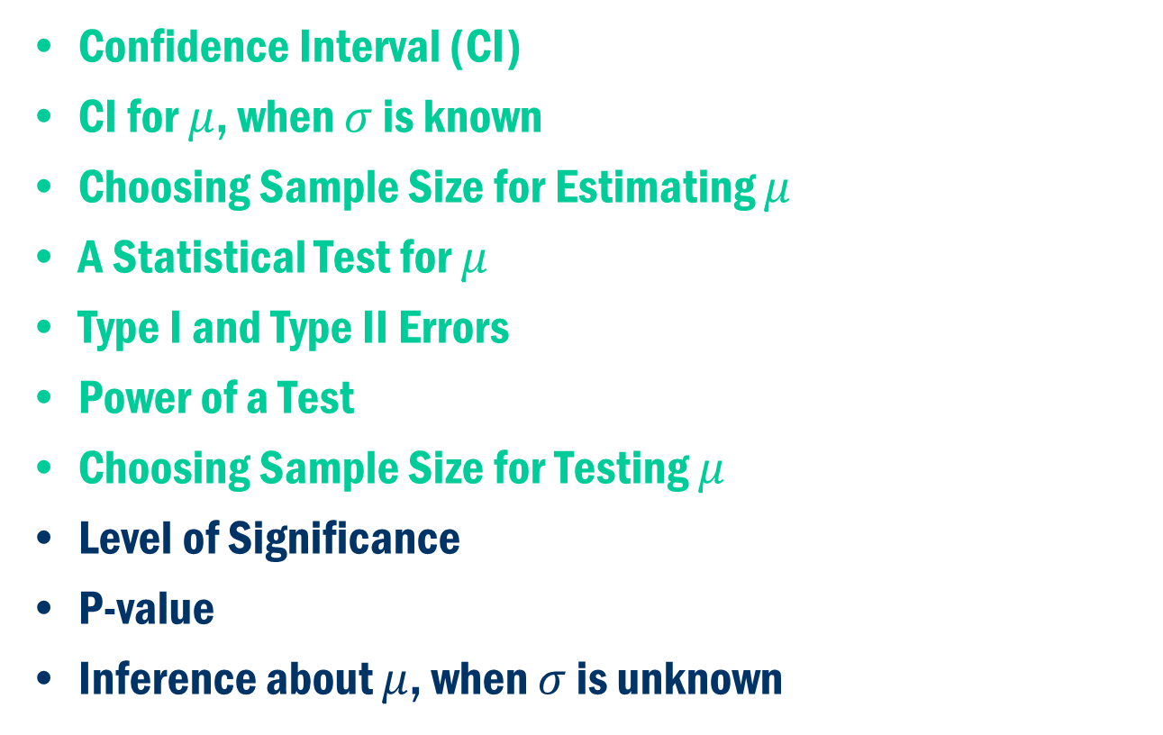
Chapter 5 (Part C)
Confidence Interval (CI)
CI for $μ$, when $σ$ is known
Choosing Sample Size for Estimating $μ$
A Statistical Test for $μ$
Type I and Type II Errors
Power of a Test
Choosing Sample Size for Testing $μ$
Level of Significance
P-value
Inference about $μ$, when $σ$ is unknown

Slide 3
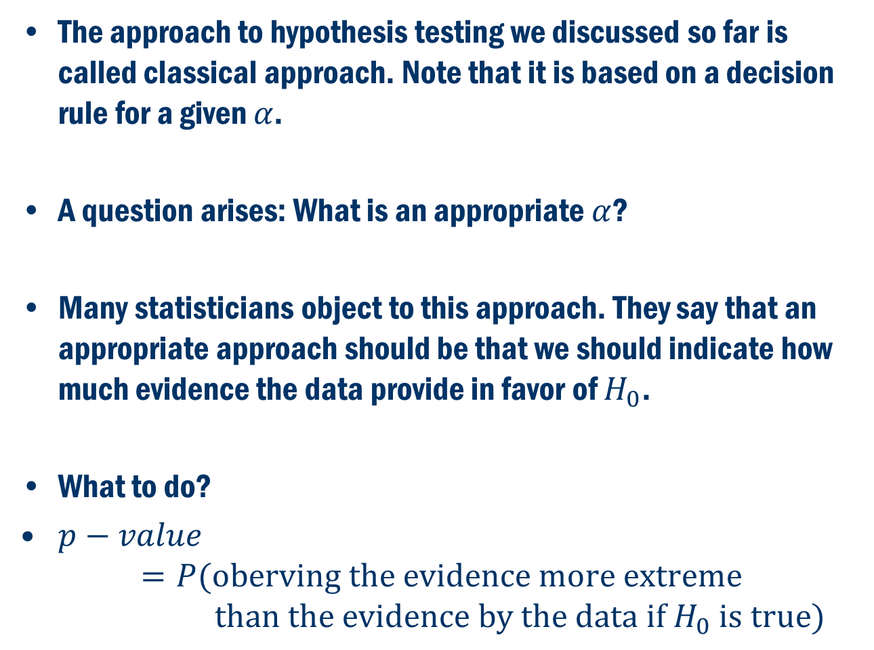
Level of Significance
The approach to hypothesis testing we discussed so far is called classical approach. Note that it is based on a decision rule for a given $α$.
A question arises: What is an appropriate $α$?
Many statisticians object to this approach. They say that an appropriate approach should be that we should indicate how much evidence the data provide in favor of $H_{0}$.
What to do?
$p−value$
$$=P(\text{oberving} \text{the} \text{evidence} \text{more} \text{extreme}$$
$$\text{than} \text{the} \text{evidence} \text{by} \text{the} \text{data} \text{if} H_{0} \text{is} \text{true})$$

Slide 4
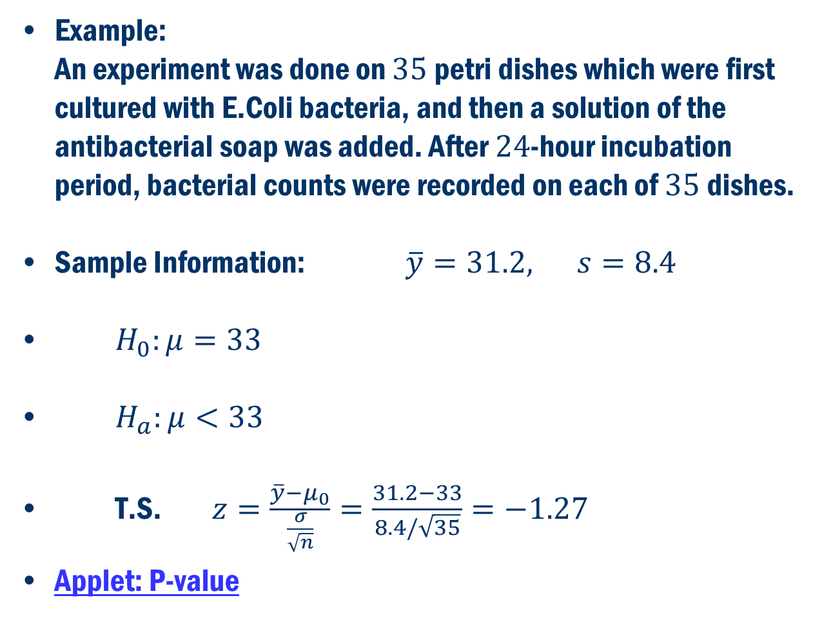
P-Value Approach
Example: An experiment was done on $35$petri dishes which were first cultured with E.Coli bacteria, and then a solution of the antibacterial soap was added. After $24$-hour incubation period, bacterial counts were recorded on each of $35$dishes.
Sample Information: $\overline{y}=31.2, s=8.4$
$H_{0}:μ=33$
$H_{a}:μ<33$
T.S. $z=\frac{\overline{y}−μ_{0}}{\frac{σ}{\sqrt{n}}}=\frac{31.2−33}{8.4/\sqrt{35}}=−1.27$
Applet: P-value

Slide 5
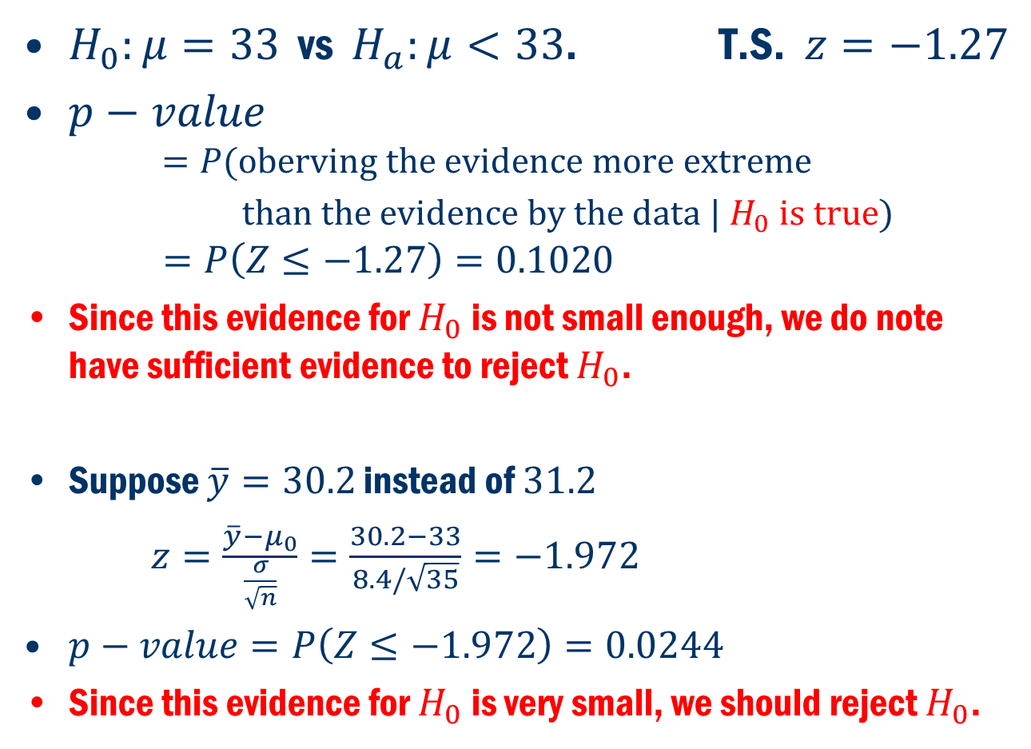
P-Value Approach Cont’D
$H_{0}:μ=33$ vs $H_{a}:μ<33$. T.S. $z=−1.27$
$p−value$
$$=P(\text{oberving} \text{the} \text{evidence} \text{more} \text{extreme}$$
$\text{than} \text{the} \text{evidence} \text{by} \text{the} \text{data}\text{ | }H_{0} \text{is} \text{true})$
$$=P\left(Z≤−1.27\right)=0.1020$$
Since this evidence for $H_{0}$ is not small enough, we do note have sufficient evidence to reject $H_{0}$.
Suppose $\overline{y}=30.2$ instead of $31.2$
$z=\frac{\overline{y}−μ_{0}}{\frac{σ}{\sqrt{n}}}=\frac{30.2−33}{8.4/\sqrt{35}}=−1.972$
$p−value=P\left(Z≤−1.972\right)=0.0244$
Since this evidence for $H_{0}$ is very small, we should reject $H_{0}$.

Slide 6
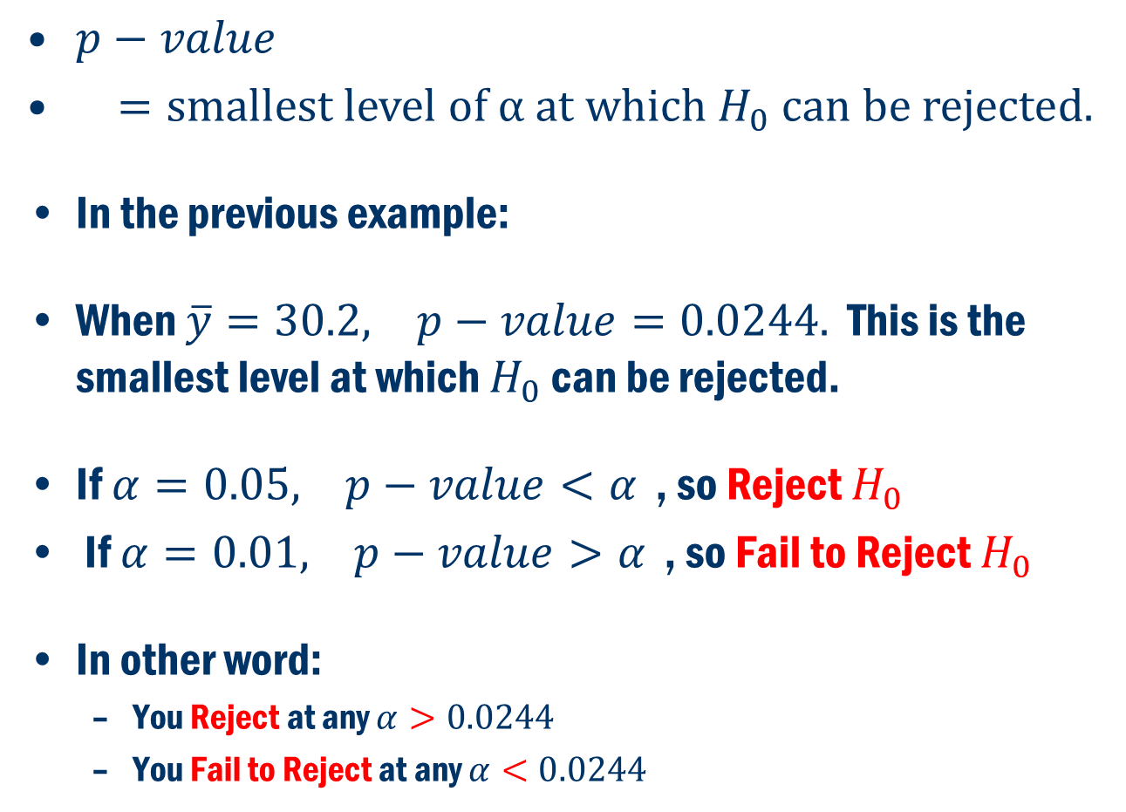
Another interpretation of p-value:
$p−value$
$=\text{smallest} \text{level} \text{of} \text{α} \text{at} \text{which} H_{0} \text{can} \text{be} \text{rejected}\text{.}$
In the previous example:
When $\overline{y}=30.2, p−value=0.0244.$ This is the smallest level at which $H_{0}$ can be rejected.
If $α=0.05, p−value<α$ , so Reject $H_{0}$
If $α=0.01, p−value>α$ , so Fail to Reject $H_{0}$
In other word:
You Reject at any $α>0.0244$
You Fail to Reject at any $α<0.0244$

Slide 7
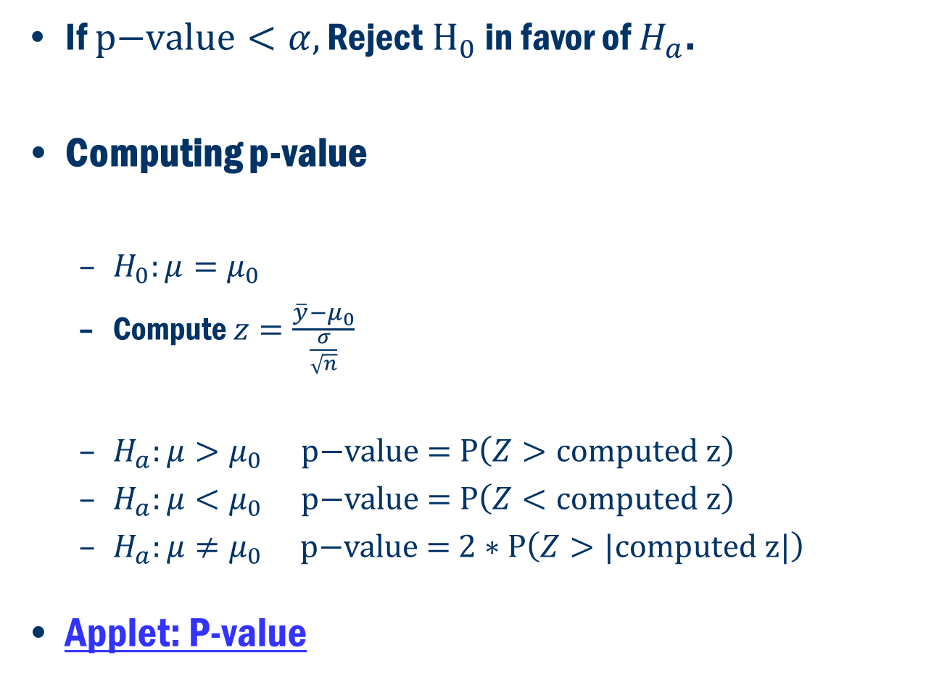
General Approach
If $\text{p}\text{−}\text{value}<α, \text{R}\text{eject} H_{0}$ in favor of $H_{a}$.
Computing p-value
$H_{0}:μ=μ_{0}$
Compute $z=\frac{\overline{y}−μ_{0}}{\frac{σ}{\sqrt{n}}}$
$H_{a}:μ>μ_{0}$ $\text{p}\text{−}\text{value} \text{=} \text{P}\left(Z>\text{computed} \text{z}\right)$
$H_{a}:μ<μ_{0}$ $\text{p}\text{−}\text{value} \text{=} \text{P}\left(Z<\text{computed} \text{z}\right)$
$H_{a}:μ≠μ_{0}$ $\text{p}\text{−}\text{value} \text{=} 2∗\text{P}\left(Z>\text{|}\text{computed} \text{z}\text{|}\right)$
Applet: P-value

Slide 8
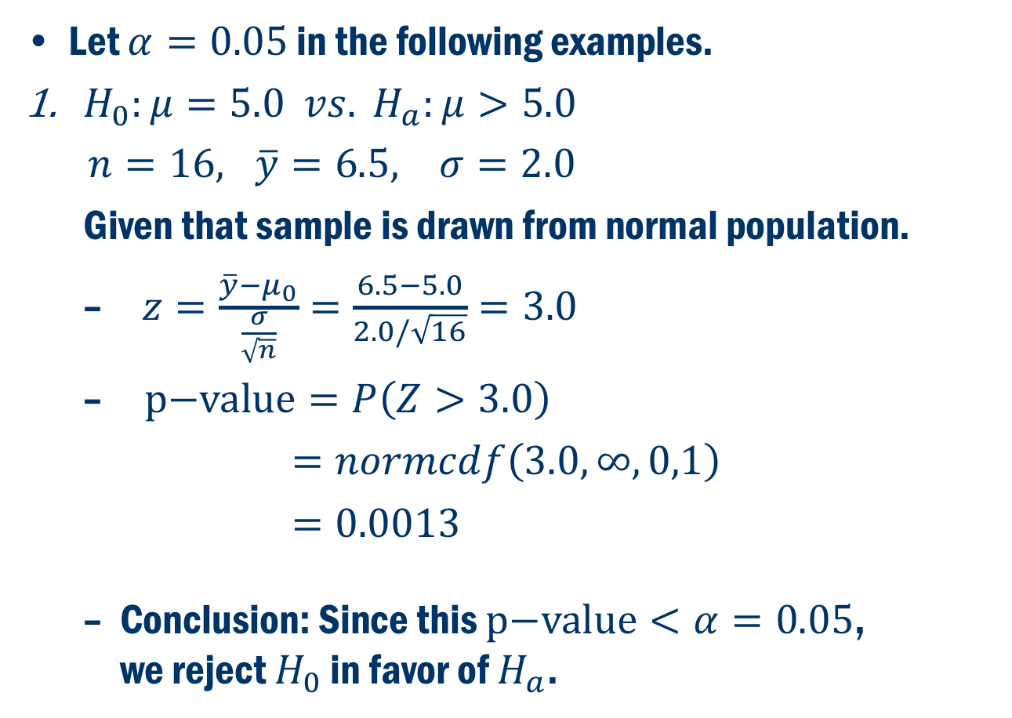
Three Examples
Let $α=0.05$ in the following examples.
$H_{0}:μ=5.0 vs. H_{a}:μ>5.0$
$n=16, \overline{y}=6.5, σ=2.0$
Given that sample is drawn from normal population.
$z=\frac{\overline{y}−μ_{0}}{\frac{σ}{\sqrt{n}}}=\frac{6.5−5.0}{2.0/\sqrt{16}}=3.0$
$\text{p}\text{−}\text{value}=P\left(Z>3.0\right)$
$=normcdf\left(3.0, ∞, 0,1\right)$
$=0.0013$
Conclusion: Since this $\text{p}\text{−}\text{value}<α=0.05$, we reject $H_{0}$ in favor of $H_{a}$.

Slide 9
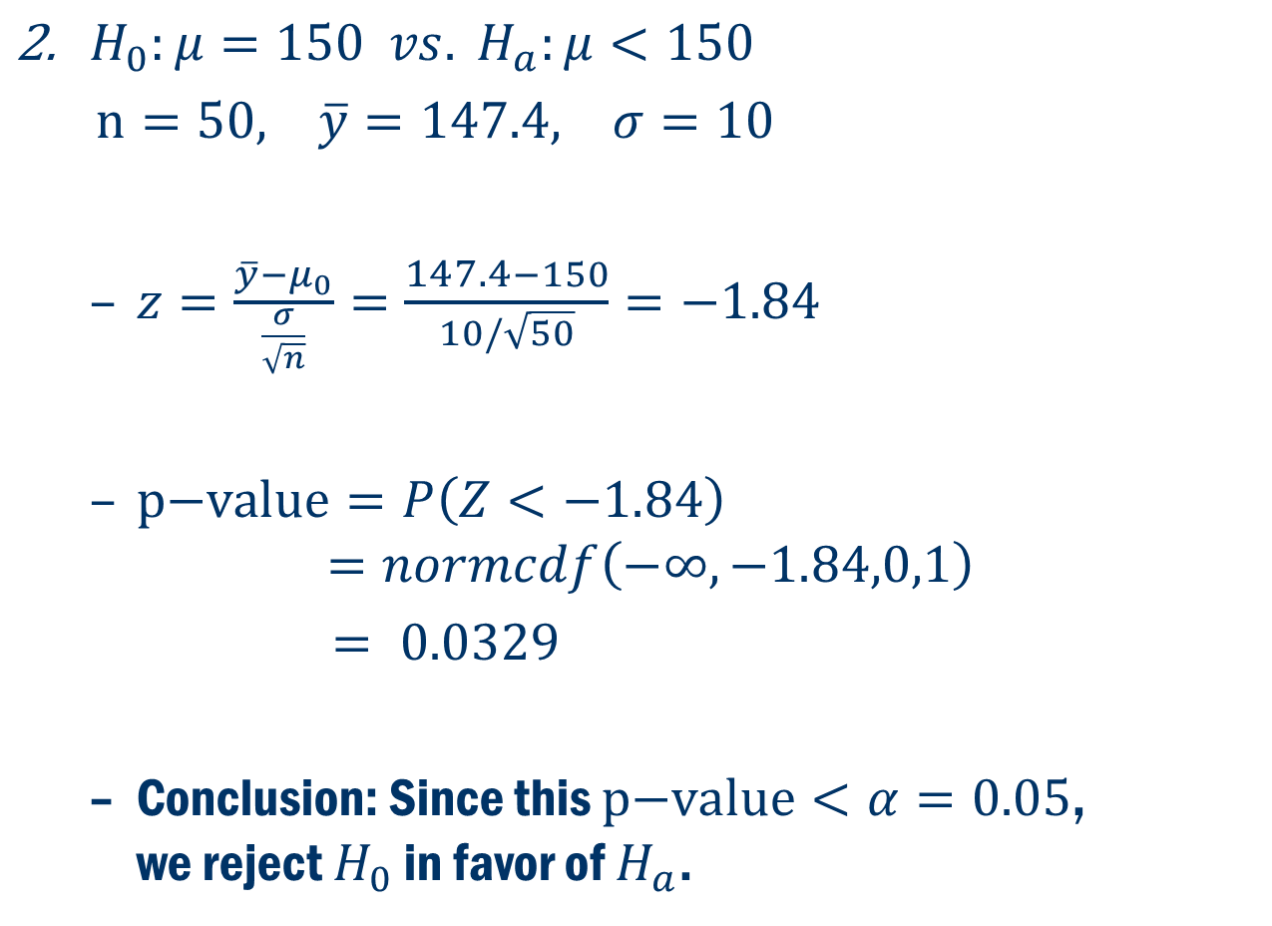
Three Examples Cont’D
$H_{0}:μ=150 vs. H_{a}:μ<150$
$n=50, \overline{y}=147.4, σ=10$
$z=\frac{\overline{y}−μ_{0}}{\frac{σ}{\sqrt{n}}}=\frac{147.4−150}{10/\sqrt{50}}=−1.84$
$\text{p}\text{−}\text{value}=P\left(Z<−1.84\right)$
$$=normcdf\left(−∞, −1.84,0,1\right)$$ $= 0.0329$
Conclusion: Since this $\text{p}\text{−}\text{value}<α=0.05$, we reject $H_{0}$ in favor of $H_{a}$.

Slide 10
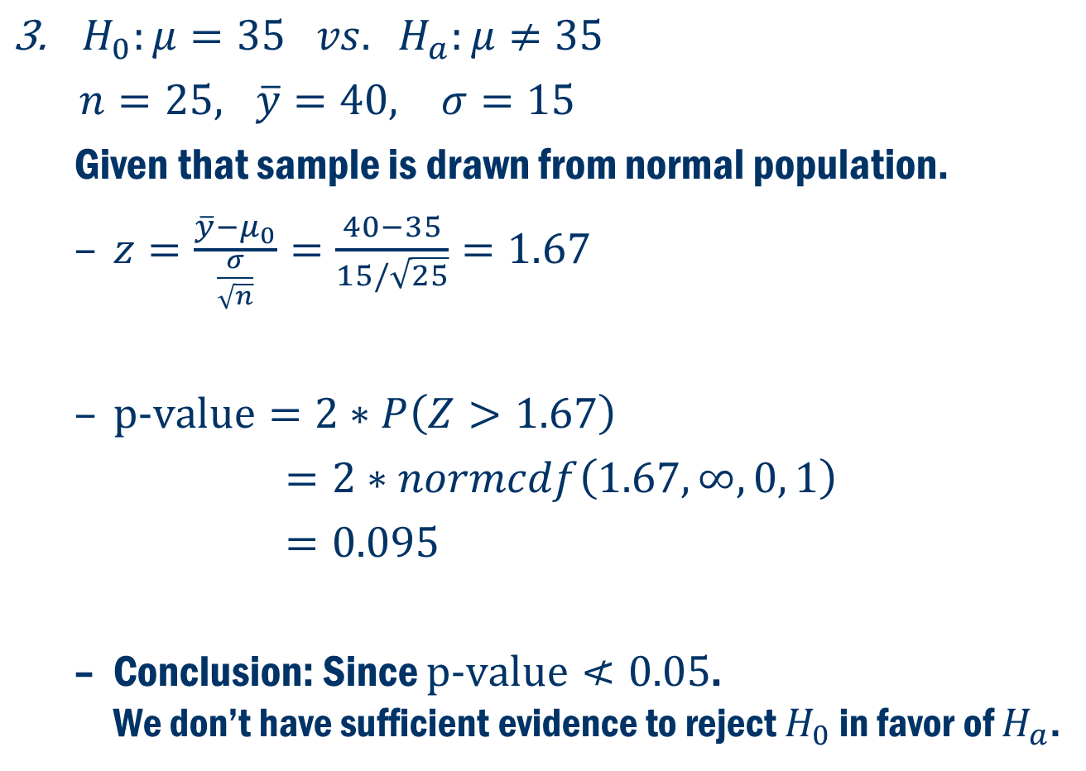
Three Examples CONT’D
$H_{0}:μ=35 vs. H_{a}:μ≠35$
$n=25, \overline{y}=40, σ=15$
Given that sample is drawn from normal population.
$z=\frac{\overline{y}−μ_{0}}{\frac{σ}{\sqrt{n}}}=\frac{40−35}{15/\sqrt{25}}=1.67$
$\text{p}\text{−}\text{value}=2∗P\left(Z>1.67\right)$
$=2∗normcdf\left(1.67, ∞, 0, 1\right)$
$=0.095$
Conclusion: Since $\text{p}\text{−}\text{value}≮0.05$. We don’t have sufficient evidence to reject $H_{0}$ in favor of $H_{a}$.

Slide 11
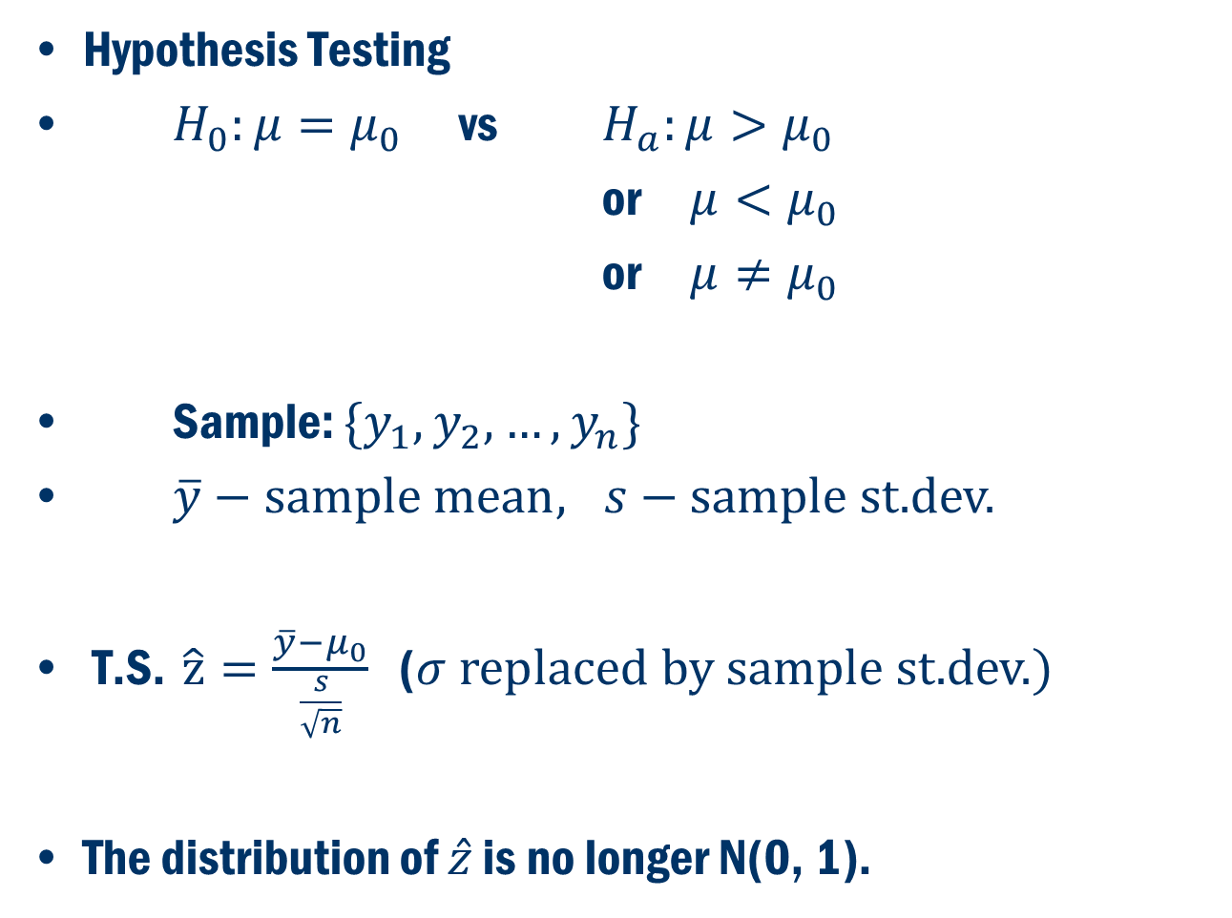
Inference about 𝝁 when 𝝈 is unknown
Hypothesis Testing
$H_{0}:μ=μ_{0}$ vs $H_{a}:μ>μ_{0}$
or $μ<μ_{0}$
or $μ≠μ_{0}$
Sample: $\{y_{1}, y_{2},…,y_{n}\}$
$\overline{y}−\text{s}\text{ample} \text{m}\text{ean}, s−\text{sample} \text{st}\text{.}\text{dev}\text{.}$
T.S. $\hat{z}=\frac{\overline{y}−μ_{0}}{\frac{s}{\sqrt{n}}}$ ($σ \text{replaced} \text{by} \text{sample} \text{st}\text{.}\text{dev}\text{.})$
The distribution of $\hat{z}$ is no longer N(0, 1).

Slide 12
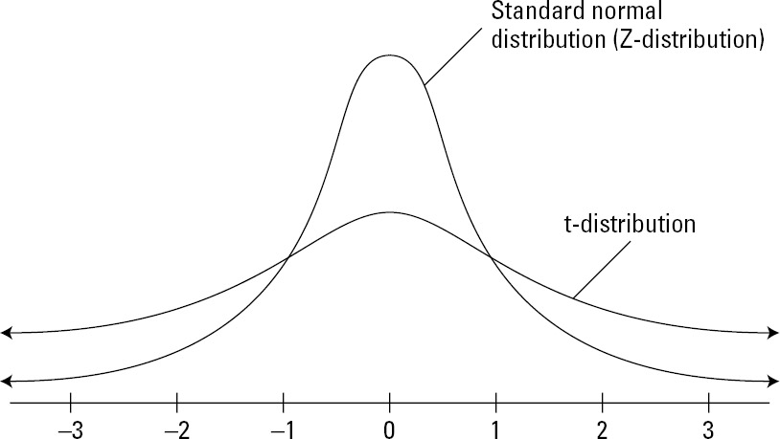

Student T-Distribution
$t=\frac{\overline{y}−μ}{\frac{s}{\sqrt{n}}}$
The distribution of $t$ is called student-t distribution.

Slide 13
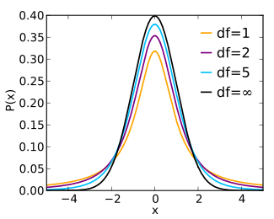
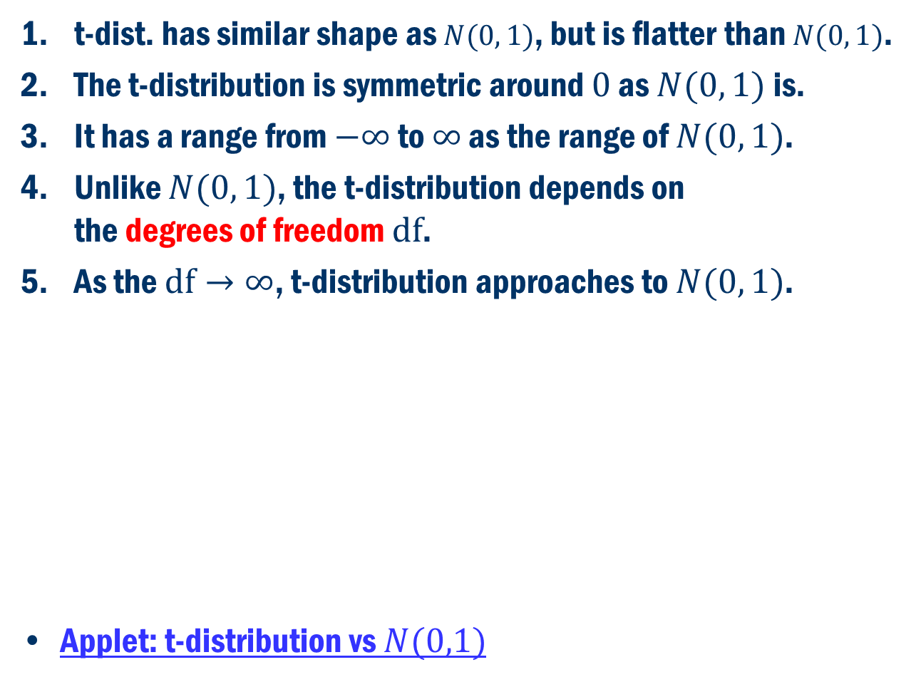
Remarks on T-Distribution
t-dist. has similar shape as $N(0, 1)$, but is flatter than $N(0, 1)$.
The t-distribution is symmetric around $0$ as $N(0, 1)$is.
It has a range from $−∞$ to $∞$ as the range of $N(0, 1)$.
Unlike $N(0, 1)$, the t-distribution depends on the degrees of freedom $df$.
As the $\text{df}→∞$, t-distribution approaches to $N(0, 1)$.
Applet: t-distribution vs $N(0,1)$

Slide 14
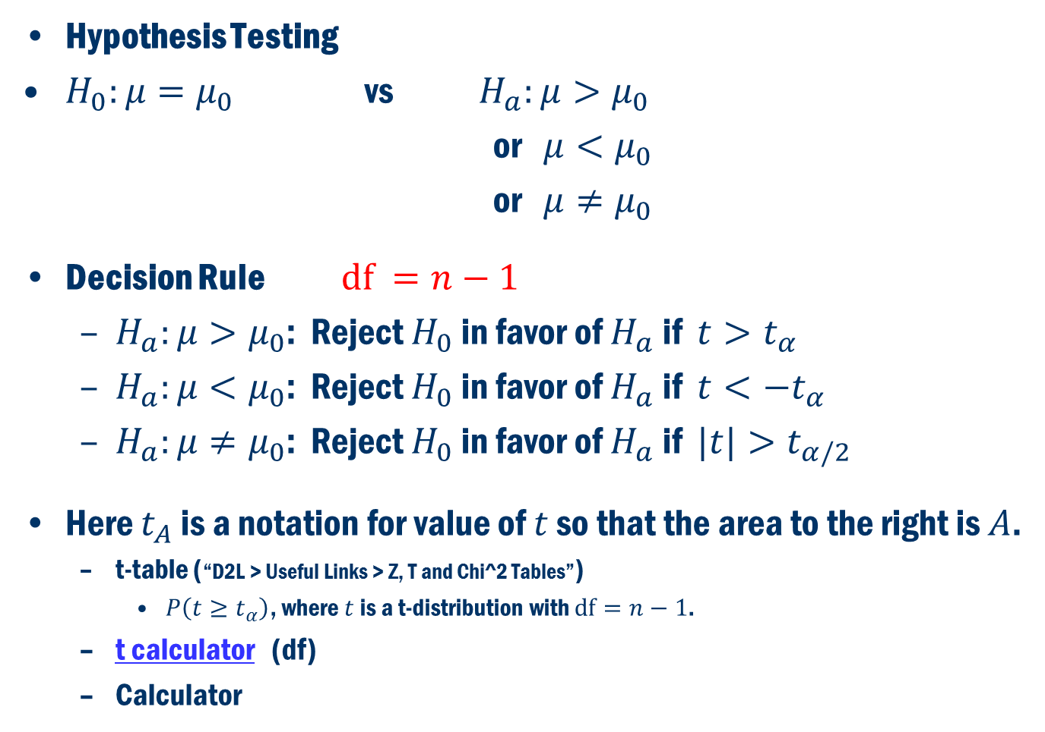
Inference about 𝝁 when 𝝈 is unknown
Hypothesis Testing
$H_{0}:μ=μ_{0}$ vs $H_{a}:μ>μ_{0}$
or $μ<μ_{0}$
or $μ≠μ_{0}$
Decision Rule $\text{df} =n−1$
$H_{a}:μ>μ_{0}$: Reject $H_{0}$ in favor of $H_{a}$ if $t>t_{α}$
$H_{a}:μ<μ_{0}$: Reject $H_{0}$ in favor of $H_{a}$ if $t<−t_{α}$
$H_{a}:μ≠μ_{0}$: Reject $H_{0}$ in favor of $H_{a}$ if $|t|>t_{α/2}$
Here $t_{A}$ is a notation for value of $t$ so that the area to the right is $A$.
t-table (“D2L > Useful Links > Z, T and Chi^2 Tables”)
$P\left(t≥t_{α}\right)$, where $t$is a t-distribution with $df=n−1$.
t calculator (df)
Calculator

Slide 15
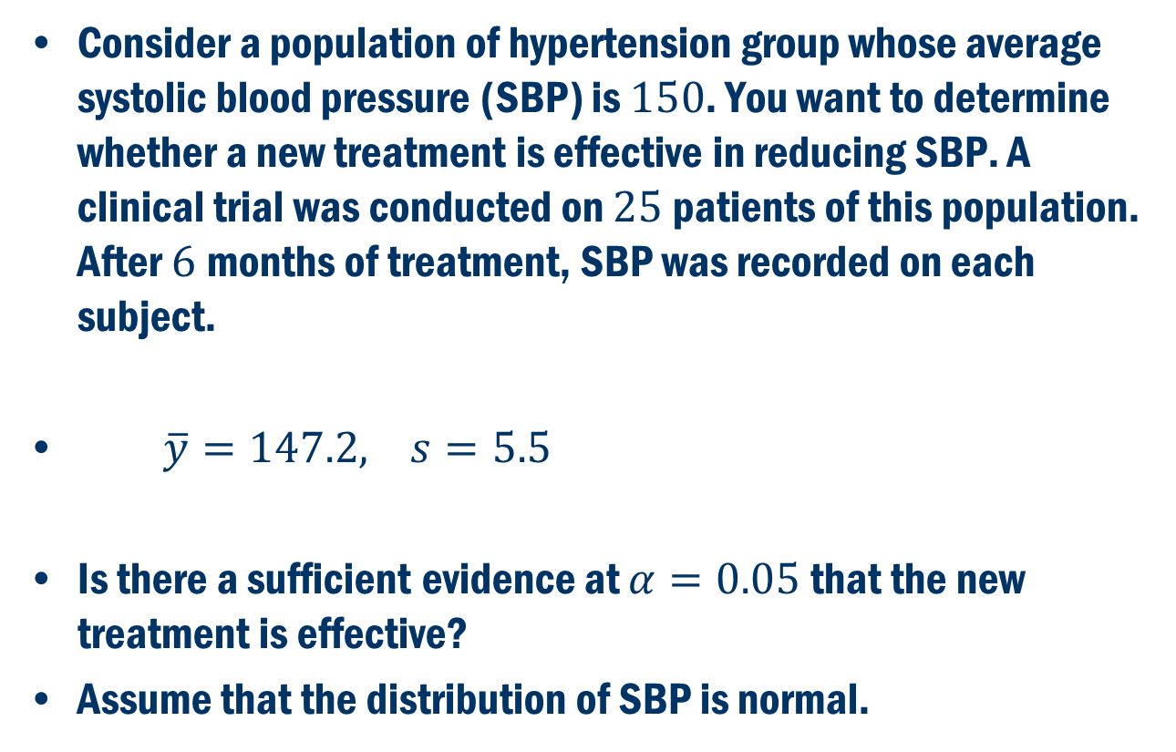
Example
Consider a population of hypertension group whose average systolic blood pressure (SBP) is $150$. You want to determine whether a new treatment is effective in reducing SBP. A clinical trial was conducted on $25$patients of this population. After $6$months of treatment, SBP was recorded on each subject.
$\overline{y}=147.2, s=5.5$
Is there a sufficient evidence at $α=0.05$that the new treatment is effective?
Assume that the distribution of SBP is normal.

Slide 16
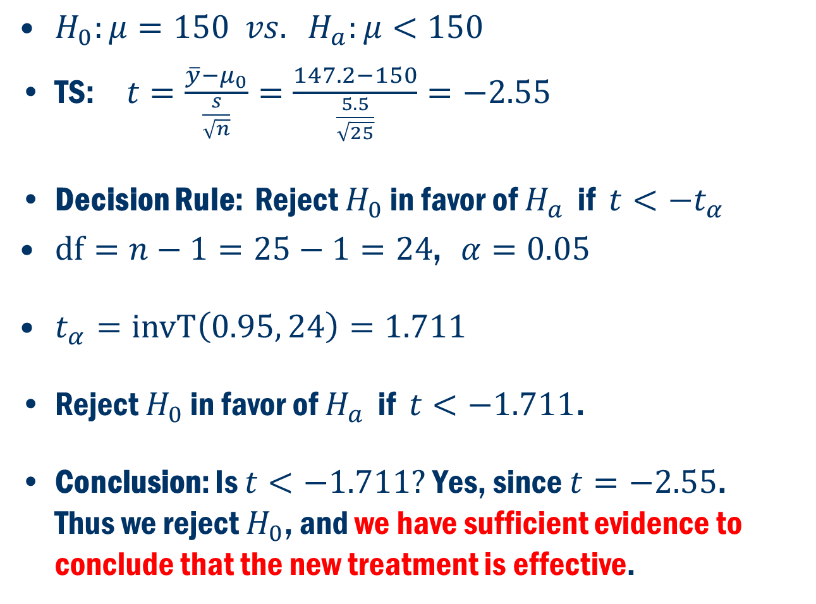
Example Cont’D
$H_{0}:μ=150 vs. H_{a}:μ<150$
TS: $t=\frac{\overline{y}−μ_{0}}{\frac{s}{\sqrt{n}}}=\frac{147.2−150}{\frac{5.5}{\sqrt{25}}}=−2.55$
Decision Rule: Reject $H_{0}$ in favor of $H_{a}$ if $t<−t_{α}$
$\text{d}\text{f}=n−1=25−1=24$, $α=0.05$
$t_{α}=\text{inv}\text{T}\left(0.95, 24\right)=1.711$
Reject $H_{0}$ in favor of $H_{a}$ if $t<−1.711$.
Conclusion: Is $t<−1.711?$ Yes, since $t=−2.55$. Thus we reject $H_{0}$, and we have sufficient evidence to conclude that the new treatment is effective.

Slide 17
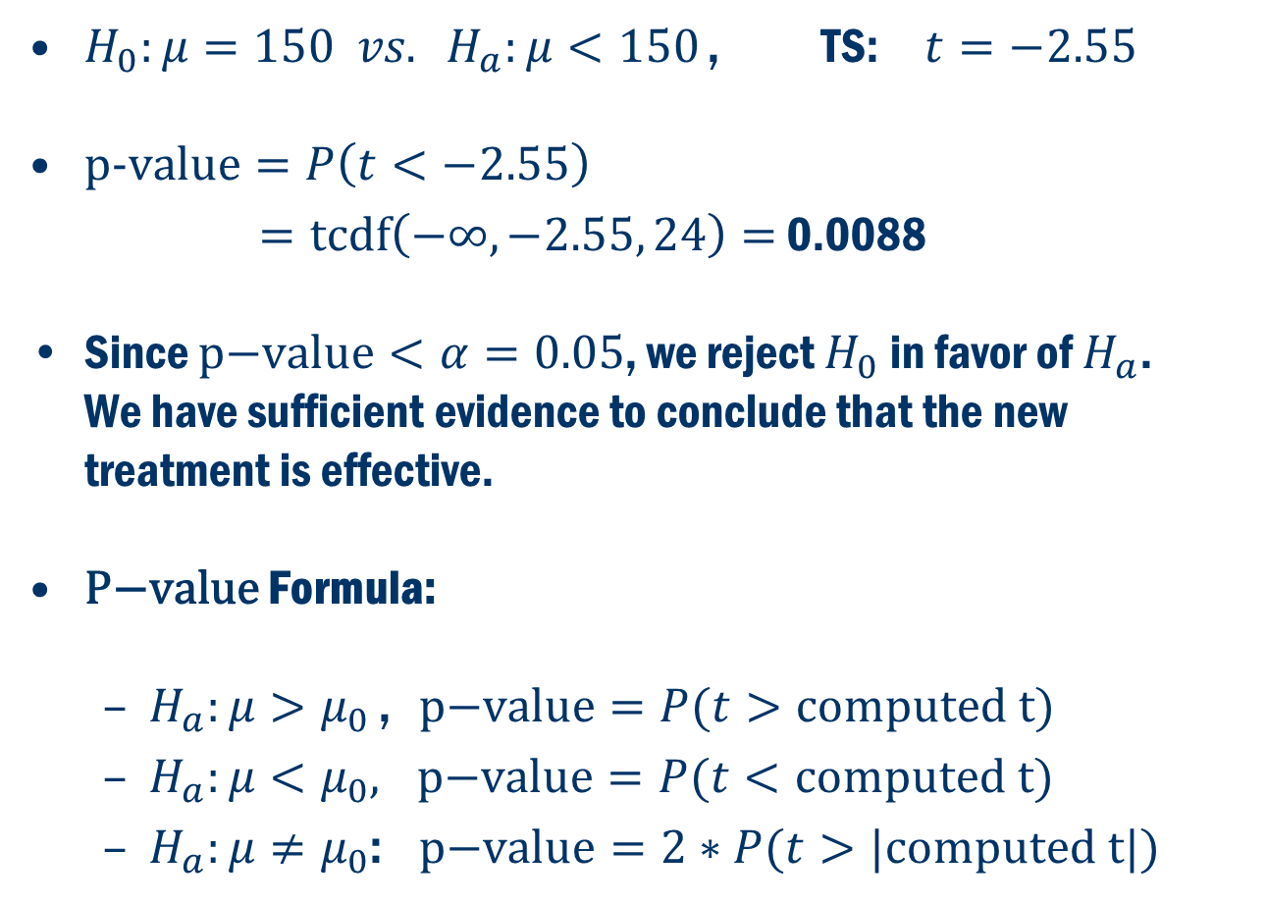
$\text{P}\text{−}\text{value}$ Approach
$H_{0}:μ=150 vs. H_{a}:μ<150$ , TS: $t=−2.55$
$\text{p}\text{−}\text{value}=P\left(t<−2.55\right)$
$=\text{tcdf}\left(−∞,−2.55, 24\right)=$ 0.0088
Since $\text{p}\text{−}\text{value}<α=0.05$, we reject $H_{0}$ in favor of $H_{a}$. We have sufficient evidence to conclude that the new treatment is effective.
$\text{P}\text{−}\text{value}$ Formula:
$H_{a}:μ>μ_{0}$ , $\text{p}\text{−}\text{value}=P(t>\text{computed} \text{t})$
$H_{a}:μ<μ_{0},$ $\text{p}\text{−}\text{value}=P(t<\text{computed} \text{t})$
$H_{a}:μ≠μ_{0}$: $\text{p}\text{−}\text{value}=2∗P(t>|\text{computed} \text{t}|)$

Slide 18
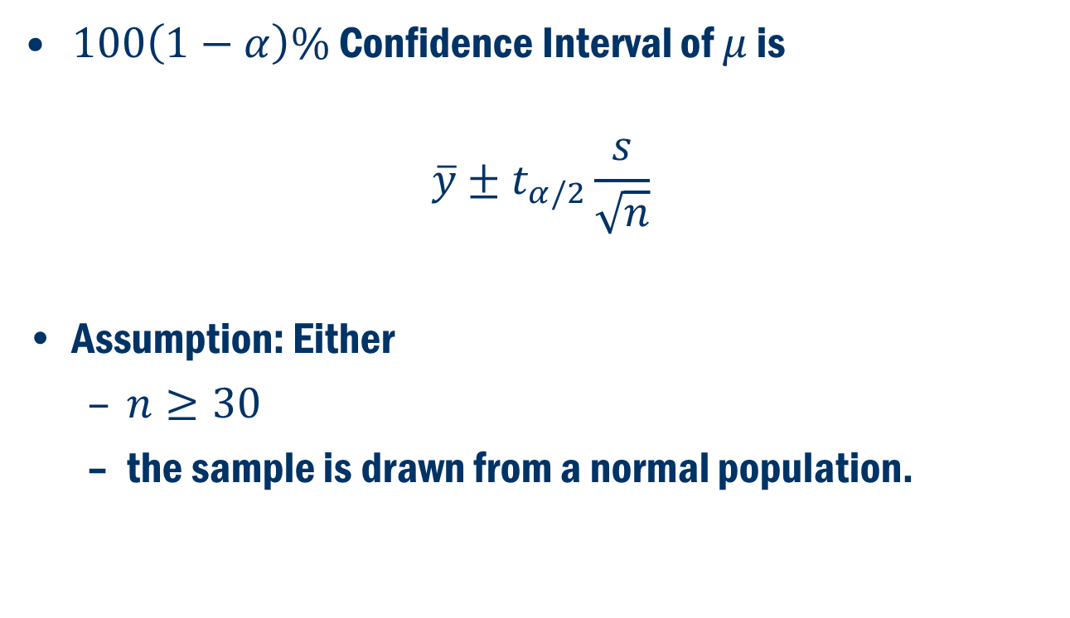

Estimation of $μ$ using a confidence interval
$100\left(1−α\right)\%$ Confidence Interval of $μ$ is
$$\overline{y}±t_{α/2}\frac{s}{\sqrt{n}}$$
Assumption: Either
$n≥30$
the sample is drawn from a normal population.

Slide 19
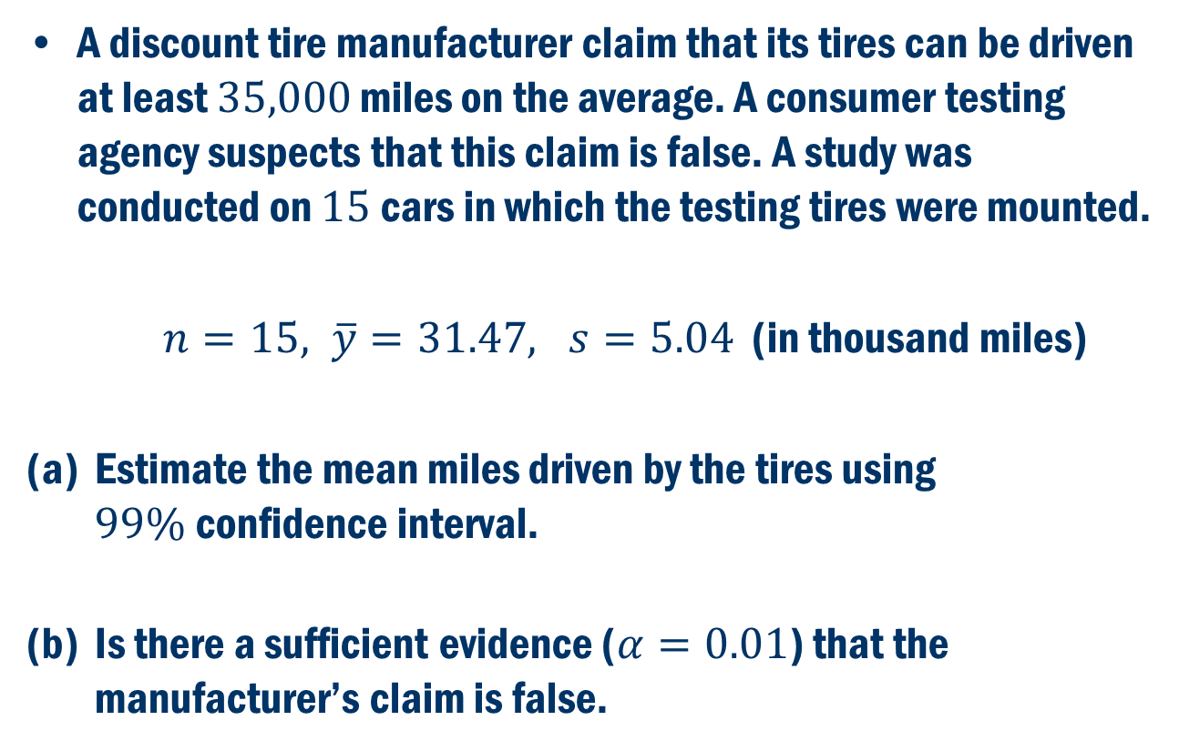
Book Exercise 5.41
A discount tire manufacturer claim that its tires can be driven at least $35,000$ miles on the average. A consumer testing agency suspects that this claim is false. A study was conducted on $15$cars in which the testing tires were mounted.
$n=15, \overline{y}=31.47, s=5.04$ (in thousand miles)
Estimate the mean miles driven by the tires using $99\%$confidence interval.
Is there a sufficient evidence ($α=0.01$) that the manufacturer’s claim is false.

Slide 20
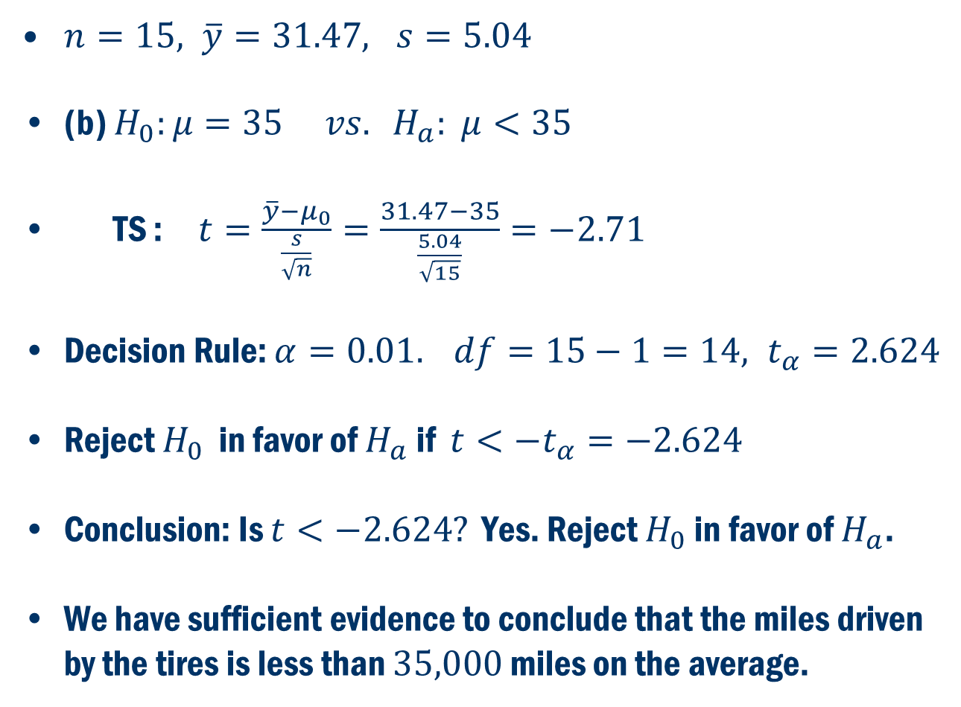
First let’s do (B)
$n=15, \overline{y}=31.47, s=5.04$
(b) $H_{0}:μ=35 vs. H_{a}: μ<35$
TS : $t=\frac{\overline{y}−μ_{0}}{\frac{s}{\sqrt{n}}}=\frac{31.47−35}{\frac{5.04}{\sqrt{15}}}=−2.71$
Decision Rule: $α=0.01. df=15−1=14, t_{α}=2.624$
Reject $H_{0}$ in favor of $H_{a}$ if $t<−t_{α}=−2.624$
Conclusion: Is $t<−2.624?$ Yes. Reject $H_{0}$ in favor of $H_{a}$.
We have sufficient evidence to conclude that the miles driven by the tires is less than $35,000$ miles on the average.

Slide 21
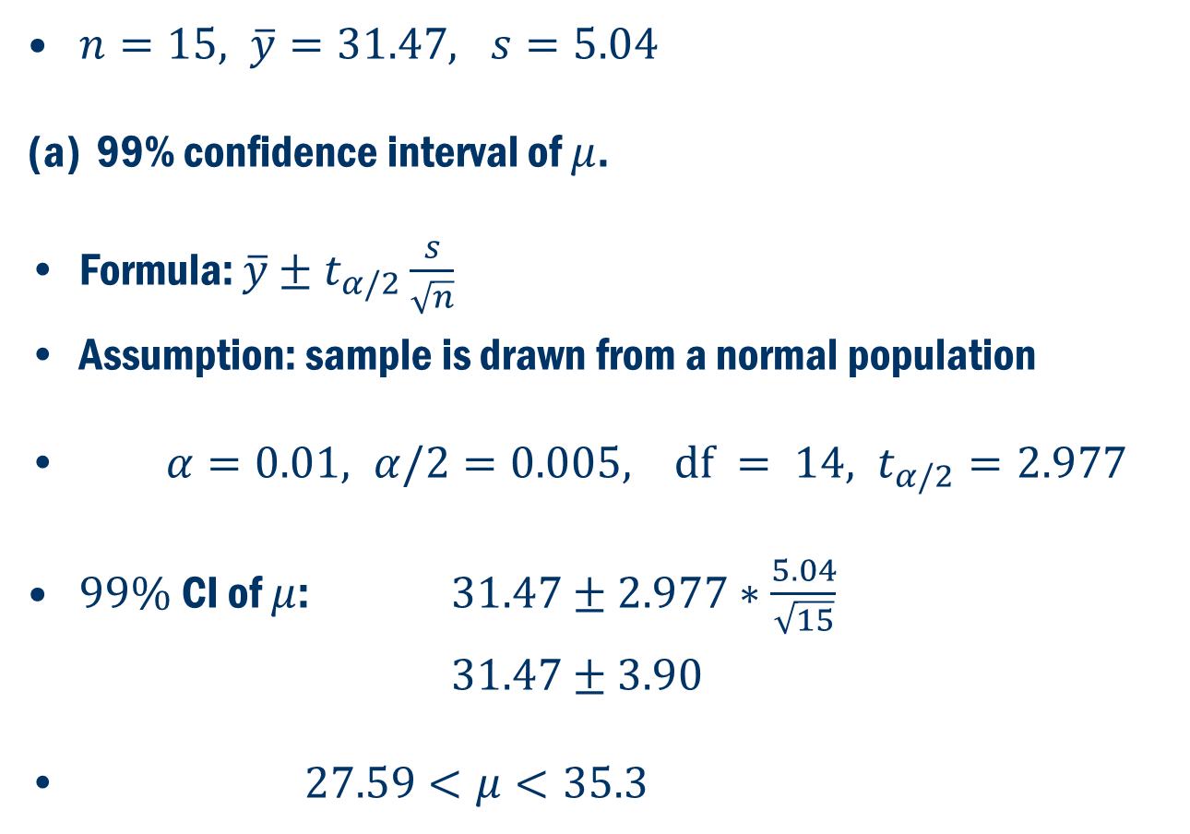
Now Let’s Do (a)
$n=15, \overline{y}=31.47, s=5.04$
99% confidence interval of $μ$.
Formula: $\overline{y}±t_{α/2}\frac{s}{\sqrt{n}}$
Assumption: sample is drawn from a normal population
$α=0.01, α/2=0.005, \text{df} = 14, t_{α/2}=2.977$
$99\%$CI of $μ$: $31.47±2.977∗\frac{5.04}{\sqrt{15}}$
$31.47±3.90$
$27.59<μ<35.3$

Slide 22
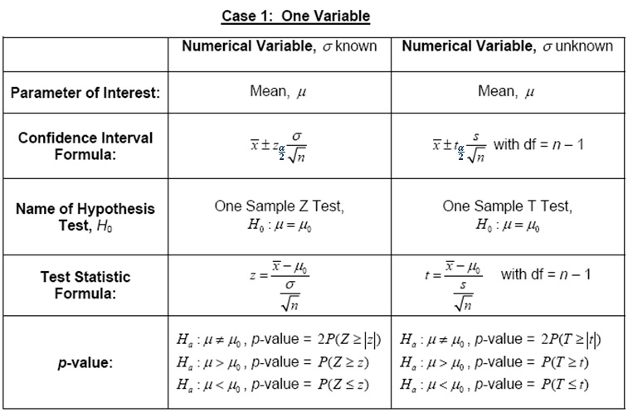
Summary

