Slide 1
Chapter 6 (Part A)

Slide 2
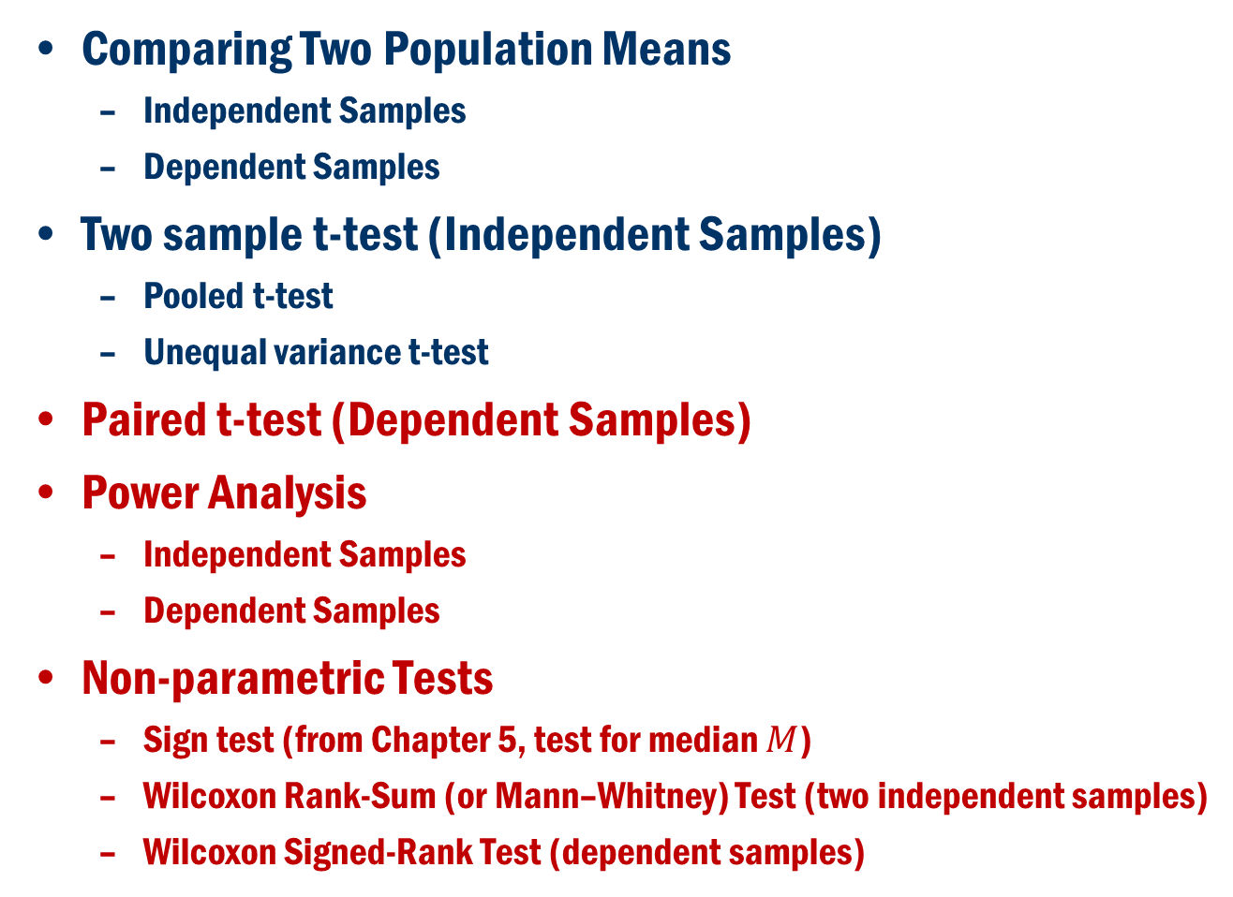
Chapter 6 (Part A)
Comparing Two Population Means
Independent Samples
Dependent Samples
Two sample t-test (Independent Samples)
Pooled t-test
Unequal variance t-test
Paired t-test (Dependent Samples)
Power Analysis
Independent Samples
Dependent Samples
Non-parametric Tests
Sign test (from Chapter 5, test for median $M$)
Wilcoxon Rank-Sum (or Mann–Whitney) Test (two independent samples)
Wilcoxon Signed-Rank Test (dependent samples)

Slide 3
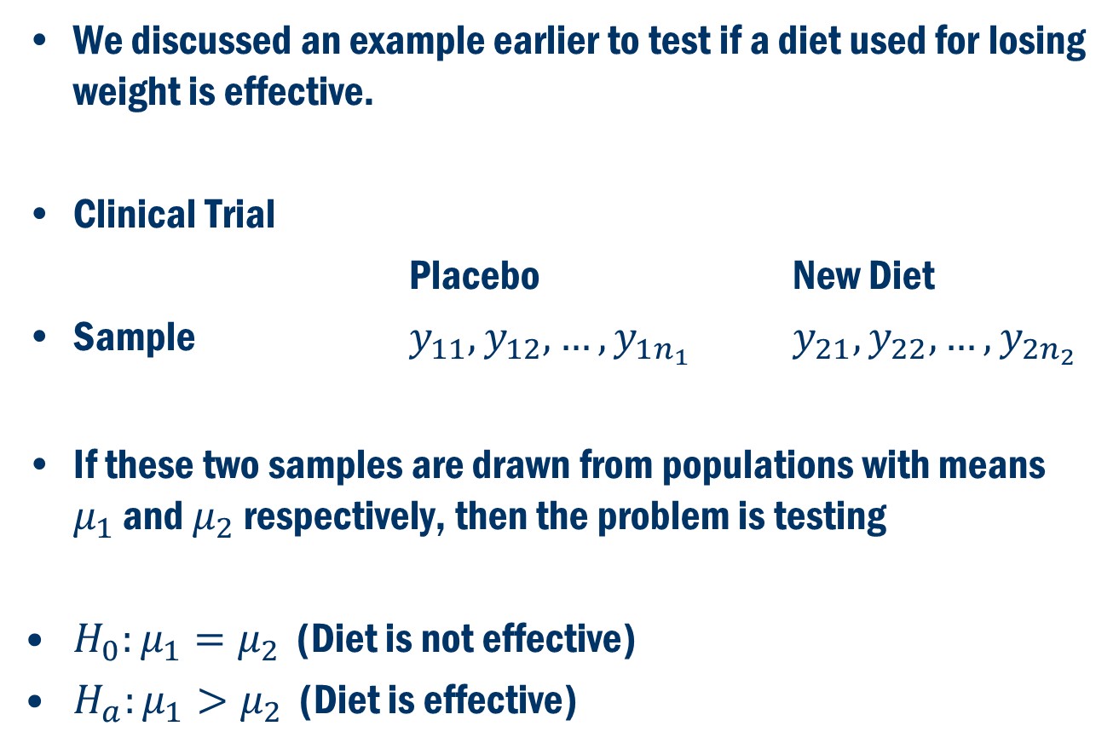
Comparing two population means
We discussed an example earlier to test if a diet used for losing weight is effective.
Clinical Trial
Placebo New Diet
Sample $y_{11},y_{12},…, y_{1n_{1}}$ $y_{21}, y_{22},…,y_{2n_{2}}$
If these two samples are drawn from populations with means $μ_{1}$ and $μ_{2}$ respectively, then the problem is testing
$H_{0}:μ_{1}=μ_{2}$ (Diet is not effective)
$H_{a}:μ_{1}>μ_{2}$ (Diet is effective)

Slide 4
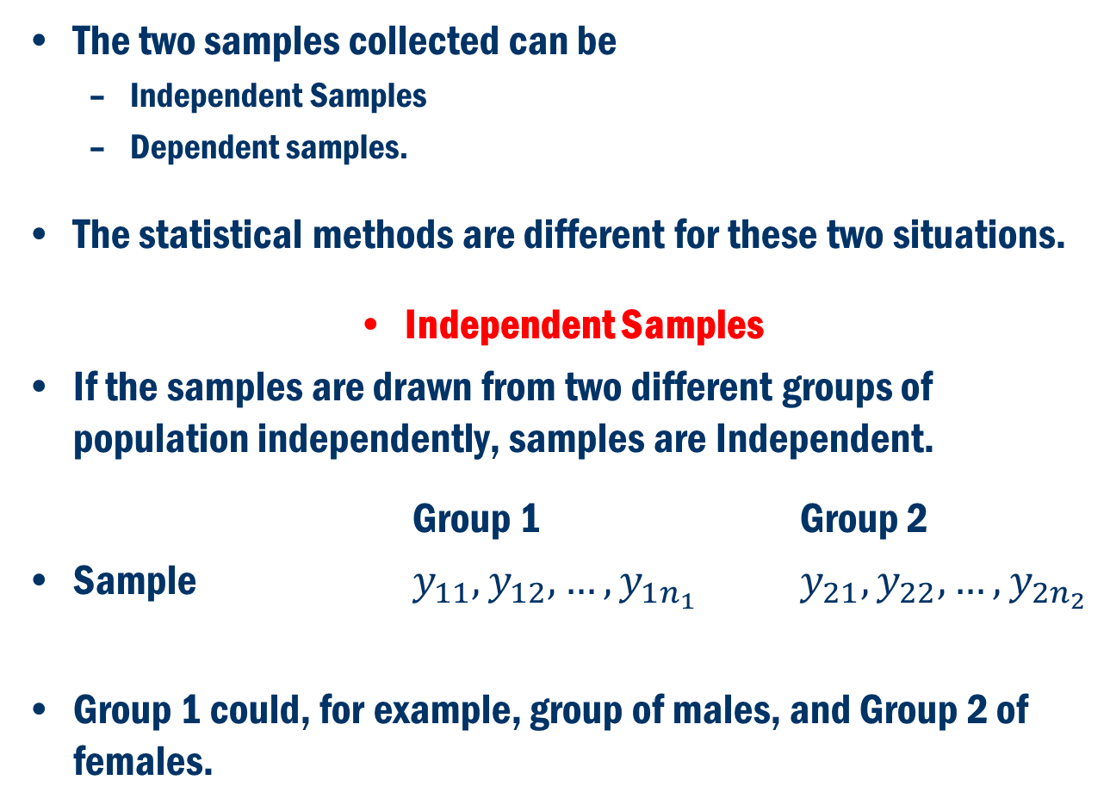
Comparing two population means Cont’D
The two samples collected can be
Independent Samples
Dependent samples.
The statistical methods are different for these two situations.
Independent Samples
If the samples are drawn from two different groups of population independently, samples are Independent.
Group 1 Group 2
Sample $y_{11},y_{12},…, y_{1n_{1}}$ $y_{21}, y_{22},…,y_{2n_{2}}$
Group 1 could, for example, group of males, and Group 2 of females.

Slide 5
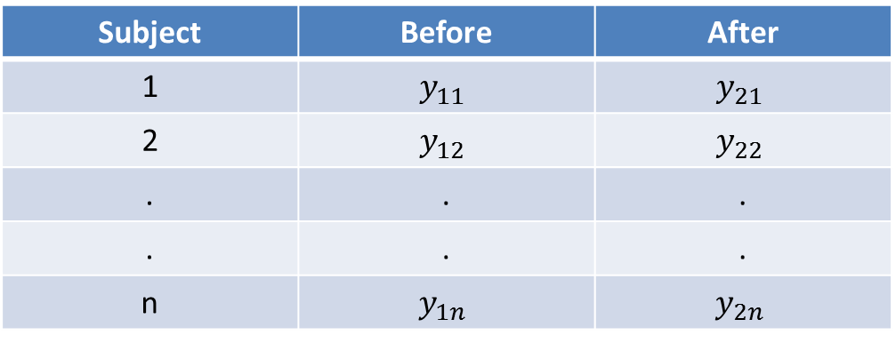
Comparing two population means Cont’D
Dependent Samples
Here, there is only one group of subjects, but two different measurements are taken from this group.
Since the subjects are same for before and after measurements, the two samples are dependent.

Slide 6
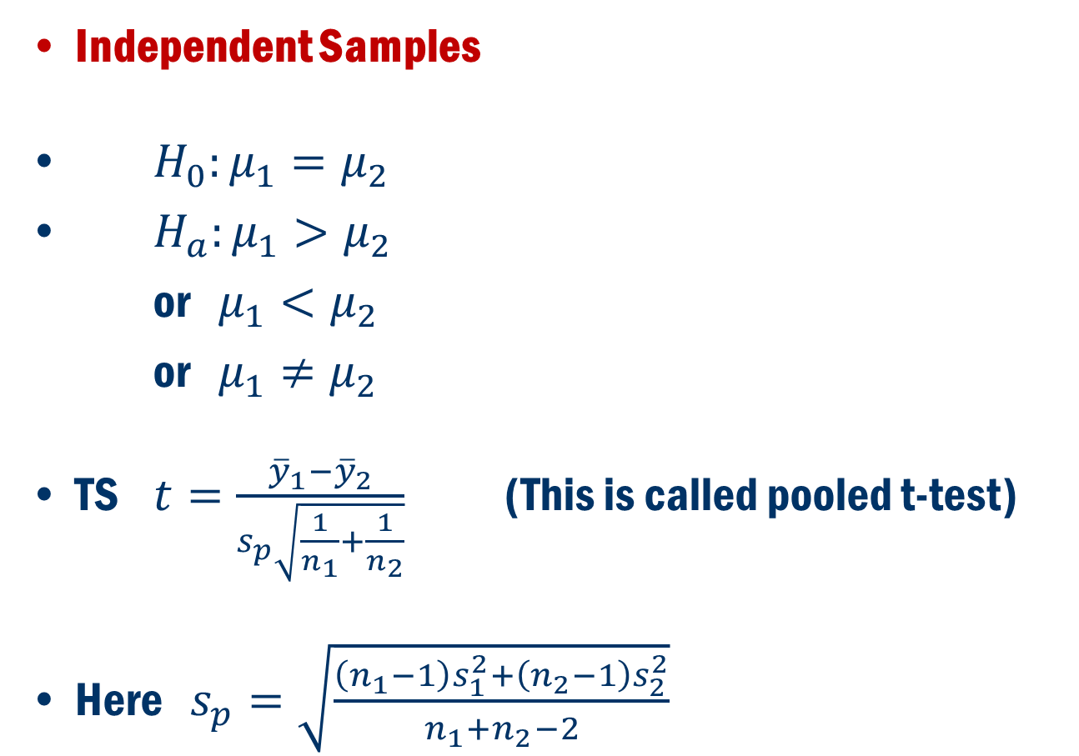
Hypothesis Testing for Independent Samples (Equal Variances)
Independent Samples
$H_{0}:μ_{1}=μ_{2}$
$H_{a}:μ_{1}>μ_{2}$
or $μ_{1}<μ_{2}$
or $μ_{1}≠μ_{2}$
TS $t=\frac{{\overline{y}}_{1}−{\overline{y}}_{2}}{s_{p}\sqrt{\frac{1}{n_{1}}+\frac{1}{n_{2}}}}$ (This is called pooled t-test)
Here $s_{p}=\sqrt{\frac{\left(n_{1}−1\right)s_{1}^{2}+\left(n_{2}−1\right)s_{2}^{2}}{n_{1}+n_{2}−2}}$

Slide 7
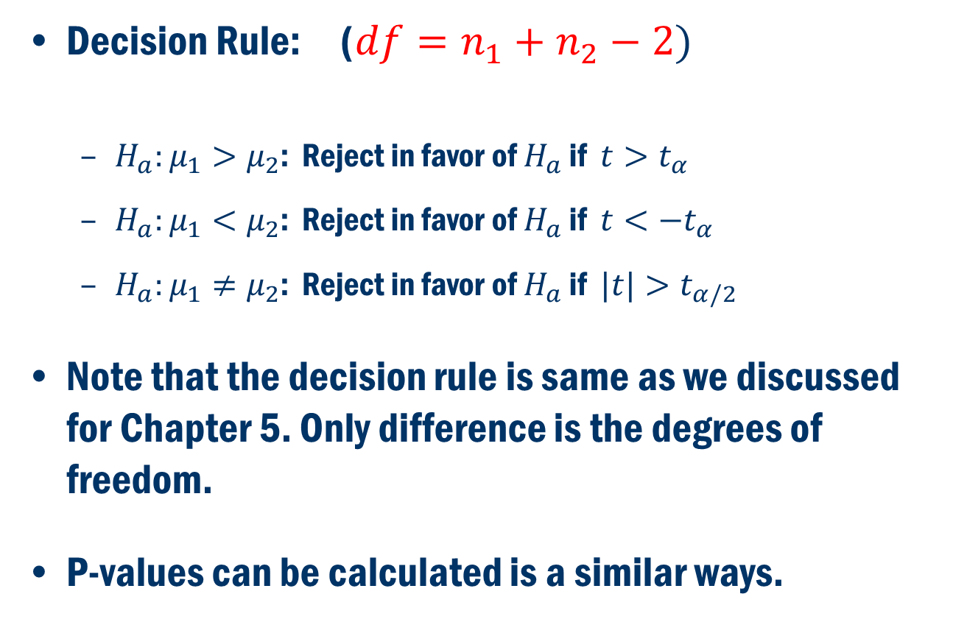
Hypothesis Testing for Independent Samples Cont’D
Decision Rule: ($df=n_{1}+n_{2}−2)$
$H_{a}:μ_{1}>μ_{2}$: Reject in favor of $H_{a}$ if $t>t_{α}$
$H_{a}:μ_{1}<μ_{2}$: Reject in favor of $H_{a}$ if $t<−t_{α}$
$H_{a}:μ_{1}≠μ_{2}$: Reject in favor of $H_{a}$ if $|t|>t_{α/2}$
Note that the decision rule is same as we discussed for Chapter 5. Only difference is the degrees of freedom.
P-values can be calculated is a similar ways.

Slide 8
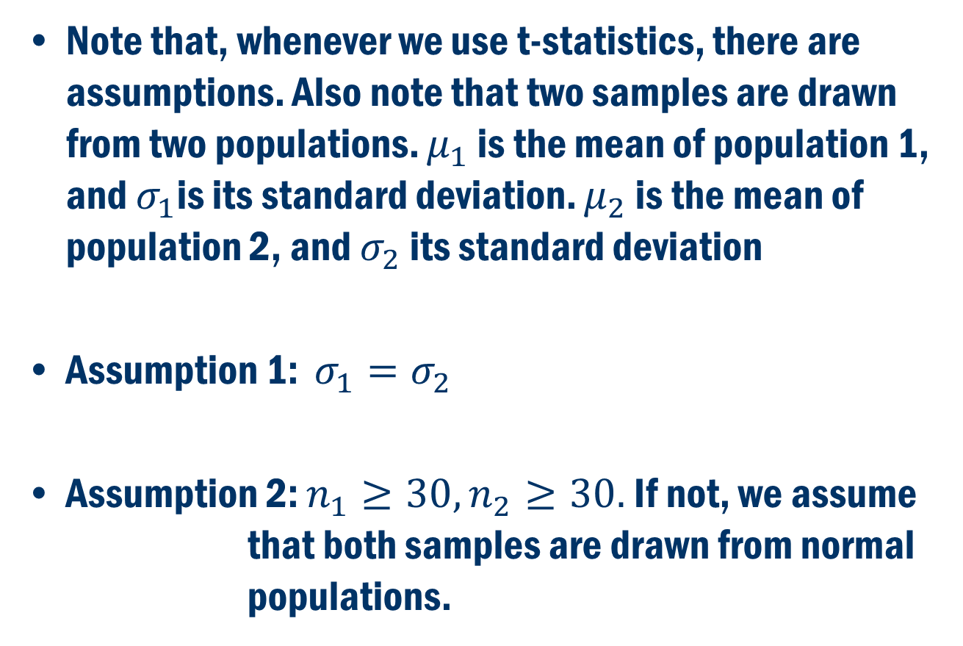
Assumptions:
Note that, whenever we use t-statistics, there are assumptions. Also note that two samples are drawn from two populations. $μ_{1}$ is the mean of population 1, and $σ_{1}$is its standard deviation. $μ_{2}$ is the mean of population 2, and $σ_{2}$ its standard deviation
Assumption 1: $σ_{1}=σ_{2}$
Assumption 2: $n_{1}≥30, n_{2}≥30.$ If not, we assume that both samples are drawn from normal populations.

Slide 9
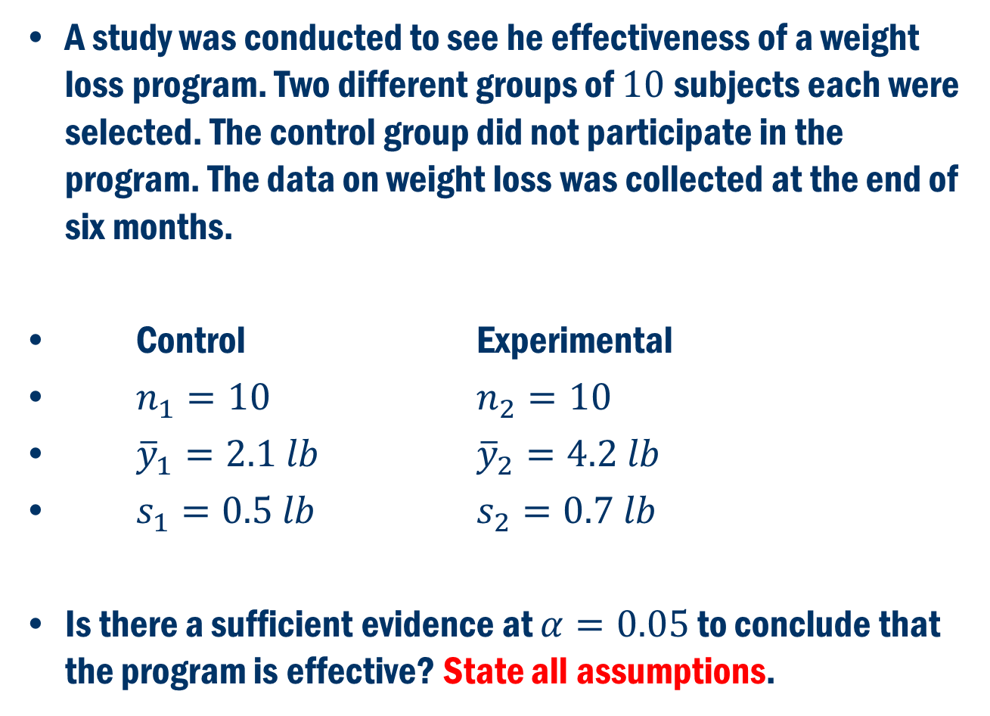
Example
A study was conducted to see he effectiveness of a weight loss program. Two different groups of $10$subjects each were selected. The control group did not participate in the program. The data on weight loss was collected at the end of six months.
Control Experimental
$n_{1}=10$ $n_{2}=10$
${\overline{y}}_{1}=2.1 lb$ ${\overline{y}}_{2}=4.2 lb$
$s_{1}=0.5 lb$ $s_{2}=0.7 lb$
Is there a sufficient evidence at $α=0.05$ to conclude that the program is effective? State all assumptions.

Slide 10
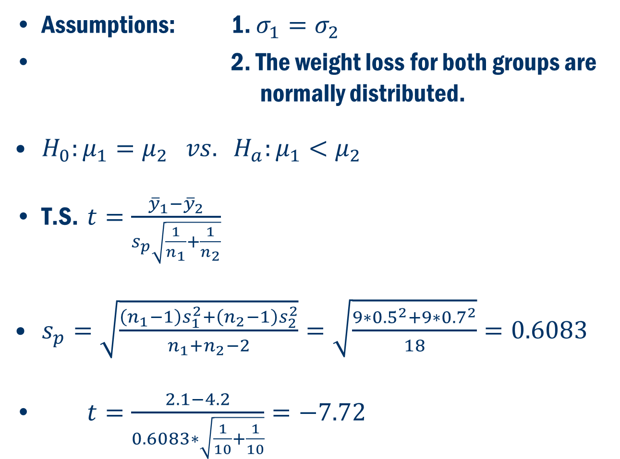
Example Cont’D
Assumptions: 1. $σ_{1}=σ_{2}$
2. The weight loss for both groups are normally distributed.
$H_{0}:μ_{1}=μ_{2} vs. H_{a}:μ_{1}<μ_{2}$
T.S. $t=\frac{{\overline{y}}_{1}−{\overline{y}}_{2}}{s_{p}\sqrt{\frac{1}{n_{1}}+\frac{1}{n_{2}}}}$
$s_{p}=\sqrt{\frac{\left(n_{1}−1\right)s_{1}^{2}+\left(n_{2}−1\right)s_{2}^{2}}{n_{1}+n_{2}−2}}=\sqrt{\frac{9∗{0.5}^{2}+9∗{0.7}^{2}}{18}}=0.6083$
$t=\frac{2.1−4.2}{0.6083∗\sqrt{\frac{1}{10}+\frac{1}{10}}}=−7.72$

Slide 11
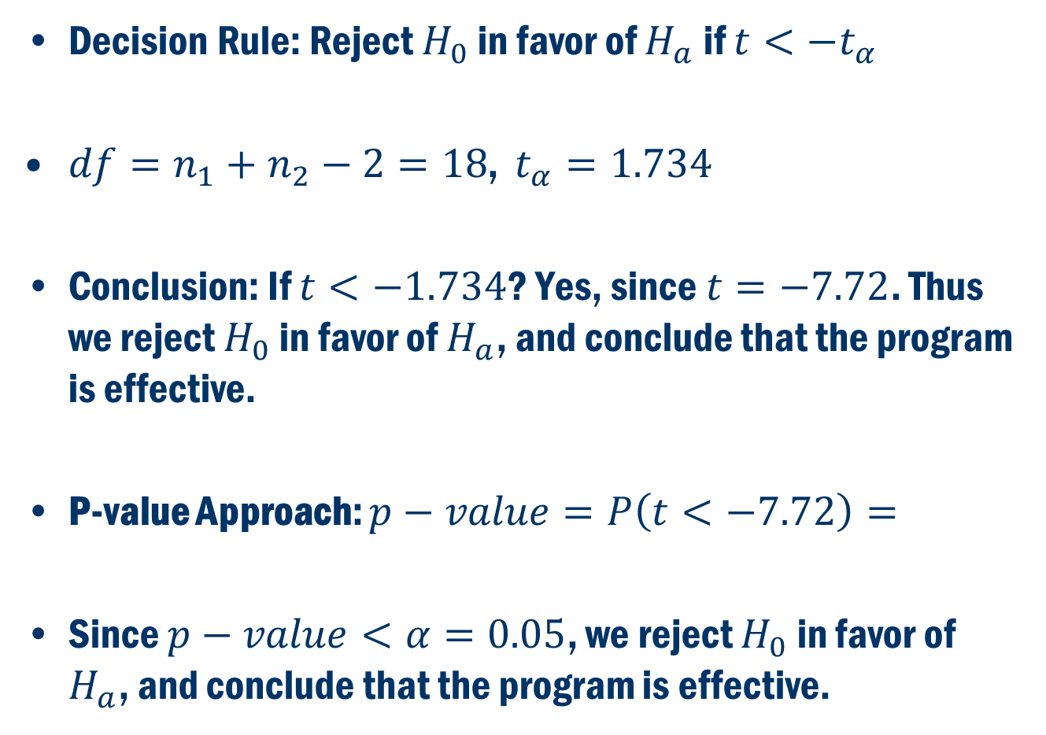
Example Cont’D
Decision Rule: Reject $H_{0}$ in favor of $H_{a}$ if $t<−t_{α}$
$df=n_{1}+n_{2}−2=18$, $t_{α}=1.734$
Conclusion: If $t<−1.734$? Yes, since $t=−7.72$. Thus we reject $H_{0}$ in favor of $H_{a}$, and conclude that the program is effective.
P-value Approach: $p−value=P\left(t<−7.72\right)=$
Since $p−value<α=0.05$, we reject $H_{0}$ in favor of $H_{a}$, and conclude that the program is effective.

Slide 12
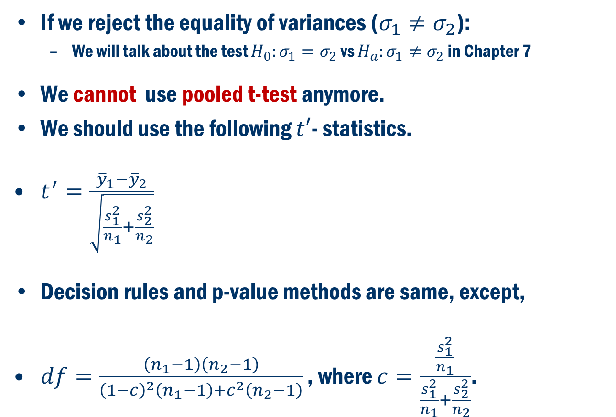
Hypothesis Testing for Independent Samples (Unequal Variances)
If we reject the equality of variances ($σ_{1}≠σ_{2}$):
We will talk about the test $H_{0}:σ_{1}=σ_{2}$ vs $H_{a}:σ_{1}≠σ_{2}$ in Chapter 7
We cannot use pooled t-test anymore.
We should use the following $t′$- statistics.
$t^{′}=\frac{{\overline{y}}_{1}−{\overline{y}}_{2}}{\sqrt{\frac{s_{1}^{2}}{n_{1}}+\frac{s_{2}^{2}}{n_{2}}}}$
Decision rules and p-value methods are same, except,
$df=\frac{\left(n_{1}−1\right)\left(n_{2}−1\right)}{{\left(1−c\right)}^{2}\left(n_{1}−1\right)+c^{2}\left(n_{2}−1\right)}$ , where $c=\frac{\frac{s_{1}^{2}}{n_{1}}}{\frac{s_{1}^{2}}{n_{1}}+\frac{s_{2}^{2}}{n_{2}}}$.

Slide 13
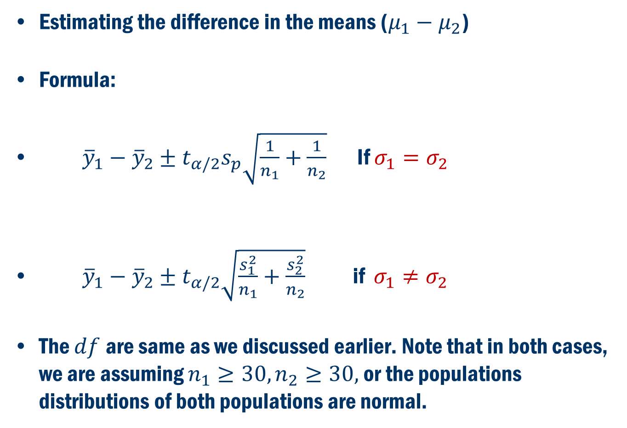

Confidence Interval for ($μ_{1}−μ_{2}$)
Estimating the difference in the means ($μ_{1}−μ_{2}$)
Formula:
${\overline{y}}_{1}−{\overline{y}}_{2}±t_{α/2}s_{p}\sqrt{\frac{1}{n_{1}}+\frac{1}{n_{2}}}$ If $σ_{1}=σ_{2}$
${\overline{y}}_{1}−{\overline{y}}_{2}±t_{α/2}\sqrt{\frac{s_{1}^{2}}{n_{1}}+\frac{s_{2}^{2}}{n_{2}}}$ if $σ_{1}≠σ_{2}$
The $df$are same as we discussed earlier. Note that in both cases, we are assuming $n_{1}≥30, n_{2}≥30,$ or the populations distributions of both populations are normal.

Slide 14
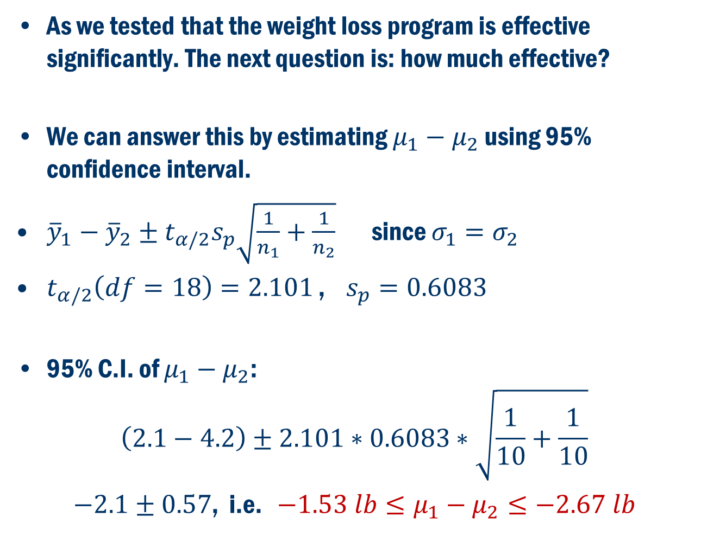
Back to the Example
As we tested that the weight loss program is effective significantly. The next question is: how much effective?
We can answer this by estimating $μ_{1}−μ_{2}$ using 95% confidence interval.
${\overline{y}}_{1}−{\overline{y}}_{2}±t_{α/2}s_{p}\sqrt{\frac{1}{n_{1}}+\frac{1}{n_{2}}}$ since $σ_{1}=σ_{2}$
$t_{α/2}\left(df=18\right)=2.101$ , $s_{p}=0.6083$
95% C.I. of $μ_{1}−μ_{2}$:
$$\left(2.1−4.2\right)±2.101∗0.6083∗\sqrt{\frac{1}{10}+\frac{1}{10}}$$
$−2.1±0.57$, i.e. $−1.53 lb≤μ_{1}−μ_{2}≤−2.67 lb$

Slide 15
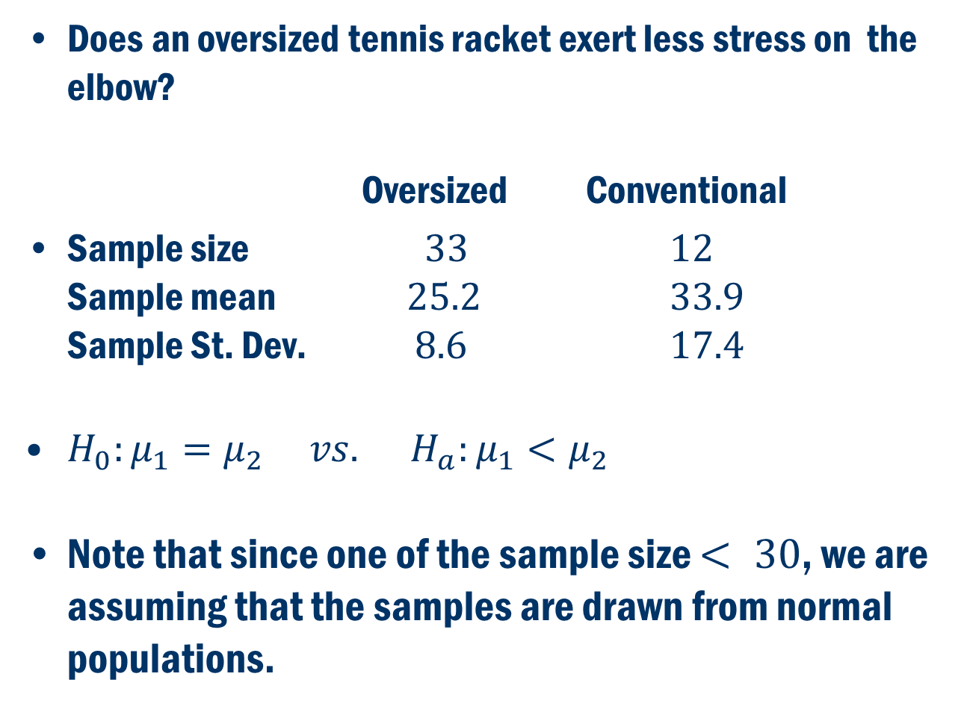
Book Example 6.4
Does an oversized tennis racket exert less stress on the elbow?
Oversized Conventional
Sample size $33$ $12$ Sample mean $25.2$ $33.9$ Sample St. Dev. $8.6$ $17.4$
$H_{0}:μ_{1}=μ_{2} vs. H_{a}:μ_{1}<μ_{2}$
Note that since one of the sample size $< 30$, we are assuming that the samples are drawn from normal populations.

Slide 16
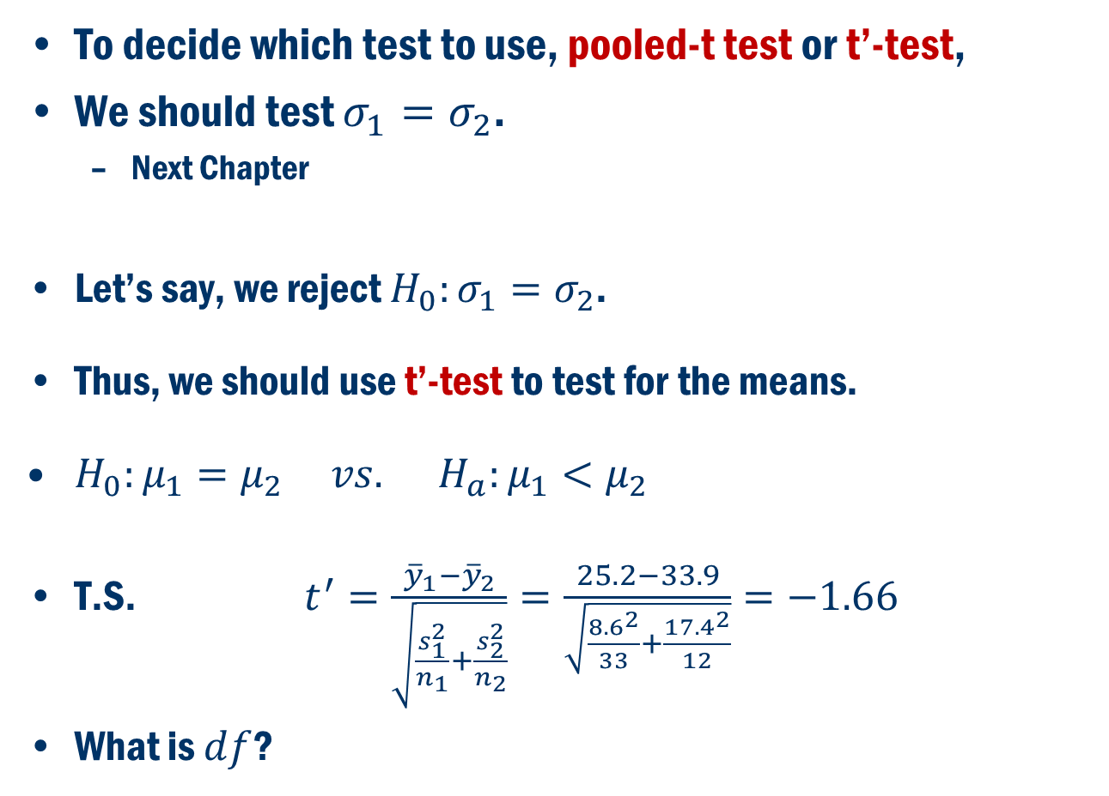
Book Example 6.4 Cont’D
To decide which test to use, pooled-t test or t’-test,
We should test $σ_{1}=σ_{2}$.
Next Chapter
Let’s say, we reject $H_{0}:σ_{1}=σ_{2}$.
Thus, we should use t’-test to test for the means.
$H_{0}:μ_{1}=μ_{2} vs. H_{a}:μ_{1}<μ_{2}$
T.S. $t^{′}=\frac{{\overline{y}}_{1}−{\overline{y}}_{2}}{\sqrt{\frac{s_{1}^{2}}{n_{1}}+\frac{s_{2}^{2}}{n_{2}}}}=\frac{25.2−33.9}{\sqrt{\frac{{8.6}^{2}}{33}+\frac{{17.4}^{2}}{12}}}=−1.66$
What is $df$?

Slide 17
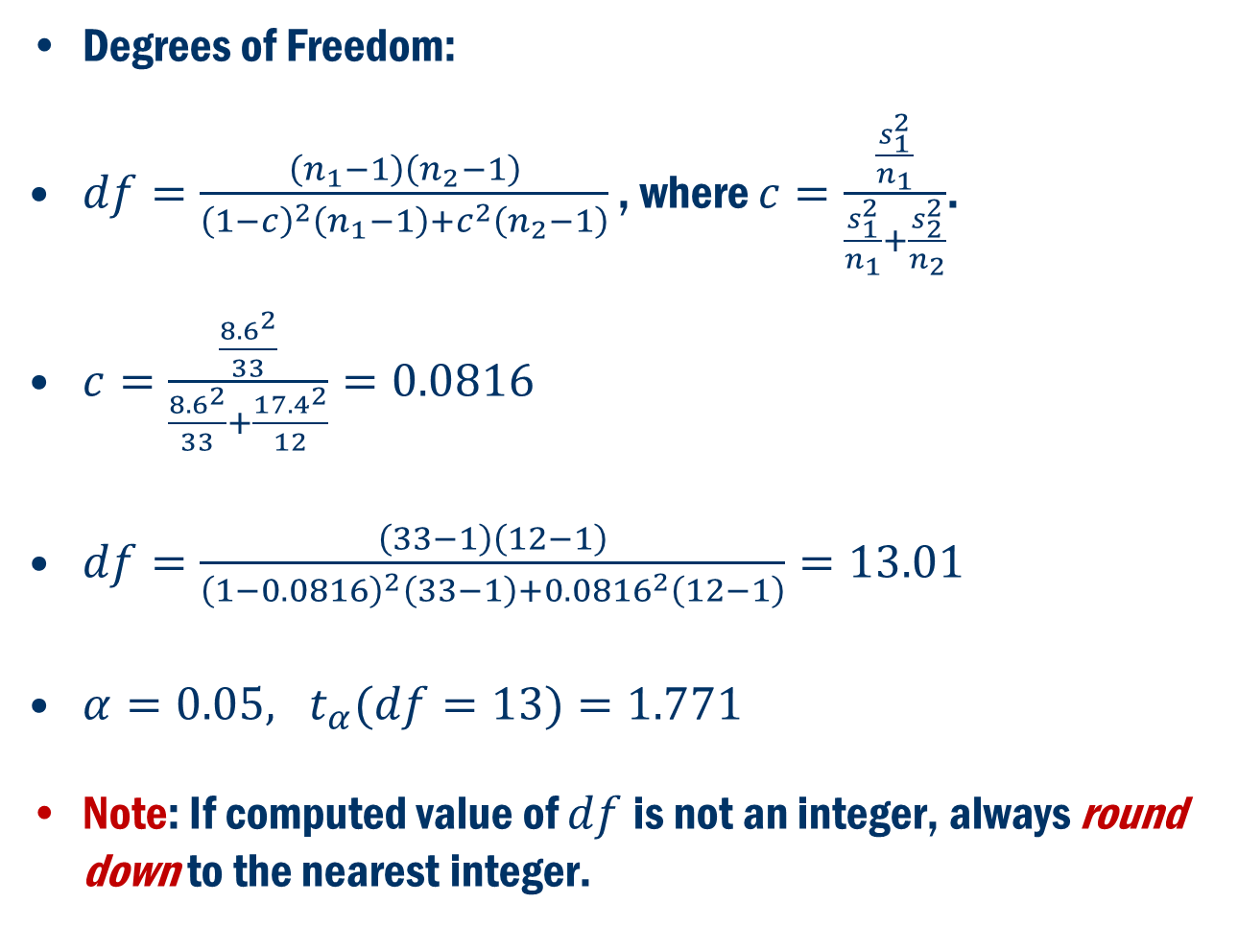
Book Example 6.4 Cont’D
Degrees of Freedom:
$df=\frac{\left(n_{1}−1\right)\left(n_{2}−1\right)}{{\left(1−c\right)}^{2}\left(n_{1}−1\right)+c^{2}\left(n_{2}−1\right)}$ , where $c=\frac{\frac{s_{1}^{2}}{n_{1}}}{\frac{s_{1}^{2}}{n_{1}}+\frac{s_{2}^{2}}{n_{2}}}$.
$c=\frac{\frac{{8.6}^{2}}{33}}{\frac{{8.6}^{2}}{33}+\frac{{17.4}^{2}}{12}}=0.0816$
$df=\frac{\left(33−1\right)\left(12−1\right)}{{\left(1−0.0816\right)}^{2}\left(33−1\right)+{0.0816}^{2}\left(12−1\right)}=13.01$
$α=0.05, t_{α}(df=13)=1.771$
Note: If computed value of $df$is not an integer, always round down to the nearest integer.

Slide 18
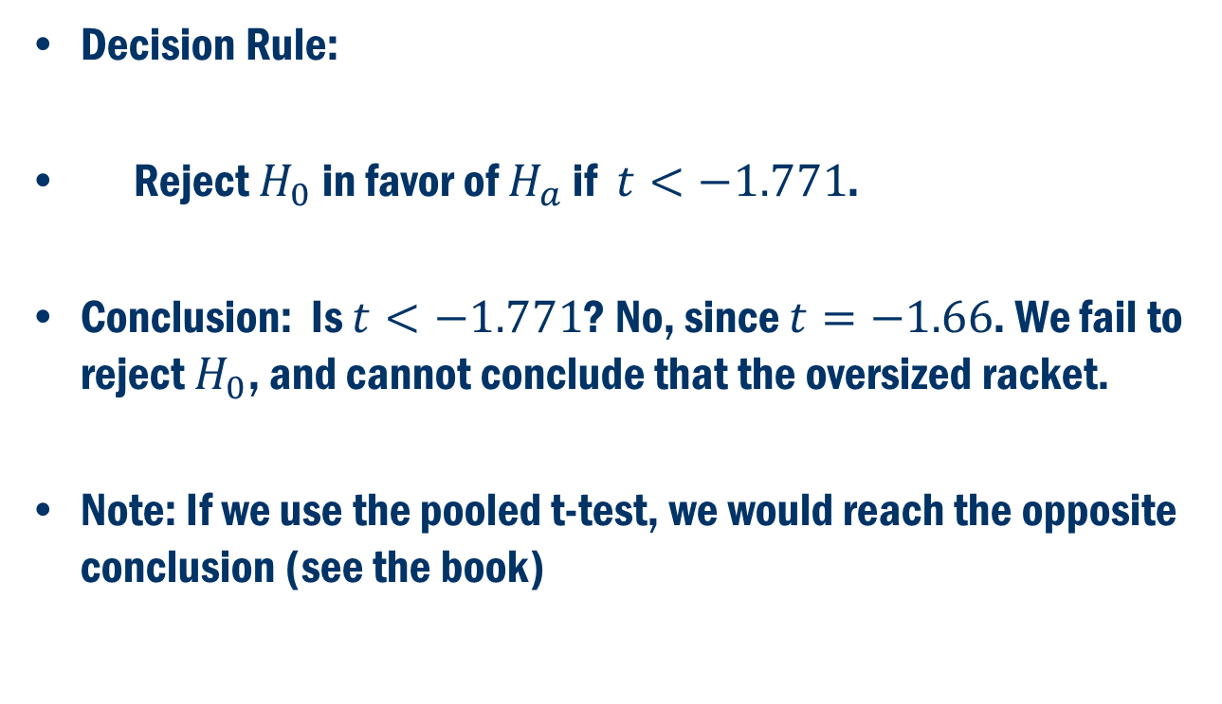
Book Example 6.4 Cont’D
Decision Rule:
Reject $H_{0}$ in favor of $H_{a}$ if $t<−1.771$.
Conclusion: Is $t<−1.771$? No, since $t=−1.66$. We fail to reject $H_{0}$, and cannot conclude that the oversized racket.
Note: If we use the pooled t-test, we would reach the opposite conclusion (see the book)

Slide 19
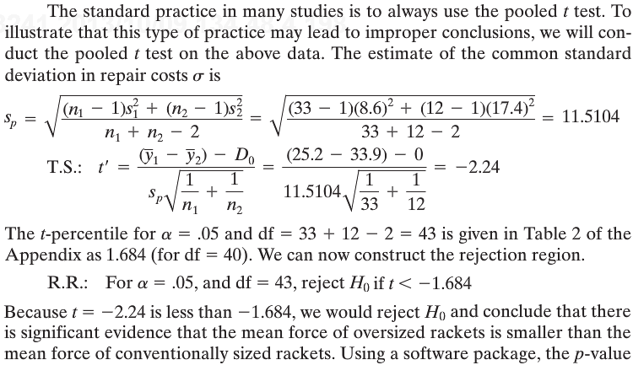
Book Example 6.4 Cont’D
WRONG analysis based on pooled t-test:

Slide 20
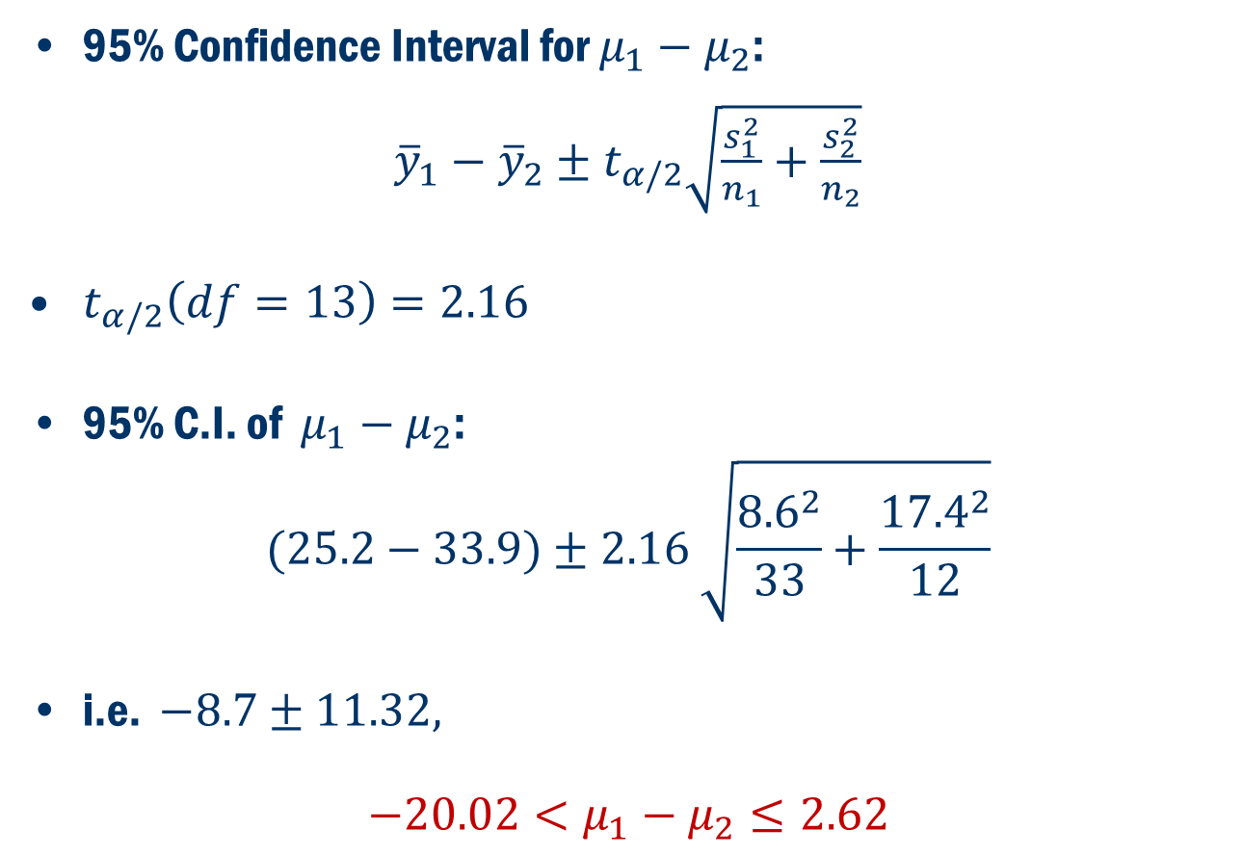
Book Example 6.4 Cont’D (Confidence Interval)
95% Confidence Interval for $μ_{1}−μ_{2}$:
${\overline{y}}_{1}−{\overline{y}}_{2}±t_{α/2}\sqrt{\frac{s_{1}^{2}}{n_{1}}+\frac{s_{2}^{2}}{n_{2}}}$
$t_{α/2}\left(df=13\right)=2.16$
95% C.I. of $μ_{1}−μ_{2}$:
$$(25.2−33.9)±2.16 \sqrt{\frac{{8.6}^{2}}{33}+\frac{{17.4}^{2}}{12}}$$
i.e. $−8.7±11.32,$
$$−20.02<μ_{1}−μ_{2}≤2.62$$

Slide 21
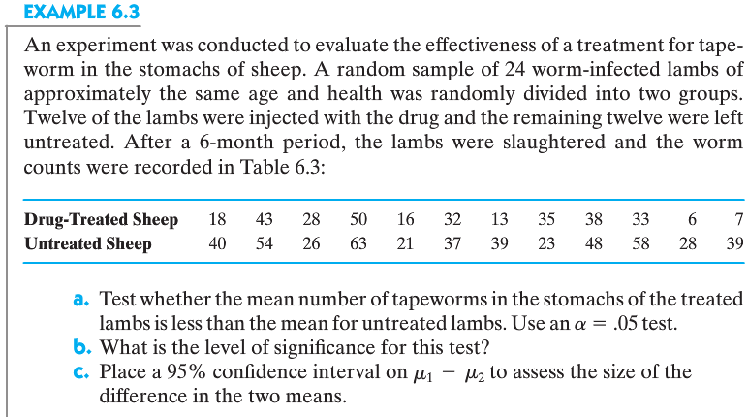
Book Example 6.3 (Minitab)
Minitab

Slide 22
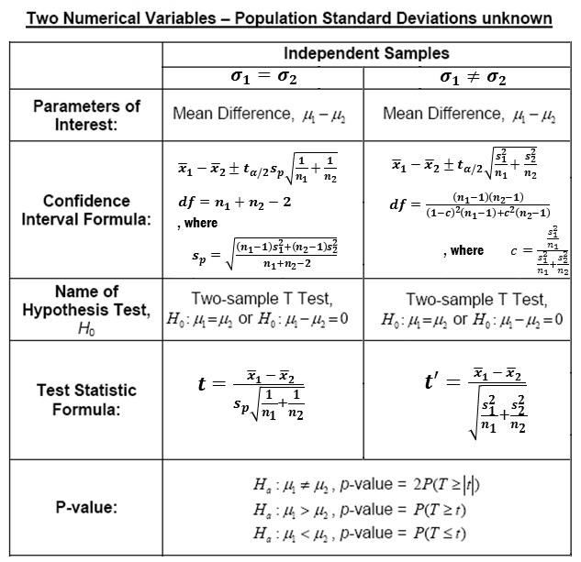
Summary

