Slide 1
Chapter 6 (Part B)

Slide 2
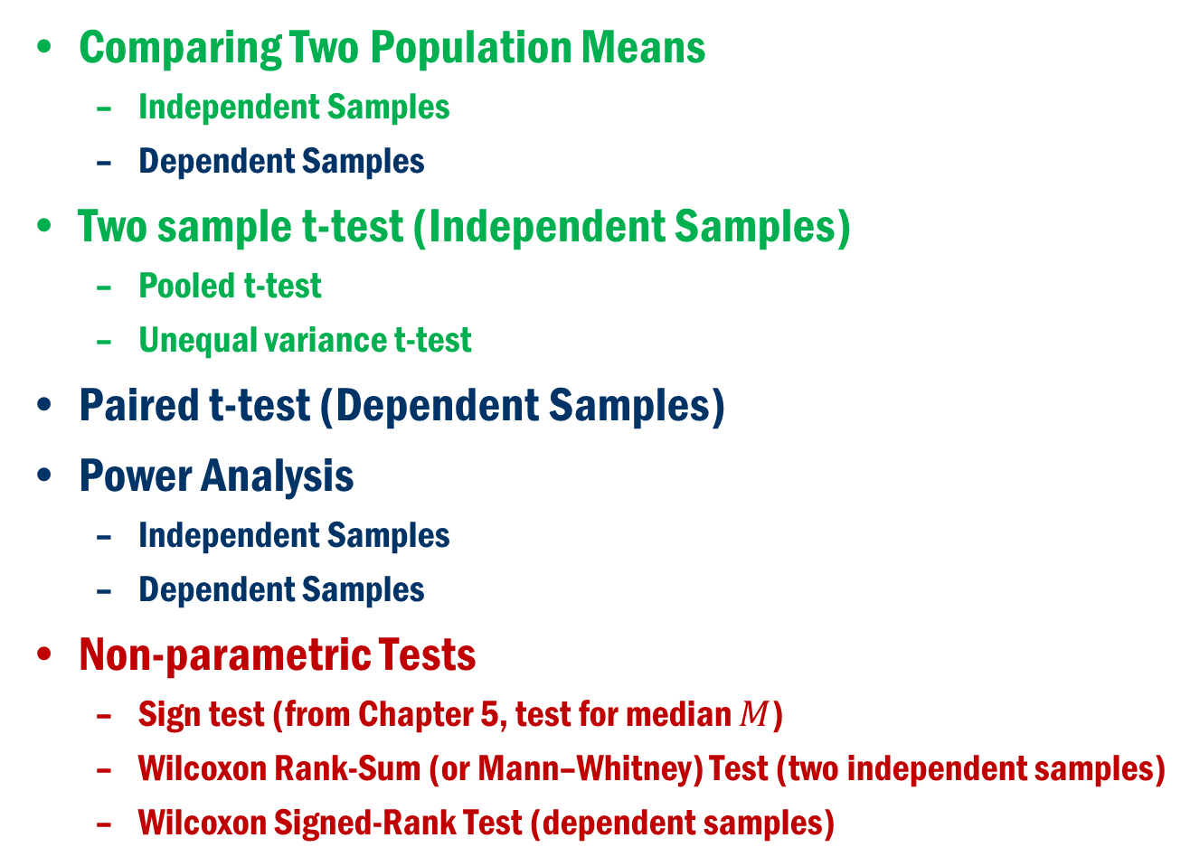
Chapter 6 (Part B)
Comparing Two Population Means
Independent Samples
Dependent Samples
Two sample t-test (Independent Samples)
Pooled t-test
Unequal variance t-test
Paired t-test (Dependent Samples)
Power Analysis
Independent Samples
Dependent Samples
Non-parametric Tests
Sign test (from Chapter 5, test for median $M$)
Wilcoxon Rank-Sum (or Mann–Whitney) Test (two independent samples)
Wilcoxon Signed-Rank Test (dependent samples)

Slide 3
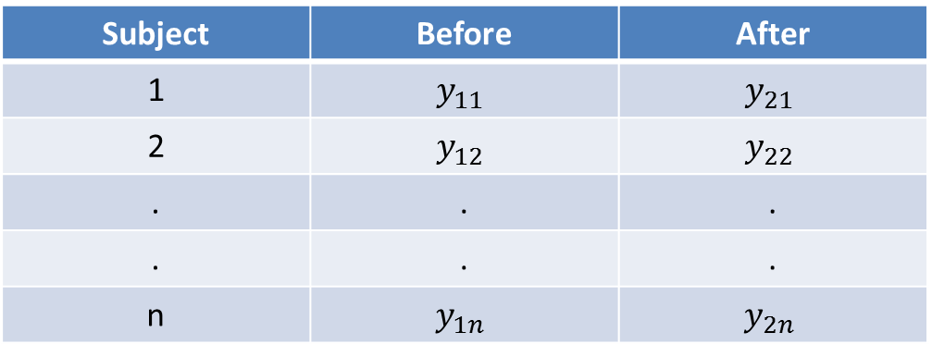
Comparing two Dependent population means (Reminder)
Dependent Samples
Here, there is only one group of subjects, but two different measurements are taken from this group.
Since the subjects are same for before and after measurements, the two samples are dependent.

Slide 4
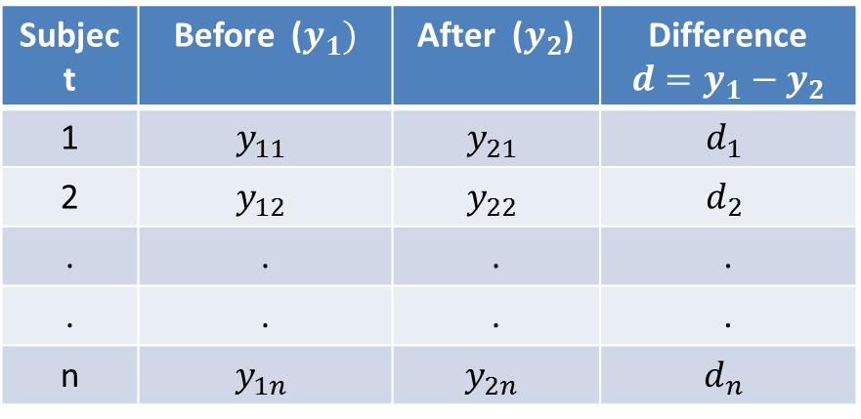
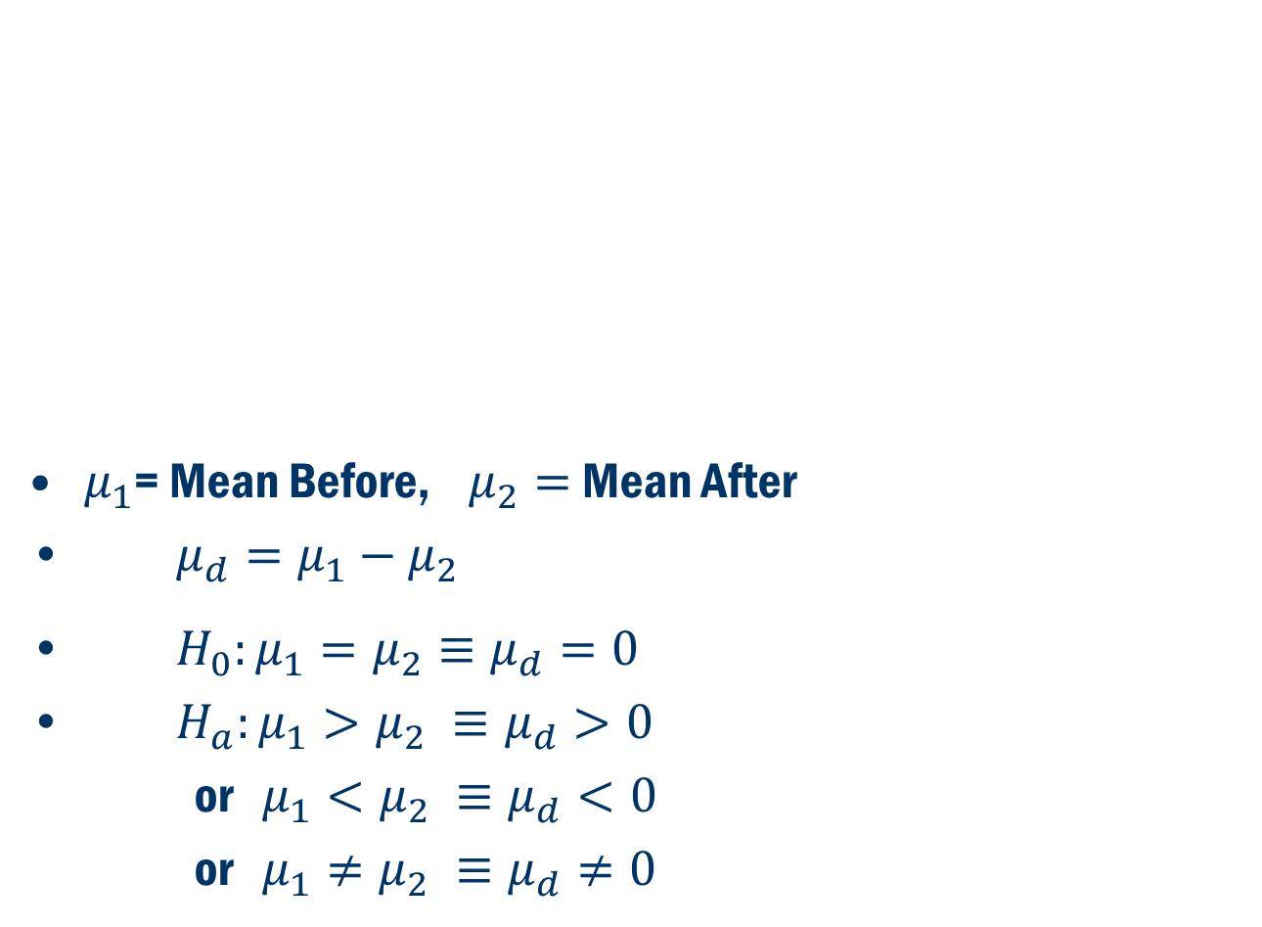
Comparing two Dependent population means (Cont’d)
$μ_{1}$= Mean Before, $μ_{2}=$ Mean After
$μ_{d}=μ_{1}−μ_{2}$
$H_{0}:μ_{1}=μ_{2}≡μ_{d}=0$
$H_{a}:μ_{1}>μ_{2} ≡μ_{d}>0$
or $μ_{1}<μ_{2} ≡μ_{d}<0$
or $μ_{1}≠μ_{2} ≡μ_{d}≠0$

Slide 5
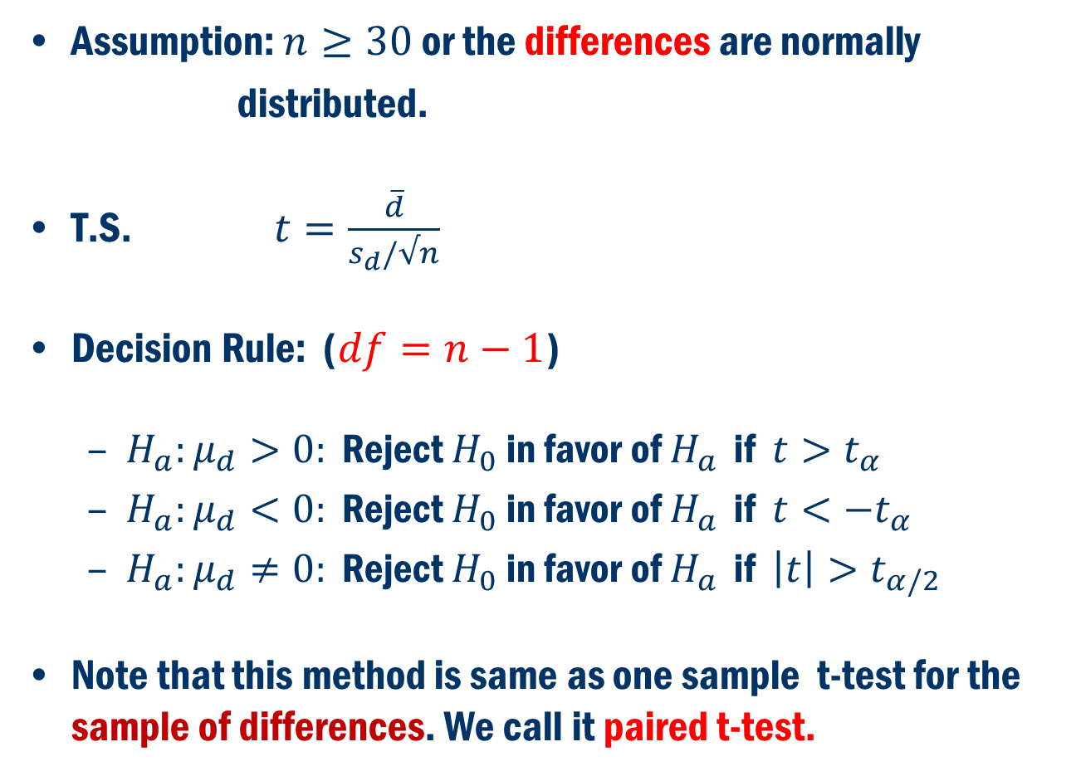
Comparing two Dependent population means (Cont’d)
Assumption: $n≥30$ or the differences are normally
distributed.
T.S. $t=\frac{\overline{d}}{s_{d}/√n}$
Decision Rule: ($df=n−1$)
$H_{a}:μ_{d}>0:$ Reject $H_{0}$ in favor of $H_{a}$ if $t>t_{α}$
$H_{a}:μ_{d}<0:$ Reject $H_{0}$ in favor of $H_{a}$ if $t<−t_{α}$
$H_{a}:μ_{d}≠0:$ Reject $H_{0}$ in favor of $H_{a}$ if $\left|t\right|>t_{α/2}$
Note that this method is same as one sample t-test for the sample of differences. We call it paired t-test.

Slide 6
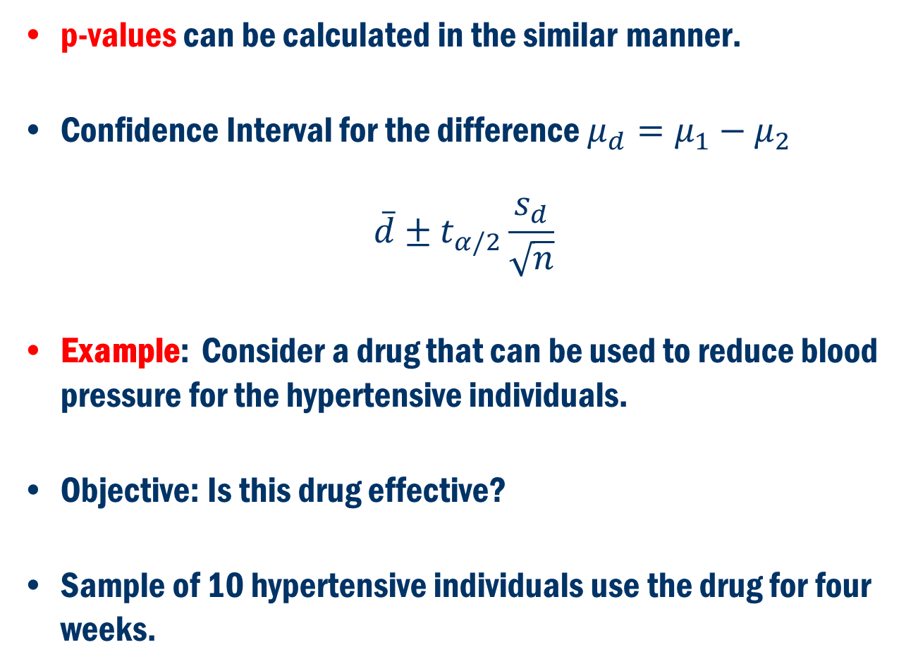
Comparing two Dependent population means (Cont’d)
p-values can be calculated in the similar manner.
Confidence Interval for the difference $μ_{d}=μ_{1}−μ_{2}$
$$\overline{d}±t_{α/2}\frac{s_{d}}{\sqrt{n}}$$
Example: Consider a drug that can be used to reduce blood pressure for the hypertensive individuals.
Objective: Is this drug effective?
Sample of 10 hypertensive individuals use the drug for four weeks.

Slide 7
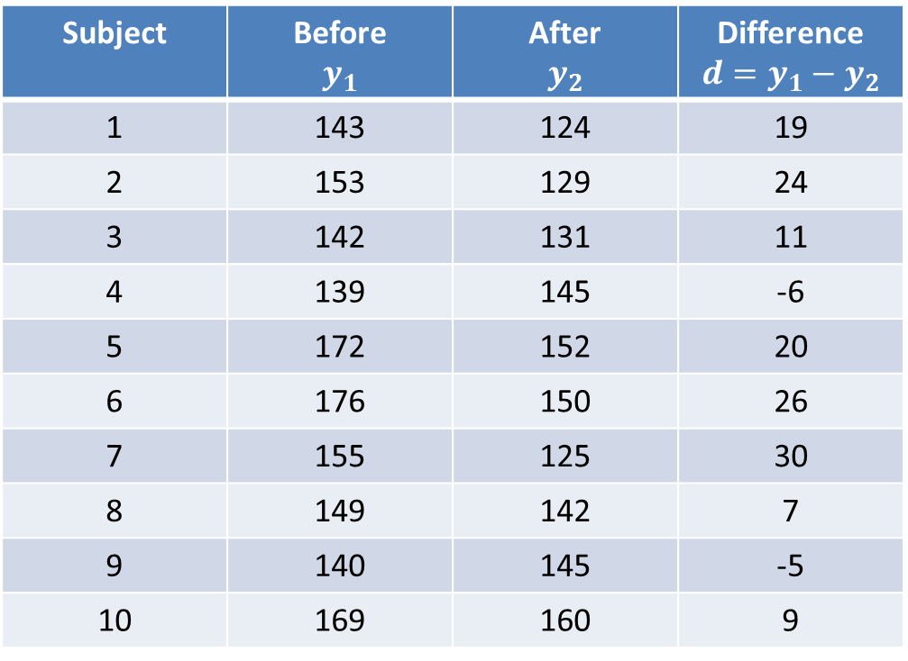
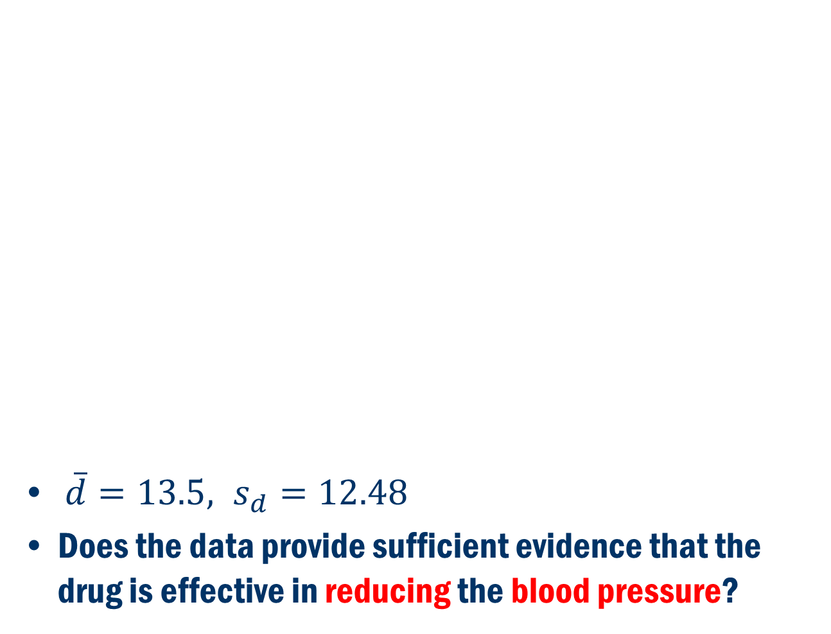
Example Cont’D
$\overline{d}=13.5, s_{d}=12.48$
Does the data provide sufficient evidence that the drug is effective in reducing the blood pressure?

Slide 8
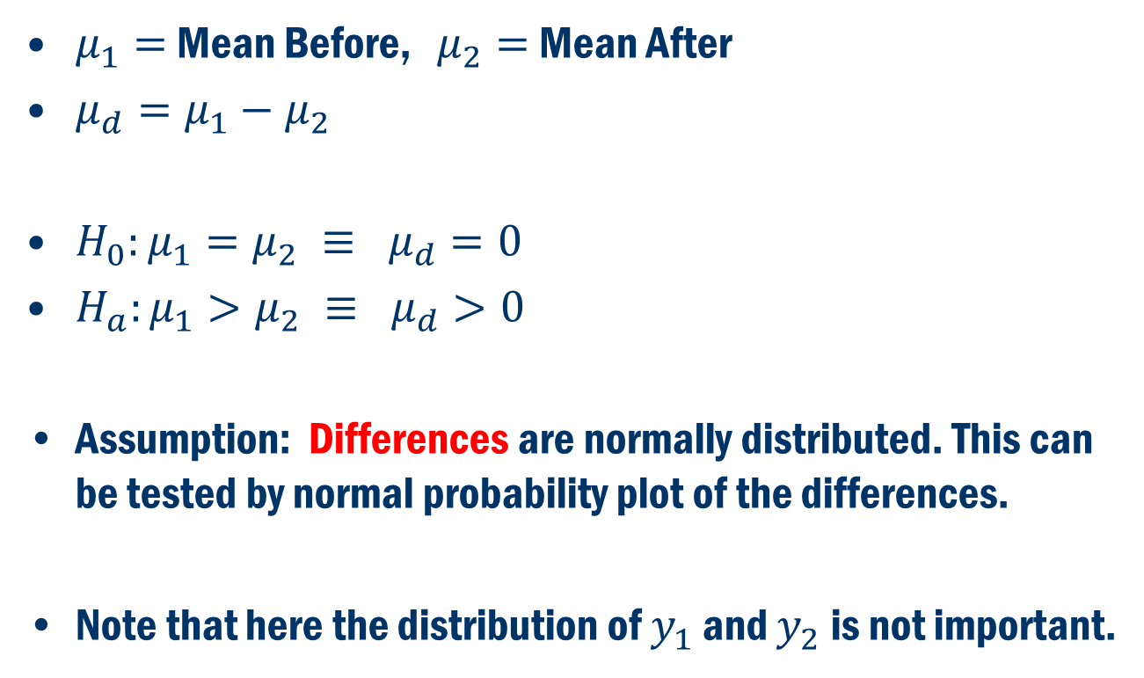
Example Cont’D
$μ_{1}=$ Mean Before, $μ_{2}=$ Mean After
$μ_{d}=μ_{1}−μ_{2}$
$H_{0}:μ_{1}=μ_{2} ≡ μ_{d}=0$
$H_{a}:μ_{1}>μ_{2} ≡ μ_{d}>0$
Assumption: Differences are normally distributed. This can be tested by normal probability plot of the differences.
Note that here the distribution of $y_{1}$ and $y_{2}$ is not important.

Slide 9
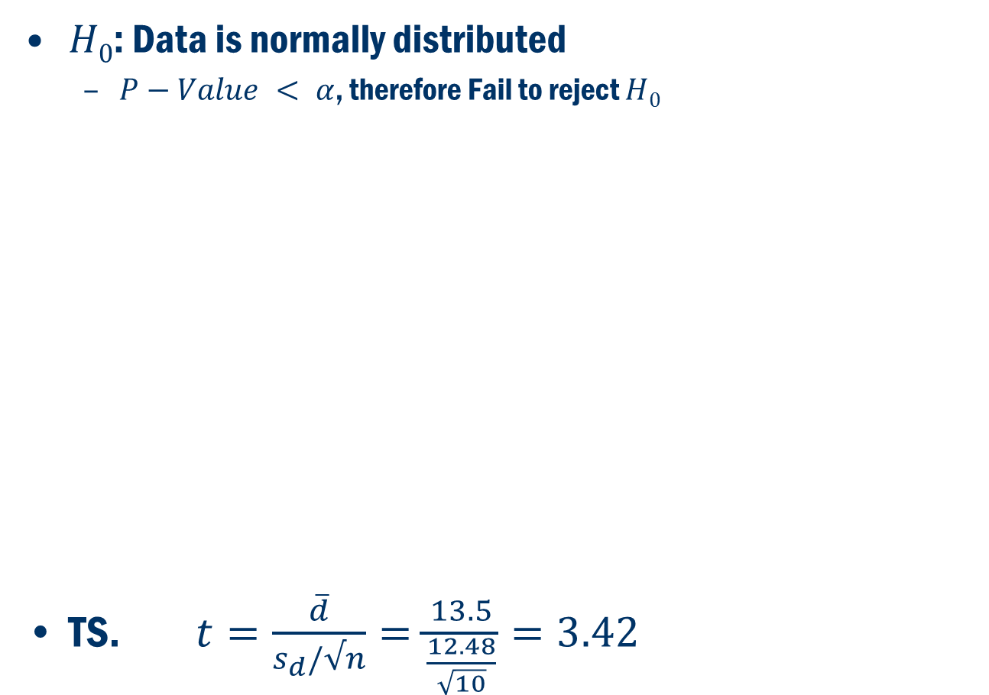
Normal probability plot
$H0$: Data is normally distributed
$P−Value < α$, therefore Fail to reject $H0$
TS. $t=\frac{\overline{d}}{s_{d}/√n}=\frac{13.5}{\frac{12.48}{\sqrt{10}}}=3.42$

Slide 10
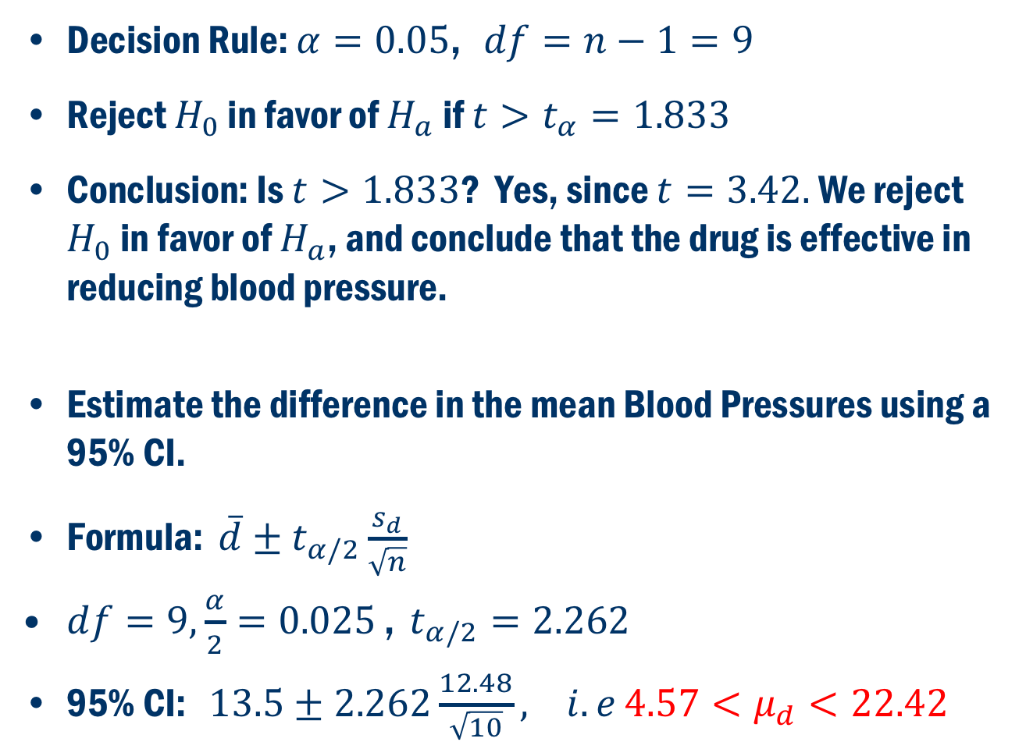
Example Cont’D
Decision Rule: $α=0.05$, $df=n−1=9$
Reject $H_{0}$ in favor of $H_{a}$ if $t>t_{α}=1.833$
Conclusion: Is $t>1.833$? Yes, since $t=3.42.$ We reject $H_{0}$ in favor of $H_{a}$, and conclude that the drug is effective in reducing blood pressure.
Estimate the difference in the mean Blood Pressures using a 95% CI.
Formula: $\overline{d}±t_{α/2}\frac{s_{d}}{\sqrt{n}}$
$df=9,\frac{α}{2}=0.025$ , $t_{α/2}=2.262$
95% CI: $13.5±2.262\frac{12.48}{\sqrt{10}}, i.e$ $4.57<μ_{d}<22.42$

Slide 11
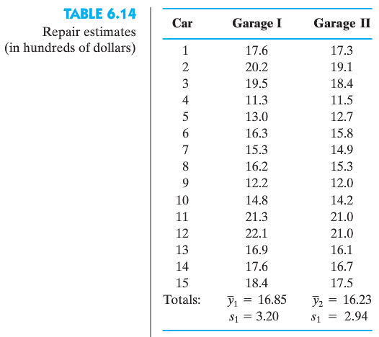
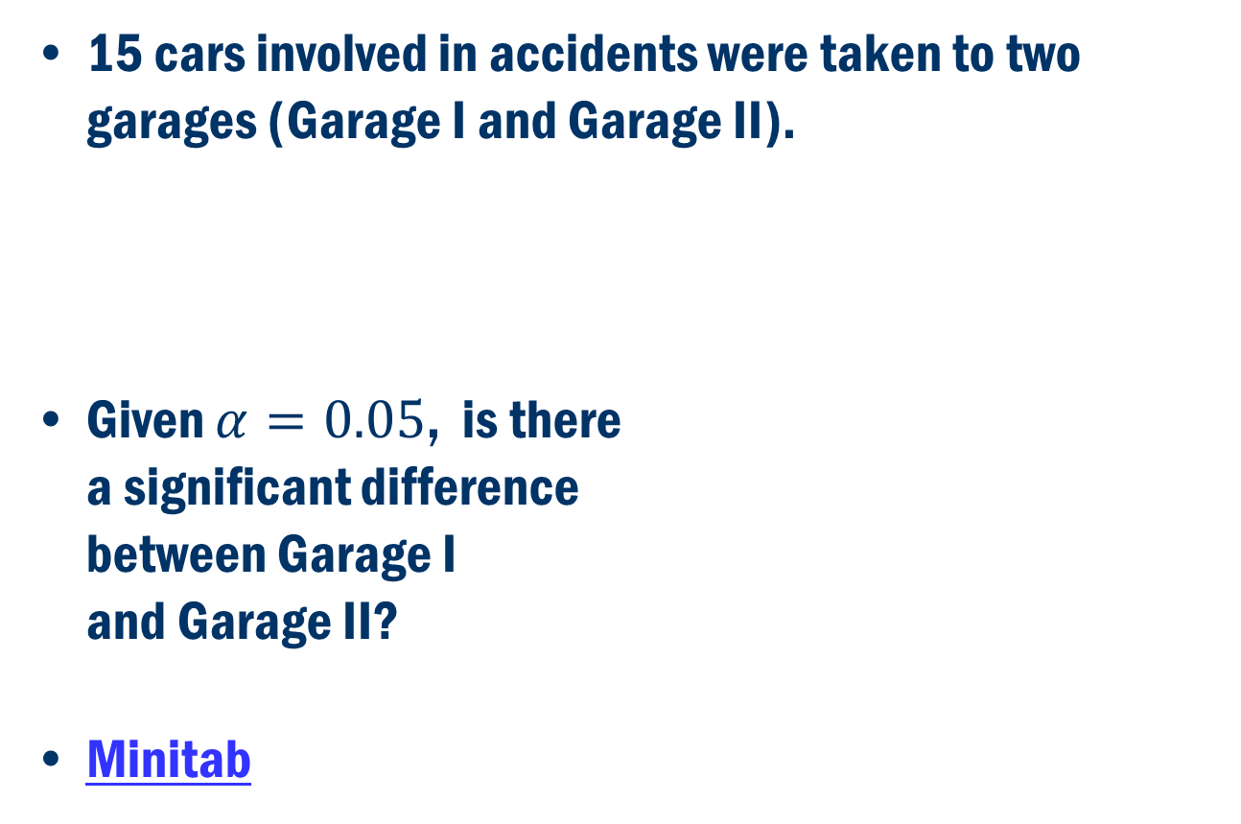
Book Example: 6.8
15 cars involved in accidents were taken to two garages (Garage I and Garage II).
Given $α=0.05$, is there a significant difference between Garage I and Garage II?
Minitab

Slide 12
Normal probability plots

Slide 13
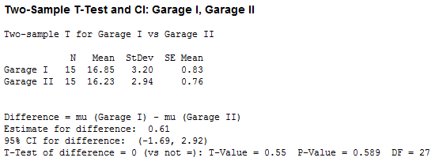

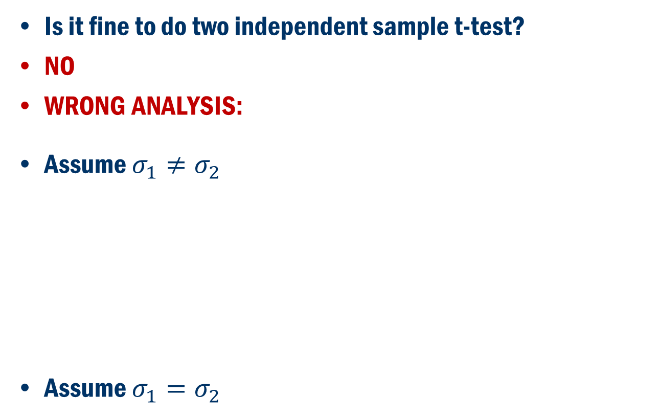
Example 6.8 (Cont’D)
Is it fine to do two independent sample t-test?
NO
WRONG ANALYSIS:
Assume $σ_{1}≠σ_{2}$
Assume $σ_{1}=σ_{2}$

Slide 14
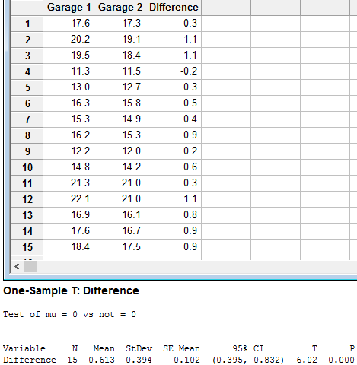
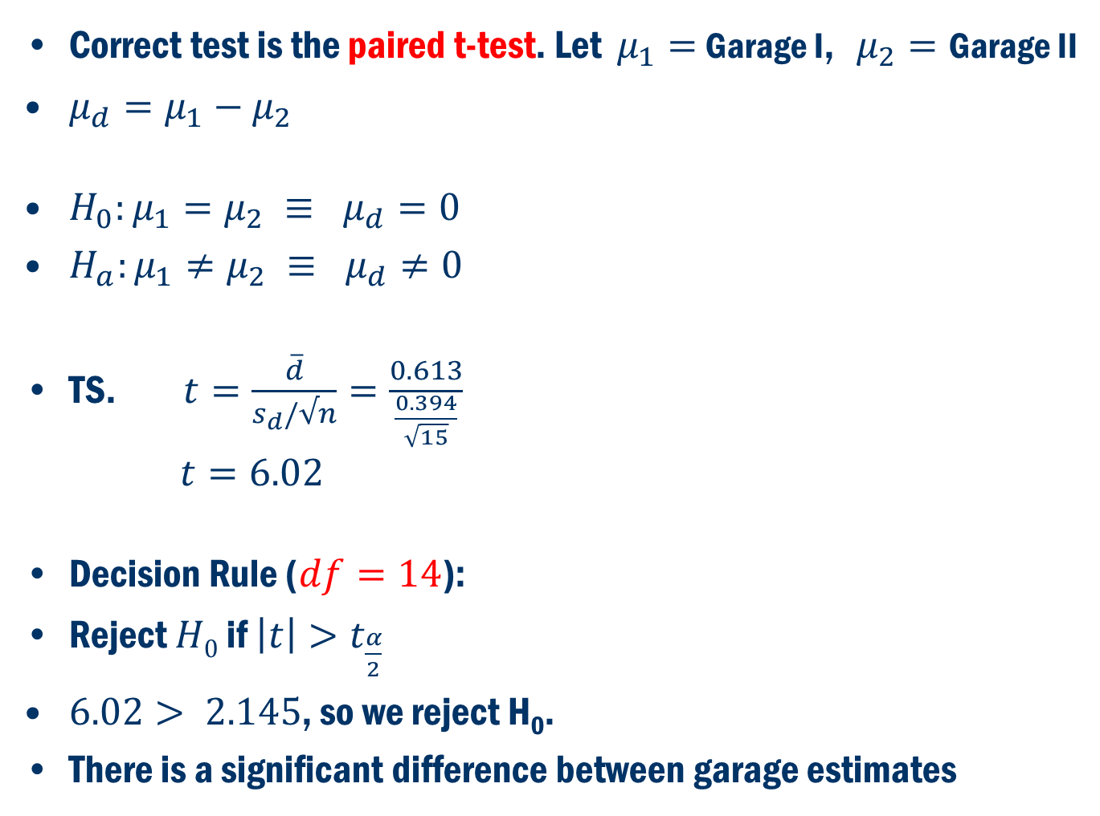
Example 6.8 (Cont’D)
Correct test is the paired t-test. Let $μ_{1}=$ Garage I, $μ_{2}=$ Garage II
$μ_{d}=μ_{1}−μ_{2}$
$H_{0}:μ_{1}=μ_{2} ≡ μ_{d}=0$
$H_{a}:μ_{1}≠μ_{2} ≡ μ_{d}≠0$
TS. $t=\frac{\overline{d}}{s_{d}/√n}=\frac{0.613}{\frac{0.394}{\sqrt{15}}}$ $t=6.02$
Decision Rule ($df=14$):
Reject $H0$ if $\left|t\right|>t_{\frac{α}{2}}$
$6.02> 2.145$, so we reject H₀.
There is a significant difference between garage estimates

Slide 15
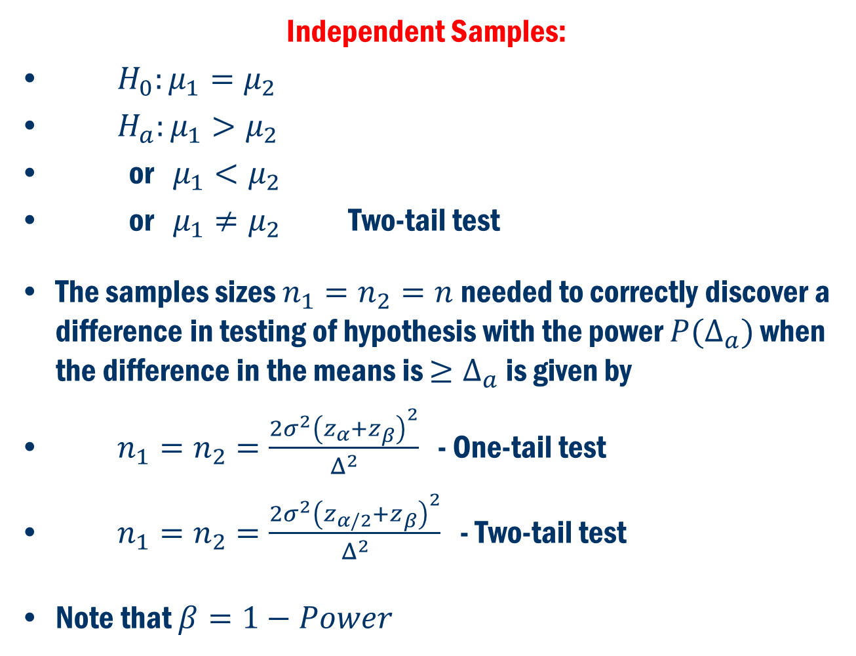
Power Analysis
Independent Samples:
$H_{0}:μ_{1}=μ_{2}$
$H_{a}:μ_{1}>μ_{2}$
or $μ_{1}<μ_{2}$
or $μ_{1}≠μ_{2}$ Two-tail test
The samples sizes $n_{1}=n_{2}=n$ needed to correctly discover a difference in testing of hypothesis with the power $P(Δ_{a})$ when the difference in the means is $≥Δ_{a}$ is given by
$n_{1}=n_{2}=\frac{{2σ}^{2}{\left(z_{α}+z_{β}\right)}^{2}}{Δ^{2}}$ - One-tail test
$n_{1}=n_{2}=\frac{{2σ}^{2}{\left(z_{α/2}+z_{β}\right)}^{2}}{Δ^{2}}$ - Two-tail test
Note that $β=1−Power$
One-tail test

Slide 16
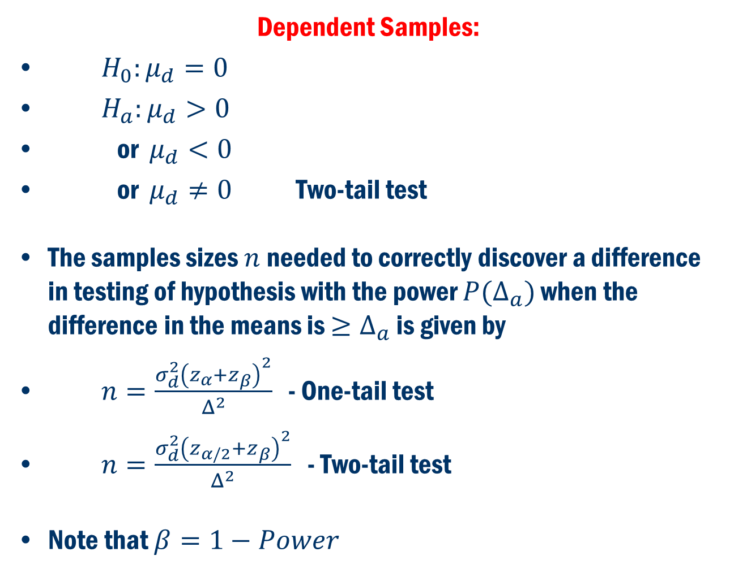
Power Analysis Cont’D
Dependent Samples:
$H_{0}:μ_{d}=0$
$H_{a}:μ_{d}>0$
or $μ_{d}<0$
or $μ_{d}≠0$ Two-tail test
The samples sizes $n$ needed to correctly discover a difference in testing of hypothesis with the power $P(Δ_{a})$ when the difference in the means is $≥Δ_{a}$ is given by
$n=\frac{σ_{d}^{2}{\left(z_{α}+z_{β}\right)}^{2}}{Δ^{2}}$ - One-tail test
$n=\frac{σ_{d}^{2}{\left(z_{α/2}+z_{β}\right)}^{2}}{Δ^{2}}$ - Two-tail test
Note that $β=1−Power$
One-tail test

Slide 17
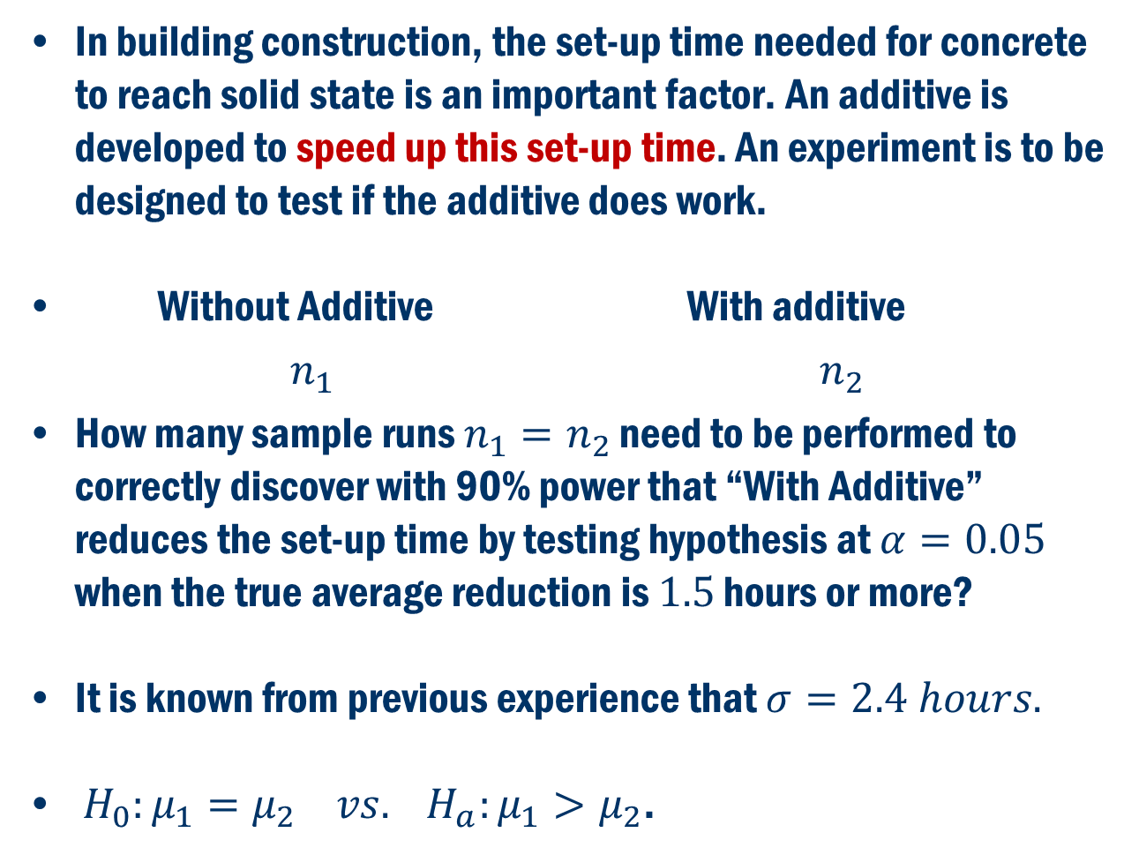
Book Example 6.10
In building construction, the set-up time needed for concrete to reach solid state is an important factor. An additive is developed to speed up this set-up time. An experiment is to be designed to test if the additive does work.
Without Additive With additive
$n_{1}$ $n_{2}$
How many sample runs $n_{1}=n_{2}$ need to be performed to correctly discover with 90% power that “With Additive” reduces the set-up time by testing hypothesis at $α=0.05$ when the true average reduction is $1.5$ hours or more?
It is known from previous experience that $σ=2.4 hours.$
$H_{0}:μ_{1}=μ_{2} vs. H_{a}:μ_{1}>μ_{2}$.

Slide 18
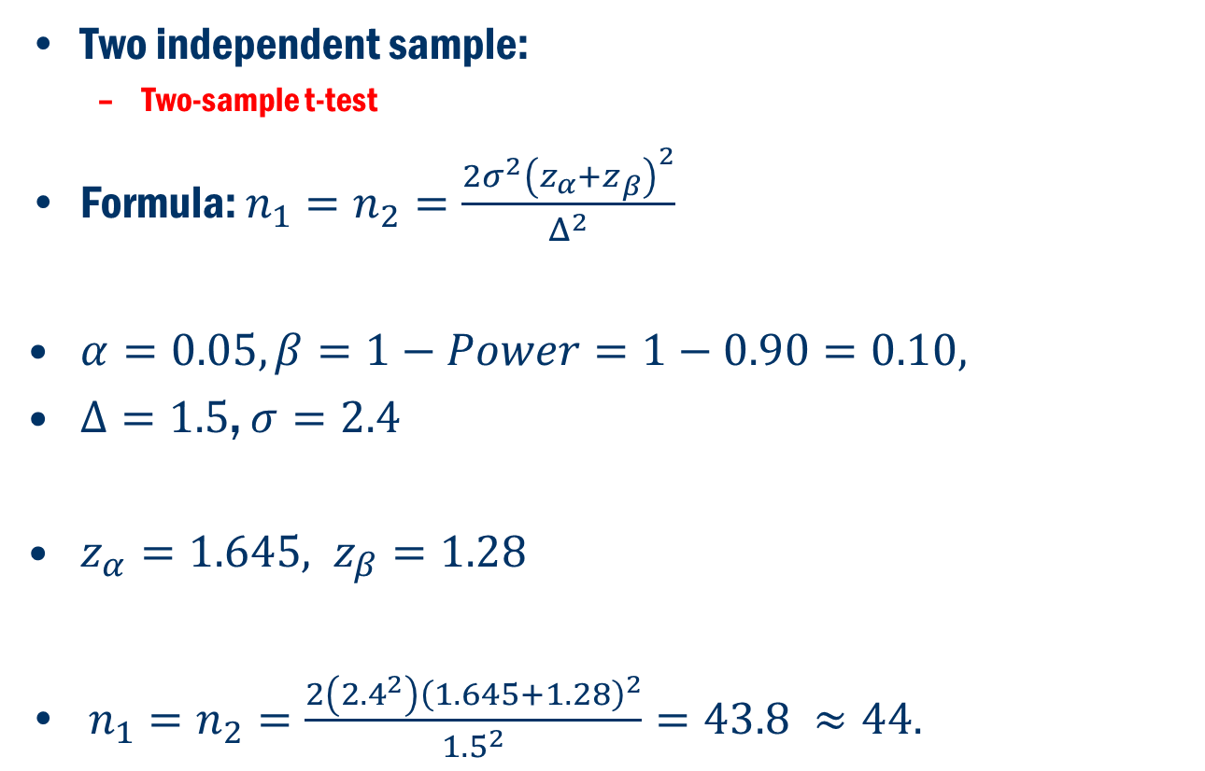
Book Example 6.10 Cont’D
Two independent sample:
Two-sample t-test
Formula: $n_{1}=n_{2}=\frac{{2σ}^{2}{\left(z_{α}+z_{β}\right)}^{2}}{Δ^{2}}$
$α=0.05, β=1−Power=1−0.90=0.10,$
$Δ=1.5$, $σ=2.4$
$z_{α}=1.645, z_{β}=1.28$
$n_{1}=n_{2}=\frac{2\left({2.4}^{2}\right){\left(1.645+1.28\right)}^{2}}{{1.5}^{2}}=43.8 ≈44.$

Slide 19
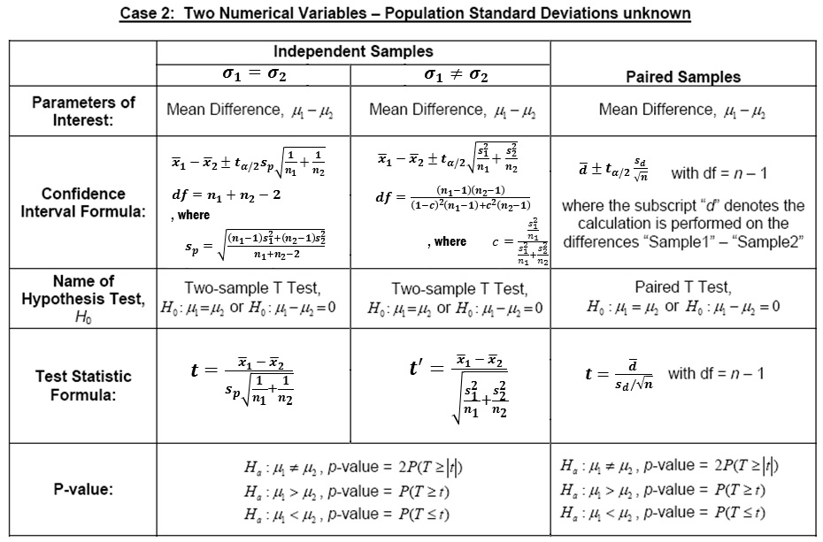
Summary

Slide 20
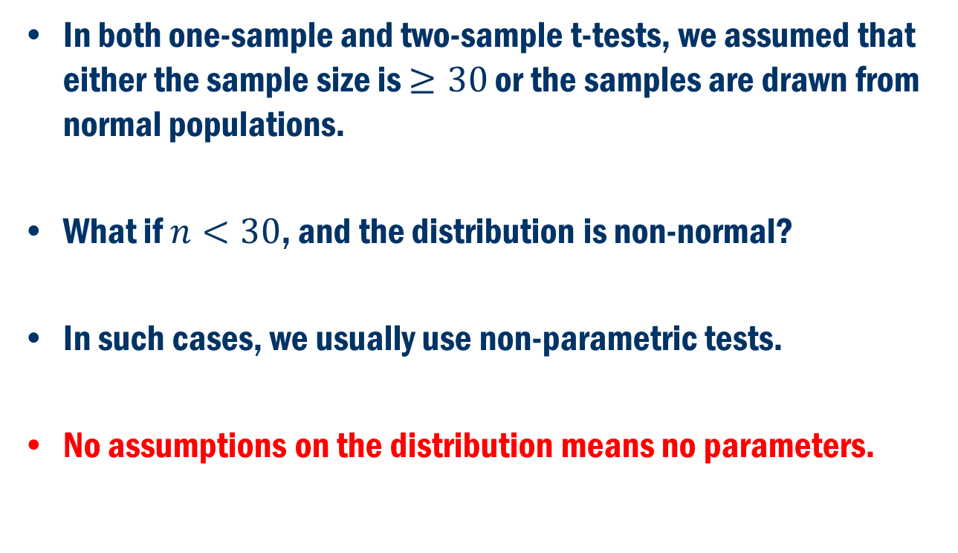
WHAT IF ASSUMPTIONS are violated?
In both one-sample and two-sample t-tests, we assumed that either the sample size is $≥30$ or the samples are drawn from normal populations.
What if $n<30$, and the distribution is non-normal?
In such cases, we usually use non-parametric tests.
No assumptions on the distribution means no parameters.

