Slide 1
Chapter 6 (Part C)

Slide 2
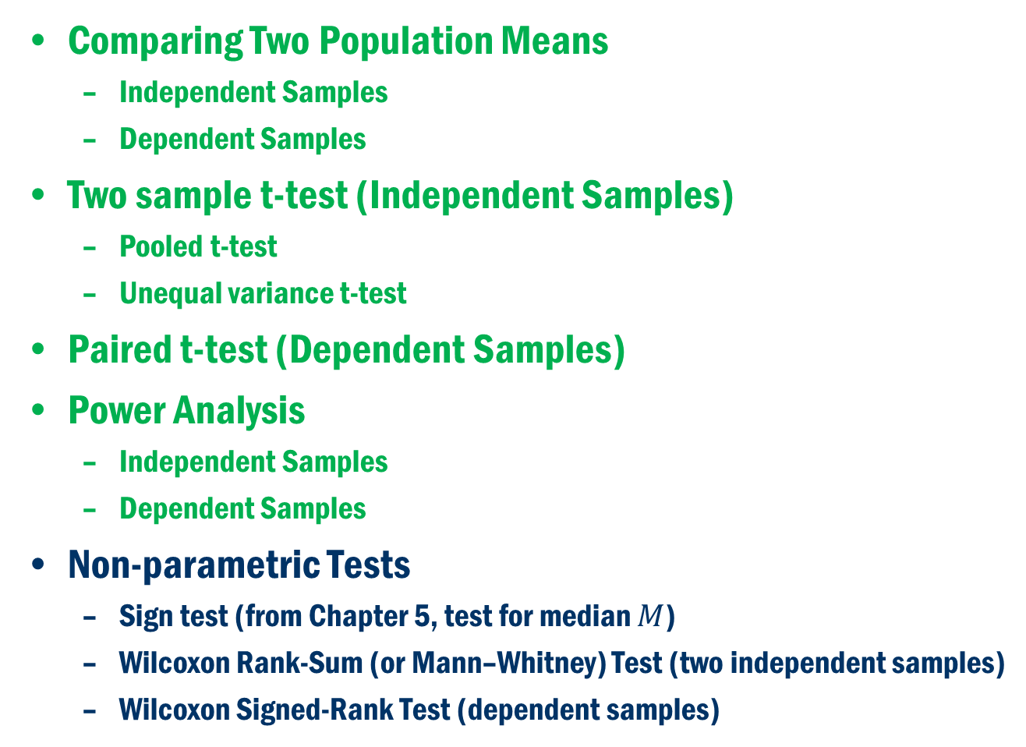
Chapter 6 (Part C)
Comparing Two Population Means
Independent Samples
Dependent Samples
Two sample t-test (Independent Samples)
Pooled t-test
Unequal variance t-test
Paired t-test (Dependent Samples)
Power Analysis
Independent Samples
Dependent Samples
Non-parametric Tests
Sign test (from Chapter 5, test for median $M$)
Wilcoxon Rank-Sum (or Mann–Whitney) Test (two independent samples)
Wilcoxon Signed-Rank Test (dependent samples)

Slide 3
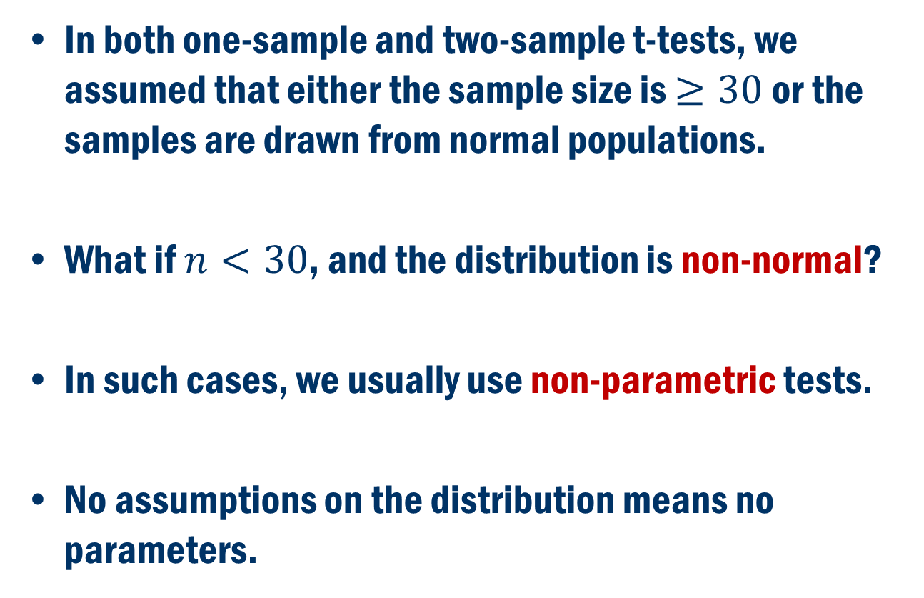
Nonparametric Inference
In both one-sample and two-sample t-tests, we assumed that either the sample size is $≥30$ or the samples are drawn from normal populations.
What if $n<30$, and the distribution is non-normal?
In such cases, we usually use non-parametric tests.
No assumptions on the distribution means no parameters.

Slide 4
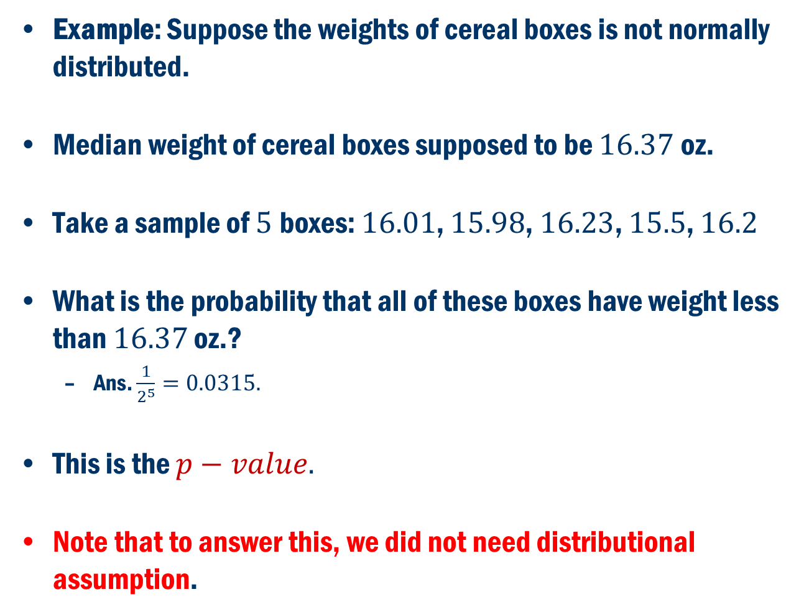
Motivation
Example: Suppose the weights of cereal boxes is not normally distributed.
Median weight of cereal boxes supposed to be $16.37$oz.
Take a sample of $5$boxes: $16.01$, $15.98$, $16.23$, $15.5$, $16.2$
What is the probability that all of these boxes have weight less than $16.37$ oz.?
Ans. $\frac{1}{2^{5}}=0.0315.$
This is the $p−value.$
Note that to answer this, we did not need distributional assumption.

Slide 5
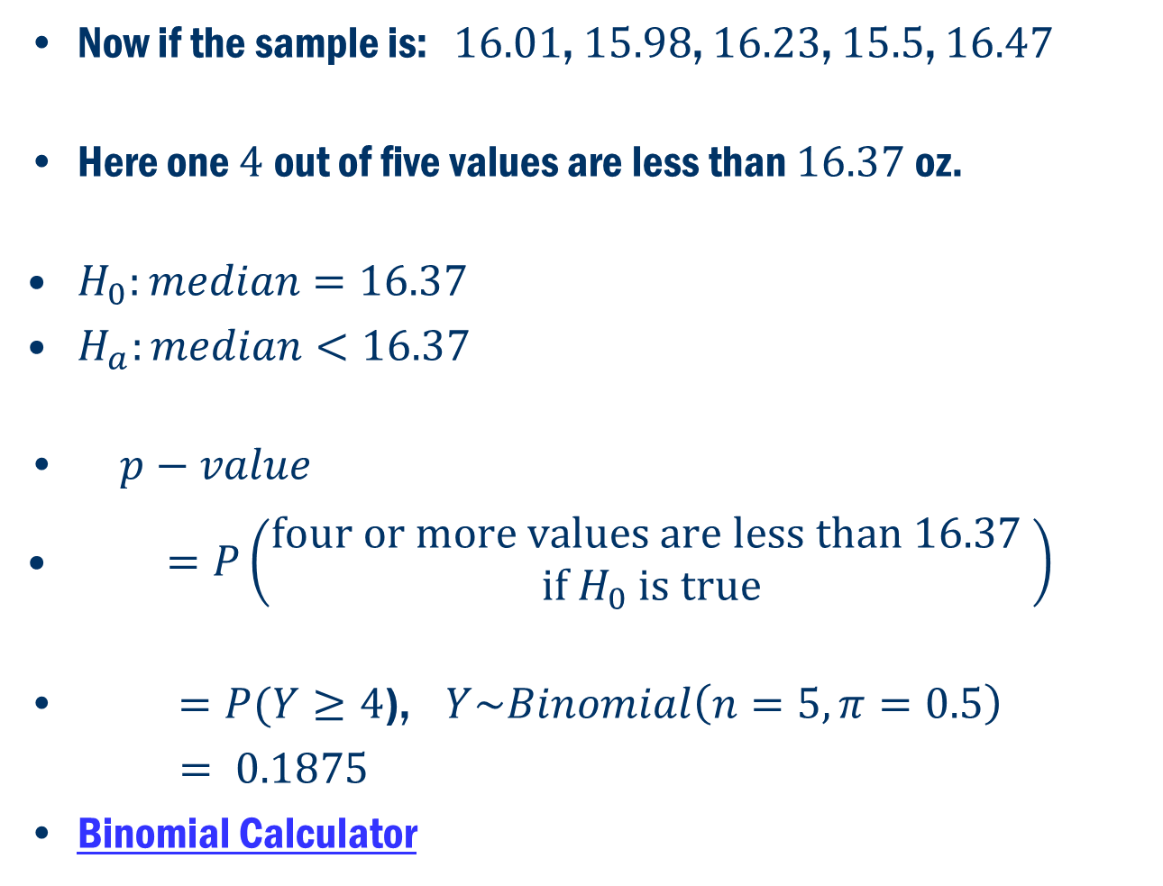
Example (Cont’d)
Now if the sample is: $16.01$, $15.98$, $16.23$, $15.5$, $16.47$
Here one $4$out of five values are less than $16.37$oz.
$H_{0}:median=16.37$
$H_{a}:median<16.37$
$p−value$
$=P\left(\begin{aligned}four or more values are less than 16.37 \\ if H_{0} is true\end{aligned}\right)$
$=P(Y≥4$), $Y\sim Binomial\left(n=5, π=0.5\right)$
$= 0.1875$
Binomial Calculator

Slide 6
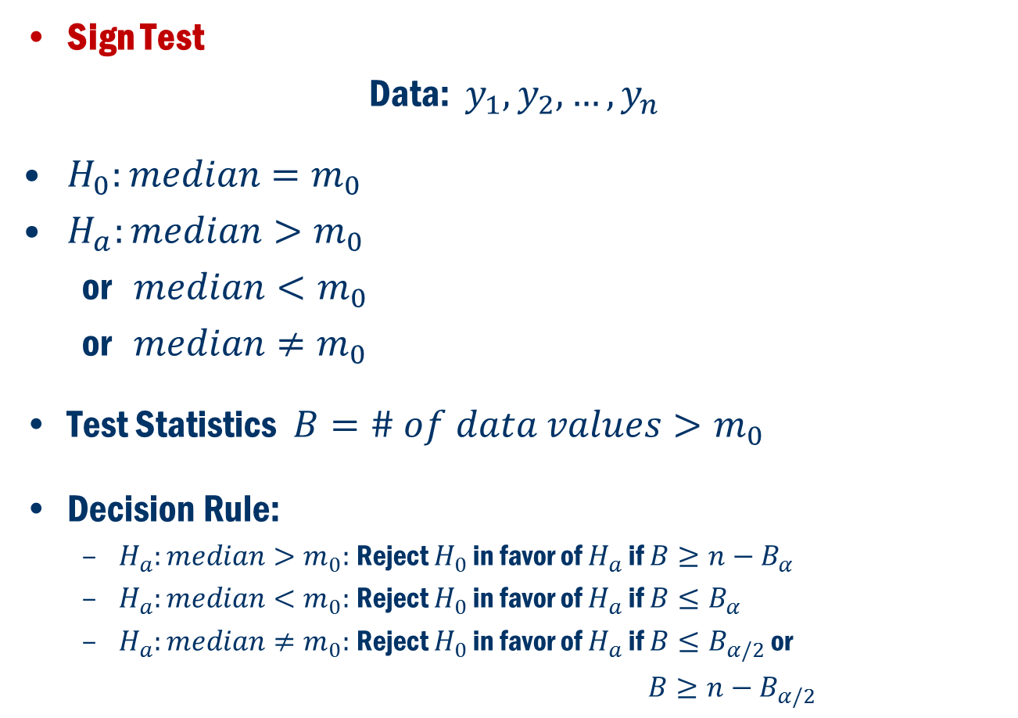
Non-parametric one sample inference (Section 5.9)
Sign Test
Data: $y_{1}, y_{2},…,y_{n}$
$H_{0}:median=m_{0}$
$H_{a}:median>m_{0}$
or $median<m_{0}$
or $median≠m_{0}$
Test Statistics $B=\# of data values>m_{0}$
Decision Rule:
$H_{a}:median>m_{0}:$Reject $H_{0}$ in favor of $H_{a}$ if $B≥n−B_{α}$
$H_{a}:median<m_{0}:$Reject $H_{0}$ in favor of $H_{a}$ if $B≤B_{α}$
$H_{a}:median≠m_{0}:$Reject $H_{0}$ in favor of $H_{a}$ if $B{≤B}_{α/2}$ or
$B≥n−B_{α/2}$

Slide 7
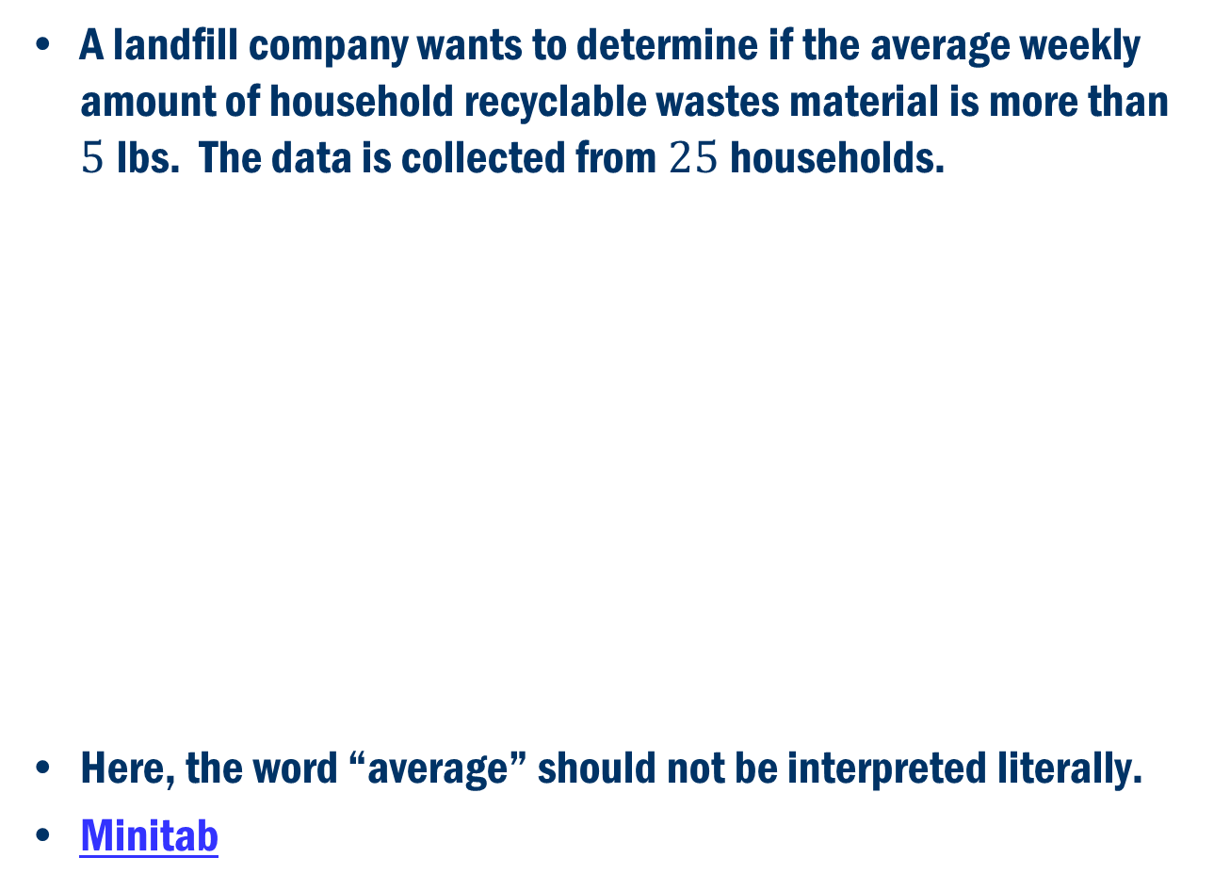
Book Example 5.20
A landfill company wants to determine if the average weekly amount of household recyclable wastes material is more than $5$lbs. The data is collected from $25$households.
Here, the word “average” should not be interpreted literally.
Minitab

Slide 8
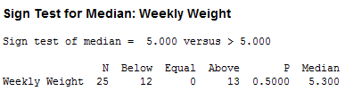
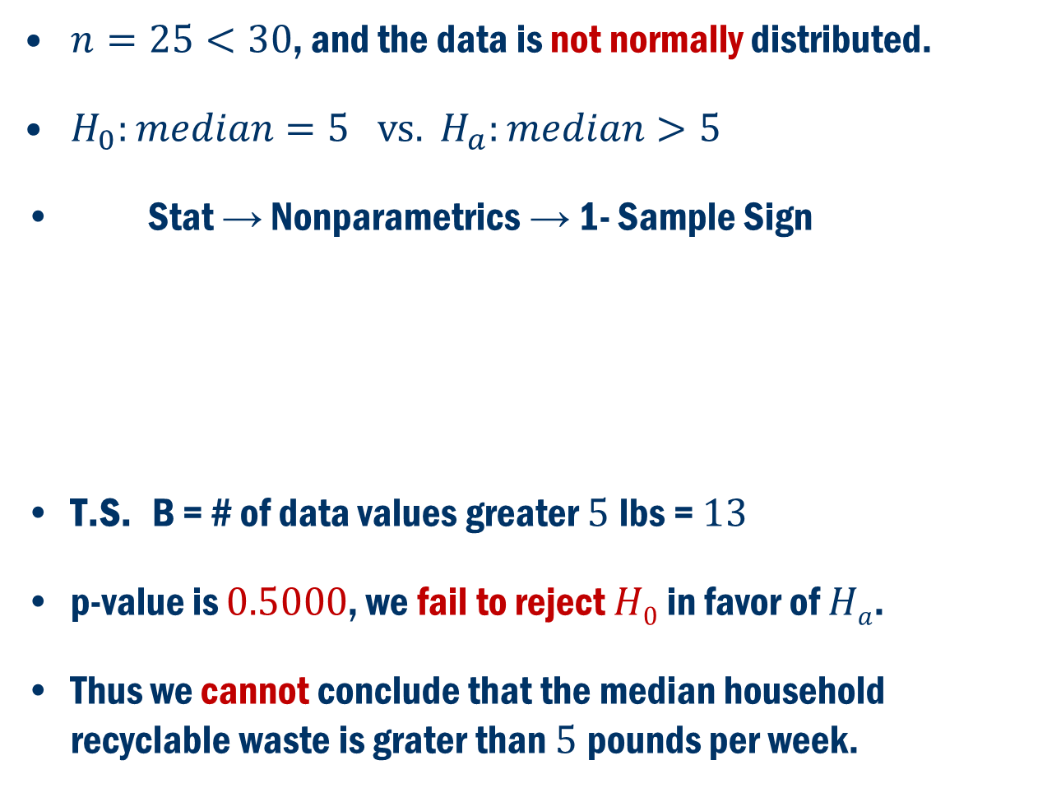
Example Cont’D
$n=25<30$, and the data is not normally distributed.
$H_{0}:median=5 vs. H_{a}:median>5$
Stat → Nonparametrics → 1- Sample Sign
T.S. B = # of data values greater $5$lbs = $13$
p-value is $0.5000$, we fail to reject $H0$ in favor of $Ha$.
Thus we cannot conclude that the median household recyclable waste is grater than $5$pounds per week.

Slide 9
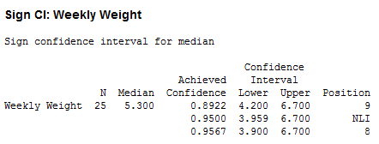
Example Cont’D
Minitab Output
95% Confidence Interval for the Median

Slide 10
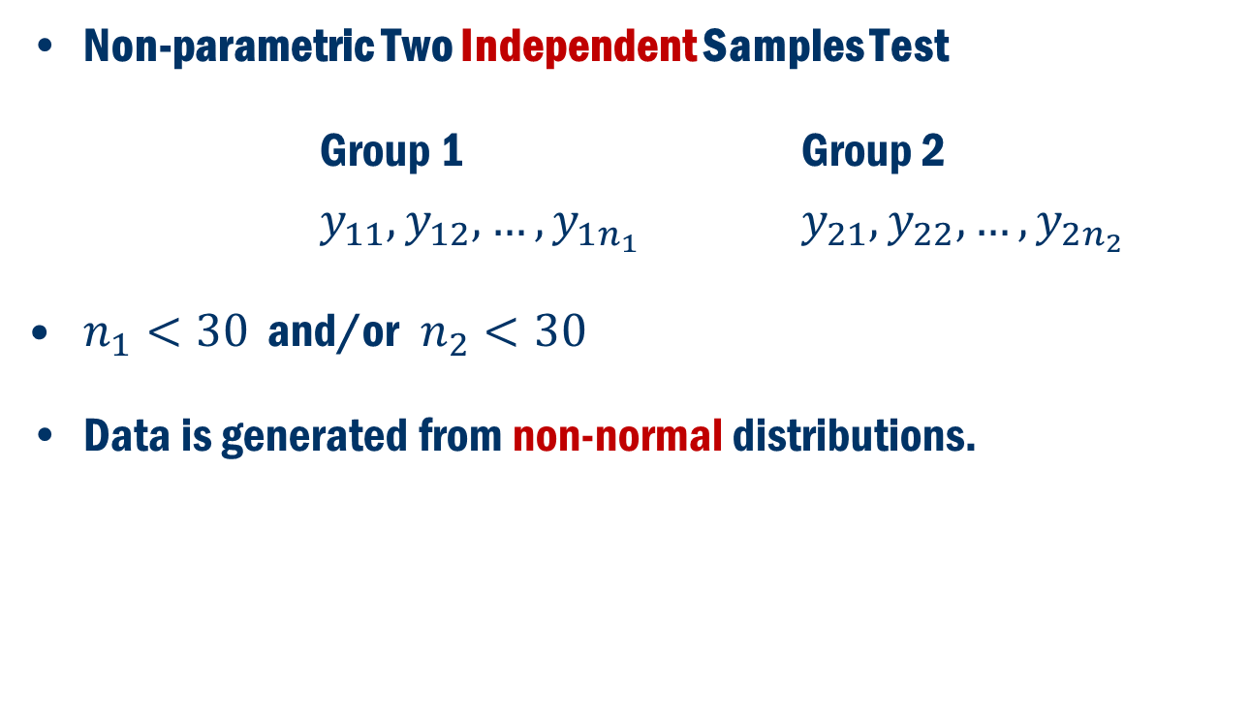
Non-parametric Two Samples Test
Non-parametric Two Independent Samples Test
Group 1 Group 2
$y_{11}, y_{12}, …, y_{1n_{1}}$ $y_{21}, y_{22},…,y_{2n_{2}}$
$n_{1}<30$ and/or$n_{2}<30$
Data is generated from non-normal distributions.

Slide 11
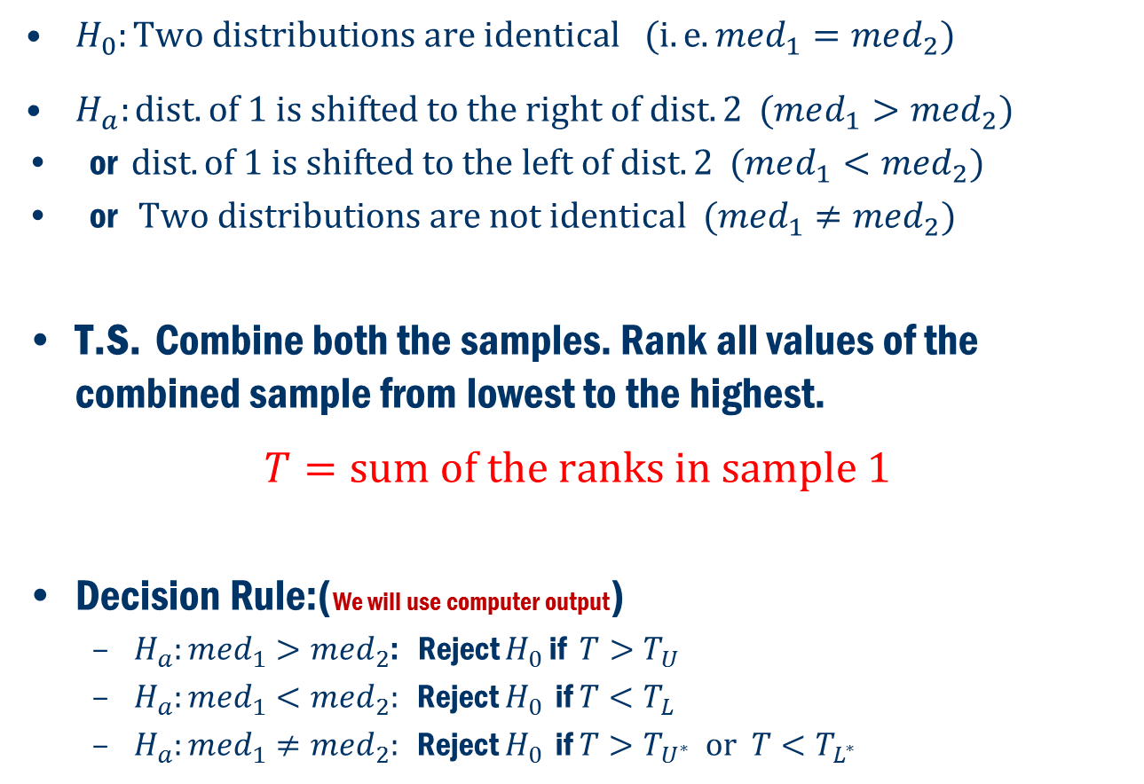
Wilcoxon Rank-Sum Test (Mann–Whitney U TEST)
$H_{0}:Two distributions are identical (i.e. med_{1}=med_{2})$
$H_{a}:dist. of 1 is shifted to the right of dist. 2 (med_{1}>med_{2})$
or $dist. of 1 is shifted to the left of dist. 2 (med_{1}<med_{2})$
or $Two distributions are not identical ({med}_{1}≠med_{2})$
T.S. Combine both the samples. Rank all values of the combined sample from lowest to the highest.
$$T=sum of the ranks in sample 1$$
Decision Rule:(We will use computer output)
$H_{a}:med_{1}>med_{2}$: Reject $H_{0}$ if $T>T_{U}$
$H_{a}:med_{1}<med_{2}:$ Reject $H_{0}$ if $T<T_{L}$
$H_{a}:med_{1}≠med_{2}:$ Reject $H_{0}$ if $T>T_{U^{∗}} or T<T_{L^{∗}}$

Slide 12
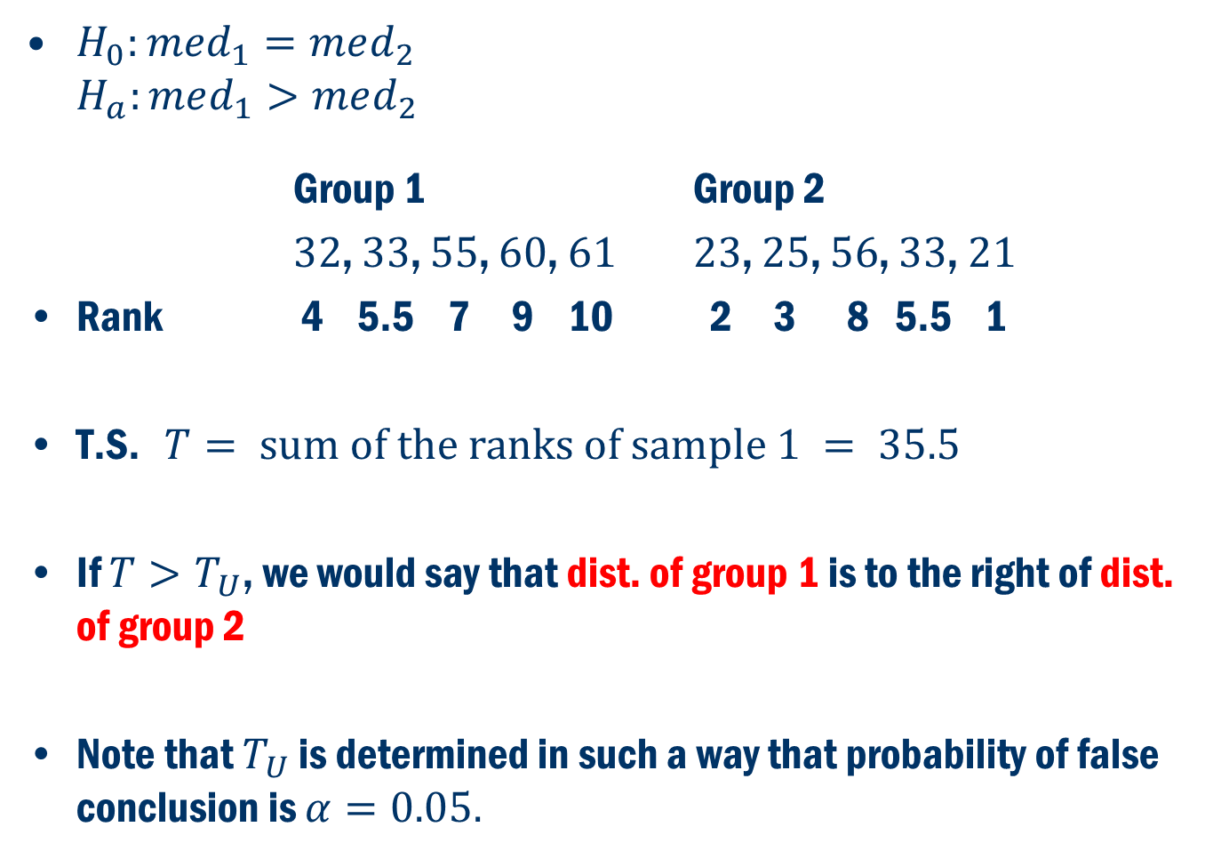
A simple Example
$H_{0}:med_{1}=med_{2}$ $H_{a}:med_{1}>med_{2}$
Group 1 Group 2
$32$, $33$, $55$, $60$, $61$ $23$, $25$, $56$, $33$, $21$
Rank 4 5.5 7 9 10 2 3 8 5.5 1
T.S. $T= sum of the ranks of sample 1 = 35.5$
If $T>T_{U}$, we would say that dist. of group 1 is to the right of dist. of group 2
Note that $T_{U}$ is determined in such a way that probability of false conclusion is $α=0.05.$

Slide 13
Book Example 6.5
An investigator is interested to study the effect of alcohol on reaction time. The following data is collected on the reaction time to an instruction.
Group 1: Alcohol Group 2: Placebo
10 subjects 10 subjects
Minitab

Slide 14
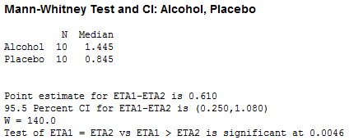
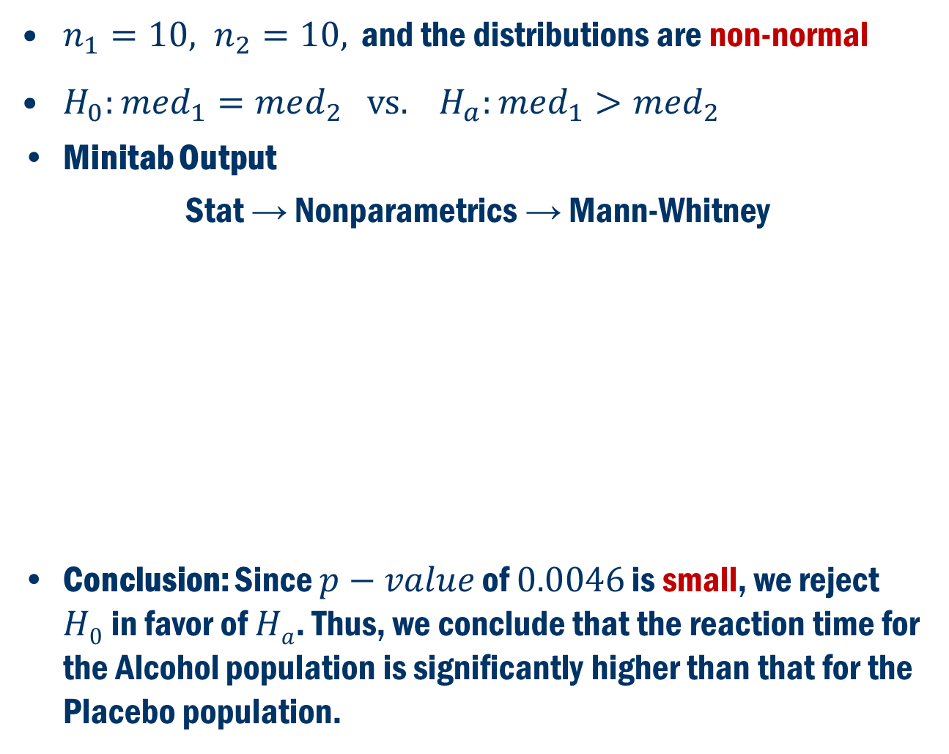
Example 6.5: (Cont’d)
$n_{1}=10, n_{2}=10,$ and the distributions are non-normal
$H_{0}:med_{1}=med_{2} vs. H_{a}:med_{1}>med_{2}$
Minitab Output
Stat → Nonparametrics → Mann-Whitney
Conclusion: Since $p−value$ of $0.0046$ is small, we reject $H0$in favor of $Ha$. Thus, we conclude that the reaction time for the Alcohol population is significantly higher than that for the Placebo population.

Slide 15
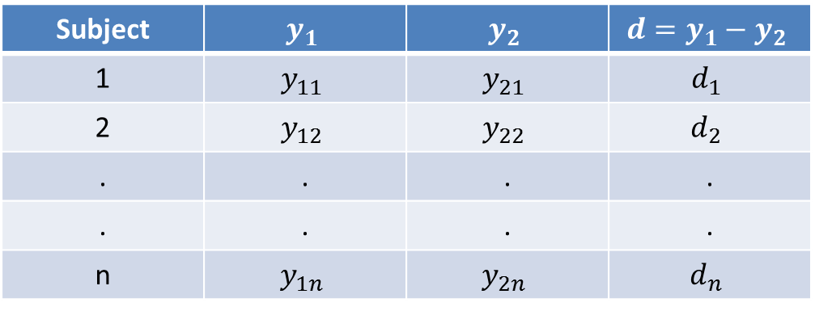
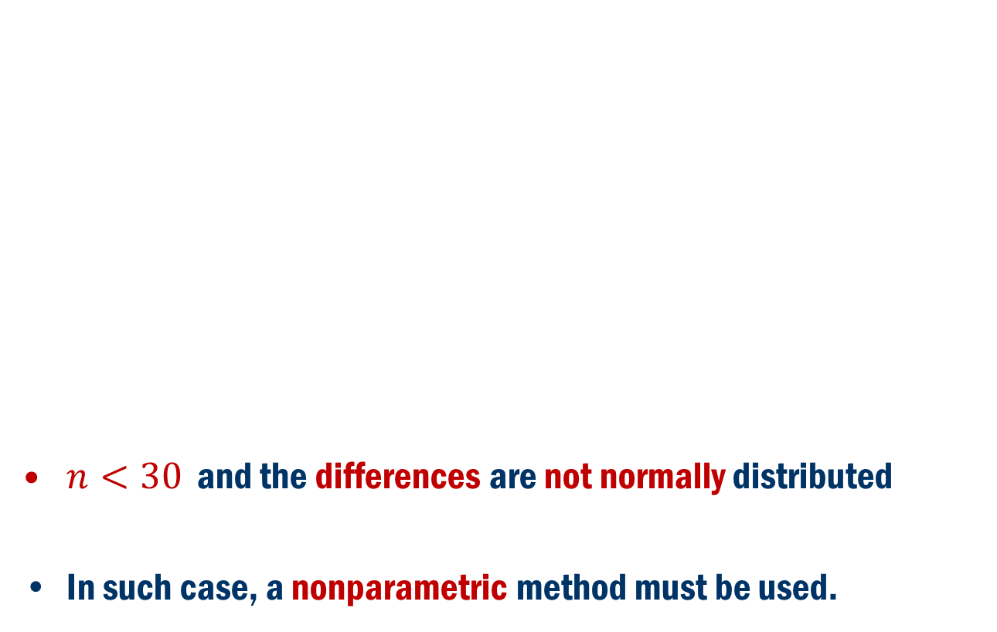
Non-Parametric Two Dependent Sample Test
$n<30$ and the differences are not normally distributed
In such case, a nonparametric method must be used.

Slide 16
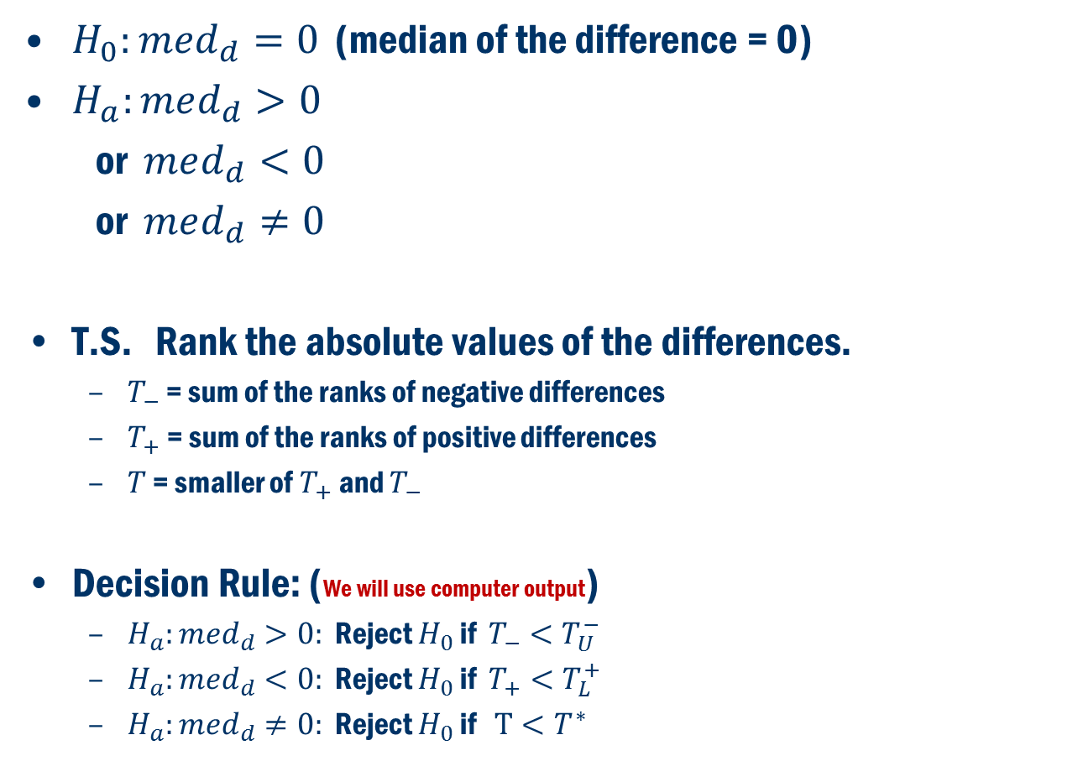
Wilcoxon Signed-Rank Test
$H_{0}:med_{d}=0$ (median of the difference = 0)
$H_{a}:med_{d}>0$
or $med_{d}<0$
or $med_{d}≠0$
T.S. Rank the absolute values of the differences.
$T_{−}$ = sum of the ranks of negative differences
$T_{+}$ = sum of the ranks of positive differences
$T$ = smaller of $T_{+}$ and $T_{−}$
Decision Rule: (We will use computer output)
$H_{a}:med_{d}>0:$ Reject $H_{0}$ if $T_{−}<T_{U}^{−}$
$H_{a}:med_{d}<0:$ Reject $H_{0}$ if $T_{+}<T_{L}^{+}$
$H_{a}:med_{d}≠0:$ Reject $H_{0}$ if $T<T^{∗}$

Slide 17
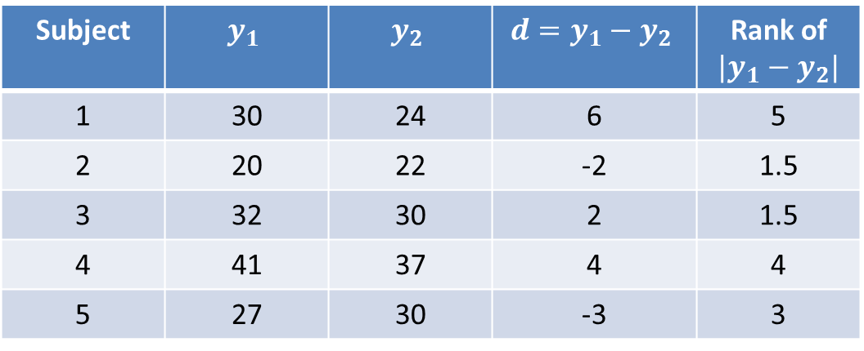
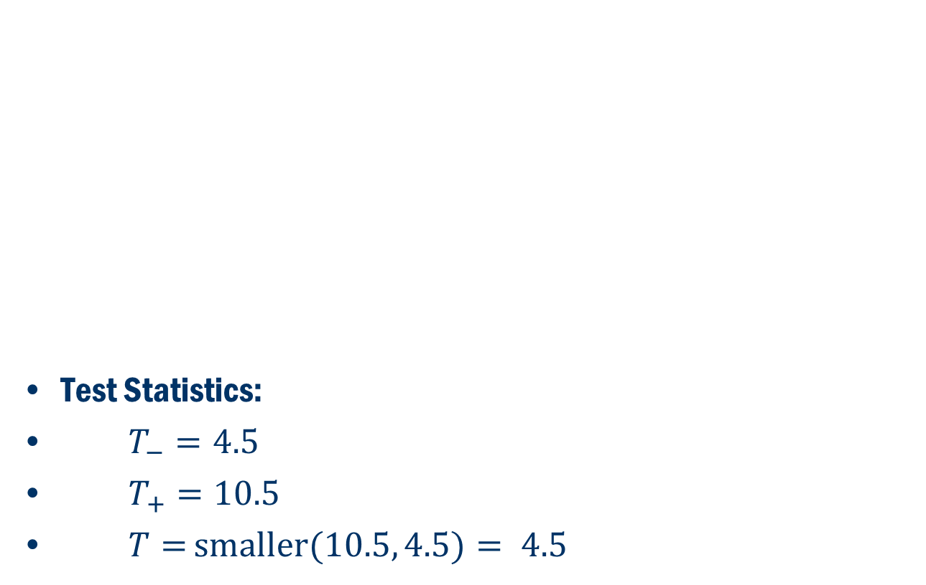
A Simple Example
Test Statistics:
$T_{−}=4.5$
$T_{+}=10.5$
$T=$ $smaller(10.5, 4.5)= 4.5$

Slide 18
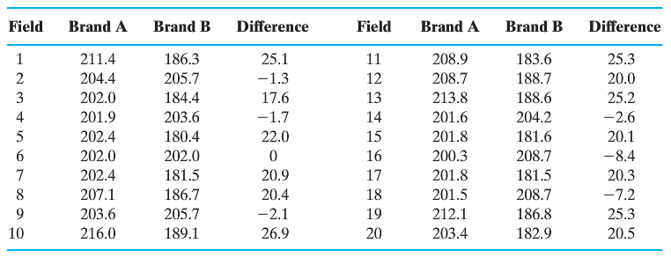
Book Example 6.9
Does Brand A fertilizer produce more grass than Brand B?
Minitab

Slide 19

Book Example 6.9 (Cont’D)
$H_{0}:med_{d}=0 vs H_{a}:med_{d}>0$

Slide 20
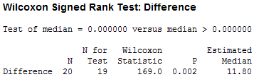
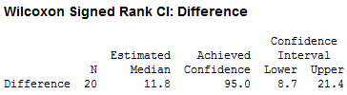
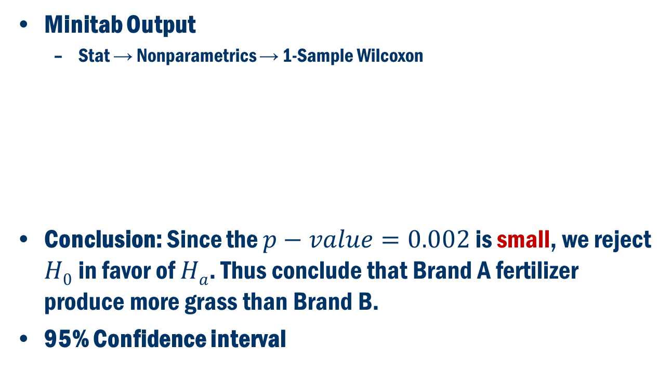
Book Example 6.9 (Cont’D)
Minitab Output
Stat → Nonparametrics → 1-Sample Wilcoxon
Conclusion: Since the $p−value=0.002$ is small, we reject $H0$in favor of $Ha$. Thus conclude that Brand A fertilizer produce more grass than Brand B.
95% Confidence interval

