Slide 1
Chapter 7

Slide 2

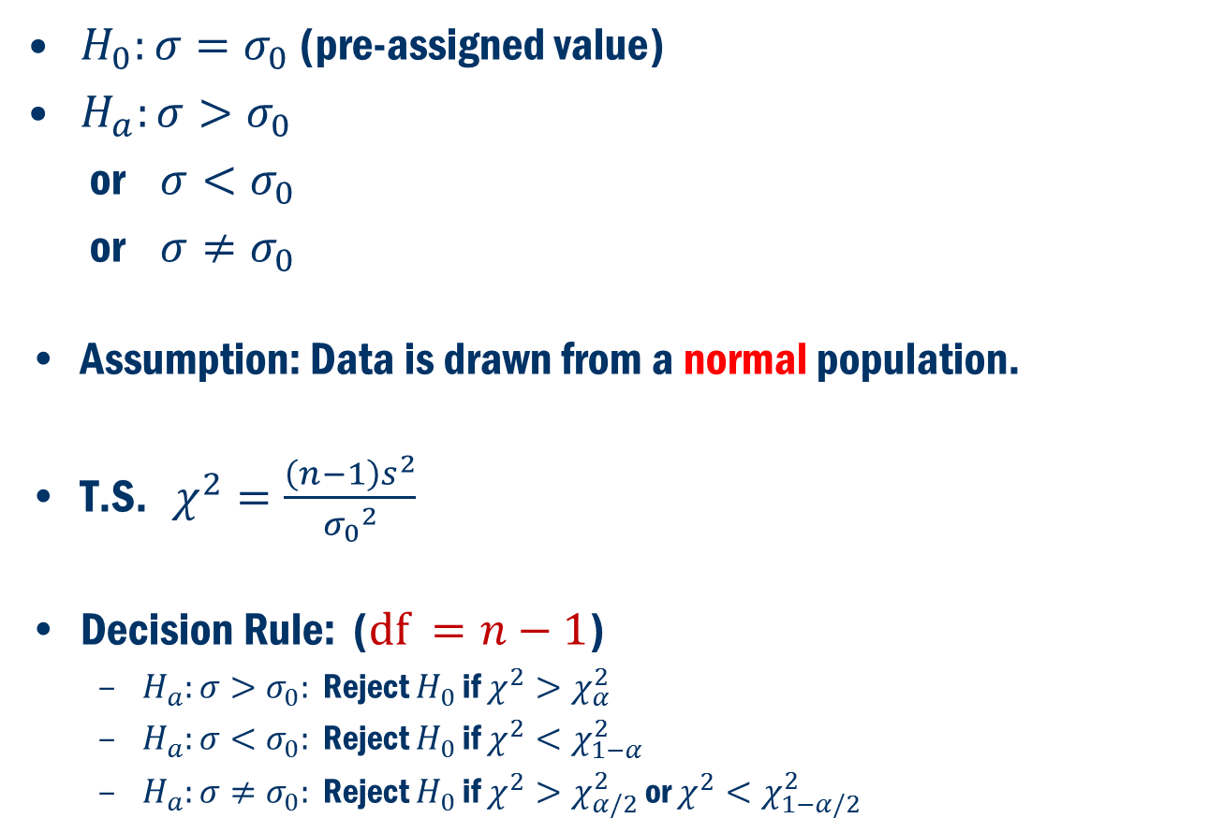
Inference about population standard deviation ($σ$)
$H_{0}:σ=σ_{0}$(pre-assigned value)
$H_{a}:σ>σ_{0}$
or $σ<σ_{0}$
or $σ≠σ_{0}$
Assumption: Data is drawn from a normal population.
T.S. $χ^{2}=\frac{\left(n−1\right)s^{2}}{{σ_{0}}^{2}}$
Decision Rule: ($df =n−1$)
$H_{a}:σ>σ_{0}:$ Reject $H_{0}$ if $χ^{2}>χ_{α}^{2}$
$H_{a}:σ<σ_{0}:$ Reject $H_{0}$ if $χ^{2}<χ_{1−α}^{2}$
$H_{a}:σ≠σ_{0}:$ Reject $H_{0}$ if $χ^{2}>χ_{α/2}^{2}$ or $χ^{2}<χ_{1−α/2}^{2}$

Slide 3
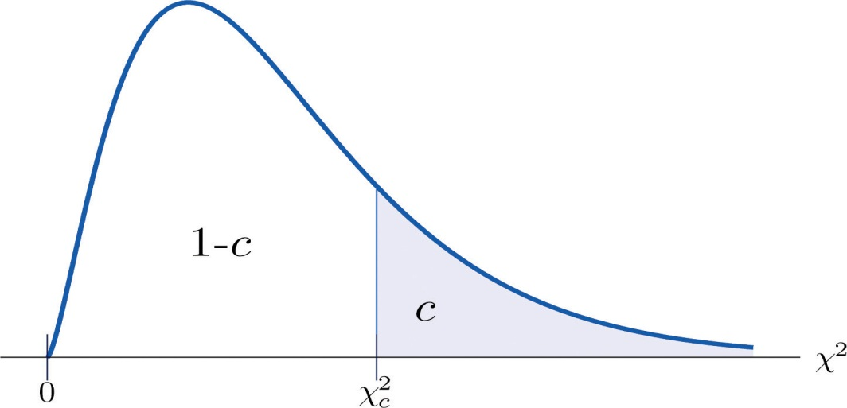
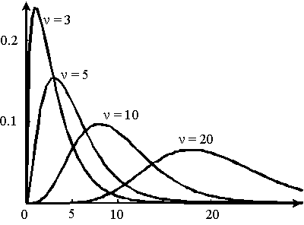
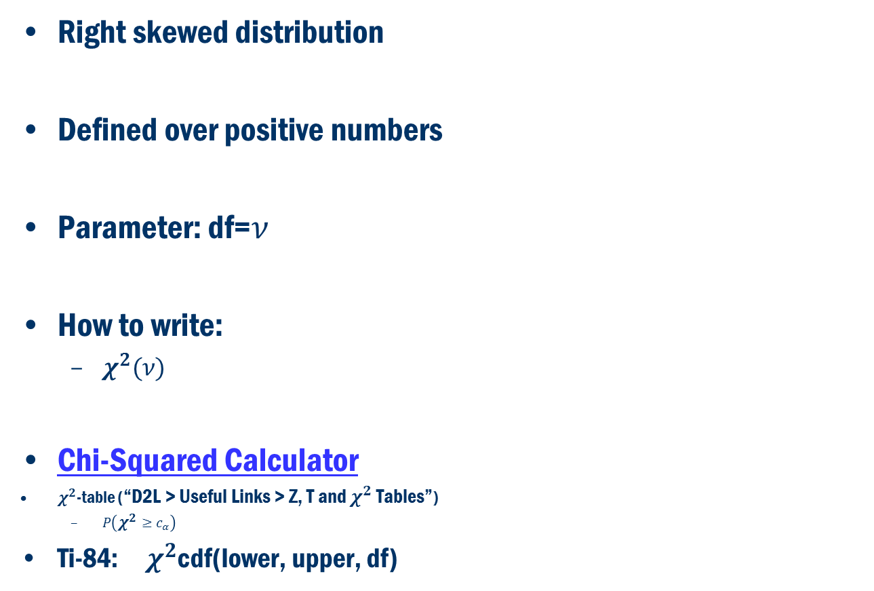
Chi-Squared ( $χ^{2 }$) Distribution
Right skewed distribution
Defined over positive numbers
Parameter: df=$ν$
How to write:
$χ^{2}(ν)$
Chi-Squared Calculator
$χ^{2}$-table (“D2L > Useful Links > Z, T and $χ^{2}$ Tables”)
$P\left(χ^{2}≥c_{α}\right)$
Ti-84: $χ^{2}$cdf(lower, upper, df)
Source: www.jrigol.com

Slide 4
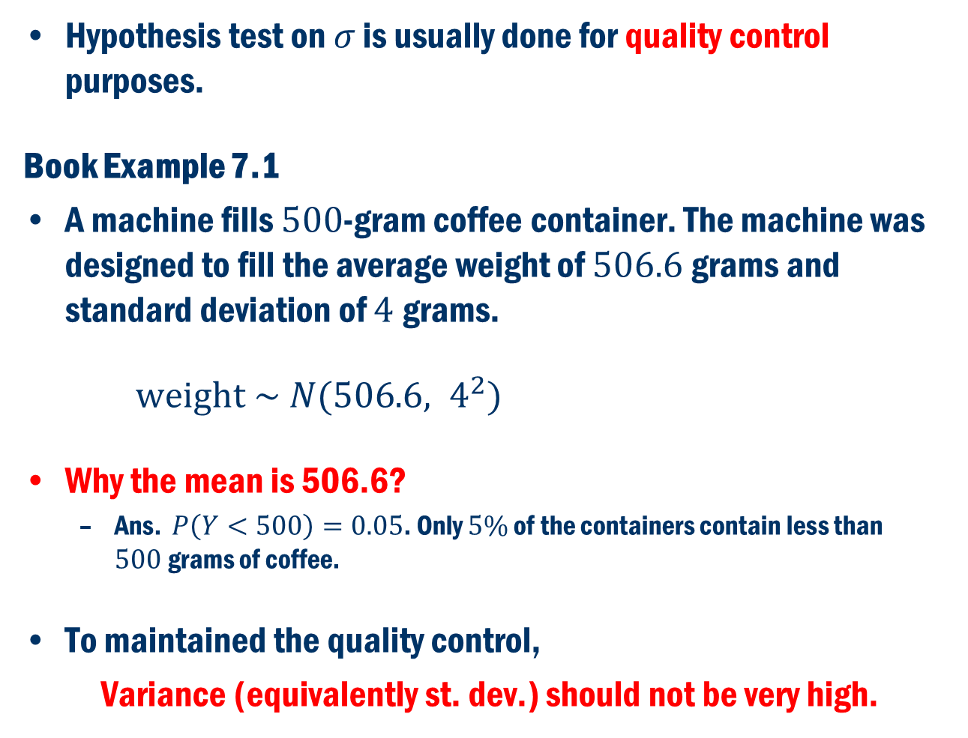
Example
Hypothesis test on $σ$ is usually done for quality control purposes.
Book Example 7.1
A machine fills $500$-gram coffee container. The machine was designed to fill the average weight of $506.6$grams and standard deviation of $4$grams.
$weight \sim N(506.6, 4^{2})$
Why the mean is 506.6?
Ans. $P\left(Y<500\right)=0.05$. Only $5\%$ of the containers contain less than $500$grams of coffee.
To maintained the quality control,
Variance (equivalently st. dev.) should not be very high.

Slide 5
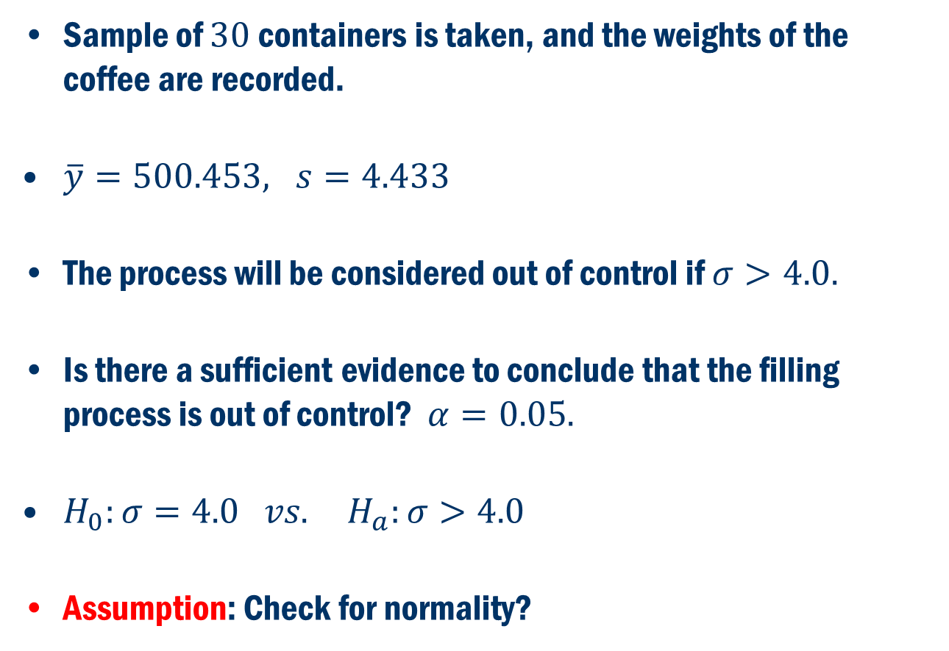
Example Cont’D
Sample of $30$containers is taken, and the weights of the coffee are recorded.
$\overline{y}=500.453, s=4.433$
The process will be considered out of control if $σ>4.0.$
Is there a sufficient evidence to conclude that the filling process is out of control? $α=0.05.$
$H_{0}:σ=4.0 vs. H_{a}:σ>4.0$
Assumption: Check for normality?

Slide 6
Check for normality
Normal probability plot confirms that the data is normally distributed.

Slide 7
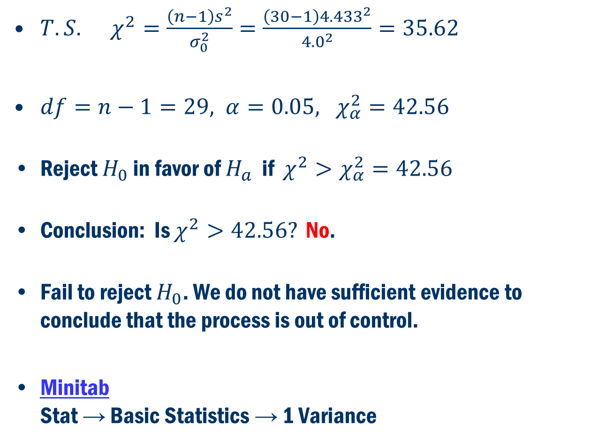
Example Cont’D
$T.S. χ^{2}=\frac{\left(n−1\right)s^{2}}{σ_{0}^{2}}=\frac{\left(30−1\right){4.433}^{2}}{{4.0}^{2}}=35.62$
$df=n−1=29, α=0.05, χ_{α}^{2}=42.56$
Reject $H_{0}$ in favor of $H_{a}$ if $χ^{2}>χ_{α}^{2}=42.56$
Conclusion: Is $χ^{2}>42.56?$ No.
Fail to reject $H_{0}$. We do not have sufficient evidence to conclude that the process is out of control.
Minitab Stat → Basic Statistics → 1 Variance

Slide 8
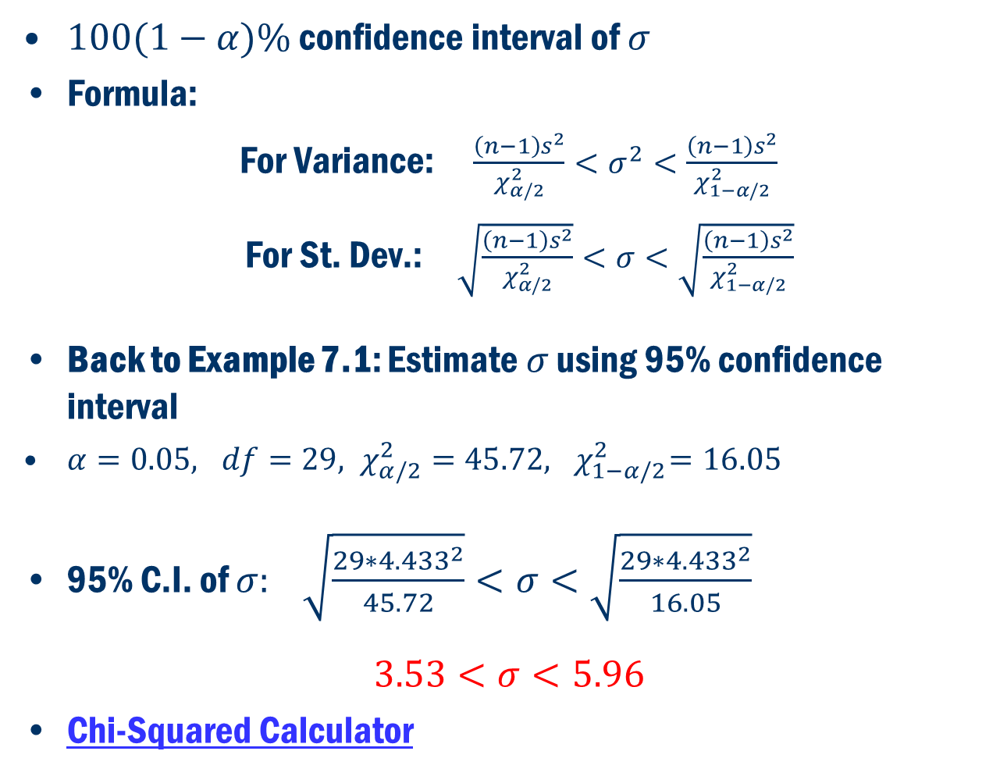
Confidence Interval
$100(1−α)\%$ confidence interval of $σ$
Formula:
For Variance: $\frac{\left(n−1\right)s^{2}}{χ_{α/2}^{2}}<σ^{2}<\frac{\left(n−1\right)s^{2}}{χ_{1−α/2}^{2}}$
For St. Dev.: $\sqrt{\frac{\left(n−1\right)s^{2}}{χ_{α/2}^{2}}}<σ<\sqrt{\frac{\left(n−1\right)s^{2}}{χ_{1−α/2}^{2}}}$
Back to Example 7.1: Estimate $σ$ using 95% confidence interval
$α=0.05, df=29, χ_{α/2}^{2}=45.72,{ χ}_{1−α/2}^{2}=16.05$
95% C.I. of $σ:$ $\sqrt{\frac{29∗{4.433}^{2}}{45.72}}<σ<\sqrt{\frac{29∗{4.433}^{2}}{16.05}}$
$$3.53<σ<5.96$$
Chi-Squared Calculator

Slide 9
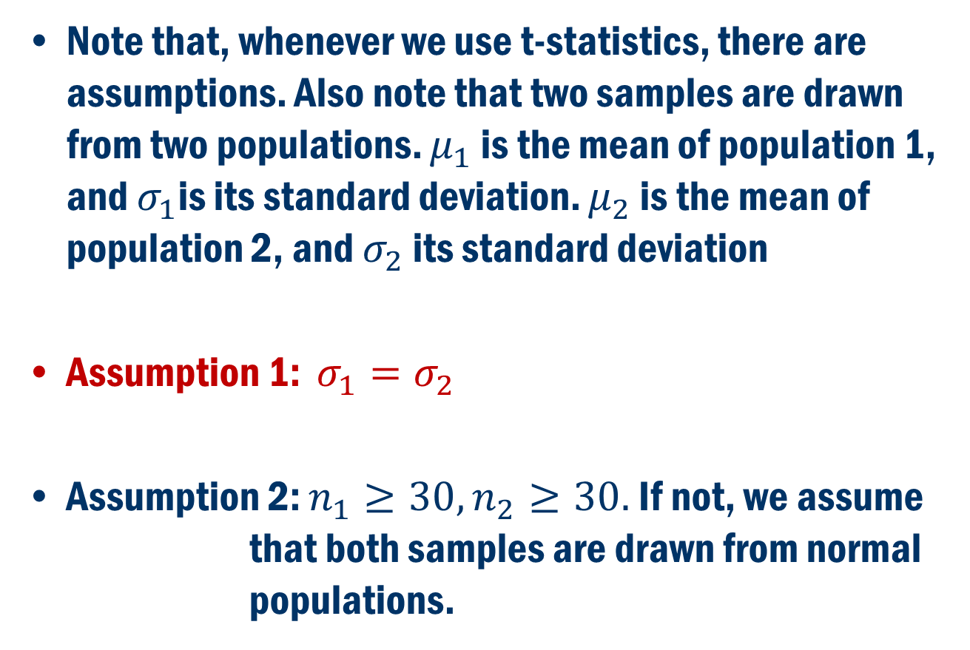
BACK to Pool T-Test Assumptions:
Note that, whenever we use t-statistics, there are assumptions. Also note that two samples are drawn from two populations. $μ_{1}$ is the mean of population 1, and $σ_{1}$is its standard deviation. $μ_{2}$ is the mean of population 2, and $σ_{2}$ its standard deviation
Assumption 1: $σ_{1}=σ_{2}$
Assumption 2: $n_{1}≥30, n_{2}≥30.$ If not, we assume that both samples are drawn from normal populations.

Slide 10
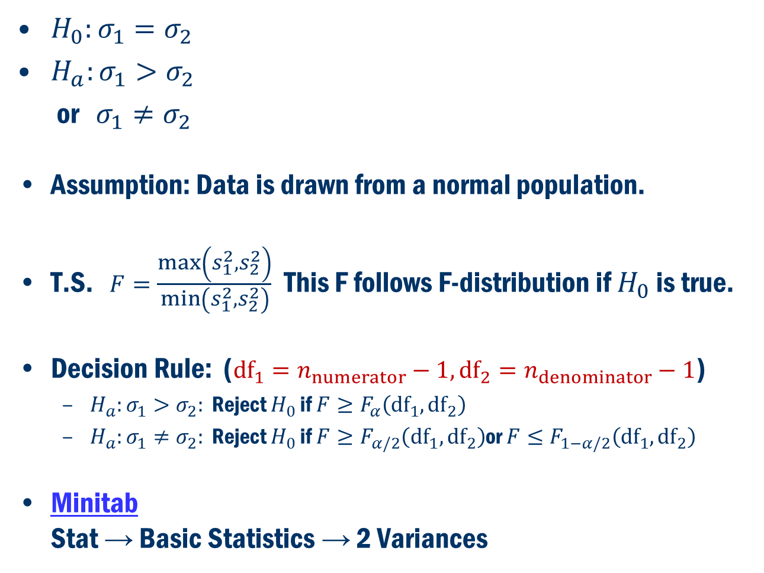
Inference about population standard deviation ($σ$)
$H_{0}:σ_{1}=σ_{2}$
$H_{a}:σ_{1}>σ_{2}$
or $σ_{1}≠σ_{2}$
Assumption: Data is drawn from a normal population.
T.S. $F=\frac{\max\left(s_{1}^{2}, s_{2}^{2}\right)}{\min\left(s_{1}^{2}, s_{2}^{2}\right)}$ This F follows F-distribution if $H_{0}$ is true.
Decision Rule: ($df_{1}=n_{numerator}−1, df_{2}=n_{denominator}−1$)
$H_{a}:σ_{1}>σ_{2}:$ Reject $H_{0}$ if $F≥F_{α}\left({df}_{1},{df}_{2}\right)$
$H_{a}:σ_{1}≠σ_{2}:$ Reject $H_{0}$ if $F≥F_{α/2}\left({df}_{1},{df}_{2}\right)$or $F≤F_{1−α/2}\left({df}_{1},{df}_{2}\right)$
Minitab Stat → Basic Statistics → 2 Variances

Slide 11
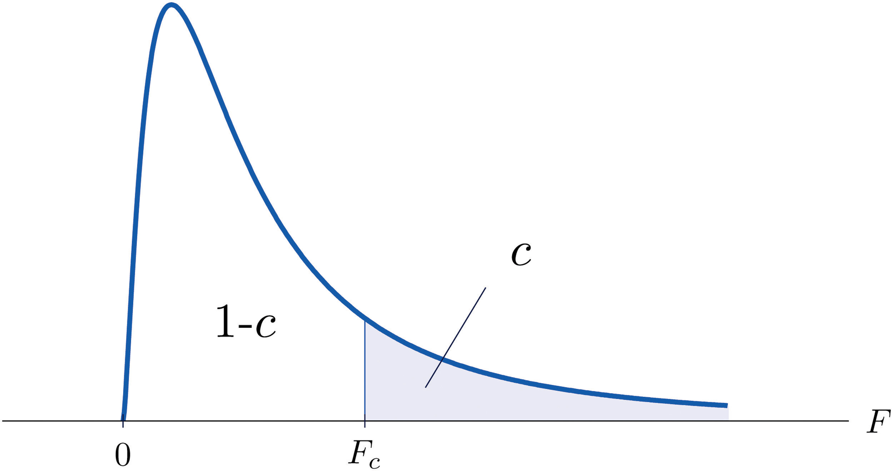
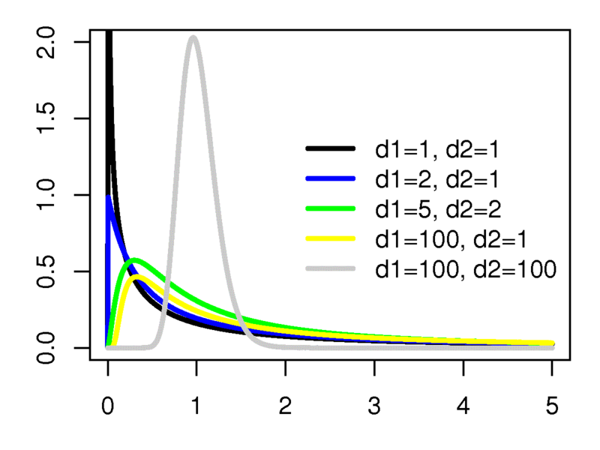
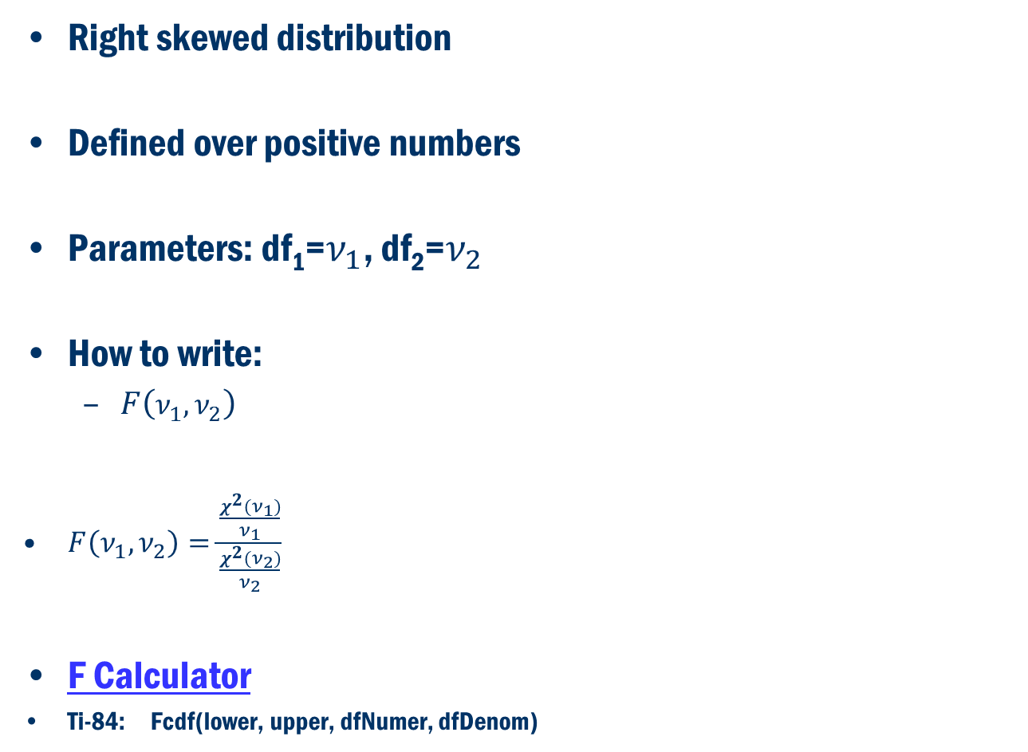
F Distribution
Right skewed distribution
Defined over positive numbers
Parameters: df₁=$ν_{1}$, df₂=$ν_{2}$
How to write:
$F\left(ν_{1},ν_{2}\right)$
$F\left(ν_{1},ν_{2}\right)=\frac{\frac{χ^{2}(ν_{1})}{ν_{1}}}{\frac{χ^{2}(ν_{2})}{ν_{2}}}$
F Calculator
Ti-84: Fcdf(lower, upper, dfNumer, dfDenom)
Source: Wikipedia

Slide 12
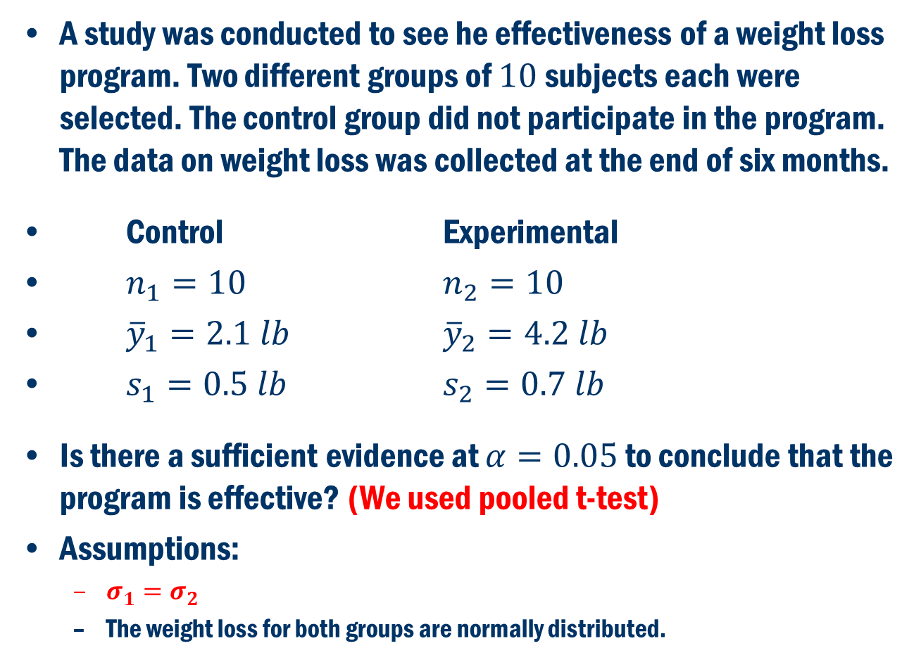
Back to the weight loss Example
A study was conducted to see he effectiveness of a weight loss program. Two different groups of $10$subjects each were selected. The control group did not participate in the program. The data on weight loss was collected at the end of six months.
Control Experimental
$n_{1}=10$ $n_{2}=10$
${\overline{y}}_{1}=2.1 lb$ ${\overline{y}}_{2}=4.2 lb$
$s_{1}=0.5 lb$ $s_{2}=0.7 lb$
Is there a sufficient evidence at $α=0.05$ to conclude that the program is effective? (We used pooled t-test)
Assumptions:
$σ_{1}=σ_{2}$
The weight loss for both groups are normally distributed.

Slide 13
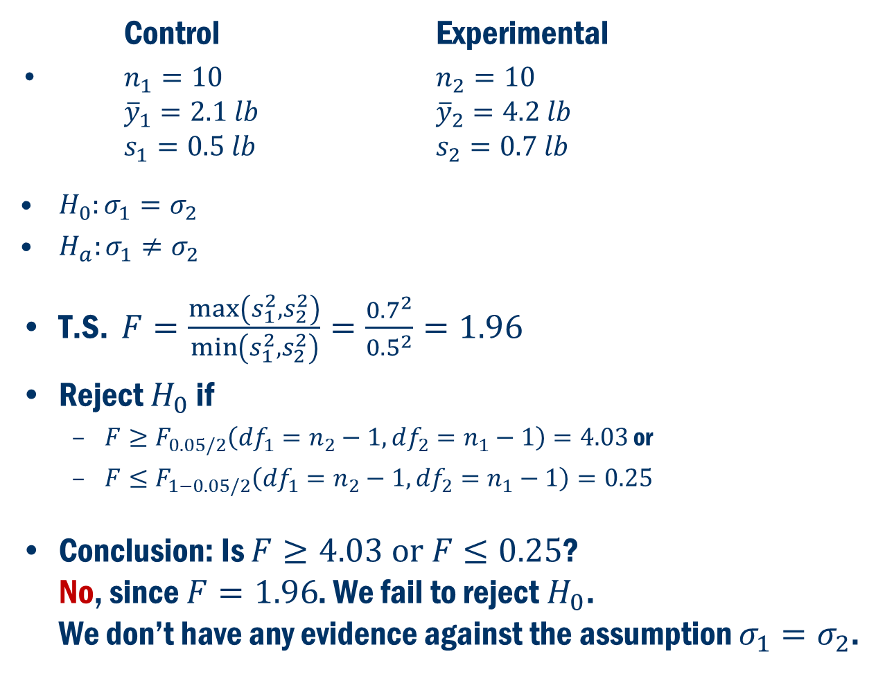
Back to the weight loss Example
Control Experimental
$n_{1}=10$ $n_{2}=10$ ${\overline{y}}_{1}=2.1 lb$ ${\overline{y}}_{2}=4.2 lb$ $s_{1}=0.5 lb$ $s_{2}=0.7 lb$
$H_{0}:σ_{1}=σ_{2}$
$H_{a}:σ_{1}≠σ_{2}$
$\text{T}\text{.}\text{S}\text{. }F=\frac{\max\left(s_{1}^{2}, s_{2}^{2}\right)}{\min\left(s_{1}^{2}, s_{2}^{2}\right)}=\frac{{0.7}^{2}}{{0.5}^{2}}=1.96$
Reject $H_{0}$ if
$F≥F_{0.05/2}\left(df_{1}=n_{2}−1, df_{2}=n_{1}−1\right)=4.03$ or
$F≤F_{1−0.05/2}\left(df_{1}=n_{2}−1, df_{2}=n_{1}−1\right)=0.25$
Conclusion: Is $F≥4.03 or F≤0.25$? No, since $F=1.96$. We fail to reject $H_{0}$. We don’t have any evidence against the assumption $σ_{1}=σ_{2}$.

Slide 14
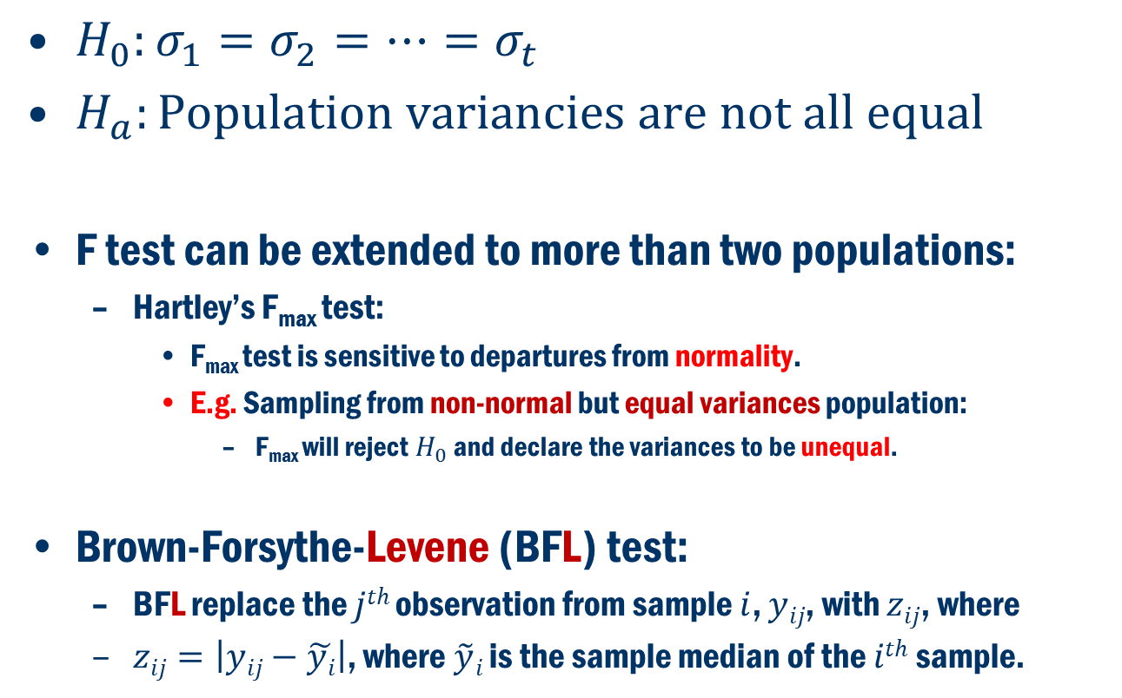
Test for Comparing variances for More than two Populations
$H_{0}:σ_{1}=σ_{2}=⋯=σ_{t}$
$H_{a}:Population variancies are not all equal$
F test can be extended to more than two populations:
Hartley’s F_{max} test:
F_{max} test is sensitive to departures from normality.
E.g. Sampling from non-normal but equal variances population:
F_{max} will reject $H_{0}$ and declare the variances to be unequal.
Brown-Forsythe-Levene (BFL) test:
BFL replace the $jth$observation from sample $i$, $yij$, with $zij$, where
$zij=\left|yij−\tilde{yi}\right|$, where $\tilde{y}i$ is the sample median of the $ith$sample.

Slide 15
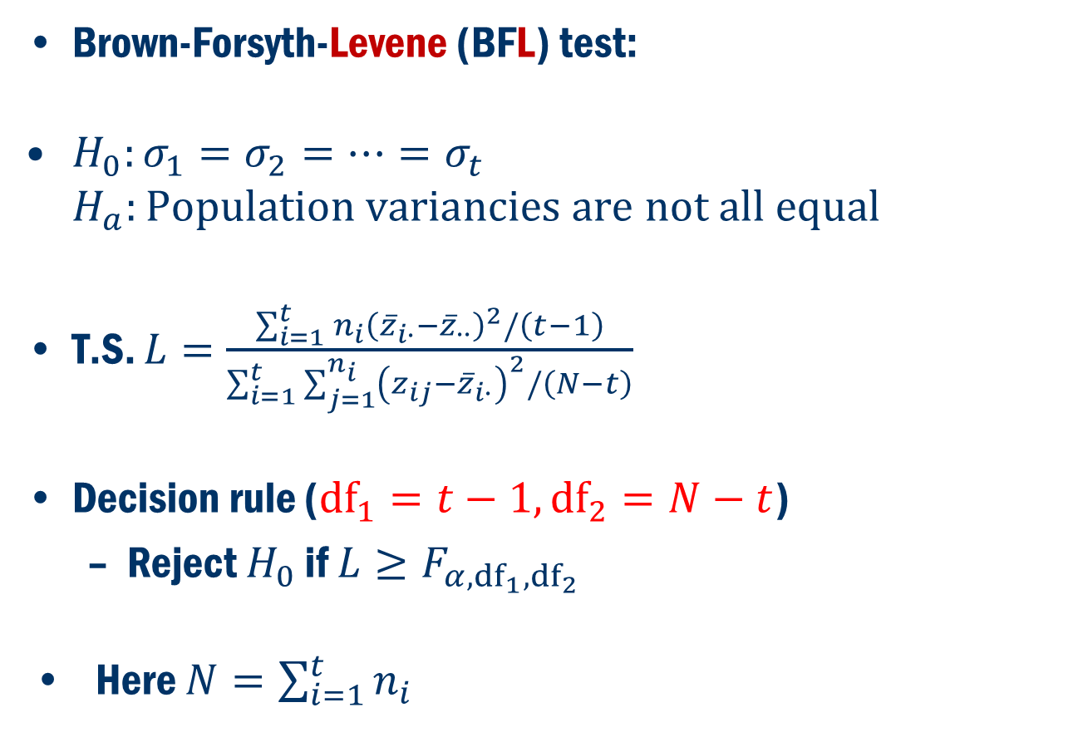
variances for More than two Populations (Cont’d)
Brown-Forsyth-Levene (BFL) test:
$H_{0}:σ_{1}=σ_{2}=⋯=σ_{t}$ $H_{a}:Population variancies are not all equal$
T.S. $L=\frac{\sum_{i=1}^{t}{n_{i}{\left({\overline{z}}_{i∙}−{\overline{z}}_{∙∙}\right)}^{2}/\left(t−1\right)}}{\sum_{i=1}^{t}{\sum_{j=1}^{n_{i}}{{\left(z_{ij}−{\overline{z}}_{i∙}\right)}^{2}/\left(N−t\right)}}}$
Decision rule (${df}_{1}=t−1,{df}_{2}=N−t$)
Reject $H_{0}$ if $L≥F_{α,{df}_{1},{df}_{2}}$
Here $N=\sum_{i=1}^{t}{n_{i}}$

Slide 16
Book Exapmle 7.9:
Three different additives that are marketed for increasing the miles per gallon (mpg) for automobiles
The percentage increase in mpg was recorded for a 250-mile test drive for each additive for 10 randomly assigned cars.
Is there a difference between the three additive with respect to their variability?
Minitab Stat → ANOVA → Test for Equal Variances

Slide 17
Normal Probability plots
Additive 1 and 2 do not appear to be normal
Avoid Hartley’s F_{max} test
Use Brown-Forsythe-Levene (BFL) test

Slide 18
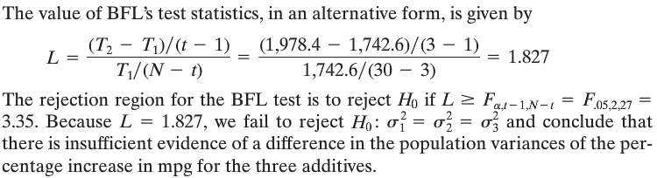
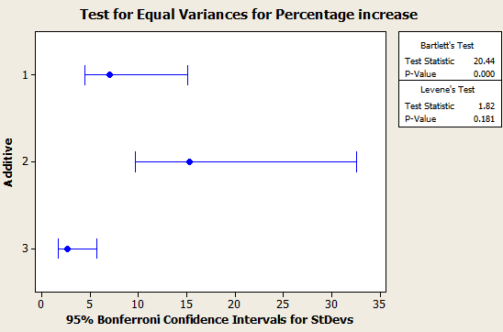
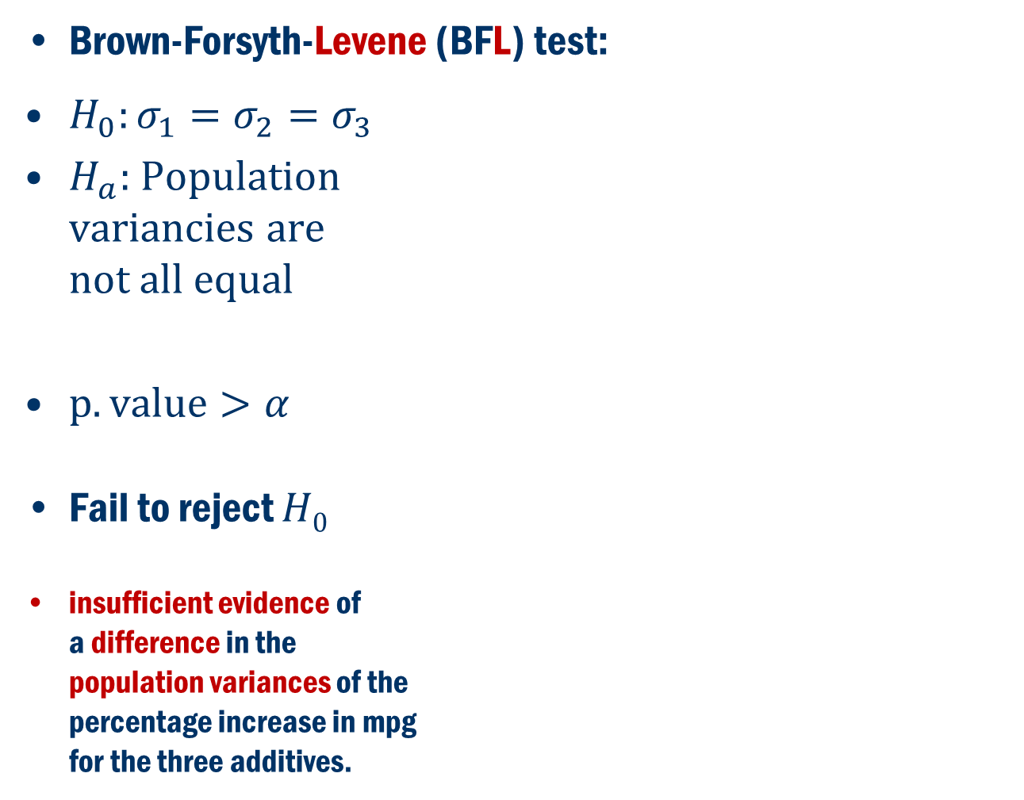
Book Exapmle 7.9 (Cont’D)
Brown-Forsyth-Levene (BFL) test:
$H_{0}:σ_{1}=σ_{2}=σ_{3}$
$H_{a}:$ Population variancies are not all equal
$p.value>α$
Fail to reject $H0$
insufficient evidence of a difference in the population variances of the percentage increase in mpg for the three additives.

