Slide 1
Chapter 8 (Part A)

Slide 2
Analysis of Variance (ANOVA)
ANOVA is one of the most popular statistical tools of analyzing data.
Does Y (the response) depends on any of the factors?
Factor 1
Y
Factor 2
A Response Variable
Factor 3

Slide 3
ANOVA Examples
Example 1: You are doing a research on mpg (miles per gallon) for a brand of automobiles.
Question: What effects mpg?
Does Y (the response) depends on any of the factors?
Driving where? City / Hwy
mpg
Level: Midsize/ SUV/ Pickup
Number of Cylinders:
V4/ V6/ V8/ V10/ …

Slide 4
ANOVA Examplesle
Example 2: (Australian Institute of Sport)
Research Question: Does body weight (Wt) depend on
Sport
Gender
Minitab
Sport
Weight
Gender

Slide 5
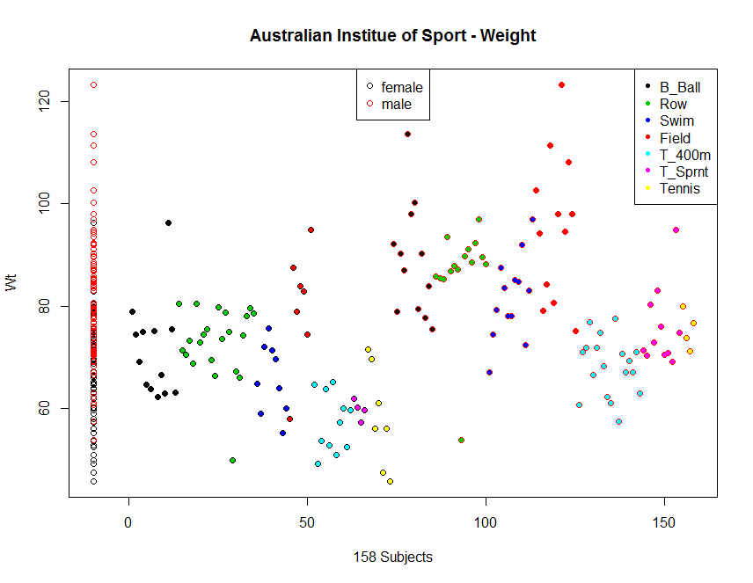
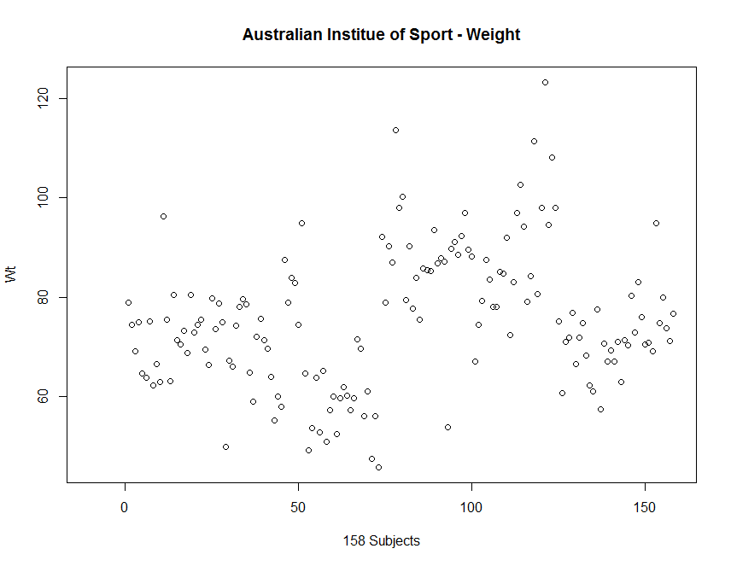
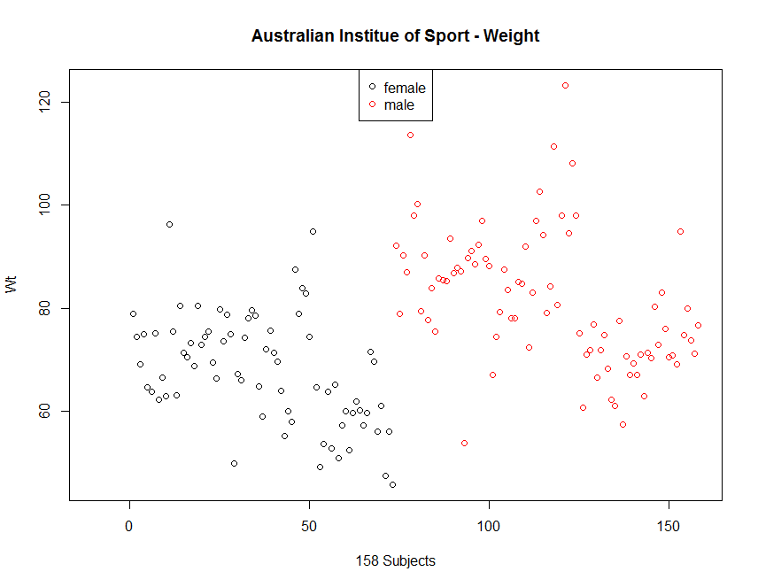
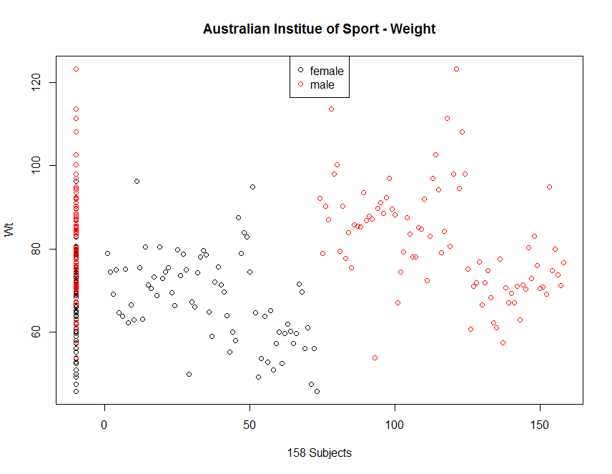
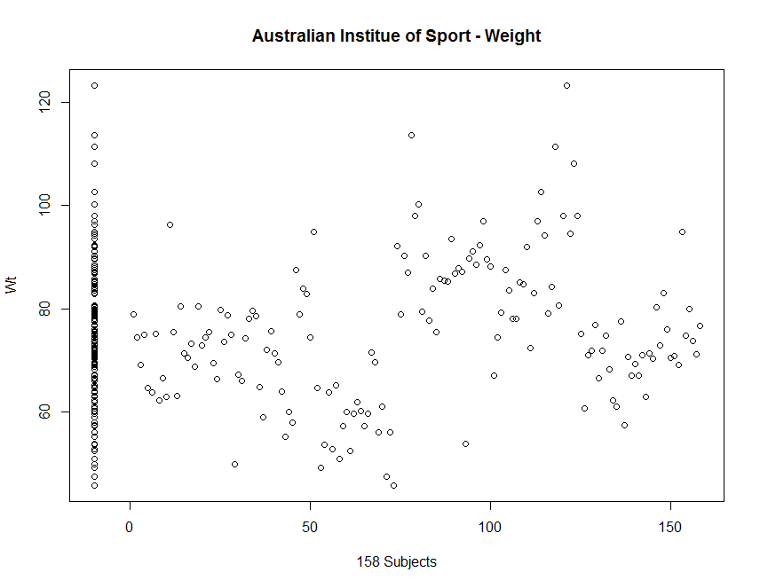
Example Cont’D
The variation in Weight
some is due to Gender
and some is due to Sport

Slide 6
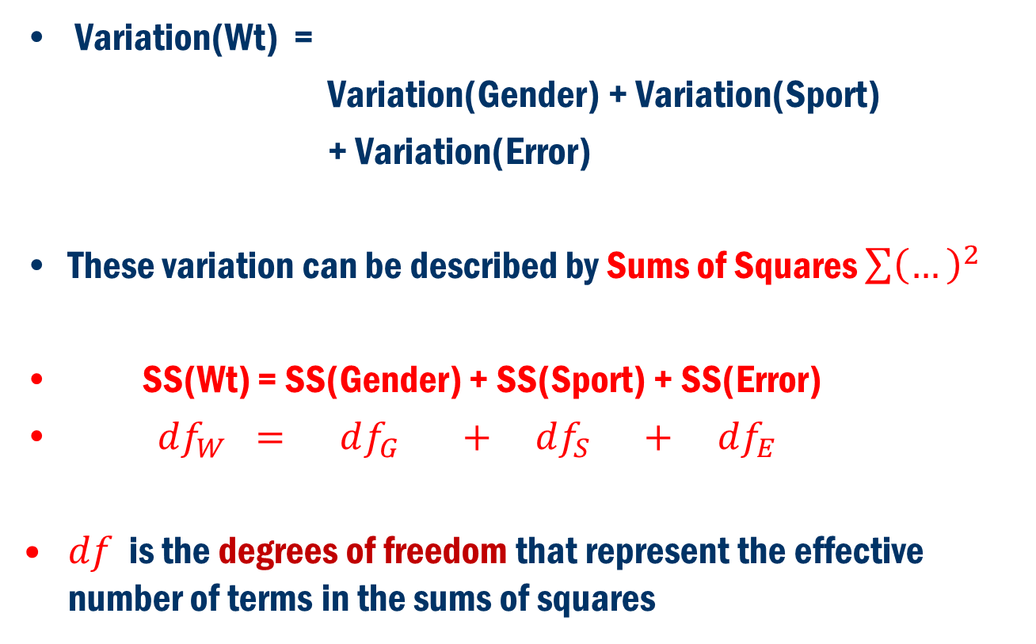
Concept
Variation(Wt) =
Variation(Gender) + Variation(Sport)
+ Variation(Error)
These variation can be described by Sums of Squares $\sum{{\left(…\right)}^{2}}$
SS(Wt) = SS(Gender) + SS(Sport) + SS(Error)
$df_{W} = df_{G} + df_{S} + df_{E}$
$df$ is the degrees of freedom that represent the effective number of terms in the sums of squares

Slide 7
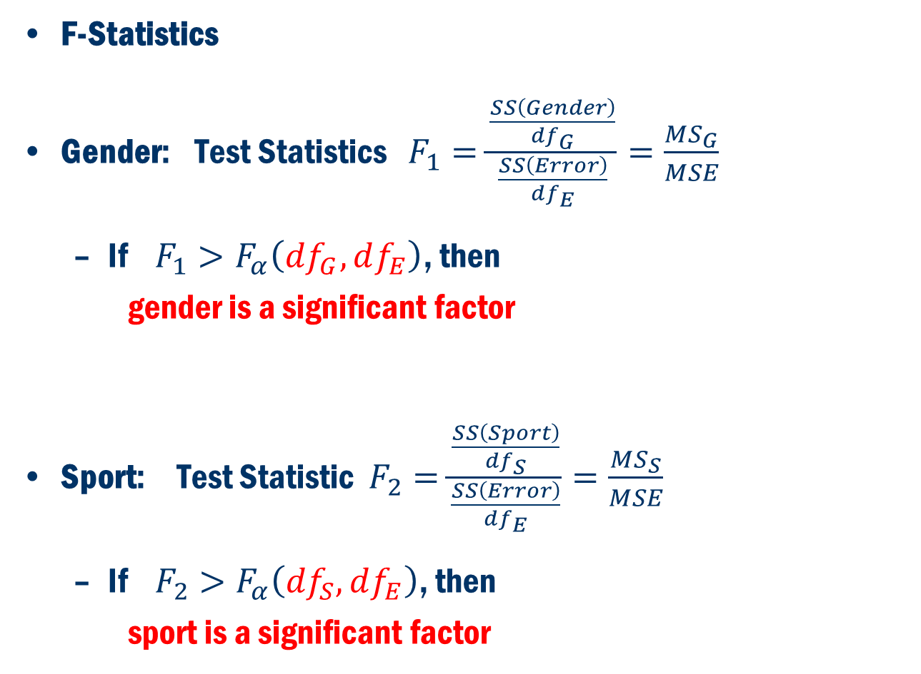
Test Statistics
F-Statistics
Gender: Test Statistics $F_{1}=\frac{\frac{SS\left(Gender\right)}{df_{G}}}{\frac{SS\left(Error\right)}{df_{E}}}=\frac{MS_{G}}{MSE}$
If $F_{1}>F_{α}\left(df_{G},df_{E}\right)$, then
gender is a significant factor
Sport: Test Statistic $F_{2}=\frac{\frac{SS\left(Sport\right)}{df_{S}}}{\frac{SS\left(Error\right)}{df_{E}}}=\frac{MS_{S}}{MSE}$
If $F_{2}>F_{α}\left(df_{S},df_{E}\right)$, then
sport is a significant factor

Slide 8
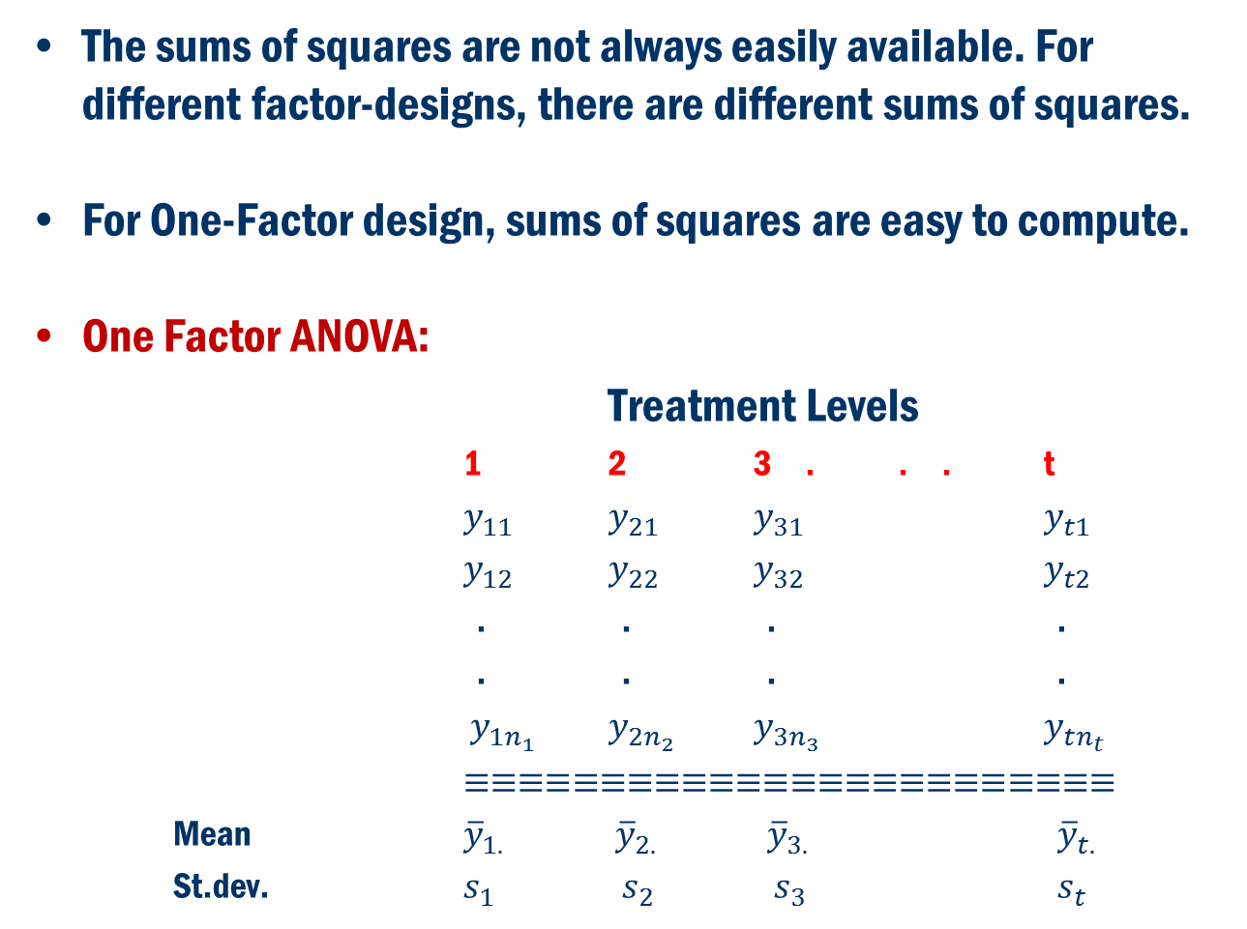
Back to Concept
The sums of squares are not always easily available. For different factor-designs, there are different sums of squares.
For One-Factor design, sums of squares are easy to compute.
One Factor ANOVA:
Treatment Levels
1 2 3 . . . t
$y_{11}$ $y_{21}$ $y_{31}$ $y_{t1}$
$y_{12}$ $y_{22}$ $y_{32}$ $y_{t2}$
. . . .
. . . .
$y_{1n_{1}}$ $y_{2n_{2}}$ $y_{3n_{3}}$ $y_{tn_{t}}$
$≡≡≡≡≡≡≡≡≡≡≡≡≡≡≡≡≡≡≡≡≡≡≡≡$
Mean ${\overline{y}}_{1.}$ ${\overline{y}}_{2.}$ ${\overline{y}}_{3.}$ ${\overline{y}}_{t.}$
St.dev. $s_{1}$ $s_{2}$ $s_{3}$ $s_{t}$

Slide 9
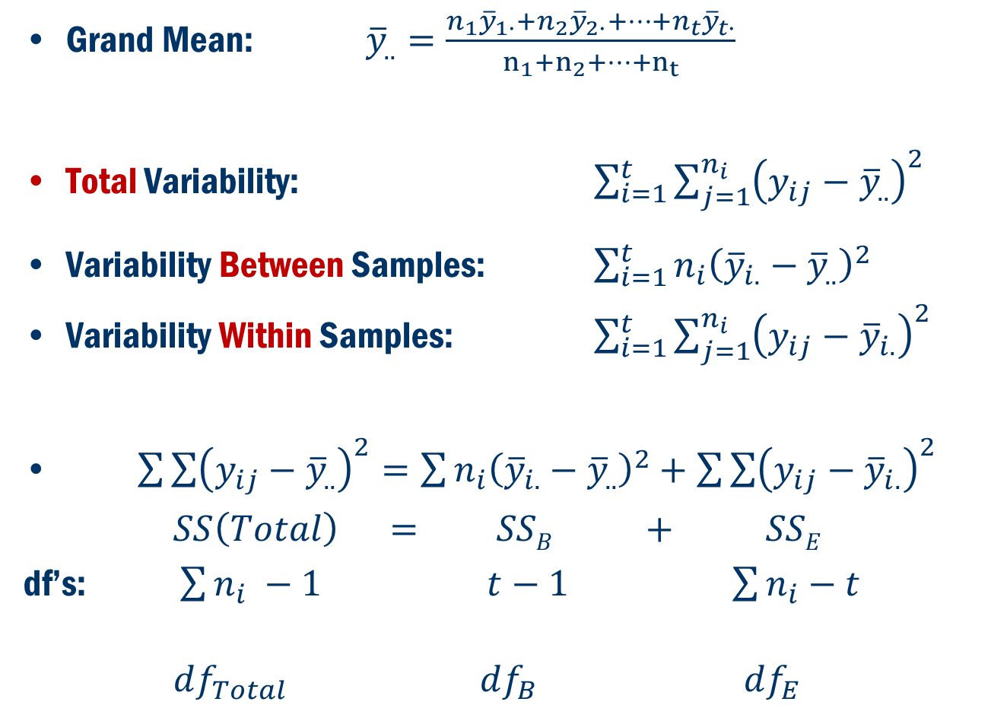
Back To Concept
Grand Mean: ${\overline{y}}_{..}=\frac{n_{1}{\overline{y}}_{1∙}+n_{2}{\overline{y}}_{2∙}+…+n_{t}{\overline{y}}_{t∙}}{n_{1}+n_{2}+…+n_{t}}$
Total Variability: $\sum_{i=1}^{t}{\sum_{j=1}^{n_{i}}{{\left(y_{ij}−{\overline{y}}_{..}\right)}^{2}}}$
Variability Between Samples: $\sum_{i=1}^{t}{n_{i}{\left({\overline{y}}_{i.}−{\overline{y}}_{..}\right)}^{2} }$
Variability Within Samples: $\sum_{i=1}^{t}{\sum_{j=1}^{n_{i}}{{\left(y_{ij}−{\overline{y}}_{i.}\right)}^{2}}}$
$\sum{\sum{{\left(y_{ij}−{\overline{y}}_{..}\right)}^{2}=\sum{n_{i}{\left({\overline{y}}_{i.}−{\overline{y}}_{..}\right)}^{2}+\sum{\sum{{\left(y_{ij}−{\overline{y}}_{i.}\right)}^{2}}}}}}$
$SS\left(Total\right) = SSB + SSE$
df’s: $\sum{n_{i}} −1$ $t−1$ $\sum{n_{i}}−t$
$df_{Total}$ $df_{B}$ $df_{E}$

Slide 10
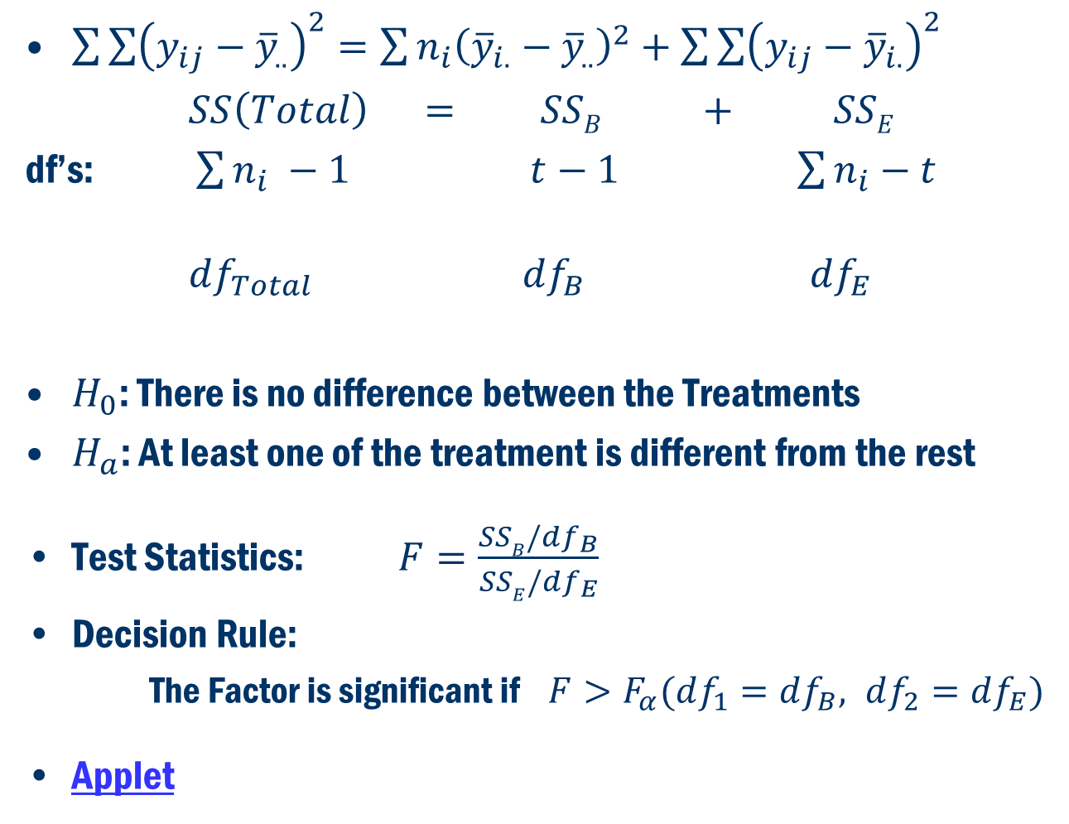
Back to Concept
$\sum{\sum{{\left(y_{ij}−{\overline{y}}_{..}\right)}^{2}=\sum{n_{i}{\left({\overline{y}}_{i.}−{\overline{y}}_{..}\right)}^{2}+\sum{\sum{{\left(y_{ij}−{\overline{y}}_{i.}\right)}^{2}}}}}}$
$SS\left(Total\right) = SSB + SSE$
df’s: $\sum{n_{i}} −1$ $t−1$ $\sum{n_{i}}−t$
$df_{Total}$ $df_{B}$ $df_{E}$
$H_{0}$: There is no difference between the Treatments
$H_{a}$: At least one of the treatment is different from the rest
Test Statistics: $F=\frac{SSB/df_{B}}{SSE/df_{E}}$
Decision Rule:
The Factor is significant if $F>F_{α}(df_{1}=df_{B}, df_{2}=df_{E})$
Applet

Slide 11
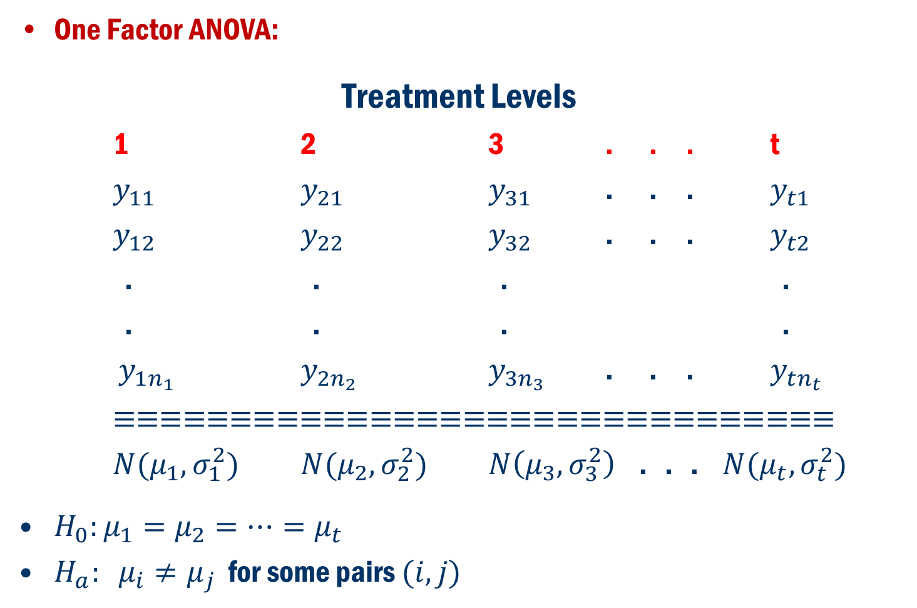
Formulation in terms of Hypothesis Problem
One Factor ANOVA:
Treatment Levels
1 2 3 . . . t
$y_{11}$ $y_{21}$ $y_{31}$ . . . $y_{t1}$
$y_{12}$ $y_{22}$ $y_{32}$ . . . $y_{t2}$
. . . .
. . . .
$y_{1n_{1}}$ $y_{2n_{2}}$ $y_{3n_{3}}$ . . . $y_{tn_{t}}$
$≡≡≡≡≡≡≡≡≡≡≡≡≡≡≡≡≡≡≡≡≡≡≡≡≡≡≡≡≡≡≡$
$N(μ_{1},σ_{1}^{2})$ $N(μ_{2},σ_{2}^{2})$ $N\left(μ_{3},σ_{3}^{2}\right)$ . . . $N(μ_{t},σ_{t}^{2})$
$H_{0}:μ_{1}=μ_{2}=…=μ_{t}$
$H_{a}: μ_{i}≠μ_{j}$ for some pairs $(i, j)$

Slide 12
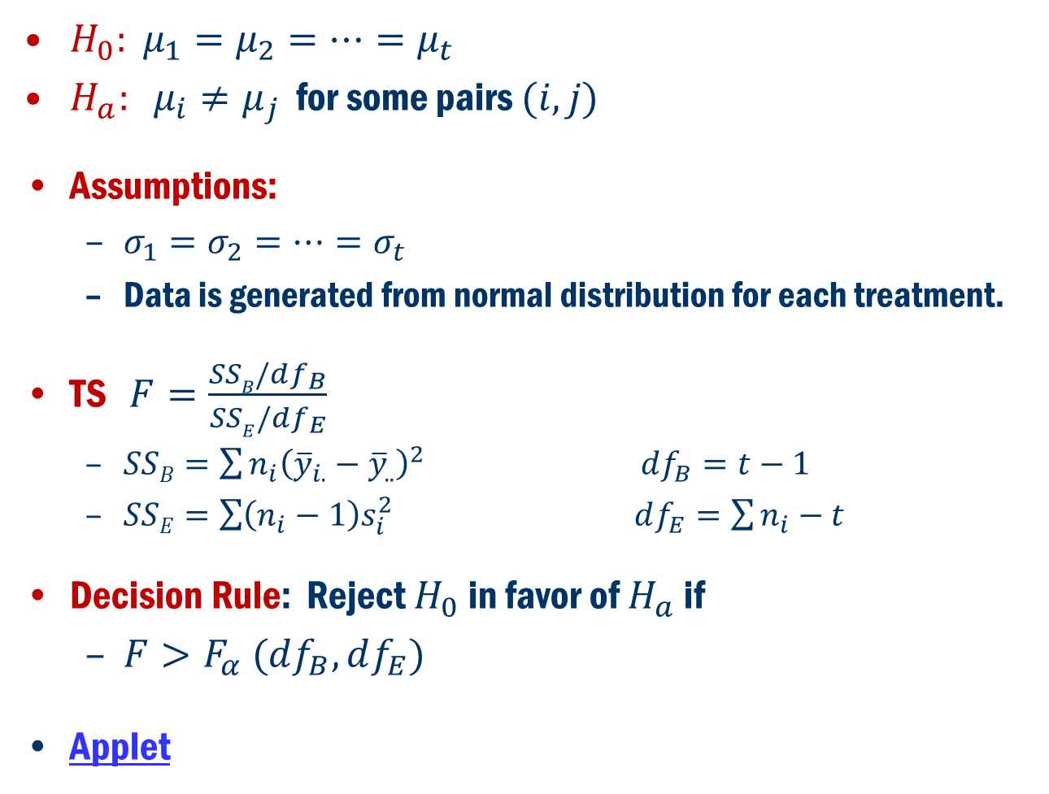
Formulation in terms of Hypothesis Problem Cont’D
$H_{0}: μ_{1}=μ_{2}=…=μ_{t}$
$H_{a}: μ_{i}≠μ_{j}$ for some pairs $(i, j)$
Assumptions:
$σ_{1}=σ_{2}=…=σ_{t}$
Data is generated from normal distribution for each treatment.
TS $F=\frac{SSB/df_{B}}{SSE/{df}_{E}}$
$SSB=\sum{n_{i}{\left({\overline{y}}_{i.}−{\overline{y}}_{..}\right)}^{2}}$ $df_{B}=t−1$
$SSE=\sum{\left(n_{i}−1\right)s_{i}^{2}}$ $df_{E}=\sum{n_{i}}−t$
Decision Rule: Reject $H_{0}$ in favor of $H_{a}$ if
$F>F_{α} (df_{B}, df_{E})$
Applet

Slide 13
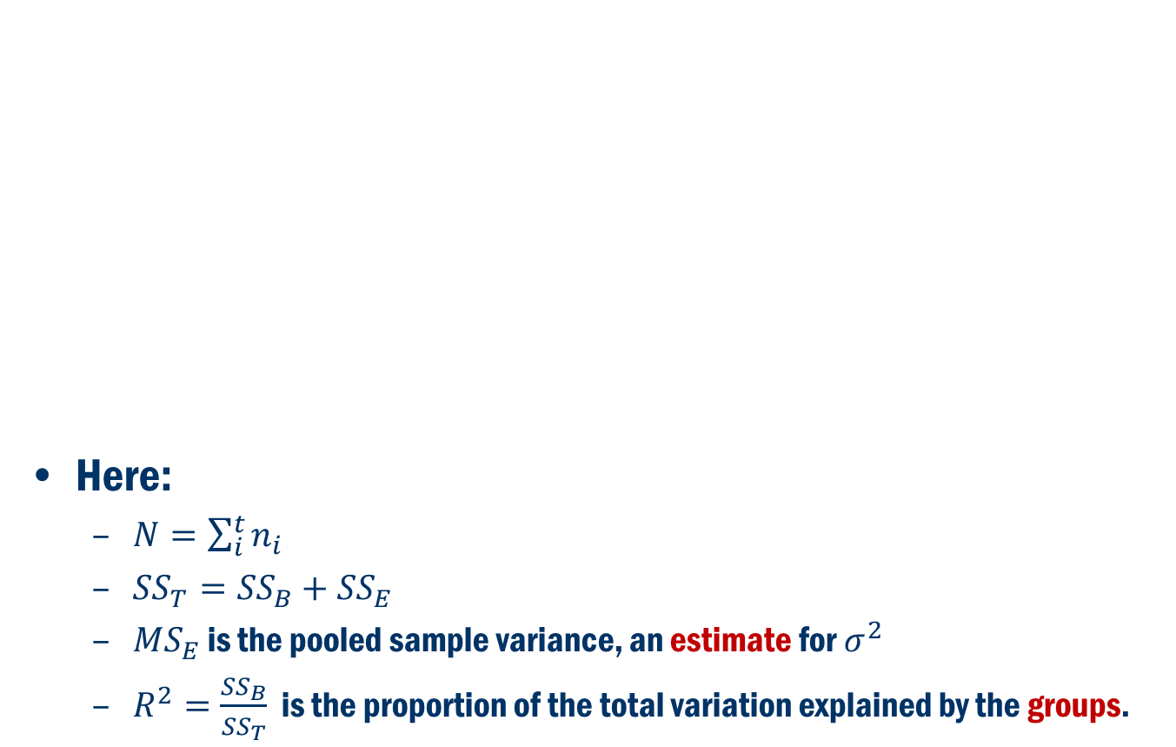
Anova Table
Source of Variation | df | Sum of Squares | Mean Square | F | p-value
Group (Between) | t – 1
Error (Within) | N – t
Total | N – 1
Here:
$N=\sum_{i}^{t}{n_{i}}$
${SS}_{T}={SS}_{B}+{SS}_{E}$
${MS}_{E}$ is the pooled sample variance, an estimate for $σ^{2}$
$R^{2}=\frac{{SS}_{B}}{{SS}_{T}}$ is the proportion of the total variation explained by the groups.

Slide 14
Book Example 8.1
A hypothesis is that a nutrient “Isoflavones” varies among three types of food items: (1) Cereals and snacks, (2) energy bars, and (3) veggie burgers. A sample of five each is taken and the amount of isoflavones is measured.

Slide 15
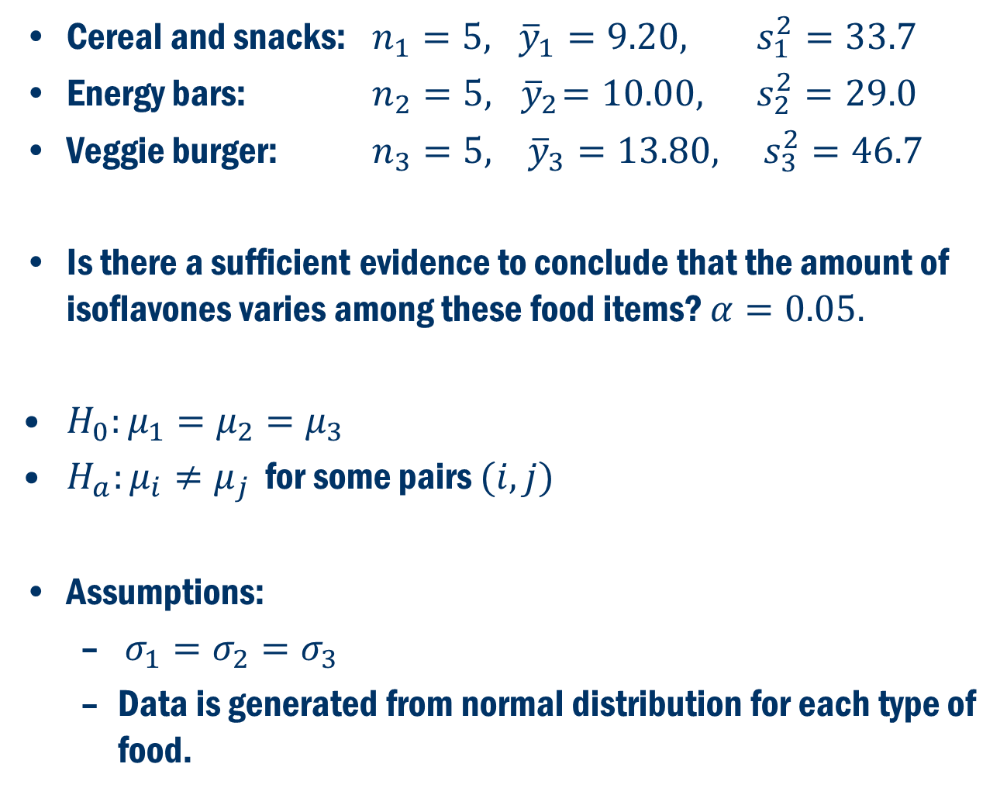
Example 8.1 Cont’D
Cereal and snacks: $n_{1}=5, {\overline{y}}_{1}=9.20, s_{1}^{2}=33.7$
Energy bars: $n_{2}=5, { \overline{y}}_{2}=10.00, s_{2}^{2}=29.0$
Veggie burger: $n_{3}=5, {\overline{y}}_{3}=13.80, s_{3}^{2}=46.7$
Is there a sufficient evidence to conclude that the amount of isoflavones varies among these food items? $α=0.05.$
$H_{0}:μ_{1}=μ_{2}=μ_{3}$
$H_{a}:μ_{i}≠μ_{j}$ for some pairs $(i,j)$
Assumptions:
$σ_{1}=σ_{2}=σ_{3}$
Data is generated from normal distribution for each type of food.

Slide 16
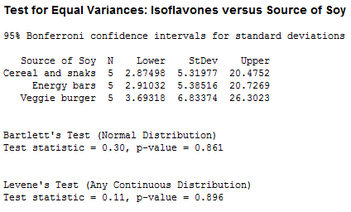
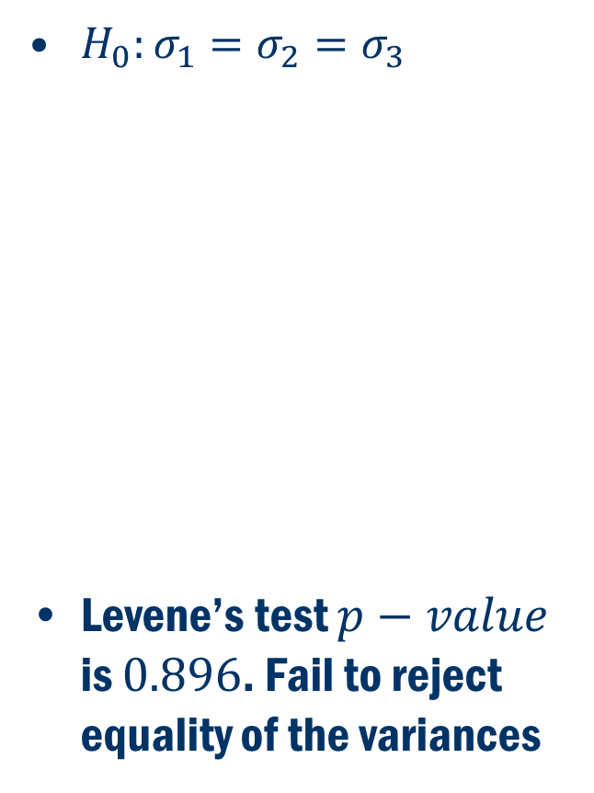
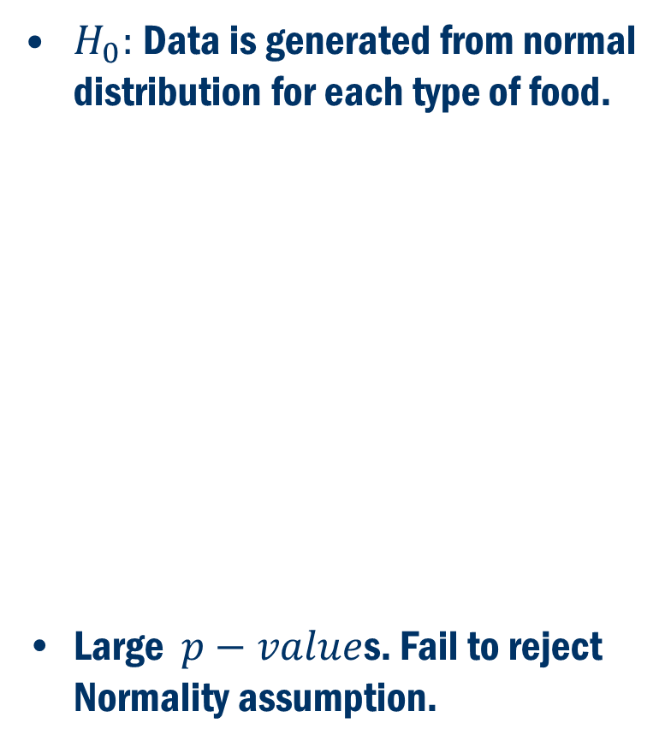
Example 8.1 Assumptions
$H_{0}:σ_{1}=σ_{2}=σ_{3}$
Levene’s test $p−value$ is $0.896$. Fail to reject equality of the variances
$H_{0}:$Data is generated from normal distribution for each type of food.
Large $p−value$s. Fail to reject Normality assumption.

Slide 17
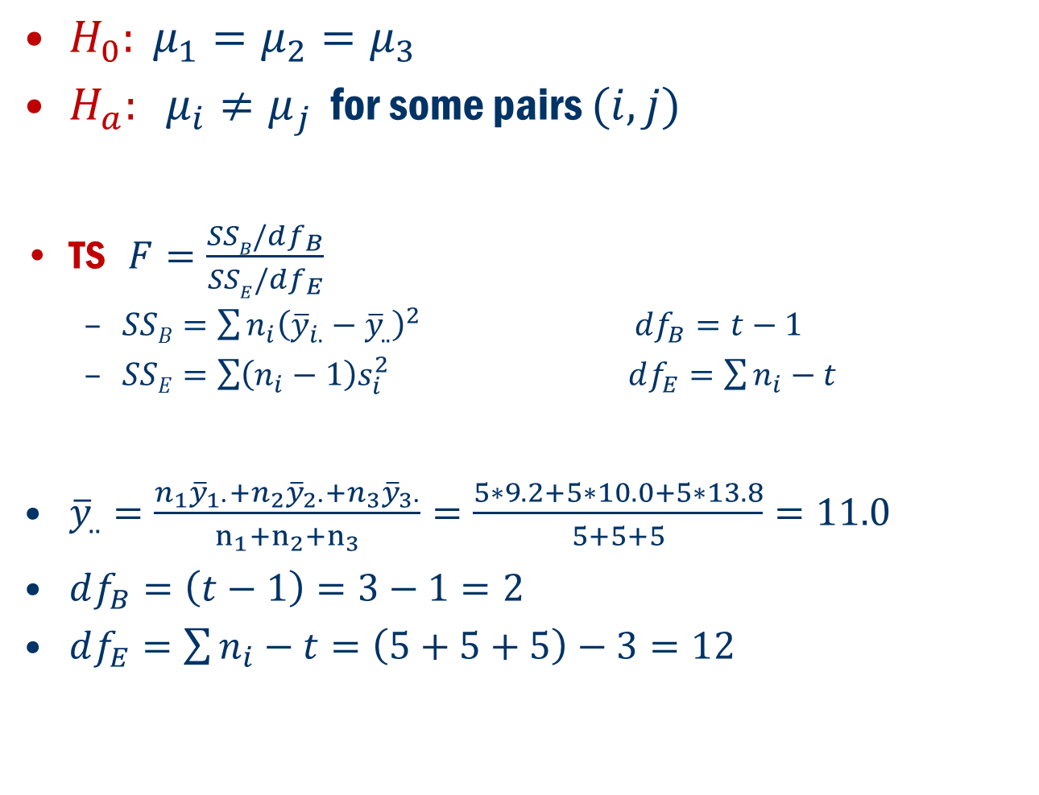
Example 8.1 Cont’D
$H_{0}: μ_{1}=μ_{2}=μ_{3}$
$H_{a}: μ_{i}≠μ_{j}$ for some pairs $(i, j)$
TS $F=\frac{SSB/df_{B}}{SSE/{df}_{E}}$
$SSB=\sum{n_{i}{\left({\overline{y}}_{i.}−{\overline{y}}_{..}\right)}^{2}}$ $df_{B}=t−1$
$SSE=\sum{\left(n_{i}−1\right)s_{i}^{2}}$ $df_{E}=\sum{n_{i}}−t$
${\overline{y}}_{..}=\frac{n_{1}{\overline{y}}_{1∙}+n_{2}{\overline{y}}_{2∙}+n_{3}{\overline{y}}_{3∙}}{n_{1}+n_{2}+n_{3}}=\frac{5∗9.2+5∗10.0+5∗13.8}{5+5+5}=11.0$
$df_{B}=\left(t−1\right)=3−1=2$
$df_{E}=\sum{n_{i}}−t=\left(5+5+5\right)−3=12$

Slide 18
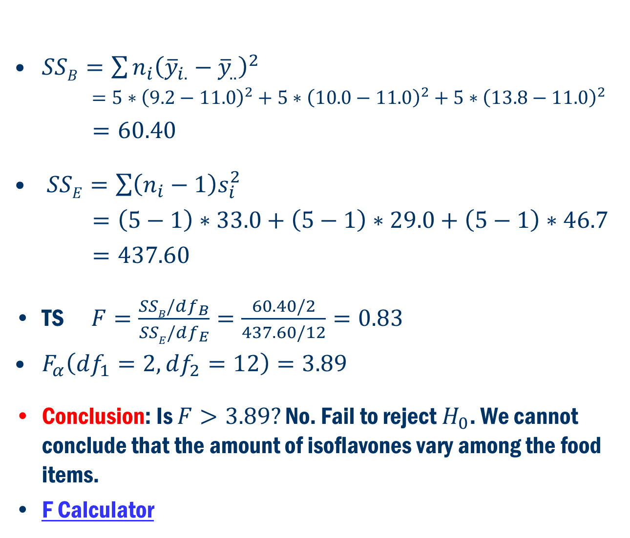
Example 8.1 Cont’D
$SSB=\sum{n_{i}{\left({\overline{y}}_{i.}−{\overline{y}}_{..}\right)}^{2}}$
$=5∗{\left(9.2−11.0\right)}^{2}+5∗{\left(10.0−11.0\right)}^{2}+5∗{\left(13.8−11.0\right)}^{2}$
$=60.40$
$SSE=\sum{\left(n_{i}−1\right)s_{i}^{2}}$
$=\left(5−1\right)∗33.0+\left(5−1\right)∗29.0+\left(5−1\right)∗46.7$
$=437.60$
TS $F=\frac{SSB/df_{B}}{SSE/df_{E}}=\frac{60.40/2}{437.60/12}=0.83$
$F_{α}\left(df_{1}=2, df_{2}=12\right)=3.89$
Conclusion: Is $F>3.89?$ No. Fail to reject $H_{0}$. We cannot conclude that the amount of isoflavones vary among the food items.
F Calculator

Slide 19
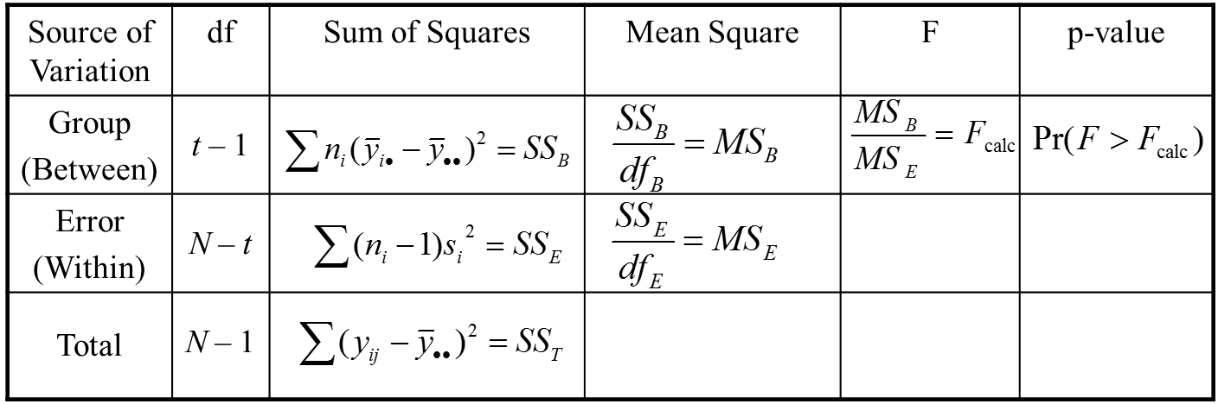
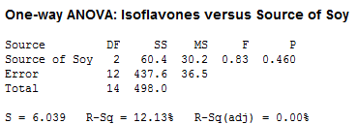
Example 8.1 Anova table
Minitab
Stat → ANOVA → One-Way

Slide 20
Book Example 8.2
A clinical psychologist compares three methods for reducing the hospitality levels in university students. HLT score is used to measure the degree of hospitality. Randomly they assigned 8 students to method 1, 7 students to method 2 and 9 students to method 3. Each student was given HLT test at the end of semester

Slide 21
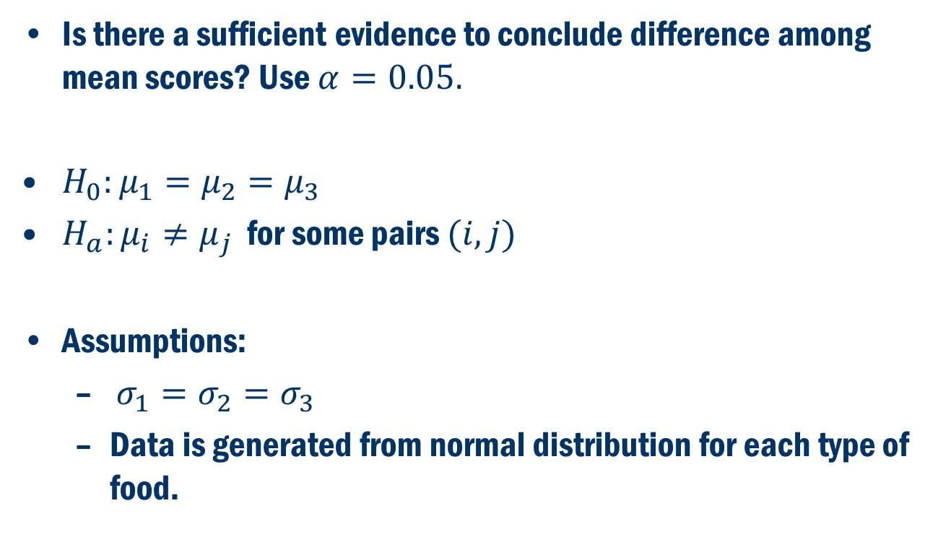
Example 8.2 Cont’D
Is there a sufficient evidence to conclude difference among mean scores? Use $α=0.05.$
$H_{0}:μ_{1}=μ_{2}=μ_{3}$
$H_{a}:μ_{i}≠μ_{j}$ for some pairs $(i,j)$
Assumptions:
$σ_{1}=σ_{2}=σ_{3}$
Data is generated from normal distribution for each type of food.

Slide 22
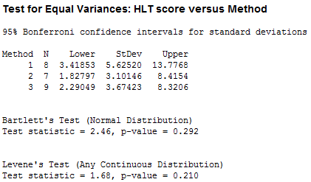

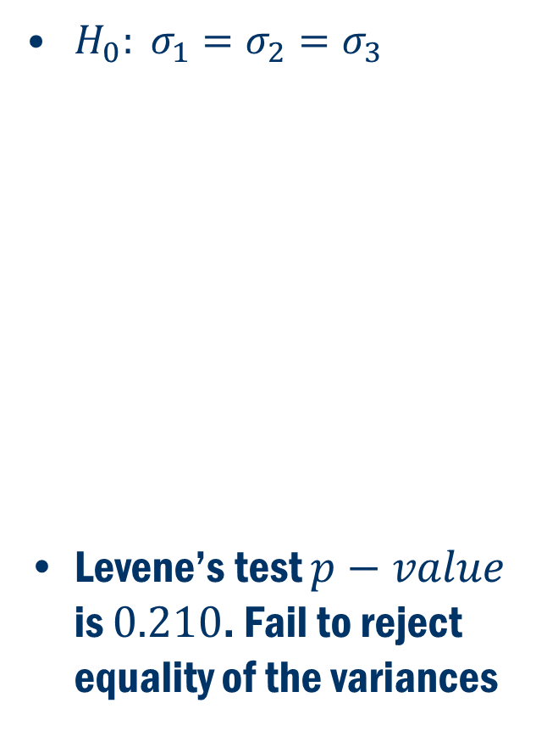
Example 8.2 Assumptions
$H_{0}: σ_{1}=σ_{2}=σ_{3}$
Levene’s test $p−value$ is $0.210$. Fail to reject equality of the variances
$H_{0}:$Data is generated from normal distribution for each type of food.
Large $p−value$s. Fail to reject Normality assumption.

Slide 23
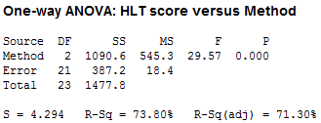
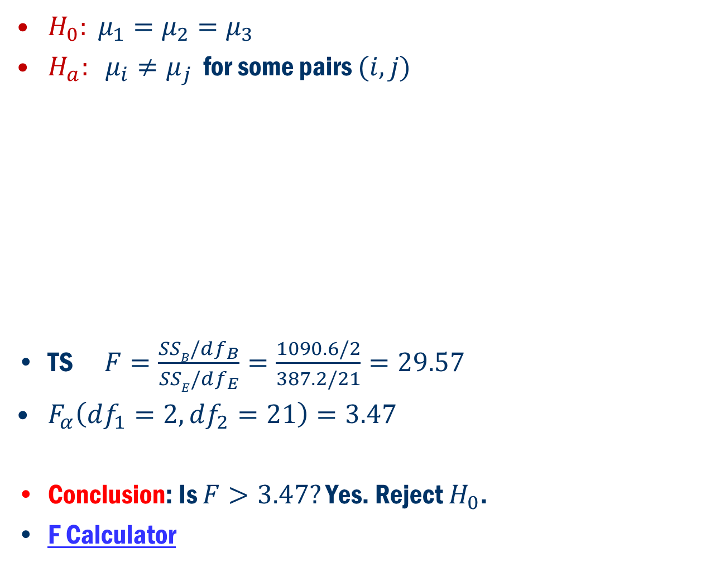
Example 8.2 Cont’D
$H_{0}: μ_{1}=μ_{2}=μ_{3}$
$H_{a}: μ_{i}≠μ_{j}$ for some pairs $(i, j)$
TS $F=\frac{SSB/df_{B}}{SSE/df_{E}}=\frac{1090.6/2}{387.2/21}=29.57$
$F_{α}\left(df_{1}=2, df_{2}=21\right)=3.47$
Conclusion: Is $F>3.47?$ Yes. Reject $H_{0}$.
F Calculator

Slide 24
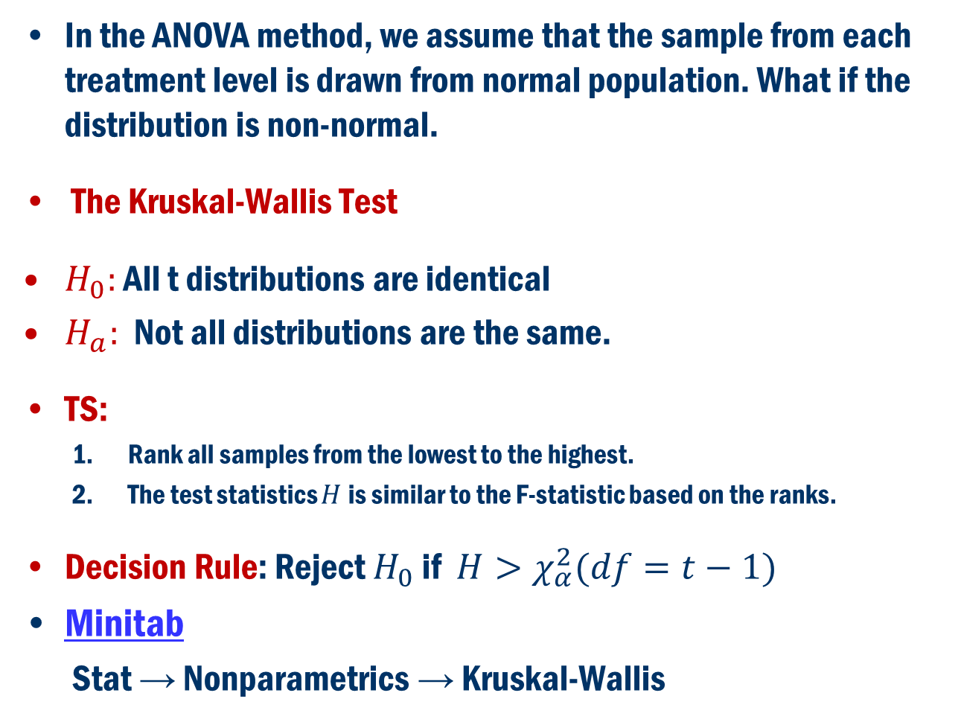
Normality Assumption Fails Non-Parametric Method
In the ANOVA method, we assume that the sample from each treatment level is drawn from normal population. What if the distribution is non-normal.
The Kruskal-Wallis Test
$H_{0}:$ All t distributions are identical
$H_{a}:$ Not all distributions are the same.
TS:
Rank all samples from the lowest to the highest.
The test statistics $H$is similar to the F-statistic based on the ranks.
Decision Rule: Reject $H_{0}$ if $H>χ_{α}^{2}(df=t−1)$
Minitab
Stat → Nonparametrics → Kruskal-Wallis

Slide 25
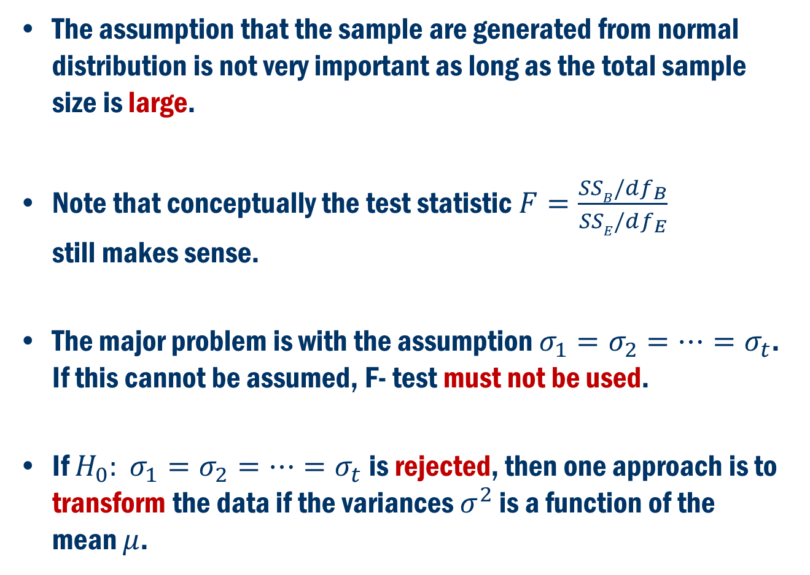
What if Equality of the Variances FAIL?
The assumption that the sample are generated from normal distribution is not very important as long as the total sample size is large.
Note that conceptually the test statistic $F=\frac{SSB/df_{B}}{SSE/df_{E}}$ still makes sense.
The major problem is with the assumption $σ_{1}=σ_{2}=…=σ_{t}$. If this cannot be assumed, F- test must not be used.
If $H_{0}: σ_{1}=σ_{2}=…=σ_{t}$ is rejected, then one approach is to transform the data if the variances $σ^{2}$ is a function of the mean $μ$.

