Slide 1
Chapter 8 (Part B)

Slide 2
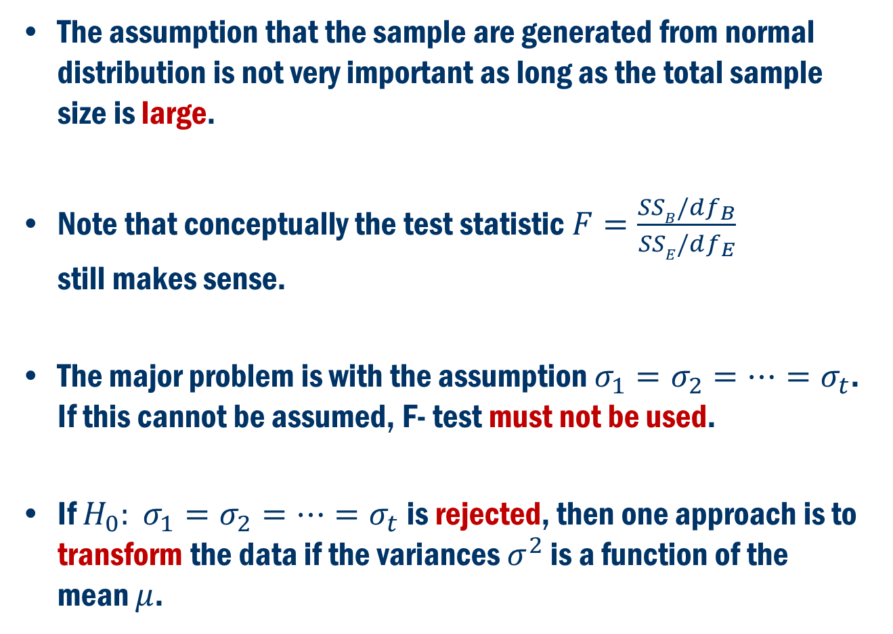
Back to ANOVA: What if Equality of the Variances FAIL?
The assumption that the sample are generated from normal distribution is not very important as long as the total sample size is large.
Note that conceptually the test statistic $F=\frac{SSB/df_{B}}{SSE/df_{E}}$ still makes sense.
The major problem is with the assumption $σ_{1}=σ_{2}=…=σ_{t}$. If this cannot be assumed, F- test must not be used.
If $H_{0}: σ_{1}=σ_{2}=…=σ_{t}$ is rejected, then one approach is to transform the data if the variances $σ^{2}$ is a function of the mean $μ$.

Slide 3
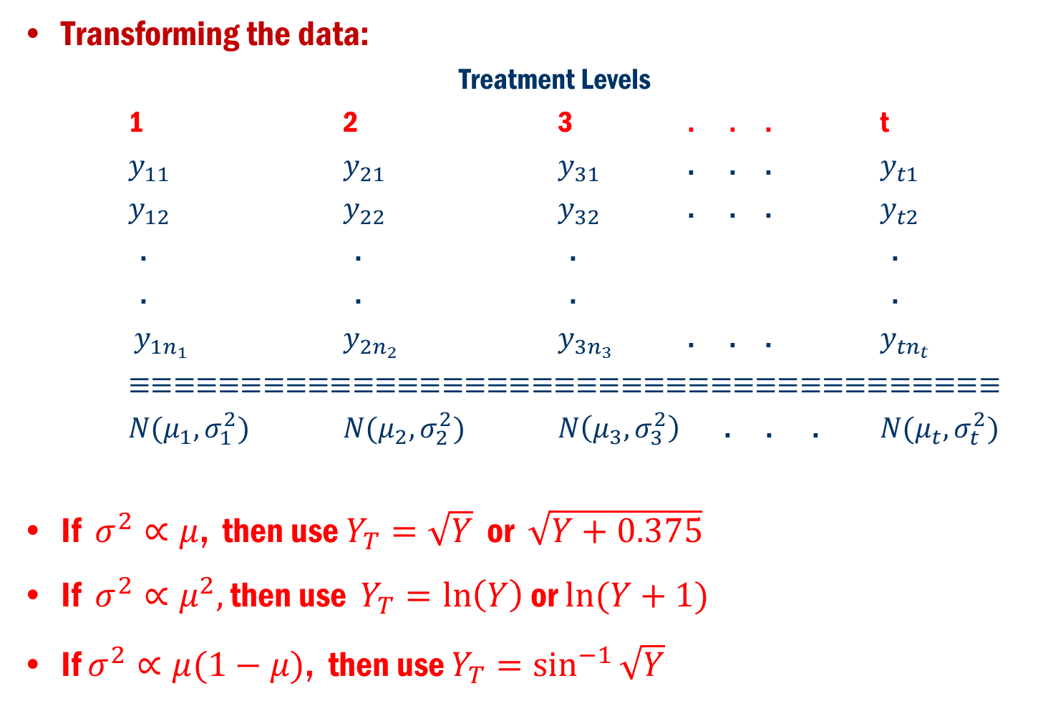
Equality of variances Fail Cont’D
Transforming the data:
Treatment Levels
1 2 3 . . . t
$y_{11}$ $y_{21}$ $y_{31}$ . . . $y_{t1}$
$y_{12}$ $y_{22}$ $y_{32}$ . . . $y_{t2}$
. . . .
. . . .
$y_{1n_{1}}$ $y_{2n_{2}}$ $y_{3n_{3}}$ . . . $y_{tn_{t}}$
$≡≡≡≡≡≡≡≡≡≡≡≡≡≡≡≡≡≡≡≡≡≡≡≡≡≡≡≡≡≡≡≡≡≡≡≡≡≡≡$
$N(μ_{1},σ_{1}^{2})$ $N(μ_{2},σ_{2}^{2})$ $N\left(μ_{3},σ_{3}^{2}\right)$ . . . $N(μ_{t},σ_{t}^{2})$
If $σ^{2}∝μ$, then use $Y_{T}=\sqrt{Y}$ or $\sqrt{Y+0.375}$
If $σ^{2}∝μ^{2},$ then use $Y_{T}=\ln\left(Y\right)$ or $ln⁡(Y+1)$
If $σ^{2}∝μ(1−μ)$, then use $Y_{T}=\sin^{−1}{\sqrt{Y}}$

Slide 4
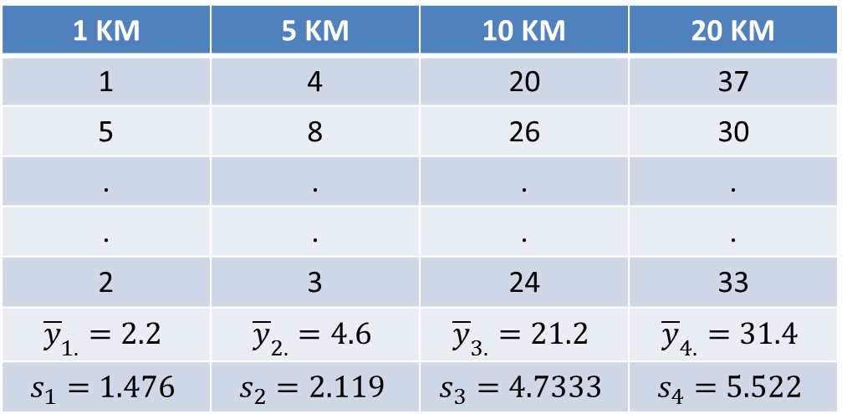
Book Example 8.4
Biologists believe that Mississippi river causes the oxygen level to be depleted near the Gulf of Mexico. To test this hypothesis water samples are taken at different distances from the mouth of Mississippi river, and the amounts of dissolve oxygen (in ppm) are recorded
Distance
Minitab
1 KM | 5 KM | 10 KM | 20 KM
1 | 4 | 20 | 37
5 | 8 | 26 | 30
. | . | . | .
. | . | . | .
2 | 3 | 24 | 33
$${\overline{y}}_{1.}=2.2$$ | $${\overline{y}}_{2.}=4.6$$ | $${\overline{y}}_{3.}=21.2$$ | $${\overline{y}}_{4.}=31.4$$
$$s_{1}=1.476$$ | $$s_{2}=2.119$$ | $$s_{3}=4.7333$$ | $$s_{4}=5.522$$
Oxygen Content

Slide 5
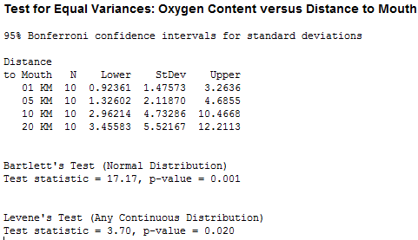
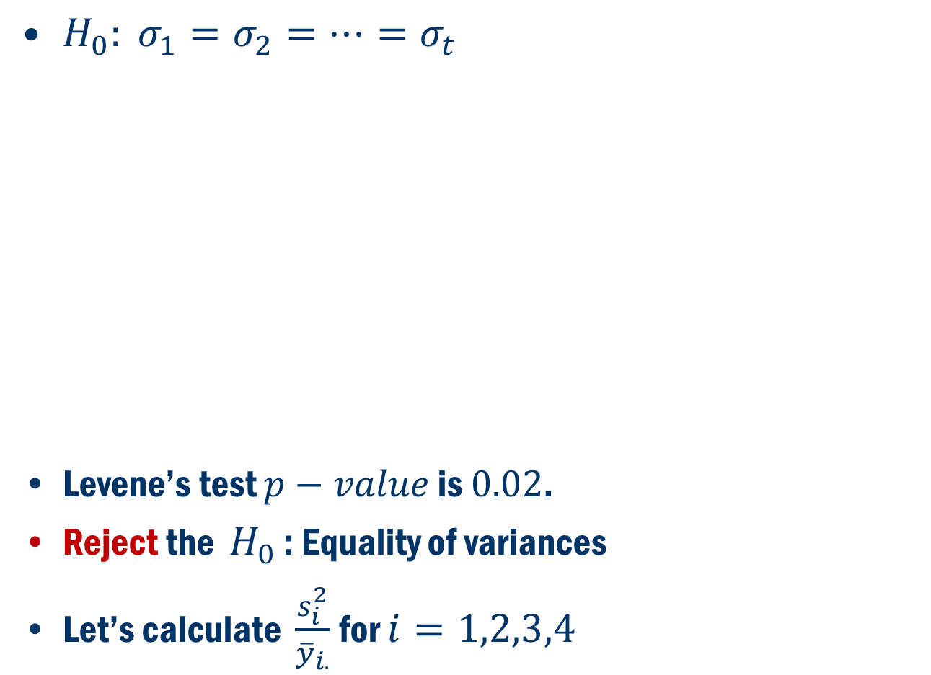
Example 8.4 Cont’D
$H_{0}: σ_{1}=σ_{2}=…=σ_{t}$
Levene’s test $p−value$ is $0.02$.
Reject the $H_{0}$ : Equality of variances
Let’s calculate $\frac{s_{i}^{2}}{{\overline{y}}_{i.}}$ for $i=1,2,3,4$

Slide 6
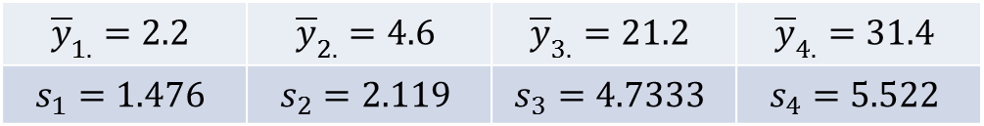
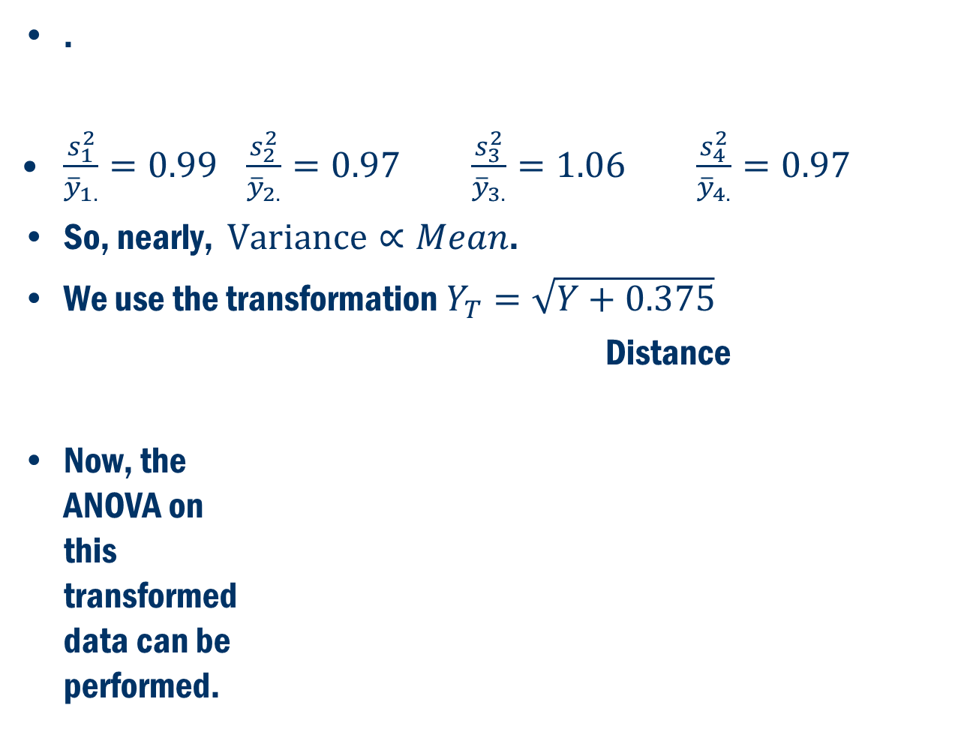
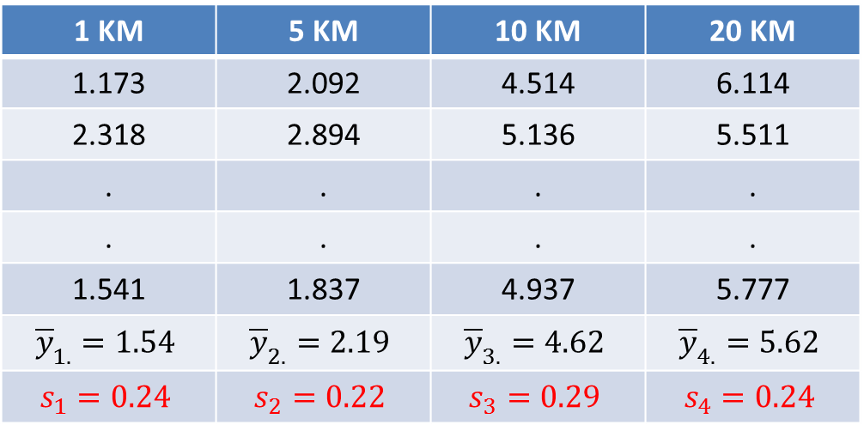
Example 8.4 Cont’D
.
$\frac{s_{1}^{2}}{{\overline{y}}_{1.}}=0.99$ $\frac{s_{2}^{2}}{{\overline{y}}_{2.}}=0.97$ $\frac{s_{3}^{2}}{{\overline{y}}_{3.}}=1.06$ $\frac{s_{4}^{2}}{{\overline{y}}_{4.}}=0.97$
So, nearly, $Variance∝Mean$.
We use the transformation $Y_{T}=\sqrt{Y+0.375}$
Distance
Now, the ANOVA on this transformed data can be performed.
$${\overline{y}}_{1.}=2.2$$ | $${\overline{y}}_{2.}=4.6$$ | $${\overline{y}}_{3.}=21.2$$ | $${\overline{y}}_{4.}=31.4$$
$$s_{1}=1.476$$ | $$s_{2}=2.119$$ | $$s_{3}=4.7333$$ | $$s_{4}=5.522$$
1 KM | 5 KM | 10 KM | 20 KM
1.173 | 2.092 | 4.514 | 6.114
2.318 | 2.894 | 5.136 | 5.511
. | . | . | .
. | . | . | .
1.541 | 1.837 | 4.937 | 5.777
$${\overline{y}}_{1.}=1.54$$ | $${\overline{y}}_{2.}=2.19$$ | $${\overline{y}}_{3.}=4.62$$ | $${\overline{y}}_{4.}=5.62$$
$$s_{1}=0.24$$ | $$s_{2}=0.22$$ | $$s_{3}=0.29$$ | $$s_{4}=0.24$$
Transformed Data

Slide 7
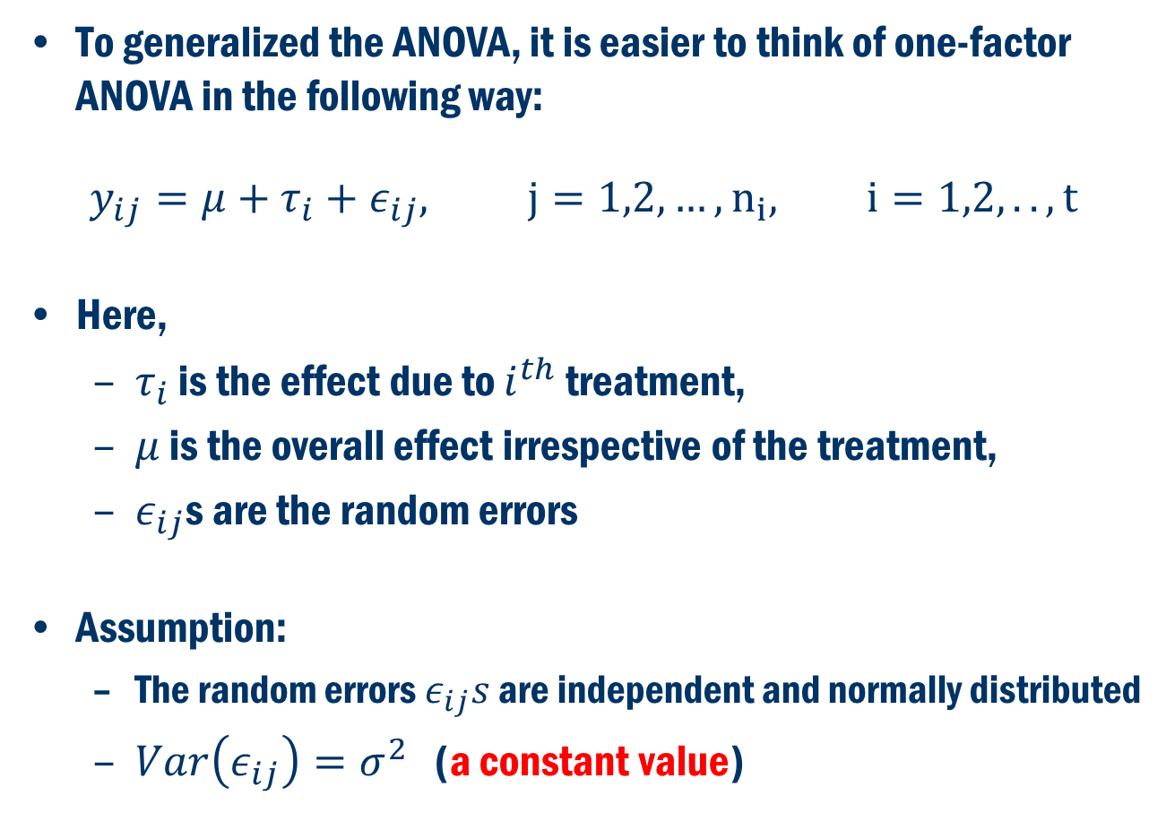
A Comprehensive Modeling Approach (Useful for Model Assessment and Extensions)
To generalized the ANOVA, it is easier to think of one-factor ANOVA in the following way:
$$y_{ij}=μ+τ_{i}+ε_{ij}, j=1,2,…, n_{i}, i=1,2,..,t$$
Here,
$τ_{i}$ is the effect due to $i^{th}$ treatment,
$μ$ is the overall effect irrespective of the treatment,
$ε_{ij}$s are the random errors
Assumption:
The random errors $ε_{ij}s$ are independent and normally distributed
$Var\left(ε_{ij}\right)=σ^{2}$ (a constant value)

Slide 8
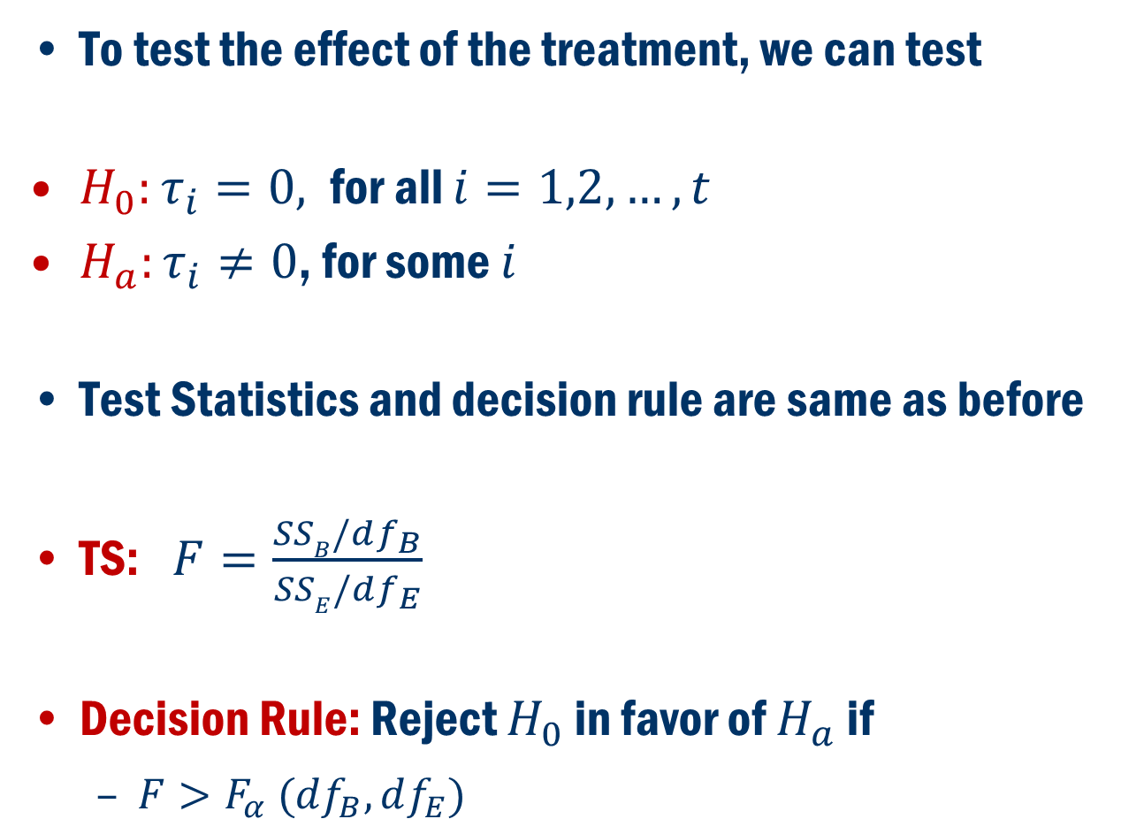
How about the Hypothesis test?
To test the effect of the treatment, we can test
$H_{0}:τ_{i}=0,$for all $i=1,2,…,t$
$H_{a}:τ_{i}≠0$, for some $i$
Test Statistics and decision rule are same as before
TS: $F=\frac{SSB/df_{B}}{SSE/df_{E}}$
Decision Rule: Reject $H_{0}$ in favor of $H_{a}$ if
$F>F_{α} (df_{B}, df_{E})$

Slide 9
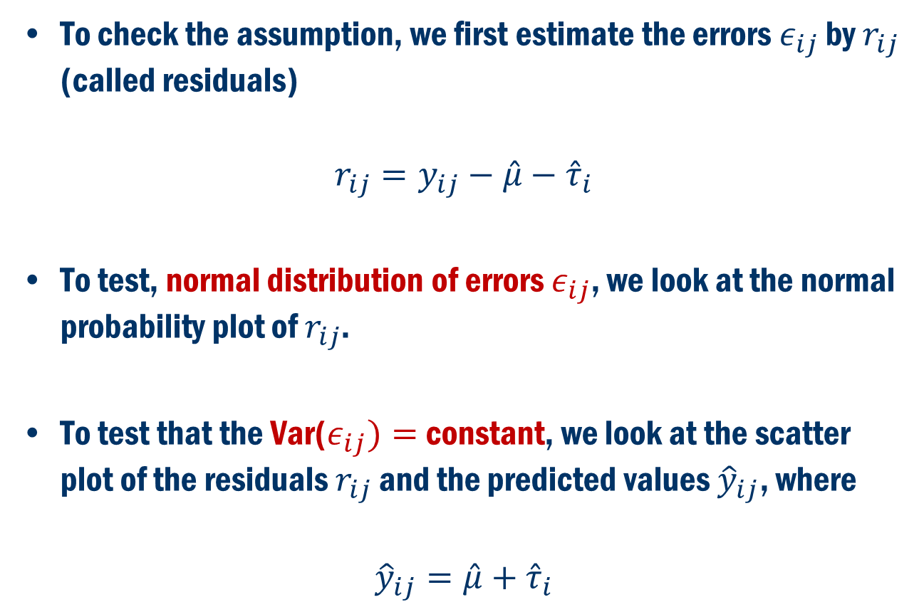
Checking the Assumptions
To check the assumption, we first estimate the errors $ε_{ij}$ by $r_{ij}$ (called residuals)
$$r_{ij}=y_{ij}−\hat{μ}−{\hat{τ}}_{i}$$
To test, normal distribution of errors $ε_{ij}$, we look at the normal probability plot of $r_{ij}$.
To test that the Var($ε_{ij})=$constant, we look at the scatter plot of the residuals $r_{ij}$ and the predicted values ${\hat{y}}_{ij}$, where
$${\hat{y}}_{ij}=\hat{μ}+{\hat{τ}}_{i}$$

Slide 10
Going Back to Example 8.4
Biologists believe that Mississippi river causes the oxygen level to be depleted near the Gulf of Mexico. To test this hypothesis water samples are taken at different distances from the mouth of Mississippi river, and the amounts of dissolve oxygen (in ppm) are recorded
Distance
Minitab
1 KM | 5 KM | 10 KM | 20 KM
1 | 4 | 20 | 37
5 | 8 | 26 | 30
. | . | . | .
. | . | . | .
2 | 3 | 24 | 33
$${\overline{y}}_{1.}=2.2$$ | $${\overline{y}}_{2.}=4.6$$ | $${\overline{y}}_{3.}=21.2$$ | $${\overline{y}}_{4.}=31.4$$
$$s_{1}=1.476$$ | $$s_{2}=2.119$$ | $$s_{3}=4.7333$$ | $$s_{4}=5.522$$
Oxygen Content

Slide 11
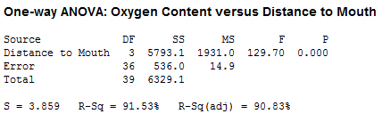
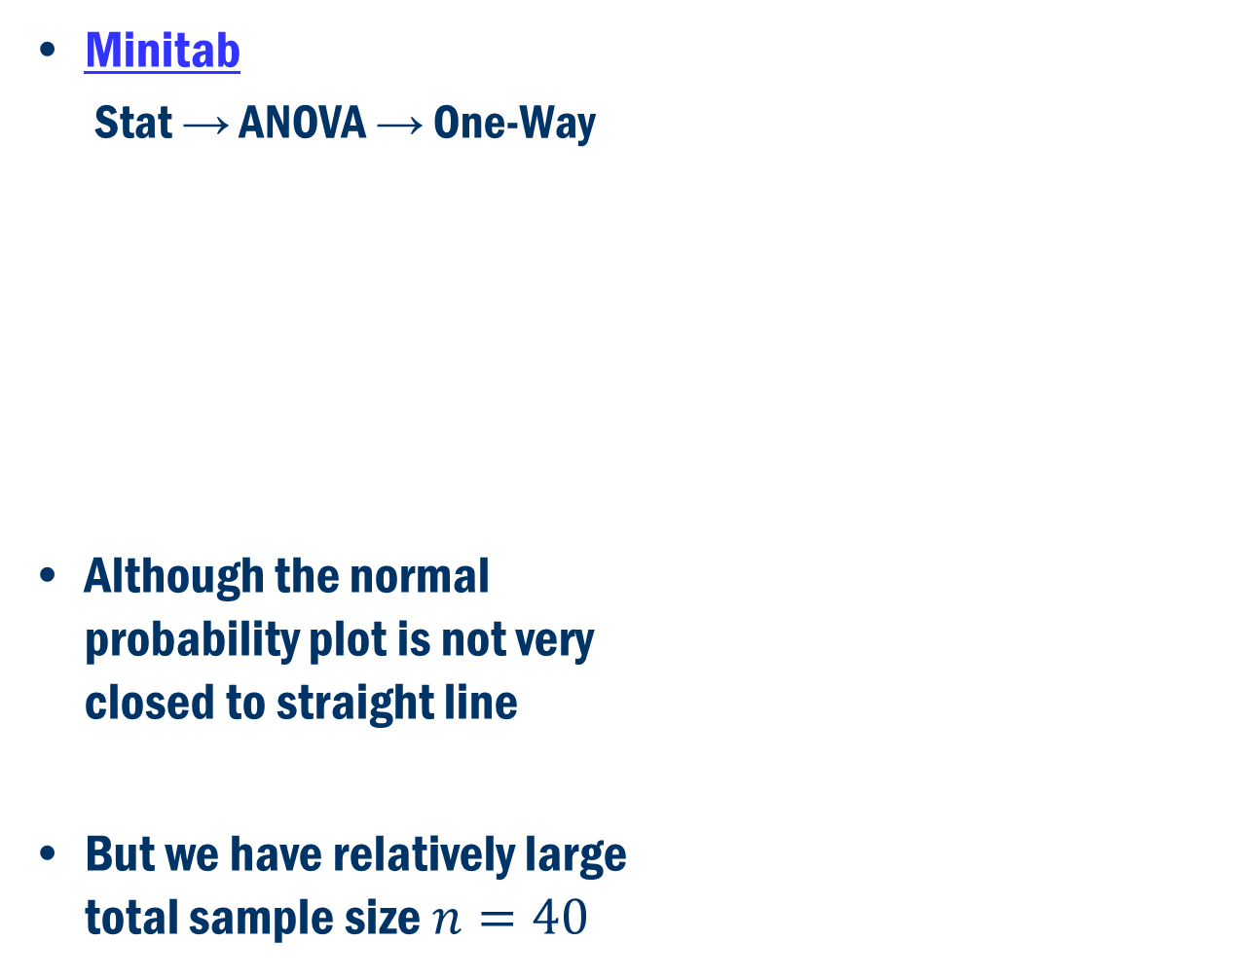
Wrong ANova
Minitab
Stat → ANOVA → One-Way
Although the normal probability plot is not very closed to straight line
But we have relatively large total sample size $n=40$

Slide 12
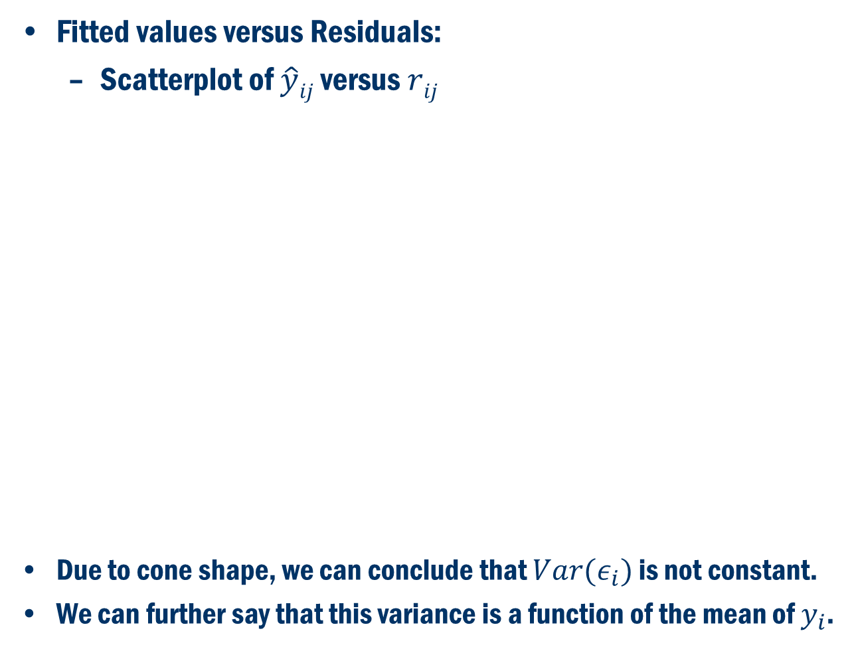
Wrong Analysis Cont’D
Fitted values versus Residuals:
Scatterplot of $\hat{y}ij$ versus $rij$
Due to cone shape, we can conclude that $Var(ε_{i})$ is not constant.
We can further say that this variance is a function of the mean of $y_{i}$.

Slide 13
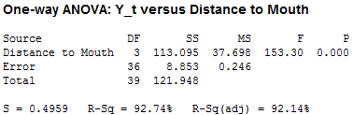
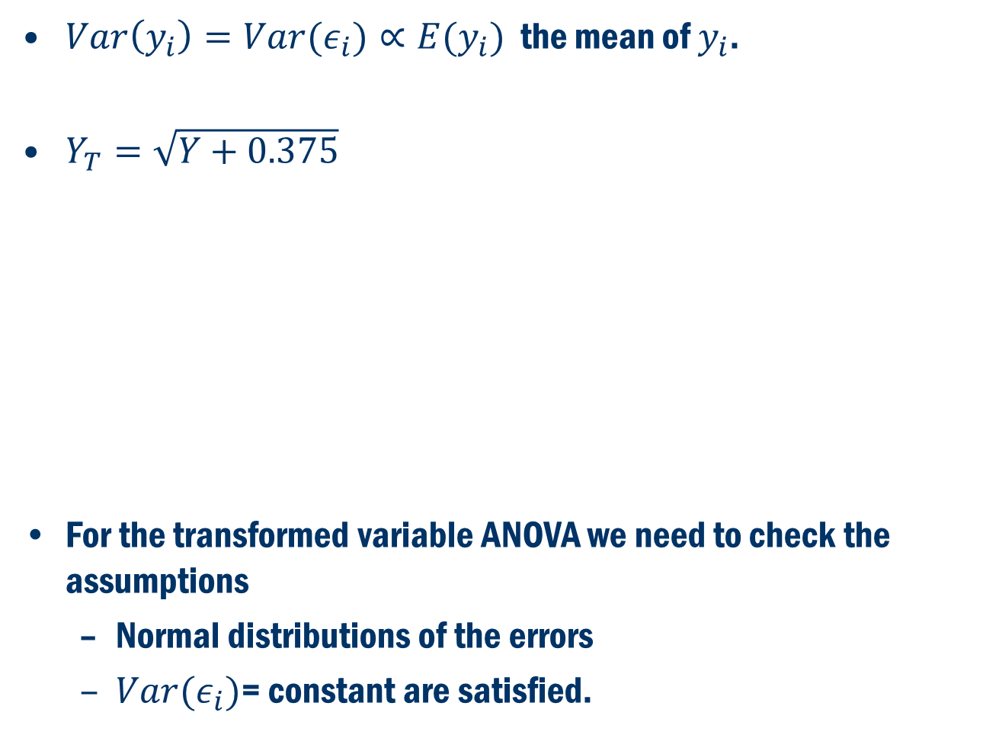
Correct Analysis Based on Transformed Data
$Var\left(y_{i}\right)=Var(ε_{i})∝E(y_{i})$ the mean of $y_{i}$.
$Y_{T}=\sqrt{Y+0.375}$
For the transformed variable ANOVA we need to check the assumptions
Normal distributions of the errors
$Var(ε_{i})$= constant are satisfied.

Slide 14

Checking the Assumptions Based on Transformed Data
$Var(ε_{i})$= constant
Normal distributions of the errors

Slide 15
Two-Factor Analysis of Variance
Two Way ANOVA
Minitab
Stat → ANOVA → Two-Way
Levels
Factor A: Low High
Factor B Low Medium High
Factor A
Y
Factor B

Slide 16
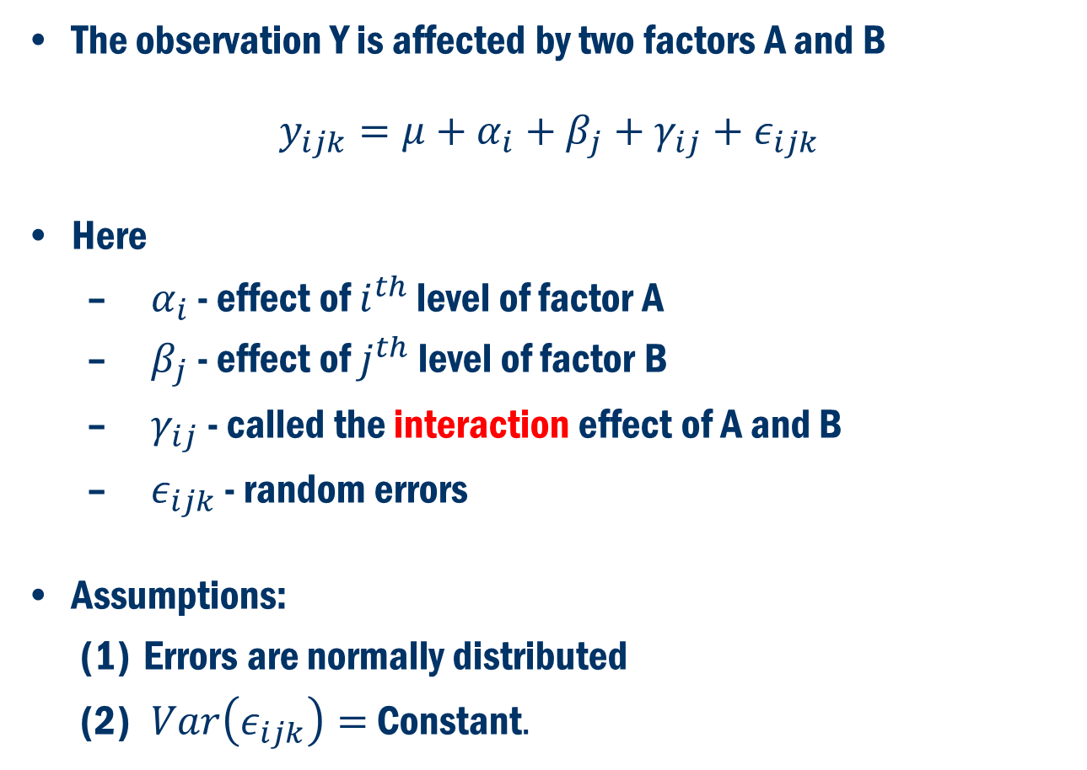
A Comprehensive Modeling Approach
The observation Y is affected by two factors A and B
$$y_{ijk}=μ+α_{i}+β_{j}+γ_{ij}+ε_{ijk}$$
Here
$α_{i}$ - effect of $i^{th}$ level of factor A
$β_{j}$ - effect of $j^{th}$ level of factor B
$γ_{ij}$ - called the interaction effect of A and B
$ε_{ijk}$ - random errors
Assumptions:
Errors are normally distributed
$Var\left(ε_{ijk}\right)=$ Constant$.$

Slide 17
What is Interaction Effect?
Meaning of Interaction Effect
B, low
Yield
B, high
A, low
A, high

Slide 18
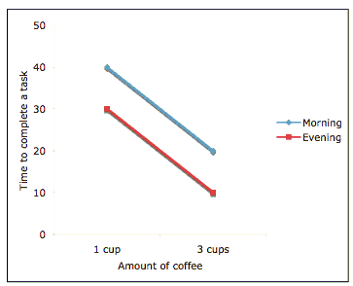
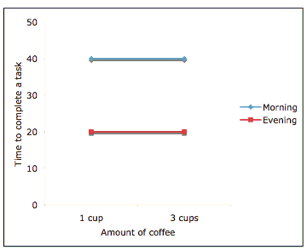
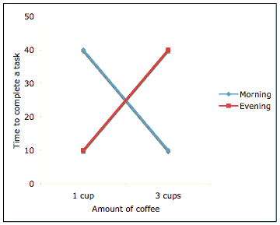
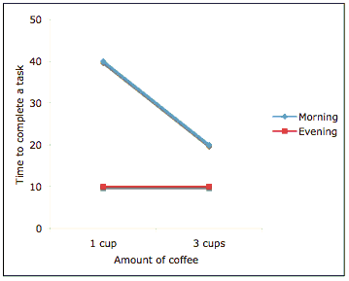
What is Interaction Effect? Cont’D
No Interaction
Interaction

Slide 19
Australian Institute of Sport Example
Response Variable: Weight
Factor A: Gender
Factor B: Sport
Two-way ANOVA: yield versus Factor A, Factor B
DF SS MS F value Pr(>F)
Gender 1 7424 7424 95.845 <2e-16 ***
Sport 6 10975 1829 23.614 <2e-16 ***
Interaction 6 185 31 0.398 0.879
Error 144 11155 77

Slide 20
Checking the Assumptions Based on Transformed Data
$Var(ε_{i})$= constant
Normal distributions of the errors

Slide 21
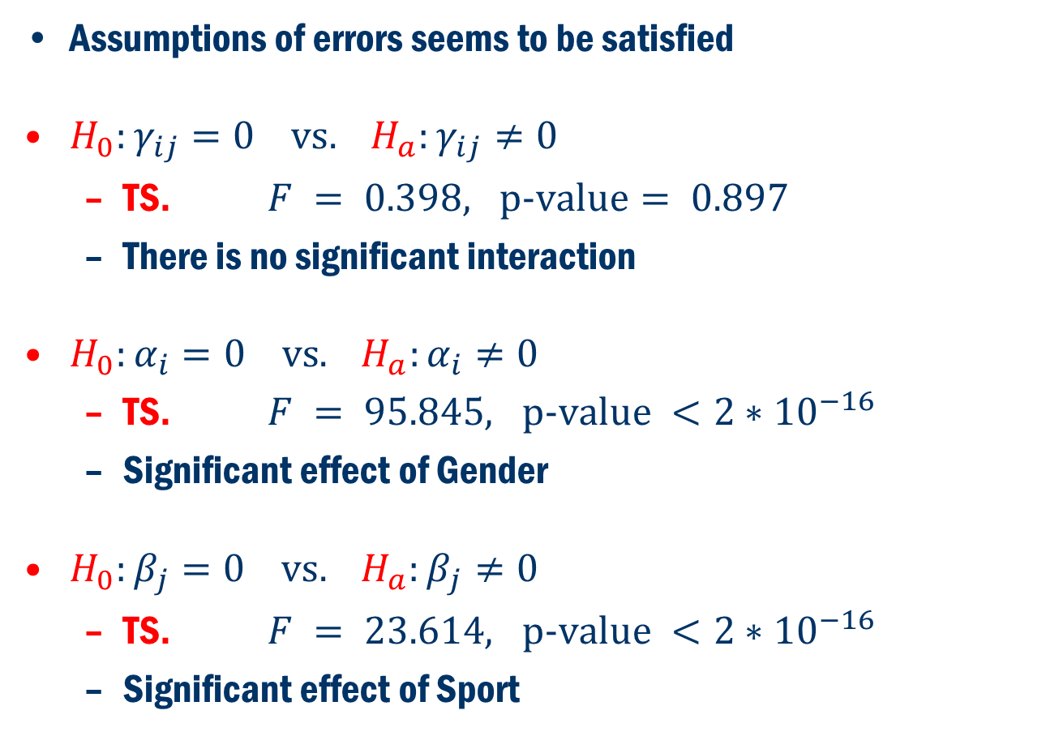
ANOVA ResultS Based on THE Transformed Data
Assumptions of errors seems to be satisfied
$H_{0}:γ_{ij}=0 \text{vs}. H_{a}:γ_{ij}≠0$
TS. $F = 0.398, \text{p}\text{−}\text{value}= 0.897$
There is no significant interaction
$H_{0}:α_{i}=0 \text{vs}. H_{a}:α_{i}≠0$
TS. $F = 95.845, \text{p}\text{−}\text{value} <2∗{10}^{−16}$
Significant effect of Gender
$H_{0}:β_{j}=0 \text{vs}. H_{a}:β_{j}≠0$
TS. $F = 23.614, \text{p}\text{−}\text{value} <2∗{10}^{−16}$
Significant effect of Sport

Slide 22
Interaction

