Slide 1
Chapter 9

Slide 2
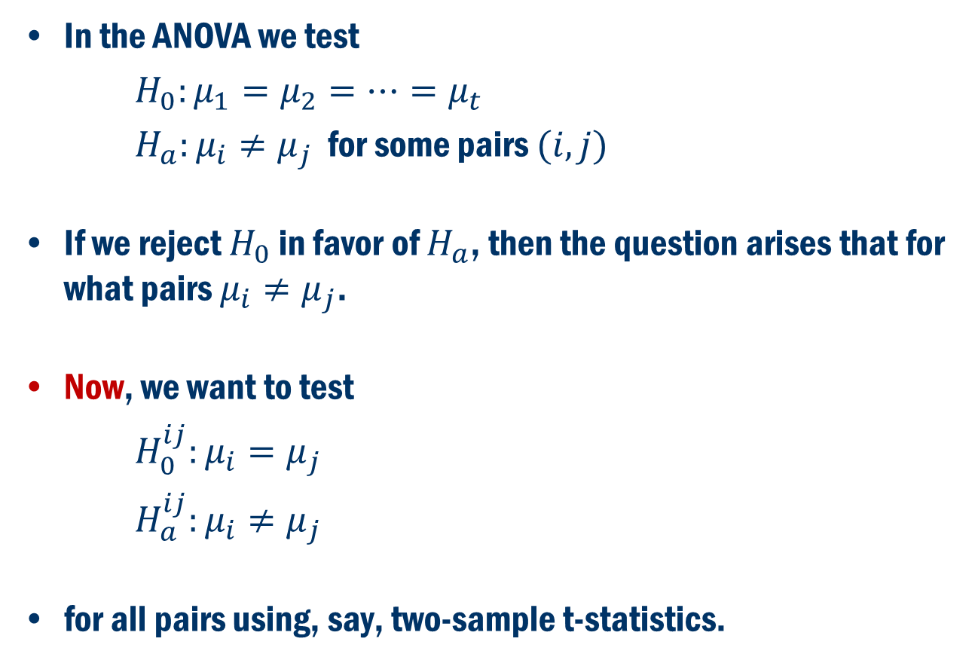
Multiple Comparison (Post hoc ANOVA)
In the ANOVA we test
$H_{0}:μ_{1}=μ_{2}=…=μ_{t}$
$H_{a}:μ_{i}≠μ_{j}$ for some pairs $(i, j)$
If we reject $H_{0}$ in favor of $H_{a}$, then the question arises that for what pairs $μ_{i}≠μ_{j}$.
Now, we want to test
$H_{0}^{ij}:μ_{i}=μ_{j}$
$H_{a}^{ij}:μ_{i}≠μ_{j}$
for all pairs using, say, two-sample t-statistics.

Slide 3
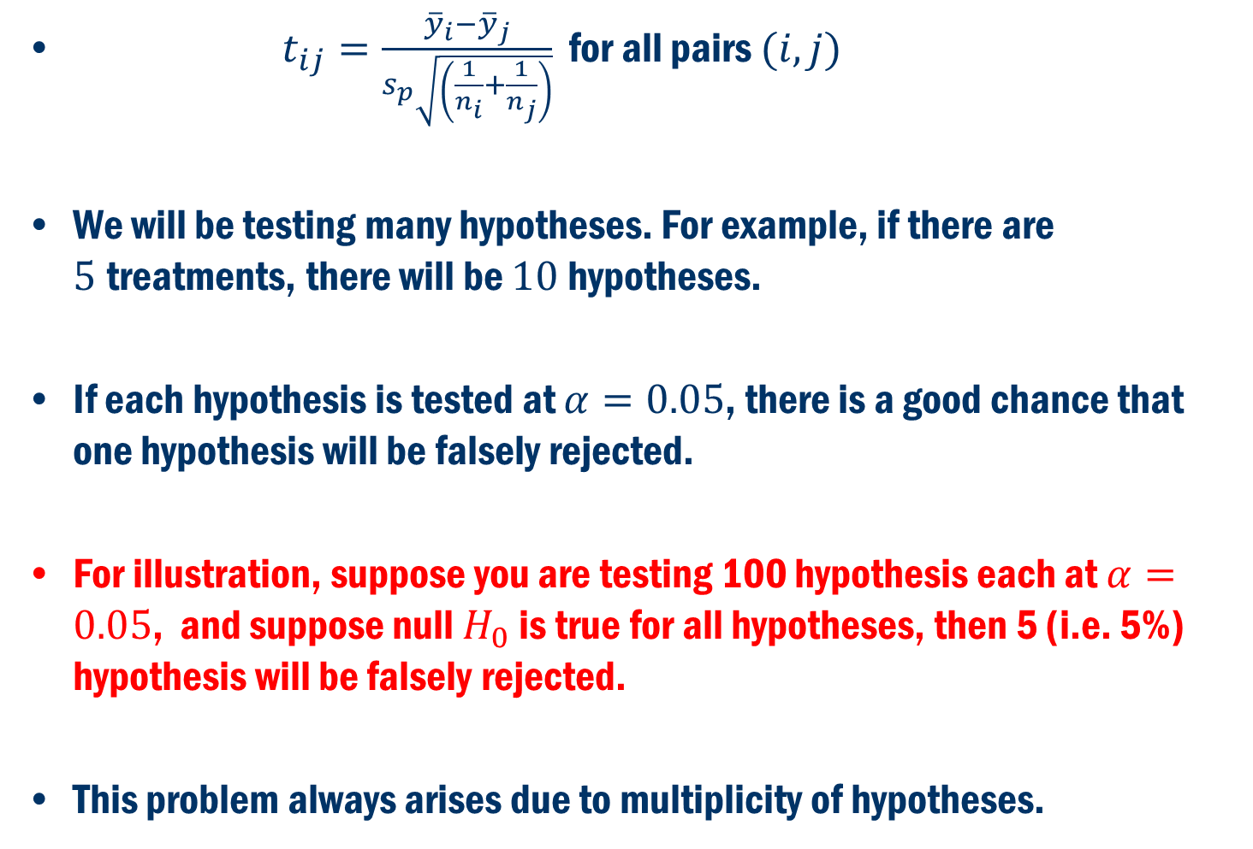
Multiple Comparison Cont’D
$t_{ij}=\frac{{\overline{y}}_{i}−{\overline{y}}_{j}}{s_{p}\sqrt{\left(\frac{1}{n_{i}}+\frac{1}{n_{j}}\right)}}$ for all pairs $(i, j)$
We will be testing many hypotheses. For example, if there are $5$treatments, there will be $10$hypotheses.
If each hypothesis is tested at $α=0.05$, there is a good chance that one hypothesis will be falsely rejected.
For illustration, suppose you are testing 100 hypothesis each at $α=0.05$, and suppose null $H_{0}$ is true for all hypotheses, then 5 (i.e. 5%) hypothesis will be falsely rejected.
This problem always arises due to multiplicity of hypotheses.

Slide 4
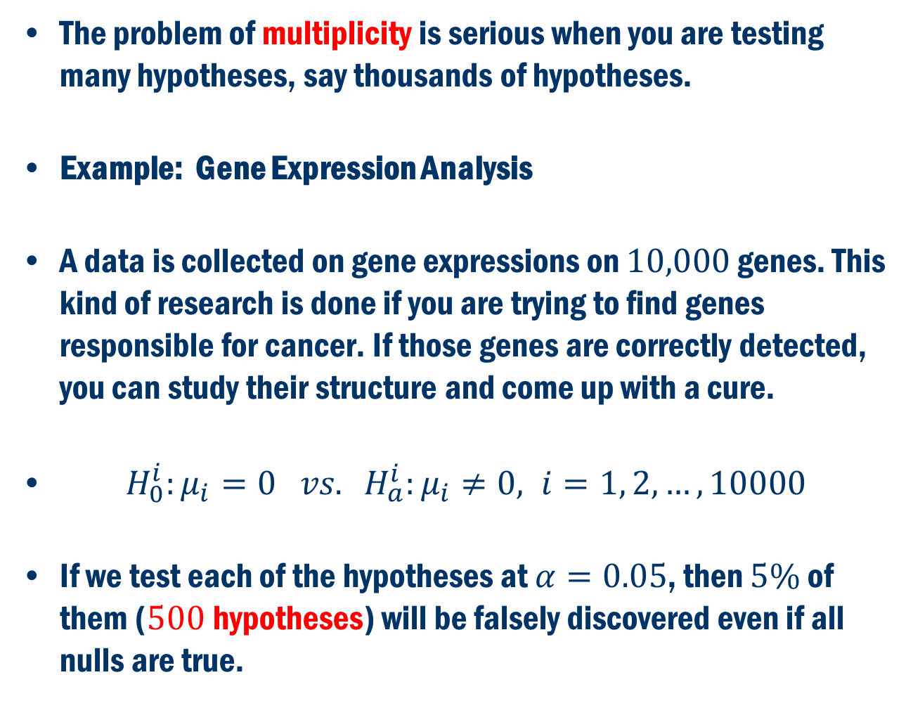
Multiple Comparison Cont’D
The problem of multiplicity is serious when you are testing many hypotheses, say thousands of hypotheses.
Example: Gene Expression Analysis
A data is collected on gene expressions on $10,000$ genes. This kind of research is done if you are trying to find genes responsible for cancer. If those genes are correctly detected, you can study their structure and come up with a cure.
$H_{0}^{i}:μ_{i}=0 vs. H_{a}^{i}:μ_{i}≠0, i=1, 2,…, 10000$
If we test each of the hypotheses at $α=0.05$, then $5\%$ of them ($500$hypotheses) will be falsely discovered even if all nulls are true.

Slide 5
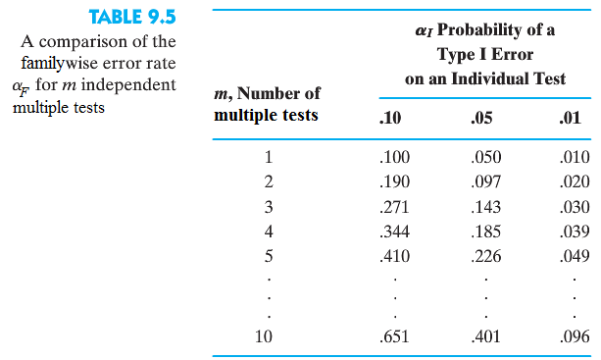
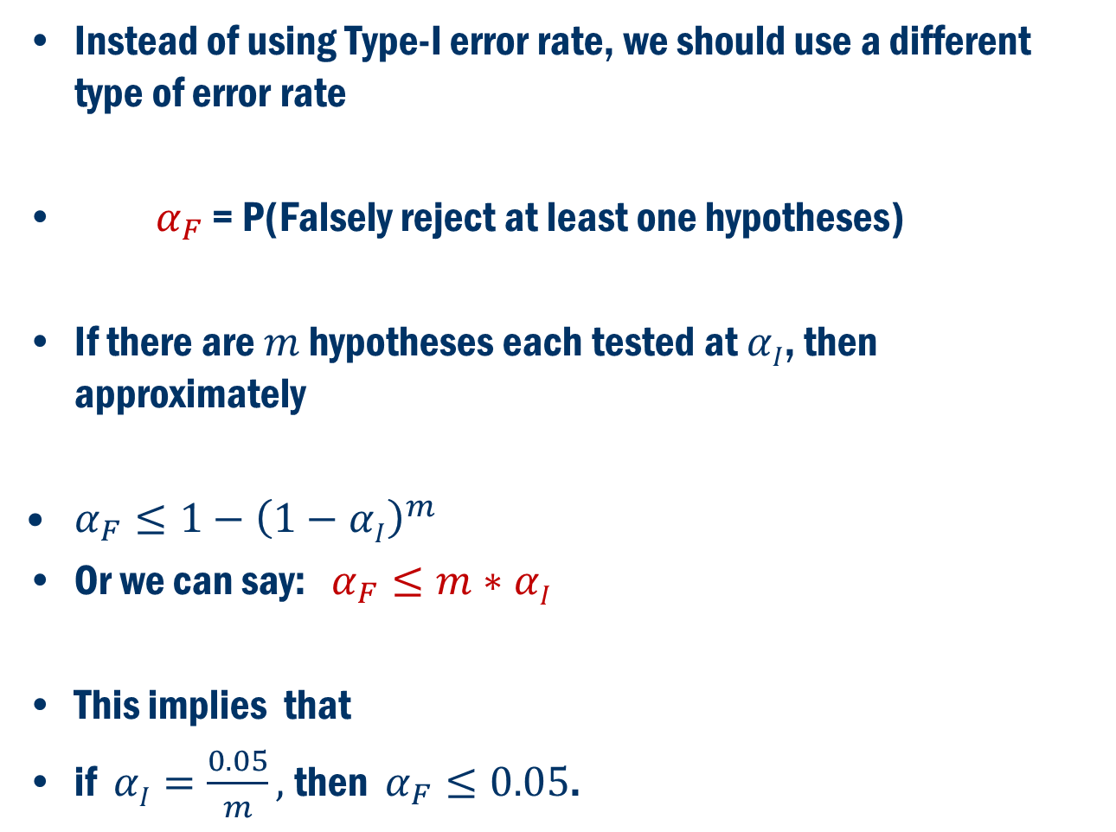
Familywise Error Rate (FEW)
Instead of using Type-I error rate, we should use a different type of error rate
$α_{F}$ = P(Falsely reject at least one hypotheses)
If there are $m$ hypotheses each tested at $αI$, then approximately
$α_{F}≤1−{\left(1−αI\right)}^{m}$
Or we can say: $α_{F}≤m∗αI$
This implies that
if $αI=\frac{0.05}{m},$ then $α_{F}≤0.05$.

Slide 6
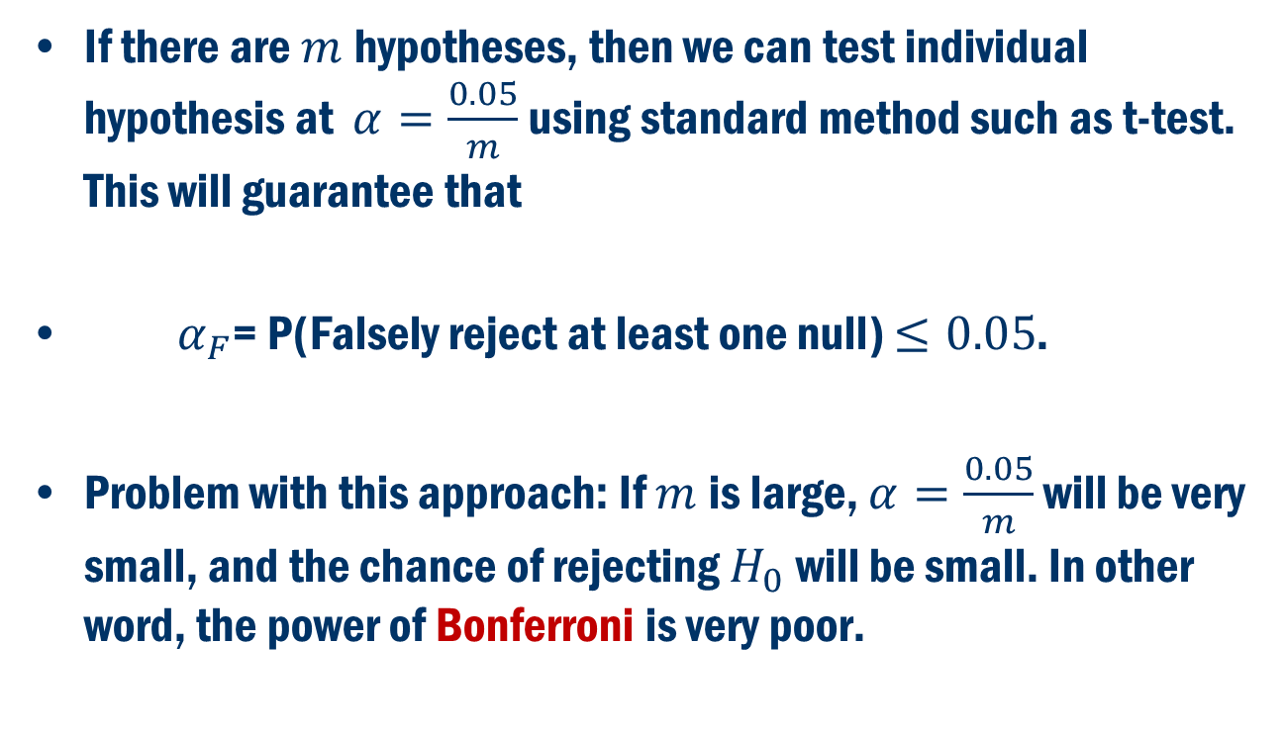
Bonferroni Method
If there are $m$hypotheses, then we can test individual hypothesis at $α=\frac{0.05}{m}$using standard method such as t-test. This will guarantee that
$α_{F}$= P(Falsely reject at least one null) $≤0.05$.
Problem with this approach: If $m$is large, $α=\frac{0.05}{m}$ will be very small, and the chance of rejecting $H_{0}$ will be small. In other word, the power of Bonferroni is very poor.

Slide 7
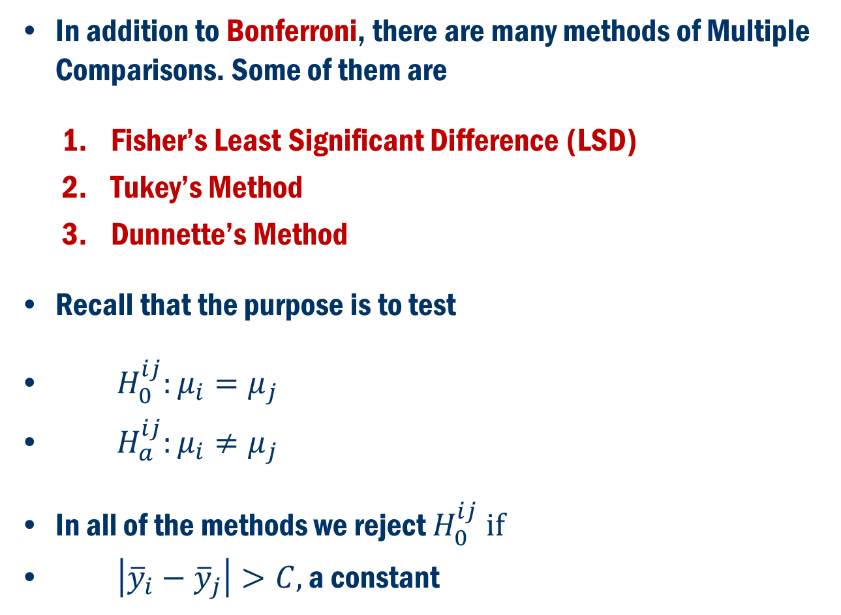
Beyond Bonferroni
In addition to Bonferroni, there are many methods of Multiple Comparisons. Some of them are
Fisher’s Least Significant Difference (LSD)
Tukey’s Method
Dunnette’s Method
Recall that the purpose is to test
$H_{0}^{ij}:μ_{i}=μ_{j}$
$H_{a}^{ij}:μ_{i}≠μ_{j}$
In all of the methods we reject $H_{0}^{ij} if$
$\left|{\overline{y}}_{i}−{\overline{y}}_{j}\right|>C,$ a constant

Slide 8
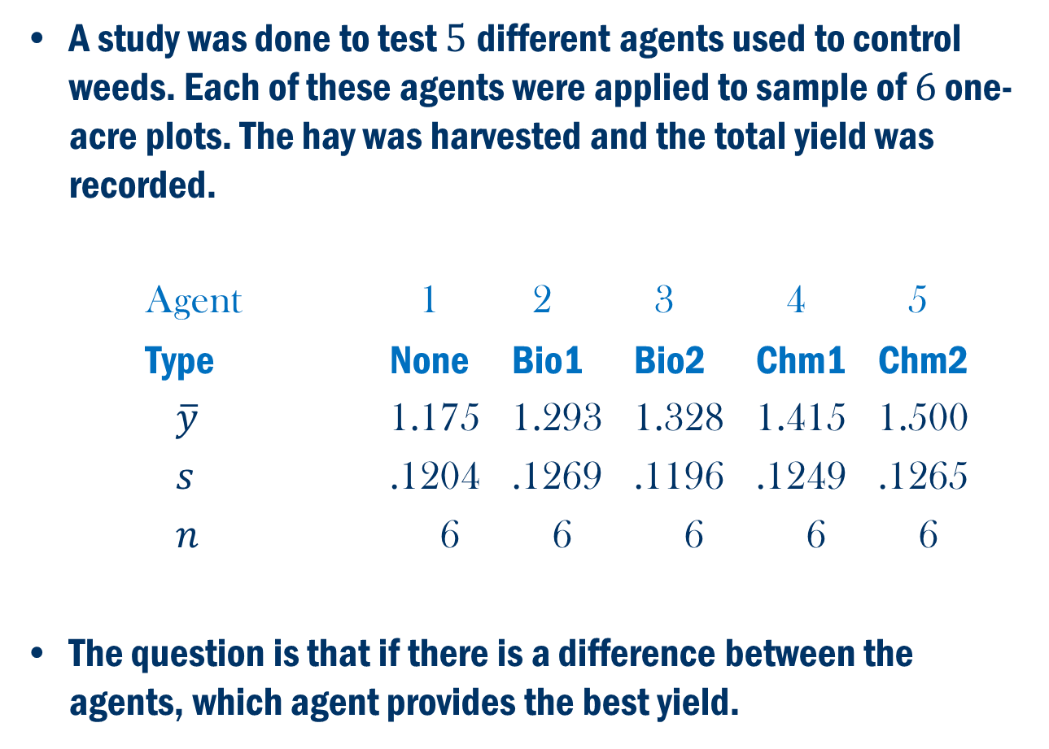
Book Example 9.3
A study was done to test $5$different agents used to control weeds. Each of these agents were applied to sample of $6$ one-acre plots. The hay was harvested and the total yield was recorded.
Agent 1 2 3 4 5
Type None Bio1 Bio2 Chm1 Chm2
$\overline{y}$ 1.175 1.293 1.328 1.415 1.500
$s$ .1204 .1269 .1196 .1249 .1265
$n$ 6 6 6 6 6
The question is that if there is a difference between the agents, which agent provides the best yield.

Slide 9
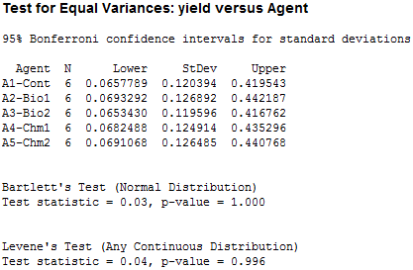

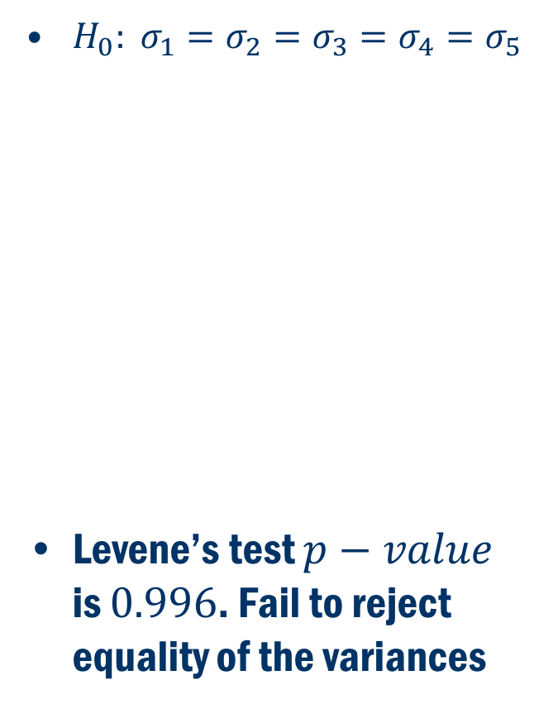
Example 9.3: Assumptions
First, we check the validity of assumptions among the agents.
$H_{0}: σ_{1}=σ_{2}=σ_{3}=σ_{4}=σ_{5}$
Levene’s test $p−value$ is $0.996$. Fail to reject equality of the variances
$H_{0}:$Data is generated from normal distribution for each type of food.
Large $p−value$s. Fail to reject Normality assumption.

Slide 10
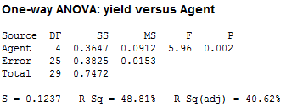
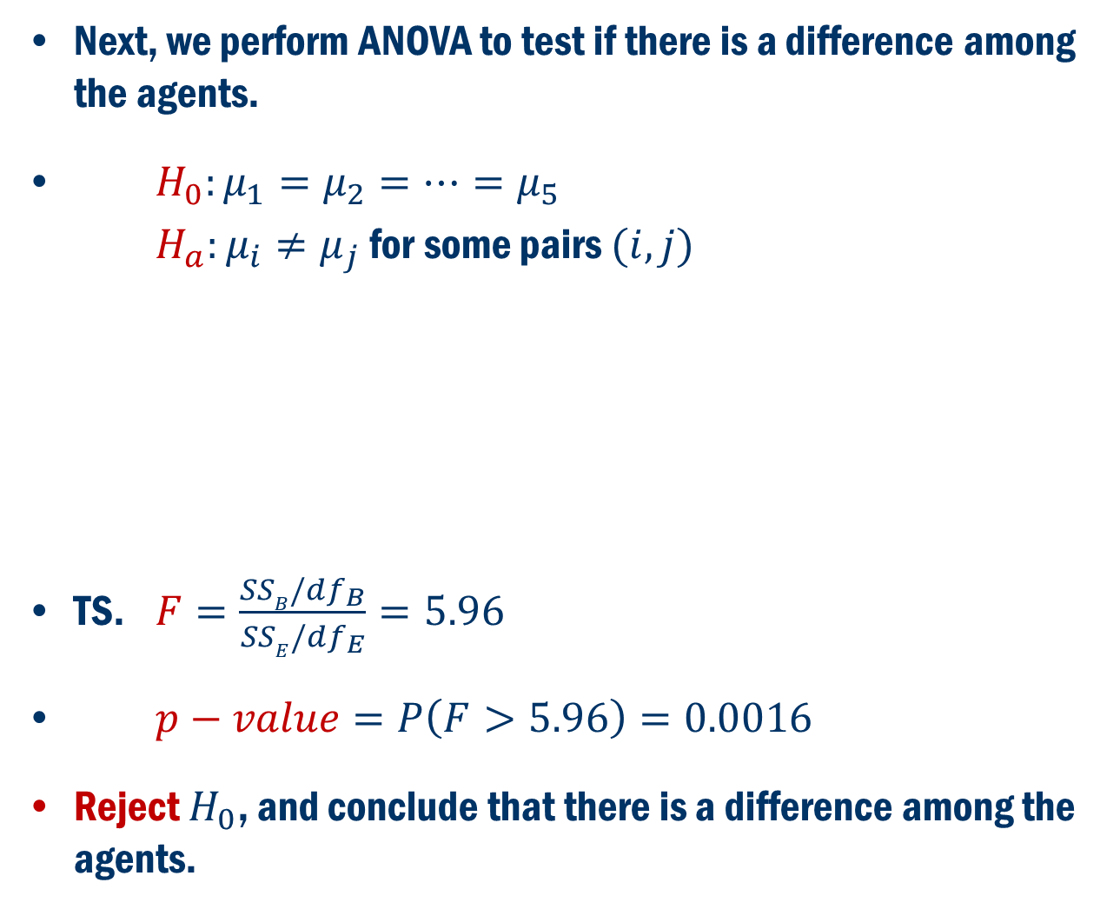
Example 9.3: ANOVA
Next, we perform ANOVA to test if there is a difference among the agents.
$H_{0}:μ_{1}=μ_{2}=…=μ_{5}$
$H_{a}:μ_{i}≠μ_{j}$ for some pairs $(i, j)$
TS. $F=\frac{SSB/df_{B}}{SSE/df_{E}}=5.96$
$p−value=P\left(F>5.96\right)=0.0016$
Reject $H_{0}$, and conclude that there is a difference among the agents.

Slide 11
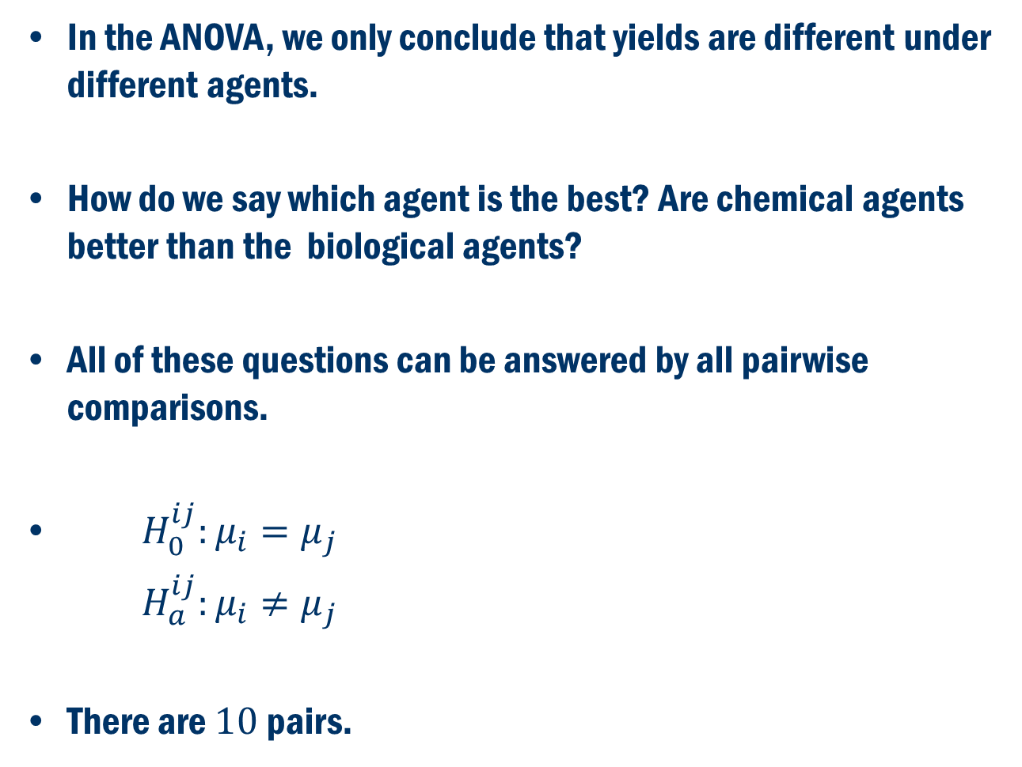
Post Hoc ANOVA
In the ANOVA, we only conclude that yields are different under different agents.
How do we say which agent is the best? Are chemical agents better than the biological agents?
All of these questions can be answered by all pairwise comparisons.
$H_{0}^{ij}:μ_{i}=μ_{j}$
$H_{a}^{ij}:μ_{i}≠μ_{j}$
There are $10$pairs.

Slide 12
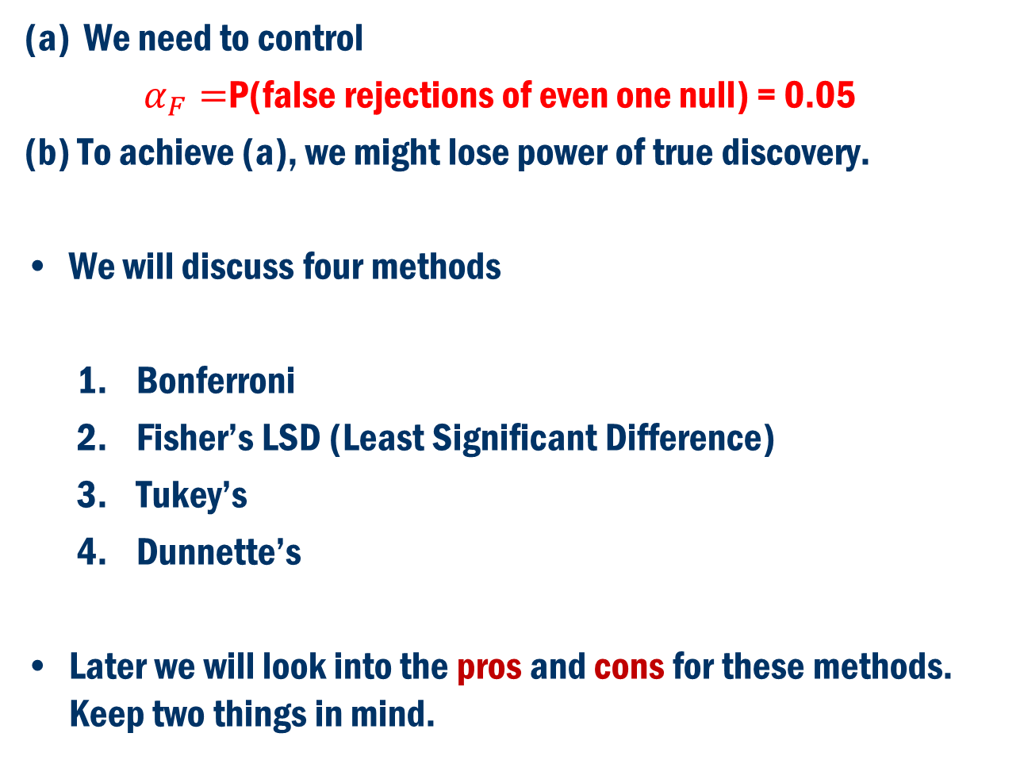
What to Do?
We need to control
$α_{F}=$P(false rejections of even one null) = 0.05
(b) To achieve (a), we might lose power of true discovery.
We will discuss four methods
Bonferroni
Fisher’s LSD (Least Significant Difference)
Tukey’s
Dunnette’s
Later we will look into the pros and cons for these methods. Keep two things in mind.

Slide 13
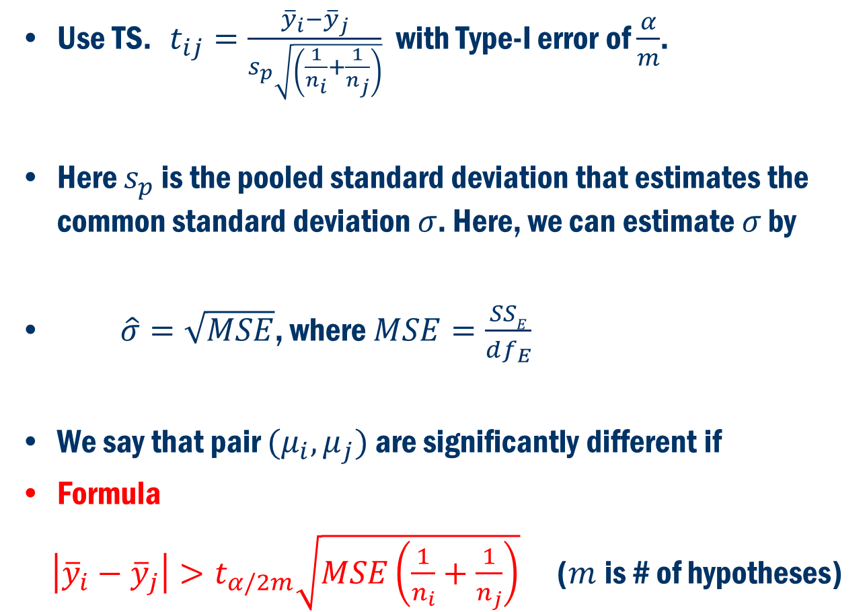
Bonferroni’s Method
Use TS. $t_{ij}=\frac{{\overline{y}}_{i}−{\overline{y}}_{j}}{s_{p}\sqrt{\left(\frac{1}{n_{i}}+\frac{1}{n_{j}}\right)}}$ with Type-I error of $\frac{α}{m}$.
Here $s_{p}$ is the pooled standard deviation that estimates the common standard deviation $σ$. Here, we can estimate $σ$ by
$\hat{σ}=\sqrt{MSE}$, where $MSE=\frac{SSE}{df_{E}}$
We say that pair $(μ_{i}, μ_{j})$ are significantly different if
Formula
$\left|{\overline{y}}_{i}−{\overline{y}}_{j}\right|>t_{α/2m}\sqrt{MSE\left(\frac{1}{n_{i}}+\frac{1}{n_{j}}\right)}$ ($m$is # of hypotheses)

Slide 14
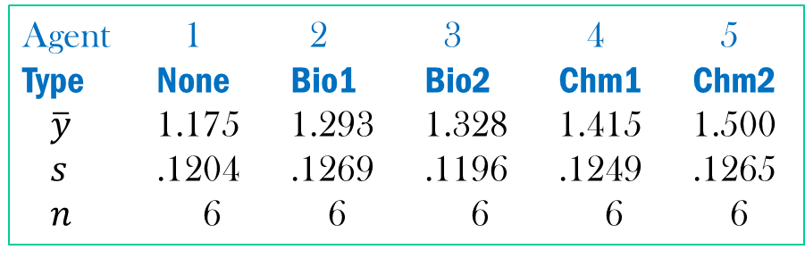
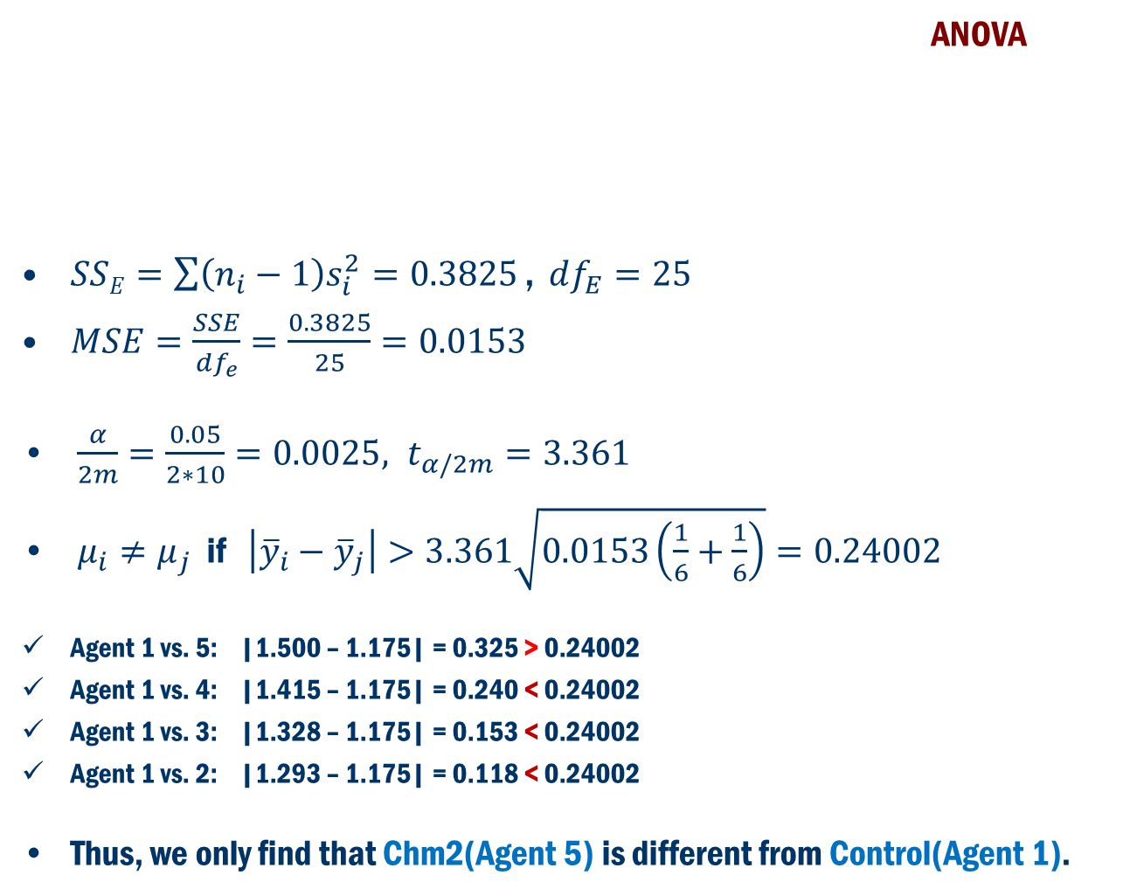
Example 9.3: Bonferroni’s Method
Agent 1 2 3 4 5
Type None Bio1 Bio2 Chm1 Chm2
$\overline{y}$ 1.175 1.293 1.328 1.415 1.500
$s$ .1204 .1269 .1196 .1249 .1265
$n$ 6 6 6 6 6
ANOVA
$SSE=\sum{\left(n_{i}−1\right)s_{i}^{2}}=0.3825\text{ , }df_{E}=25$
$MSE=\frac{SSE}{df_{e}}=\frac{0.3825}{25}=0.0153$
$\frac{α}{2m}=\frac{0.05}{2∗10}=0.0025, t_{α/2m}=3.361$
$μ_{i}≠μ_{j}$ if $\left|{\overline{y}}_{i}−{\overline{y}}_{j}\right|>3.361\sqrt{0.0153\left(\frac{1}{6}+\frac{1}{6}\right)}=0.24002$
Agent 1 vs. 5: |1.500 – 1.175| = 0.325 > 0.24002
Agent 1 vs. 4: |1.415 – 1.175| = 0.240 < 0.24002
Agent 1 vs. 3: |1.328 – 1.175| = 0.153 < 0.24002
Agent 1 vs. 2: |1.293 – 1.175| = 0.118 < 0.24002
Thus, we only find that Chm2(Agent 5) is different from Control(Agent 1).

Slide 15
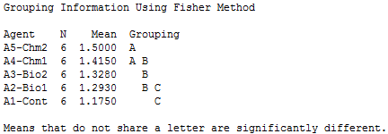
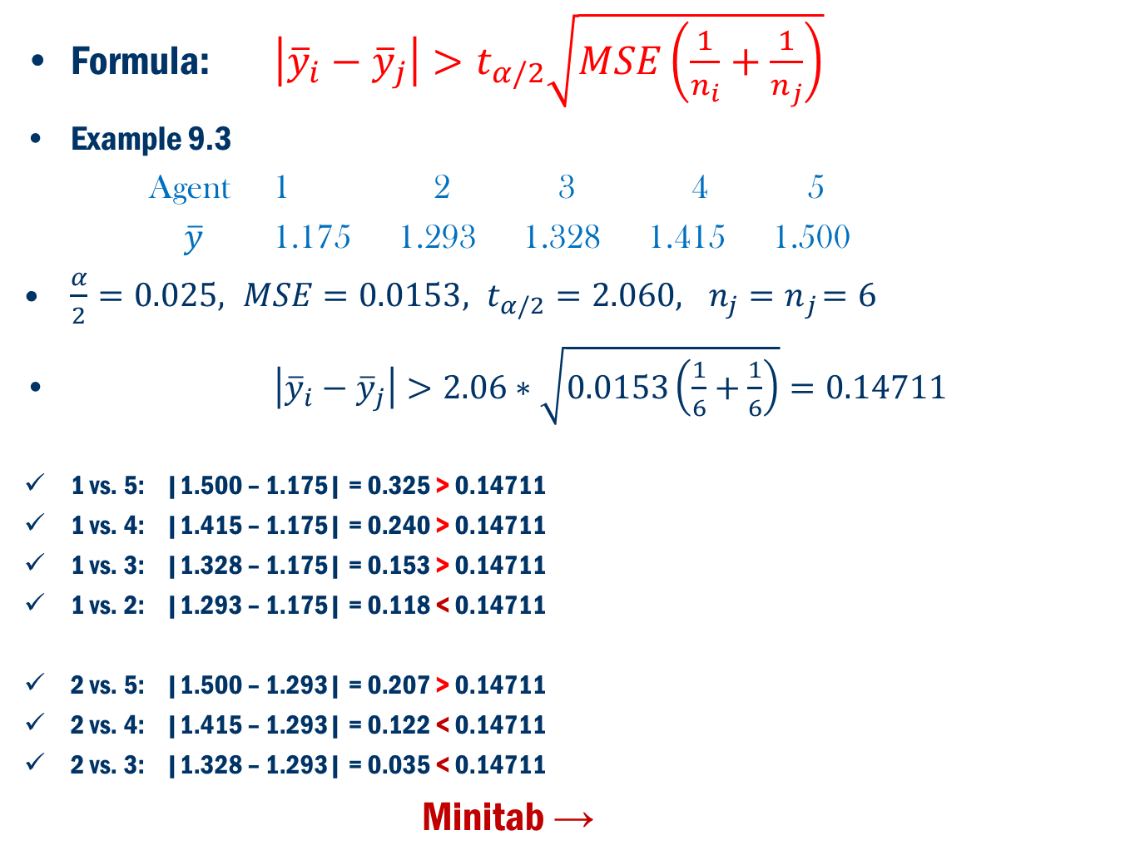
Fisher’s LSD
Formula: $\left|{\overline{y}}_{i}−{\overline{y}}_{j}\right|>t_{α/2}\sqrt{MSE\left(\frac{1}{n_{i}}+\frac{1}{n_{j}}\right)}$
Example 9.3
Agent 1 2 3 4 5
$\overline{y}$ 1.175 1.293 1.328 1.415 1.500
$\frac{α}{2}=0.025, MSE=0.0153, t_{α/2}=2.060,{ n_{j}=n}_{j}=6$
$\left|{\overline{y}}_{i}−{\overline{y}}_{j}\right|>2.06∗\sqrt{0.0153\left(\frac{1}{6}+\frac{1}{6}\right)}=0.14711$
1 vs. 5: |1.500 – 1.175| = 0.325 > 0.14711
1 vs. 4: |1.415 – 1.175| = 0.240 > 0.14711
1 vs. 3: |1.328 – 1.175| = 0.153 > 0.14711
1 vs. 2: |1.293 – 1.175| = 0.118 < 0.14711
2 vs. 5: |1.500 – 1.293| = 0.207 > 0.14711
2 vs. 4: |1.415 – 1.293| = 0.122 < 0.14711
2 vs. 3: |1.328 – 1.293| = 0.035 < 0.14711
Minitab →
Agent 3,4 and 5 are different from control
Agent 2 and 5 are different

Slide 16
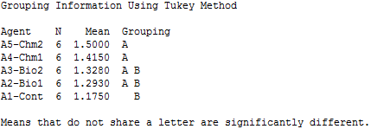
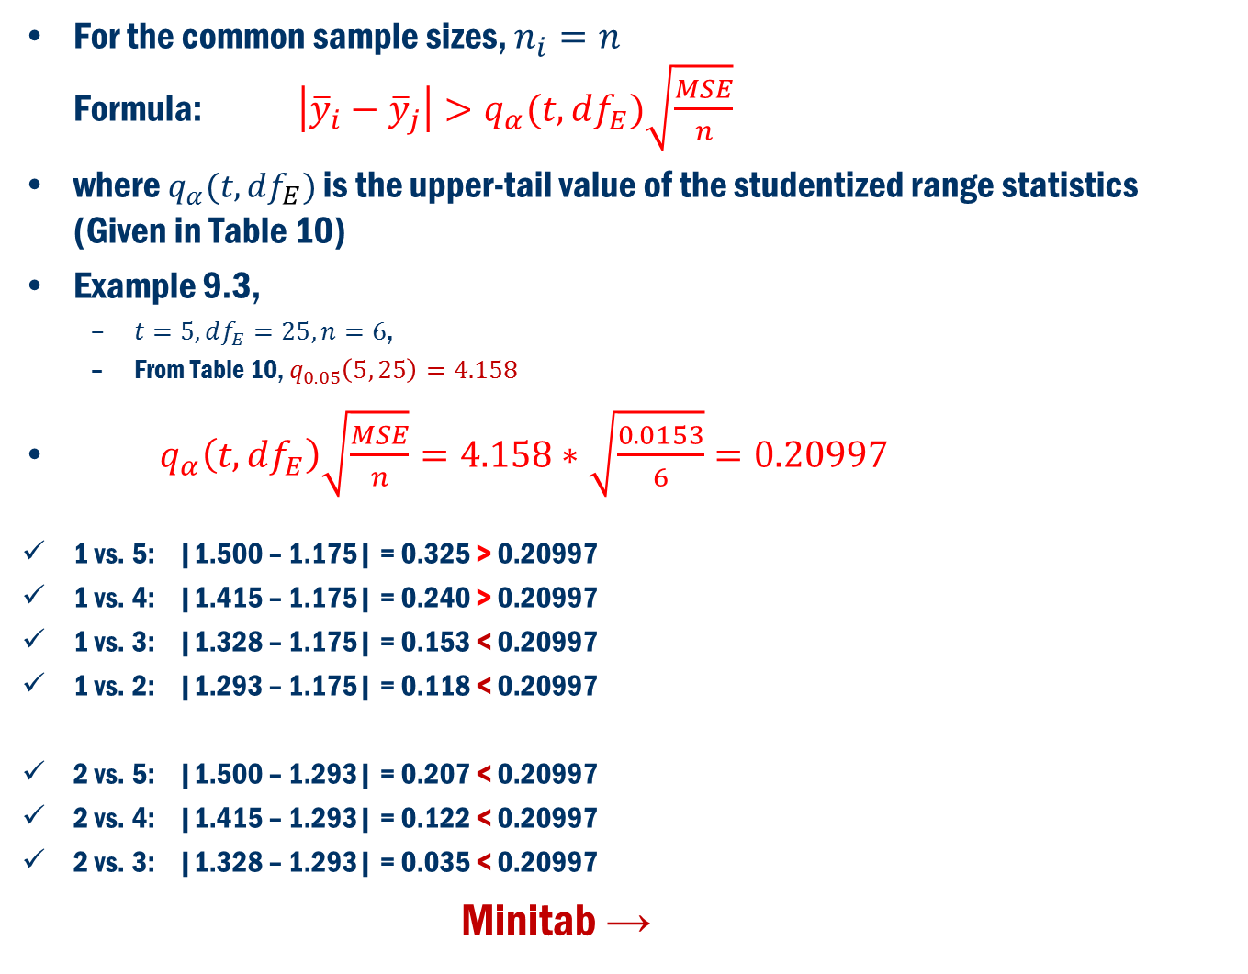
Tukey’s Method
For the common sample sizes, $n_{i}=n$ Formula: $\left|{\overline{y}}_{i}−{\overline{y}}_{j}\right|>q_{α}(t, df_{E})\sqrt{\frac{MSE}{n}}$
where $q_{α}(t, df_{E})$ is the upper-tail value of the studentized range statistics (Given in Table 10)
Example 9.3,
$t=5, df_{E}=25, n=6$,
From Table 10, $q_{0.05}\left(5, 25\right)=4.158$
$q_{α}\left(t, df_{E}\right)\sqrt{\frac{MSE}{n}}=4.158∗\sqrt{\frac{0.0153}{6}}=0.20997$
1 vs. 5: |1.500 – 1.175| = 0.325 > 0.20997
1 vs. 4: |1.415 – 1.175| = 0.240 > 0.20997
1 vs. 3: |1.328 – 1.175| = 0.153 < 0.20997
1 vs. 2: |1.293 – 1.175| = 0.118 < 0.20997
2 vs. 5: |1.500 – 1.293| = 0.207 < 0.20997
2 vs. 4: |1.415 – 1.293| = 0.122 < 0.20997
2 vs. 3: |1.328 – 1.293| = 0.035 < 0.20997
Minitab →
Agents 4 and 5 are different from control
No Significant difference between agents 2,3,4 and 5

Slide 17
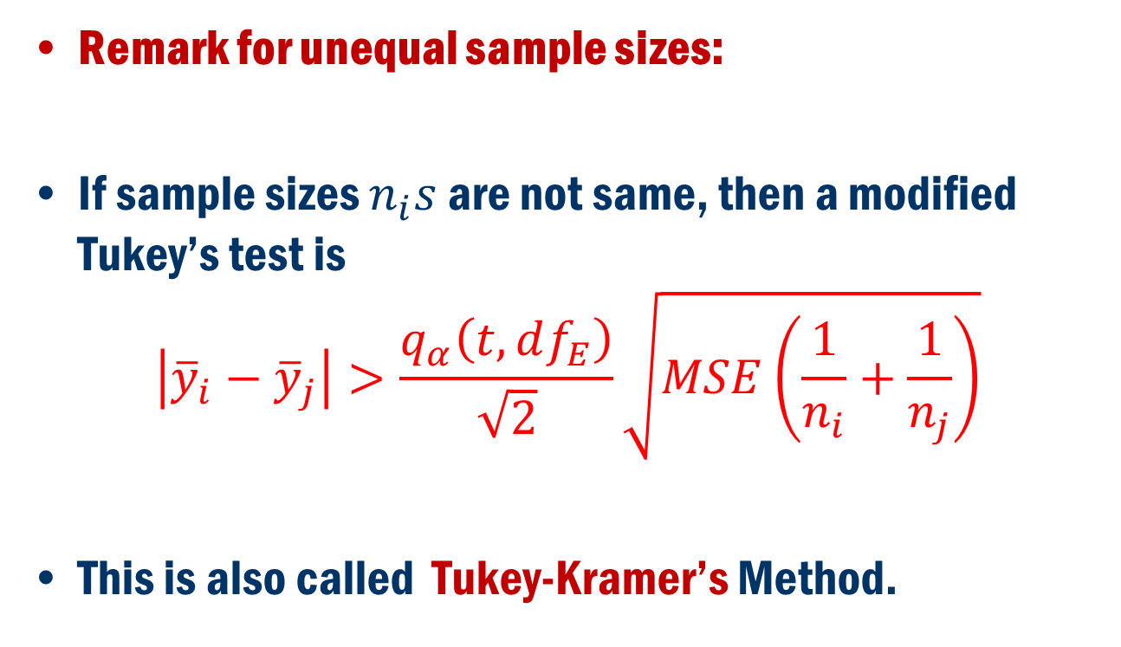
Tukey’s Method Cont’D
Remark for unequal sample sizes:
If sample sizes $n_{i}s$ are not same, then a modified Tukey’s test is
$$\left|{\overline{y}}_{i}−{\overline{y}}_{j}\right|>\frac{q_{α}\left(t, df_{E}\right)}{\sqrt{2}}\sqrt{MSE\left(\frac{1}{n_{i}}+\frac{1}{n_{j}}\right)}$$
This is also called Tukey-Kramer’s Method.

Slide 18
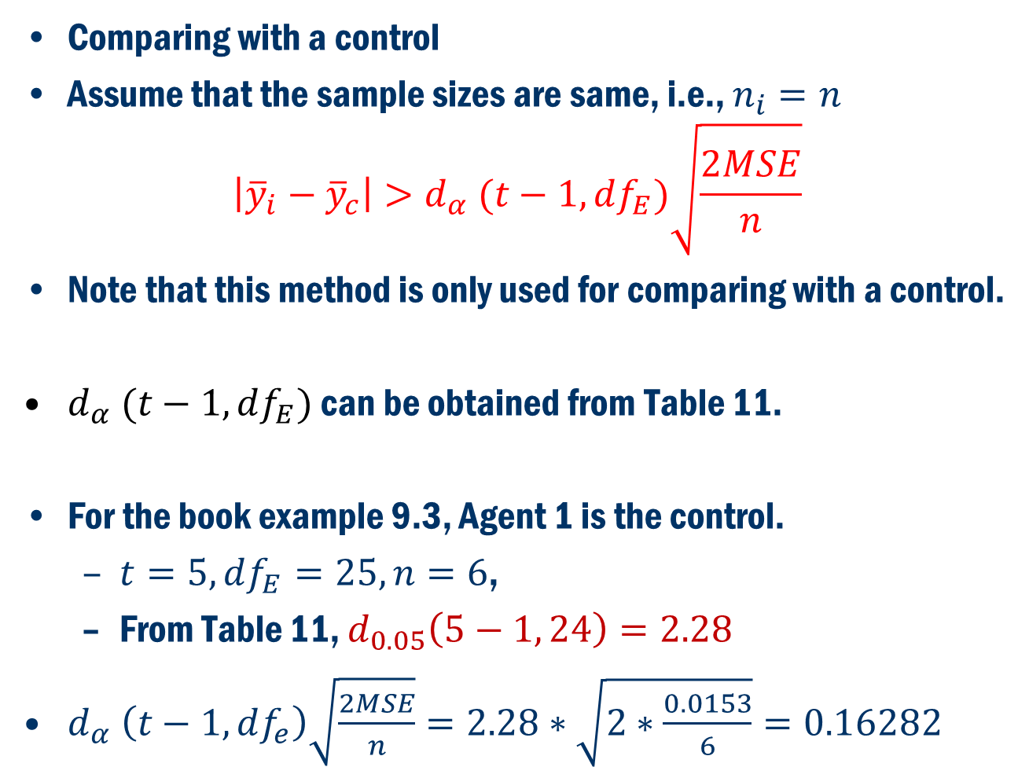
Dunnett’s Method
Comparing with a control
Assume that the sample sizes are same, i.e., $n_{i}=n$
$$\left|{\overline{y}}_{i}−{\overline{y}}_{c}\right|>d_{α} (t−1, df_{E})\sqrt{\frac{2MSE}{n}}$$
Note that this method is only used for comparing with a control.
$d_{α} (t−1, df_{E})$ can be obtained from Table 11.
For the book example 9.3, Agent 1 is the control.
$t=5, df_{E}=25, n=6$,
From Table 11, $d_{0.05}\left(5−1, 24\right)=2.28$
$d_{α} \left(t−1, df_{e}\right)\sqrt{\frac{2MSE}{n}}=2.28∗\sqrt{2∗\frac{0.0153}{6}}=0.16282$

Slide 19
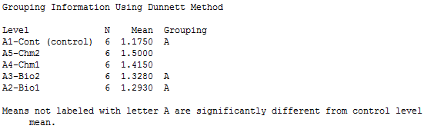
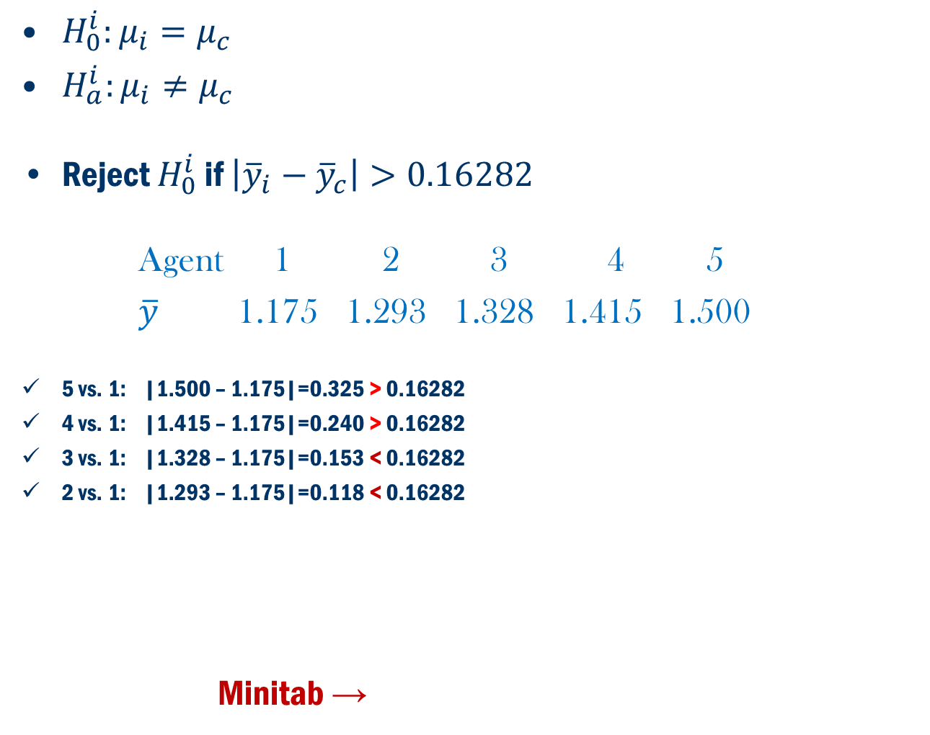
Dunnett’s Method: Example 9.3
$H_{0}^{i}:μ_{i}=μ_{c}$
$H_{a}^{i}:μ_{i}≠μ_{c}$
Reject $H_{0}^{i}$ if $\left|{\overline{y}}_{i}−{\overline{y}}_{c}\right|>0.16282$
Agent 1 2 3 4 5
$\overline{y}$ 1.175 1.293 1.328 1.415 1.500
5 vs. 1: |1.500 – 1.175|=0.325 > 0.16282
4 vs. 1: |1.415 – 1.175|=0.240 > 0.16282
3 vs. 1: |1.328 – 1.175|=0.153 < 0.16282
2 vs. 1: |1.293 – 1.175|=0.118 < 0.16282
Minitab →
Only the chemical agents 4 and 5 are different from control. No biological agents are different from control.

Slide 20
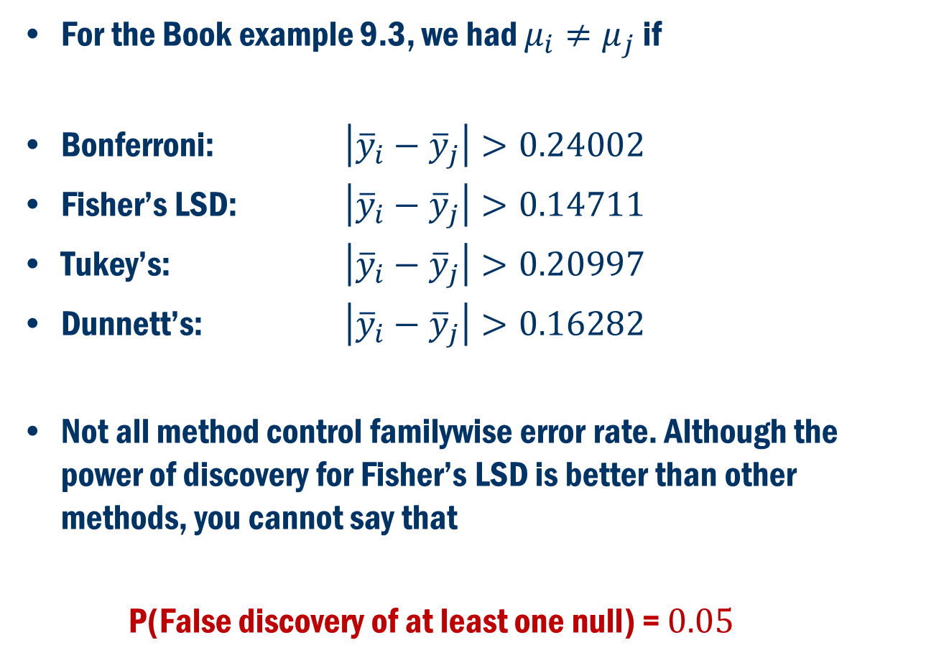
Comparison of Bonferroni, LSD, Tukey’s and Dunnett’s methods.
For the Book example 9.3, we had $μ_{i}≠μ_{j}$ if
Bonferroni: $\left|{\overline{y}}_{i}−{\overline{y}}_{j}\right|>0.24002$
Fisher’s LSD: $\left|{\overline{y}}_{i}−{\overline{y}}_{j}\right|>0.14711$
Tukey’s: $\left|{\overline{y}}_{i}−{\overline{y}}_{j}\right|>0.20997$
Dunnett’s: $\left|{\overline{y}}_{i}−{\overline{y}}_{j}\right|>0.16282$
Not all method control familywise error rate. Although the power of discovery for Fisher’s LSD is better than other methods, you cannot say that
P(False discovery of at least one null) = $0.05$

Slide 21
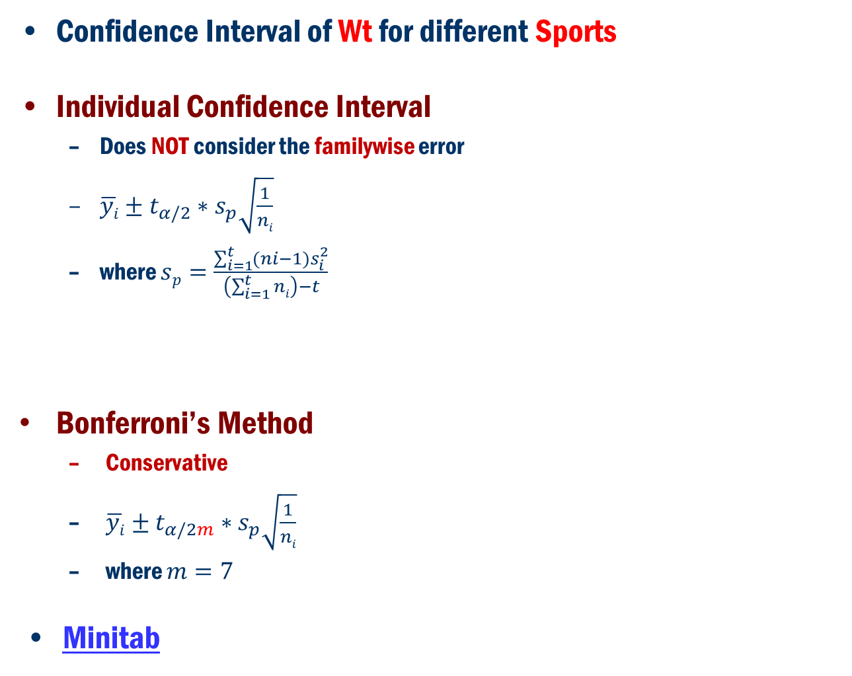
Australian Institute of Sport
Confidence Interval of Wt for different Sports
Individual Confidence Interval
Does NOT consider the familywise error
$\overline{yi}±t_{α/2}∗s_{p}\sqrt{\frac{1}{ni}}$
where $sp=\frac{\sum_{i=1}^{t}{(ni−1)s_{i}^{2}}}{\left(\sum_{i=1}^{t}{ni}\right)−t}$
Bonferroni’s Method
Conservative
$\overline{yi}±t_{α/2m}∗s_{p}\sqrt{\frac{1}{ni}}$
where $m=7$
Minitab

Slide 22
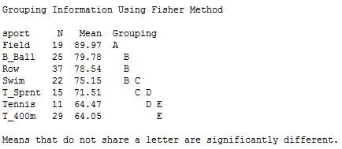
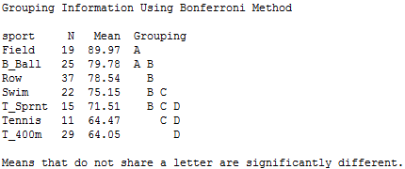
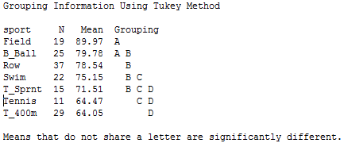
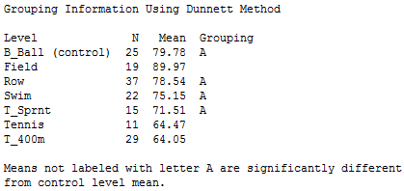
Australian Institute of Sport
Pairwise comparison of Wt for different Sports
Fisher’s Method
Does NOT consider the familywise error
Tukey’s Method
Consider the familywise error
Bonferroni’s Method
Conservative
Dunnett’s Method
Comparing with a Control group

Slide 23
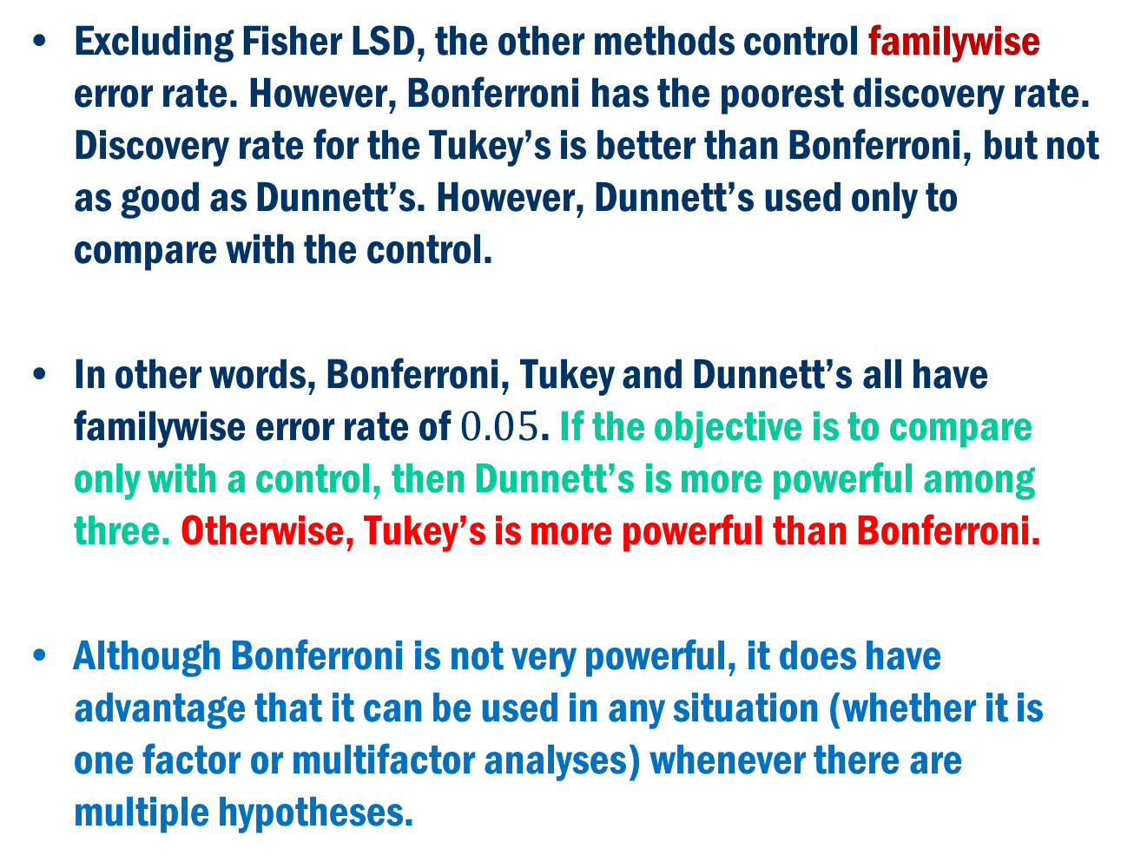
Conclusion
Excluding Fisher LSD, the other methods control familywise error rate. However, Bonferroni has the poorest discovery rate. Discovery rate for the Tukey’s is better than Bonferroni, but not as good as Dunnett’s. However, Dunnett’s used only to compare with the control.
In other words, Bonferroni, Tukey and Dunnett’s all have familywise error rate of $0.05$. If the objective is to compare only with a control, then Dunnett’s is more powerful among three. Otherwise, Tukey’s is more powerful than Bonferroni.
Although Bonferroni is not very powerful, it does have advantage that it can be used in any situation (whether it is one factor or multifactor analyses) whenever there are multiple hypotheses.

