Slide 1
AIML Capstone Project - CV - Car detection
Jun20A Group 6B
- Antara
- Deepiga
Gowtham
Manoj
- Shashank

Slide 2
Project Details
Project Objective: Design a DL based car identification model
Domain: Automotive. Surveillance
Context: Computer vision can be used to automate supervision and generate action appropriate action trigger if the event is predicted from the image of interest. For example a car moving on the road can be easily identified by a camera as make of the car, type, colour, number plates etc .
Data Description: The Cars dataset contains 16,185 images of 196 classes of cars. The data is split into 8,144 training images and 8,041 testing images, where each class has been split roughly in a 50-50 split. Classes are typically at the level of Make, Model, Year, e.g. 2012 Tesla Model S or 2012 BMW M3 coupe.
Data description:
‣ Train Images: Consists of real images of cars as per the make and year of the car.
‣ Test Images: Consists of real images of cars as per the make and year of the car.
‣ Train Annotation: Consists of bounding box region for training images.
‣ Test Annotation: Consists of bounding box region for testing images

Slide 3
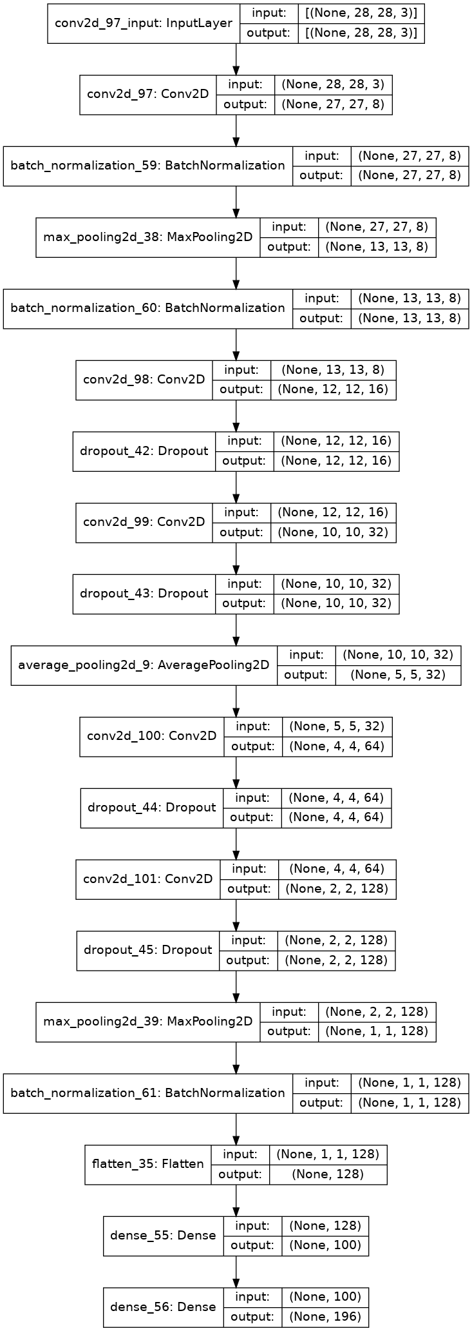
CNN for classification
Image size
28x28x3
Trainable Parameters
Total params: 120,656
Trainable params: 120,368
Non-trainable params: 288
Train Accuracy
loss: 2.3558
accuracy: 0.3774
val_loss: 12.9033
val_accuracy: 0.0020
Test Accuracy
0.005845044273883104
Important points
Used SGD optimizer
Lr=0.01, momentum =0.9
100 epoch
Details for annexure
Further tuning

Slide 4
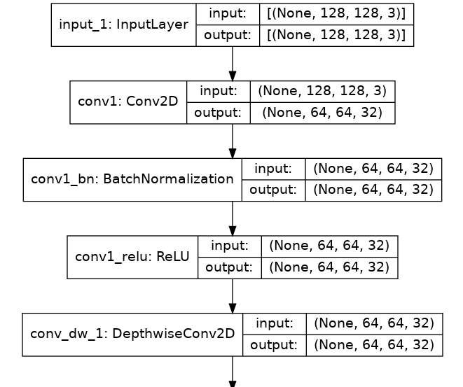
MobileNet for Object detection (bounding box)
Image size
128x128x3
Trainable Parameters
Total params: 3,294,404
Trainable params: 65,540
Non-trainable params: 3,228,864
Train Accuracy
loss: 25.9123
IoU: 0.8815
val_loss: 56.1673
val_IoU: 0.8019
Test Accuracy
0.8018515706062317
Important points
Used Mobile net transfer learning
Details for annexure
Further tuning
Full model box diagram

Slide 5
Consolidated Model Results

Slide 6
Future Steps
Week 1
Week 2
Week 3

Slide 7
Annexure
Create single doc/text file attach it to the annexure.

