Slide 1
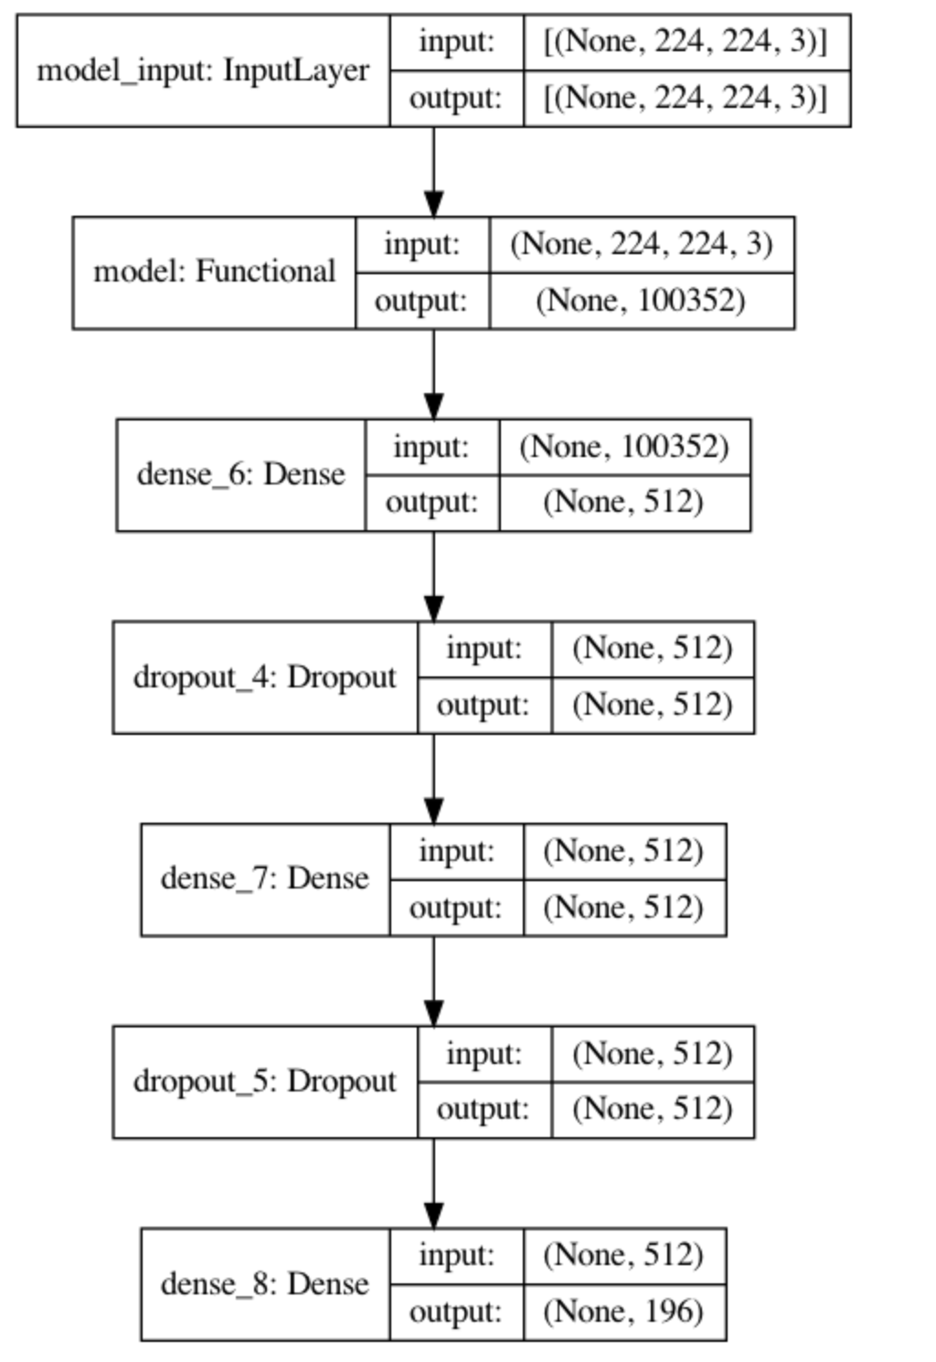
ResNet50 – Image Classification
Architecture details
Transfer Learning – Pre-trained model
Unfreezing a few of the last convolution blocks while keeping the first early conv blocks frozen
Transfer Learning/Custom
ResNet50
imagenet weights
removed the last predicting layer of the pre-trained model and replace them with our own predicting layers
Input Image Size
124*124
Trainable Parameters
Total params: 75,331,652
Trainable params: 75,278,532
Model Performance
Train Accuracy : 0.0063
Train Loss : 5.2901
Val accuracy : 0.0119
Val Loss : 5.2800
Important Note
To improve performance unfreezing early layers to make it trainable
Annexure for details

Slide 2
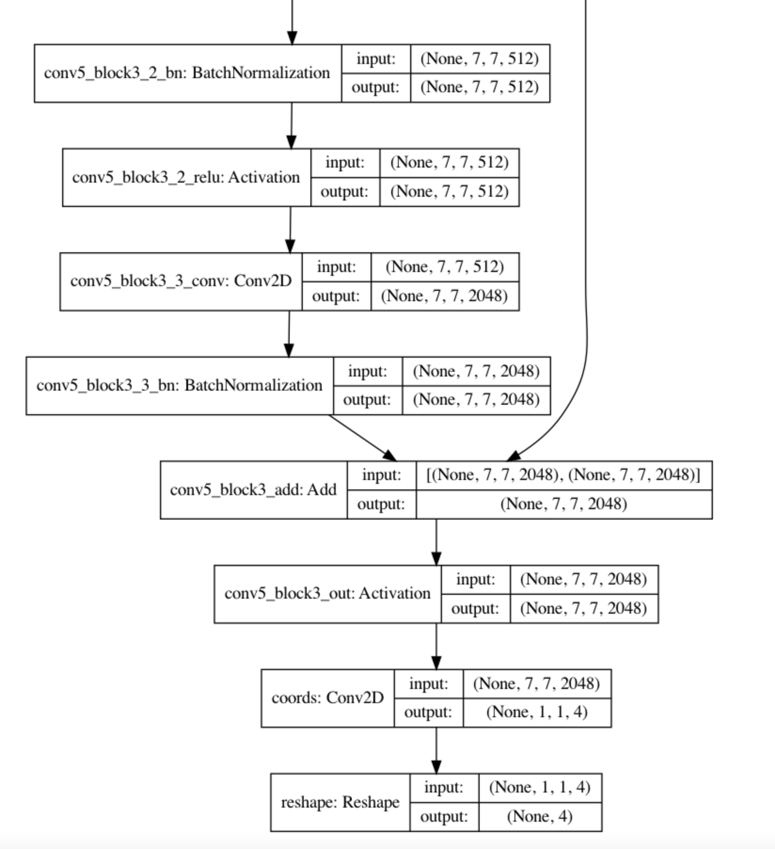
ResNet50 – Object Detection
Architecture details
Transfer Learning – Pre-trained model
Transfer Learning/Custom
ResNet50
imagenet weights
removed the last predicting layer of the pre-trained model and replace it with our own predicting layers
Input Image Size
124*124
Trainable Parameters
Total params: 23,989,124
Trainable params: 401,412
Model Performance
Train Accuracy : 0.7639
Train Loss : 278.0834
Test accuracy : 0.7662
Test Loss : 274.9186
Important Note
image augmentation, cross validation, hyperparameter tuning to improve performance
Annexure for details

Slide 3
Consolidated Performance Reports
Image Classification
Model | Train Accuracy | Train Loss | Val / Test Acc | Val / Test Loss
ResNet50 | 0.0063 | 5.2901 | 0.0119 | 5.2800
CNN
Object Detection
Model | Train Accuracy | Train Loss | Val / Test Acc | Val / Test Loss
ResNet50 | 0.7639 | 278.0834 | 0.7662 | 274.9186
MobileNet | 0.8815 | 25.9123 | 0.8019 | 56.1673

Slide 4
Annexure

