Slide 1
AIML Capstone Project - CV - Car detection
Jun20A Group 6B

Slide 2
Project Details
Project Objective: Design a DL based car identification model
Domain: Automotive. Surveillance
Context: Computer vision can be used to automate supervision and generate action appropriate action trigger if the event is predicted from the image of interest. For example a car moving on the road can be easily identified by a camera as make of the car, type, colour, number plates etc .
Data Description: The Cars dataset contains 16,185 images of 196 classes of cars. The data is split into 8,144 training images and 8,041 testing images, where each class has been split roughly in a 50-50 split. Classes are typically at the level of Make, Model, Year, e.g. 2012 Tesla Model S or 2012 BMW M3 coupe.
Data description:
‣ Train Images: Consists of real images of cars as per the make and year of the car.
‣ Test Images: Consists of real images of cars as per the make and year of the car.
‣ Train Annotation: Consists of bounding box region for training images.
‣ Test Annotation: Consists of bounding box region for testing images

Slide 3
Approach
Understanding Data:
EDA
Image Augmentation and bounding boxes
Model Exploration:
Design, train and test CNN models to classify the car
Design, train and test RCNN & its hybrids based object detection models to impose the bounding box
Fine Tuning Approach:
Read documentation and change points one step at a time
Auto fine tuners
Future Steps:
Further fine tuning
Pickle the tuned models
Implementing both CNN model and RCNN/hybrid approach for identifying car and its further details in a single step
UI design brainstorming
UI for automating tasks
Select data set folder
Select model – CNN
Select Model RCNN/Hybrid
Select test folder
Analyze result
Test on single images as choosen
Pickled model to be used for future prediction and viewing image

Slide 4
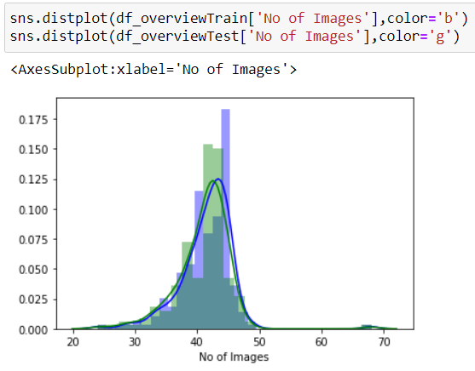
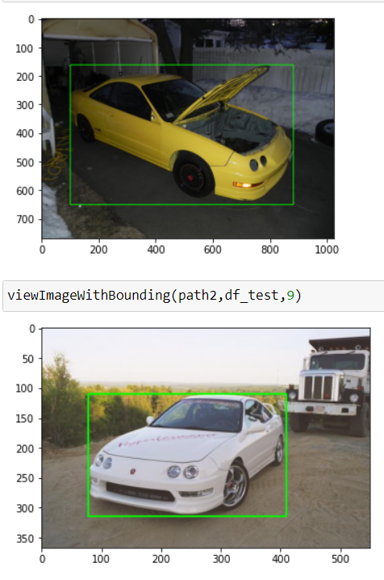
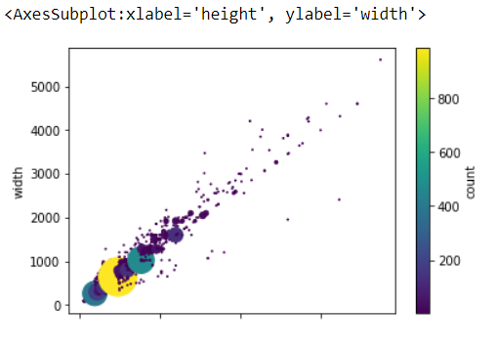
EDA
Data Provided:
Sets of car images and their bounding boxes coordinates
Total car types present in the dataset – 196
Distribution of images among the car types is very wide.
Its ranging from 22 images in a folder to 68 in train ad test sets.
For training and test sets, majority of folders are have 35-45 images
Images are of having very dynamic range
Images are having multiple light conditions
Only one car image coordinate is provided among multiple cars if present.
Image size are of varying nature
Image sizes range from very small size in 50x50 to 5000x5000 as well
Notice below image for concentration of image sizes
Maximum images are having size of 640x480

Slide 5
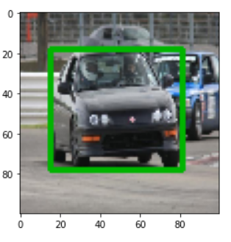
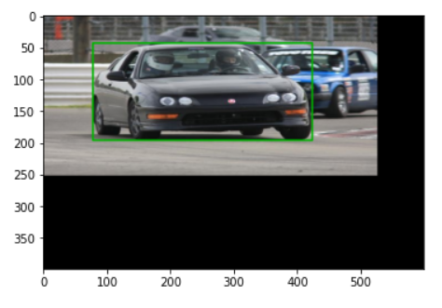
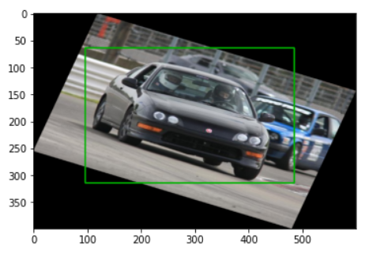
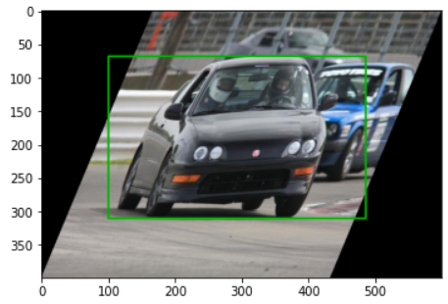
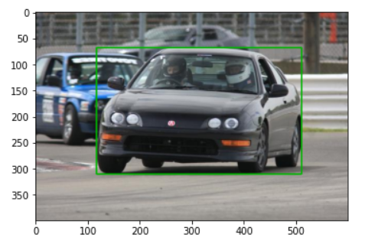
Image Augmentation & Bounding Boxes
Data/Image Augmentation: Data/Image augmentation works is by thinking of it as a way to artificially expand our dataset. As is the case with deep learning applications, the more data, the merrier.
We have many deep learning libraries like torchvision, keras, and specialised libraries on Github to support data augmentation for classification training tasks, but we don’t have a data augmentation for object detection tasks, which will follow the bounding box along with it.
Augmentation type options attempted:
Resizing with/without letterbox pattern
Horizontal Flip
Scale
Rotation
Translation
Shearing

Slide 6
Faster RCNN
Why not RCNN? : Introduction of R-CNN was important turn of event in object detection algorithm world. It was topped with Fast–RCNN and then finally by Faster-RCNN.
R-CNN was proposed to deal with the problem of efficient object localization in object detection
Earlier method uses exhaustive search to find object
R-CNN uses the Selective search algorithm which takes advantage of segmentation of objects and Exhaustive search to efficiently determine the region proposals
Selective search algorithm proposes approximately 2000 region proposals per image
Issues:
Each image needs to classify 2000 region proposals. Might not be an ideal case for all.
To store feature map, it requires lot of disk space.
R-CNN couldn’t be used real time. Each region proposal is fed independently to the CNN for feature extraction. This makes it impossible to run R-CNN in real-time.
For our current project objective of car detection, RCNN has a major drawback which leads to rejection. It can not be used in real time.

Slide 7
Faster RCNN
Why Not Fast RCNN? :- Fast R-CNN overcomes several issues in R-CNN. It justifies its tag ahead of RCNN and is Fast.
Removes the requirement to store a feature map and saves disk space
Takes the whole image and region proposals as input in its CNN architecture in one forward propagation
Softmax layer instead of SVM in its classification of region proposal which proved to be faster and generate better accuracy than SVM
Softmax layer to predict the class scores
FC layer to predict the bounding boxes of the detected objects
Issues:
Most of the time taken by Fast R-CNN during detection is a selective search region proposal generation algorithm. Hence, it is the bottleneck of this architecture which was dealt with in Faster R-CNN

Slide 8
Faster RCNN
Why Faster RCNN? :- Faster R-CNN is a single-stage model that is trained end-to-end.
Region proposal network (RPN) which is a fully convolutional network that generates proposals with various scales and aspect ratios
Introduced the concept of anchor boxes
Convolutional computations are shared across the RPN and the Fast R-CNN. This reduces the computational time
Architecture of Faster R-CNN:
RPN: For generating region proposals
Fast R-CNN: For detecting objects in the proposed regions
Drawback:
One drawback of Faster R-CNN is that the RPN is trained where all anchors in the mini-batch, of size 256, are extracted from a single image. Because all samples from a single image may be correlated (i.e. their features are similar), the network may take a lot of time until reaching convergence.

Slide 9
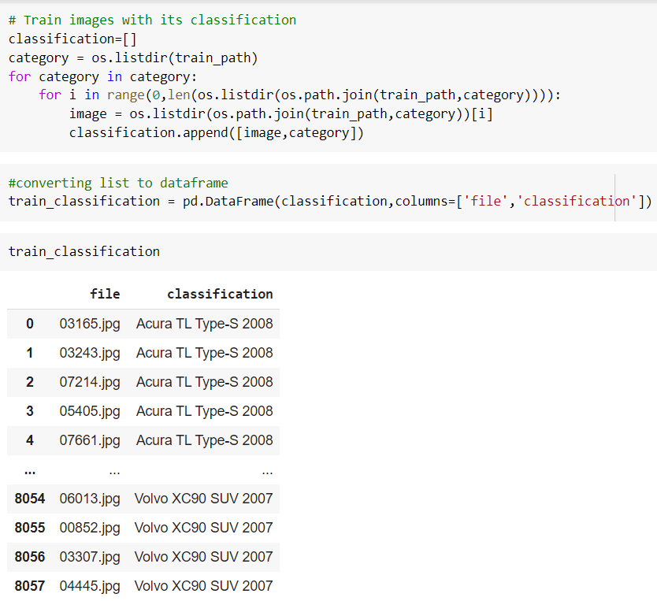
Data Preparation for Modeling
Mapping of Images in train folder with it class and storing in a dataframe

Slide 10
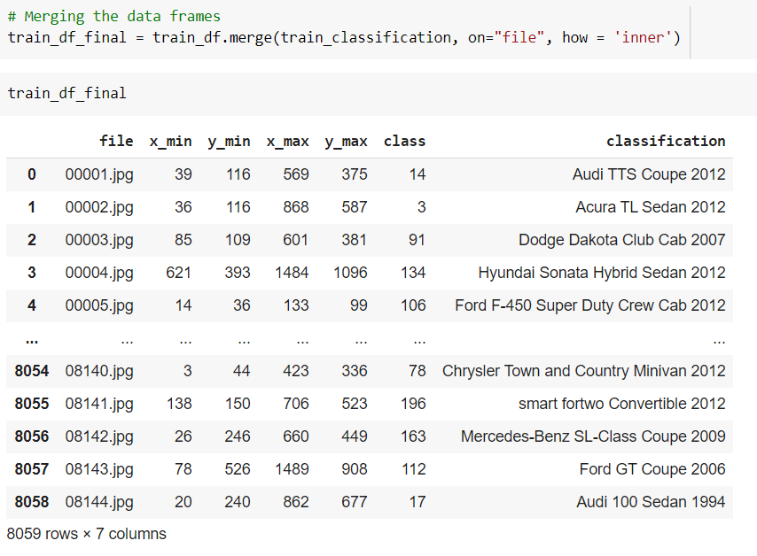
Data Preparation for Modeling
Train Images with the classification are merged with respective the bounding box Co-oridnates

Slide 11
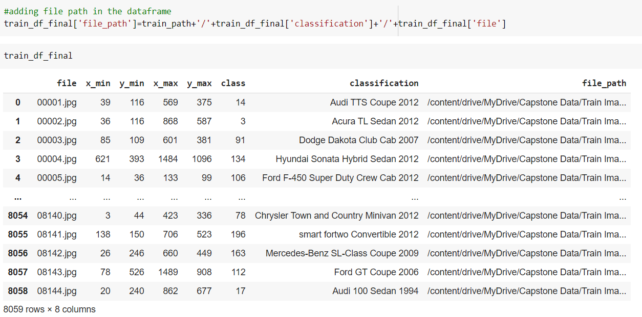
Data Preparation for Modeling
File path has been added against each training images , so that we can create the pipeline to access the images at ease

Slide 12
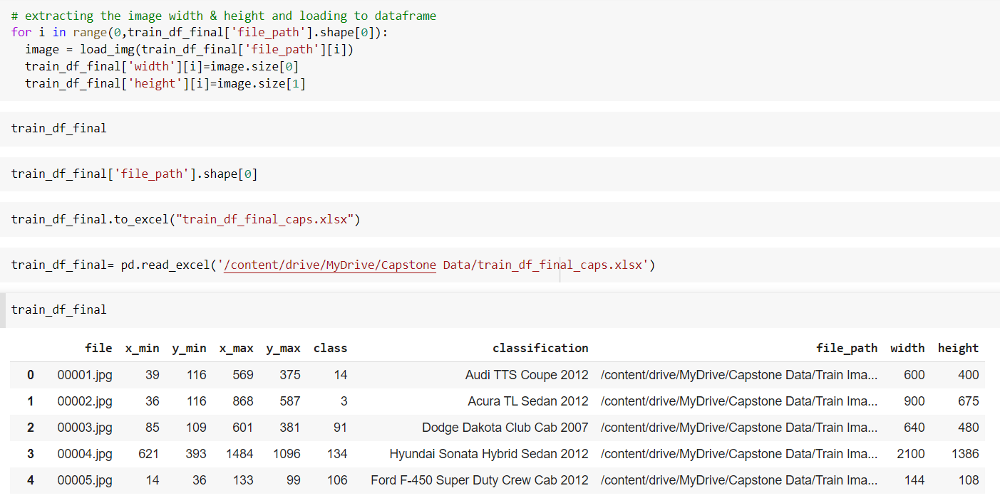
Data Preparation for Modeling
Image width and height is mapped against the following function , it will be required when we have to modify the bounding box coordinates based on the resized images

Slide 13
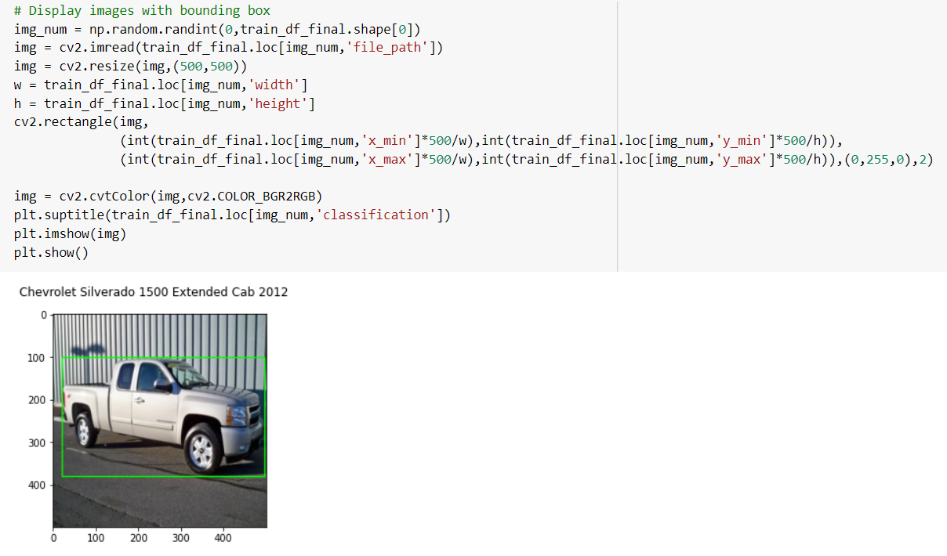
Data Preparation for Modeling
Cv2 library is used to display the random images with it bounding boxes

