Slide 1
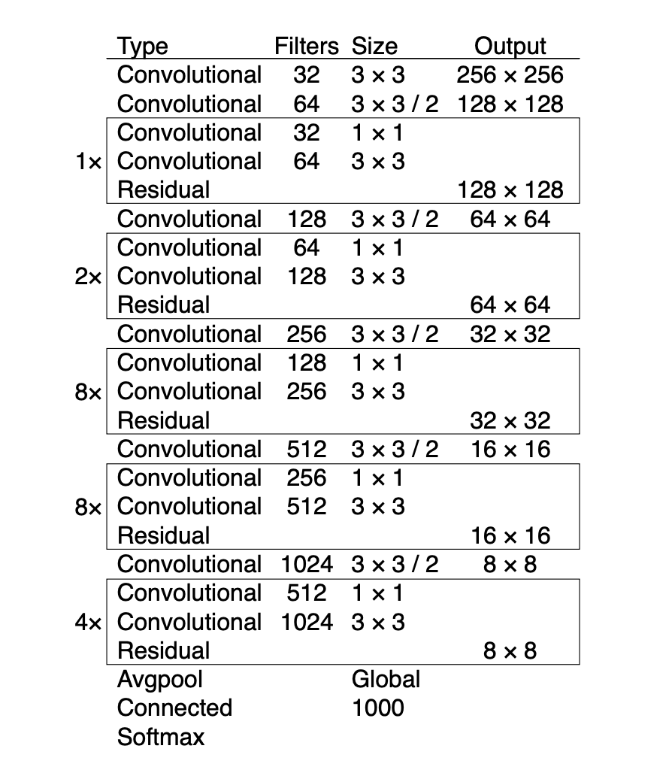
Yolo for Object detection (bounding box)
Image size
416x416x3
Trainable Parameters
Total params: 62,001,757
Trainable params: 61,949,149
Non-trainable params: 52,608
Train Accuracy
IoU: 76.8
Test Accuracy
IoU: 57.9
Important points
All layers are made trainable
Details for annexure
Full model architecture and bounding box calculations

