Slide 1
AIML Capstone Project - CV - Car classification & detection
Jun20A Group 6B
- Antara
- Deepiga
Gowtham
Manoj
- Shashank

Slide 2
Project Details
Project Objective: Design a DL based car detection and identification model
Domain: Automotive. Surveillance
Context: Computer vision can be used to automate supervision and generate action appropriate action trigger if the event is predicted from the image of interest. For example, a car moving on the road can be easily identified by a camera as make of the car, type, colour, number plates etc .
Data Description: The Cars dataset contains 16,185 images of 196 classes of cars. The data is split into 8,144 training images and 8,041 testing images, where each class has been split roughly in a 50-50 split. Classes are typically at the level of Make, Model, Year, e.g., 2012 Tesla Model S or 2012 BMW M3 coupe.
Data description:
‣ Train Images: Consists of real images of cars as per the make and year of the car.
‣ Test Images: Consists of real images of cars as per the make and year of the car.
‣ Train Annotation: Consists of bounding box region for training images.
‣ Test Annotation: Consists of bounding box region for testing images

Slide 3
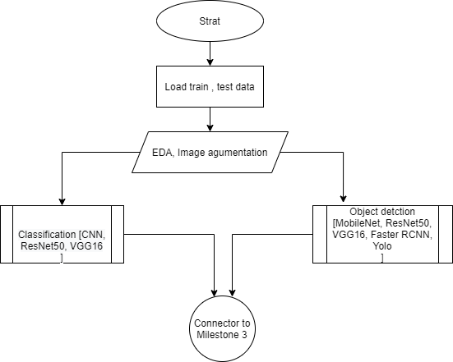
Approach – Milestone 1 & 2

Slide 4
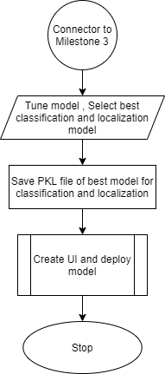
Approach – Milestone 3

Slide 5
Model Exploration Summary
Classification
Custom CNN – Using max-pooling, dropout, batch-normalization, optimizer (adam, SGD)
ResNet50 – Transfer Learning, pretrained model with imagenet weights, top layers trainable
VGG16 - Transfer Learning, pretrained model with imagenet weights, top layers trainable
Localization / Object Detection
MobileNet - Transfer Learning, pretrained model with MobileNet weights
ResNet50 – Transfer Learning, pretrained model with imagenet weights
VGG16 - Transfer Learning, pretrained model with imagenet weights, top layers trainable
Faster RCNN – ResNet50 as backbone network, transfer learning, pretrained model with all layers trainable
Yolo – Custom backbone, pretrained model with yolov2 weights and all layers trainable

Slide 6
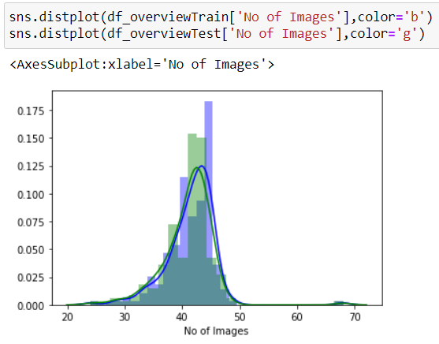
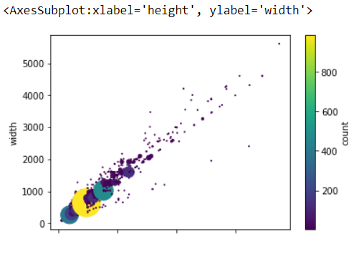
EDA
Image distribution
Data details:
Sets of car images and their bounding boxes coordinates
Total images in train data ➔ 8144
Total images in test data ➔ 8041
Observations:
Class Imbalance:
Image distribution is skewed
Majority car types have image in range of 35-45
Have to use data augmentation to increase data availability on few classes
Image size:
Highly volatile range of image size
Major concentration of images have size of 640x480
Resize images to sizes close to 600 to capture maximum features if model allows
Image size count

Slide 7
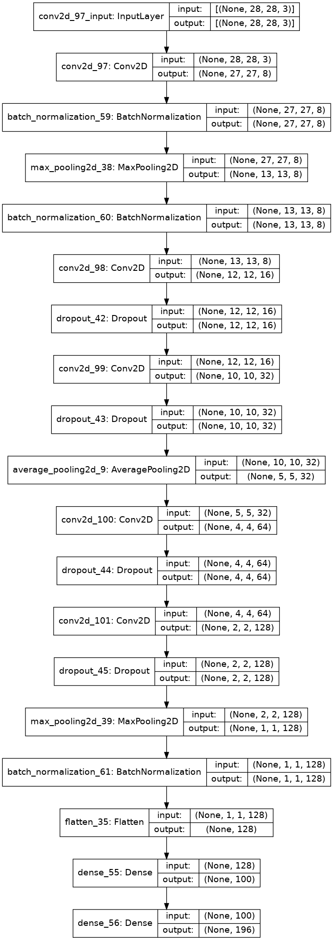
CNN for classification
Image size
28x28x3
Trainable Parameters
Total params: 120,656
Trainable params: 120,368
Non-trainable params: 288
Train Accuracy
loss: 2.3558
accuracy: 0.3774
val_loss: 12.9033
val_accuracy: 0.0020
Test Accuracy
0.005845044273883104
Important points
Used SGD optimizer
Lr=0.01, momentum =0.9
100 epoch
Details for annexure
Further tuning

Slide 8
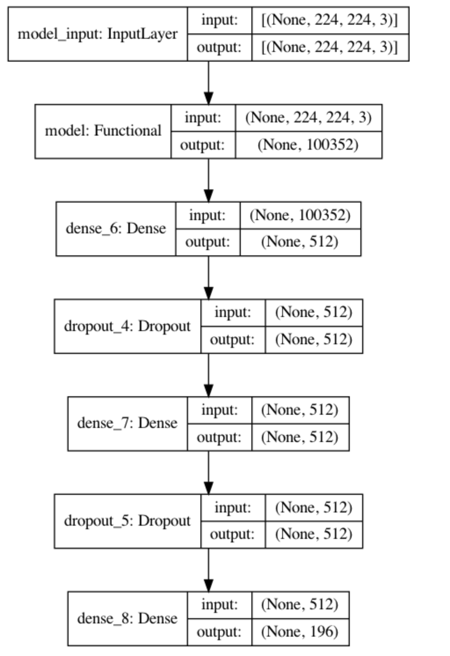
ResNet50 – Image Classification
Architecture details
Transfer Learning – Pre-trained model
Unfreezing a few of the last convolution blocks while keeping the first early conv blocks frozen
Transfer Learning/Custom
ResNet50
imagenet weights
removed the last predicting layer of the pre-trained model and replace them with our own predicting layers
Input Image Size
124*124
Trainable Parameters
Total params: 75,331,652
Trainable params: 75,278,532
Model Performance
Train Accuracy : 0.0063
Train Loss : 5.2901
Val accuracy : 0.0119
Val Loss : 5.2800
Important Note
To improve performance unfreezing early layers to make it trainable
Annexure for details

Slide 9
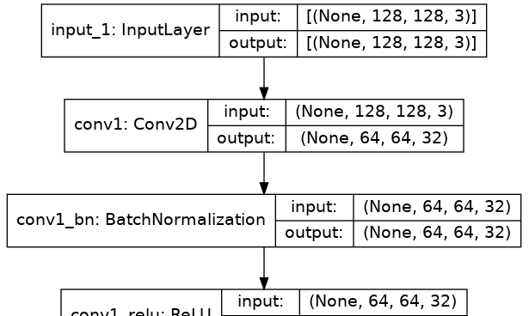
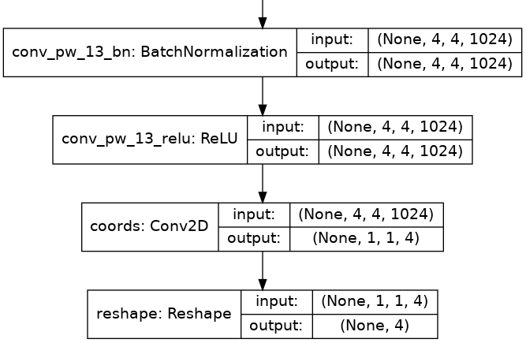
MobileNet for Object detection (bounding box)
Image size
128x128x3
Trainable Parameters
Total params: 3,294,404
Trainable params: 65,540
Non-trainable params: 3,228,864
Train Accuracy
loss: 25.9123
IoU: 0.8815
val_loss: 56.1673
val_IoU: 0.8019
Test Accuracy
0.8018515706062317
Important points
Used Mobile net transfer learning
Details for annexure
Further tuning
Full model box diagram
------ intermediate steps---

Slide 10
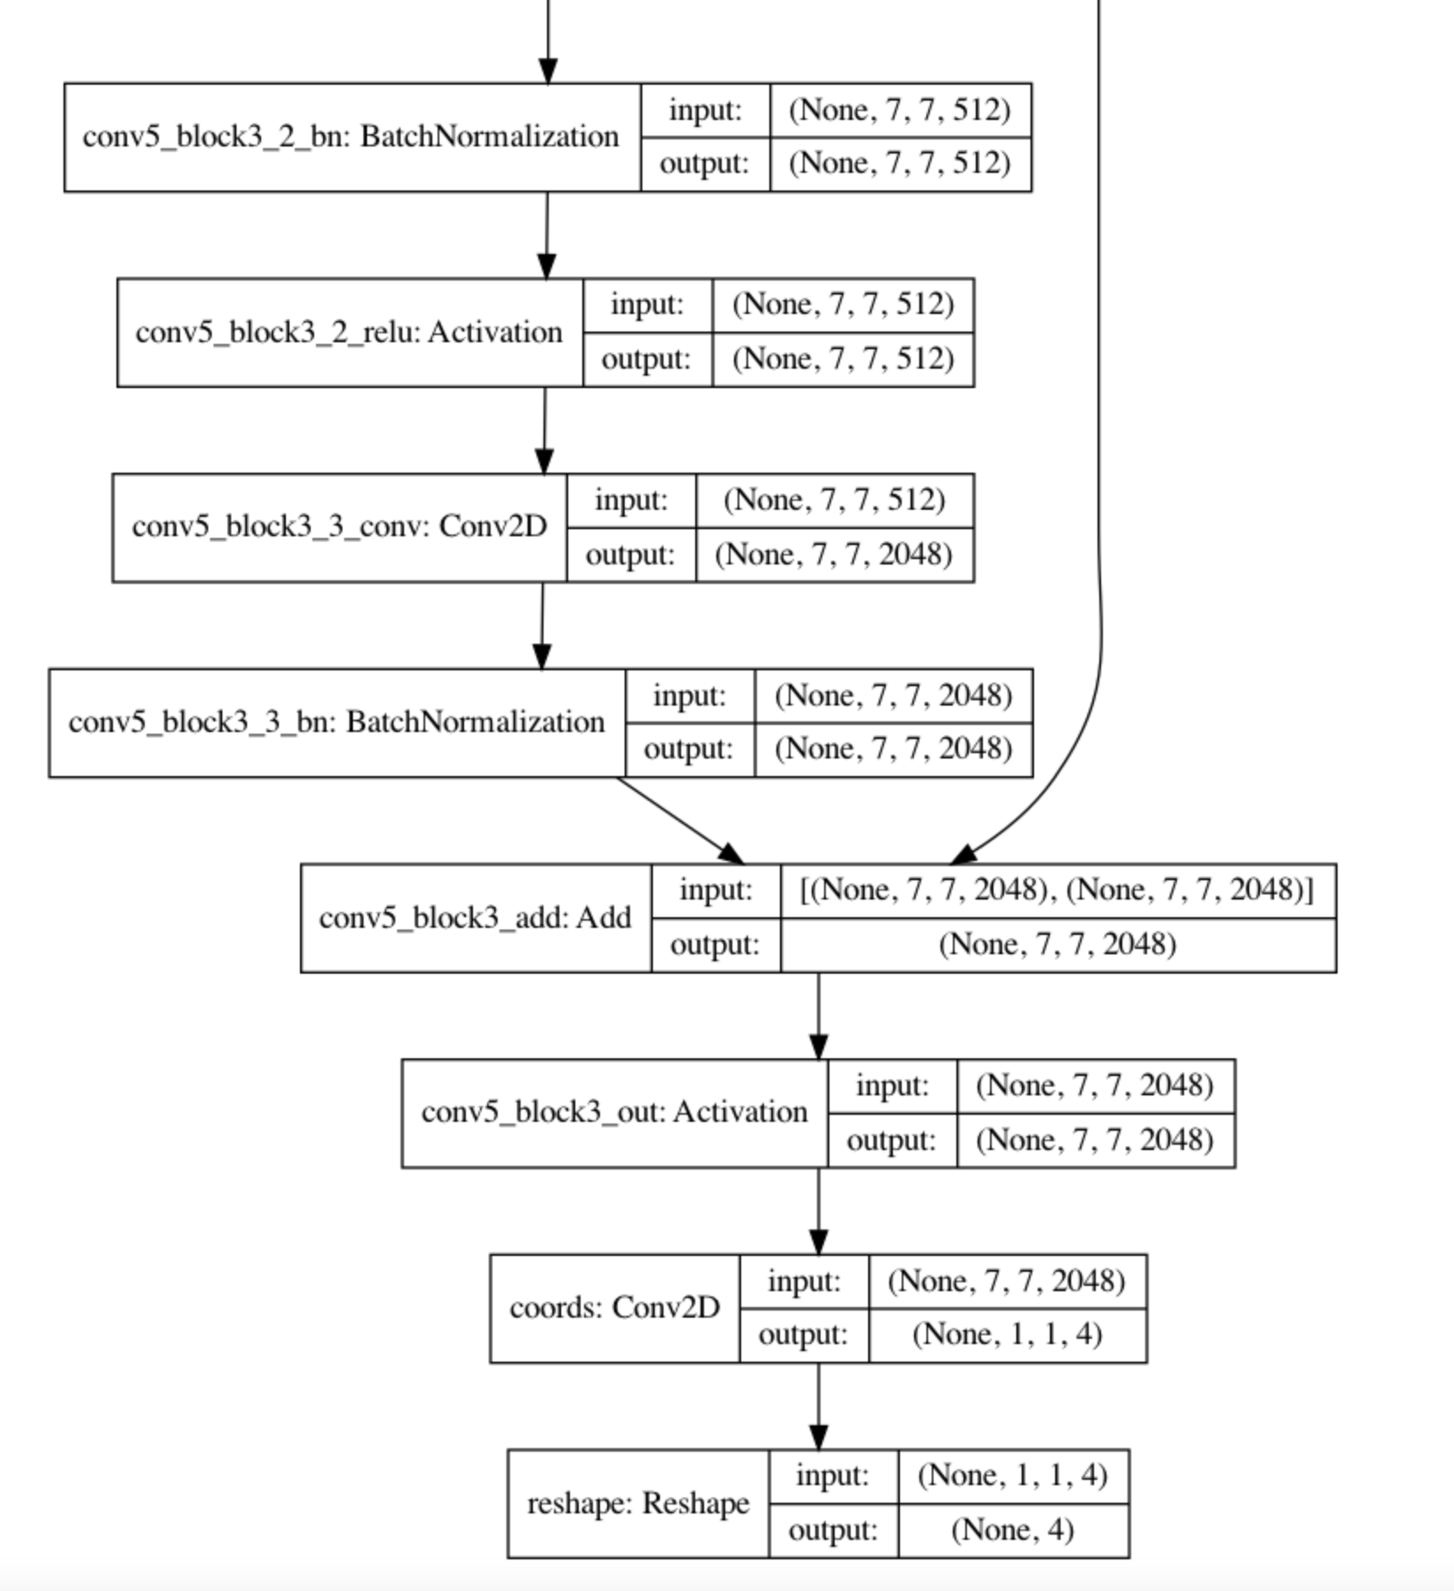
ResNet50 – Object Detection
Architecture details
Transfer Learning – Pre-trained model
Transfer Learning/Custom
ResNet50
imagenet weights
removed the last predicting layer of the pre-trained model and replace it with our own predicting layers
Input Image Size
124*124
Trainable Parameters
Total params: 23,989,124
Trainable params: 401,412
Model Performance
Train Accuracy : 0.7639
Train Loss : 278.0834
Test accuracy : 0.7662
Test Loss : 274.9186
Important Note
image augmentation, cross validation, hyperparameter tuning to improve performance
Annexure for details

Slide 11
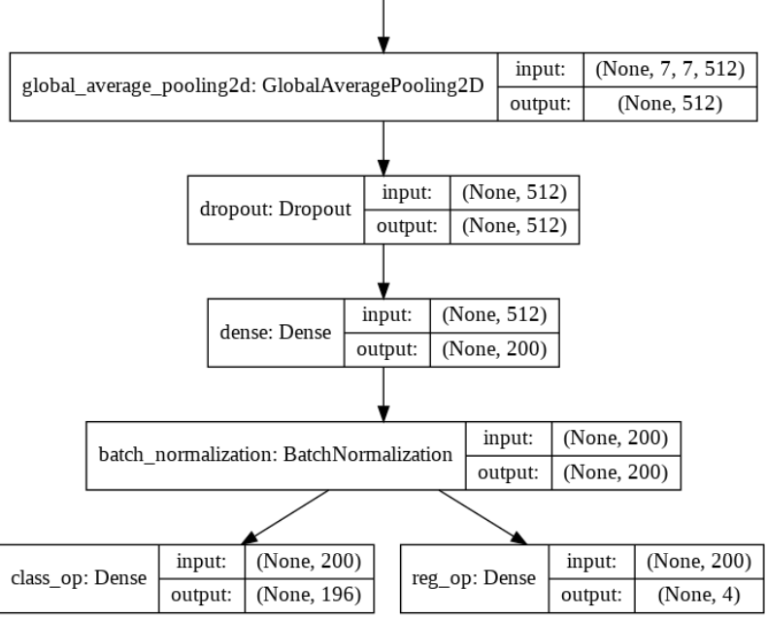
VGG16
Model - Key Details:
Used Transfer Learning Approach
VGG16 is the Backbone architecture
Input Image size is 224*224*3
Used ‘Imagenet’ weights
Image Augmentation not done
Optimizer = Adam
Loss for box coordinates =‘mse’
Loss for Classification = ‘categorical_crossentropy’
Metric for box coordinates =‘IoU’
Metric for box Classification =‘Accuracy’
Trainable params: 143,200
Non-trainable params: 14,715,088
Training & Validation Accuracy for Classification = 0.11 & 0.001
Training & Validation IoU for Bounding Boxes = 0.004 & 0.004
Model Architecture:
Pretrained VGG16 Model Excluding Top Layer
Additional References:
Data Preparation steps for Modeling
Defining Batch Generator function
Defining IoU calculation function

Slide 12
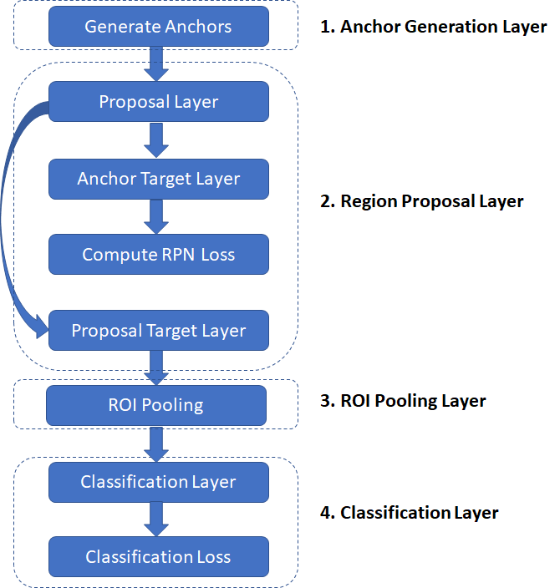
Faster RCNN
Architecture details
Base network – Resnet50
All Layers kept trainable with low learning rate
Transfer Learning
Pre trained Resnet50 model
resnet50_weights_tf_dim_ordering_tf_kernels.h5
Image size
Based on EDA, Maximum images are having size of 640x480. Hence keeping below size for saving max feature details.
600
Parameters Details
Total params: 28,342,195
Trainable params: 28,235,955
Non-trainable params: 106,240
Accuracy Details
Classification accuracy -
Loss details -
Test Accuracy
Test accuracy
Important points
Details for annexure

Slide 13
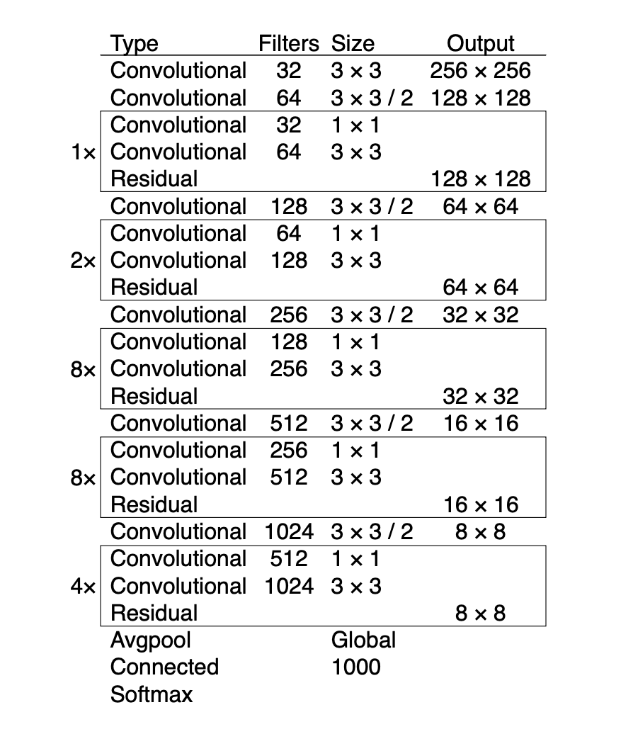
Yolo for Object detection (bounding box)
Image size
416x416x3
Trainable Parameters
Total params: 62,001,757
Trainable params: 61,949,149
Non-trainable params: 52,608
Train Accuracy
IoU: 76.8
Test Accuracy
IoU: 57.9
Important points
All layers are made trainable
Details for annexure
Full model architecture and bounding box calculations

Slide 14
Consolidated Performance Reports
Image Classification
Model | Train Accuracy | Train Loss | Val / Test Acc | Val / Test Loss
ResNet50 | 0.0063 | 5.2901 | 0.0119 | 5.2800
CNN | 0.3774 | 2.3558 | 0.0020 / 0.0058 | 12.9033
VGG16 | 0.11 | 2.57 | 0.001 | 3.87
Object Detection
Model | Train Accuracy | Train Loss | Val / Test Acc | Val / Test Loss
ResNet50 | 0.7639 | 278.0834 | 0.7662 | 274.9186
MobileNet | 0.8815 | 25.9123 | 0.8019 | 56.1673
VGG16 | 0.004 | 0.01 | 0.004 | 0.10
Faster RCNN
Yolo | 0.768 |  | 0.579

Slide 15
Future Steps
Week 1
Week 2
Week 3
Fine Tuning of models
Conclusion on final model selection
based on performance
Pipelining of classification and detection
Brainstorming session on UI & Model deployment
Explore on UI Design
UI Design / implementation
Finalize on UI & Model deployment
Implement UI Design
Deploy UI & Model
Thorough Testing

Slide 16

Annexure
Model | Additional Information
Custom CNN
ResNet50
MobileNet
VGG16
Faster RCNN
Yolo

