Slide 1
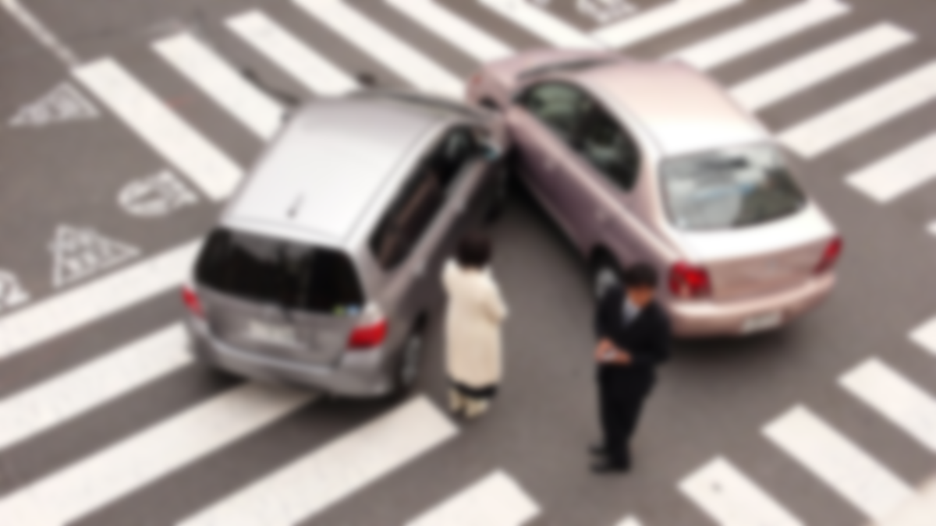
Road Accident Analysis Results
Mohammad Mahdi Norouzi

Slide 2




Objective of Analysis
1
Finding Patterns in the Dataset I
2
Providing Multiple Solutions um
3
Conclusion
4
Notes:
© Copyright PresentationGO.com – The free PowerPoint and Google Slides template library

Slide 3
We aim to extract patterns and useful information from the provided dataset. The first and simplest method involves analyzing the number of casualties according to different parameters, such as pedestrian location, age of casualties, and others. In the subsequent slides, we will illustrate these relationships and provide explanations for each.
1
Objective

Slide 4
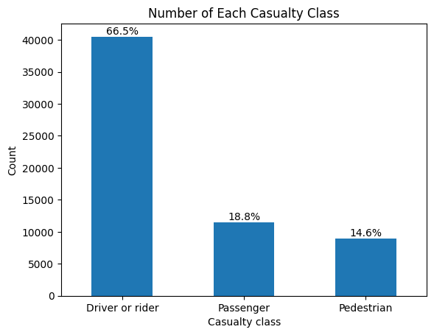
2
Patterns
According to the plot below, we can observe that 66.5 percent of casualties are drivers or riders. From this result, we can conclude that in the majority of accidents, there are either no pedestrians or passengers involved. Alternatively, if passengers are present, they are less likely to become casualties.

Slide 5
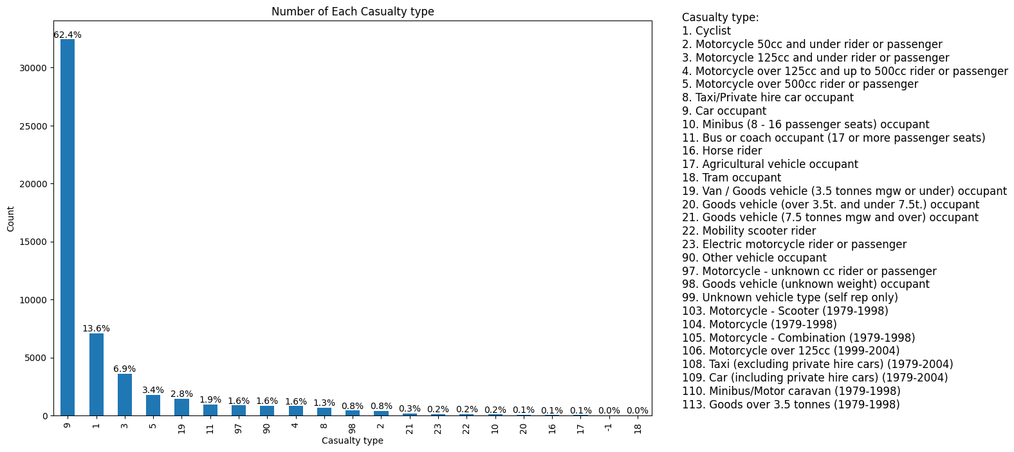
The plot below displays that over 60 percent of driver or rider casualties are car occupants, with cyclists being the second most affected group.

Slide 6
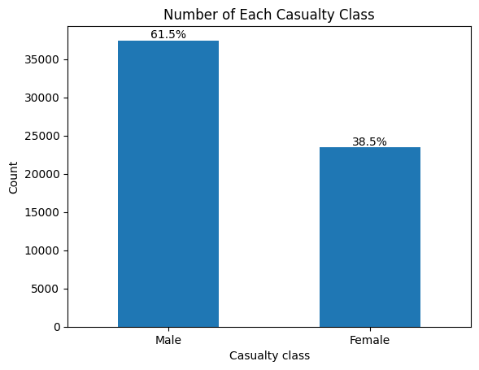
2
Patterns
More than 1.5 times the casualties are male.

Slide 7
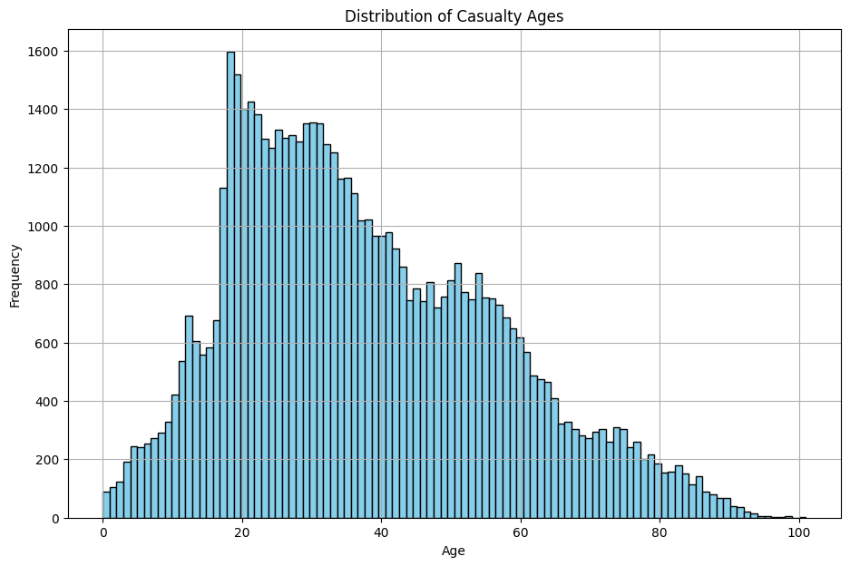
According to the plot below, the majority of casualties are related to individuals aged 18.

Slide 8
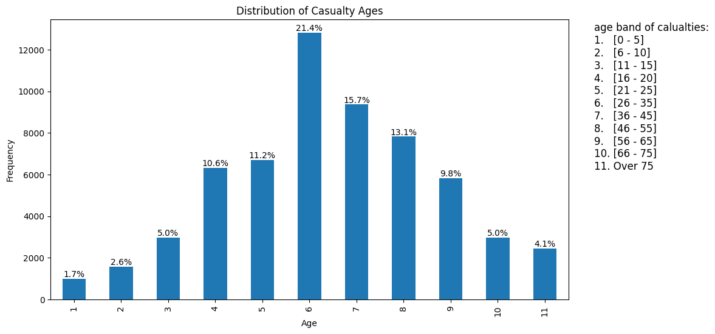
2
Patterns
But the majority of casualties are in the 6th age band.

Slide 9
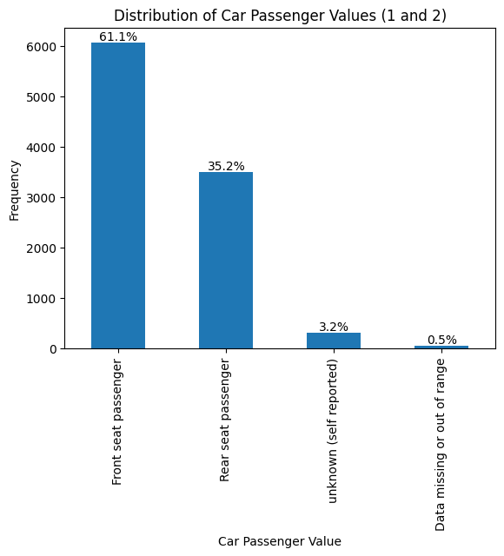
2
Patterns
According to the plot below, front-seat passengers are the most frequently injured. However, without knowing whether the cars involved in the accidents had any specific type of passenger, we cannot perform any further analysis.

Slide 10
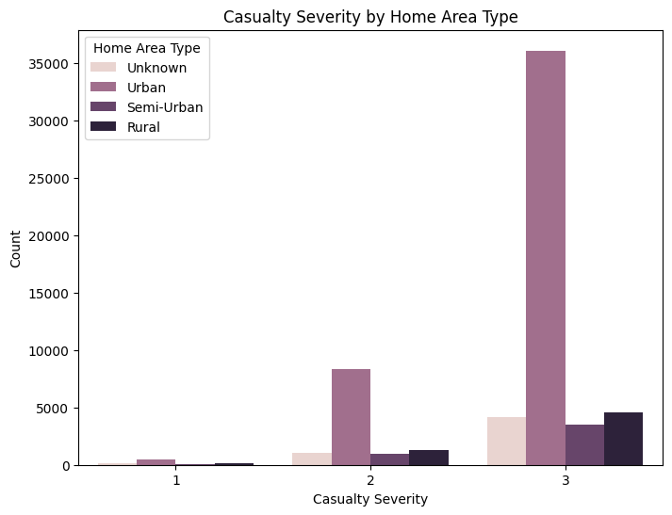
If we plot the number of casualties in different home area types for different casualty classes, we observe that the highest number of casualties in each casualty class is related to urban areas first, followed by rural areas.

Slide 11
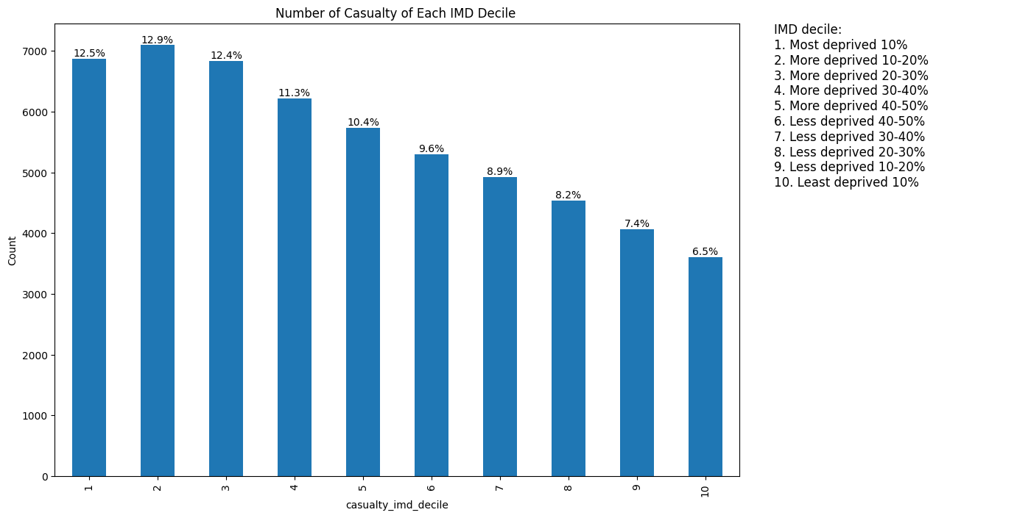
The following plot displays the IMD decile of the area where the casualty resides. However, due to a lack of data regarding the number of populations in each IMD decile, further analysis is limited.

Slide 12
2
Patterns
Next, we proceed with a more complex analysis. In this step, we employ a heatmap to describe the relationship between the number of casualties and two different parameters. The plot below illustrates the correlation of each parameter with other parameters in the columns.

Slide 13
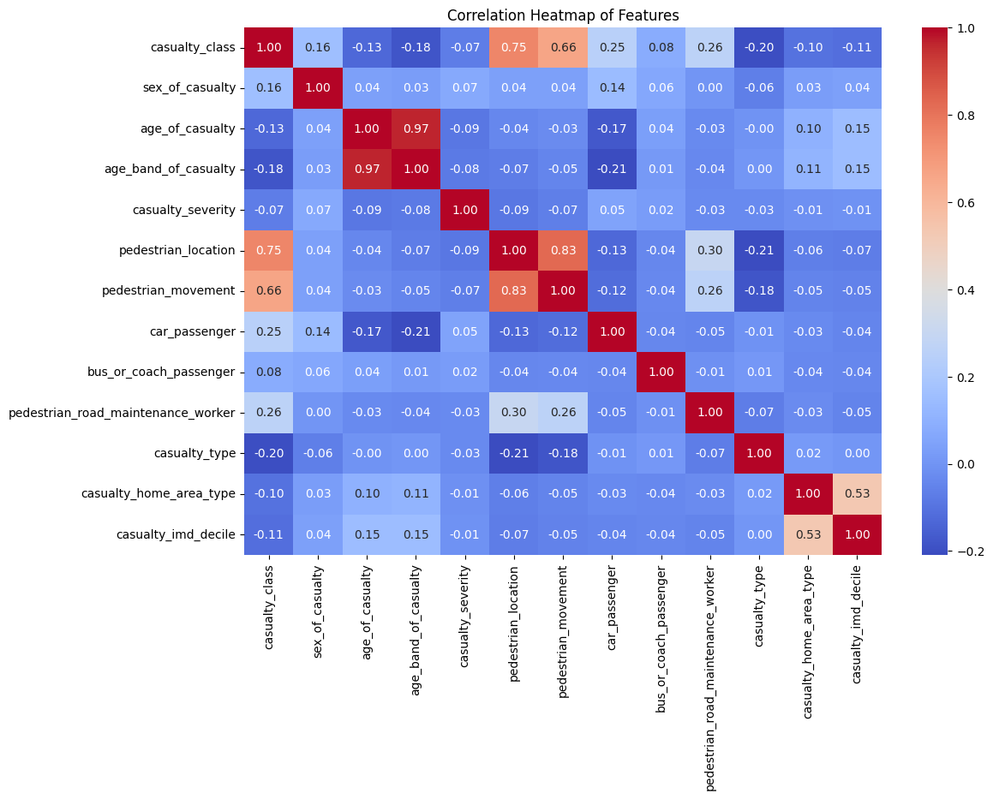

Slide 14
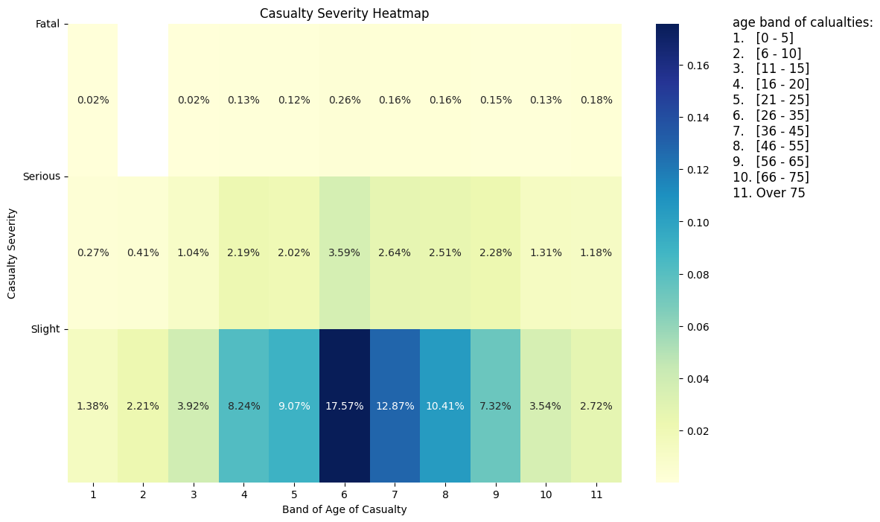
In the plot below, we can observe the general relationship between the number of casualties, casualty severity, and the age of casualties.

Slide 15
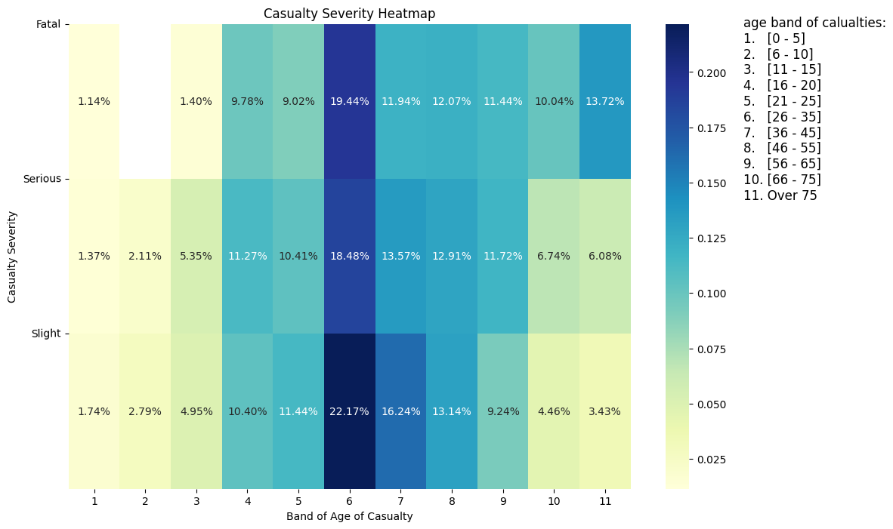
In another view of the last plot, we can observe the most common age bands of casualties for each type of casualty severity. For example, fatal casualties consist of more people aged over 66 years old than other casualty severities.

Slide 16
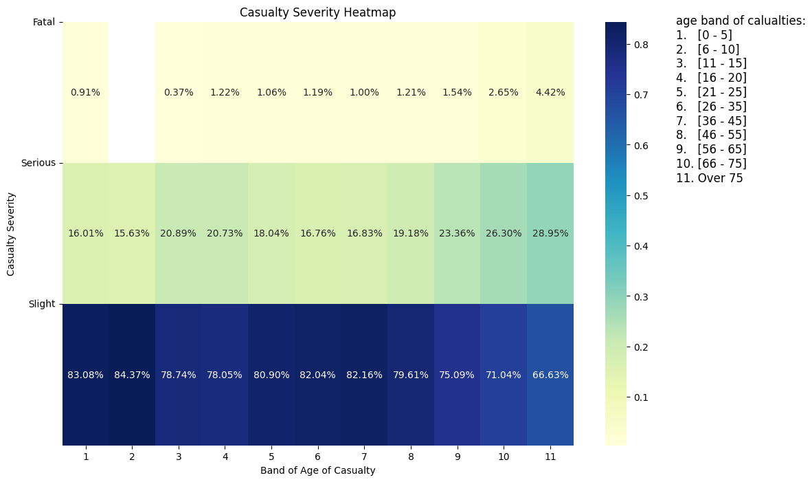
Alternatively, in another plot of this type, we can observe the percentage of each type of casualty within each age band of casualties. We may notice a consistent pattern across all age bands of casualties.

Slide 17
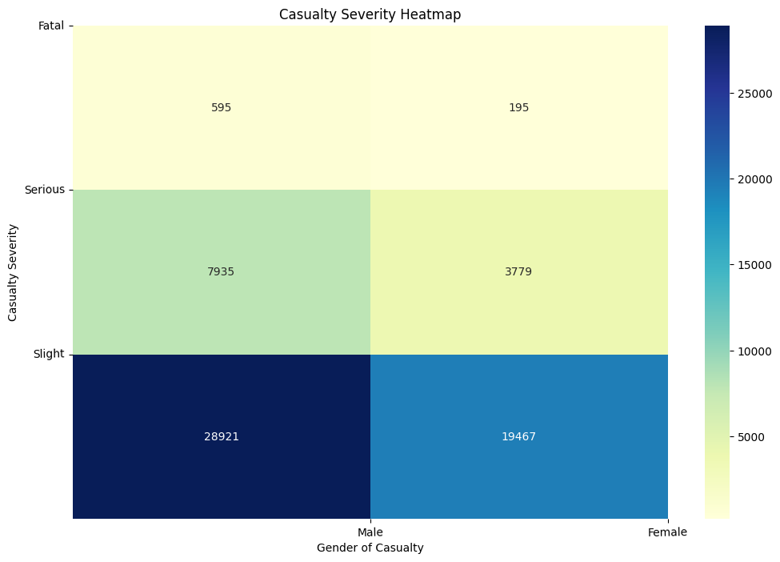
In these three slides, we can observe the same analysis as before using a heatmap, but in this step, we compare different genders. The majority of casualties are male, and their injuries tend to be slight.

Slide 18
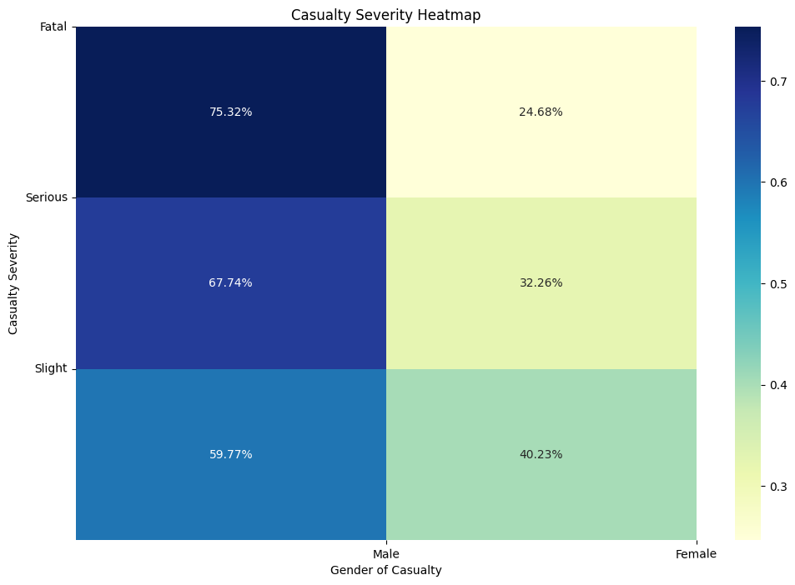
In the following plot, we can observe which gender most of the casualties of each type belong to.

Slide 19
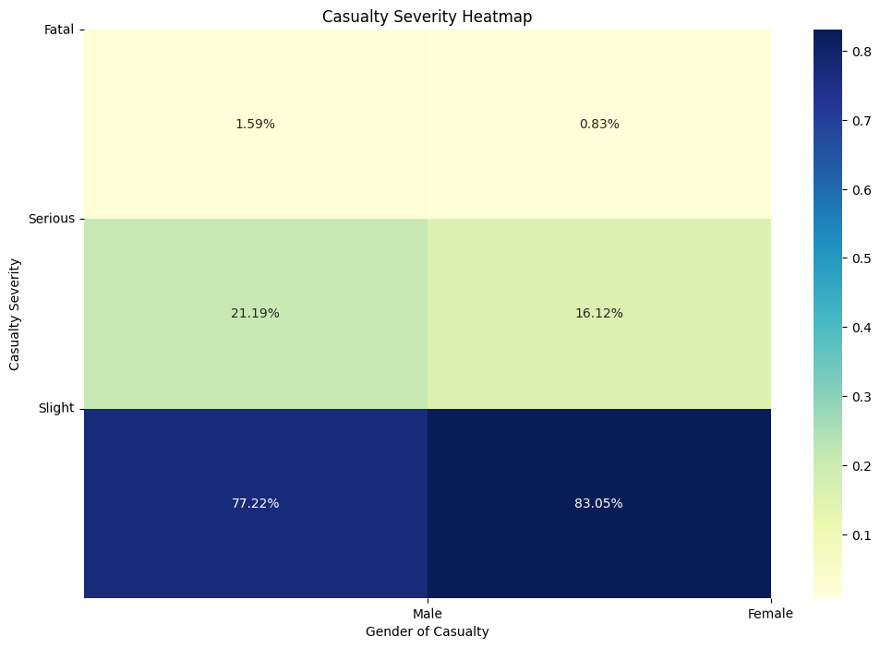
The result of the following plot indicates that females have fewer fatal casualties than males.

Slide 20
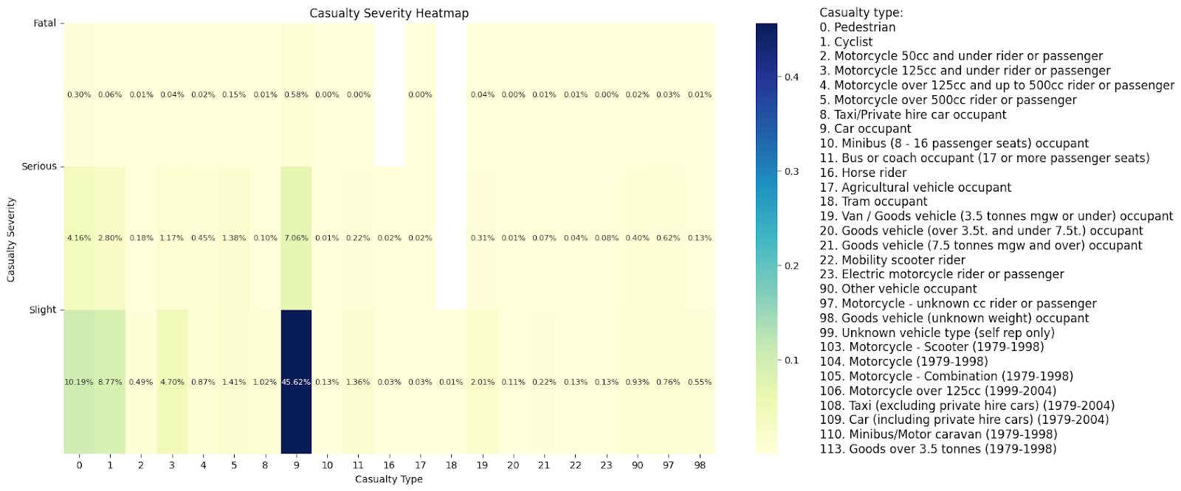
Like the previous heatmap, we can conduct the same analysis for casualty severity and casualty type. In the following heatmap plot, we can observe that the majority of casualties are car occupants and have slight casualties.

Slide 21
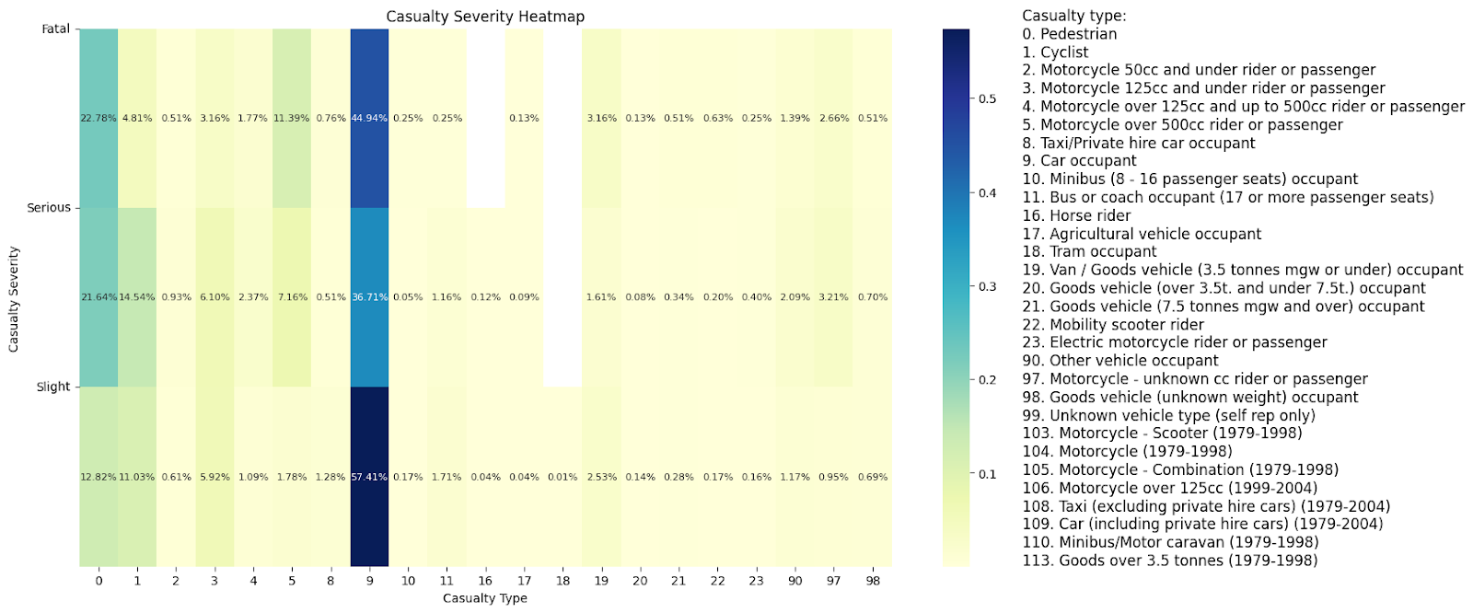
From the following result, we can conclude that "car occupant," "pedestrian," and "Motorcycle over 500cc rider or passenger" are the main fatal casualties, respectively. However, cyclist casualties rank third in terms of slight casualties.

Slide 22
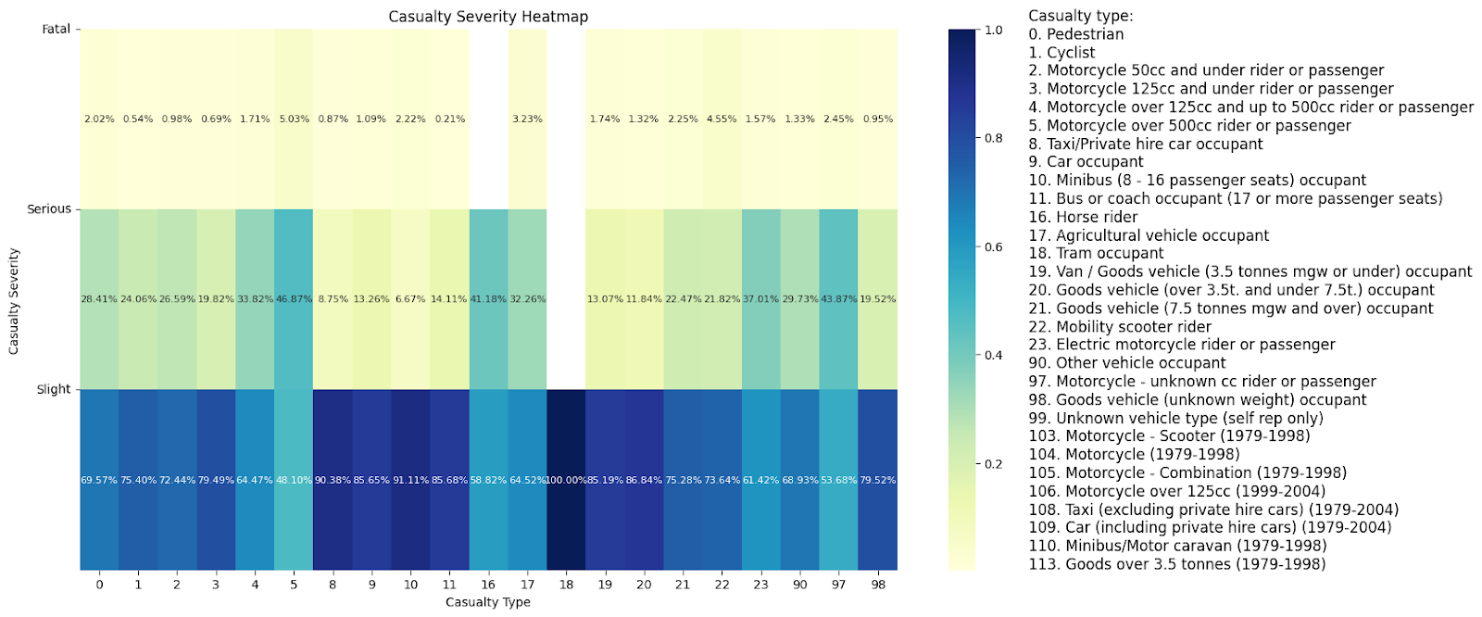
The heatmap below shows that "minibus," "Taxi/Private hire car occupant," and "Goods vehicle (over 3.5t. and under 7.5t.) occupant" have the minimum serious casualties, respectively. However, in contrast, motorcycles have the maximum serious casualties compared to other casualty types.

Slide 23
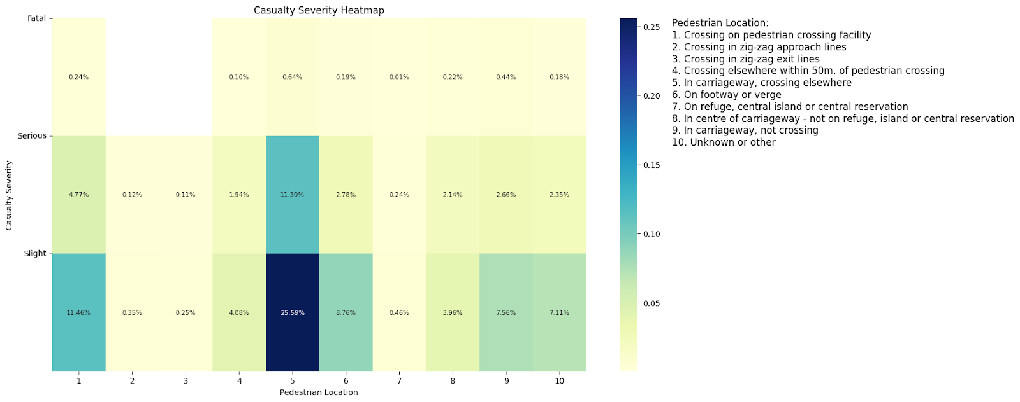
The heatmap of pedestrian locations shows that "In carriageway, crossing elsewhere" has the greatest number of casualties; however, these casualties belong to the slight casualty class.

Slide 24
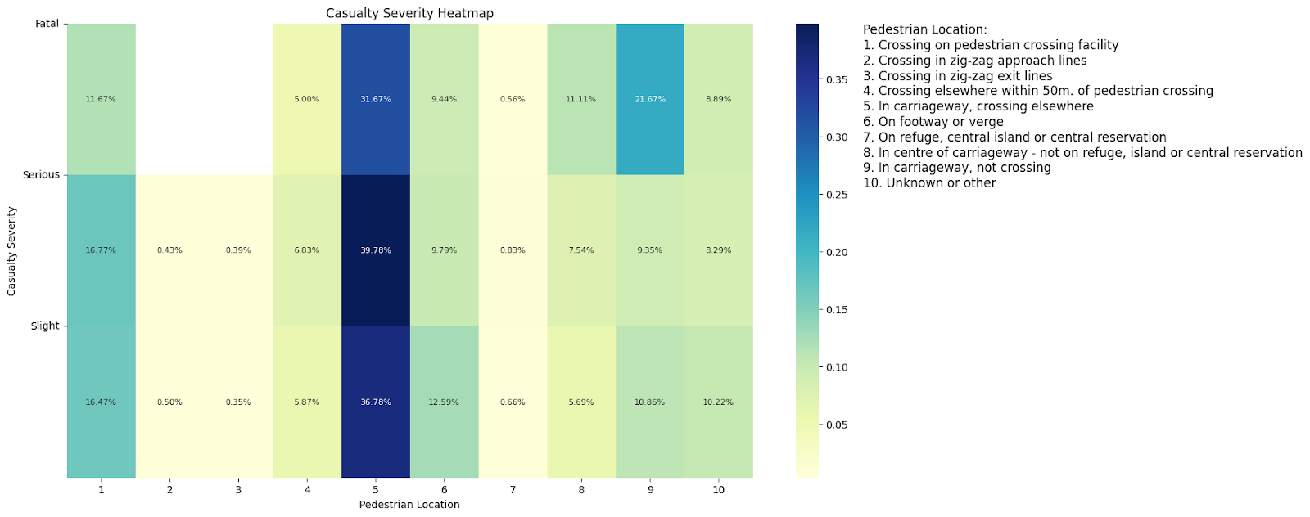
The majority of fatal casualties belong to "In carriageway, crossing elsewhere" and "In carriageway, not crossing," respectively. However, "Crossing on pedestrian crossing facility" has the second most serious casualties. Conversely, "Crossing in zig-zag exit lines," "Crossing in zig-zag approach lines," and "On refuge, central island, or central reservation" have the minimum casualties of each type.

Slide 25
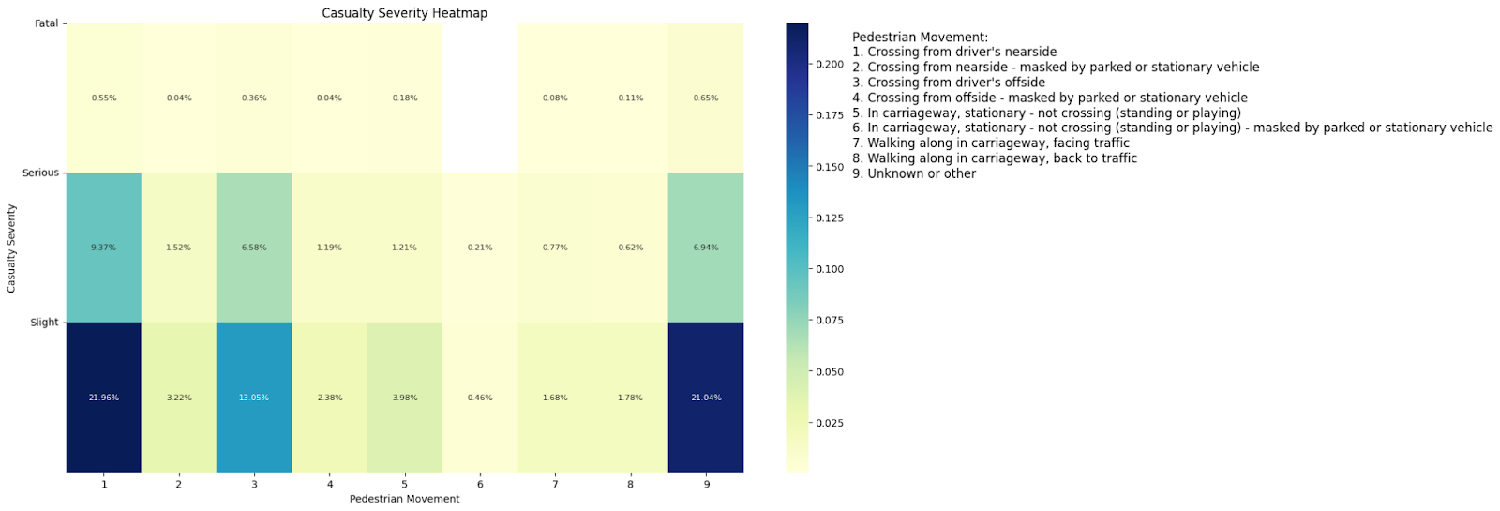
For pedestrian movement, we observe that "Crossing from driver's nearside" has the maximum number of casualties of the slight type in the first position, followed by "Crossing from driver's offside" in the second position.

Slide 26
1
Solutions
If people use public transport (such as taxis or minibuses) the injuries will not be serious in the event of an accident
Since accidents at pedestrian crossings have many injured people (the second rank), by increasing the fine in this area, this number can be reduced.

