Slide 1
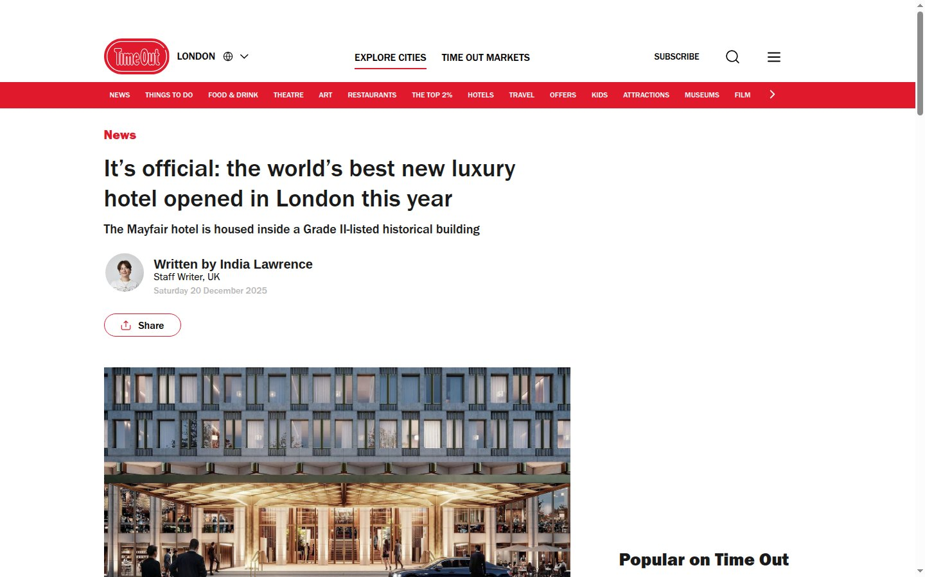
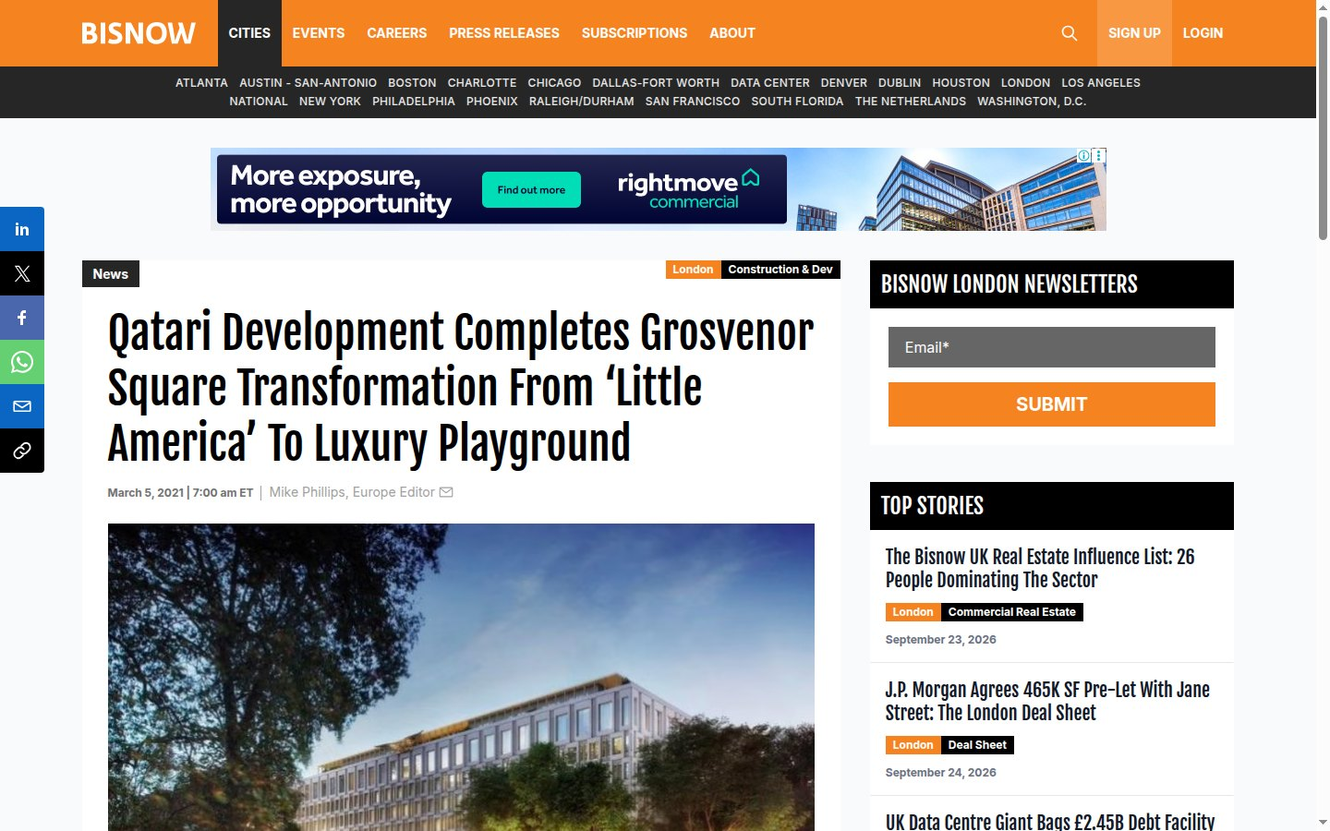
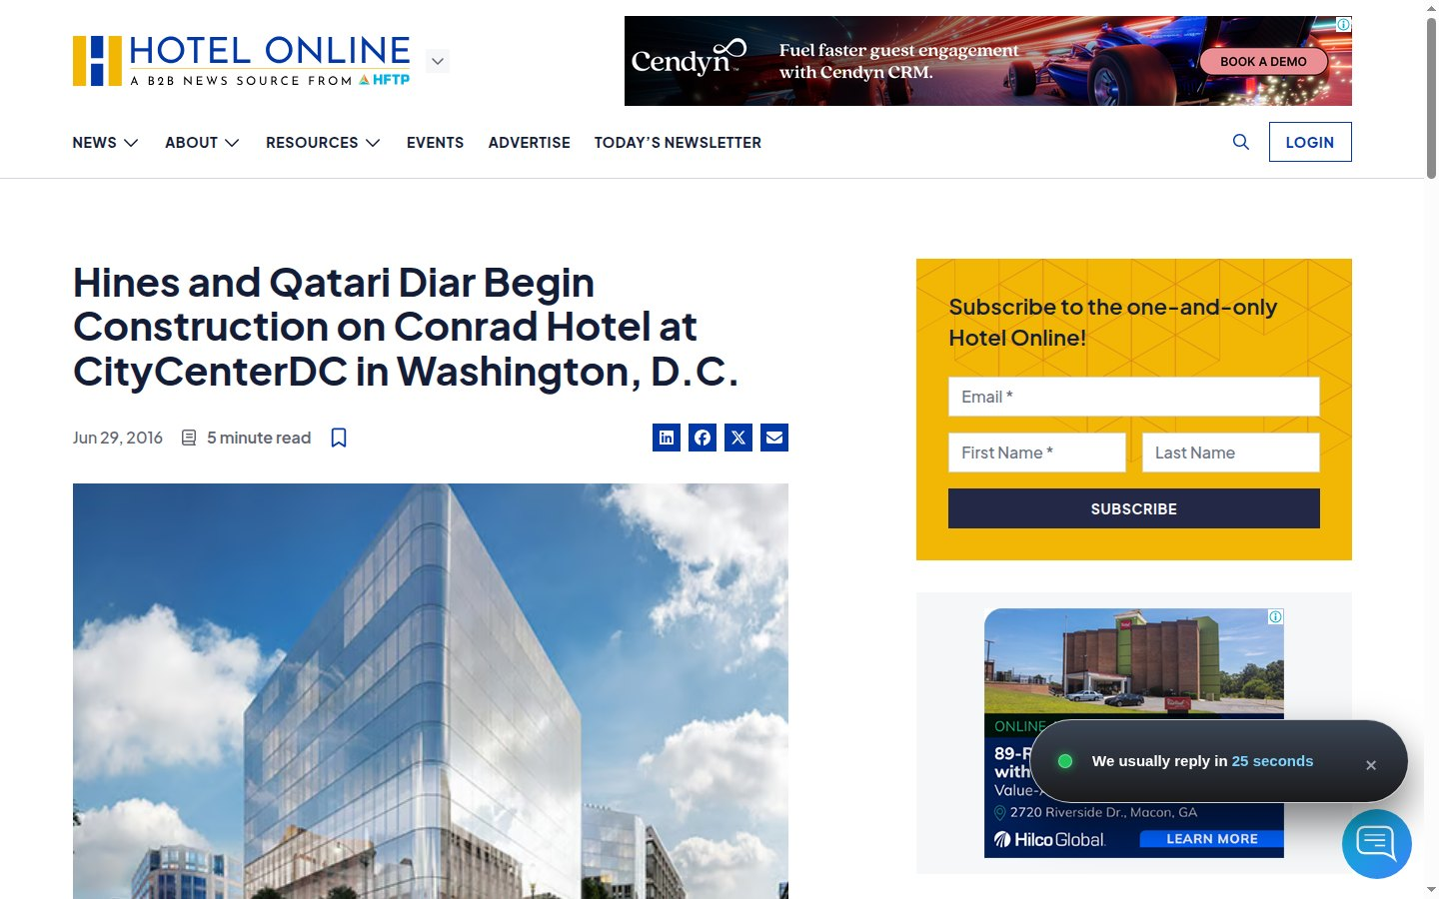
INTERNATIONAL MEDIA COVERAGE REPORT
Qatari Diar Hotels in the Global Press
Non-Arabic coverage of The Chancery Rosewood, London and Conrad Washington, DC — with headline, publication, link and a live screenshot of every article.
25
35
4
articles with screenshots
articles identified
languages
Screenshots captured 27 September 2026

Slide 2
Coverage at a glance
Two landmark hotel developments by Qatari Diar drew coverage from international news, business, architecture and travel media across Europe, North America and Australia.
16
9
9
10
London articles
Washington DC articles
countries of publication
further articles listed
The Chancery Rosewood
Conrad Washington, DC
UK, US, Spain, France and more
sites that block screenshots
Qatari Diar Hotels | International Media Coverage Report

Slide 3
London coverage index
# | Publication | Headline | Language | Link
1 | Wallpaper* | The Chancery Rosewood: A new chapter for London’s modernist icon | English | wallpaper.com
2 | Monocle | Inside a brutalist US embassy reborn as London’s newest Rosewood hotel | English | monocle.com
3 | Time Out London | It’s official: the world’s best new luxury hotel opened in London this year | English | timeout.com
4 | RIBA Journal | Diplomatic framework: how London’s hulking former US Embassy was reborn as an opulent hotel | English | ribaj.com
5 | Bisnow London | Qatari Development Completes Grosvenor Square Transformation From ‘Little America’ To Luxury Playground | English | bisnow.com
6 | CoStar News | Qatari Diar agrees £450 million refinancing for Grosvenor Square Rosewood hotel | English | costar.com
7 | Hospitality ON | The Chancery Rosewood opens in London’s Grosvenor Square | English edition | hospitality-on.com
8 | Global Traveler | Former American Embassy in London Opens as Upscale Chancery Rosewood Hotel | English | globaltravelerusa.com
9 | Luxury Travel Magazine | The Chancery Rosewood transforms Mayfair’s former US Embassy | English | luxurytravelmag.com.au
10 | LIST Magazine | Hotel Review: The Chancery Rosewood, London | English | listmag.com
11 | Voyages d’Affaires | Rosewood : haute diplomatie à Londres | French | voyages-d-affaires.com
12 | Forbes España | La antigua embajada estadounidense en Londres se convertirá en un hotel de lujo | Spanish | forbes.es
13 | El Debate | La embajada de Estados Unidos se convierte en el hotel con la construcción más cara de la historia de Londres | Spanish | eldebate.com
14 | idealista/news | La espectacular metamorfosis de una embajada en Londres en hotel de lujo | Spanish | idealista.com
15 | reisetopia | The Chancery Rosewood London: Neues Luxushotel am Grosvenor Square eröffnet | German | reisetopia.ch
16 | First Class & More | The Chancery Rosewood: Londons neue Luxusadresse eröffnet im September | German | first-class-and-more.de
Qatari Diar Hotels | International Media Coverage Report

Slide 4
Washington DC coverage index
# | Publication | Headline | Language | Link
17 | Office of the DC Mayor | Mayor Bowser Celebrates the Opening of Conrad Washington, DC | English | mayor.dc.gov
18 | Hotel News Resource | Conrad Washington, DC Hotel Opens | English | hotelnewsresource.com
19 | PoPville | “The property’s signature restaurant, Estuary, features a menu helmed by James Beard Award recipients and “Top Chef” finalists, Bryan and Michael Voltaggio” | English | popville.com
20 | Bisnow Washington DC | Hines, Qatari Fund Break Ground At CityCenter’s Conrad Hotel | English | bisnow.com
21 | Hotel Business | Construction Begins on Conrad Washington, DC | English | archive.hotelbusiness.com
22 | Hotel Online | Hines and Qatari Diar Begin Construction on Conrad Hotel at CityCenterDC in Washington, D.C. | English | hotel-online.com
23 | CLADglobal | Construction begins on Herzog & de Meuron’s Conrad hotel in Washington | English | cladglobal.com
24 | Hotel Designs | Construction begins on Conrad Washington D.C. | English | hoteldesigns.net
25 | SWFI | Hines and Qatari Diar Can Move Forward on Conrad Washington, D.C. | English | swfinstitute.org
Qatari Diar Hotels | International Media Coverage Report

Slide 5
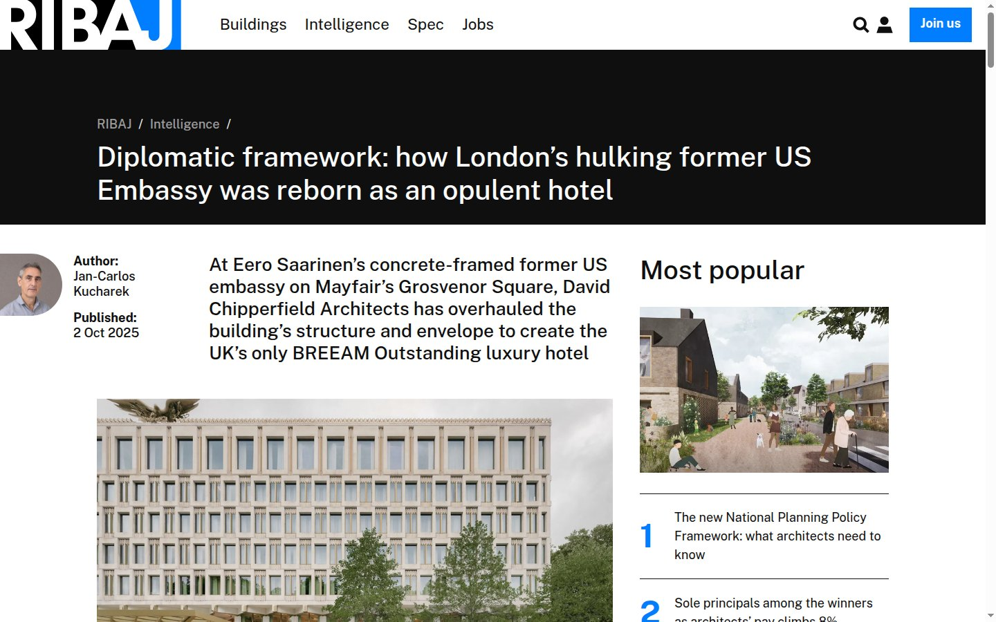
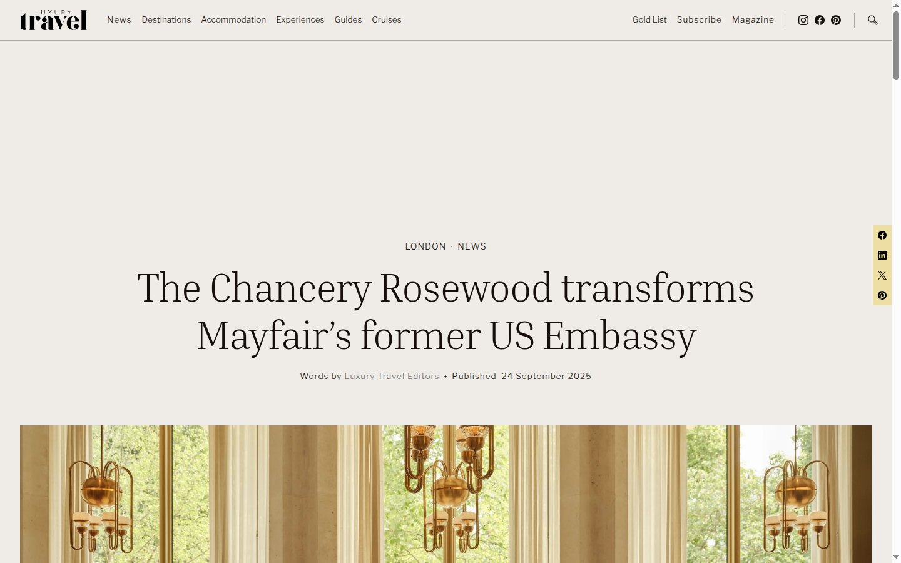
01
The Chancery Rosewood
Former US Embassy, Grosvenor Square, London
Developed by Qatari Diar Europe LLP
Eero Saarinen landmark restored by David Chipperfield Architects
Opened 1 September 2025 · 144 suites
16 non-Arabic articles captured
Qatari Diar Hotels | International Media Coverage Report

Slide 6
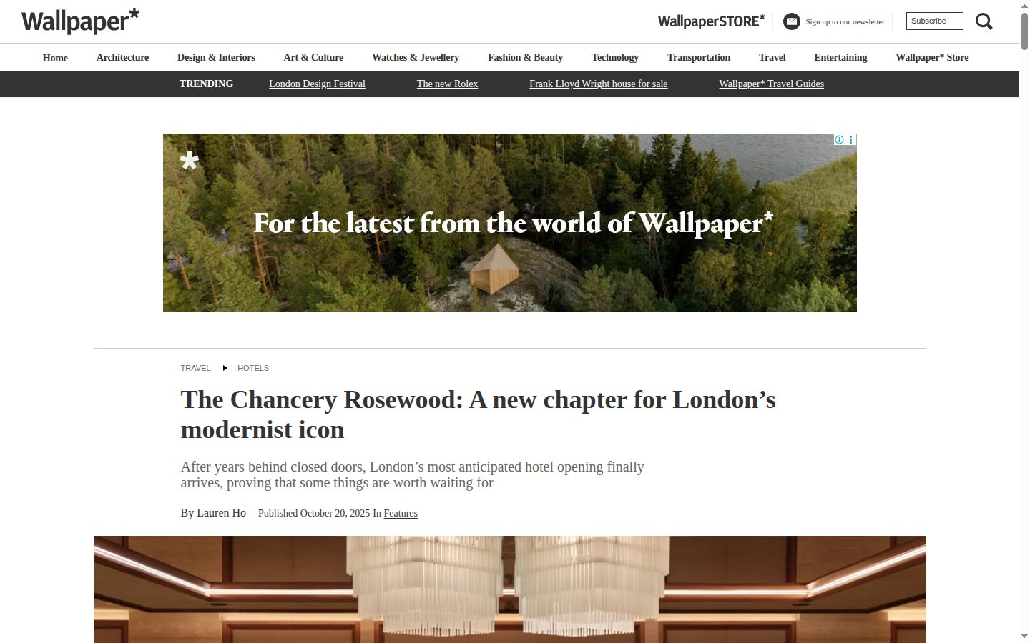
LONDON · THE CHANCERY ROSEWOOD
01 / 25
wallpaper.com
Wallpaper*
United Kingdom
English
HEADLINE
The Chancery Rosewood: A new chapter for London’s modernist icon
Media type Design & lifestyle magazine
Published 20 October 2025
ARTICLE LINK
https://www.wallpaper.com/travel/hotels/the-chancery-rosewood-london-review
Screenshot of the published article — captured 27 September 2026
Open original article ↗
Qatari Diar Hotels | International Media Coverage Report

Slide 7
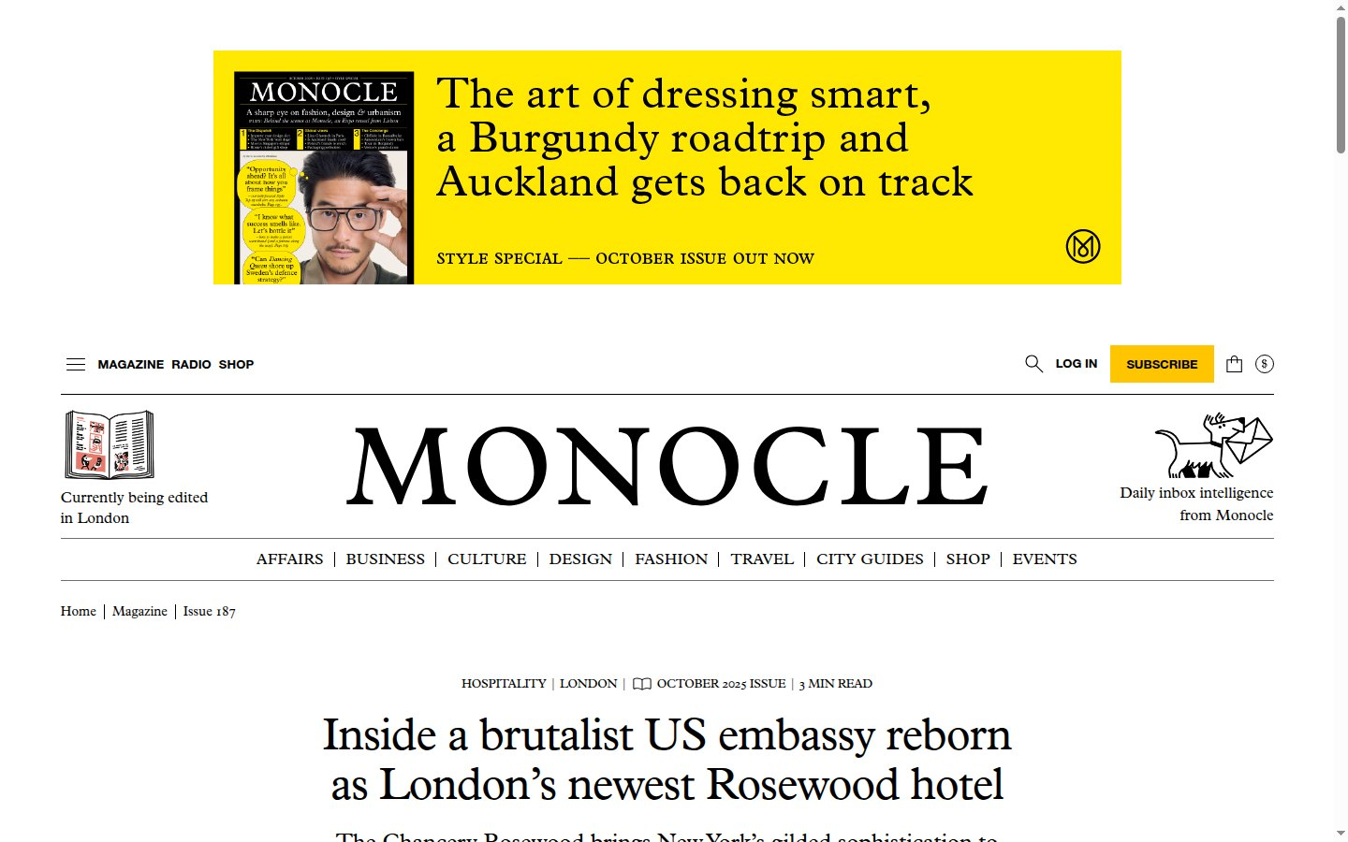
LONDON · THE CHANCERY ROSEWOOD
02 / 25
monocle.com
Monocle
United Kingdom
English
HEADLINE
Inside a brutalist US embassy reborn as London’s newest Rosewood hotel
Media type Global affairs & design magazine
Published 24 September 2025
ARTICLE LINK
https://monocle.com/travel/hospitality/inside-londons-chancery-rosewood-hotel/
Screenshot of the published article — captured 27 September 2026
Open original article ↗
Qatari Diar Hotels | International Media Coverage Report

Slide 8
LONDON · THE CHANCERY ROSEWOOD
03 / 25
timeout.com
Time Out London
United Kingdom
English
HEADLINE
It’s official: the world’s best new luxury hotel opened in London this year
Media type City news & culture
Published 20 December 2025
ARTICLE LINK
https://www.timeout.com/london/news/its-official-the-worlds-best-new-luxury-hotel-opened-in-london-this-year-122025
Screenshot of the published article — captured 27 September 2026
Open original article ↗
Qatari Diar Hotels | International Media Coverage Report

Slide 9
LONDON · THE CHANCERY ROSEWOOD
04 / 25
ribaj.com
RIBA Journal
United Kingdom
English
HEADLINE
Diplomatic framework: how London’s hulking former US Embassy was reborn as an opulent hotel
Media type Architecture (Royal Institute of British Architects)
Published 2 October 2025
ARTICLE LINK
https://www.ribaj.com/intelligence/making-buildings-us-embassy-chancery-rosewood-hotel-david-chipperfield-architects/
Screenshot of the published article — captured 27 September 2026
Open original article ↗
Qatari Diar Hotels | International Media Coverage Report

Slide 10
LONDON · THE CHANCERY ROSEWOOD
05 / 25
bisnow.com
Bisnow London
United Kingdom / USA
English
HEADLINE
Qatari Development Completes Grosvenor Square Transformation From ‘Little America’ To Luxury Playground
Media type Commercial real estate news
Published 5 March 2021
ARTICLE LINK
https://www.bisnow.com/news/london/construction-development/qatari-development-completes-grosvenor-square-transformation-from-little-america-to-luxury-playground-107999
Screenshot of the published article — captured 27 September 2026
Open original article ↗
Qatari Diar Hotels | International Media Coverage Report

Slide 11
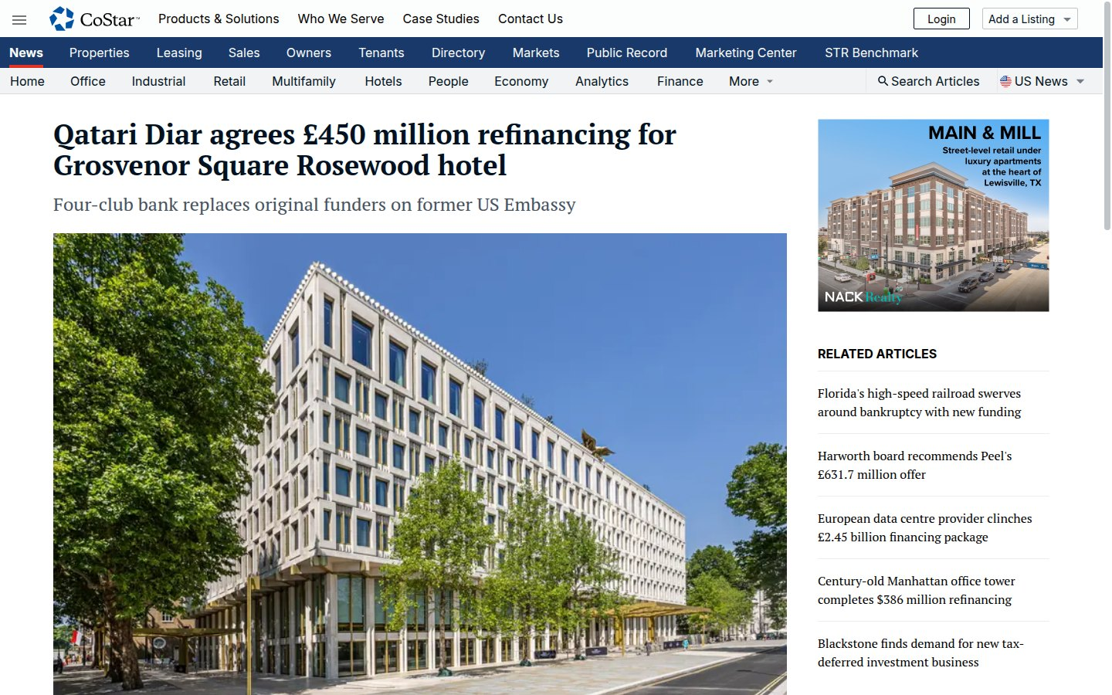
LONDON · THE CHANCERY ROSEWOOD
06 / 25
costar.com
CoStar News
USA / United Kingdom
English
HEADLINE
Qatari Diar agrees £450 million refinancing for Grosvenor Square Rosewood hotel
Media type Commercial real estate intelligence
ARTICLE LINK
https://www.costar.com/article/1062477359/qatari-diar-agrees-450-million-refinancing-for-grosvenor-square-rosewood-hotel
Screenshot of the published article — captured 27 September 2026
Open original article ↗
Qatari Diar Hotels | International Media Coverage Report

Slide 12
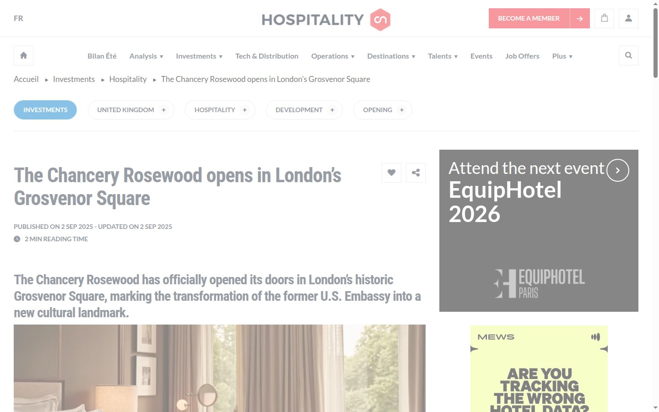
LONDON · THE CHANCERY ROSEWOOD
07 / 25
hospitality-on.com
Hospitality ON
France
English edition
HEADLINE
The Chancery Rosewood opens in London’s Grosvenor Square
Media type Hospitality industry media
Published 2 September 2025
ARTICLE LINK
https://hospitality-on.com/en/hospitality/chancery-rosewood-opens-londons-grosvenor-square
Screenshot of the published article — captured 27 September 2026
Open original article ↗
Qatari Diar Hotels | International Media Coverage Report

Slide 13
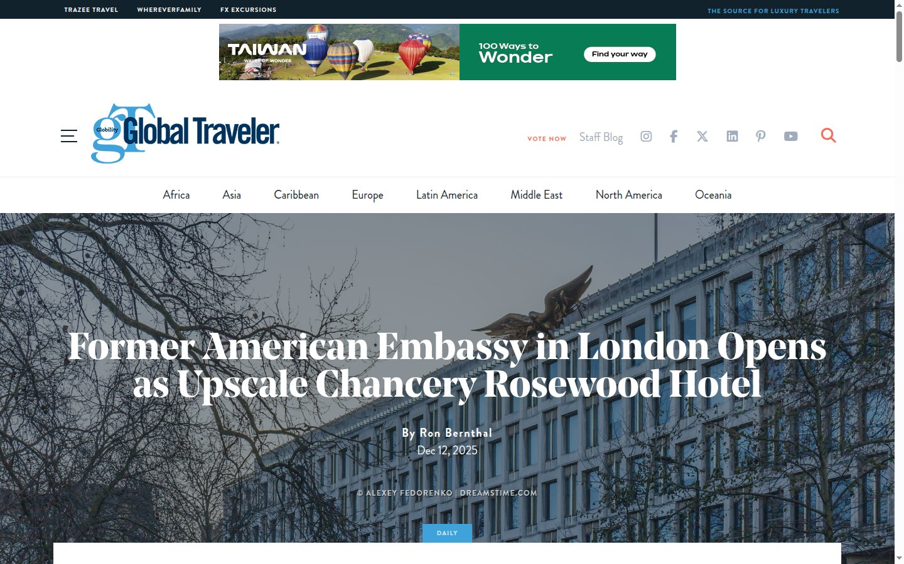
LONDON · THE CHANCERY ROSEWOOD
08 / 25
globaltravelerusa.com
Global Traveler
USA
English
HEADLINE
Former American Embassy in London Opens as Upscale Chancery Rosewood Hotel
Media type Premium travel magazine
Published 12 December 2025
ARTICLE LINK
https://www.globaltravelerusa.com/former-american-embassy-in-london-opens-as-upscale-chancery-rosewood-hotel/
Screenshot of the published article — captured 27 September 2026
Open original article ↗
Qatari Diar Hotels | International Media Coverage Report

Slide 14
LONDON · THE CHANCERY ROSEWOOD
09 / 25
luxurytravelmag.com.au
Luxury Travel Magazine
Australia
English
HEADLINE
The Chancery Rosewood transforms Mayfair’s former US Embassy
Media type Luxury travel magazine
Published 24 September 2025
ARTICLE LINK
https://www.luxurytravelmag.com.au/news/chancery-rosewood-mayfair
Screenshot of the published article — captured 27 September 2026
Open original article ↗
Qatari Diar Hotels | International Media Coverage Report

Slide 15
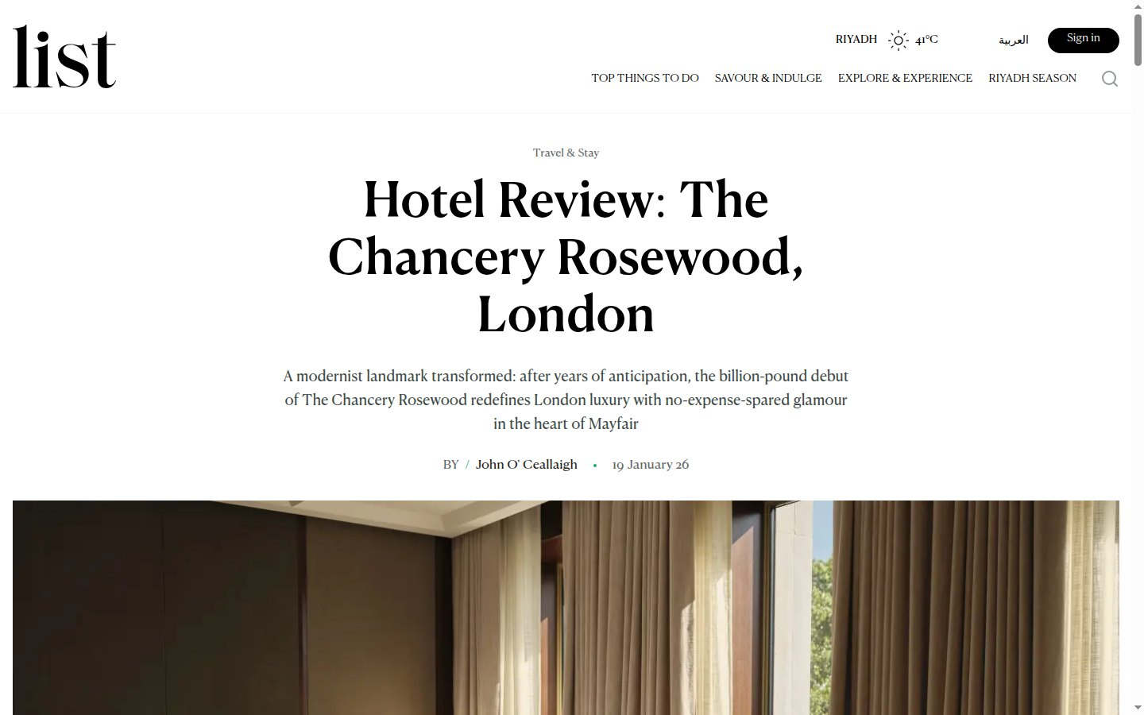
LONDON · THE CHANCERY ROSEWOOD
10 / 25
listmag.com
LIST Magazine
UAE
English
HEADLINE
Hotel Review: The Chancery Rosewood, London
Media type Luxury lifestyle magazine
Published 19 January 2026
ARTICLE LINK
https://www.listmag.com/en/travel-and-stay/luxury-travel/hotel-review-the-chancery-rosewood-london-4164
Screenshot of the published article — captured 27 September 2026
Open original article ↗
Qatari Diar Hotels | International Media Coverage Report

Slide 16
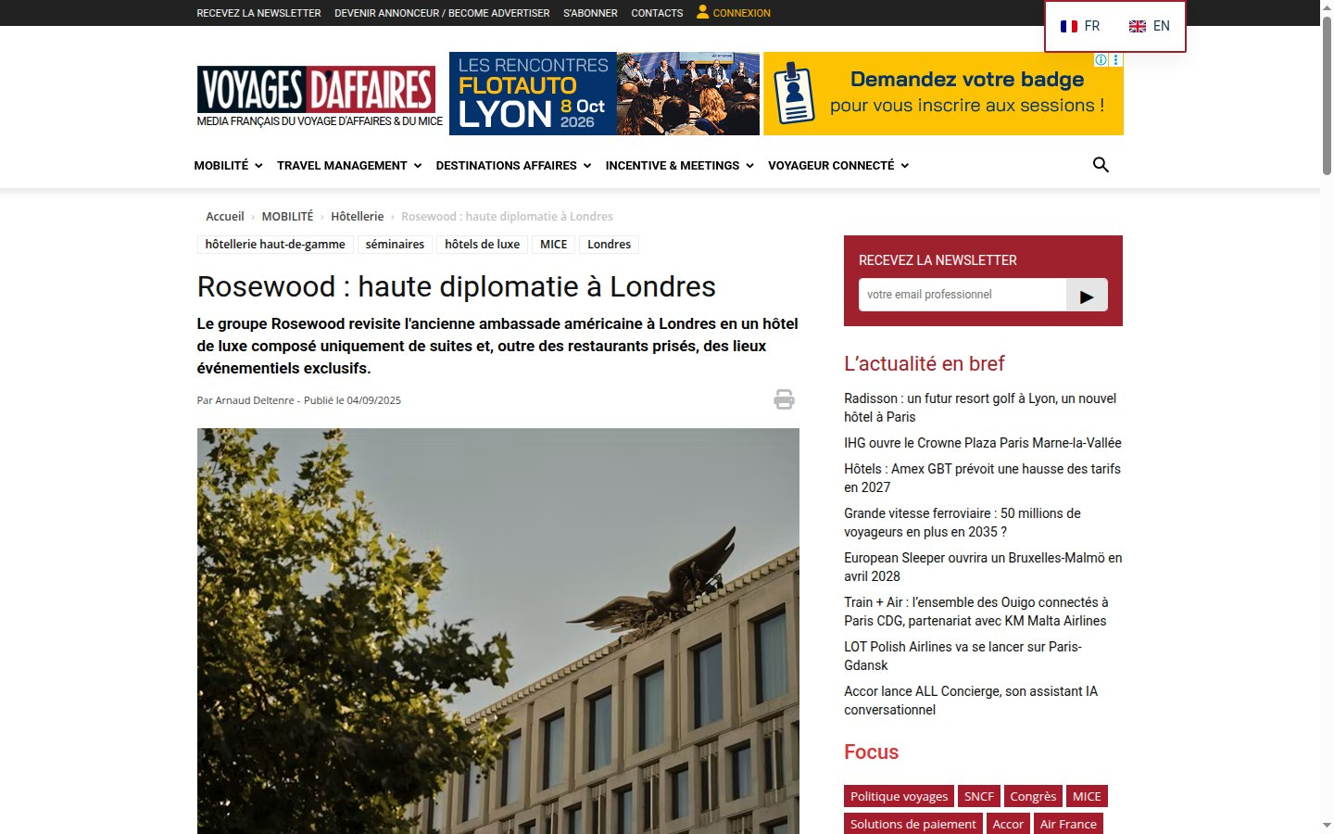
LONDON · THE CHANCERY ROSEWOOD
11 / 25
voyages-d-affaires.com
Voyages d’Affaires
France
French
HEADLINE
Rosewood : haute diplomatie à Londres
English: Rosewood: high diplomacy in London
Media type Business travel magazine
Published 4 September 2025
ARTICLE LINK
https://www.voyages-d-affaires.com/rosewood-ambassade-americaine-londres-20250904.html
Screenshot of the published article — captured 27 September 2026
Open original article ↗
Qatari Diar Hotels | International Media Coverage Report

Slide 17
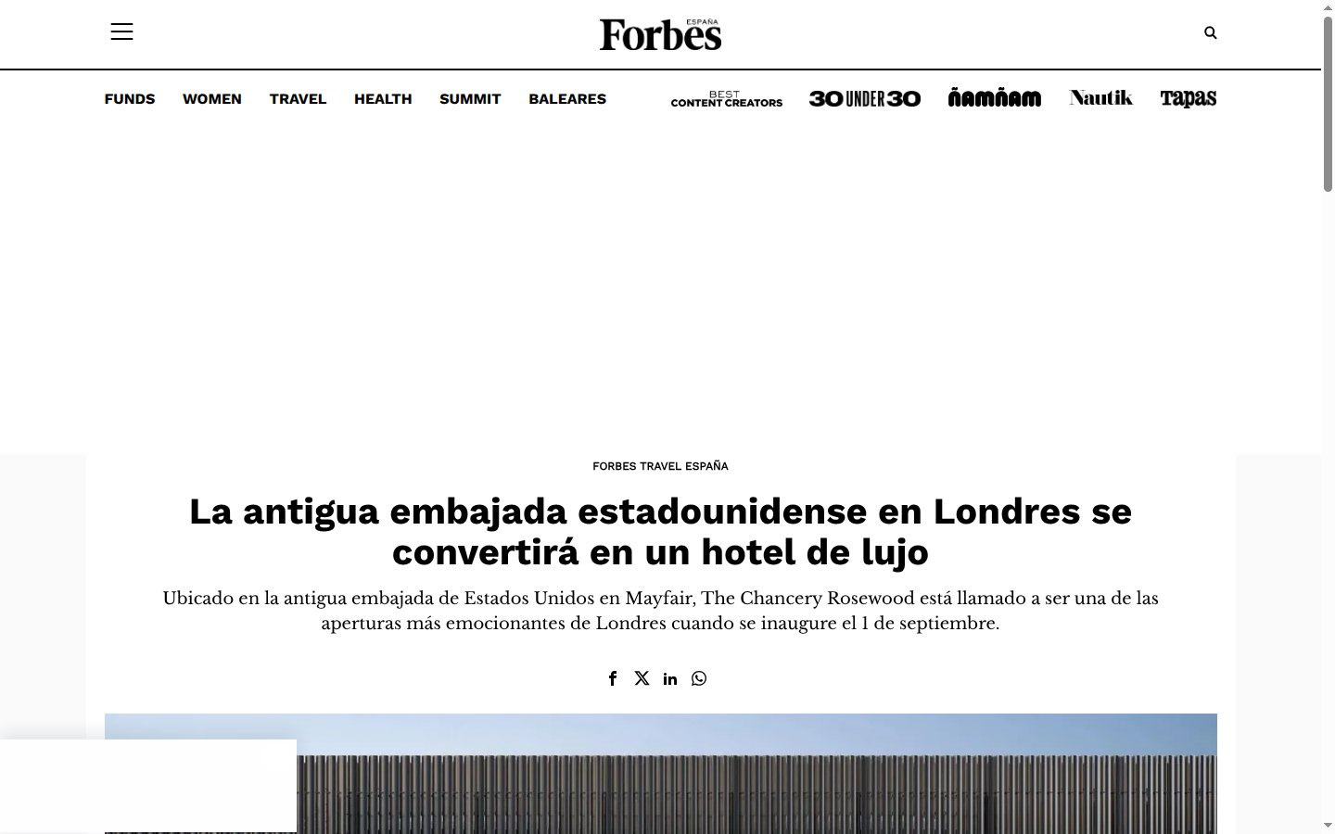
LONDON · THE CHANCERY ROSEWOOD
12 / 25
forbes.es
Forbes España
Spain
Spanish
HEADLINE
La antigua embajada estadounidense en Londres se convertirá en un hotel de lujo
English: The former US embassy in London will become a luxury hotel
Media type Business magazine
ARTICLE LINK
https://forbes.es/forbestravel/671347/la-antigua-embajada-estadounidense-en-londres-se-convierte-en-un-hotel-de-lujo/
Screenshot of the published article — captured 27 September 2026
Open original article ↗
Qatari Diar Hotels | International Media Coverage Report

Slide 18
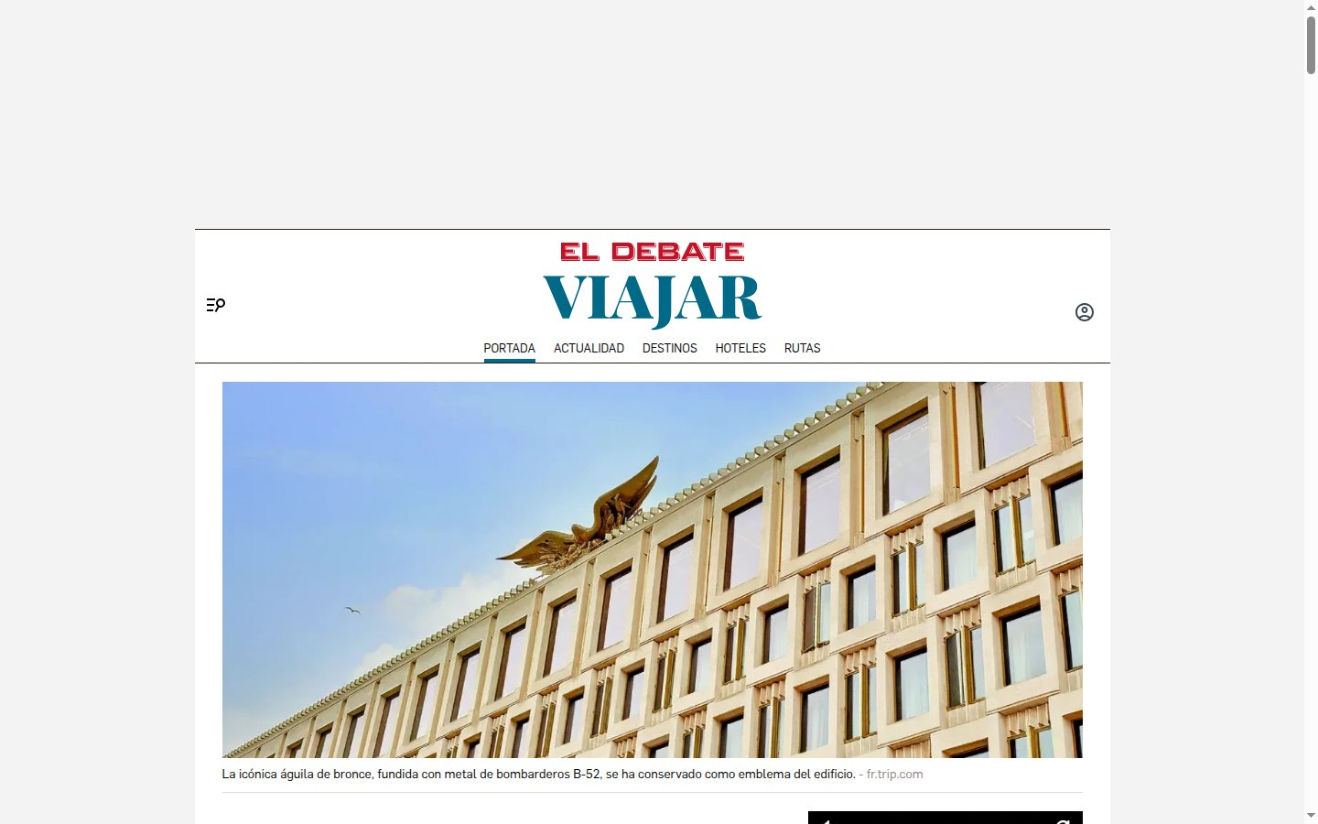
LONDON · THE CHANCERY ROSEWOOD
13 / 25
eldebate.com
El Debate
Spain
Spanish
HEADLINE
La embajada de Estados Unidos se convierte en el hotel con la construcción más cara de la historia de Londres
English: The US embassy becomes the most expensive hotel construction in London’s history
Media type National daily newspaper
Published 16 September 2025
ARTICLE LINK
https://www.eldebate.com/estilo-vida/viajar/20250916/embajada-estados-unidos-convierte-hotel-construccion-cara-historia-londres_334729.html
Screenshot of the published article — captured 27 September 2026
Open original article ↗
Qatari Diar Hotels | International Media Coverage Report

Slide 19
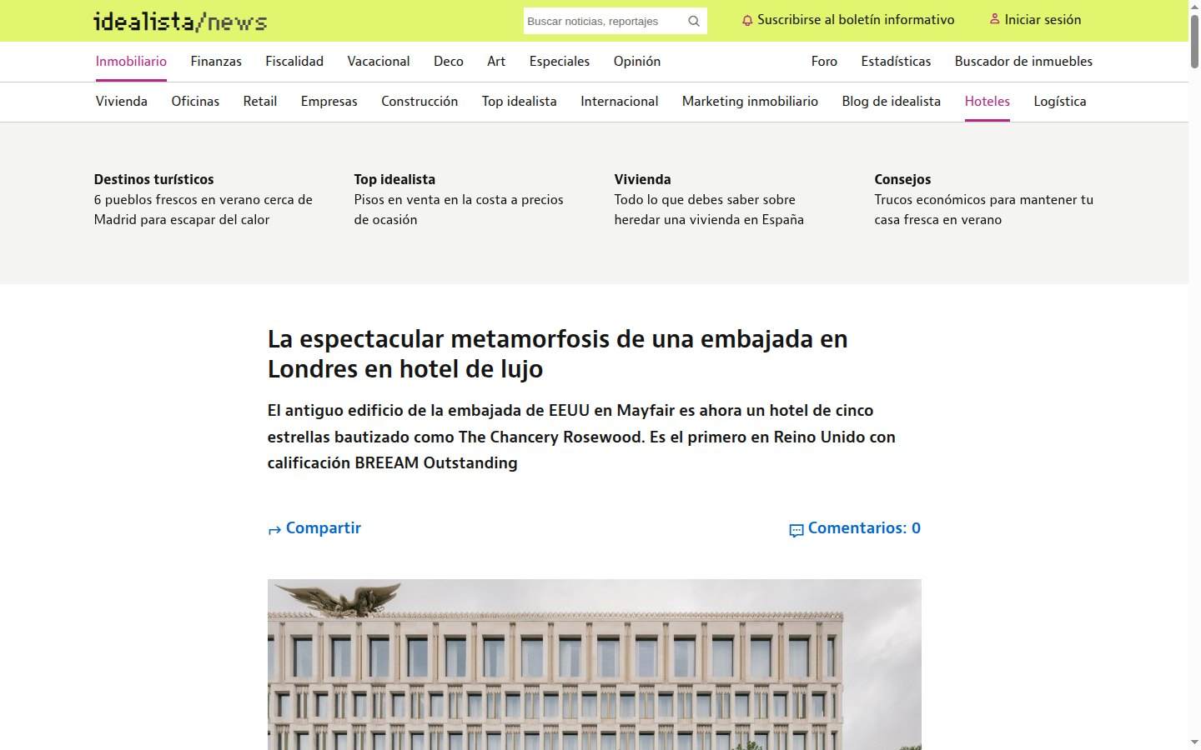
LONDON · THE CHANCERY ROSEWOOD
14 / 25
idealista.com
idealista/news
Spain
Spanish
HEADLINE
La espectacular metamorfosis de una embajada en Londres en hotel de lujo
English: The spectacular metamorphosis of a London embassy into a luxury hotel
Media type Real estate news portal
Published 22 December 2025
ARTICLE LINK
https://www.idealista.com/news/inmobiliario/hoteles/2025/12/22/873009-la-espectacular-metamorfosis-de-una-embajada-en-londres-en-hotel-de-lujo
Screenshot of the published article — captured 27 September 2026
Open original article ↗
Qatari Diar Hotels | International Media Coverage Report

Slide 20
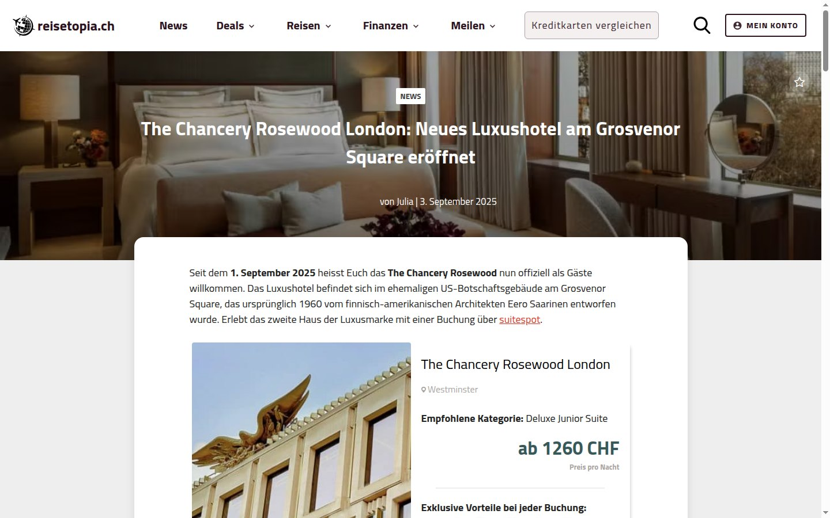
LONDON · THE CHANCERY ROSEWOOD
15 / 25
reisetopia.ch
reisetopia
Switzerland
German
HEADLINE
The Chancery Rosewood London: Neues Luxushotel am Grosvenor Square eröffnet
English: New luxury hotel opens on Grosvenor Square
Media type Travel news portal
Published 3 September 2025
ARTICLE LINK
https://reisetopia.ch/news/the-chancery-rosewood-london/
Screenshot of the published article — captured 27 September 2026
Open original article ↗
Qatari Diar Hotels | International Media Coverage Report

Slide 21
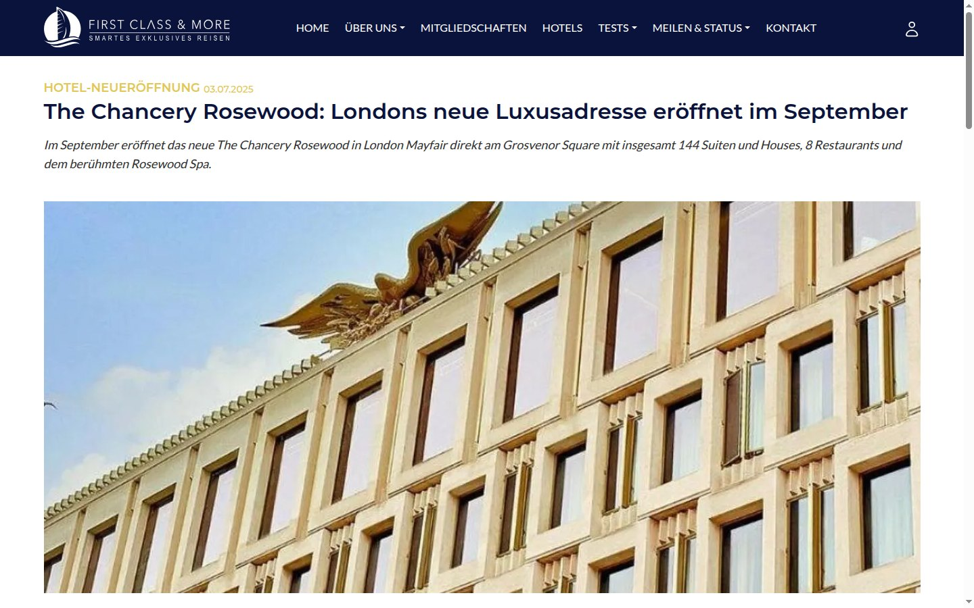
LONDON · THE CHANCERY ROSEWOOD
16 / 25
first-class-and-more.de
First Class & More
Germany
German
HEADLINE
The Chancery Rosewood: Londons neue Luxusadresse eröffnet im September
English: London’s new luxury address opens in September
Media type Premium travel portal
Published 3 July 2025
ARTICLE LINK
https://first-class-and-more.de/the-chancery-rosewood-londons-neue-luxusadresse-startet-im-september
Screenshot of the published article — captured 27 September 2026
Open original article ↗
Qatari Diar Hotels | International Media Coverage Report

Slide 22
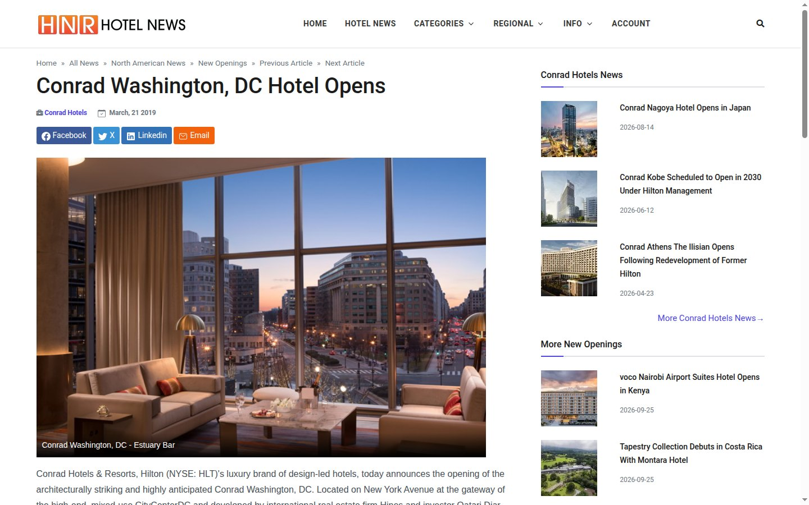
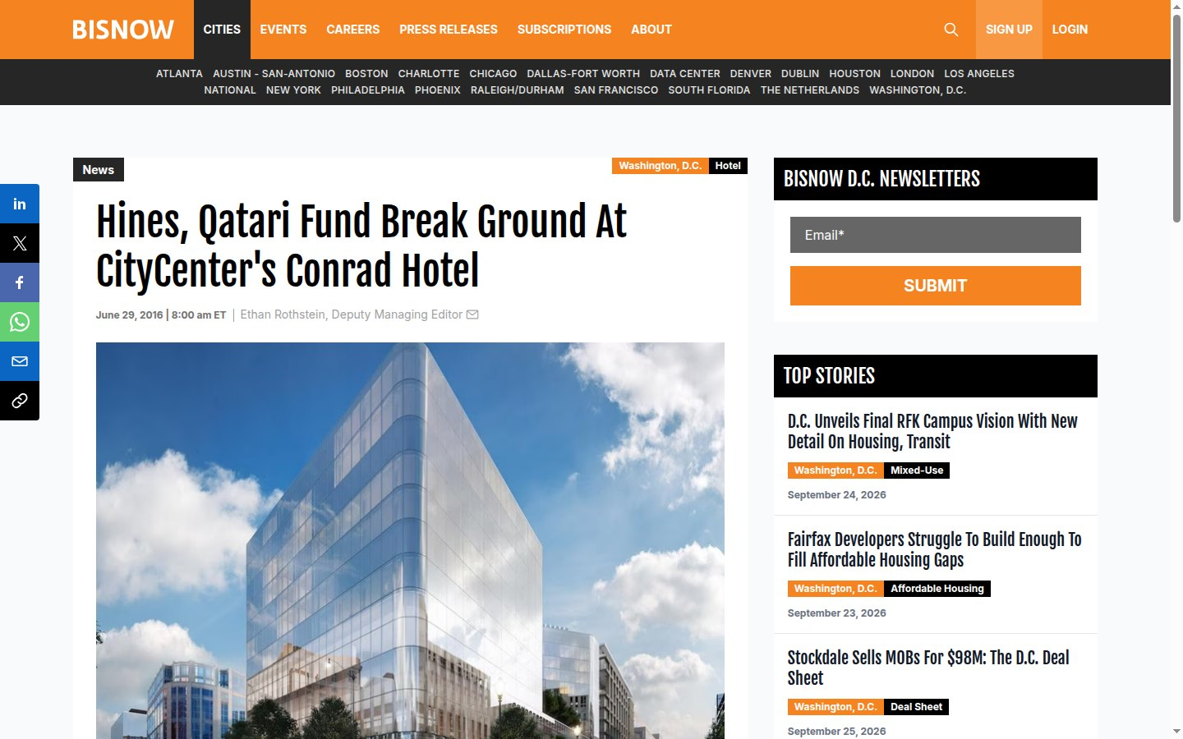
02
Conrad Washington, DC
CityCenterDC, New York Avenue, Washington DC
Developed by Hines and Qatari Diar
Designed by Herzog & de Meuron · 360 rooms
Construction began 2016 · opened 2019
9 non-Arabic articles captured
Qatari Diar Hotels | International Media Coverage Report

Slide 23
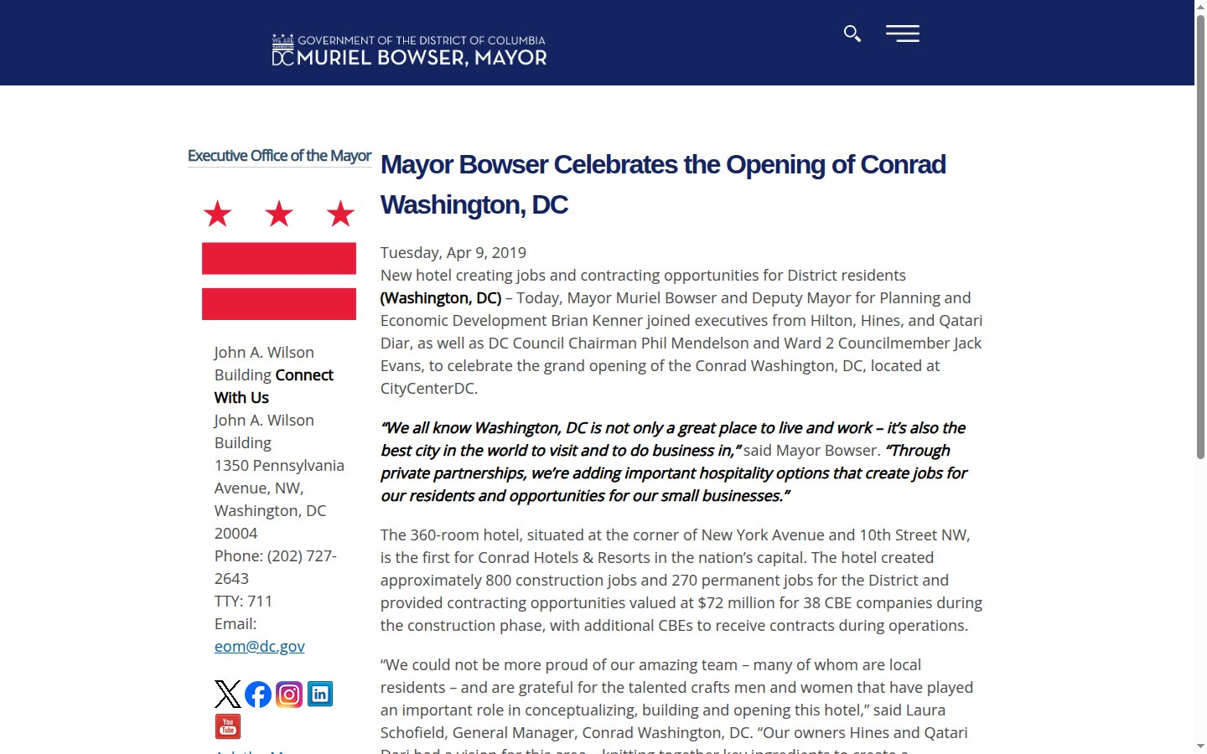
WASHINGTON DC · CONRAD WASHINGTON, DC
17 / 25
mayor.dc.gov
Office of the DC Mayor
USA
English
HEADLINE
Mayor Bowser Celebrates the Opening of Conrad Washington, DC
Media type Official government release
Published 9 April 2019
ARTICLE LINK
https://mayor.dc.gov/release/mayor-bowser-celebrates-opening-conrad-washington-dc
Screenshot of the published article — captured 27 September 2026
Open original article ↗
Qatari Diar Hotels | International Media Coverage Report

Slide 24
WASHINGTON DC · CONRAD WASHINGTON, DC
18 / 25
hotelnewsresource.com
Hotel News Resource
International
English
HEADLINE
Conrad Washington, DC Hotel Opens
Media type Hospitality news wire
Published 21 March 2019
ARTICLE LINK
https://www.hotelnewsresource.com/article104501.html
Screenshot of the published article — captured 27 September 2026
Open original article ↗
Qatari Diar Hotels | International Media Coverage Report

Slide 25
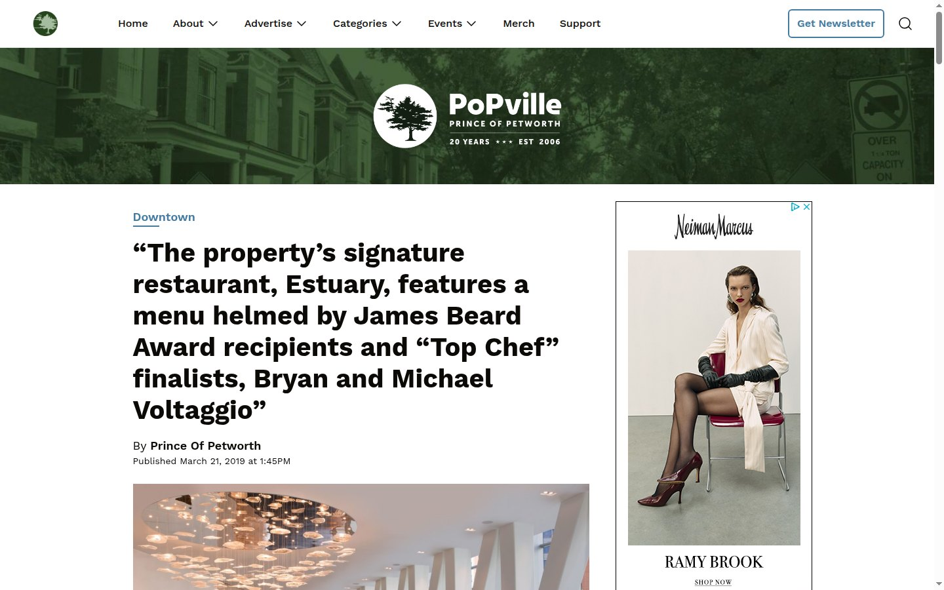
WASHINGTON DC · CONRAD WASHINGTON, DC
19 / 25
popville.com
PoPville
USA
English
HEADLINE
“The property’s signature restaurant, Estuary, features a menu helmed by James Beard Award recipients and “Top Chef” finalists, Bryan and Michael Voltaggio”
Media type Local DC news
Published 21 March 2019
ARTICLE LINK
https://www.popville.com/2019/03/conrad-washington-dc-hotel-open/
Screenshot of the published article — captured 27 September 2026
Open original article ↗
Qatari Diar Hotels | International Media Coverage Report

Slide 26
WASHINGTON DC · CONRAD WASHINGTON, DC
20 / 25
bisnow.com
Bisnow Washington DC
USA
English
HEADLINE
Hines, Qatari Fund Break Ground At CityCenter’s Conrad Hotel
Media type Commercial real estate news
Published 29 June 2016
ARTICLE LINK
https://www.bisnow.com/news/washington-dc/hotel/hines-qatari-fund-break-ground-at-citycenters-conrad-hotel-62055
Screenshot of the published article — captured 27 September 2026
Open original article ↗
Qatari Diar Hotels | International Media Coverage Report

Slide 27
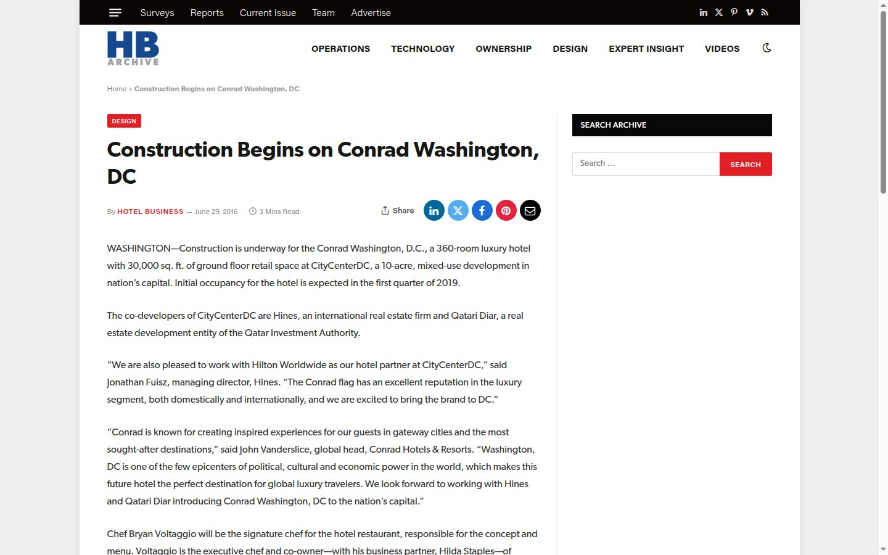
WASHINGTON DC · CONRAD WASHINGTON, DC
21 / 25
archive.hotelbusiness.com
Hotel Business
USA
English
HEADLINE
Construction Begins on Conrad Washington, DC
Media type Hospitality trade magazine
Published 29 June 2016
ARTICLE LINK
https://archive.hotelbusiness.com/construction-begins-on-conrad-washington-dc/
Screenshot of the published article — captured 27 September 2026
Open original article ↗
Qatari Diar Hotels | International Media Coverage Report

Slide 28
WASHINGTON DC · CONRAD WASHINGTON, DC
22 / 25
hotel-online.com
Hotel Online
USA
English
HEADLINE
Hines and Qatari Diar Begin Construction on Conrad Hotel at CityCenterDC in Washington, D.C.
Media type Hospitality industry news
Published 29 June 2016
ARTICLE LINK
https://www.hotel-online.com/news/hines-and-qatari-diar-begin-construction-on-conrad-hotel-at-citycenterdc
Screenshot of the published article — captured 27 September 2026
Open original article ↗
Qatari Diar Hotels | International Media Coverage Report

Slide 29

WASHINGTON DC · CONRAD WASHINGTON, DC
23 / 25
cladglobal.com
CLADglobal
United Kingdom
English
HEADLINE
Construction begins on Herzog & de Meuron’s Conrad hotel in Washington
Media type Architecture & design news
Published 30 June 2016
ARTICLE LINK
https://www.cladglobal.com/CLADnews/architecture-design/Herzog--de-Meuron-Conrad-Hotels-and-Resorts-Hilton-Worldwide-HKS-Architects-Washington-DC-Bryan-Voltaggio-CityCenterDC/325191
Screenshot of the published article — captured 27 September 2026
Open original article ↗
Qatari Diar Hotels | International Media Coverage Report

Slide 30

WASHINGTON DC · CONRAD WASHINGTON, DC
24 / 25
hoteldesigns.net
Hotel Designs
United Kingdom
English
HEADLINE
Construction begins on Conrad Washington D.C.
Media type Hotel design media
Published 5 July 2016
ARTICLE LINK
https://hoteldesigns.net/industry-news/construction-begins-on-conrad-washington-d-c/
Screenshot of the published article — captured 27 September 2026
Open original article ↗
Qatari Diar Hotels | International Media Coverage Report

Slide 31
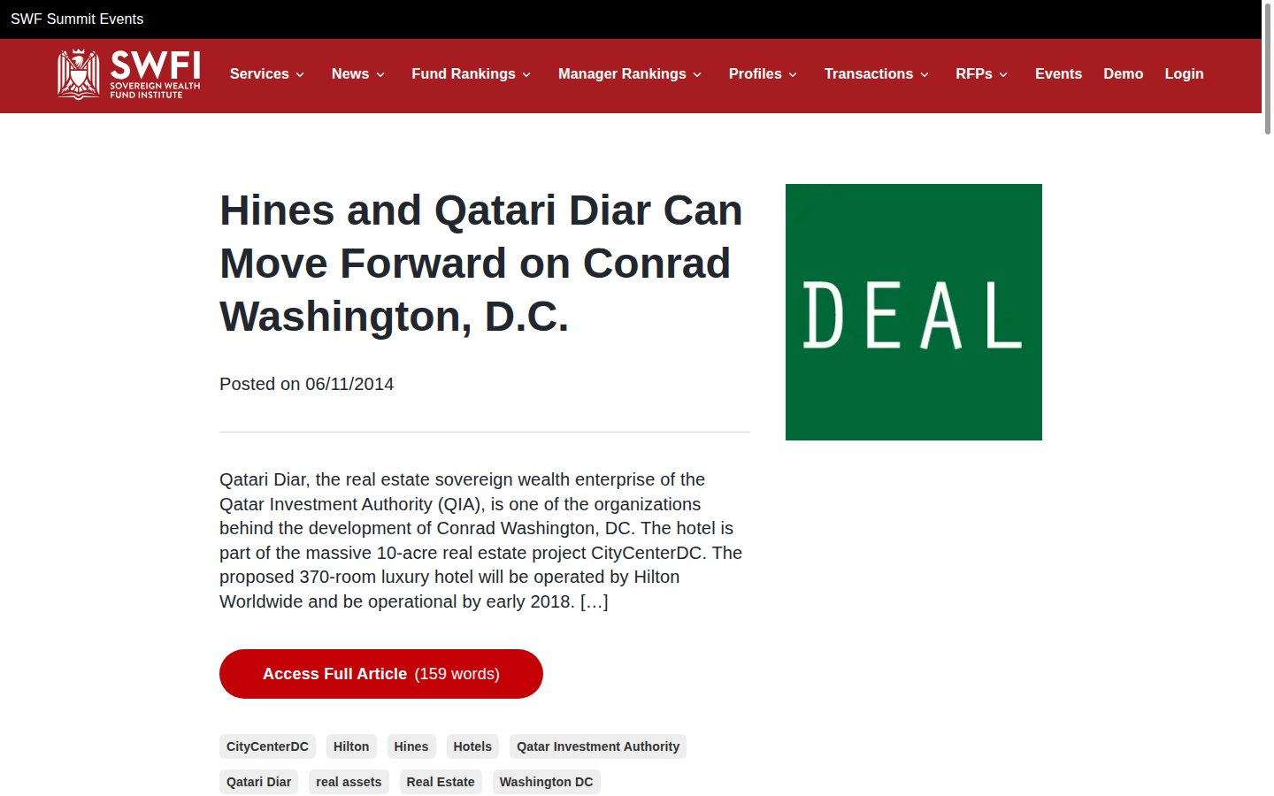
WASHINGTON DC · CONRAD WASHINGTON, DC
25 / 25
swfinstitute.org
SWFI
USA
English
HEADLINE
Hines and Qatari Diar Can Move Forward on Conrad Washington, D.C.
Media type Sovereign Wealth Fund Institute
Published 2014
ARTICLE LINK
https://www.swfinstitute.org/news/17365/hines-and-qatari-diar-can-move-forward-on-conrad-washington-d-c
Screenshot of the published article — captured 27 September 2026
Open original article ↗
Qatari Diar Hotels | International Media Coverage Report

Slide 32
Additional coverage identified
These articles were located during research, but the publishers’ bot protection blocked automated screenshot capture. Open each link to view the article.
Publication | Country | Hotel | Headline | Link
Forbes | USA | London | The Chancery Rosewood: London’s Long-Awaited Hotel Opens Its Doors | forbes.com
Forbes | USA | London | A New Hotel Is Coming To London’s Former American Embassy In September | forbes.com
Dezeen | United Kingdom | London | David Chipperfield Architects transforms Saarinen-designed US Embassy into The Chancery Rosewood | dezeen.com
Boutique Hotelier | United Kingdom | London | The Chancery Rosewood officially opens in London | boutiquehotelier.com
Travel And Tour World (FR) | France | London | The Chancery Rosewood London : un hôtel de luxe qui transforme le paysage hôtelier de la ville | travelandtourworld.fr
Hospitality Net | Netherlands | Washington DC | Opening Of Conrad Washington, DC Marks The Brand’s First Property In The Nation’s Capital | hospitalitynet.org
Hotel Management | USA | Washington DC | Conrad debuts in Washington, D.C. | hotelmanagement.net
Hotel Management | USA | Washington DC | Herzog & de Meuron, HKS, Rottet Studio design first D.C. Conrad | hotelmanagement.net
Commercial Property Executive | USA | Washington DC | Conrad Washington, DC Opens Doors | commercialsearch.com
Construction Week Online | UAE / International | Washington DC | Work starts on Qatari Diar’s Conrad Washington, DC | constructionweekonline.com
Qatari Diar Hotels | International Media Coverage Report

Slide 33
Methodology
1
Scope
Non-Arabic media (English, French, Spanish, German) covering Qatari Diar’s London and Washington DC hotel developments.
2
Headlines
Taken verbatim from each article page; non-English headlines include an English translation.
3
Screenshots
Captured live from each publisher’s website on 27 September 2026; cookie banners were dismissed where possible.
4
Links
Every article link in this deck is clickable and was confirmed to load at the time of capture.
Qatari Diar Hotels | International Media Coverage Report

