Slide 1
Waste Management

Slide 2

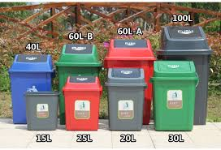
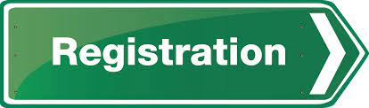

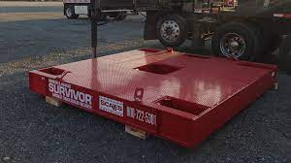

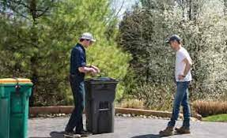
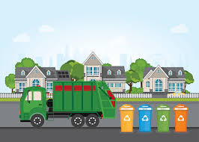
Architecture Diagram – Conceptual Level
Book slot for 15mins
Redeemable points to user wallet
Smart Waste Management App
Check for another slot
Check availability and bin capacity
Ask user to verify and book another slot.
Above Threshold
Check capacity
Within Threshold
Weight sensor to measure garbage quantity
Record collection data of user in IOT Cloud
Unlock Bin
Alert Garbage collectors.

