Slide 1
Optimizing the Beta Value of Beta VAE using N-arm-bandit and Simulated Annealing
Md Mahin, Abhijit BAUL, Mahsa Rezaei Firuzkuhi

Slide 2
Outline
Problem Statement
Our Contribution
Methodology
Experiment Settings
Results
Conclusion and Future Plan
References
Appendix [Summary sudo code]

Slide 3
Problem Statement

Slide 4
Deep learning-based generative models
Key idea:
Reality is complex
Can we approximate it with something “simple”?
Just need to make sure the simple thing is “close” to the complex thing
Goal:
Learning the data distribution from training set
Ideally want to learn representation without labelled data – unsupervised
Two solutions GANs & AutoEncoders

Slide 5
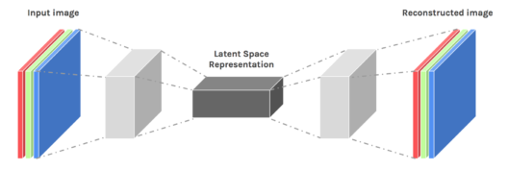
Autoencoders
Autoencoders are designed to reproduce their input, especially for images.
Key point is to reproduce the input from a learned encoding.

Slide 6
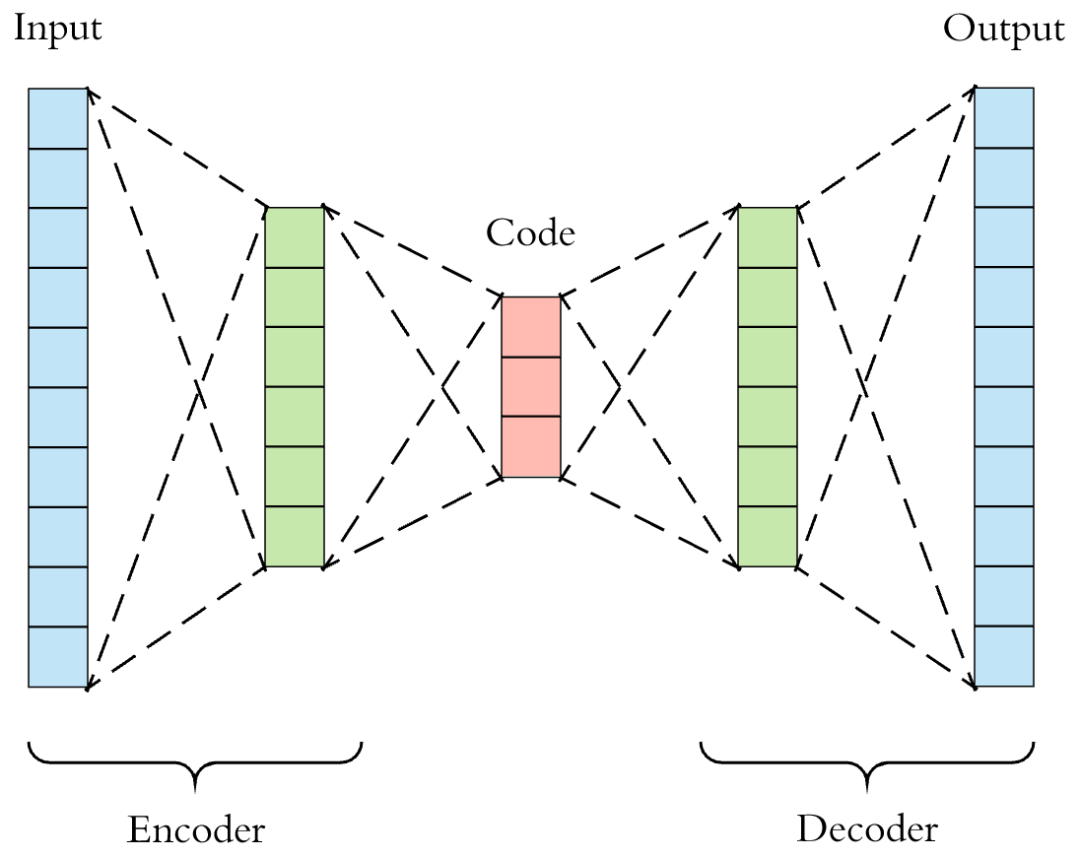
Auto-encoders
Auto-encoder Diagram
Details
Encoder layers reduces dimensionality of inputs into smaller code layer dimension
Decoder layers tries to reconstruct the input from smaller code layer
This z dimension is fixed for normal auto-encoders
Goal is
Dimensionality reduction
Representations learning
Image Source: https://towardsdatascience.com/applied-deep-learning-part-3-autoencoders-1c083af4d798

Slide 7
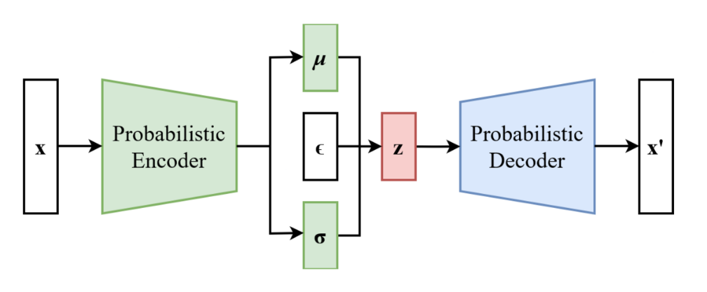
Variational Auto-encoders
Details
Variational Auto-encoder Diagram
The z dimension now has two layers
One layer learn mean
Second layer learn standard deviation
Idea is learning distribution of representation in place of single representation
Decoder has additional sampling part, to get a sample from the distribution
Learns better representation
Image Source: https://en.wikipedia.org/wiki/File:Reparameterized_Variational_Autoencoder.png

Slide 8
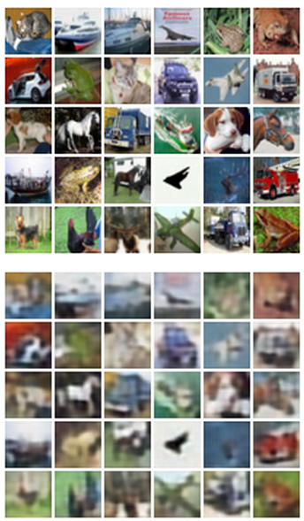

Variational Autoencoders
8
Train such that features can be used to
reconstruct original data
L2 Loss function:
Reconstructed data
Reconstructed input data
Decoder
Features
Encoder: 4-layer conv
Decoder: 4-layer upconv
Encoder
Input data
Input data

Slide 9
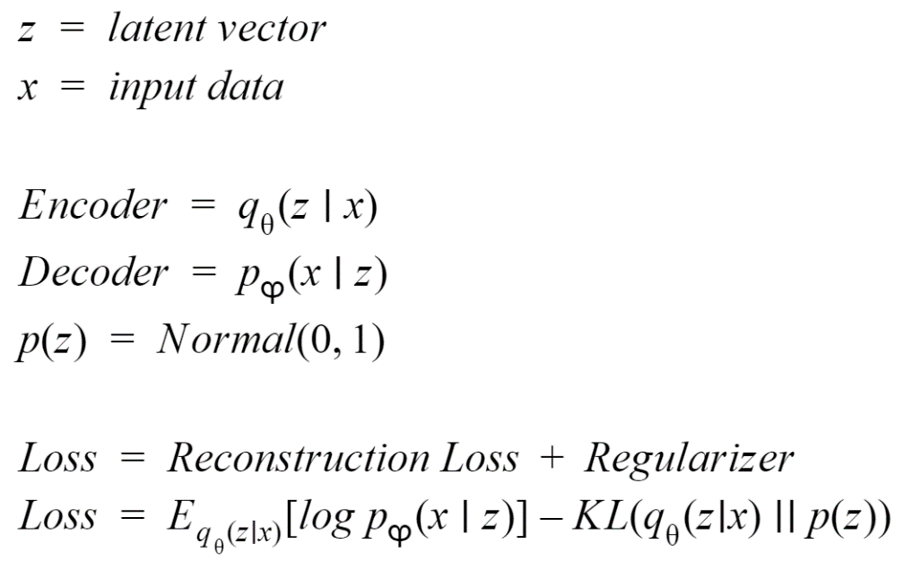
Variational Auto-encoders Loss Function
The loss function has two parts:
Loss Function
“x Reconstruction Loss”
How well the reconstructed data x’ compares to the original data x
“z KL* loss”, or relative entropy
Difference between the actual z distribution and an ideal Gaussian with μ 0 and sd of 1
Regularizer term helps to learn the representation better

Slide 10
Beta VAE Loss Function
Proposed by Higgins et al.[1]
Multiply the KL divergence (relative entropy) by a factor β typically in range 5-150
Less weight on reconstruction fidelity, more on minimising KL divergence
Beta value greater than 1 enforces the autoencoder to learn disentangled representation better by restricting la- tent channels capacity
Reduction in reconstruction accuracy with improving disentanglement (larger β)
Improved Loss

Slide 11
The Problems with Beta
We do not know the optimal value for beta, apart from it should be greater than 1
The authors said about beta:
Disentangled representations emerge when the right balance is found between information preservation (reconstruction cost as regularisation) and latent channel capacity restriction (beta > 1)
The optimal beta will be different for different datasets
The authors did not provide any method to learn the beta during the training

Slide 12
Our Contribution
Estimate beta during training
First we separate Beta value into n sub division from 1 to infinity
A Multi-arm bandit is employed to learn the range of beta value that improves the loss
Simulated annulling is applied within each range to learn the optimal beta value within that range.

Slide 13
Methodology

Slide 14
How the Whole Approach Works
Our target is
Select N target ranges greater than 1
Using a N arm bandit find which range gives more reward (lower loss)
Using Simulated Annealing to find which value is optimal in each range

Slide 15
Challenges!
How to define Reward for N arm bandit?
How to measure this reward?
The effect will only be visible during next iterations loss calculation
In simulated annealing when we chose a candidate, how we can compare it with current value?
Again, we can only see the effect after propagating the value

Slide 16
Solutions
A new reward calculation method for n arm bandit that uses current and next loss
An additional step to compare candidate with current position in the arm range for the simulated annealing
This step compares candidate with current value
Updates the reward for the arm
No error propagation here
We needed to change the error propagation system

Slide 17
Our Steps
First Step:
Select an arm
Calculate a candidate within the arm based on current value
Propagate the loss
Second Step:
Evaluate the candidate with best value and current value based on the previous loss and loss in this step
This is a blank step where no errors are propagated
Exception:
For the first selection of each arm
We select the middle value
Propagate that
Consider that best and current value for the arm

Slide 18
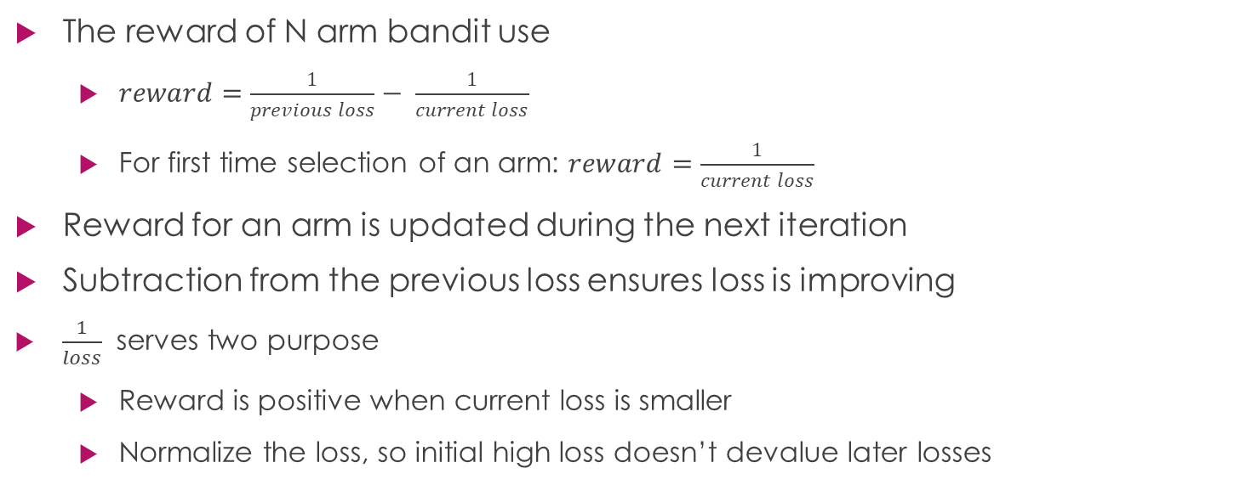
N arm bandit Reward System
The reward of N arm bandit use
$reward=\frac{1}{previous loss}− \frac{1}{current loss}$
For first time selection of an arm: $reward=\frac{1}{current loss}$
Reward for an arm is updated during the next iteration
Subtraction from the previous loss ensures loss is improving
$\frac{1}{loss}$ serves two purpose
Reward is positive when current loss is smaller
Normalize the loss, so initial high loss doesn’t devalue later losses

Slide 19
Experiment Settings
5 Fully Connected Layers
Shape: 784:400:20:400:784
Dataset:
MINST character dataset
Classes 10
Trained for only 15 epochs

Slide 20
Result Analysis

Slide 21
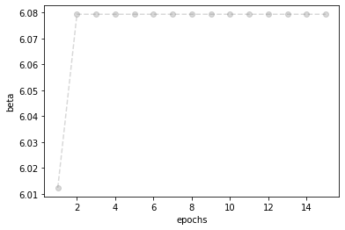
Beta values

Slide 22
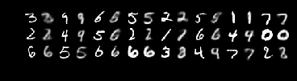
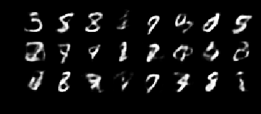
Reconstruction vs Generation
Reconstructions
Generation

Slide 23
Conclusion and Future Work

Slide 24
Conclusion and Future Works
Our Model learning the beta value
In future we can make it more dependent on the input distribution
Implementing and testing the model more heavy settings

Slide 25
References
Higgins, I., Matthey, L., Pal, A., Burgess, C., Glorot, X., Botvinick, M., Mohamed, S. and Lerchner, A., 2016. beta-vae: Learning basic visual concepts with a constrained variational framework.

Slide 26
Appendix (Algorithm: Page 1: Initializations)
Initialize N arm bandit parameters
Selection_Count Vector for n arms
Sum_of_reward Vector for n arms
Allow_arm_generation = 1
Initialize Simulated Annealing parameters
Best_value_per_arm vector
Best_loss_per_arm vector
Current_value_per_arm vector
Current_loss_per_arm vector
Step_size_per_arm vector
Temperature
Range_per_arm vector
Previous_loss

Slide 27
Appendix (Algorithm: Page 2: N arm Bandit)
For each iteration
If arm_generation_allow == 1 #This will restrict arm generation every second step
a. Select an arm using Upper Confidence Bound (UCB)
b. Update selection_count[arm] += 1

Slide 28
Appendix (Algorithm: Page 3: First Pass For Each Arm)
If selection_count[arm] == 1 # First pass will select mean value from arm range and propagate loss
beta = mean range[arm]
calculate loss
propagate loss
loss = previous_loss
sum_reward[arm] = 1/loss
best_value_per_arm[arm] = current_value_per_arm[arm] = beta
best_loss_per_arm[arm] = current_loss_per_arm[arm] = loss

Slide 29
Appendix (Algorithm: Page 4: Candidate Selection: Simulated Annealing)
If selection_count[arm] != 1
a. if arm_generation_allow == 1:
Select candidate based on current arm and step size
calculate candidate loss
propagate candidate loss
previous_loss = candidate loss

Slide 30
Appendix (Algorithm: Page 6: Candidate Evolution: Simulated Annealing)
4.b. else:
calculate new loss
Update best_arm and best loss comparing new loss and best loss
compare candidate with current loss and update current loss
update sum_reward[arm] += [1/pre-loss-1/current_loss]
Allow_arm_generation for next iteration
Update reward for arm

Slide 31
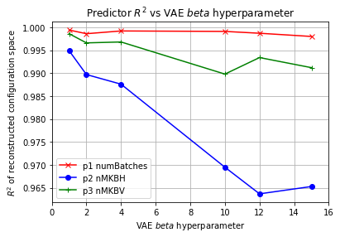
β-VAE lessons
Larger β indeed seems to give disentangled representation – for some seeds
See expected reduction in reconstruction accuracy with improving disentanglement (larger β)
SVD of z space gives clear result that collapsing (or forcing) number of independent z directions to dimensionality of generators c results in disentangled representation – fully unsupervised process.
Setting z dimensionality equal to that of c gives same result - but we don’t a priori know the c dimensionality
Very critical balance between value of β and batch_size – need to keep both as high as possible, and hope training converges

