Slide 1
Predicting accidents severity in the US
The high death rate from road accidents is a major concern in today's society.
An efficient and valid treatment is therefore of great importance for citizens and societies.
Large efforts and studies have addressed the question of road safety.

Slide 2
Data acquisition and cleaning
Car accidents severity in the US (2016-2020) from Kaggle dataset, data scraped from kaggle
In total, 351362 rows and 49 features in the raw dataset. Duplicate, highly similar or highly correlated features were dropped.
Cleaned data contains 25 features.

Slide 3
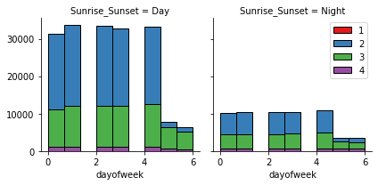
Accidents are more likely to happen during the day, and less likely during the weekend.

Slide 4
Classification models performance
Weighted RMSE:
KNeighbors:
Decision Tree:
Random Forest:
SVM:
LogisticRegression :

Slide 5
Conclusion and future directions
Built useful models to predict the severity of an accident.
Accuracy of the models has room for improvement.
Capture more details of the cars and the locations.
Ideas include:
Car type.
Road type.

