Slide 1

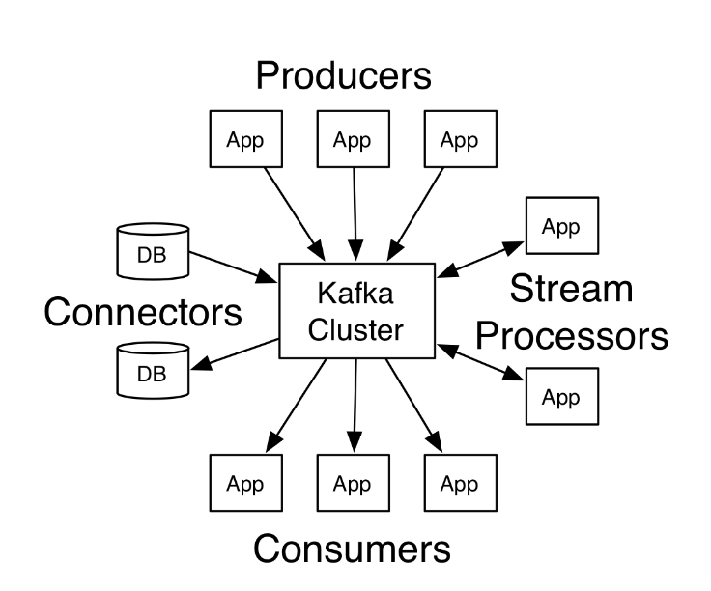
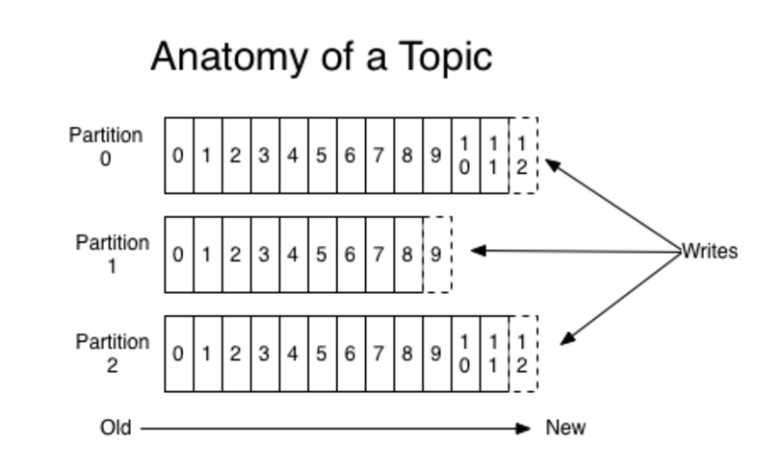
Kafka
is a distributed streaming platform.
APIs
Partitioned Log

Slide 2
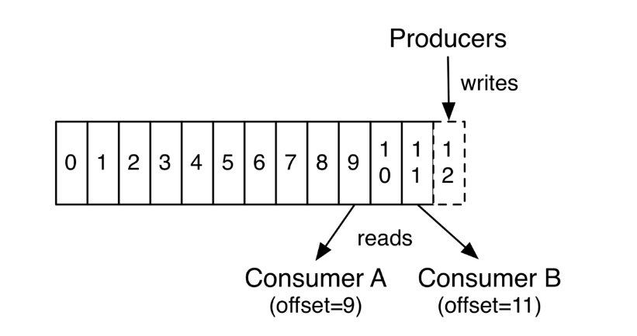
Kafka
Producers / Consumers
Consumers
Lightweight consumers
Each consumer controls it’s own offset
Each consumer can freely navigate the logs
Producers
Publish data
Always appending to log
Choose partition to send data
Round-robin
Using semantics(i.e – based on some key)

Slide 3
Kafka
Partitions
Partitions are distributed over servers
Allow log to scale beyond a size that fits a single server
Act as a unit of parallelism
Replicated (configurable)
One “Leader” and zero or more “followers” per partition
Leader handles all read and write while followers replicate the leader
Ordering provided per partition, not between partitions in a topic

Slide 4
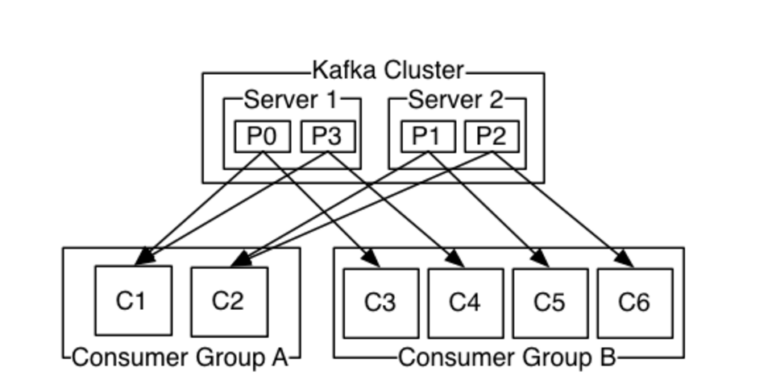
Kafka
Consumers
Has a consumer group
Can be in separate processes or machines
Multiple groups can exist per topic
Partitions divided by consumers in a group
  Handled by Kafka protocol dynamically

Slide 5
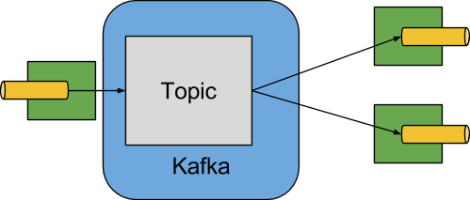
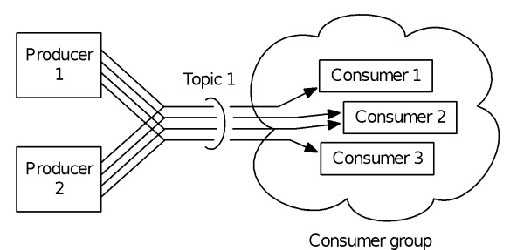
Kafka
Guarantees
Messages will be appended in the order they are sent(per partition).
A consumer instance sees records in the order they are stored in the log.
For a topic with replication factor N, we will tolerate up to N-1 server
failures without losing any
records committed to the log.

Slide 6
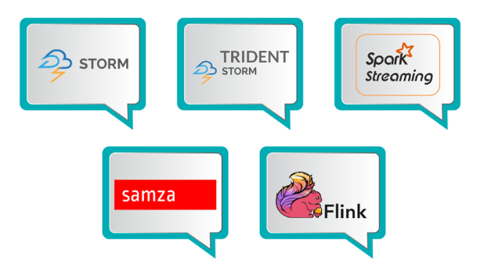
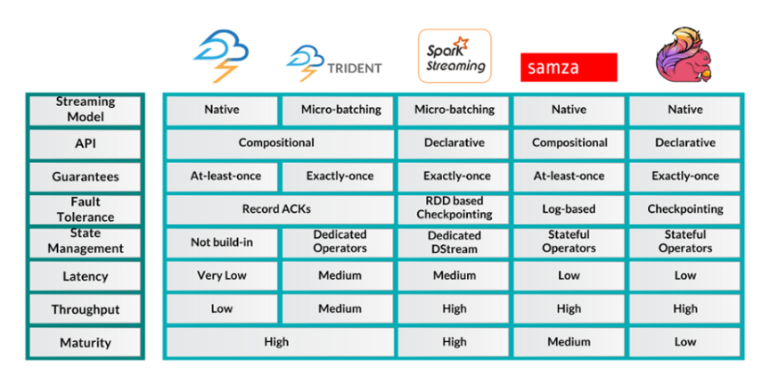
Kafka
Streams - Platforms

Slide 7
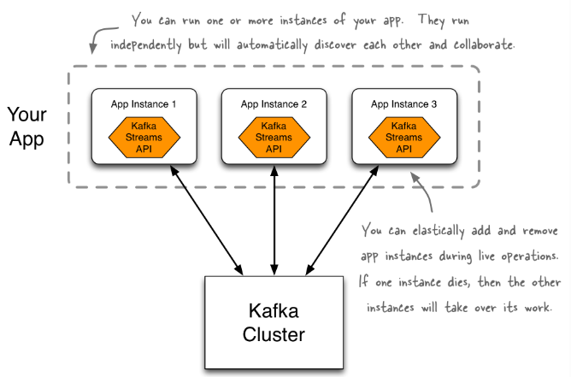
Kafka
Streams

Slide 8
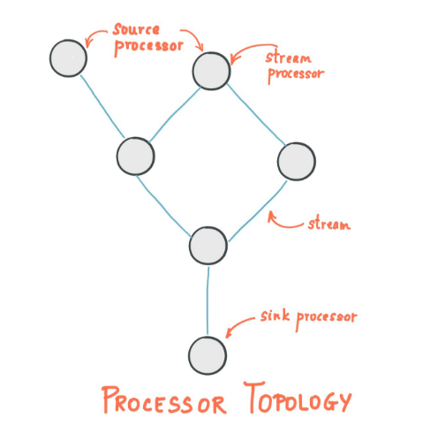
Kafka
Streams
A stream is the most important abstraction provided by Kafka Streams: it represents an unbounded, continuously updating data set. A stream is an ordered, replayable, and fault-tolerant sequence of immutable data records, where a data record is defined as a key-value pair.
A stream processing application is any program that makes use of the Kafka Streams library. It defines its computational logic through one or more processor topologies, where a processor topology is a graph of stream processors (nodes) that are connected by streams (edges).
A stream processor is a node in the processor topology; it represents a processing step to transform data in streams by receiving one input record at a time from its upstream processors in the topology, applying its operation to it, and may subsequently produce one or more output records to its downstream processors.
There are two special processors in the topology:
  Source Processor: A source processor is a special type of stream processor that does not have any upstream processors. It produces an input stream to its topology from one or multiple Kafka topics by consuming records from these topics and forward them to its down-stream processors.
  Sink Processor: A sink processor is a special type of stream processor that does not have down-stream processors. It sends any received records from its up-stream processors to a specified Kafka topic.

Slide 9

Kafka
Streams – Use cases
Travel companies can build applications with the Kafka Streams API to make real-time decisions to find best suitable pricing for individual customers, to cross-sell additional services, and to process bookings and reservations.
The finance industry can build applications to aggregate data sources for real-time views of potential exposures and for detecting and minimizing fraudulent transactions.
Logistics companies can build applications to track their shipments fast, reliably, and in real-time.
Retailers can build applications to decide in real-time on next best offers, personalized promotions, pricing, and inventory management.
Automotive and manufacturing companies can build applications to ensure their production lines perform optimally, to gain real-time insights into their supply chains, and to monitor telemetry data from connected cars to decide if an inspection is needed.
Real time alerting.

Slide 10
Kafka
Streams

Slide 11

Questions

