Slide 1

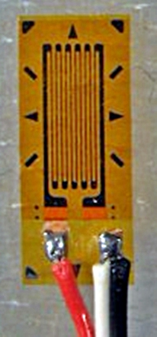
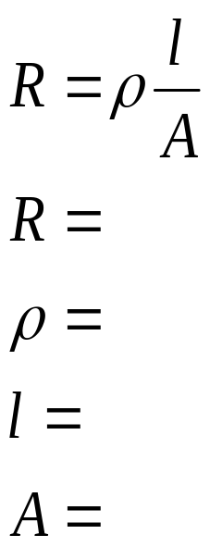
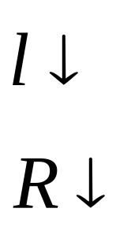
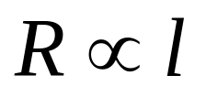
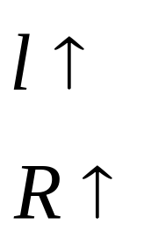
Strain Gauge
Tension
Compression
=>
Resistance
Property of material
Length of wire
Effective cross sectional area of wire

Slide 2
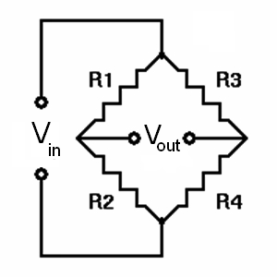
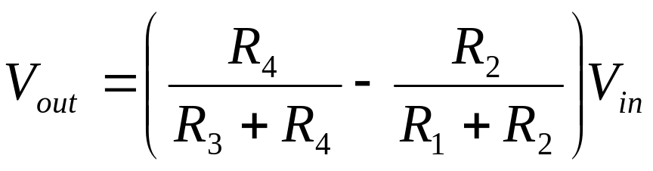
Wheatstone Bridge

Slide 3
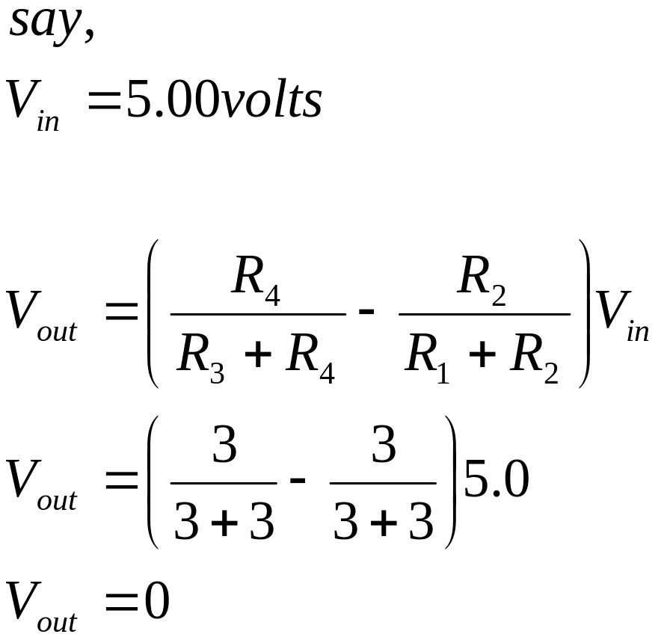
Wheatstone Bridge
(3)
(3)
(3)
(3)

Slide 4
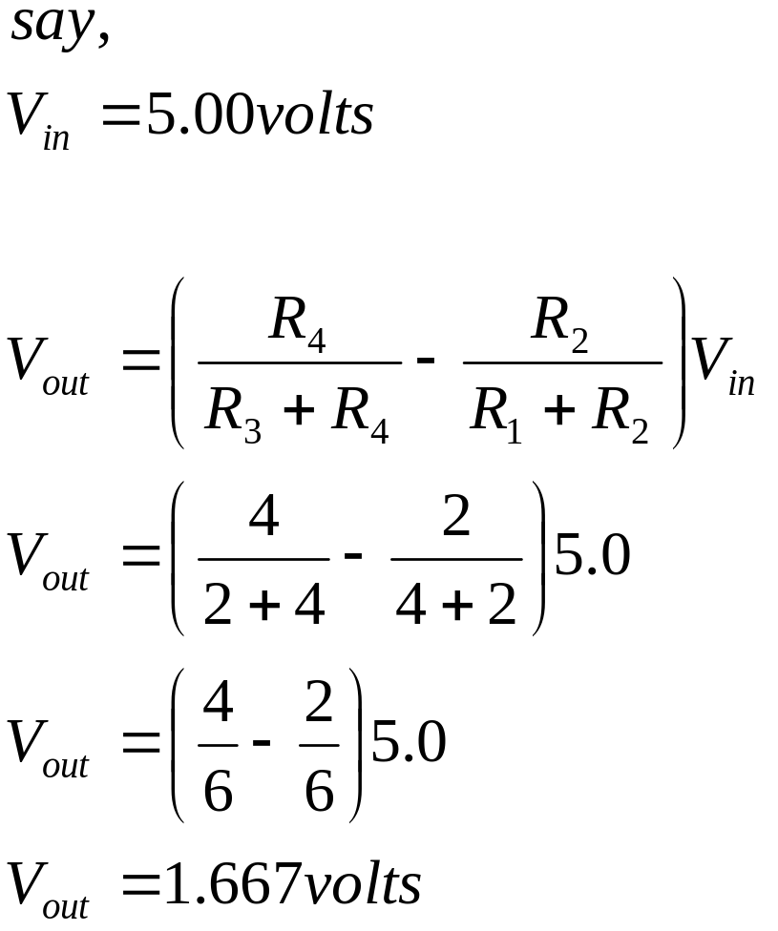
Wheatstone Bridge
(4)
(2)
(2)
(4)

Slide 5
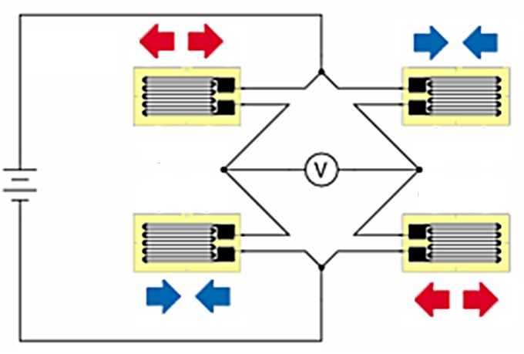
Full Bridge Strain Gauge
R
R
R
R

Slide 6
Tension
Compression
No Force Applied
R
R
R
R

Slide 7
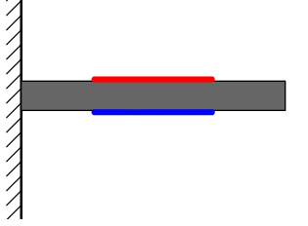
Bending Beam Load Cell
Strain Gauge
Strain Gauge

Slide 8
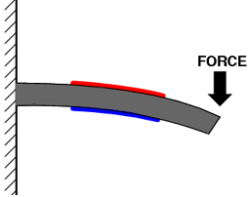
Bending Beam Load Cell
Strain Gauge
In Tension
Strain Gauge
in compression

