Slide 1




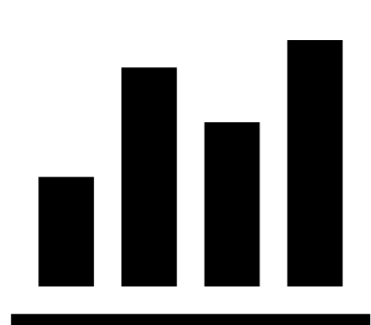
Document
Corpus
Automated
Benchmark
Generation
Capability
Insights

Slide 2

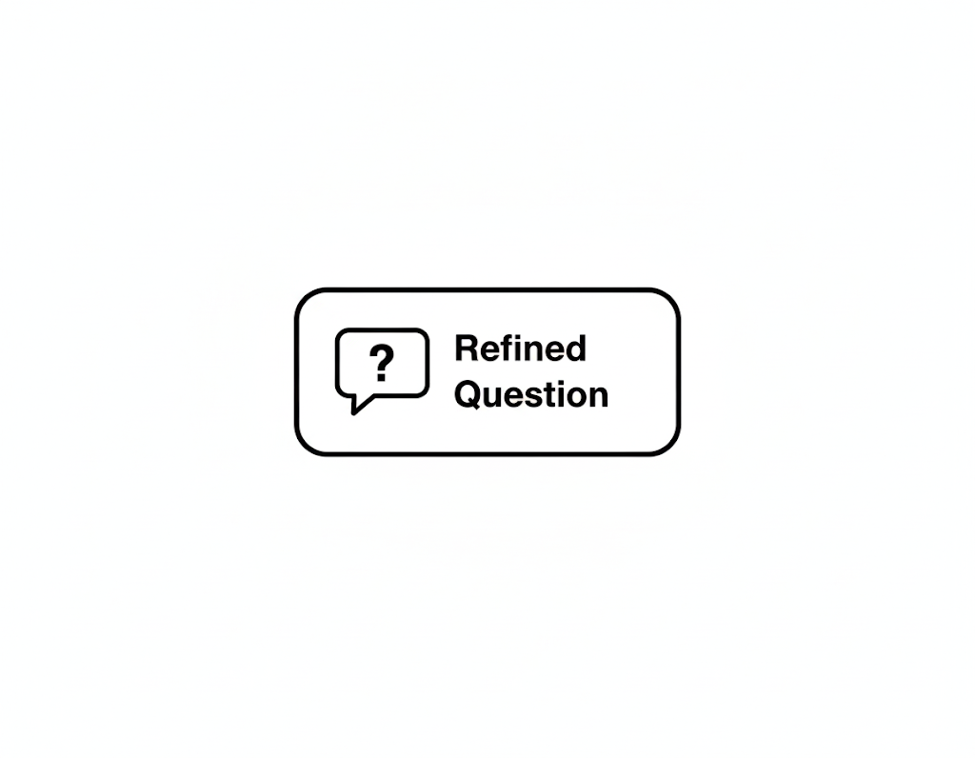
User
Question
Contextually
Grounded
Rewrite
Improved
Accuracy
Refined
Question
Document

Slide 3
User
Question
Contextually
Grounded
Rewrite
Refined
Question
Document
Improved
Accuracy

Slide 4


+
User Query
Refined
Question
Response
LM1
Contextually
Grounded
Query Rewrite
Improved
Accuracy
Context
Document
LM2

Slide 5
+
User Query
Refined
Question
LM1
LM2
Contextually
Grounded
Query Rewrite
Context
Document
Improved
Response

Slide 6
+
User Query
Refined
Question
LM1
LM2
Answer-Free,
Contextually
Grounded
Query Rewrite
Improved
Response
Accuracy
Context
Document

Slide 7


User
Query
Answer-Free,
Contextually
Grounded
Query Rewrite
+
Refined
Query
Context
Document
LM1
Improved
Response
Accuracy

Slide 8
User
Query
Answer-Free,
Contextually
Grounded
Query Rewrite
+
Refined
Query
Context
Document
Improved
Accuracy
LM1

