Slide 1
PIRVISION
Fog Presence Detection using Machine Learning
MALAVIKA M
Class: III BCA A
Machine Learning Project
1

Slide 2
1. About the Project
Project Objective
Why Fog Detection?
PIRVISION is a machine learning classification project designed to detect fog presence from PIR sensor readings and environmental information.
Early fog detection can support safer monitoring and decision-making in environments where visibility conditions can change.
Input
Output
Temperature and multiple PIR sensor readings collected over time.
A target class indicating the observed fog-related condition in the dataset.
2

Slide 3
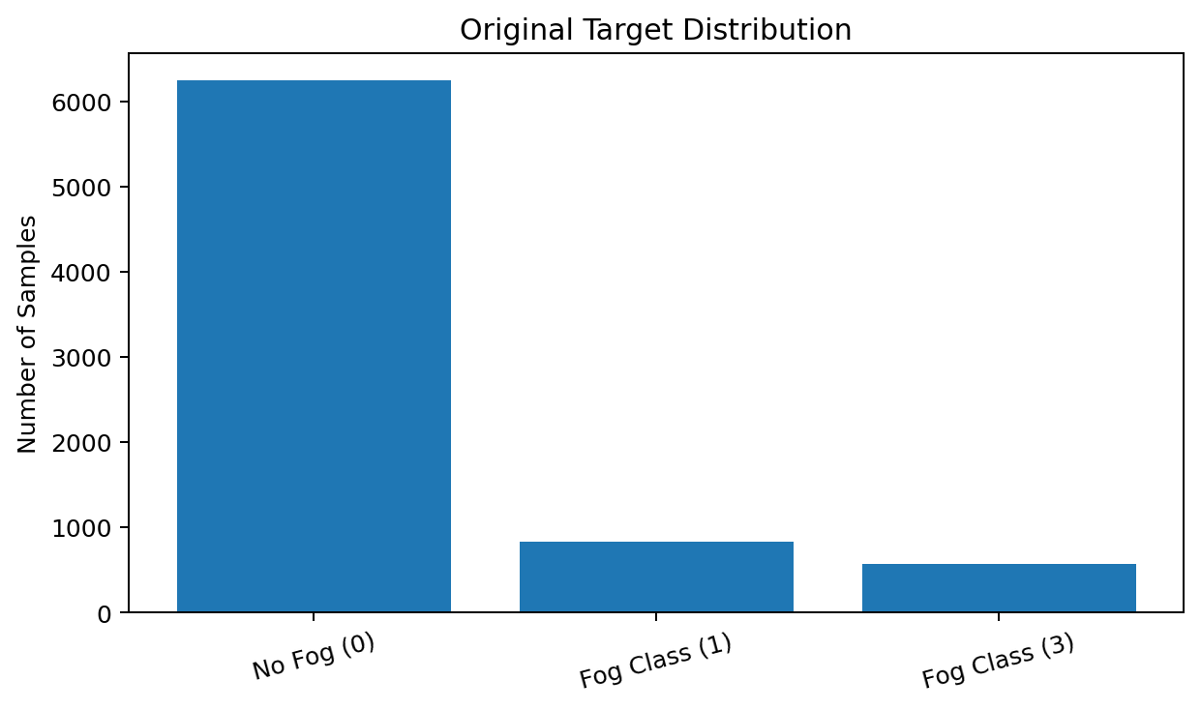
2. About My Dataset
Pirvision sensor dataset used for multiclass classification
• Original dataset size: 7,651 rows × 59 columns.
• Features include Date, Time, Temperature_F and PIR_1 to PIR_55.
• Target column: Label.
• Original target distribution: 0 = 6,247; 1 = 833; 3 = 571.
• Missing values: 0. Duplicate rows: 0.
• After Date/Time feature extraction, the modeling table contains 62 input features + target.
3

Slide 4
3. EDA Process
1. Statistical Analysis
2. Data Quality
info(), describe(), shape, columns
Missing values and duplicate checks
3. Correlation
4. Encoding
Correlation matrix and heatmap
Label Encoding for target; no unnecessary OHE for numeric PIR inputs
5. Outliers
6. Class Balance
Box plot + IQR clipping
SMOTE applied to training data
7. Feature Selection
8. Skewness & Scaling
SelectKBest with ANOVA F-test; top 25 features
Yeo-Johnson transformation + StandardScaler
4

Slide 5
4. Train–Test Split & Data Preparation
Training Set
Testing Set
Split Strategy
80% = 6,120 samples
Used to learn model patterns.
20% = 1,531 samples
Used only for final evaluation.
Stratified split
Random state = 42
SMOTE
Feature Selection & Scaling
Training data was balanced using SMOTE. Each class in the resampled training set contains 4,997 samples, giving 14,991 training samples.
SelectKBest reduced the inputs to 25 relevant features. Yeo-Johnson transformation handled skewness, followed by StandardScaler.
5

Slide 6
5. Machine Learning Algorithms
Logistic Regression
Decision Tree
Linear multiclass classifier used as a baseline.
Rule-based tree model for nonlinear classification.
Random Forest
K-Nearest Neighbors
Ensemble of decision trees; strong for complex sensor patterns.
Classifies using similarity to nearby training samples.
Support Vector Machine
Finds a separating decision boundary using an RBF kernel.
6

Slide 7
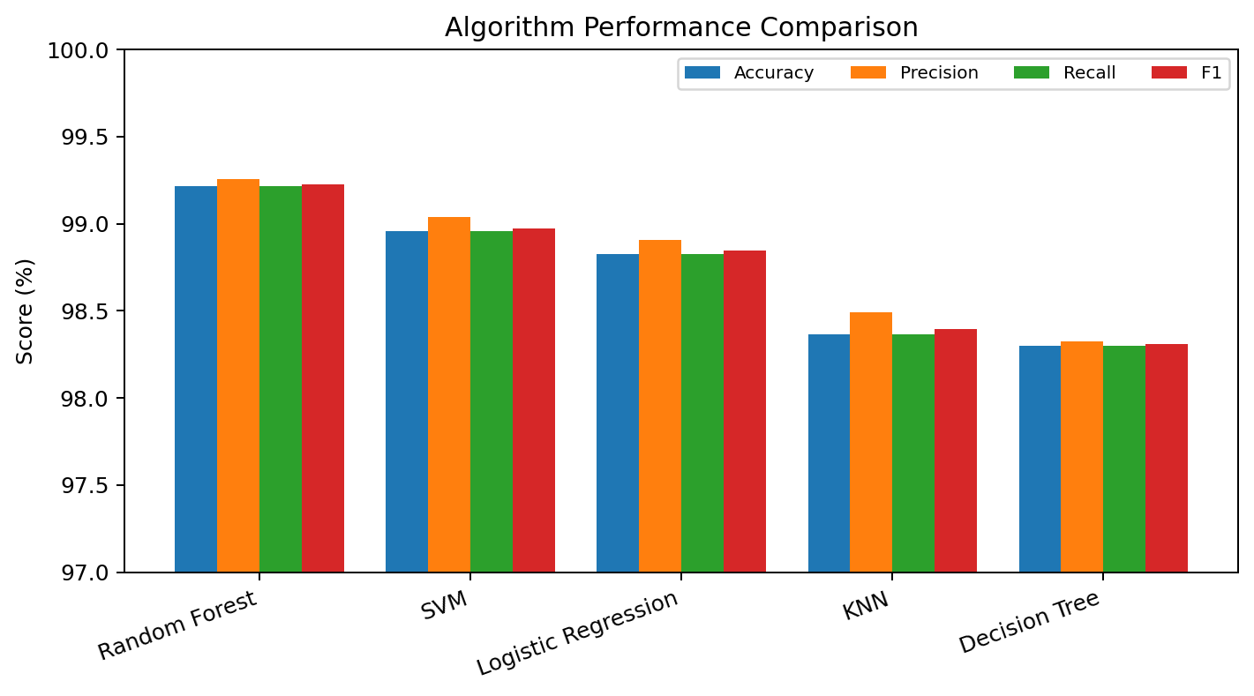
6. Evaluation Metrics & Results
Algorithm | Accuracy | Precision | Recall | F1
Random Forest | 99.22% | 99.26% | 99.22% | 99.23%
SVM | 98.95% | 99.04% | 98.95% | 98.97%
Logistic Regression | 98.82% | 98.91% | 98.82% | 98.84%
KNN | 98.37% | 98.49% | 98.37% | 98.40%
Decision Tree | 98.30% | 98.32% | 98.30% | 98.31%
• Accuracy: overall correct predictions.
• Precision: correctness of positive/class predictions.
• Recall: ability to identify actual class samples.
• F1-score: balance between precision and recall.
7

Slide 8
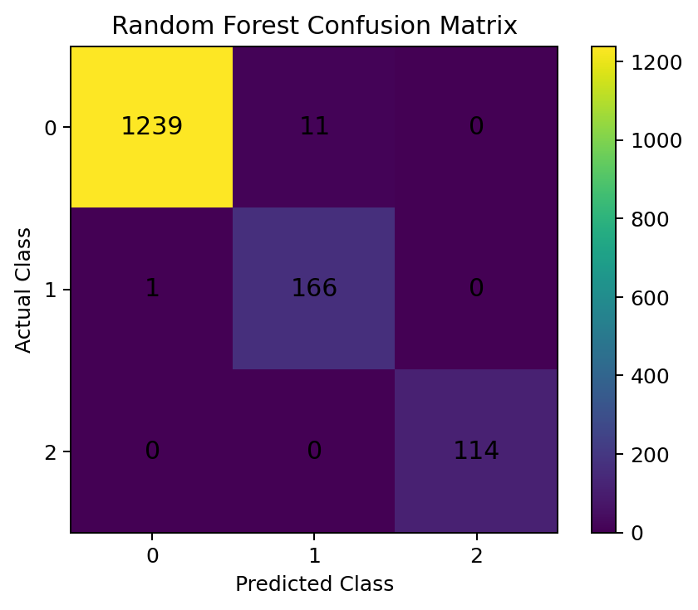
7. Best Performing Algorithm
Winner: Random Forest
Why Random Forest Performed Best
Best overall result with 99.22% accuracy and 99.23% F1-score.
The ensemble combines multiple decision trees, which helps capture nonlinear relationships among the PIR sensor features while reducing the weakness of relying on a single tree.
Test Performance
Accuracy: 99.22%
Precision: 99.26%
Recall: 99.22%
F1-score: 99.23%
Confusion Matrix
Most test samples were classified correctly, with very few class confusions.
8

Slide 9
8. Conclusion & Future Scope
Conclusion
Key Result
PIRVISION demonstrates that PIR sensor and temperature features can be used effectively for fog-presence classification. After EDA, balancing, feature selection and scaling, Random Forest achieved the best result.
Random Forest achieved 99.22% accuracy on the held-out test set, outperforming SVM, Logistic Regression, KNN and Decision Tree in this experiment.
Future Scope
Thank You
• Real-time sensor integration
• Live fog alerts
• Larger and more varied weather datasets
• Model deployment for practical monitoring
MALAVIKA M
III BCA A
PIRVISION – Fog Presence Detection
Questions?
9

