Slide 1
Distributed Oscilloscope over
White Rabbit network
Author
Miłosz Malczak
Supervisor
dr inż. Grzegorz Kasprowicz

Slide 2
Motivation
Providing a system for monitoring signals located over large distances
Disadvantages of current solutions:
custom-made,
not scalable,
not precise enough,
lack of compatibility.

Slide 3
Existing solutions
LAN-based eXtensions for Instrumentation (LXI)
  Standardizes access to various types of laboratory instrumentation
  Synchronization based on IEEE 1588-2002 Precision Time Protocol (PTP)
OASIS
  Currently used at CERN for monitoring signals
  Triggers distributed over coaxial cables
  Provisional compensation
  Costly, lack of proper synchronization

Slide 4
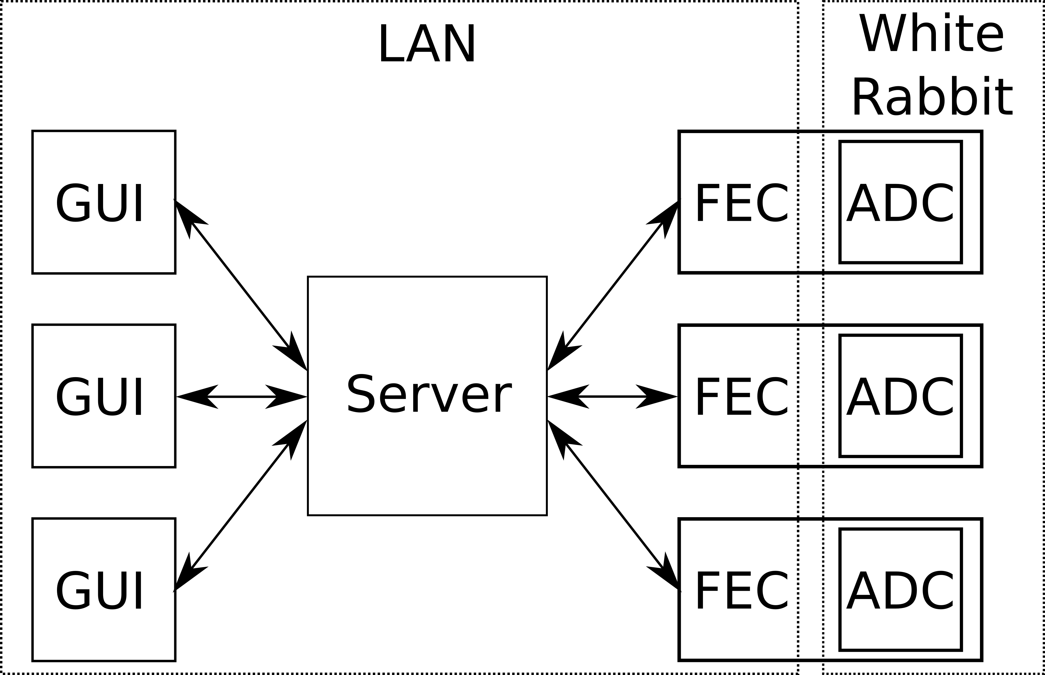
Distributed Oscilloscope

Slide 5
White Rabbit Trigger Distribution (WRTD)
Distribution of the timestamps
Possibility of compensation for logical latencies and cable lengths
Information about the delay between the triggers
Introducing delays

Slide 6
White Rabbit Network
125 MHz clock
Subnanosecond precision
Information about transmission delays over the fiber
Sending data packets

Slide 7
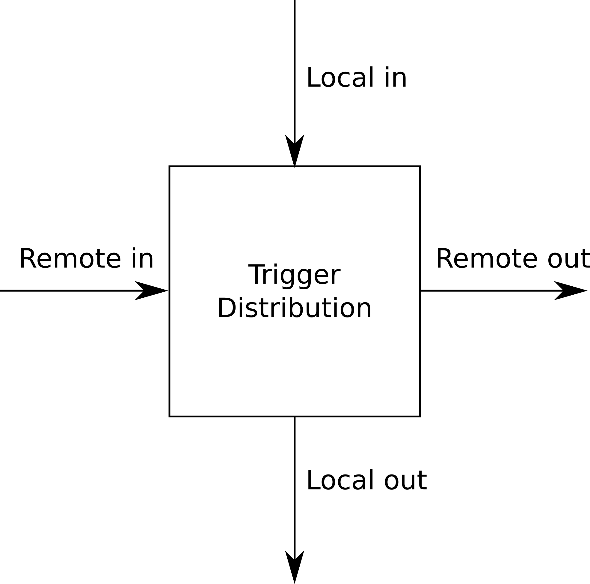
White Rabbit Trigger Distribution block
Local in
  Time to Digital Converter (TDC)
  ADC producing timestamp on threshold
Local out
  Fine Delay Generator
  WRTD enabled ADC
Remote in/out
  Connection with other WRTD blocks

Slide 8
Triggers in Distributed Oscilloscope
Synchronized triggering of ADCs:
Programming the time when the ADCs should be triggered
Triggering the ADCs based on the timestamp received from the other ADC.

Slide 9
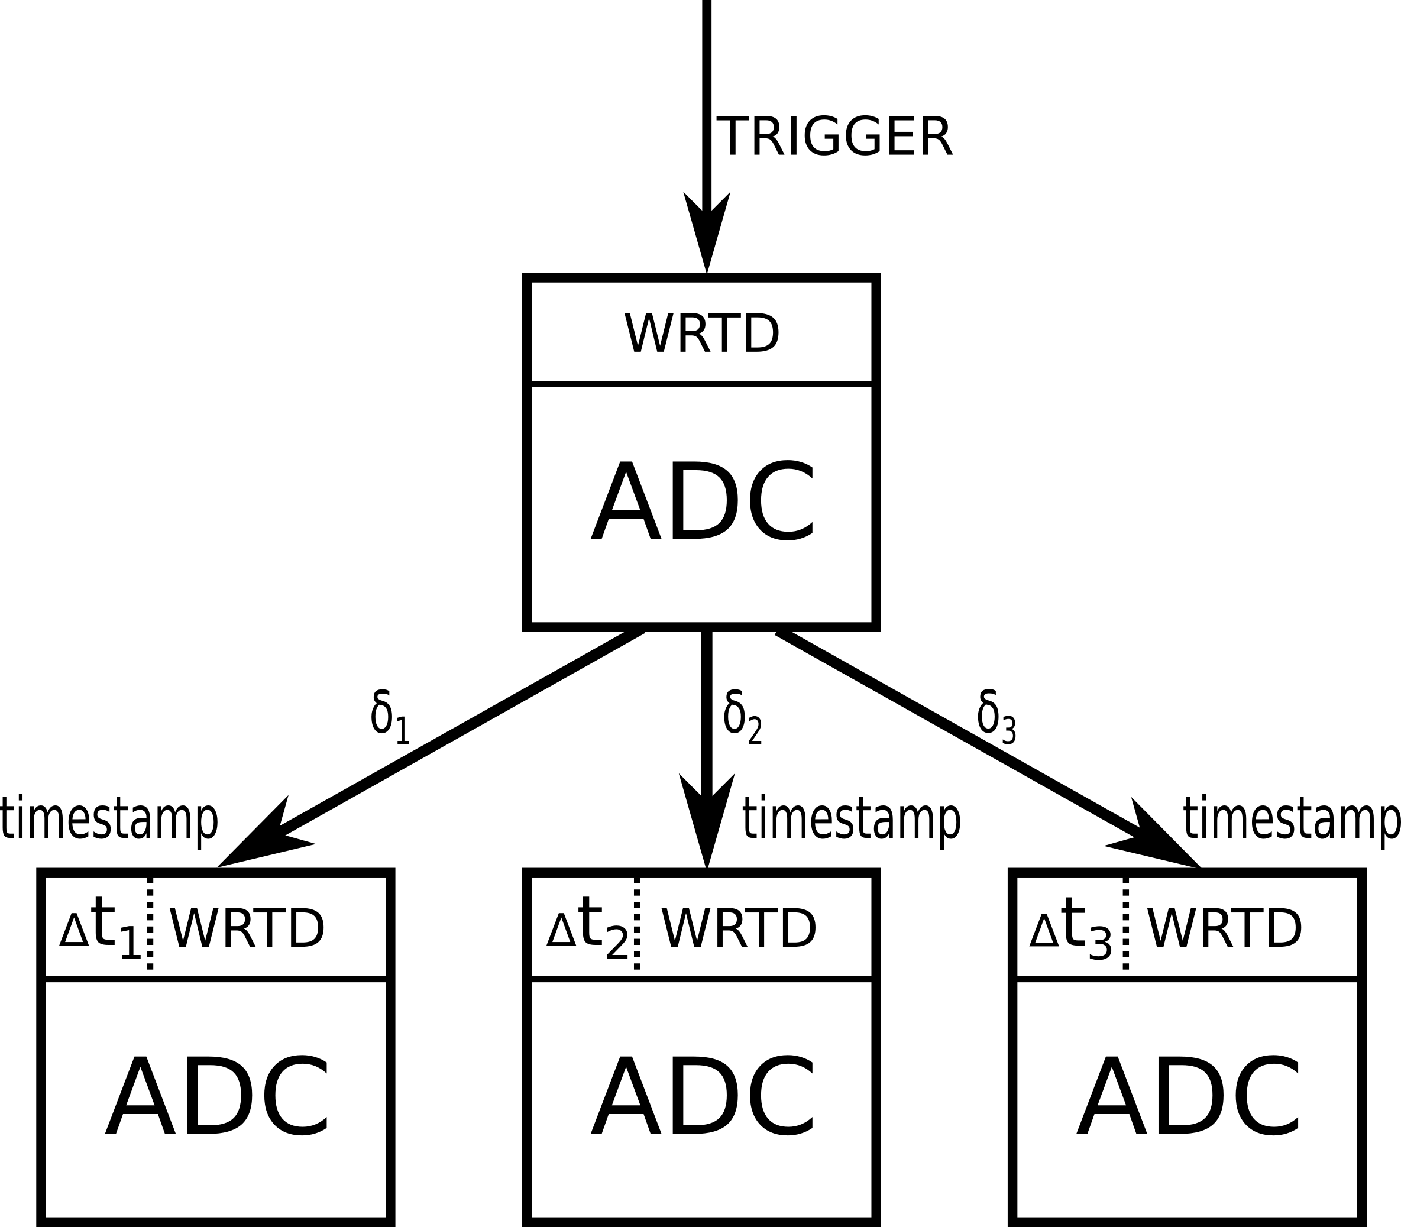
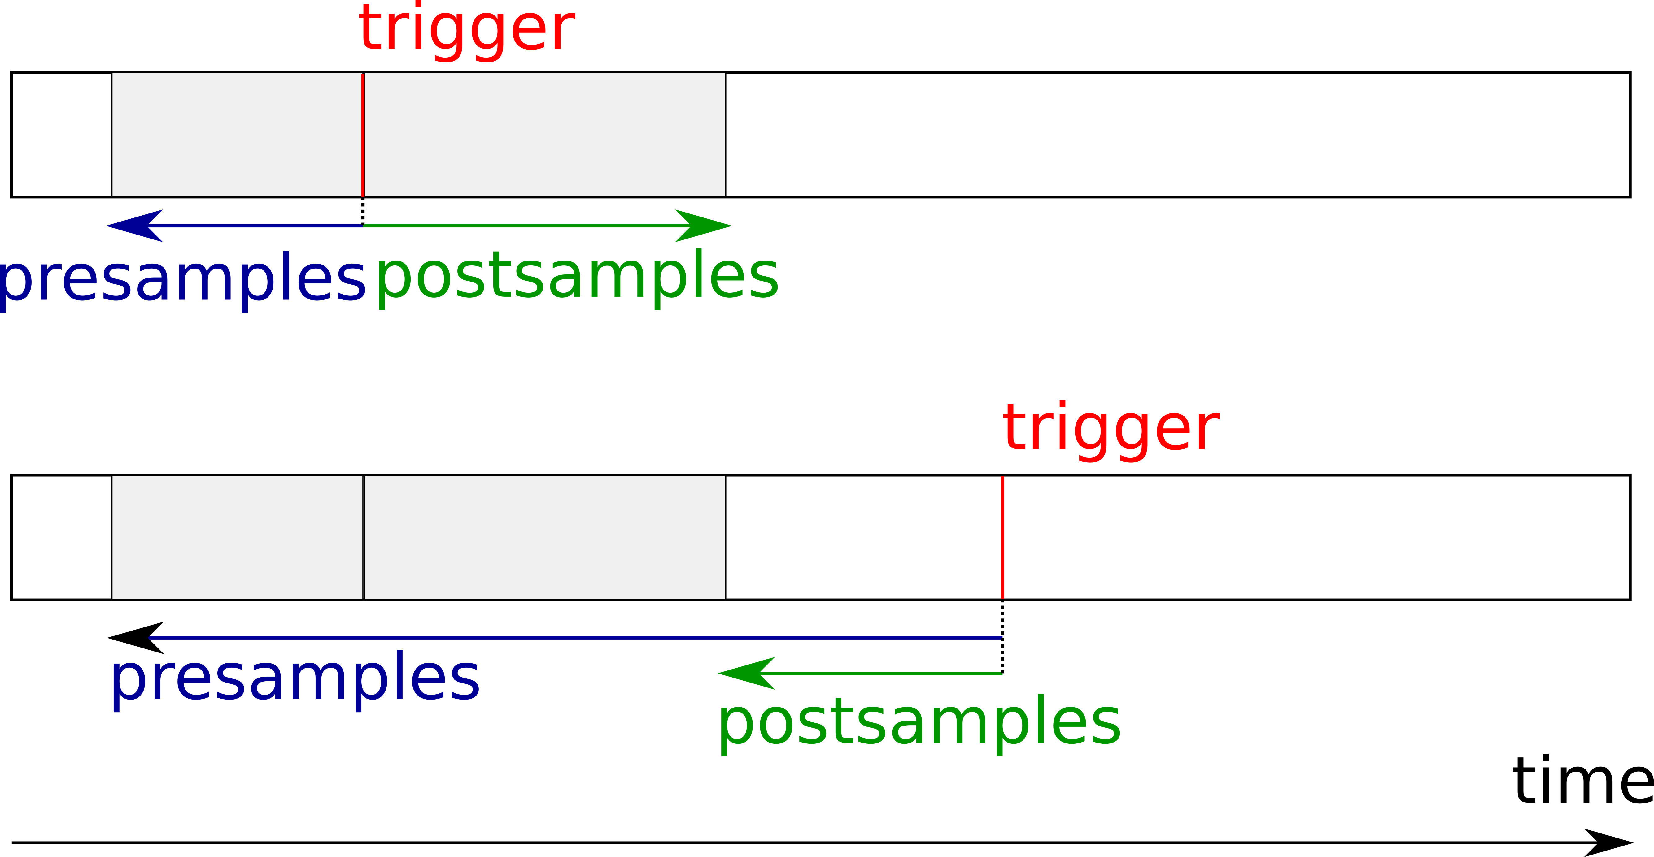
WRTD in Distributed Oscilloscope
∆t_{i}>=δ_{i}
∆t_{i} — delay introduced by WRTD
δ_{i} — propagation delay of the network
presamples = presamples_{required}+ ∆t *f_{s}
postsamples = postsamples_{required} - ∆t *f_{s}

Slide 10
Done
To do
basic Distributed Oscilloscope
possibility of specifying time of the trigger
adding support for WRTD
making Distributed Oscilloscope more generic
adding support for different ADCs
adding support for TDCs
providing common interface for different types of devices
possibility to display White Rabbit network topology in the form of a graph
locking ADCs sampling clock to the White Rabbit clock
adding support for ADCs without a host

