Slide 1
Distributed Oscilloscope
Questions, doubts, things to focus on:
Is it better two have separate classes for internal or external triggers, or unify them and handle exceptions?
I will be happy to hear any advises on exceptions – when should be added, how should be handled?
https://gitlab.cern.ch/mmalczak/server.git
Commit: 9996ae47ef6fd96f6487e6aacc913a39b02ed254
https://gitlab.cern.ch/mmalczak/pyqt_app.git
Commit: c25845285c33953a923d8c898a85b1f21d6f6315
https://gitlab.cern.ch/mmalczak/fec.git
Commit: 46c99fcf0a93d2bacbcdd2ef544f8e9dd69d8b46

Slide 2
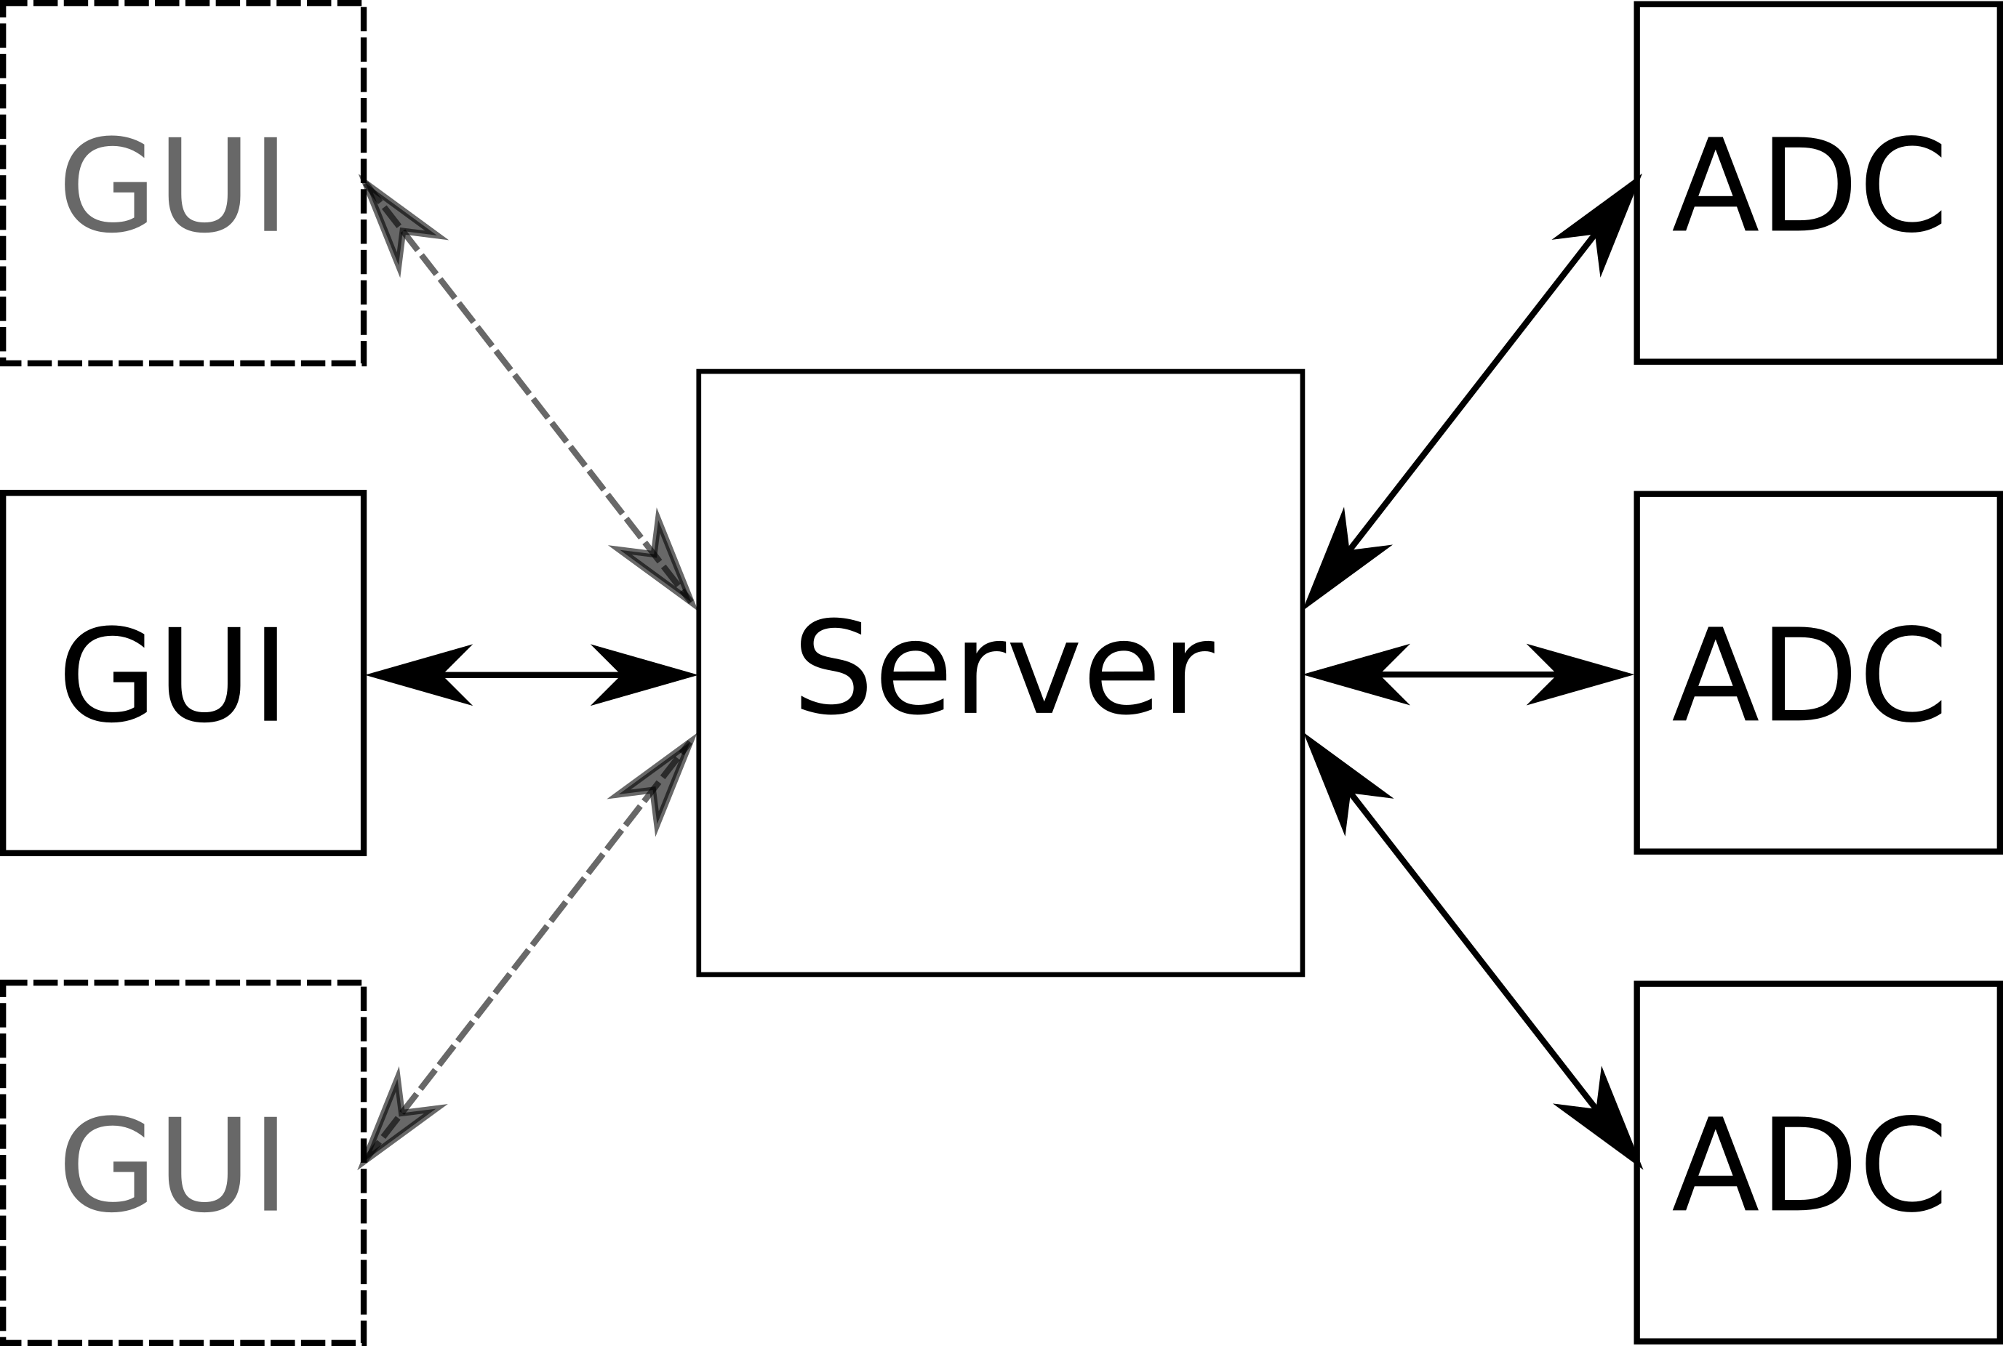

Slide 3
Server
Entry point – main_server.py
https://gitlab.cern.ch/mmalczak/server.git
Commit: 9996ae47ef6fd96f6487e6aacc913a39b02ed254
Configuring ADCs:
general ADC settings – presamples, postsamples etc.
channels settings
triggers settings
WRTD_settings
acquisition configuration – should be done in the loop, at the moment RPC call ‘debug’, to avoid receiving great amounts of data
Retrieving current configuration from the ADCs
Retrieving data from the ADCs
Passing data and configurations to GUI

Slide 4
Data flow
Configuration data | Samples
User makes changes in the GUI GUI sends RPC request to the server to configure parameter Server sends RPC request to the ADC to configure parameter Server retrieves all the configuration data from the ADC and updates the ADC in the GUI: | In the loop (currently on RPC request) – starts the acquisition in all the ADCs ADC that sends the WRTD triggers is configured at the end. When ADC retrieves the data, it sends it to the server using RPC call. Server checks if it has received the data from all requested channels, if yes, it sends to the GUI the data together with information about number of presamples and postsamples and offsets between the triggers

Slide 5
Establishing connection
If the server and GUI/ADC are in the same network, zeroconf can be used – the connection is established automatically. Otherwise the IP of the server has to be passed as the argument during startup.

Slide 6
main_server.py
Creates Oscilloscope instance and all the threads
Threads:
thread_GUI_expose
thread_ADC_expose
thread_zero_conf

Slide 7
ADC_expose.py
Functionalities exposed to the ADC in seperate thread
ThreadADC_expose
add_service
remove_service
update_data → receive the data from the ADC
Establishing connection in case of different networks

Slide 8
GUI_expose.py
Functionalities exposed to the GUI in seperate thread
ThreadGUI_expose
add_service
remove_service
add_channel
add_trigger
remove_channel
remove_trigger
set_presamples
set_postsamples
set_channel_range
set_ADC_parameter
Establishing connection in case of different networks
Directly applied to the oscilloscope
For passing configuration requests from the GUI to the ADC

Slide 9
GUI_expose.py
Set the number of presamples and postsamples in all ADCs used in the GUI
set_presamples
set_postsamples
set_channel_range – this function is not included in the genieric set_ADC_parameter because it also requires the changes in the threshold
set_ADC_parameter – generic functions for configuring acquisition – it takes as arguments the name of the parameter, value, ADC_name and optionally channel index. If mapper method is provided it modifies the provided value accordingly, otherwise the value is unchanged

Slide 10
set_ADC_parameter
@update_GUI_after
def set_ADC_parameter(self, parameter_name, value, unique_ADC_name, idx = -1):
function_name = 'set_' + parameter_name
mapper_function_name = 'map_' + parameter_name
mapper_methods_closure = self.MapperMethodsClosure()
mapper_function = getattr(mapper_methods_closure, mapper_function_name)
ADC_value = mapper_function(value, unique_ADC_name, idx, self.osc.available_ADCs)
self.send_RPC_request(function_name, unique_ADC_name, ADC_value, idx)
def send_RPC_request(self, function_name, unique_ADC_name, ADC_value, idx):
proxy = self.get_proxy(unique_ADC_name)
if(idx == -1):
proxy.set_adc_parameter(function_name, ADC_value)
else:
proxy.set_adc_parameter(function_name, ADC_value, idx)
def get_proxy(self, unique_ADC_name):
proxy = get_proxy(self.osc.available_ADCs[unique_ADC_name].ADC_proxy_addr)
return proxy
class MapperMethodsClosure():
def __getattr__(self, *args):
return lambda *x: x[0]
def map_internal_trigger_threshold(self, value, *args):
return threshold_mV_to_raw(value, *args)
def map_channel_termination(self, value, *args):
return int(value)
def update_GUI_after(func):
def wrapper(self, *args, **kwargs):
func(self, *args, **kwargs)
unique_ADC_name = None
for arg in args:
try: # find the name of the ADC in the arguments - fixme
if(arg[0:3]=="ADC"):
unique_ADC_name = arg
print(arg)
except:
pass
for GUI_name, GUI in self.osc.GUIs.items():
for channel_dx, channel_GUI in GUI.channels.items():
if(channel_GUI.unique_ADC_name == unique_ADC_name):
GUI.update_conf(unique_ADC_name)
break
return wrapper

Slide 11
service_management.py
Zeroconf is being run in separate thread.
Functions add_service and remove_service can be called either by the zeroconf or by the RPC
add_service checks the name, if it is ADC or GUI and accordingly registers ADC or GUI in the oscilloscope and sets it’s own address in the service

Slide 12
osciloscope.py
Oscilloscope class contains information about available ADCs and GUI. It is responsible for their registration.
What is more, it is responsible for updating the acquisition data received from the ADC – it updates the data in all the GUIs
Method validate_data is not currently used

Slide 13
GUI.py
The GUI class contains the information about the channels and triggers requested by the user of the particular GUI.
Additionally, it has the list of available ADCs, ADCs that are currently used by the particular ADC and the address of the GUI – for sending RPC requests
Whenever the channel and trigger are added, the list of used ADCs is updated, as well as all the configuration of the particular ADC.
Just as described before, functions responsible for configuring acquisition will be invoked in the loop – currently by RPC call.
Whenever presamples or postsamples are configured, all the used ADCs have to be configured – for consistency in the GUI.
Method update_conf retrieves all the configurations from the ADC and and sends the configuration of used channels and triggers together with horizontal settings to the GUI – TODO all the configurations should be send in one RPC call instead of three

Slide 14
ADC.py
ADC class is actually a mapping of the ADC device. It also contains the recently retrieved acquisition data, scaled appropriately.

Slide 15
conversion.py
Functions for converting values from mV to raw binary and the other way around

Slide 16
proxy.py
xmlrpc imports plus function get_proxy

Slide 17
timestamp_operations.py
Functions for manipulating the timestamps. Currently only one of them is used

Slide 18
GUI
https://gitlab.cern.ch/mmalczak/pyqt_app.git
Commit: c25845285c33953a923d8c898a85b1f21d6f6315
Entry point – main.py
In principle it should expose the available functionality to the user – which is quite limited. It should be as similar as possible to the standard oscilloscope – fixed number of channels (could be reconfigurable), one trigger source
WRTD configured automatically without users knowledge (or without need for configuration by the user) by the server

Slide 19
main.py
Mainly initialization
If the ip of the server is provided, the RPC request is sent to the server, to add the service. Otherwise it is done automatically by the zeroconf.

Slide 20
mainwinddow.py
Created by Qtcreator from mainwindow.ui

Slide 21
threads
Except for the main thread, one additional thread – ThreadServerExpose that exposes certain functionalities to the server.

Slide 22
server_expose.py
add_available_ADC
remove_available_ADC
update_data
set_horizontal_params
set_channel_params
set_trigger_params
set_server_address – zeroconf is used to inform the server about the existence. When the GUI is registered in the server, it sets its IP address in the GUI. Until it is not done, the execution in the GUI is hold. The behaviour is the same independently if the ip address of the server was provided by the user or not.
show_widgets – just for debugging
Directly mapped to the oscilloscope class methods

Slide 23
GUI.py
Oscilloscope class all the classes that create the users interface:
ChannelClosure
TriggerClosure
Presamples/Postsamples
All the methods of the oscilloscope class are available to the server. They cannot be called directly by the user.
All the methods are rather self explanatory.
Function update_data except for plotting the received data it also shifts the data accordingly depending on the offset provided by the server, calculated based on the difference between received timestamps

Slide 24
channels.py
ChannelsClosure class contains:
layout – in this layout all the widgets are added.
plot – for plotting channels data
properties – ChannelProperties class is responsible for managing widgets for configuring channels – it is mapped to the channels configuration of the ADC.
All the widgets have either action method or value_change method that whenever some action happens, it sends the RPC request to the server. (Probably the action and value_changed should be unified)
menu – the widget for selecting the channel to be configured and displayed

Slide 25
triggers.py
The triggers structure is very similar to the channels, but there could be only one trigger.
There are two possible types of the trigger – internal or external. The only difference between them is the threshold.

Slide 26
parent_classes.py
Contains classes from which the widgets inherit.
These classes inherit from QT classes, adjusted a little bit for the oscilloscope – they contain the information about the ADC_name, channel idx etc.

Slide 27
plot.py
class PlotMine responsible for managing channels and triggers. By channels I mean data corresponding to the channel.

Slide 28
horizontal_settings.py
Contains Presamples and Postsamples classes.
In the future should I do something like HorizontalSettings Closure class, to make it the same as triggers and channels??

Slide 29
proxy.py
The same as in the case of the server with addition of the Proxy class.
The Proxy class is used for passing the address of the server to various classes. There is separate class for this, because the address during initialization doesn’t have to be known so it is None. When the None is passed to other classes, it is passed by value, not by reference, so when the address is finally set, it is not changed in classes to which it was passed. To overcome this problem, the address is the attribute of Proxy class which is mutable therefore passed by reference

Slide 30
ADC
https://gitlab.cern.ch/mmalczak/fec.git
Commit: 46c99fcf0a93d2bacbcdd2ef544f8e9dd69d8b46
Entry point – adc_client.py
Responsible for configuring the ADC hardware according to servers requests – configuration of channels, triggers, general settings, acquisition and WRTD

Slide 31
adc_client.py
Mainly initialization. The same as in the case of the GUI, if ip of the server is provided, it sends RPC request to register itself, otherwise if it is in the same network as the server, the zeroconf takes care of that

Slide 32
threads
Except for the main thread there is a thread managing RPC requests and a thread managing user commands.
Overmore ,threads for the acquisition are dynamically created.

Slide 33
commands.py
Mainly useful for proper exiting – so that the ADC is properly unregistered in the server – should by added handling of the case when the ADC disconnects not properly
There is also a function for printing rpc command – will be removed

Slide 34
server_expose.py
set_adc_parameter – generic function for changing ADC configuration
set_server_address – exactly the same as in the case of the GUI
set_channel_range – should be removed
configure_acquisition_async – configures acquisition and waits for the trigger in seperate thread
set_WRTD_master – whenever the trigger is added it the GUI, the ADC corresponding to this trigger is configured as ADC master. The default is the slave.

Slide 35
ADC.py
ADC class is responsible for interaction with the hardware.
For configuring the ADC it uses adc_lib_wrapper.py.
For configuring the WRTD it uses subprocess call to Tristans tool wrtd-config. Soon it will be done using wrtd_wrapper.py
At the moment every time the server starts the acquisition, the buffer is requested, it will be done once.
The function configure_acquisition_retrieve_and_send_data will be cleaned a little bit and split into smaller functions but will not be changed a lot, so if there is something wrong there, I will be happy to hear.
WRTD:
In case of the WRTD master, the rule dist_triggers is enabled, that sends the triggers over the LAN.
In case of WRTD slave, the rule receive triggers is enabled, that triggers the ADC when the message from the LAN is received. For this rule, delay is added.
To the number of presamples, the samples corresponding to the delay are added. Respectively, the appropriate time is subtracted from the timestamp.
At the moment WRTD channels and the delay are configured statically – it should be configured dynamically

Slide 36
adc_lib_wrapper.py, wrtd_wrapper.py
Wrappers for adc library and wrtd library with some additional functions. To be reviewed with Federico soon.

Slide 37
proxy.py
Exactly the same as in the GUI

Slide 38
map_timer_trig.py, test.py – not used

