Slide 1

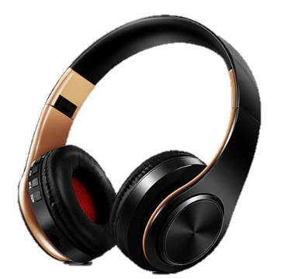
Black & Gold Bluetooth Headphones
40 % Discount, @ R 399.99
Free Shipping
GearAcademy

Slide 2
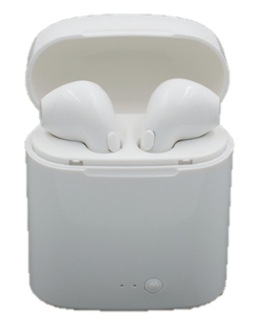
i7s Bluetooth Earbuds
50 % Discount, @ R 249.99
Free Shipping
GearAcademy

