Slide 1
Improving Neural Networks

Slide 2
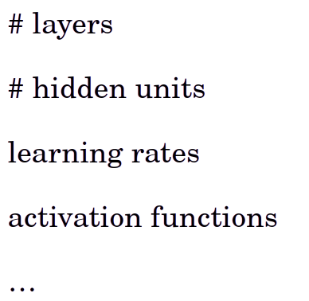
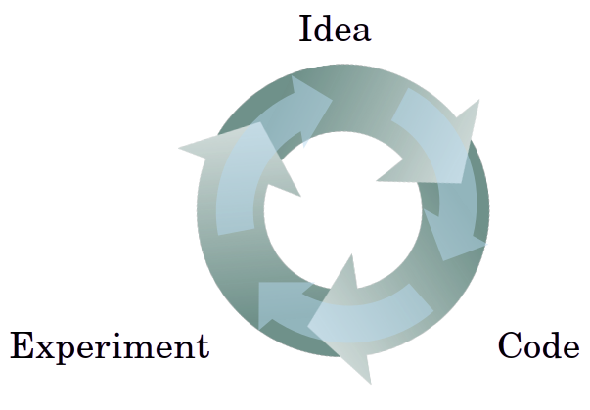
Applied ML is a highly iterative process

Slide 3
usacases
NLP
VISION
Speech
structured data (search, Ads, …)

Slide 4
Intuition from a domain often does not transfer to other area!

Slide 5
constraints
Amount of GPU
CPU
Type of data
..
It would be helpful to know what to do to efficiently do the cycle!

Slide 6
Train/dev/test
sets

Slide 7
Data
Train
Cross validation set
Development set
Dev set
Test set

Slide 8
Role of the Dev set
For deciding which algorithm (or architecture) to use

Slide 9
80 - 20 split
70 - 30 split
Good for smaller size data

Slide 10
But for big data, Having like millions of data points
10,000 point would be enough for deciding on an algorithm.
For case where we have 1 million data points
98% train
1% dev
1% test

Slide 11
Mismatched train/test distribution

Slide 12

Suppose you have an app that recognise cats, and users upload their images and you want to recognise them

Slide 13
Training set:
Cat pictures from web pages
High resolution
Good data
Dev/test sets:
Cat pictures from users using your app
Train distribution should be the same as the test distribution

Slide 14
Not having a test set might be okay (only dev set)
People call the dev set “test set” in the case of the train/dev

Slide 15
Bias / Variance

Slide 16
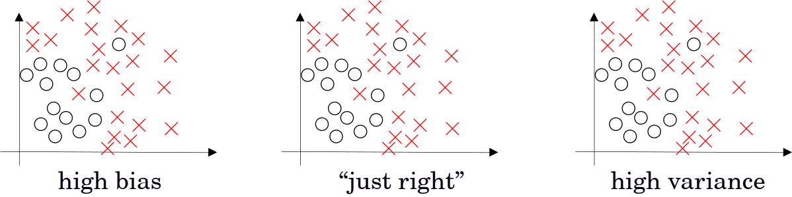

Slide 18
underfit
overfit

Slide 19
Not learning
Training set
Variablity of the
Test set gives bad result

Slide 20
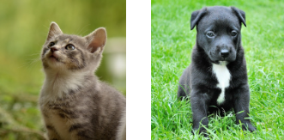
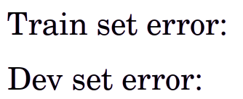
Bias and Variance
10 % 15 % 15 % 0.5 %
11 % 16 % 30 % 10 %
High
variance
High
bias
High bias
High variance
low bias
low variance
Cat classification

Slide 21
The bias depends on the task, for images of cat and dog, we know that the human perform very good at it (0 %) so even the 15 % is high for this task.
We call the optimal error Bayse error, and we regard it as 0%
But if it was higher (like 15%), so the previous 15% is also good!

Slide 22
We assume the Bayes error to be 0 %
we assume that the test and train are drawn from the same distribution

Slide 23
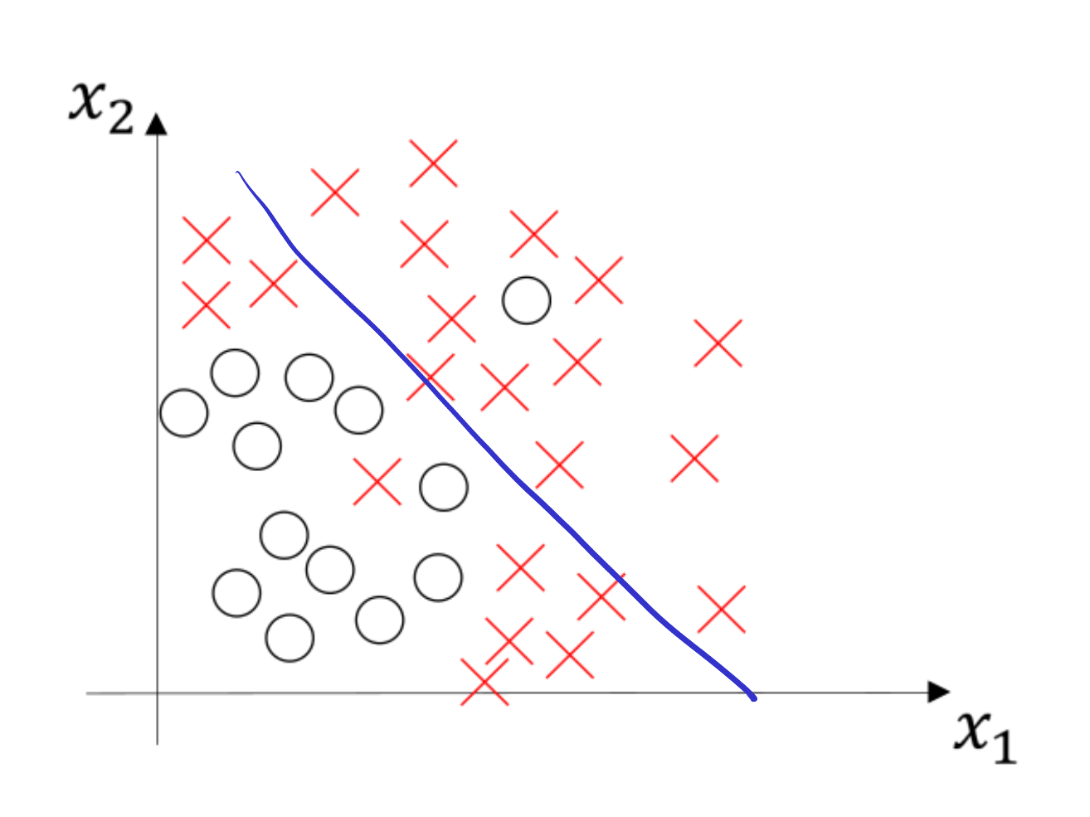
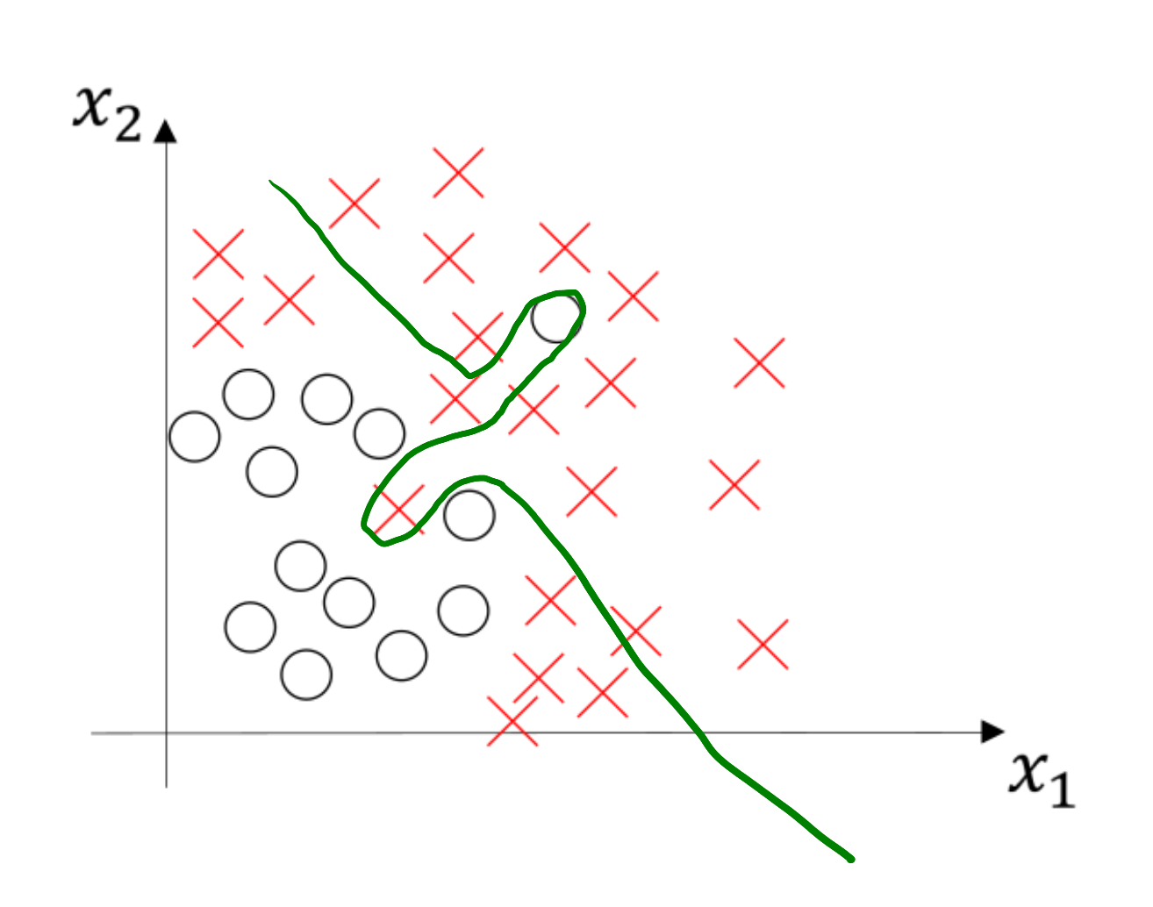
High bias
High bias
High variance
High variance because there is region of the overfitting but the model overall is not fitting it correctly (high bias)

Slide 24
Basic recipe for machine learning
High bias? (training data problem) → Bigger Network - train longer - better NN arch

Slide 25
Basic recipe for machine learning
High bias? (training data problem) → Bigger Network - train longer - better NN arch
High variance? (dev test problem) → get more data - Regulations - better NN arch

Slide 26
Basic recipe for machine learning
Do it until getting low variance and low bias
High bias? (training data problem) → Bigger Network - train longer - better NN arch
High variance? (dev test problem) → get more data - Regulations - better NN arch

Slide 27
Note:
For High bias adding more data may would not help! Try to be selective in the process

Slide 28
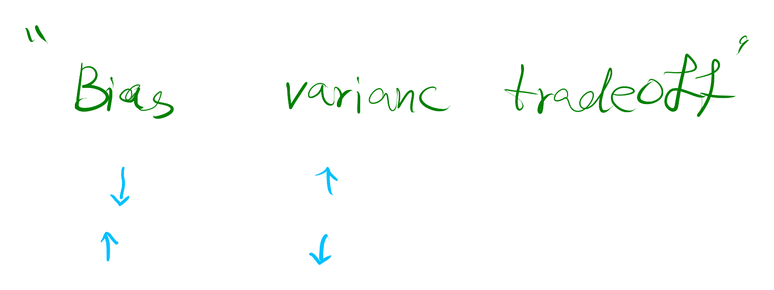
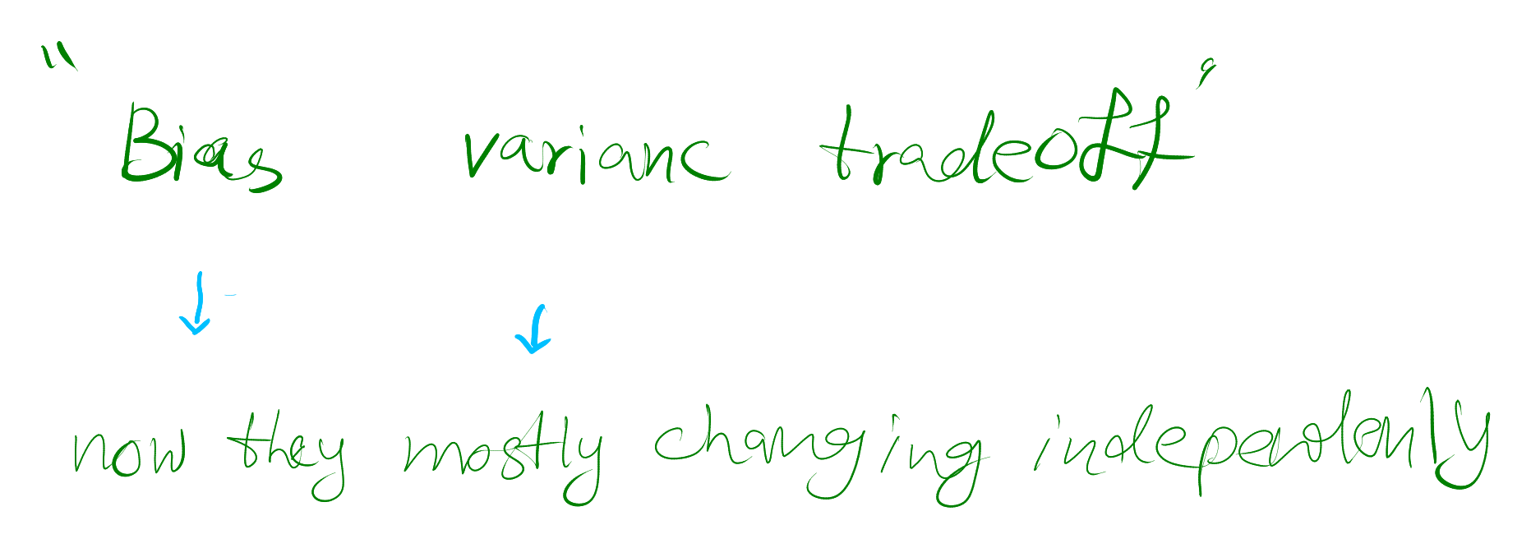
Pre big data era (changing one changes the other)
After big data era (mostly independent)

Slide 29
One of the reasons that deep learning working very well for the supervised data is that having more data or bigger NNs help reduce the bias and variance without affecting other.

Slide 30
Regularization
If we suspect overfitting (high variance), get more data, if you don’t have:
Use regularization

Slide 31
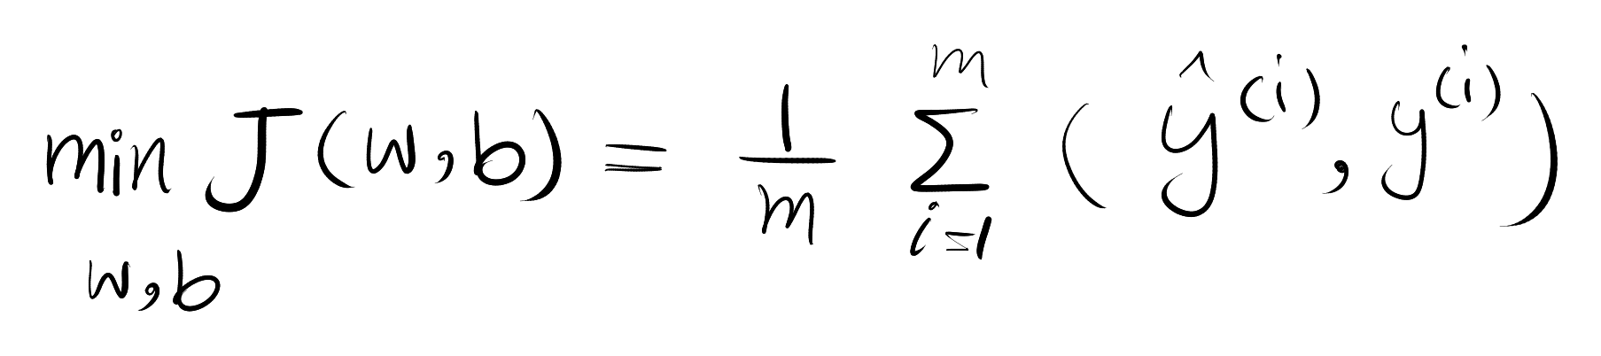
Logistic regression

Slide 33
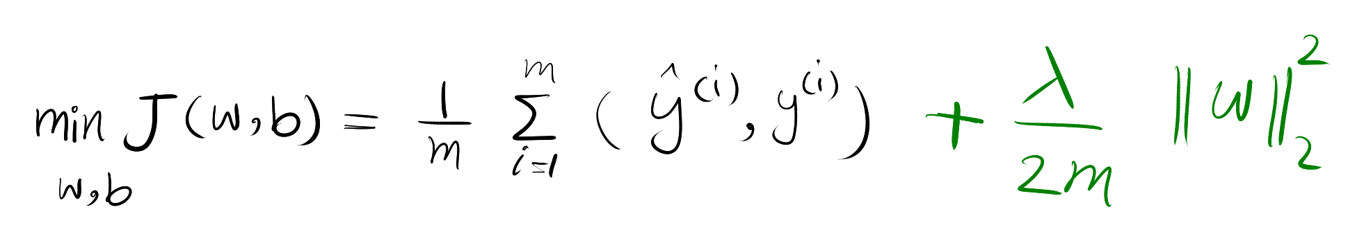
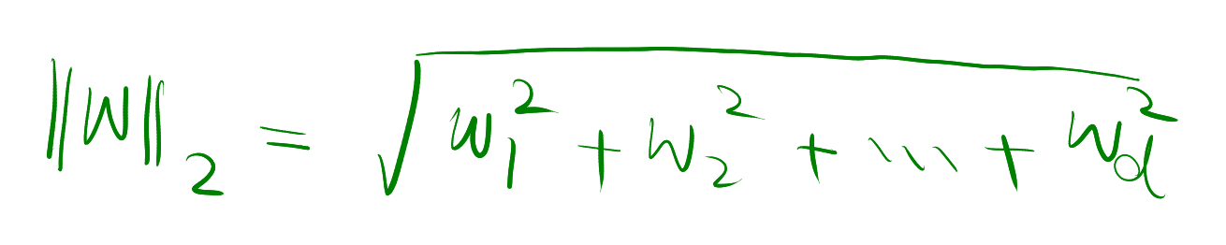
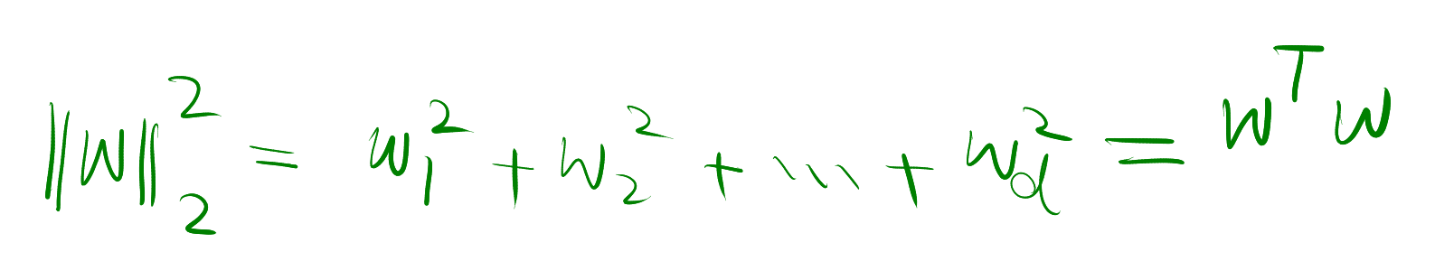
L2 reg. (euclidean norm)

Slide 34
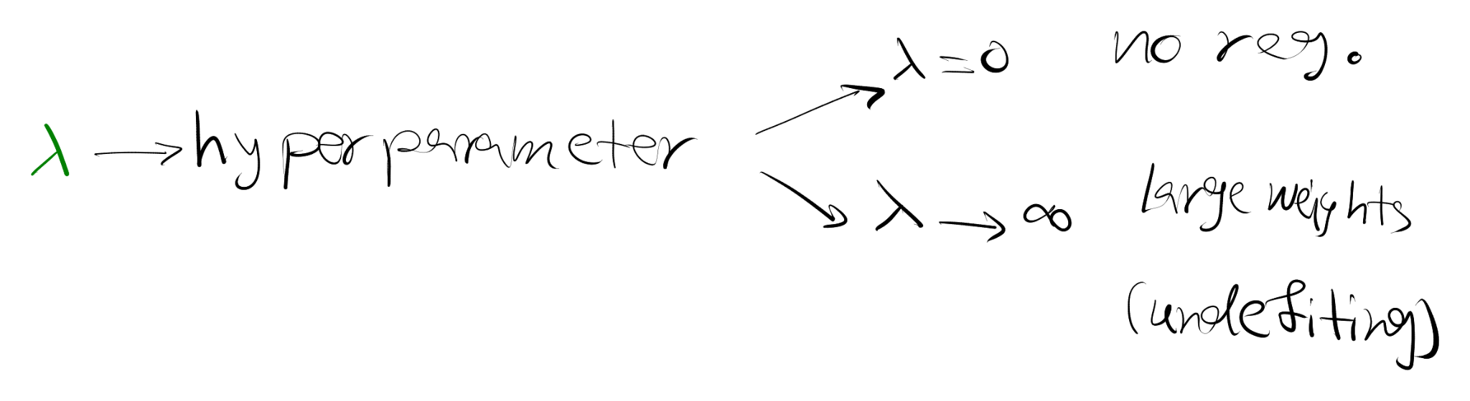
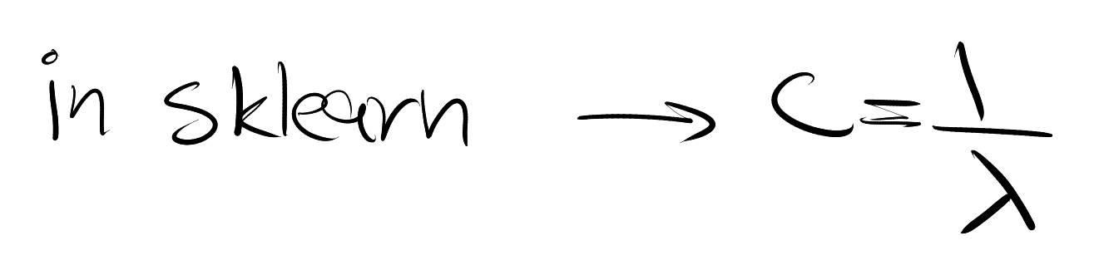

Slide 35
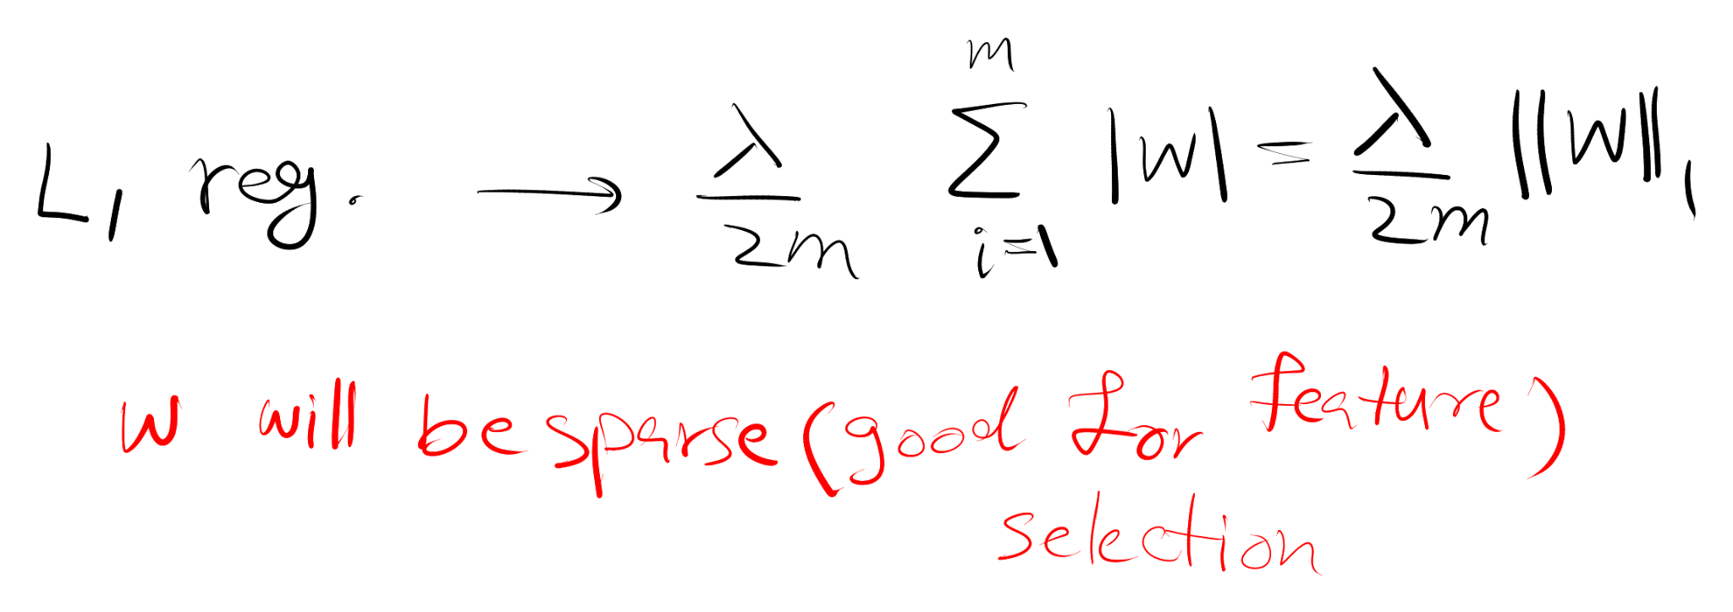
L1
W can be zero

Slide 36
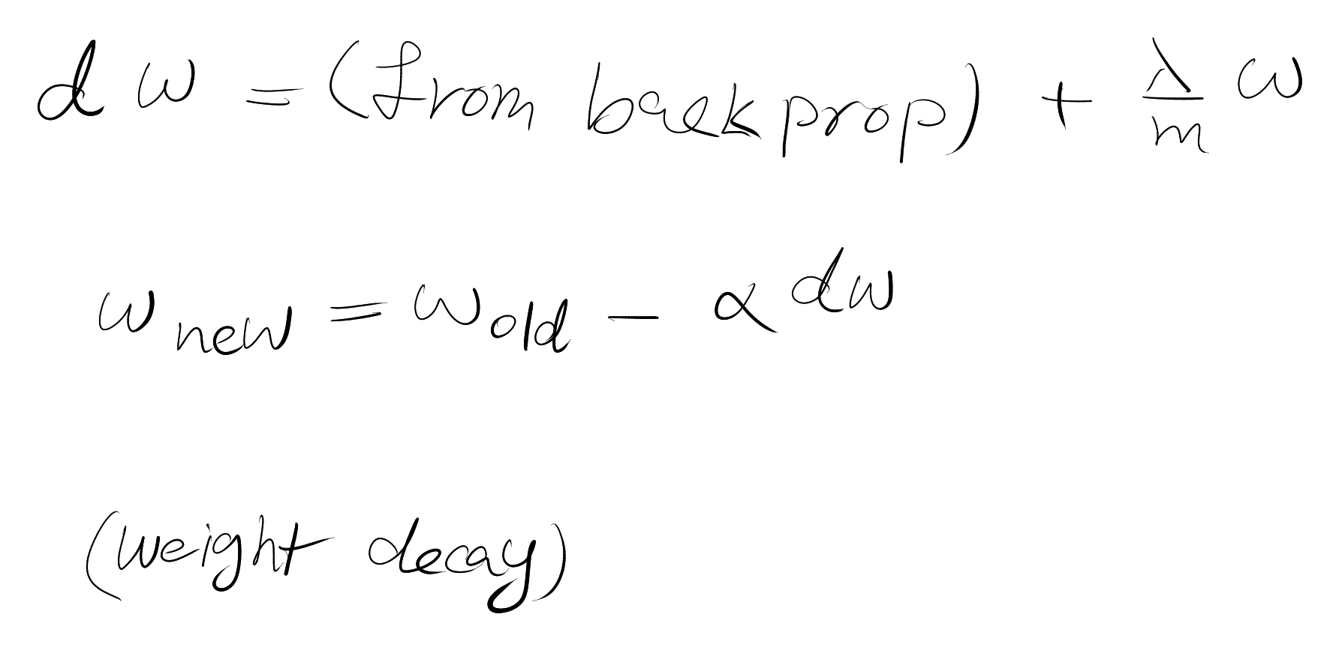
NN

Slide 37
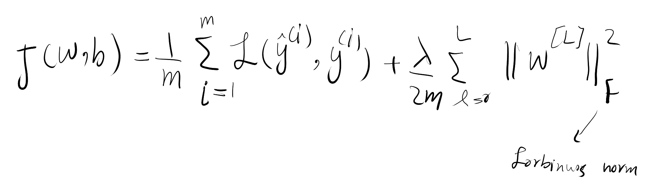
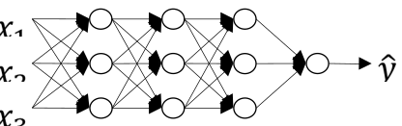
Why Reg. reduce overfitting?
underfit
overfit

Slide 38
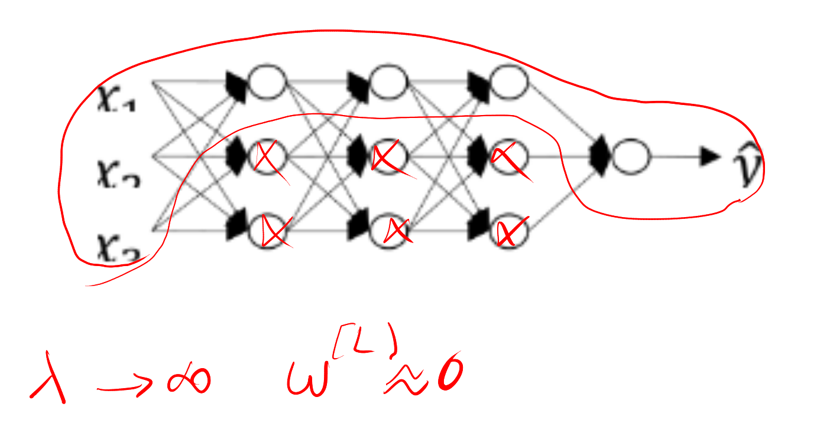
Maybe the w = 0 makes the network simpler!

Slide 39
But the correct view is that the network is still uses the whole neurons but each unit have smaller effect.

Slide 40
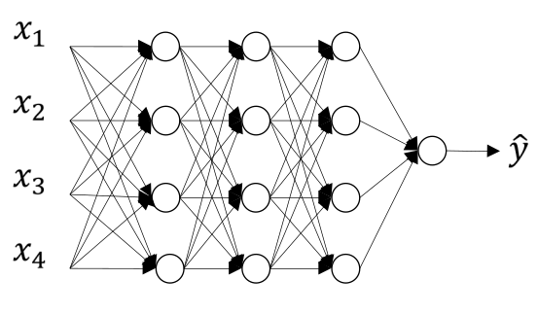
Dropout regularization

Slide 41
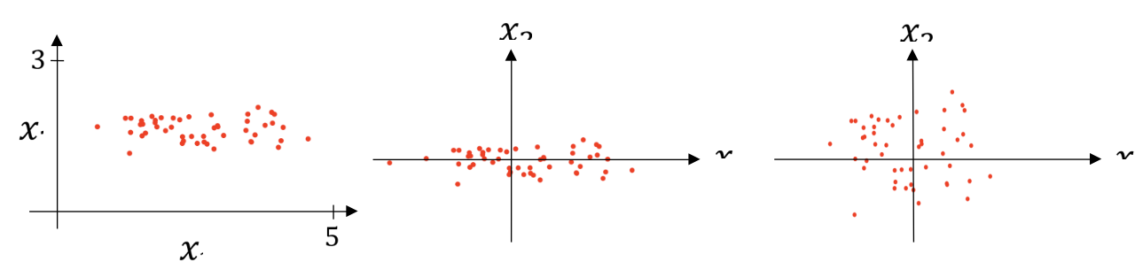
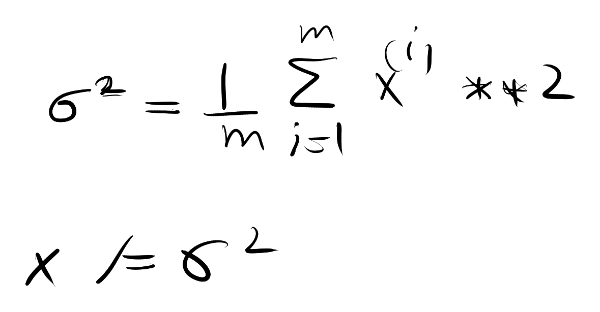
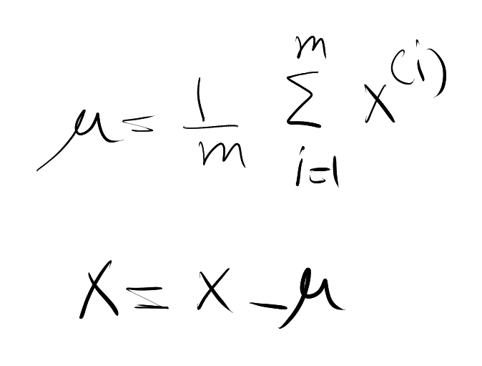
Normalizing Input

Slide 42
Why bother doing it?

Slide 43
