Slide 1
NN From Scratch

Slide 2

A Single Neuron

Slide 3
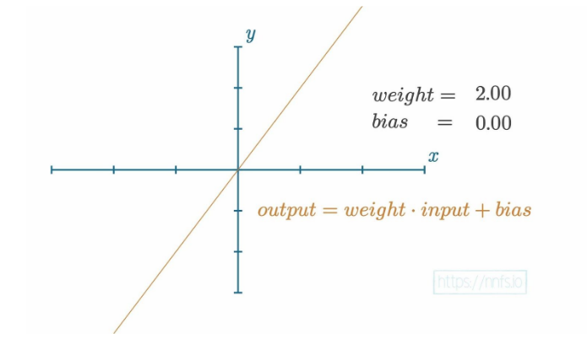
Review bias

Slide 4
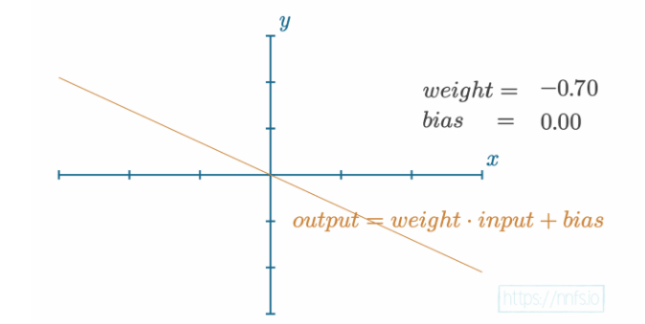

Slide 5
A Single Neuron

Slide 6

A Single Neuron

Slide 7

A Single Neuron

Slide 8
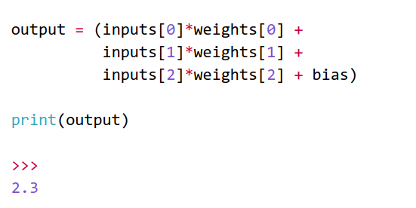

Slide 9
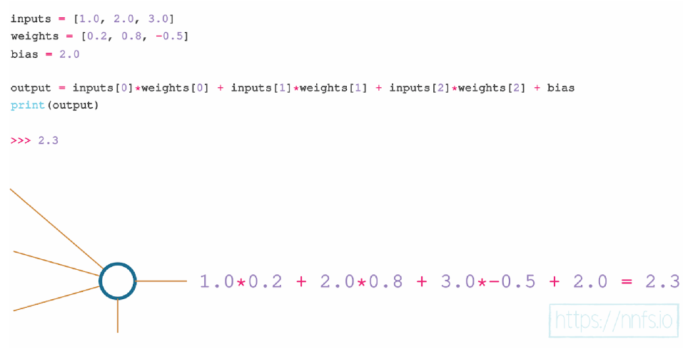

Slide 10
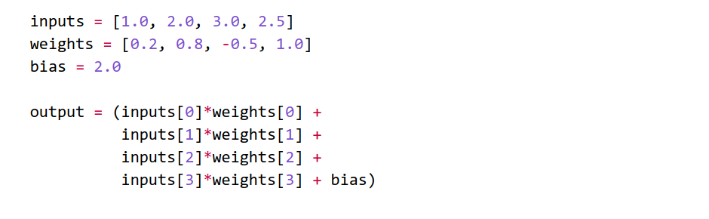
More weights + inputs

Slide 11
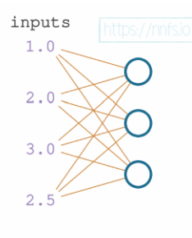
A layer

Slide 12
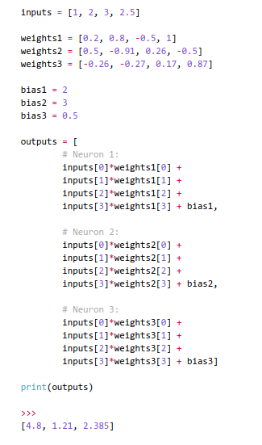

Slide 13
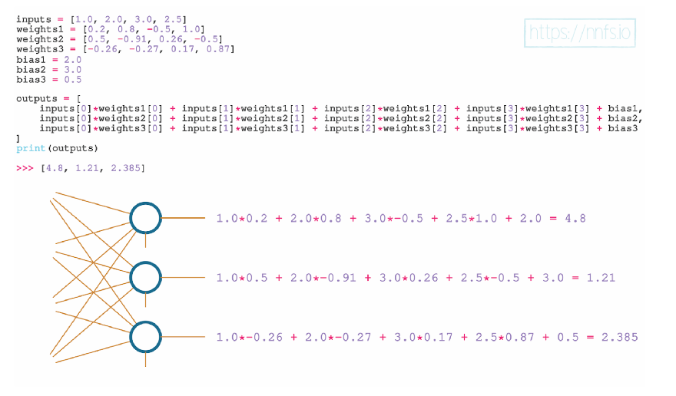

Slide 14
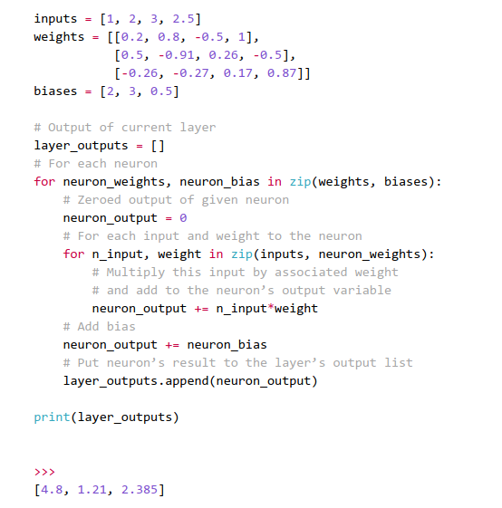

Slide 15

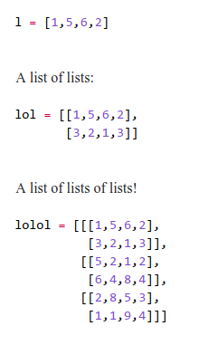
Tensors, Arrays and Vectors

Slide 16
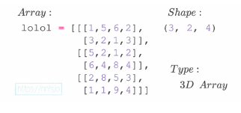

Slide 17
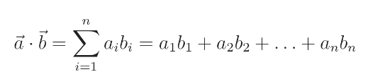


Slide 18

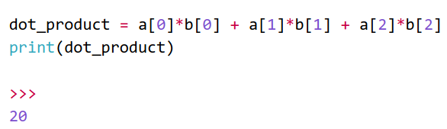

Slide 19
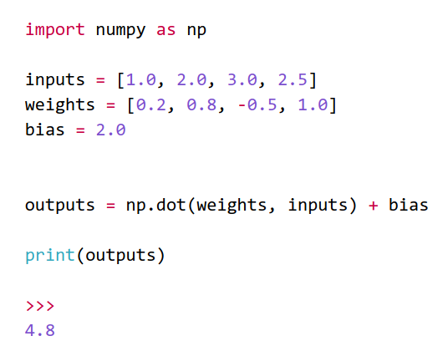

Slide 20
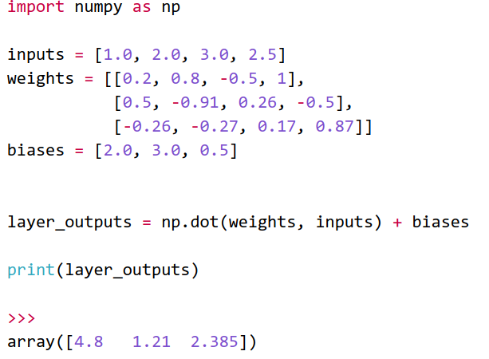
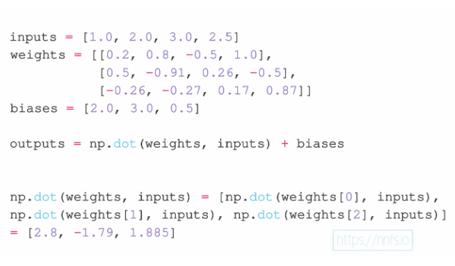
A Layer of Neurons with NumPy

Slide 21
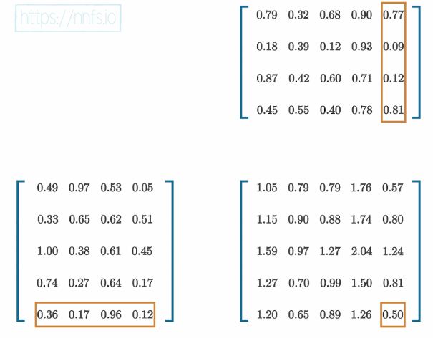
Matrix Product

Slide 22
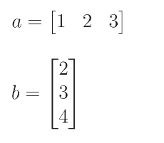
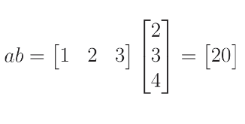
perform the matrix product on vectors

Slide 23
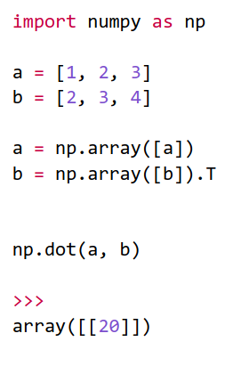
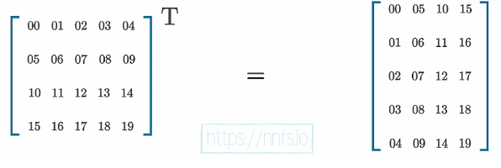
Transposition for the Matrix Product

Slide 24
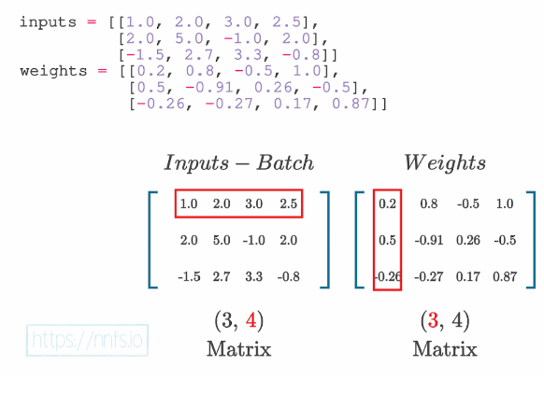
A Layer of Neurons & Batch of Data w/ NumPy

Slide 25
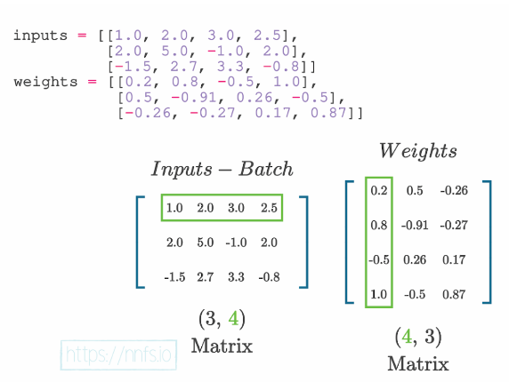
After transposition, we can perform the matrix product.

Slide 26
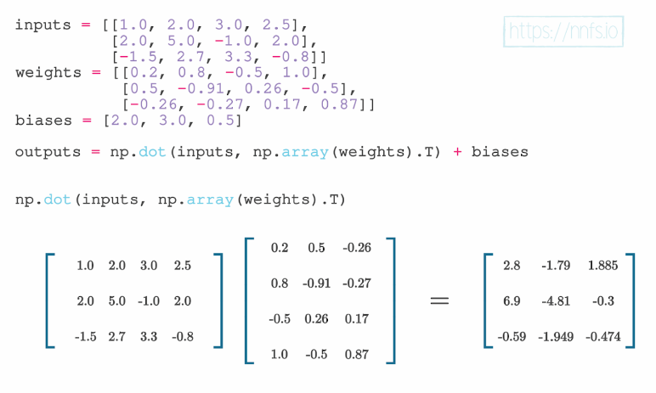

Slide 27
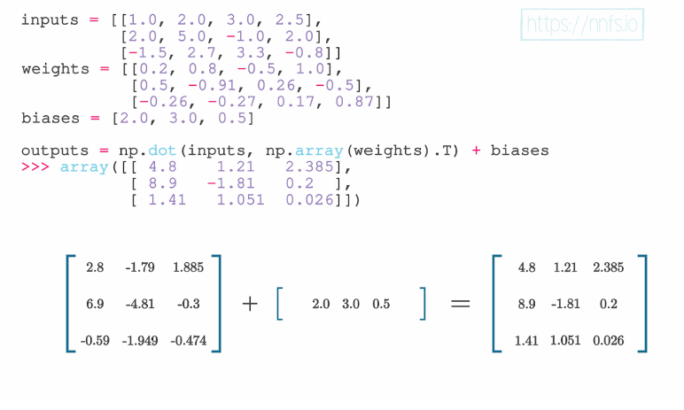

Slide 28
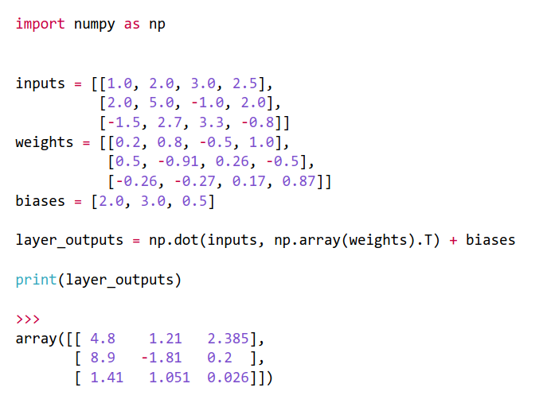

Slide 29
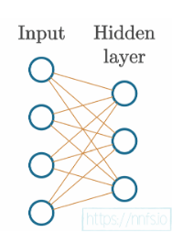
Adding Layers

Slide 30
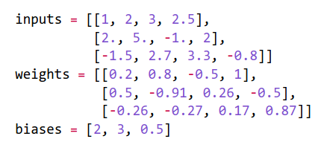
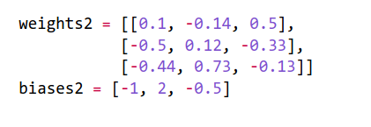

Slide 31
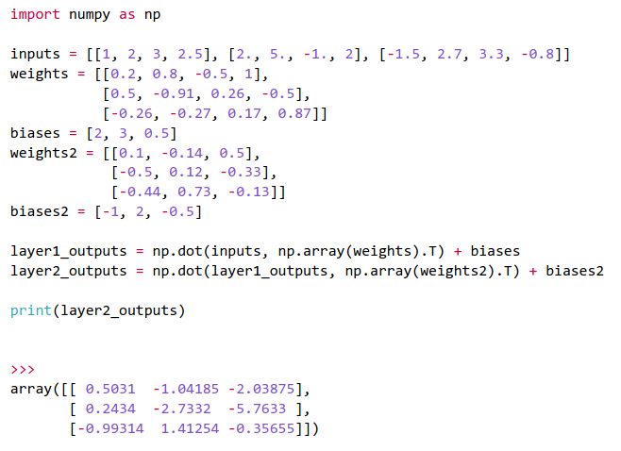

Slide 32
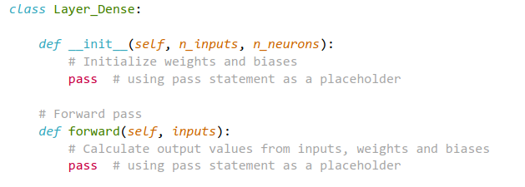
Dense Layer Class

Slide 33
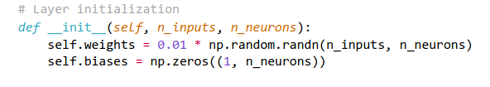

Slide 34
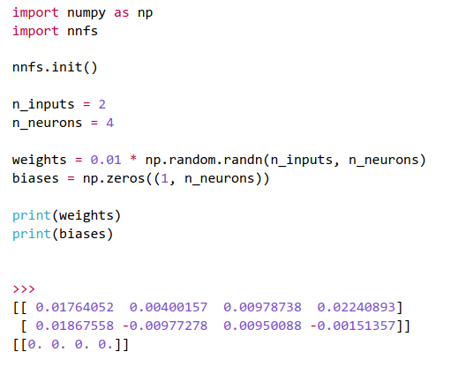

Slide 35
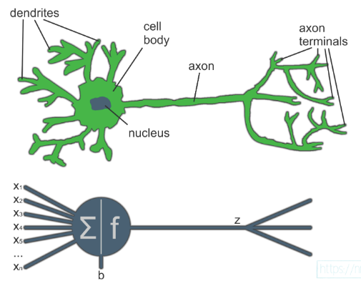
Activation functions (review)

Slide 36
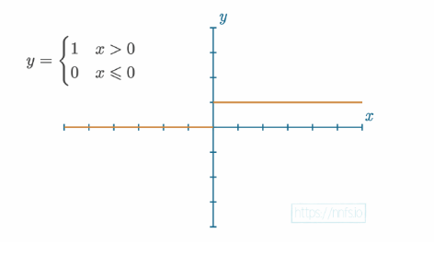
Step function

Slide 37


Slide 38
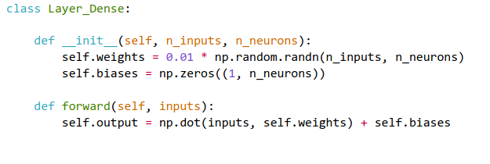

Slide 39
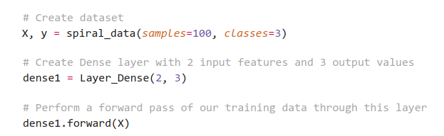

Slide 40
Activation Functions

Slide 41
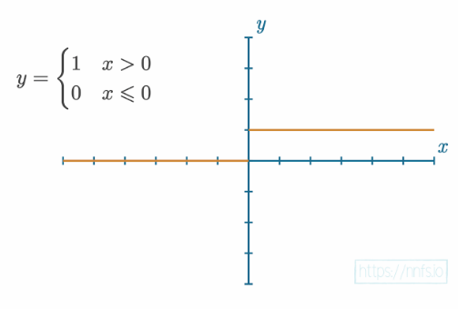
The Step Activation Function

Slide 42
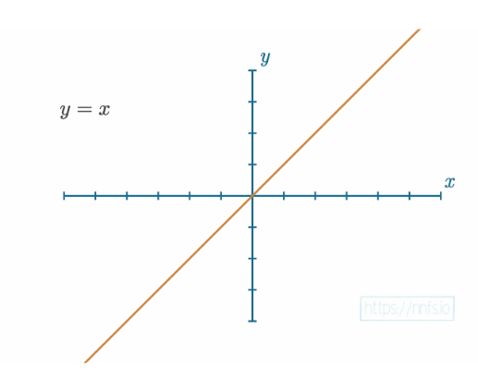
The Linear Activation Function

Slide 43
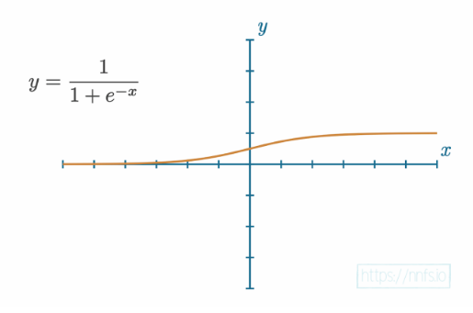
The Sigmoid Activation Function

Slide 44
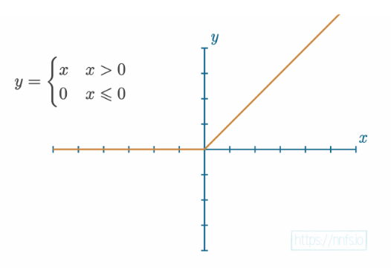
The Rectified Linear Activation Function

Slide 45
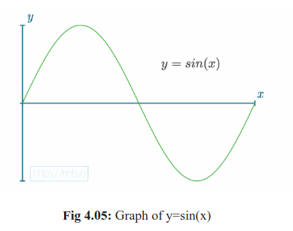
Why Use Activation Functions?

Slide 46
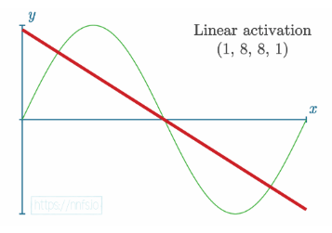
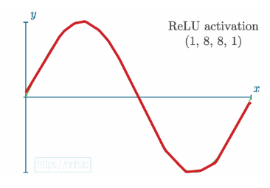

Slide 47
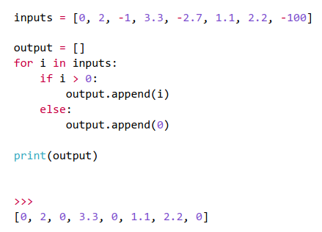
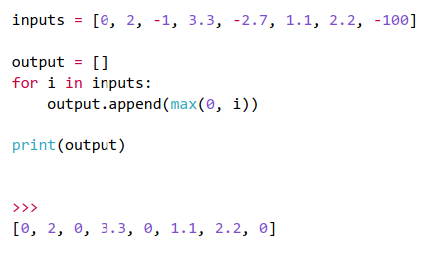
ReLU Activation Function Code

Slide 48
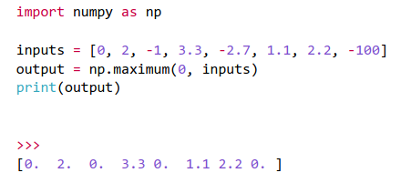
NumPy contains an equivalent —

Slide 49
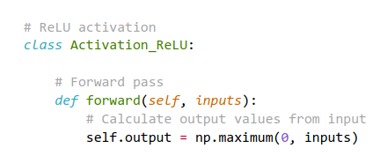

Slide 50
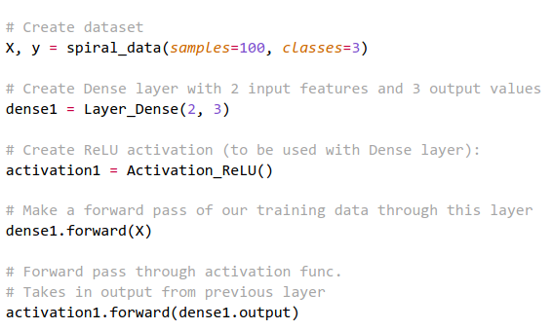
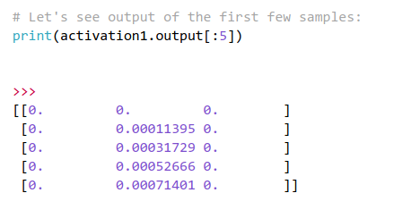

Slide 51

The Softmax Activation Function

Slide 52



Slide 53


Slide 54


Slide 55



Slide 56
Calculating Network Error with Loss

Slide 57

Categorical Cross-Entropy Loss

Slide 58



Slide 59


Slide 60


we can make a few assumptions given one-hot target vectors.
First, what are the values for target_output[1] and target_output[2] in this case? They’re both 0, and anything multiplied by 0 is 0. Thus, we don’t need to calculate these indices. Next, what’s the value for target_output[0] in this case? It’s 1.

Slide 61


Slide 62


Slide 63


Slide 64



note!

Slide 65
Checkout code
nn_02.py

Slide 66

Accuracy Calculation

Slide 67

Add accuracy to the code
nn_03.py

Slide 68
Introducing Optimization
determine how to adjust the weights and biases

Slide 69




Slide 70


Build the NN again
Large initilia loss

Slide 71

iterate as many times as desired, pick random values for weights and biases, and save the weights and biases if they generate the lowest-seen loss

Slide 72
Would it be good?

Slide 73


Slide 74

Running an additional 90,000 iterations for 100,000 in
total
nn_04.py

Slide 75

After running for 1 billion iteration

Slide 76
How to solve the problem?
If the adjustment decreases loss, we will make it the new point to
adjust from

Slide 77



Slide 78

nn_05.py

Slide 79

What about spirals?

