Slide 1
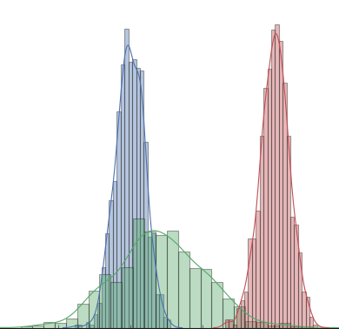
Mastering Probability and Statistics in Python
Notes:
1

Slide 2
Probability Vs Statistics
What is probability?
Notes:
2

Slide 3
Probability Vs Statistics
What is probability?
What is statistics?
Notes:
3

Slide 4
Sets
What is Set?
Notes:
4

Slide 5
Sets
What is Set?
Operations on Sets
Notes:
5

Slide 6
Sets
Notes:
6

Slide 7
Sets
What is Set?
Operations on Sets
Sets in Python
Notes:
7

Slide 8
Experiment
Random Experiment
Notes:
8

Slide 9
Experiment
Random Experiment
Outcome
Notes:
9

Slide 10
Experiment
Random Experiment
Outcome
Sample Space
Notes:
10

Slide 11
Experiment
Random Experiment
Outcome
Sample Space
Event
Notes:
11

Slide 12
Probability Model
From Event to a number
Notes:
12

Slide 13
Probability Model
From Event to a number
Axioms of Probability
Notes:
13

Slide 14
Probability Model
From Event to a number
Axioms of Probability
Conditional Probability
Notes:
14

Slide 15
Probability Model
From Event to a number
Axioms of Probability
Conditional Probability
Total Probability Theorem
Notes:
15

Slide 16
Bayes Rule
Bayes Rule
Notes:
16

Slide 17
Independence
Independence
Notes:
17

Slide 18
Independence
Independence
Conditional Independence
Notes:
18

Slide 19
Random Variables
From Events to Variables
Notes:
19

Slide 20
Random Variables
From Events to Variables
Transformation of a random variable
Notes:
20

Slide 21
Random Variables
From Events to Variables
Transformation of a random variable
Expectation
Notes:
21

Slide 22
Random Variables
From Events to Variables
Transformation of a random variable
Expectation
Mean
Notes:
22

Slide 23
Random Variables
From Events to Variables
Transformation of a random variable
Expectation
Mean
Variance
Notes:
23

Slide 24
Multiple Random Variables
Joint PMFs
Joint PDFs
Conditioning random variables
Independence of random variables
Bayes classifier
Naïve Bayes classifier
Notes:
24

Slide 25
Estimation
What is a parametric distribution?
Maximum Likelihood Estimate (MLE)
Maximum A Posterior Estimate (MAP)
Log Likelihood
Notes:
25

Slide 26
Logistic Regression
I.I.D data
MLE on Bernoulli random variables
From MLE towards Cross Entropy Loss function
Need of Gradient Descent
Notes:
26

Slide 27
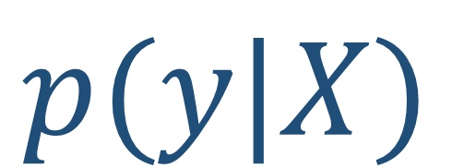
SoftMax: Deep Neural Networks
$$p(y|X)$$
Notes:
27

